Slide 1
SALES DATA ANALYSIS
Exploratory Data Analysis & Power BI Dashboard
Week 6 Assignment
Prepared by: Vikas Varma
Sales Data Analysis | Week 6 Assignment 1

Slide 2
1. Project Overview
• Analyze sales transaction data to understand sales, quantity and profit performance.
• Clean and prepare the dataset using Python and Pandas.
• Perform Exploratory Data Analysis (EDA) to identify patterns, trends and outliers.
• Create meaningful visualizations and an interactive Power BI dashboard.
• Generate business insights and practical recommendations.
Sales Data Analysis | Week 6 Assignment 2

Slide 3
2. Problem Statement
• Raw sales data can contain missing values, duplicate records and inconsistent data types.
• Business users need a simple way to compare products, regions and categories.
• Monthly trends should be visible to support planning and decision-making.
• The project converts raw transaction data into clean analysis and an interactive dashboard.
Sales Data Analysis | Week 6 Assignment 3

Slide 4
3. Dataset & Tools
Dataset
800 cleaned records
8 columns
Python
Pandas
Matplotlib
Power BI
Dashboard
KPIs & Filters
GitHub
Version control
Project sharing
• Main fields: Date, Product, Region, Quantity, Category, Unit_Price, Sales and Profit.
Sales Data Analysis | Week 6 Assignment 4

Slide 5
4. Data Cleaning & Preparation
• Loaded the sales CSV file
• Checked shape, data types and summary statistics
• Detected 2 duplicate rows and 2 missing Profit values
• Converted Date and numeric columns to suitable data types
• Removed duplicates and filled missing Profit values using the median
• Final cleaned dataset: 800 rows, 8 columns, no missing values
Sales Data Analysis | Week 6 Assignment 5

Slide 6
5. Exploratory Data Analysis
• Product-wise sales and profit were compared to identify high-performing products.
• Region-wise sales were analyzed to compare market performance.
• Category-wise sales showed the contribution of major categories.
• Monthly sales trend was plotted to observe changes across the year.
• Correlation analysis and boxplots were used to examine relationships and outliers.
Sales Data Analysis | Week 6 Assignment 6

Slide 7
6. Key Visualizations
Product-wise Sales
Bar chart
Region-wise Sales
Bar chart
Category-wise Sales
Bar chart
Product-wise Profit
Bar chart
Monthly Sales Trend
Line chart
Sales Data Analysis | Week 6 Assignment 7

Slide 8
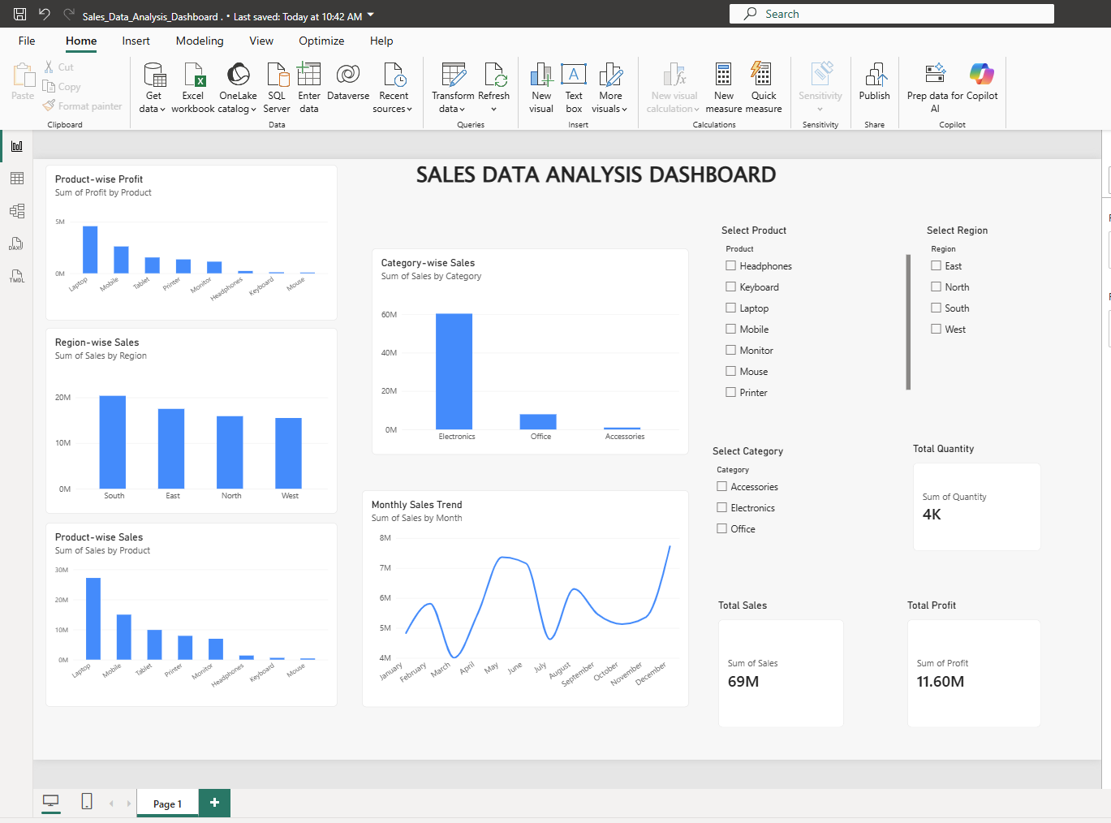
7. Power BI Dashboard
Interactive dashboard with KPIs, charts and slicers
Sales Data Analysis | Week 6 Assignment 8

Slide 9
8. Key Insights
• Total Sales: approximately 69M.
• Total Profit: approximately 11.60M.
• Total Quantity: approximately 4K units.
• South region records the highest sales among the four regions.
• Electronics is the dominant sales category, while Laptop is the leading product.
Sales Data Analysis | Week 6 Assignment 9

Slide 10
9. Recommendations
• Prioritize high-performing products such as Laptop and the Electronics category while maintaining adequate inventory.
• Investigate lower-performing regions/categories and use targeted promotions or pricing strategies to improve sales.
• Use the monthly trend and Power BI filters regularly to monitor changes and support future sales planning.
Sales Data Analysis | Week 6 Assignment 10

Slide 11
10. Conclusion
• The project demonstrates a complete data-analysis workflow from raw data to business dashboard.
• Python was used for cleaning, EDA and visualization, while Power BI was used for interactive reporting.
• The final dashboard makes key sales, quantity and profit metrics easier to understand.
• GitHub provides version control and a central location for the project files.
Sales Data Analysis | Week 6 Assignment 11

Slide 12
PROJECT REPOSITORY
GitHub: Vikas3106 / Sales-Data-Analysis-
Thank You
Questions & Discussion
Sales Data Analysis | Week 6 Assignment 12

