Slide 1
Algoscraper
Intelligent UI Automation and testing Framework
K Vikas Rao
24250142
MCA-B

Slide 2
Introduction
AlgoScraper is a Chrome Extension designed to simplify web automation and UI testing directly from the browser.
It allows users to:
Extract UI elements from websites
Analyze website links
Record user interactions
Generate automation scripts
Manage testing scenarios

Slide 3
Problem Statement
UI testing faces several challenges:
Manual testing consumes a lot of time
Automation tools require coding knowledge
Broken or slow links affect user experience
Creating test scripts manually is difficult
Managing testing workflows is complex

Slide 4
Objectives
The objectives of AlgoScraper are:
Simplify UI automation
Extract UI elements automatically
Detect broken or slow links
Record user interaction scenarios
Generate automation scripts
Provide a user-friendly interface

Slide 5
Solution
AlgoScraper provides a browser-based automation solution.
The system:
Works as a Chrome Extension
Captures UI elements automatically
Performs link analysis
Records user interactions
Generates automation scripts

Slide 6
Key Features
Major features of AlgoScraper include:
UI Element Scraping
Ping Link Analysis
Scenario Recording
Automation Script Generation
Scenario Management
Test Result Monitoring

Slide 7
System Architecture
AlgoScraper follows a layered architecture:
Chrome Extension Interface
Frontend Layer
Backend API Services
Database Layer

Slide 8
Technology Used
Frontend Technologies
React.js
Redux
Material UI
Chrome Extension APIs
Backend Technologies
Node.js
Express.js
REST APIs
Database
MongoDB

Slide 9
User Roles
AlgoScraper supports the following users:
QA Engineer / Tester
Records automation scenarios
Executes automated tests
Generates scripts
Reviews results
Basic User
Scrapes UI elements
Performs link analysis
Views automation results

Slide 10
System Workflow
User opens the Chrome Extension
User selects a feature:
Scrape UI
Ping Link Analysis
Recording
System processes the request
Backend APIs handle the data
Results are stored in database
Results are displayed to the user

Slide 11
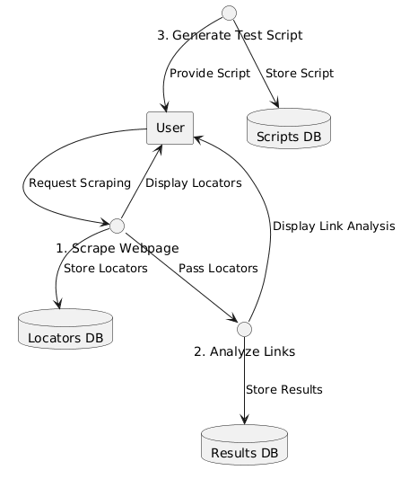
SYSTEM DESIGN DIAGRAMS
Data Flow Diagram (DFD Level 01)

Slide 12
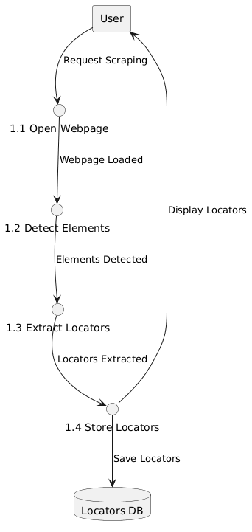
Data Flow Diagram (DFD Level 02)

Slide 13
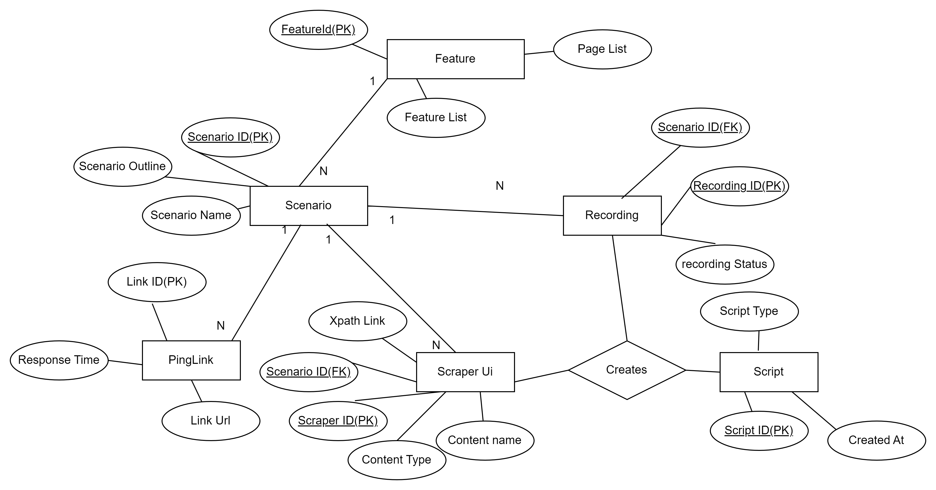
ER Diagram

Slide 14
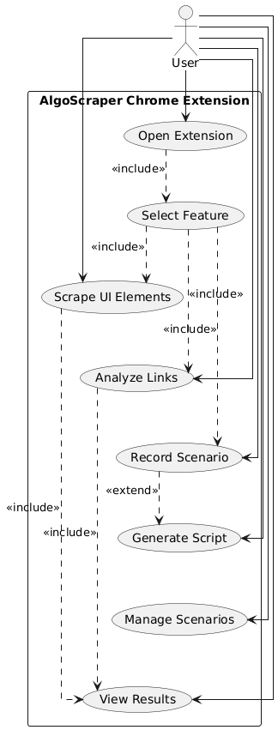
Usecase diagram

Slide 15
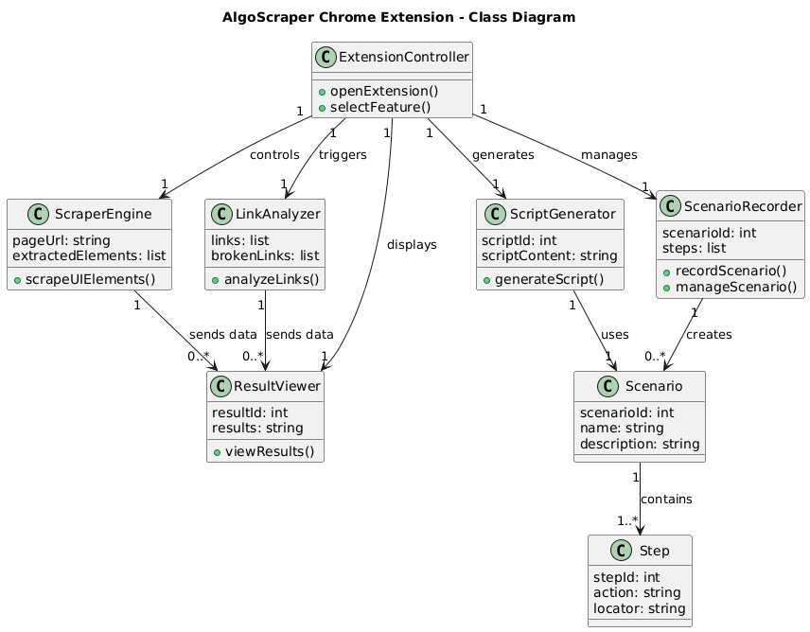
Class Diagram

Slide 16
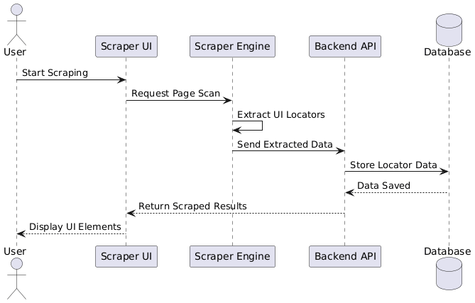
Sequence Diagram

Slide 17
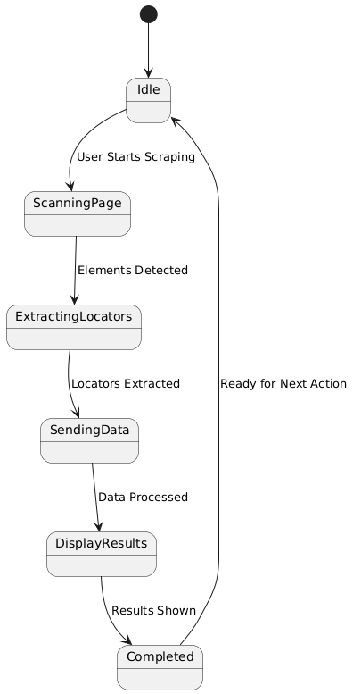
State chart Diagrams

Slide 18
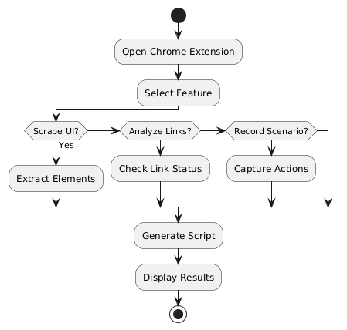
Activity Diagrams

Slide 19
Thank You

