Slide 1

NOIDA INSTITUTE OF ENGINEERING & TECHNOLOGY GREATER NOIDA
Project Management and Vendor Development
Lecture – 1 Topic: Project Identification & Selection
Market & Demand Analysis Project Risk
By
Priya Bharti
Assistant Professor
MBA
NIET, GREATER NOIDA

Slide 2
Index
S No | Content
1 | Name of Subject with code, Course and Subject Teacher
2 | Brief Introduction of Faculty member with Photograph
3 | Evaluation Scheme
4 | Syllabus
5 | Branch wise Application
6 | Course Objective(s)
7 | Course Outcome(s)
8 | Program Outcomes (POs)
9 | COs and POs Mapping
10 | Program Educational Objectives (PEOs)
11 | Result Analysis
12 | End Semester Question paper Templates
13 | Prequisite/Recap

Slide 3
Index
S No | Content
14 | Brief Indtroduction about the Subject with Videos
15 | Unit Content
16 | Unit Objectives
17 | Topic Objectives & Topic Outcome
18 | Lecture related to topic
19 | Daily Quiz
20 | Weekly Assignment
21 | Topic Links
22 | MCQs
23 | Glossary Questions
24 | Old question papers
25 | Expected Questions
26 | Recap of unit

Slide 4
Brief Introduction of the Faculty Member
Faculty Name: Priya Bharti
Designation: ASSISTANT PROFESSOR
Department: MBA
Email ID: shrutisharma@niet.co.in
Qualification: MBA (pursuing PHD.)
Specialization: Finance & Human Resource Management
Research Area: Entrepreneurship and innovation
Teaching Area: Management (Finance & Core subjects)
Total Experience: 3.5 years

Slide 5
Evaluation Scheme

Slide 6
Syllabus

Slide 7
Syllabus

Slide 8
Branch Wise Application
Handling projects.
Evaluating & Monitoring Project Process
Taking necessary and corrective action.

Slide 9
Course objective(s)
To empower the students to get insights of basic concepts on project management.
To create awareness on the roles and responsibilities of project manager.
To build the confident among the students to take up any kind of projects.
To sharpen the planning, scheduling and controlling skills of the students with respect to individual projects.
To understand the perspectives in which optimum decisions are to be taken in case of risks with planned activities in project.

Slide 10
Course outcome(s)
CO 1 | Understand the basic concepts and characteristics of Project and Project manager, management | Understanding (K2)
CO 2 | Understand the roles and responsibilities along with tools & techniques used in Project Management | Evaluating (K5)
CO 3 | Develop confident to take up any kind of projects | Evaluating (K5)
CO 4 | Students will understand the scheduling and monitoring process in Project. They will be able to apply PERT and CPM method for project scheduling | Applying (K3)
CO 5 | Students will understand the perspectives in which optimum decisions are to be taken in case of risks with planned activities in project | Creating (K6)

Slide 11
Program outcome (POs)
PO1. Apply knowledge of management theories and practices to solve business problems.
PO2. Foster analytical and critical thinking abilities for data-based decision-making.
PO3. Ability to develop value-based leadership ability.
PO4. Ability to understand, analyze, and communicate global, economic, legal, and ethical aspects of business.
PO5. Ability to lead themselves and others in the achievement of organizational goals, contributing effectively to a team environment.

Slide 12
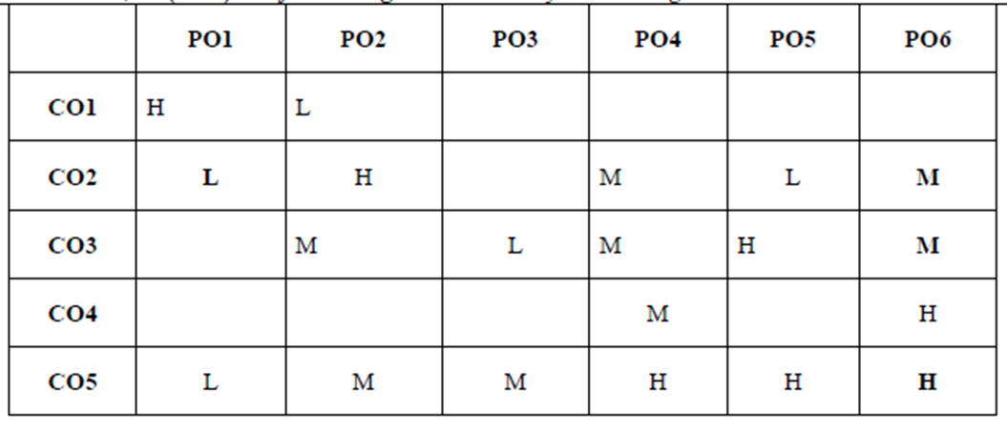
COs and POs Mapping
*1=High, *2=Medium, *3=Low

Slide 13
Program Educational Objectives (PEOs)
PEO 1: Graduates of the management program will have conceptual knowledge, to adapt to the rapidly changing environment, learn new skills and demonstrate application of management principles in a professional work setting.
PEO 2: Graduates will apply appropriate tools for decision making required for solving complex managerial problems in the local or global context.
PEO 3: Graduates of the management program will exhibit integrity, social responsibility, and teamwork.
PEO 4: Graduates will exhibit ethics, communication skills, leadership qualities and entrepreneurial mindset using creativity and innovation.

Slide 14
Result Analysis

Slide 15
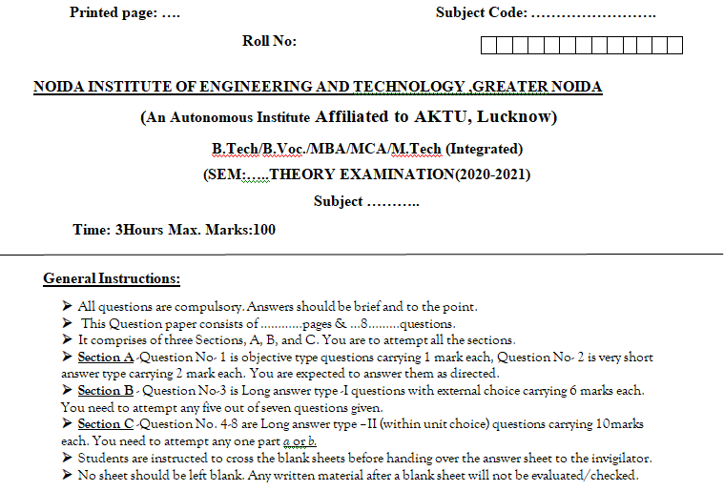
End Semester Question paper Templates

Slide 16
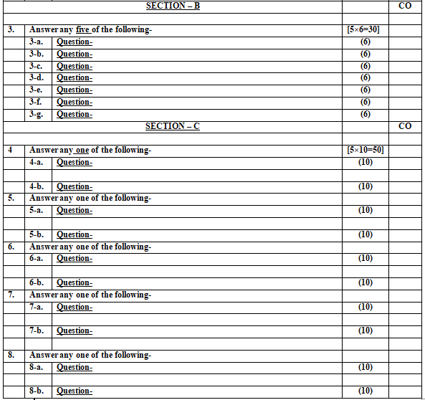
End Semester Question paper Templates

Slide 17
Prerequisite /Recap
Prerequisites for this session are:
General understanding of project management.
General understanding of tools & techniques of project management.
Recap:
Introduction of project
Project management process
Project team
Scope of project management

Slide 18
Brief Introduction about the Subject with Videos
Project management is the discipline of initiating, planning, executing, controlling, and closing the work of a team to achieve specific goals and meet specific success criteria.
It involves the application of knowledge, skills, tools, and techniques to project activities to meet project requirements.
Effective project management ensures that projects are completed within scope, on time, and within budget, while delivering the desired outcomes.
https://www.youtube.com/watch?v=EyPFi0YO32M
https://www.youtube.com/watch?v=BOU1YP5NZVA

Slide 19
Unit Content
Unit-2:
Project Identification & Selection:
Identification, Generation of Ideas, Approaches to Project Screening and Selection, Project Rating Index.
Market & Demand Analysis Techniques: Survey & Trend Projection Methods.
Project Risk Management: Concepts and Types of Project Risks, Risk Identification, Risks Analysis, Risks Mitigation Strategies.

Slide 20
Unit objective
Objectives of this unit are:
To understand how projects are identified and selected.
To understand and conduct the market and demand analysis
To manage the project risks about risk identification, risk analysis and mitigation strategies

Slide 21
Topic Objectives & Topic Outcome
S.NO | TOPIC OBJECTIVE | TOPIC OUTCOME
1 | To understand the Identification & Generation of ideas. | CO2

Slide 22
Idea Generation & Sources
Identifying prospective investment opportunities that offer good commercial returns or satisfy strategic goals.
Key Sources of Ideas:
Internal Sources: R&D departments, employee suggestions, operational bottlenecks.
External Sources: Market demand analysis, customer pain points, competitor analysis, government policies/incentives.
Techniques for Idea Generation:
Brainstorming: Group idea creation without immediate criticism.
Delphi Technique: Expert consensus obtained through iterative rounds of anonymous questionnaires.
SWOT Analysis: Leveraging organizational Strengths and Opportunities while guarding against Weaknesses and Threats.

Slide 23
Comparative Rating & Screening Approaches
Objective of Screening: Quickly eliminate non-viable ideas before spending high capital on detailed feasibility reports.
Approaches to Screening:
Unpromising Idea Elimination: Filtering out ideas incompatible with organizational capability or regulatory boundaries.
Comparative Rating Matrix: Evaluating multiple product ideas against a set of key factors on a numerical scale.

Slide 24
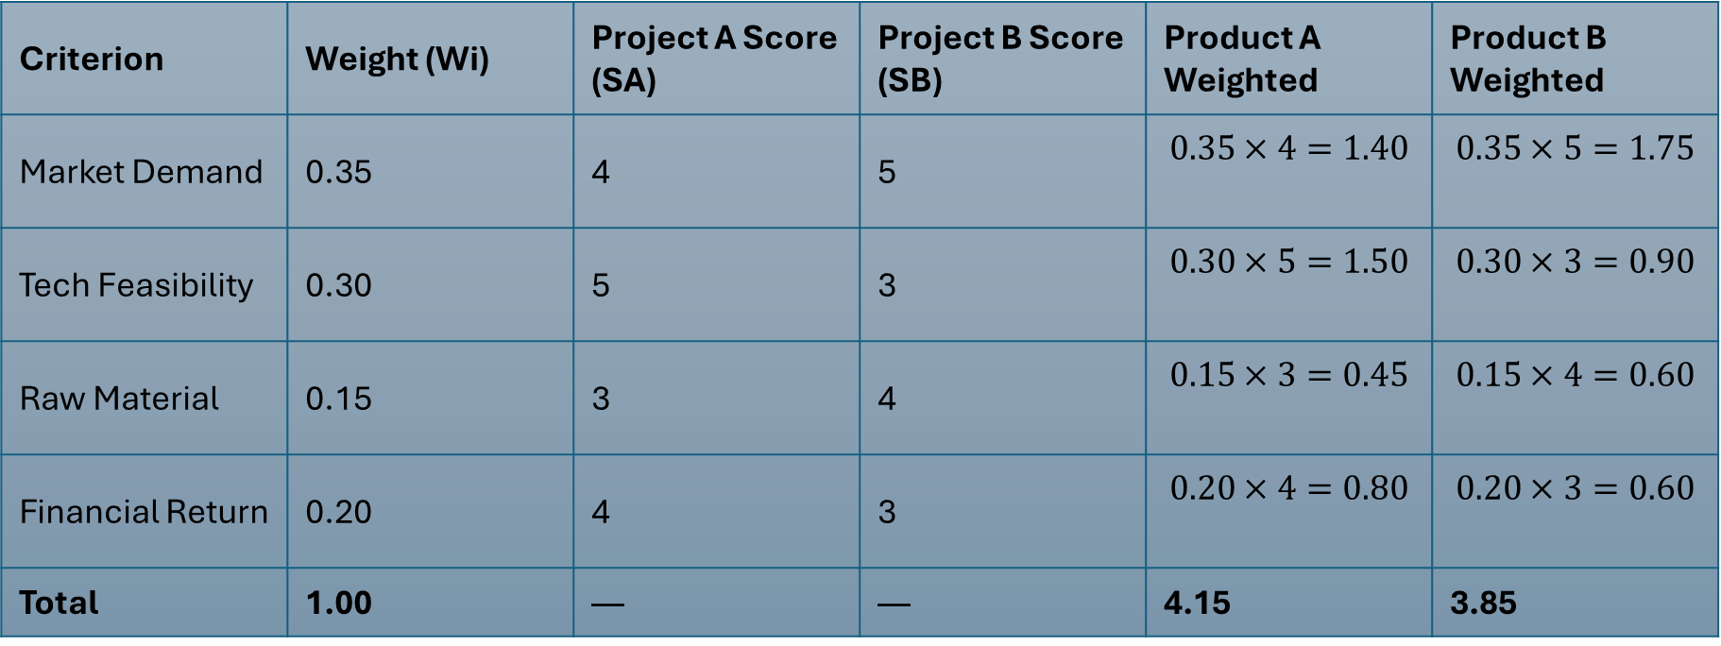
Example
Criterion | Weight (Wi​) | Project A Score (SA​) | Project B Score (SB​) | Product A Weighted | Product B Weighted
Market Demand | 0.35 | 4 | 5 | $$0.35×4=1.40$$ | $$0.35×5=1.75$$
Tech Feasibility | 0.30 | 5 | 3 | $$0.30×5=1.50$$ | $$0.30×3=0.90$$
Raw Material | 0.15 | 3 | 4 | $$0.15×3=0.45$$ | $$0.15×4=0.60$$
Financial Return | 0.20 | 4 | 3 | $$0.20×4=0.80$$ | $$0.20×3=0.60$$
Total | 1.00 | — | — | 4.15 | 3.85
Product A is preferred due to higher technical feasibility and overall score.

Slide 25

Project feasibility and Pre-feasibility report
Pre-Feasibility Report: A preliminary, coarse evaluation of a project concept. It determines whether to commit funds to a full-fledged Feasibility Study.
Full Feasibility Study: A comprehensive, multi-dimensional evaluation covering four main pillars.

Slide 26
Project feasibility and Pre-feasibility report
The 4 Stages of Feasibility Analysis
1. Market Feasibility
Demand Estimation: Past consumption trends, market share projections.
Supply & Competition: Existing plant capacities, import/export scenarios.
Pricing & Distribution: Price elasticity, marketing channels, sales force requirements.
2. Technical Feasibility
Manufacturing Process: Selection of appropriate technology/equipment.
Plant Capacity & Location: Economies of scale, proximity to raw materials, logistics, availability of power and water.
Civil Works & Layout: Floor planning, environmental waste handling infrastructure.

Slide 27
Project feasibility and Pre-feasibility report
3. Financial Feasibility
Capital Cost: Land, building, plant & machinery, working capital requirement.
Operating Cost: Raw material, labor, energy, maintenance.
Financial Evaluation Metrics:
Net Present Value (NPV)
Internal Rate of Return (IRR)
Payback Period
Debt Service Coverage Ratio (DSCR)
4. Social Cost-Benefit Analysis (SCBA)
Purpose: Evaluates project impact on society and national economy (crucial for public sector projects).
Key Factors:
Employment Generation: Direct and indirect job creation.
Shadow Pricing: Adjusting market prices to reflect true social value (e.g., social cost of pollution, social benefit of foreign exchange savings).
Regional Development: Impact on backward regions.

Slide 28
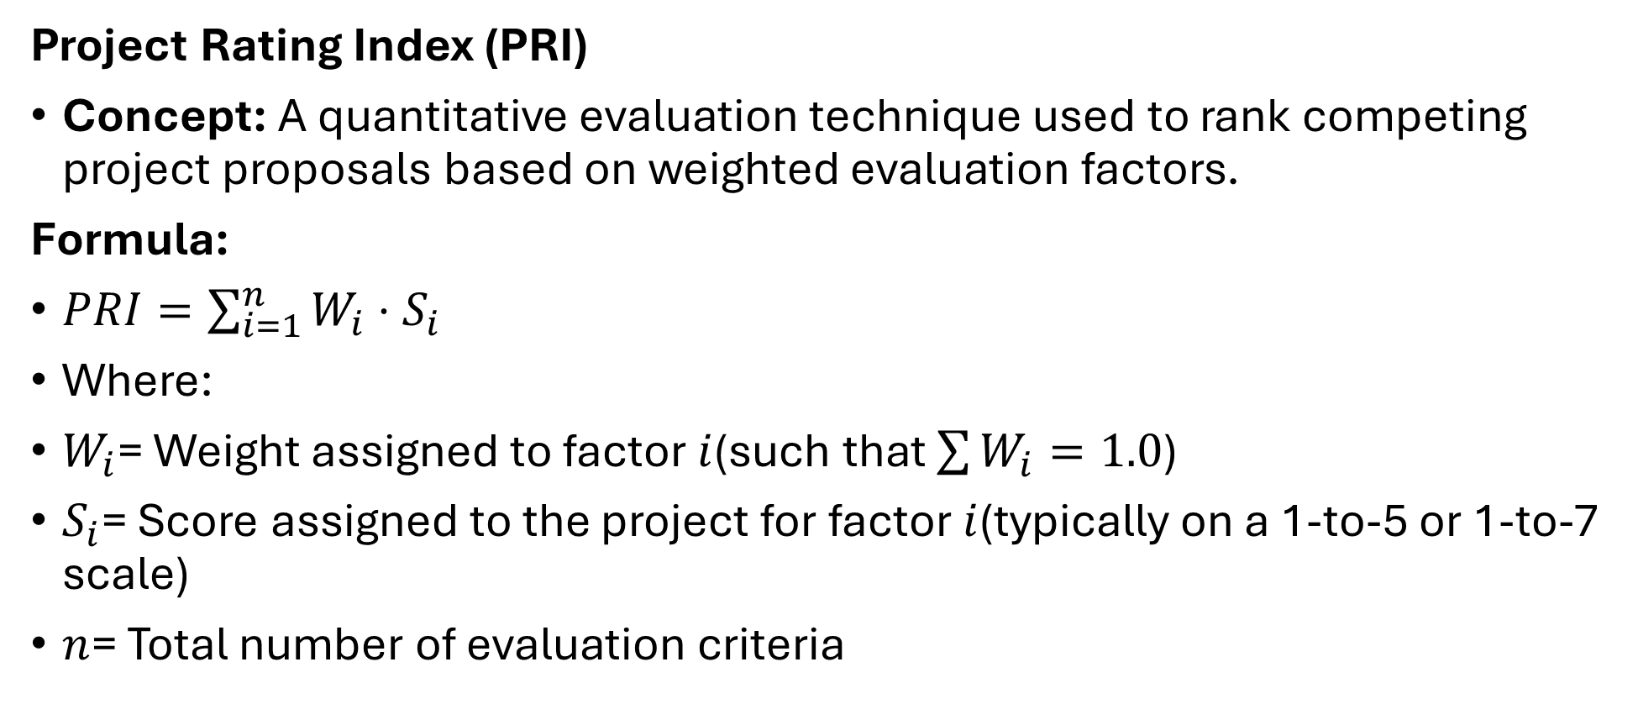
Project Selection & Project Rating Index
Project Rating Index (PRI)
Concept: A quantitative evaluation technique used to rank competing project proposals based on weighted evaluation factors.
Formula:
$PRI=\sum_{i=1}^{n}{W_{i}}⋅S_{i}$
Where:
$W_{i}$= Weight assigned to factor $i$(such that $\sum{W_{i}}=1.0$)
$S_{i}$= Score assigned to the project for factor $i$(typically on a 1-to-5 or 1-to-7 scale)
$n$= Total number of evaluation criteria

Slide 29
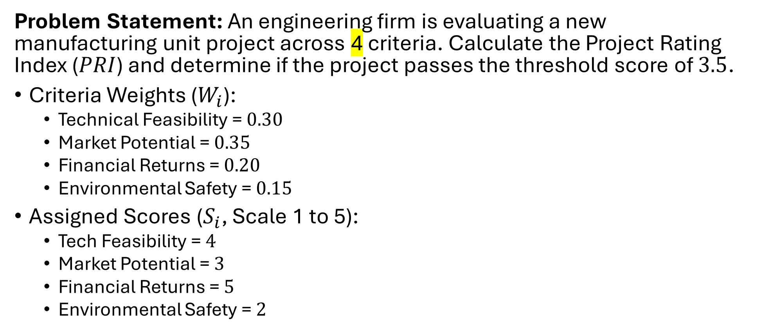
Numerical
Problem Statement: An engineering firm is evaluating a new manufacturing unit project across 4 criteria. Calculate the Project Rating Index ($PRI$) and determine if the project passes the threshold score of $3.5$.
Criteria Weights ($W_{i}$):
Technical Feasibility = $0.30$
Market Potential = $0.35$
Financial Returns = $0.20$
Environmental Safety = $0.15$
Assigned Scores ($S_{i}$, Scale 1 to 5):
Tech Feasibility = $4$
Market Potential = $3$
Financial Returns = $5$
Environmental Safety = $2$

Slide 30
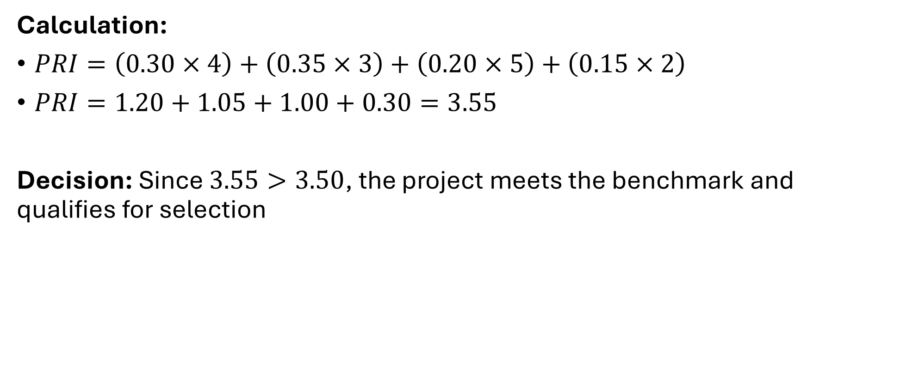
Numerical
Calculation:
$PRI=\left(0.30×4\right)+\left(0.35×3\right)+\left(0.20×5\right)+\left(0.15×2\right)$
$PRI=1.20+1.05+1.00+0.30=3.55$
Decision: Since $3.55>3.50$, the project meets the benchmark and qualifies for selection

Slide 31
Project Identification
Requires:
Imagination
Sensitivity to Environmental Changes
Realistic assessment of what the firm can do

Slide 32
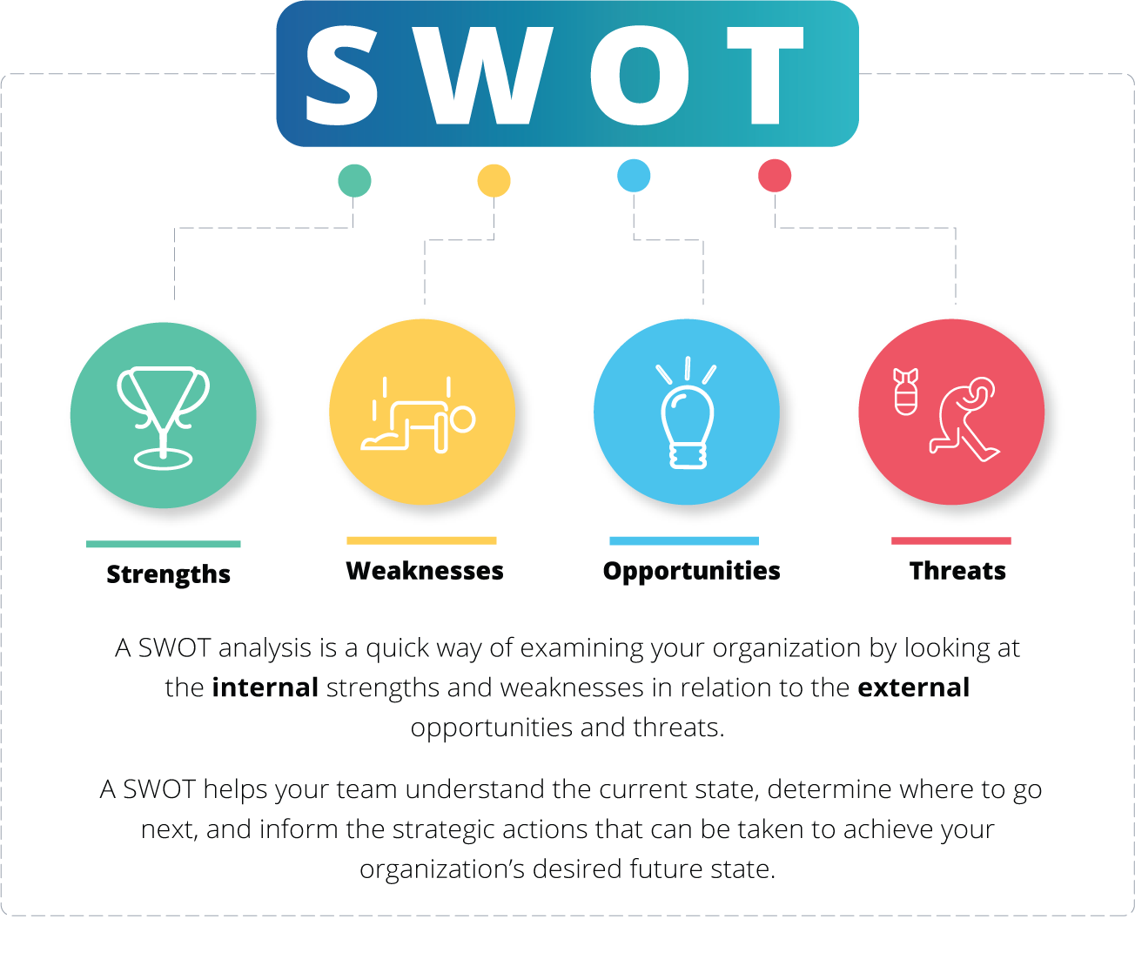
Stimulation of Flow of Ideas
SWOT analysis

Slide 33
Stimulation of Flow of Ideas
Clear Articulation of Objectives:
The operational objectives of the firm can be one or more of following:
Cost Reduction
Productivity Improvement
Increase in Capacity Utilization
Improvement in Contribution Margin
Expansion into Promising Fields

Slide 34
Stimulation of Flow of Ideas
Fostering a Conducive Climate:
To tap the creativity of the people and to harness their entrepreneurial urges, a conducive organizational climate has to be fostered.

Slide 35
Tools for Identifying Project Opportunities
Porter Model
Life Cycle Approach
The Experience Curve

Slide 36
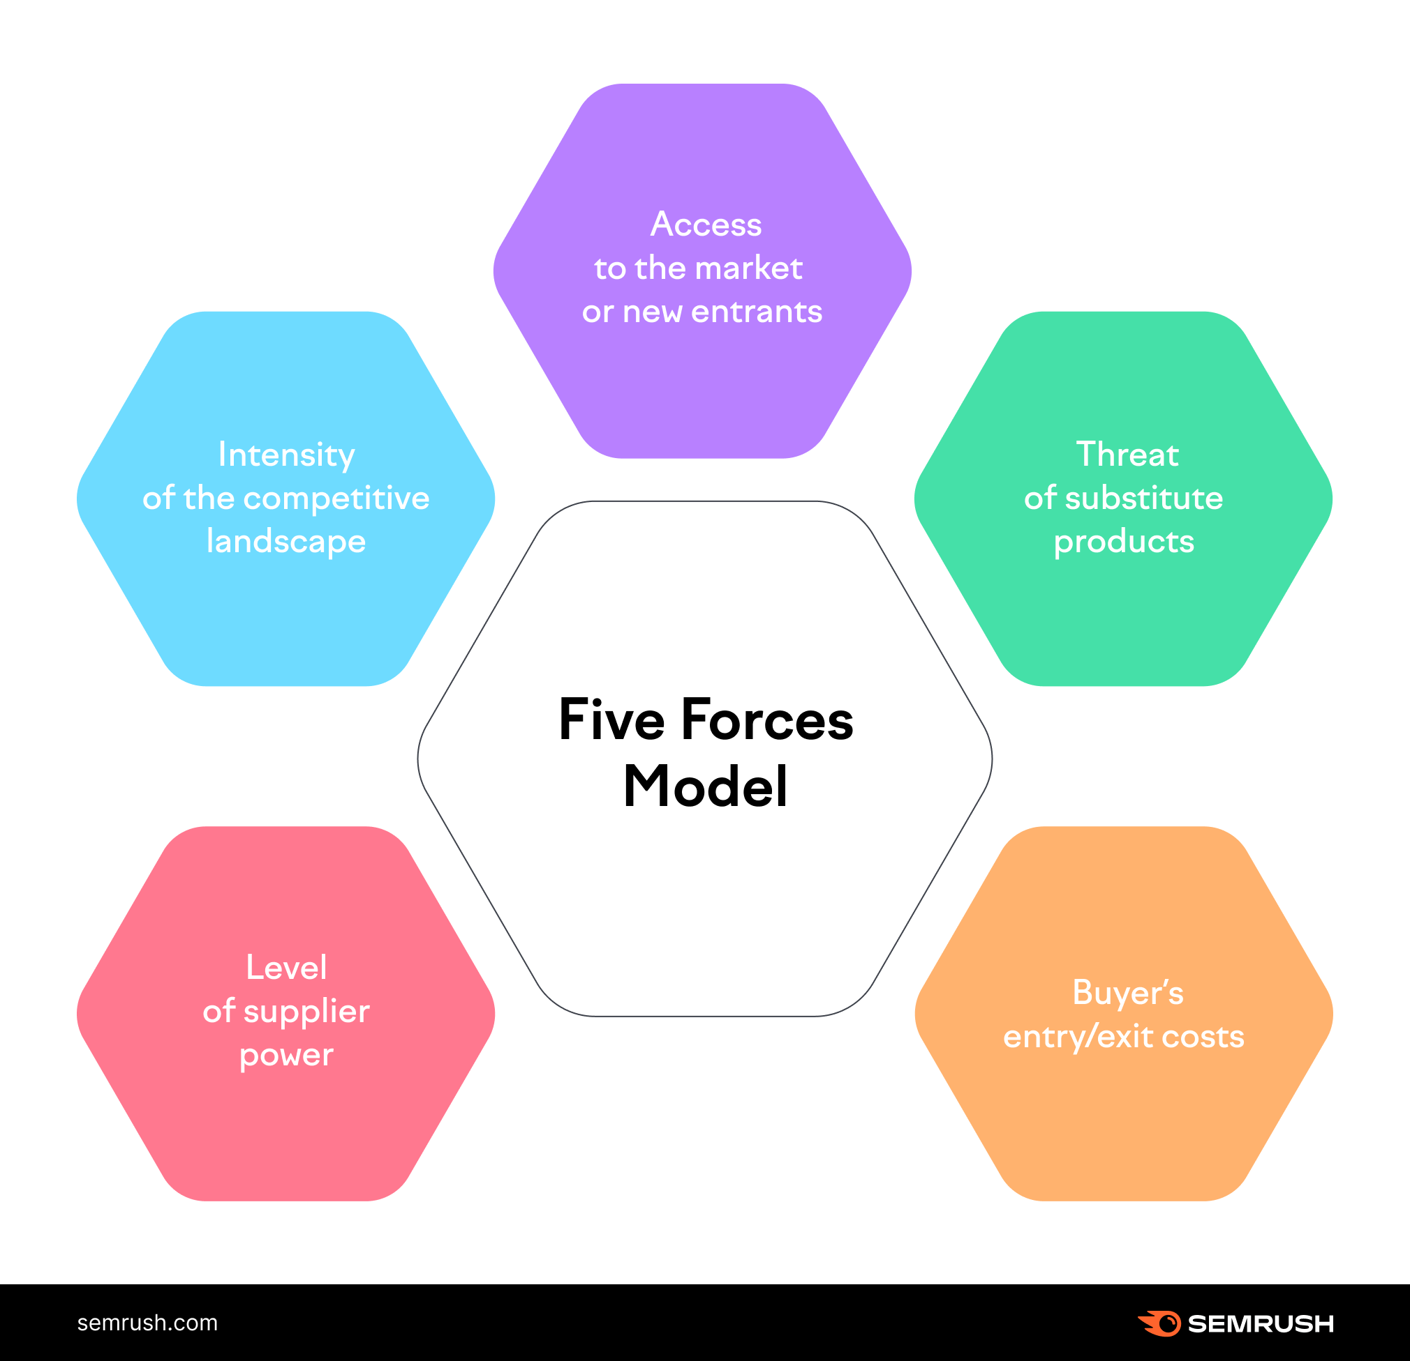
1. Porter’s 5 Forces

Slide 37


2. Life cycle approach
Pioneering Stage (-ve NPV)
Rapid Growth Stage (+ve NPV)
Maturity & Stabilization Stage (Neutral)
Decline Stage (-ve NPV)

Slide 38
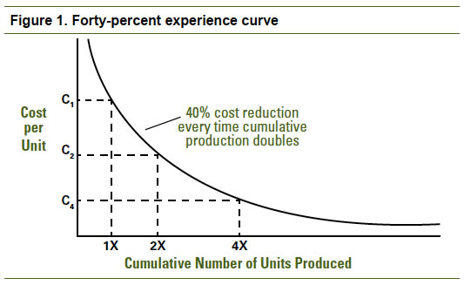
3. Experience curve

Slide 39
Generating Project Ideas
Analyze the performance of existing industries
Examine inputs & outputs of various industries
Review imports & exports
Study plan outlay & Government guidelines
Investigate local materials & resources
Analyze economic & social trends

Slide 40
Generating Project Ideas
Study new technological developments
Draw clues from consumption abroad
Explore the possibility of reviving sick units
Identify unfulfilled psychological needs
Attend trade fairs
Stimulate creativity for generating new ideas

Slide 41
Project Implementation Stages
Project Initiation & Approvals: Securing statutory clearances, land acquisition, funding sign-offs.
Detailed Engineering & Design: Finalizing blueprints, technical specifications, and purchase descriptions.
Procurement & Contracting: Issuing RFPs/Tenders, vendor selection, contract negotiation.
Construction & Erection: Civil works, equipment installation, site assembly.
Testing & Commissioning: Dry runs, performance testing, quality validation.
Handover: Commercial operations date (COD), transferring control to operations team.

Slide 42
Topic objective and topic outcome
s.no. | topic | CO
1 | To learn the Approaches to Project Screening and Selection & Project Rating Index | CO2

Slide 43
Project Screening & Selection
Some kind of preliminary screening is required to eliminate ideas that prima facie are not promising, The Following aspects may be looked into:
Compatibility with the promoter
Consistency with Government priorities
Availability of inputs
Adequacy of market
Reasonableness of cost
Acceptability of risk level

Slide 44
1. Compatibility with the promoter
The idea must be compatible with the interest, personality & resources of an entrepreneur:
Real Opportunity has three characteristics (Murphy)
It fits the personality of the entrepreneur- it squares with his abilities, training & proclivities
It is accessible to him
It offers him the prospects of rapid growth & high return on invested capital

Slide 45
2. Consistency with Government priorities
Questions to be raised in this context are:
Is the project consistent with national goals & priorities?
Are there any environmental effects contrary to Government regulations?
Can the foreign exchange requirement of the project can be easily accommodated?
Will there be any difficulty in obtaining the license for the project?

Slide 46
3. Availability of inputs
Power (Electric, diesel, coal)
Foreign Exchange
Important Raw Material
Supplies of Agricultural Products

Slide 47
4. Adequacy of market
The following factors have to be analyzed.
Total present domestic market
Competitors & their market share
Quality-Price profile
Sales & distribution system
Barriers to the entry of new units
Economic, social & demographic trends
Patent protection

Slide 48
5. Reasonableness of Cost
The cost structure the project must enable it to realise an acceptable profit with a price.
Cost of material inputs
Labor cost
Factory overheads
General administration expenses
Selling & distribution costs
Services costs

Slide 49
6. Acceptability of risk level
In the assessment of risk the following factors should be considered:
Vulnerability of business cycle
Technological changes
Competition from substitutes
Competition from imports
Shifts in consumer preferences

Slide 50
Project Rating Index (PRI)
When a firm evaluates a large number of project ideas, it may be helpful to streamline the process of preliminary screening. For this purpose, a preliminary evaluation may be translated into a Project Rating Index.

Slide 51
Steps of PRI
Identify factors relevant for project rating.
Assign weights to these factors. (Subject to their relative importance)
Rate the project proposal on various factors, using a suitable rating scale. (5 point scale)
For each factor, multiply the factor rating with the factor weight to get the factor score
Add all the factors scores to get the overall project rating index

Slide 52
Ranking Potential Projects
Scale of Benefit
Size of the opportunity
Money saved
Cost avoidance
Time saved
Repeatable benefit
Ease of implementation
Estimated resource hours
Estimated timescale
Estimated level of resistance
Number of cross-teams impacted
Other considerations
Alignment to strategy
Sustain/develop client focus
Quality policy
Capital required

Slide 53
Using Priority Matrix
S.No. | Criteria | Weight (W) | Score (S) | Weighted score
1 | Organisational alignment | 25% |  | W*S
2 | Projected benefits 2.1 External customers 2.2 External stakeholders 2.3 Employee or internal customer 2.4 Other(community/environment) | 20%
3 | Resources required | 15%
4 | Scope in terms of required returns | 15%
5 | Clarity of deliverables | 10%
6 | Time to complete | 10%
7 | Team membership requirements | 5%
 | Total weighted score | 100%

Slide 54
Topic Objectives & Outcome
s.no. | topic | outcomes
1 | To understand conducting the Market & Demand Analysis Techniques: | CO2

Slide 55
Market & Demand Analysis
Market & Demand analysis is concerned with two broad issues:
What is the likely aggregate demand for the product?
What share of the market will the proposed project enjoy?

Slide 56
Factors, that answer >
Patterns of consumption
Income & Price elasticity of demand
Composition of market
Nature of competition
Availability of substitutes
Reach of distribution channel

Slide 57
Collection of Secondary Information
Census of India
National Sample Survey Report
Plan Reports
Statistical Abstracts of Indian Union
India Year Book (Ministry of Info & Broad )
Statistical Year Book (United Nations)
Economic Survey (Ministry of Finance)
Guidelines to Industries (Min of Industrial Dev)
Annual Survey of Industries (CSO)

Slide 58
Conduct of Survey
Define the Target Population
Select the Sample & Sampling Technique
Develop the Questionnaire
Recruit & Train the Field Advisors
Obtain Information as Per Questionnaire
Scrutinize the Information Gathered
Analyze & Interpret the Information

Slide 59
Characterization of Market
Effective demand in the past & present
Breakdown of demand
Price
Methods of distribution & sales promotion
Consumers
Supply & competition
Government Policy

Slide 60
Marketing Strategy
Target Segment
Positioning
Product Line
Price
Distribution
Sales Force
Sales Promotion
Advertising
Notes:
Sales force: a group of employees whose job involves selling or promoting their company's products and services. sales promotion: a short-term marketing strategy used to boost immediate sales, increase demand, or introduce products by providing incentives to consumers, retailers, or salespeople

Slide 61
Demand Forecasting
(I)Qualitative Methods
Jury of Executive Opinion Method
Delphi Method

Slide 62
Jury of Executive Opinion Method
Involves soliciting the opinions of a group of managers on expected future sales and combining them into a sales estimate.
Advantages:
Expeditious
Variety of factors involved
Immense appeal to managers who tend to prefer their judgment
Notes:
Expeditious: done with speed and efficiency.

Slide 63
Delphi Method
Used for eliciting the opinions of a group of experts with the help of a mail survey.
Experts are send the questionnaire by mail & asked to express their views
Responses are summarized without disclosing identity, in case of extreme view, further reasons are asked in second round
Continued for one or more round till a reasonable agreement emerges in the view of the experts
Notes:
Elicit: manage to get information.

Slide 64
Demand Forecasting
(II)Time Series Projection Method
Trend Projection Method
Exponential Smoothing Method
Moving Average Method

Slide 65
Trend projection method
Involves
Determining the trend of consumption by analyzing past consumption statistics
Projecting future trends by extrapolating the trends
The linear relationship is used to find out the projected demand
Yt = a + bt

Slide 66
Moving Average Method
The forecast for the next period is equal to the average of sales for several preceding periods
F_{t+1} = (S_{t} + S_{t-1} + …..+S_{t-n+1})/ n
F_{t+1} = Forecast for the next period
S_{t} = Sales for the current period
n = Number of Preceding years
.

Slide 67
Demand Forecasting
(III)Casual Methods
Seek to develop forecasts based on cause-effect relationship
Chain Ratio Method
Consumption Level Method
End-use Method
Bass Diffusion Method
Leading Indicator Method
Econometric Method

Slide 68
Chain Ratio Method
The potential sales of a product may be estimated by applying a series of factors to a measure of aggregate demand.
It uses a simple analytical approach to demand estimation. However, its reliability is critically dependent on the ratios and rates of usage in the process of determining sales potential

Slide 69
Consumption Level Method
Consumption level method: Useful for a product that is directly consumed; this method estimates consumption level based on elasticity coefficients, the important ones being the income elasticity of demand and the price elasticity of demand.
Estimates consumption level on the basis of elasticity coefficients, the important ones being the income elasticity & price elasticity of demand

Slide 70
End-use method
Suitable for estimating the demand for intermediate products, also called the consumption coefficient method.
Required key inputs are:
Projected output levels of consuming industries, and
Consumption Coefficient

Slide 71
Bass Diffusion Method (Frank Bass)
p: The Coefficient of Innovation
The likelihood that a potential customer would adopt the product because of its innovative features
q: The Coefficient of Imitation
The tendency of a potential customer to buy the product because many others have bought it.

Slide 72
Leading Indicator Method
Leading indicators are variables that change ahead of other variables, the lagging variables.
eg. Change in the level of urbanization (leading indicator) may be used to predict a change in the demand of air conditioners (lagging indicator)

Slide 73
Econometric method
An econometric model is a mathematical representation of economic relationship(s) derived from economic theory.
Two types of models are employed:
Single Equation Model
Simultaneous Equation Model

Slide 74
Single Equation Model
One variable, the dependent variable (Explained variable), is influenced by one or more independent variables (Explanatory variable).
D_{t} = a₀ + a₁P_{t} + a₂N_{t}
D_{t =} Demand for a certain product in year t
P_{t=} Price for the product in year t
N_{t=} Income in year t

Slide 75
Simultaneous Equation Model
Portrays economic relationship in terms of two or more equations.
GNP_{t} = G_{t} + I_{t} + C_{t}
I_{t} = a₀ + a₁GNP_{t}
C_{t} = b₀ + b₁GNP_{t}
where: G_{t} = Government purchases for the year
I_{t} = Gross investment for the year
C_{t} = Consumption for the year t

Slide 76
Topic Objectives & Outcome
s.no. | topic | outcomes
1 | To understand the Concepts and Types of Project Risks | CO2

Slide 77
Project Risk & Uncertainty
A risk is defined as “an uncertain event or condition that, if it occurs, has a positive or negative effect on a project's objectives” (PMI, 2004). It must be emphasized that a risk is characterized by having both a consequence and a probability.
An uncertainty is defined as “the difference between the amount of information required to perform the task and the amount of information already possessed by the organization” (Galbraith, 1977).

Slide 78
Project Risk
A formal, comprehensive project risk plan allows the project manager to be proactive regarding the innumerable things that can and do go wrong with a project.
Project risk management begins early in the life cycle. A clear understanding of the risks that face the project must be established. The sources of project risk are almost limitless, emphasizing the need for a well-thought-out, detailed plan.
Typical examples include the loss of a key team member, weather emergencies, technical failures, and poor suppliers.

Slide 79
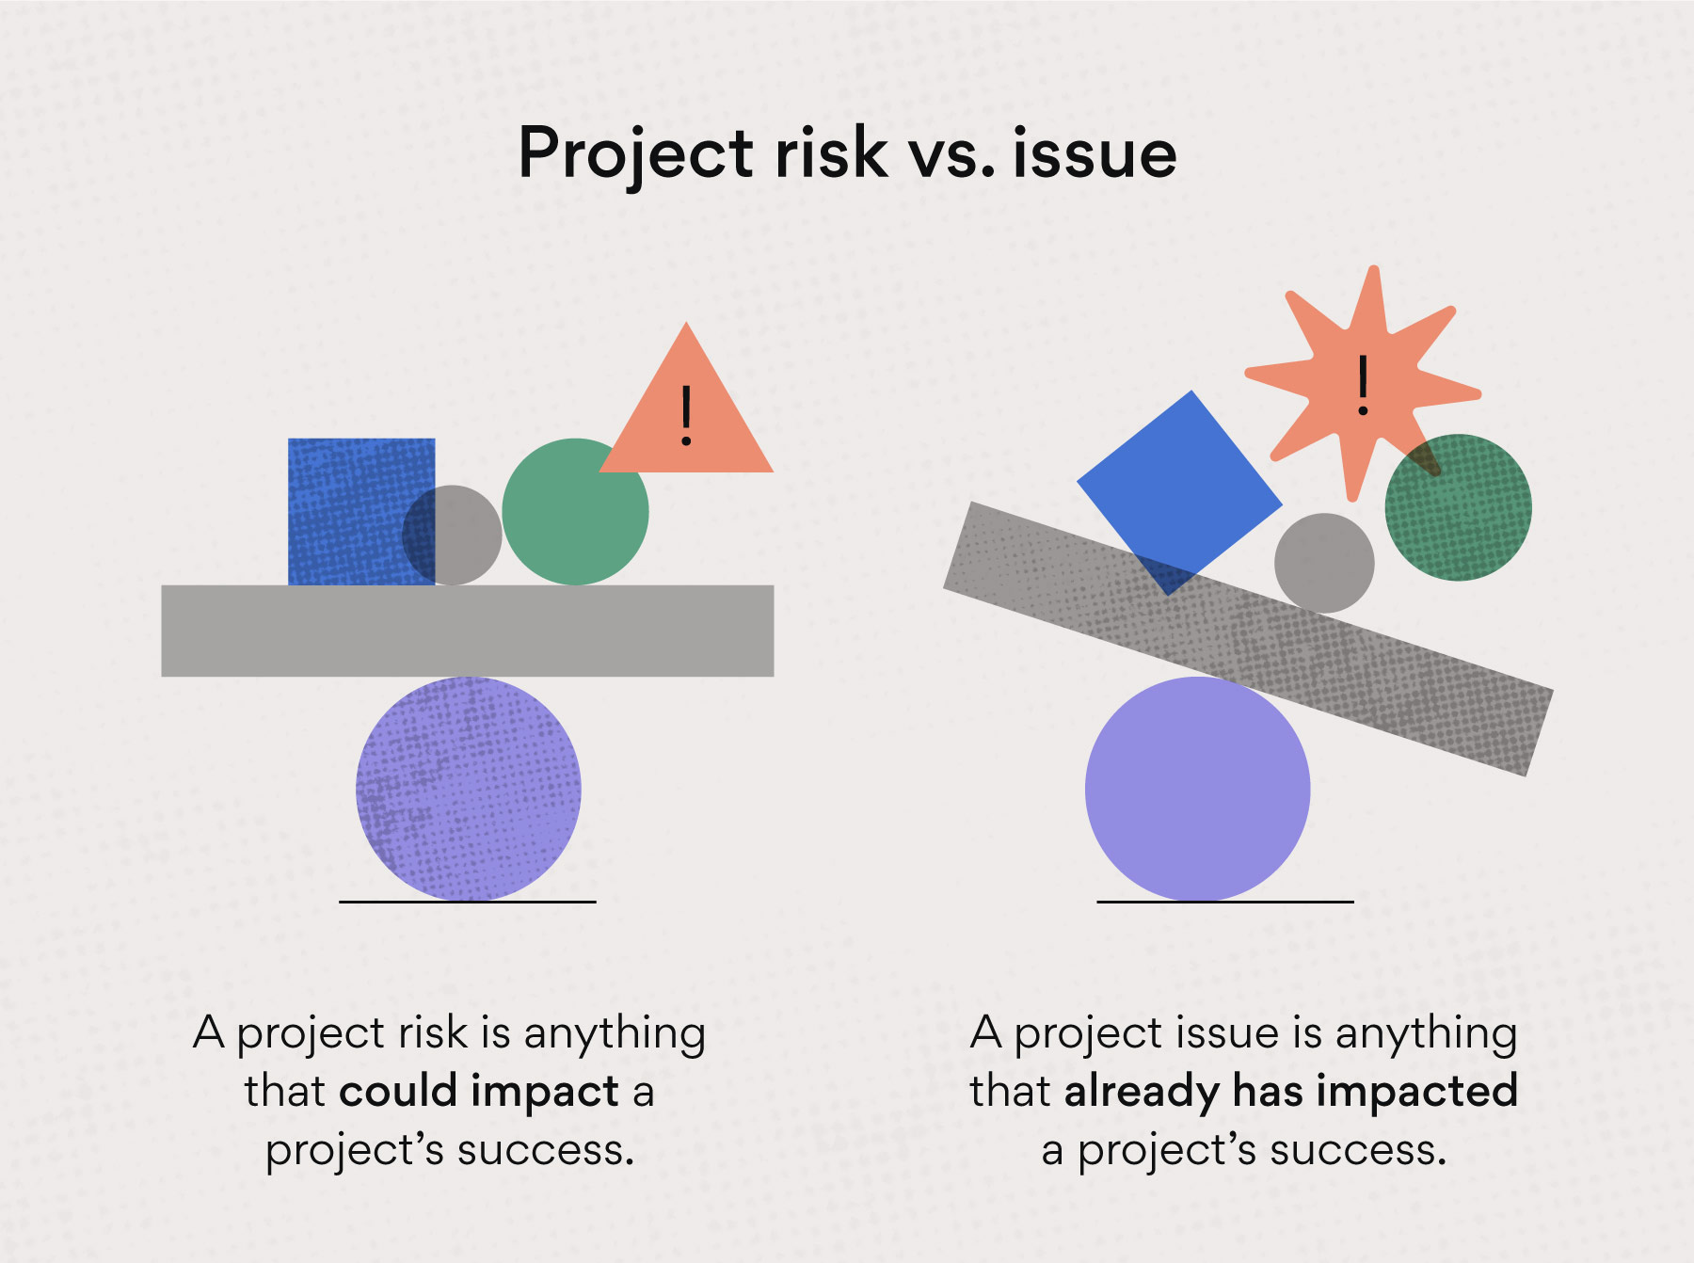
Project Risk

Slide 80
Types of Risk
To relate the risk categories to the levels of project objectives, the three categories are defined.
Operational Risks
Short-term strategic Risks
Long-term strategic Risks

Slide 81
Operational Risk
Risks related to the operational objectives of the project. This means risks restricted to the direct results of the project—that is, its products.

Slide 82
Short-term strategic Risks
Short-term strategic risks are risks related to the objectives for project owner's use of the project results after the project has been completed.
It may also mean the risk for first-order effects of the project—that is, risk for the effects that should be achieved for the target group or users.

Slide 83
Long-term strategic Risks
Risks related to long-term strategic objectives of the project—in other words, risks related to the project purpose, or, the long-term objective that the project is meant to contribute to.

Slide 84
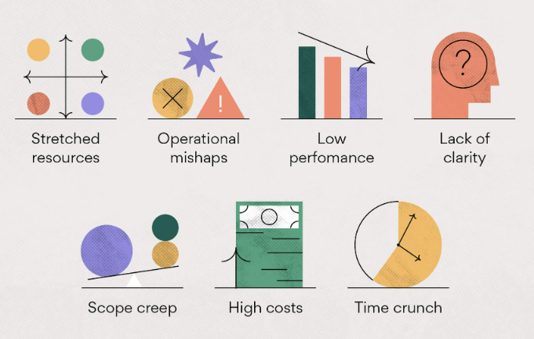
Common Project Risk

Slide 85
Criteria to Categories Risk
Operational criteria, used to evaluate whether a given risk element is long-term strategic, short-term strategic, or operational include the following:
The risk element is considered an operational risk when: the risk element is a risk to the project output (which should be specified in a project definition/delivery contract)—i.e., a risk to the project's ability to deliver.

Slide 86
Criteria to Categories Risk
The risk element is a short-term strategic risk when: the risk element is a risk to a functionality not specified in the project definition/delivery contract, but is necessary to achieve the effects of the project (restricted to the first-order effects for the target group/users).

Slide 87
Criteria to Categories Risk
The risk element is a long-term strategic risk when: the risk element is a risk to achieving the long-term objectives of the project, but not a risk of the two categories mentioned above (i.e., operational or short-term strategic risk).

Slide 88
Topic Objectives & Outcome
s.no. | topic | outcomes
1 | To identify the project risk. | CO2
2 | To do the Risks Analysis of projects | C02

Slide 89
Risk Identification & Analysis
The risk identification function should not be left to chance but should be explicitly covered in a number of project documents:
Statement of work (SOW),
Work breakdown structure (WBS),
Budget,
Schedule,
Acquisition plan, and
Execution plan.

Slide 90
Risk Identification & Analysis
The full project team should be actively involved.
Potential risks should be identified by all members of the project team.
No criticism of any suggestion is permitted.
Any potential risk identified by anyone should be recorded, regardless of whether other members of the group consider it to be significant.
All potential risks identified by brainstorming should be documented and followed up by the integrated project team.

Slide 91
Six Steps Process
Step 1: Make a List
Steps 2 & 3: Determine the Probability of Risk Occurrence and Negative Impact.
Step 4: Prevent or Mitigate the Risk
Step 5: Consider Contingencies
Step 6: Establish the Trigger Point

Slide 92
Step 1: Make a List
Brainstorm. Making a list of potential risks to the project should not be an analysis but a formal brainstorming session, when all ideas are captured.
Involve everyone.
Take a holistic approach to establishing the list, as all types of risks will need to be identified and dealt with accordingly.

Slide 93
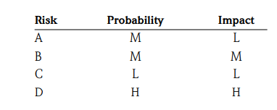
Step 2 & step 3
If the risk becomes a reality, how badly will it damage the project? This is the next question that needs to be asked and answered.
If the risk becomes reality, how will it affect the budget, schedule, resource utilization, scope of work, and so on? The output of steps 2 and 3 results in a list of potential risks with corresponding values for probability and negative impact.

Slide 94
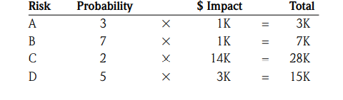
Step 2 & step 3
The probability scale can be based on a range of 1 through 10, with 1 representing unlikely and 10 being very likely. Negative impact can be represented by the same scale or in budgetary impact:

Slide 95
Step 4: Prevent or Mitigate the Risk
Some risks can be prevented; others can only be mitigated. Earthquakes or the retirement of an important stakeholder, for instance, cannot be prevented.
Kill the risk before it has a chance to grow and flourish, and you won’t have to deal with it again.
For example, if a vendor or supplier is targeted for your project and one of your team members has had previous dealings with the company and was not impressed, he will inform you that the supplier’s material deliveries are frequently late and often rejected. Assuming that the supplier is not a sole source (your only choice), you can prevent the risk by finding an alternate supplier that is more reliable.

Slide 96
Step 5: Consider Contingencies
Contingencies represent the specific actions that will be taken if the risk occurs.
Here, you answer the question “If the risk becomes reality, what will we do”?
For example, if acceptance testing for a supplier’s widgets has been identified as medium to high risk and a test failure occurs, an appropriate contingency might be to supply engineering support at the vendor’s expense. Another contingency might be to switch to another predetermined vendor if he has widgets in stock.
If the risk is a high priority (high probability, high negative impact) you will want to identify multiple contingencies.
If the risk falls in the middle range of the prioritization scale, you should establish at least one contingency.

Slide 97
Step 6: Establish the Trigger Point
The trigger point is the point at which the risk becomes enough of a reality that the project manager needs to trigger the contingency.
The trigger point is often the most important element of the project risk plan. There is a direct relationship between the trigger point and the contingencies.
Trigger too soon and you will probably spend time, effort, or money for no good reason. Trigger too late and you may end up experiencing the full impact of the occurrence, with little value added by implementing the contingency.

Slide 98
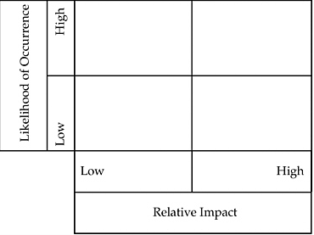
Risk Screening

Slide 99
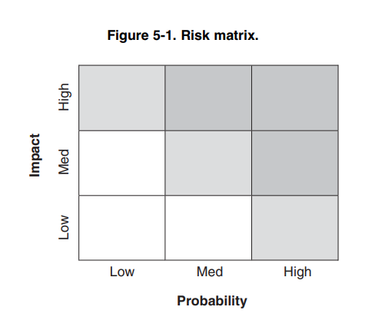
Risk Matrix
A useful tool when managing many risks across projects is the standard risk matrix.
Once the threats have been plotted onto the risk matrix, an H-M-L prioritization can be applied where the highest priority risks are positioned toward the upper right corner and lower priority ones toward the lower left.

Slide 100
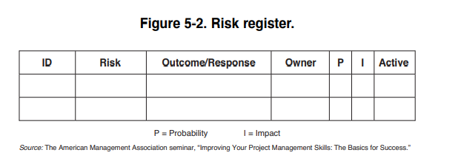
Risk Register
The risk register is a useful tool in managing actions taken regarding accepted risks to the project.
The risk register is the last ingredient of the project risk plan. The risk register also helps you identify ownership of contingency implementation, outcomes of actions taken, and active and inactive risks.

Slide 101
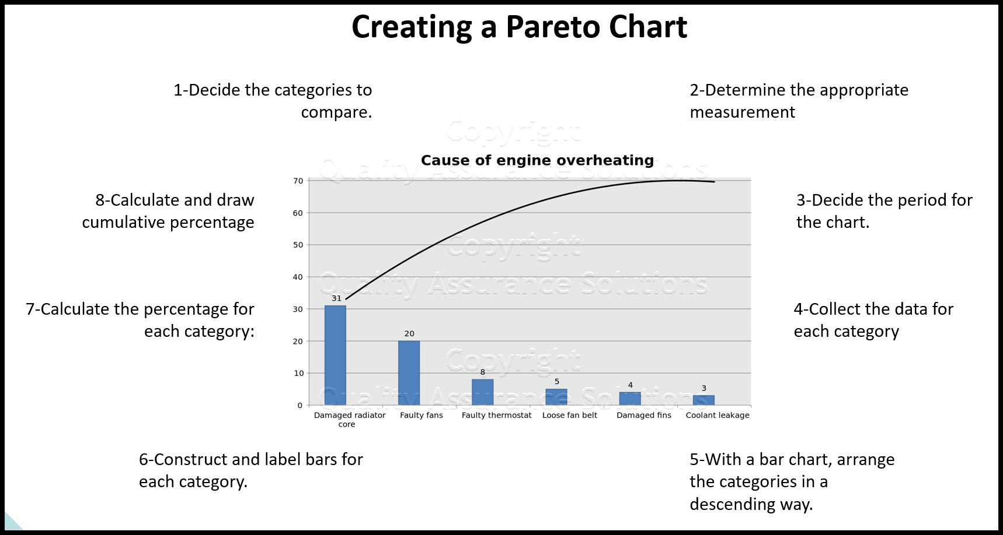
Pareto diagram

Slide 102
Failure Modes and Effects Analysis
In project risk assessment, a failure can be any significant event that the sponsor does not want to happen—a budget overrun, a schedule overrun, or a failure to meet scope, quality, or mission performance objectives.
The objective of failure modes and effects analysis is the identification of root or common causes, which may affect the project as a whole.

Slide 103










Project Definition Rating Index
It includes detailed descriptions of issues and a weighted checklist of project scope definition elements to jog the memory of project team participants.
It provides the means to assess risk at various stages during the front-end project planning process and to focus efforts on high-risk areas that need additional definition.

Slide 104
Quantitative Risk Analysis
Multivariate Statistical Models:
These methods are objective in that they do not rely on subjective probability distributions elicited from (possibly biased) project advocates.
Analysts build linear or nonlinear statistical models based on data from multiple past projects and then compare the project in question to the models.

Slide 105
Quantitative Risk Analysis
Event Trees:
The results of the evaluations are the probabilities of various outcomes from given faults or failures.
Each event tree shows a particular event at the top and the conditions causing that event, leading to the determination of the likelihood of these events.
These methods can be adapted to project cost, schedule, and performance risk assessments.

Slide 106








Quantitative Risk Analysis
Sensitivity Analysis:
A sensitivity coefficient is a derivative: the change in some outcome concerning a change in some input.
Even if the probability of a particular risk cannot be determined precisely, sensitivity analysis can be used to determine which variables have the greatest influence on the risk.

Slide 107
Topic Objectives & Outcome
s.no. | topic | outcomes
1 | To learn the Risks Mitigation Strategies. | CO2

Slide 108
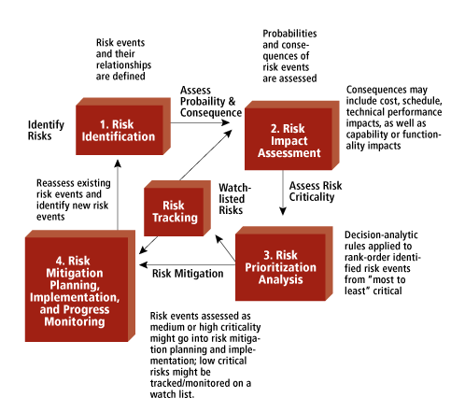
Risk Identification Analysis

Slide 109
Risk Identification Analysis
1. Include risk management in your projects
2. Communicate risks to others
3. Prioritize risks
4. Analyze risks
5. Implement risk responses as early as possible
6. Track them down regularly

Slide 110
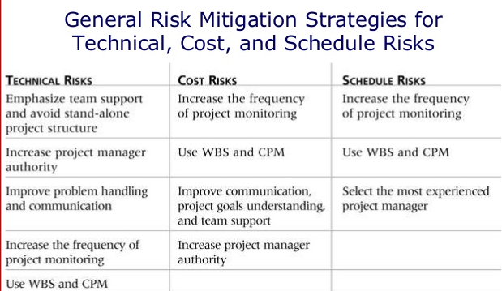
Risk Identification Analysis

Slide 111
Daily quiz
Discuss the project identification.
Explain the idea generation process.
Explain various sources of secondary data.
Describe the chain ratio method of demand forecasting.
Discuss the methodology of the Delphi Technique.
Describe the types of risks associated with projects.
Explain various risk mitigation strategies in project management
Discuss the process of identifying the risk associated to project.

Slide 112
Weekly assignment
Q1. Describe the identification and generation of ideas in project management.
Q2. Describe the market and demand analysis techniques for project management.
Q3. Describe various types of risks associated with project management.
Q4. Describe various risk mitigation strategies in project management.

Slide 113
Topic links
https://www.youtube.com/watch?v=dAJy-3A6lPM
https://www.youtube.com/watch?v=4Or352bDQd4
https://www.youtube.com/watch?v=a0pAWPrKiGk

Slide 114
MCQs
Q1. ETIG stands for.
Economic times intelligence group
Economic, Technological, Implementation, Governance
Early Times investigation group
None of the above
Q2. The market survey can be a.
Census survey
Sample survey
Both A & B
None of the above

Slide 115
MCQs
Q3. In market survey, a sample of _______is contacted or observed.
Population
Sample Frame
Universe
None of the Above
Q4. Which of the following attributes of the questionnaire has an impact on the results of the market survey?
A. Quality
B. Adequate questions
C. Accuracy
D. All of the above

Slide 116
MCQs
Q5. Bass Diffusion method was developed by.
Frank Bass
Huses Bass
Pascal
Devorak
Q6. Leading indicators are the variables that change ______of the other variables.
Ahead
After
Simultaneously
None of these

Slide 117
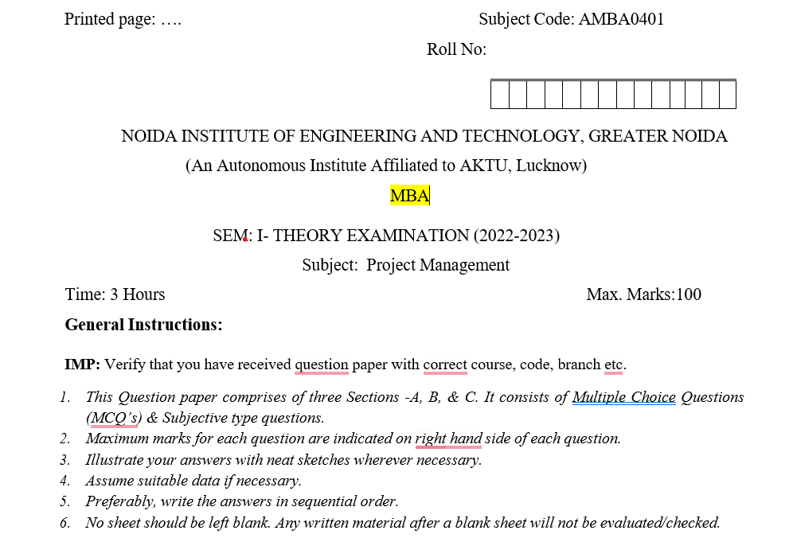
Old question paper

Slide 118
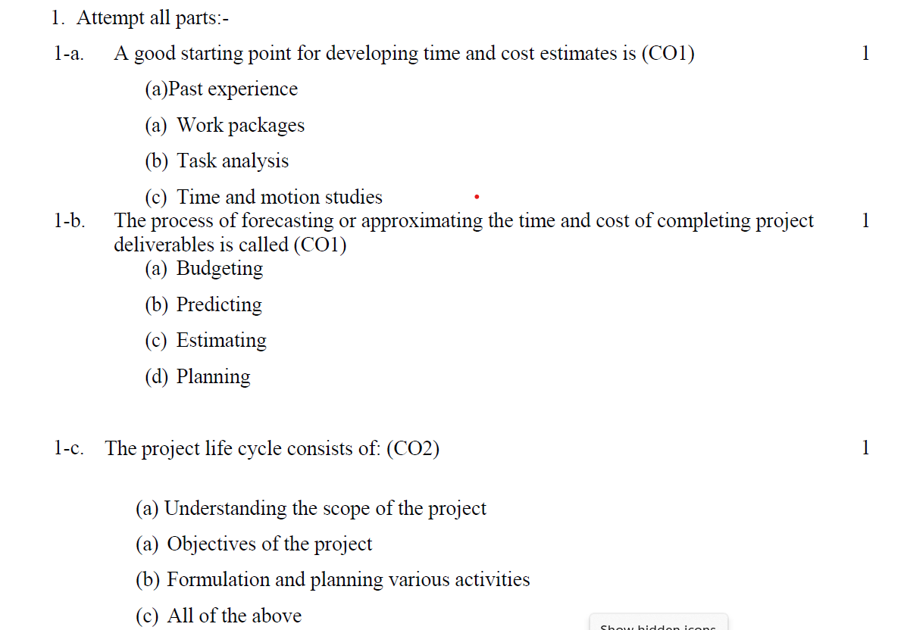
Old question paper

Slide 119
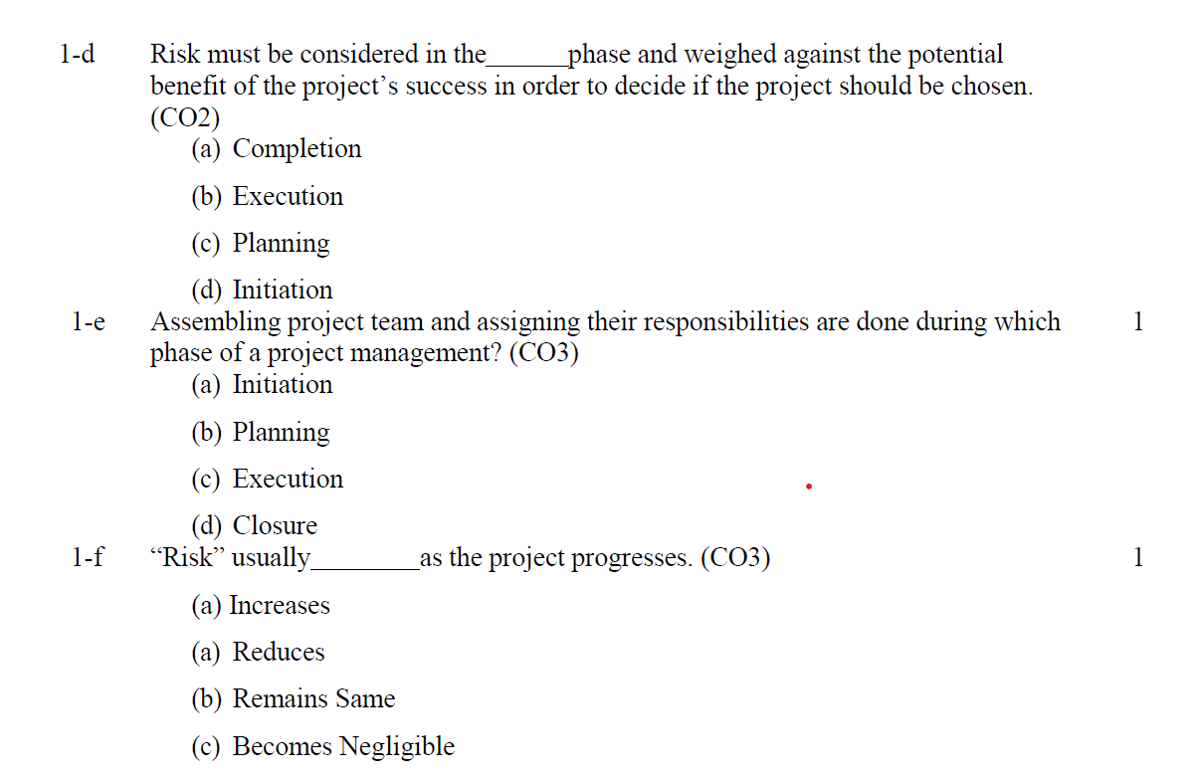
Old question paper

Slide 120
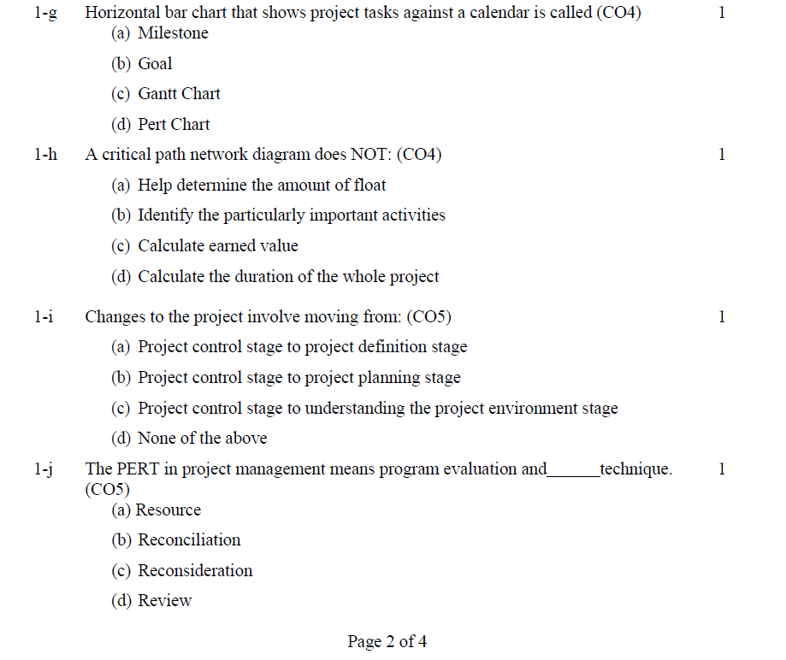
Old question paper

Slide 121
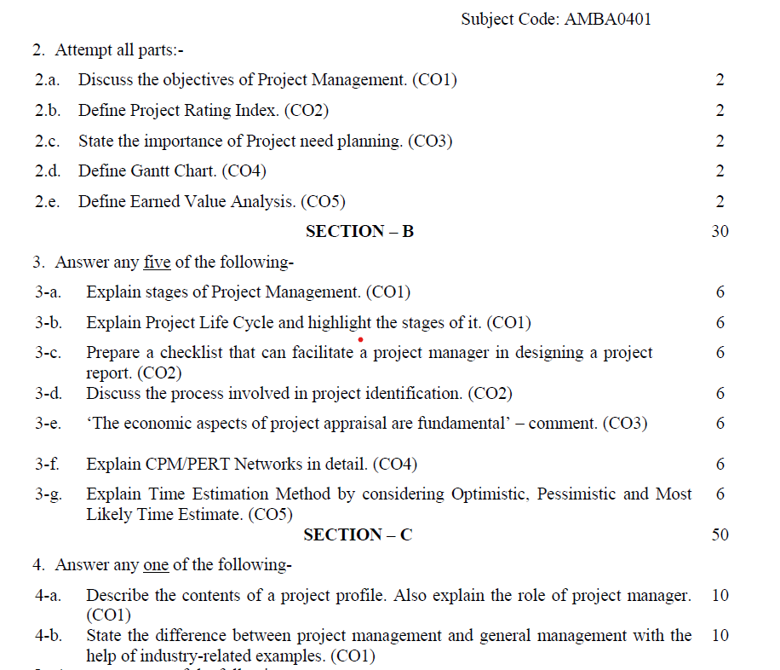
Old question paper

Slide 122
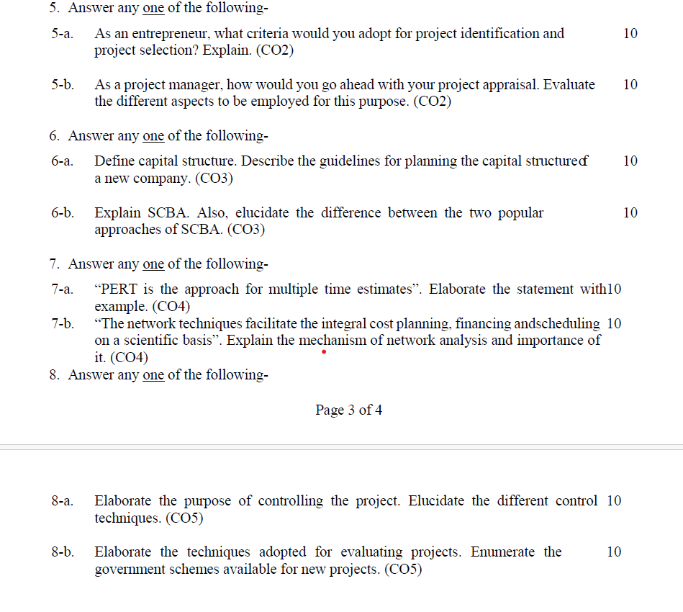
Old question paper

Slide 123
Expected Questions
Q1. Describe the situational analysis.
Q2. Discuss the demand analysis. Explain various demand forecasting techniques used in demand analysis.
Q3. Explain the project risk. Discuss various categories of the project risks.
Q4. Explain various risk mitigation strategies that are used in project risk management.

Slide 124
References
Books:
Larsen, E.W., Gray C.F., & Joshi, R. (2021). Project management: The Managerial process. McGraw Hill.
Chandra, P. (2019). Projects: Planning, Analysis, Selection, Financing, Implementation and Review. McGraw Hill.
REFERENCE BOOK:
Nagarajan, K. (2017). Project Management. New Age International Pvt. Ltd.
Paneerselvam, R., & Senthilkumar, P. (2013). Project Management. Prentice Hall India Learning Pvt. Ltd.
Pinto, J.K. (2020). Project Management. Global EduTech.
Desai, V. (2016). Project Management. Himalaya Publishing House.

Slide 125
Recap of unit
A risk is defined as “an uncertain event or condition that, if it occurs, has a positive or negative effect on a project's objectives”
The project idea must be compatible with the interest, personality & resources of an entrepreneur
Project Identification is often the outcome of TRIGGERING PROCESSES / EVENTS rather than an analytical exercise.
To tap the creativity of the people and to harness their entrepreneurial urges, a conducive organizational climate has to be fostered.
Some kind of preliminary screening is required to eliminate ideas which prima facie are not promising

