Slide 1


Noida Institute of Engineering and Technology, Greater Noida
Introduction to Organizational Behaviour
Unit: 1
Human Psychology & OB(AOE0765)
Shruti Mittal
Assistant Professor MBA
Course Details (B Tech CYS, IOT & DS 7th Sem )

Slide 2

Index/ Content
S. No. | Index
1. | Name of Subject with code, Course and Subject Teacher
2. | Brief Introduction of Faculty member with Photograph
3. | Evaluation Scheme
4. | Syllabus
5. | Branch wise Application
6. | Course Objective(s)
7. | Course Outcome(s)
8. | Program Outcomes (POs)
9. | COs and POs Mapping

Slide 3
Index/ Content
S. No. | Index
10. | Program Specific Outcomes (PSOs)
11. | Cos and PSOs Mapping
12. | Program Educational Objectives (PEOs)
13. | Result Analysis
14. | End Semester Question paper Templates
15. | Prequisite/Recap
16. | Brief Indtroduction about the Subject with Videos
17. | Unit Contents
18. | Unit Objectives
19. | Topic Objectives/ Topic Outcome

Slide 4
Index/ Content
S. No. | Index
20. | Lecture related to topic
21. | Daily Quiz
22. | Weekly Assignment
23. | Topic Links
24. | MCQs
25. | Glossary Questions
26. | Old question papers
27. | Expected Questions
28. | Recap of unit

Slide 5
Brief Introduction of the Faculty Member

Slide 6
Evaluation Scheme

Slide 7
Subject Syllabus
Course Contents / Syllabus
UNIT-I | Introduction to Organisation Behaviour | Hours- 8
Introduction to OB , Definition, Nature and Scope – Environmental and organizational context – Impact of globalization, Diversity, Ethics, culture. Importance of OB in understanding Human Behaviour. Cognitive Processes,I: Perception and Attribution: Nature and importance of Perception – Perceptual selectivity and organization , Social perception – Attribution Theories ,Locus of control –Attribution Errors.
UNIT-II | Dimensions of Human Behaviour and Psychology | Hours-8
Cognitive Processes,II: Personality and Attitudes, Personality as a continuum - Meaning of personality , Johari Window and Transactional Analysis , Nature and Dimension of Attitudes -Job satisfaction and organizational commitment, Motivational needs and processes, Theories of Motivation

Slide 8
Subject Syllabus
UNIT-III | Dynamics of OB –I | Hours-8
Dynamics of OB –I ,Stress and Conflict: Meaning and types of stress ,Stress Management, Meaning and types of conflict , Effect of stress and intra individual conflict , Conflict management.
UNIT-IV | Dynamics of OB-II | Hours-8
Dynamics of OB-II Power and Politics: Meaning and types of power – empowerment , Groups Vs. Teams – Nature of groups – dynamics of informal groups – dysfunctions of groups and teams – teams in modern work place.
UNIT-V | Leadership and Organisation Change. |  | Hours-8
High performance work practices , Behavioural performance management: reinforcement and punishment as principles of Learning –Process of Behavioural modification , Leadership theories , Styles, Activities and skills of Great leaders. Organizational change , meaning, factors in Organizational change, process of planned Change, Resistance to change.

Slide 9
Branch Wise Application
This subject will help the students gain understanding of the functions and responsibilities of managers. It shall provide students the tools and techniques to be used in the performance of the managerial job. And will also enable them to analyze and understand the complex human behaviour at organization.

Slide 10
Course Objective
1 | Understand the various dimensions of Human psychology.
2 | Familiarize students with the concept of Organisation Behaviour.
3 | Enable students to describe how people behave under different conditions and understand why people behave as they do.
4 | To introduce students to the concepts of Team and Organization change.

Slide 11
Course Outcome
CO1-Understand the concept of Organization Behavior and human psychology in terms of the key factors that influence organizational behavior. | Knowledge (K2), Remembering (K1)
CO2-Analyze and evaluate the behavior for enhancing individual and group performance. | Comprehending (K 3)
CO3-Demonstrate the applicability of analyzing the complexities associated with management of individual behavior in the organization. | Knowledge (K2), Applying (K4)
CO4-Analyze the complexities associated with management of the group behavior in the organization. | Knowledge (K2), Analyzing (K5)
CO5- Create the conducive work environment encompassing the theories of leadership and change management. | Applying (K4)

Slide 12
Program Outcomes
1. PO1 Engineering knowledge - Apply the knowledge of mathematics, science, engineering fundamentals, and an engineering specialization to the solution of complex engineering problems
2. PO2 Problem analysis - Identify, formulate, review research literature, and analyze complex engineering problems reaching substantiated conclusions using first principles of mathematics, natural sciences, and engineering sciences
3. PO3 Design/development of solutions - Design solutions for complex engineering problems and design system components or processes that meet the specified needs with appropriate consideration for the public health and safety, and the cultural, societal, and environmental considerations
4. PO4 Conduct investigations of complex problems - Use research-based knowledge and research methods including design of experiments, analysis and interpretation of data, and synthesis of the information to provide valid conclusions

Slide 13
Program Outcomes
5. PO5 Modern tool usage - Create, select, and apply appropriate techniques, resources, and modern engineering & IT tools including prediction and modeling to complex engineering activities with an understanding of the limitations.
6. PO6 The engineer and society - Apply reasoning informed by the contextual knowledge to assess societal, health, safety, legal and cultural issues and the consequent responsibilities relevant to the professional engineering practice.
7. PO7 Environment and sustainability - Understand the impact of professional engineering solutions in societal and environmental contexts, and demonstrate the knowledge of, and need for sustainable development.
8. PO8 Ethics - Apply ethical principles and commit to professional ethics and responsibilities and norms of the engineering practice.
9. PO9 Individual and team work - Function effectively as an individual, and as a member or leader in diverse teams, and in multidisciplinary settings.

Slide 14
Program Outcomes
10. PO10 Communication - Communicate effectively on complex engineering activities with the engineering community and with society at large, such as, being able to comprehend and write effective reports and design documentation, make effective presentations, and give and receive clear instructions.
11. PO11 Project management and finance - Demonstrate knowledge and understanding of the engineering and management principles and apply these to one’s own work, as a member and leader in a team, to manage projects and in multidisciplinary environments.
12. PO12 Life-long learning - Recognize the need for, and have the preparation and ability to engage in independent and life-long learning in the broadest context of technological change.

Slide 15
CO-PO Mapping
Human Psychology & Organization Behaviour (AOE0765 )
CO/PO | PO1 | PO2 | PO3 | PO4 | PO5 | PO6 | PO7 | PO8 | PO9 | PO10 | PO11 | PO12
CO1 | 1 | - | - | - | - | 1 | 2 | - | - | 1 | - | -
CO2 | - | 2 | - | - | 2 | - | 2 | - | - | - | 1 | -
CO3 | 2 | 2 | - | - | 3 | - | - | 2 | - | - | - | -
CO4 | 3 | - | - | 1 | - | 2 | - | - | 1 | - | - | 1
CO5 | 2 | - | 1 | - | - | - | 3 | - | - | - | - | -

Slide 16
Program Specific Outcomes
Our graduates will be able to
PSO1: Apply suitable techniques, modern tools to solve complex engineering problems in the field of computer science.
PSO2: Design and optimize, ethical and innovative solutions for the betterment of the society.
PSO3: Work as an individual or lead in a team with good communication and engage in life-long learning.

Slide 17
Program Educational Objectives
PEO1: Conceptual Knowledge to adapt in rapidly changing environment and learn new skills and demonstrate application of management principles in professional work setting.
PEO2: Apply appropriate tools for decision making for solving complex managerial problems in local or global context.
PEO3: Exhibit Integrity, social responsibility and teamwork.
PEO4: Exhibit ethics, communication skills, leadership qualities and entrepreneurial mindset.

Slide 18
Result Analysis
 |  |  |  |  |  |  |  |  | No. of students in Marks Range
Subject Name | Section | Faculty Name | Total Students | Pass Students | % Section wise Result | Overall % Result of Subject | Highest Marks | Average Marks | 40 - 50 | 51-60 | 61-70 | 71 - 80 | >81
Digital Marketing | -

Slide 19
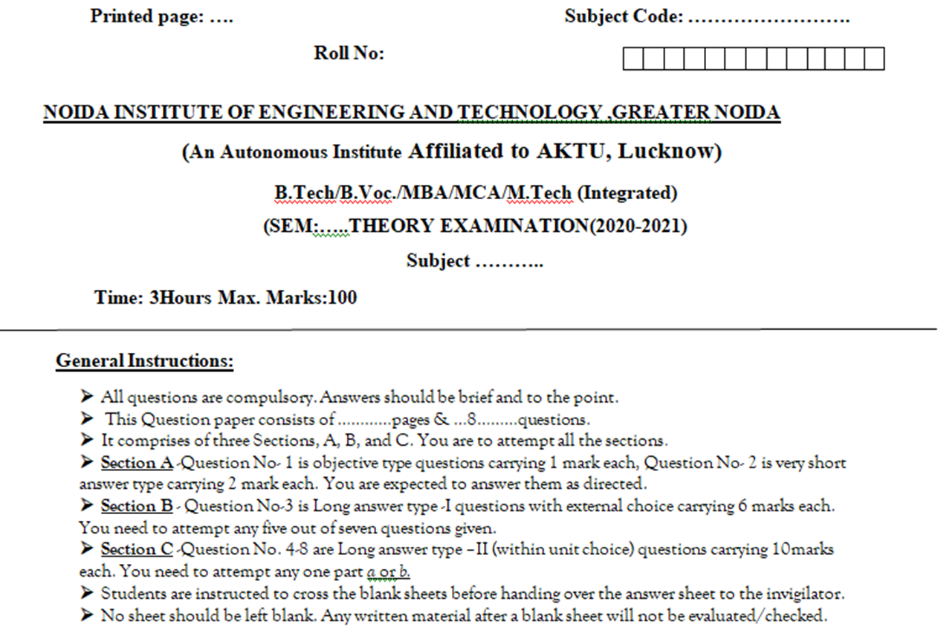
End Semester Question Paper Template

Slide 20
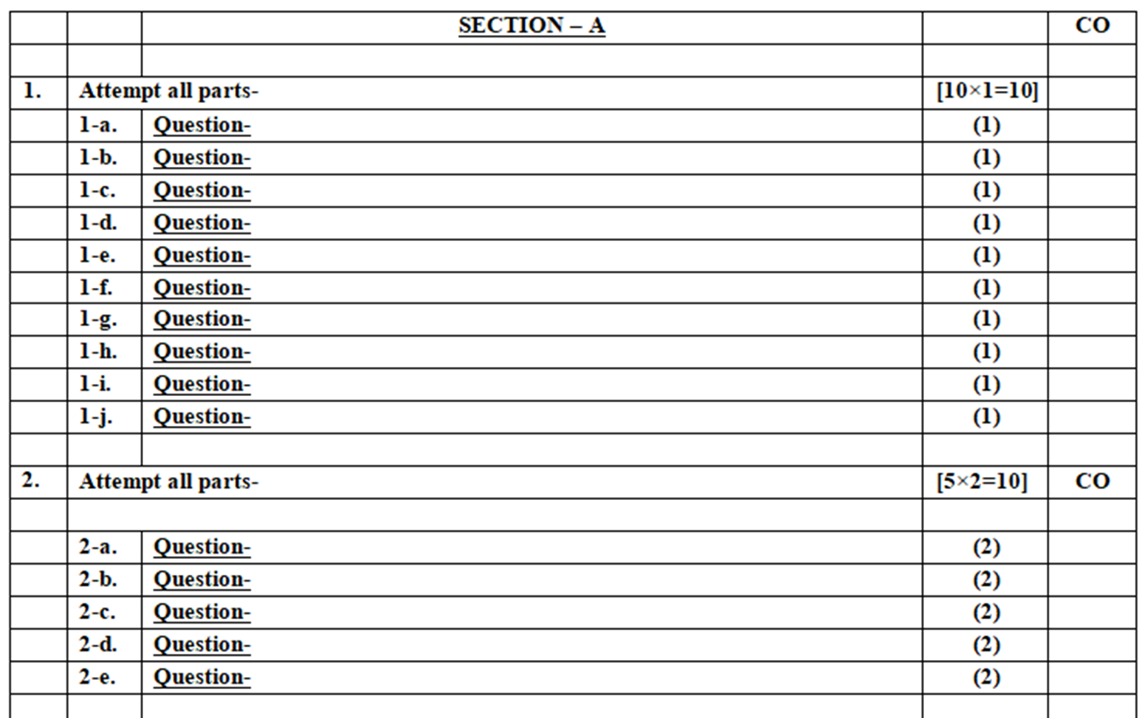
End Semester Question Paper Template

Slide 21
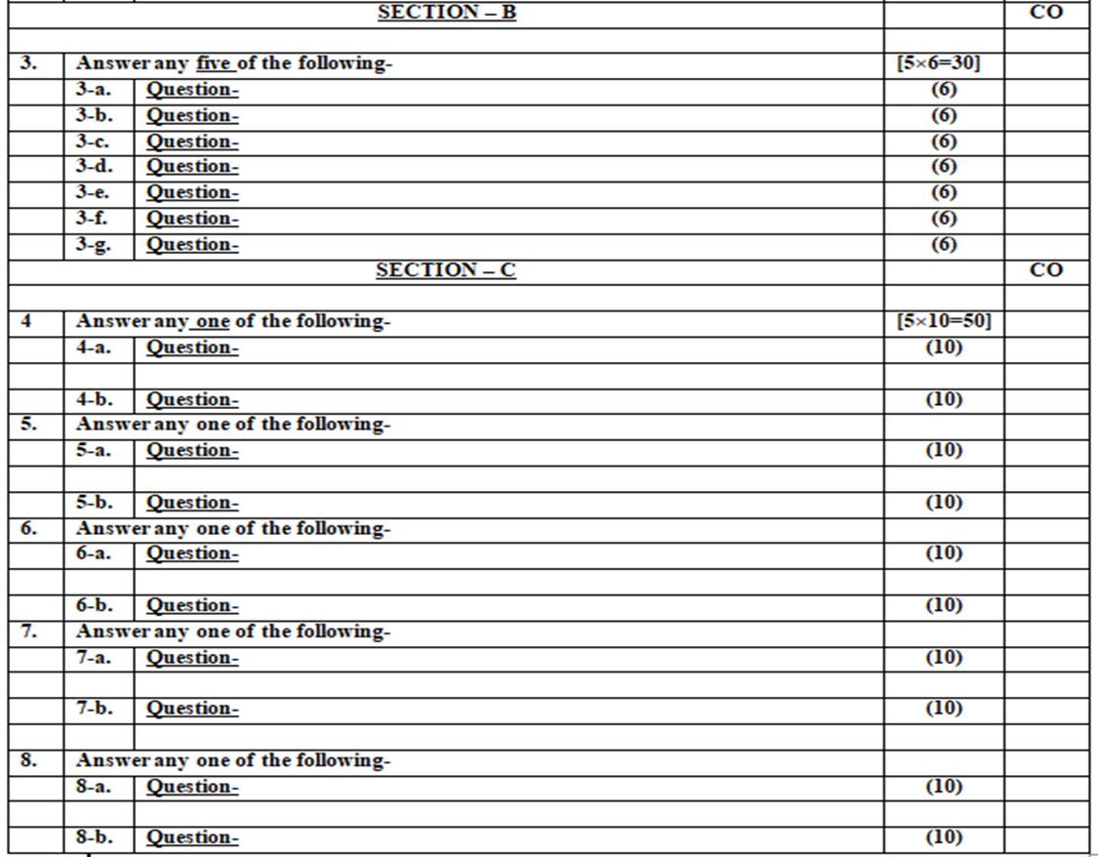
End Semester Question Paper Template

Slide 22
Prerequisite
Student should have a primary understanding of management thought.
Students should be having preliminary knowledge of planning.

Slide 23
Brief Introduction about the Subject
Management comprises planning, organizing, staffing, leading or directing, and controlling an organization to accomplish a goal. It also includes resourcing that encompasses the deployment and manipulation of human resources, financial resources, technological resources, and natural resources. Organizational Behavior (OB) can be defined as the understanding, prediction and management of human behavior both individually or in a group that occur within an organization. Internal and external perspectives are the two theories of how organizational behavior can be viewed from an organization's point of view.

Slide 24
Unit Objectives
The objectives of this unit are:
To understand the concept, nature and scope of Organizational behaviour
To understand importance of OB in understanding Human behaviour
To gain an understanding of the cognitive processes
To learn about different attribution errors.

Slide 25
Topic Objective/ Topic Outcome
Name of Topic | Objective of Topic | Mapping with CO
Introduction to OB | To understand the Organization | CO1
Definition, Nature and scope | To understand the concept of OB | CO1
Scope – Environmental and organizational context | To understand the concept of OB in organizational context | CO1

Slide 26
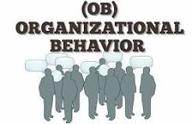
Meaning of Organization Behaviour
Organizational behavior is the study of human behavior in an organizational setting.
This includes how individuals interact with each other in addition to how individuals interact with the organization itself.
Organizational behavior is a critical part of human resources, though it is embedded across a company.

Slide 27
Organization Behaviour
Organizational behavior is the academic study of how people interact within groups and its principles are applied primarily in attempts to make businesses operate more effectively.
The study of organizational behavior includes areas of research dedicated to improving job performance, increasing job satisfaction, promoting innovation, and encouraging leadership and is a foundation of corporate human resources.

Slide 28

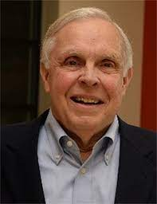
Definitions of Organization Behaviour
According to Stephen P Robbins - “Organisational behaviour is a field of study that investigates the impact that individuals, groups and structure have on behaviours within the organizations for the purpose of applying such knowledge towards improving an organizations effectiveness”
According to Fred Luthans - “Organisational behaviour is directly concerned with the understanding production and control of human behaviour in organization”

Slide 29

Definitions of OB
Organizational behaviour can be defined as – “the study and application of knowledge about human behaviour related to other elements of an organization such as structure, technology and social systems (LM Prasad).

Slide 30
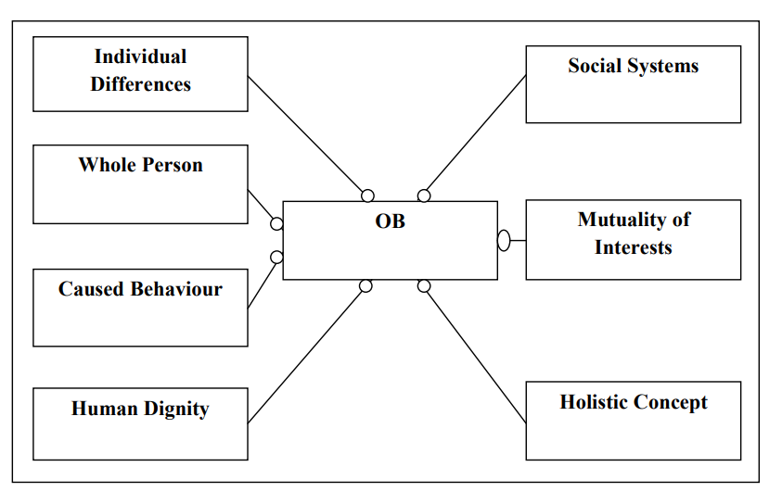
Foundations of OB

Slide 31
Contributing Disciplines of OB
Psychology
Sociology
Anthropology
Political science

Slide 32
Nature of OB
1. A Separate Field of Study and Not a Discipline Only
2. An Interdisciplinary Approach
3. An Applied Science
4. A Normative Science
5. A Humanistic and Optimistic Approach
6. A Total System Approach

Slide 33
Scope of OB
Impact of Personality on performance
Employee motivation
Leadership
Perception
Individual behavior
Attitude
Management of Change
Management of Stress and Conflict
Organizational development

Slide 34

Applications of OB in Management
Responding to Globalization
Managing workforce diversity
Improving quality & productivity
Improving people skills
Stimulating Innovation and Change
Work-life balance

Slide 35
Recap
In this topic, We learned about Digital Transformation.
We also learned about its features & process.

Slide 36
Daily Quiz
Organisational behaviour is_______
a) A science
b) An art
c) A science as well as an art
d) None of the above
A study of the culture and practises in different societies is called _____
a) Personality
b) Anthropology
c) Perception
d) Attitudes

Slide 37
Daily Quiz
In present context, challenges for Organizational Behaviour are _____
a) Employee expectation
b) Workforce diversity
c) Globalization
d) All of the above
The term ‘psychology’ is derived from the word ‘psyche’, which means ‘soul’ or ‘spirit’_______
a) Latin
b) French
c) Greek
d) None of these

Slide 38
Noida Institute of Engineering and Technology, Greater Noida
Environmental & Organizational Context
Topic 2
Human Psychology & OB (AOE0765)

Slide 39
Prerequisite
Basic knowledge of Organization Behaviour.

Slide 40
Topic Objective & Topic Outcome
Name of Topic | Objective of Topic | Mapping with CO
Impact of globalization, Diversity, Ethics, culture | To study the meaning of Ethics & Culture | CO1
Importance of OB in understanding Human Behaviour | To study the importance of OB | CO1

Slide 41
Globalization
Globalization is the process that improves the interaction through integration of society, culture, politics and business across the world. Globalization is the integration of any market with the global economy.
In short, Globalization refers to the complex economic networks of international competition, resource suppliers, and product markets.

Slide 42
Globalization
Before the globalization national borders were perfectly insulated and businesses were free from any foreign competition.
Today world is a global village where multinationals are spreading their business across the world.
At the same time large pool of workforce are chasing down job opportunities across national borders.

Slide 43
Culture
Organizational culture can be defined as the group norms, values, beliefs and assumptions practiced in an organization. It brings stability and control within the firm. The organization is more stable and its objective can be understood more clearly.
Organizational culture helps the group members to resolve their differences, overcome the barriers and also helps them in tackling risks.

Slide 44
Elements of Organizational Culture
The two key elements seen in organizational culture are −
Visible elements − These elements are seen by the outer world. Example, dress code, activities, setup, etc.
Invisible elements − These inner elements of the group cannot be seen by people outside the group or firm. Example, values, norms, assumptions, etc. Now let us discuss some other elements of organizational culture. They are −
Stories − Stories regarding the history of the firm, or founder.
Rituals − Precise practices an organization follows as a habit.

Slide 45
Types of Organizational Culture
The culture a firm follows can be further classified into different types. They are −
Mechanistic and Organic culture
Authoritarian and Participative culture
Subculture and Dominant culture
Strong and Weak culture
Entrepreneurial and Market culture

Slide 46
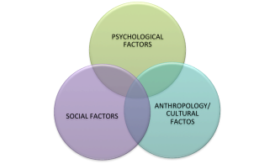
Globalization & Culture
As globalization has fostered the thought of multiculturalism, the relationship between culture and organizational behavior has become increasingly valued.

Slide 47
Diversity
Cultural diversity is geared toward having a deep respect and understanding of the various people in the organization.
This aspect of the organization is strengthened by having feedback, teamwork, team-building activities and interpersonal communication.
During such engagements, individuals are able to interact and appreciate each other’s culture; consequently, an accommodating culture and organizational behavior is established within the organization.

Slide 48
Globalization & Leadership
Leadership might be universal in terms of a kind of social process but that the content of leadership was affected by the culture.
Different cultures would lead to different contents, styles and effectiveness of leadership.
In most situations, leadership styles might not reveal leaders’ personal will, but reflect the culture and tradition of the societies they are in.
Moreover, the effectiveness of leadership would also be influenced by local social context. For example: Defining, measuring and rewarding performance in the same way does not work well across functions, business units and occupations

Slide 49
Globalization & Leadership
Today in a globalized scenario cross-cultural management must give more emphasis on 3R rule-
Recognize cultural difference
Respect people’s right to differ
Reconcile the issues differences create

Slide 50
Multi Cultural Team
Multicultural team can provide strategic advancement for an organization.
However culturally diverse team, work as or more effectively as a homogeneous team when leadership helps to prevent communication breakdown.
In fact global virtual teams are more effective when they impose formal temporal coordinating mechanism and develop norms for meaningful participation.

Slide 51
Advantages of Globalization
Learning
Experience and Knowledge
International skills
Reputation

Slide 52
Importance of OB in understanding Human Behaviour
Impact of Personality on performance
Employee motivation
Leadership
Perception
Individual behavior
Attitude
Management of Change
Management of Stress and Conflict
Organizational development

Slide 53
Importance of OB
1. Good Workplace Relationships
2. Employee Motivation
3. Builds a Psychologically Safe Workplace
4. Nature of Employees
5. Higher Efficiency in Teams

Slide 54
Recap
In this topic, We learned about Digital Leadership & its benefits.
Also we learnt about Role of a Leader including Progressive Leadership.

Slide 55
Daily Quiz
Define Globalization.
Explain what is Diversity.
Discuss the impact of Leadership on team behavior.
Define ethics.

Slide 56

Noida Institute of Engineering & Technology, Greater Noida
Management Principles & Organizational Behaviour
Topic 3
Human Psychology & OB (AOE0765)

Slide 57
Prerequiste
Knowledge of Digital Transformation & Digital Leadership including its-
Features, Process & Advantages
Role of a Leader
Progressive Leadership

Slide 58
Topic Objective/ Topic Outcome
Name of Topic | Objective of Topic | Mapping with CO
Cognitive Processes I: Perception and Attribution | To study the concept of Perception & Attribution | CO1
Nature and importance of Perception | To study the importance of Perception | CO1

Slide 59
Cognitive Processes
Cognitive processes are the mental functions assumed to be involved in the acquisition, storage, interpretation, manipulation, transformation, and use of knowledge.
These processes encompass such activities as attention, perception, learning, and problem solving
Cognitive processes allow us to create cultures, societies, friends and occupations, many important aspects of human life

Slide 60
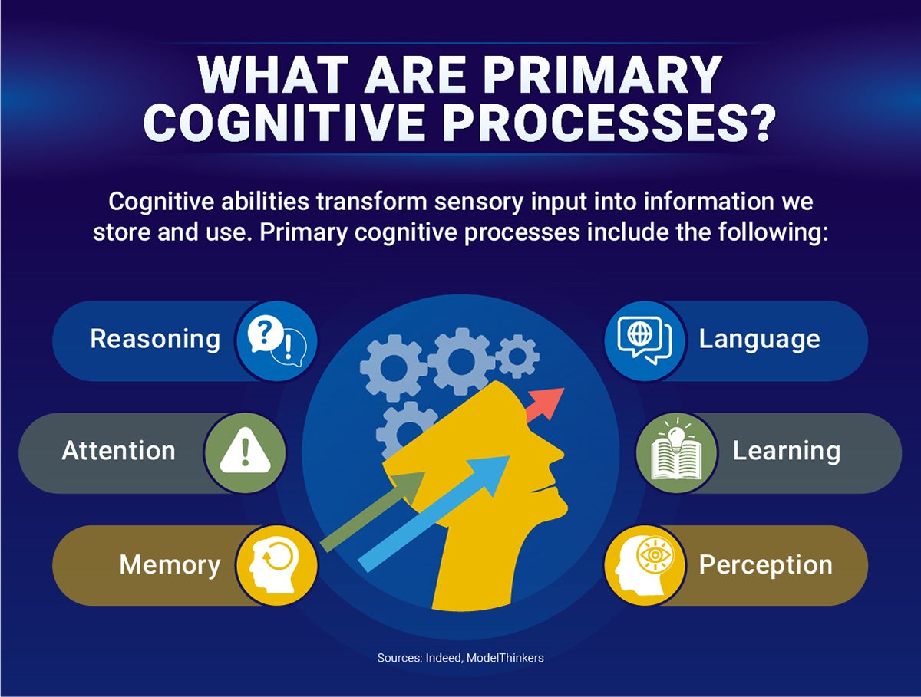
Cognitive Processes

Slide 61
Definition of Perception
Perception is defined as “a process by which individuals organize and interpret their sensory impressions in order to give meaning to their environment (Robbins)”
Perception (from the Latin perceptio, meaning gathering or receiving) is the organization, identification, and interpretation of sensory information in order to represent and understand the presented information or environment.

Slide 62
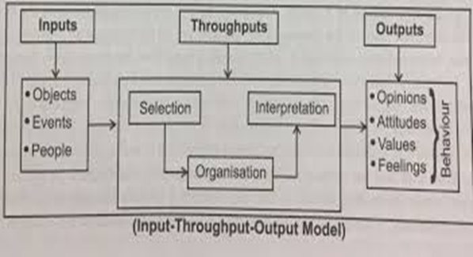
Perceptual Process
1. Receiving Stimuli
2. Selection of Stimuli
3. Organization of Stimuli (i) Grouping(ii) Closure
(iii) Simplification. (iv)Interpretation

Slide 63
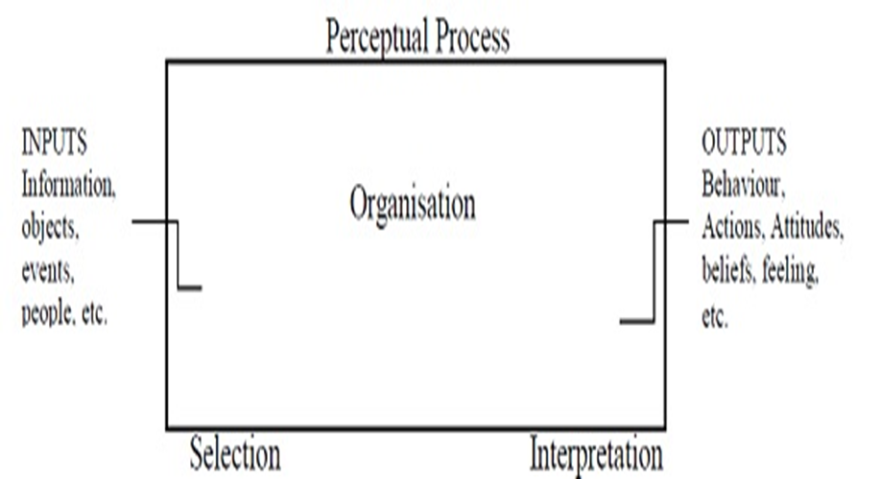
Model of the Perceptual Process

Slide 64
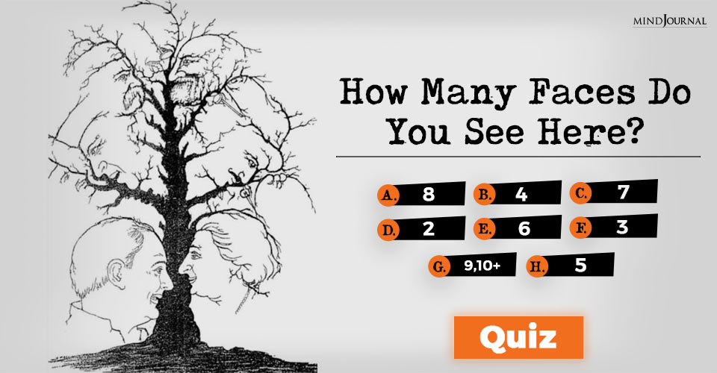
Perception Test

Slide 65
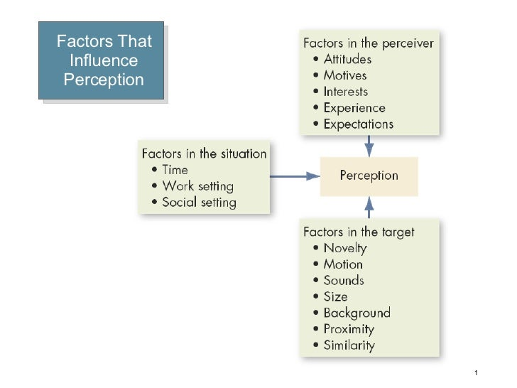
Factors Affecting Perception/ Perceptual Selectivity

Slide 66
Perceptual Organization
Perceptual organization is concerned with process of organizing the inputs into identifiable whole objects.
A person’s perceptual process organizes the incoming information into meaningful whole.
Perceptual organisation is a process that groups the visual elements so that it is easy to determine the meaning of the visual as a whole.
It is an essential concept because it allows individuals to make sense of the things that they see at a rapid pace.

Slide 67
Principles of Perpetual Organization
1. Figure Ground
Basic principle “the perceived objects stands out as separable from their general back ground”. Perceptual selectivity will influence perceptual organization. The viewer is set to perceive one things and the situation is deferent, perceptual organization will be effected.

Slide 68
Principles of Perpetual Organization
2. Perceptual Grouping
There is a tendency to group several stimuli together into a recognizable pattern. Grouping is done on the basis of Closure, Continuity, proximity or similarity.

Slide 69
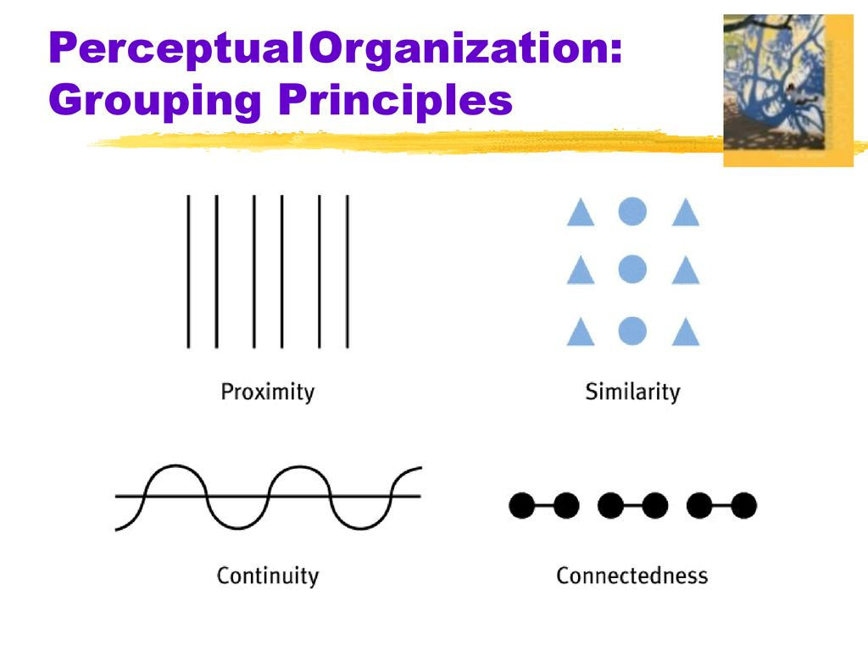
Principles of Perpetual Organization

Slide 70
Errors or Barriers to Perception
Selective perception is a perceptual process in which a person only perceives what he desires to and sets aside or ignores other perceptions or viewpoints.
Halo Effect-The "halo effect" is when one trait of a person or thing is used to make an overall judgment of that person or thing.

Slide 71
Errors or Barriers to Perception
Stereotyping-We always have a tendency to classify people to a general groups /categories in order to simplify the matter. For example-Women are always good homemakers and can do well in work life balance
Contrast Effect-We again sometimes judge people in comparison to others . This example generally found in sports, academics and performance review

Slide 72
Errors or Barriers to Perception
Projection-This is very common among Perceptual errors. Projection of one's own attitude, personality or behavior into some other person. For example- To all honest people, everybody is honest.
Impression-We all know the term "first impression is the last impression" and we apply that too .For example-During the time of hiring, thought like this "The most decent and modest person in the interview can do very well in every roles and responsibilities " always arise.
Attribution is what happens when a person takes the information they perceived and determines a reason as to what happened.

Slide 73
Behavioral Implications of Perception
Perception is very important in understanding human behavior because every person perceives the world and approaches life problems differently.
If people behave on the basis of their perception, we can predict their behavior in the changed circumstances by understanding their present perception of the environment.
With the help of perception, the needs of various people can be determined, because people’s perception is influenced by their needs.
Perception is very important for the manager who wants to avoid making errors when dealing with people and events in the work setting.

Slide 74
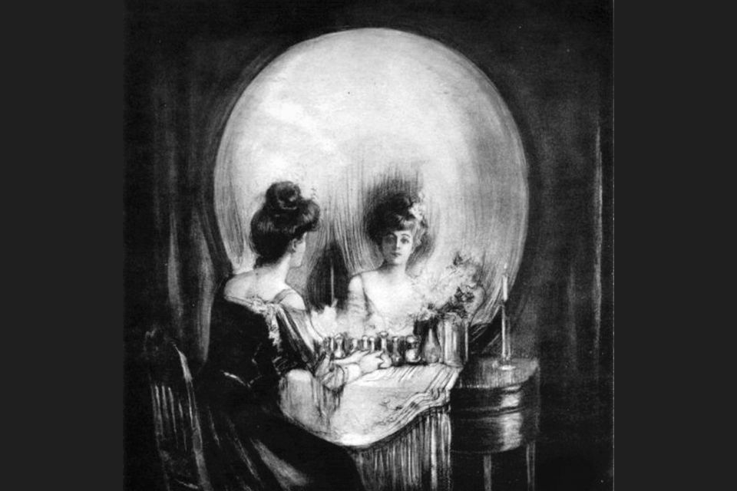
Perception Tests

Slide 75

Perception Tests

Slide 76
Recap
In this topic ,we learned about Online Public Relations
We have also learned about how Online PR is different from PR & Online Reputation Management.

Slide 77
Daily Quiz
Which of the following words does NOT describe perception?
A passive process
A psychological process
No direct contact with the physical world
Using sense organs
Sensation is to ________ as perception is to ________.
a. vision, olfaction
b. conscious, unconscious
c. awareness, interpretation
d. taste, vision

Slide 78
Daily Quiz
Mary is so beautiful, I bet she is smart too. This is an example of :
Stereotyping
Impression
Halo effect
Recency effect
______ prevents you from seeing an individual as an individual rather than a group or community.
a. Recency effect
b. Stereotyping
c. Halo effect
d. Leniency effect

Slide 79
You Tube Links
https://courses.lumenlearning.com/waymaker-psychology/chapter/reading-what-is-perception/
https://www.youtube.com/watch?v=uWCcFrnGPBw

Slide 80
Noida Institute of Engineering & Technology, Greater Noida
Attribution
Topic 4
Human Psychology & OB (AOE0765)

Slide 81
Topic Objective/ Topic Outcome
Name of Topic | Objective of Topic | Mapping with CO
Social perception – Attribution Theories | To study the social perception & attribution theories | CO1
Locus of control –Attribution Errors | To study the Attribution errors | CO1

Slide 82
Attribution
Attribution theory, proposed by Fritz Heider (1958), is a social psychology theory that deals with how individuals relate and make sense of the social world.
More specifically, it is concerned with how people translate events around them and how their translations affect their thinking and behavior.

Slide 83
Types of Attribution
Heider says that all behavior is considered to be determined by either internal or by external factors:
External Attribution (Situational Attribution)
Internal Attribution (Dispositional Attribution)

Slide 84
External Attribution
External Attribution (Situational Attribution): Causality is assigned to an outside factor, agent or force. Outside factors fall outside your control.
You perceive you have no choice. So your behavior is influenced, limited or even completely determined by influences outside your control.
Therefore you feel not responsible.
A generic example is the weather.

Slide 85
Internal Attribution
Internal Attribution (Dispositional Attribution): Causality is assigned to an inside factor, agent or force. Inside factors fall inside your own control.
You can choose to behave in a particular way or not. So your behavior is not influenced, limited or even completely determined by influences outside your control.
Therefore you feel responsible. A typical example is your own intelligence.

Slide 86
Locus of Control
Locus of control refers to a person's beliefs about how much control they have over what happens to them in their life and how much influence they have over what happens in the world around them.
Locus of control refers to one’s assumption about responsibility for good and bad events. Every person during his lifetime comes across some good and some had outcomes. While he acts to maximise the possibility of good outcomes and enjoys the success of his life, he tries to minimise the possibility of bad outcomes.

Slide 87
Locus of Control-Types
(1) Internal Locus of control
(2) External Locus of control.

Slide 88
Internal Locus of Control
Internal locus of control means that control comes from within. You have personal control over your own behavior.
When you have an internal locus of control, you believe you have personal agency over your own life and actions. Because of this, these people tend to have more self-efficacy.

Slide 89
External Locus of Control
External locus of control means that control stems from external forces. When you have an external locus of control, you believe that events outside of your control drive your actions and the outcomes you get.
Those who are always at the mercy of luck, fate and unforeseen uncontrollable outside force and feel helpless all the time and never like to take the responsibility for their bad outcomes and miserable performances in life are said to have external locus of control.

Slide 90
Daily Quiz
1. Sathish has a low absenteeism rate. He takes responsibility for his health and has good health habits. He is likely to have a(an):
a. Internal locus of control
b. External locus of control
c. Core locus of control
d. High emotional stability level
2. Some people strongly believe that each person have control of his own life. This is
a. extroversion
b. conscientiousness
c. internal locus of control
d. external locus of control

Slide 91
Daily Quiz
3. If a person responds the same way over time, attribution theory states that the behaviour shows.
a. Distinctiveness
b. Consensus
c. Consistency
d. continuity
4. Mr.Balu is late for work each day by about ten minutes. How would attribution theory describe this behaviour?
a. It shows consensus.
b. It shows similarity.
c. It shows reliability.
d. It shows consistency

Slide 92
Weekly Assignment
Define OB. Discuss its nature and scope.
Discuss the impact of Globalization and diversity on Organizational behavior.
Explain the implications of Perception on managerial decision making.
Differentiate between Internal and External Locus of Control.

Slide 93
YouTube & NPTEL Video Links along with Online Course Details
https://www.youtube.com/watch?v=f_S_bapYEm4
https://www.youtube.com/watch?v=GW2A8xoSoYk

Slide 94
MCQs
Which behavioural science discipline is most focused on understanding individual behaviour?
Sociology
social psychology
Psychology
anthropology
2. The science that seeks to measure, explain, and sometimes change the behaviour of humans and other animals is known as .
Psychiatry
Psychology
Sociology
organizational behavior

Slide 95
MCQs
3. Organization Behavior is
An interdisciplinary approach
A humanistic approach
Total system approach
All of these
4. Organization Behavior is not a /an
A separate field of study
Applied science
Normative science
Pessimistic approach

Slide 96
MCQs
5. The cognitive process through which an individual selects, organizes but misinterprets environmental stimuli is known as_________
Perception
Projection
Selective Perception
Mis-Perception
6. What is the process by which individuals organize and interpret their sensory impressions in order to give meaning to their environment?
Interpretation
environmental analysis
Outlook
perception

Slide 97
Glossary Question

Slide 98
Old Question Papers

Slide 99
Old Question Papers

Slide 100
Old Question Papers

Slide 101
Expected Question for University Exam
What is organizational behavior?
What are the major behavioural science disciplines that contribute to OB?
What is the link between perception and decision making? How does one affect the other?
What are some of the common decision biases or errors that people make?
What are the influences of individual differences, organizational constraints, and culture on decision making?
Discuss the nature and scope of OB.
Discuss the impact of Globalization and diversity on Organizational behavior.
Explain the implications of Perception on managerial decision making.
Differentiate between Internal and External Locus of Control.
10. Explain the Attribution theory.

Slide 102
References
1.Robbins Stephen P& Judge Timothy A. ―Organizational Behaviour (Pearson)
2. Pareek Udai :Understanding Organizational Behaviour, (Oxford University Press, 4th Edition, 2016)
3. Luthans Fred : Organizational Behaviour, (McGraw Hill International Edition, 12th Edition,2013)

Slide 103
Thank You

