Slide 1
INSURANCE DATA SET
Basic ML Project
By: Vikas Rohra

Slide 2
Agenda
Data background.
Steps followed during ML Project.
Conclusion.

Slide 3
Data background

Slide 4
WHat data is all about
Insurance is a contract, represented by a policy, in which an individual or entity receives financial protection or reimbursement against losses from an insurance company.
Insurance policies are used to hedge against the risk of financial losses, both big and small, that may result from damage to the insured or her property, or from liability for damage or injury caused to a third party.
Insured needs to pay some amount in form of “Premium” to the insurance company in order to continue the benefits of the insurance policy.

Slide 5
Data Description
Insurance Dataset comprises of 59381 rows X 127 columns of data
Target Variable i.e. “Response” Columns is Ordinal in nature with values from 1 to 8
Remaining 126 Columns represent the Feature or Independent Variables

Slide 6
INSURANCE Data Fields
Column Name | Description
Id | A unique identifier associated with an application.
Product_Info_1-7 | A set of normalized variables relating to the product applied for
Ins_Age | Normalized age of applicant
Ht | Normalized height of applicant
Wt | Normalized weight of applicant
BMI | Normalized BMI of applicant.
Employment_Info_1-6 | A set of normalized variables relating to the employment history of the applicant.
InsuredInfo_1-6 | A set of normalized variables providing information about the applicant.
Insurance_History_1-9 | A set of normalized variables relating to the insurance history of the applicant.
Family_Hist_1-5 | A set of normalized variables relating to the family history of the applicant.
Medical_History_1-41 | A set of normalized variables relating to the medical history of the applicant.
Medical_Keyword_1-48 | A set of dummy variables relating to the presence of/absence of a medical keyword being associated with the application.
Response | This is the target variable, an ordinal variable relating to the final decision associated with an application.

Slide 7
STEP BY STEP PROCESS FOLLOWED during ml project

Slide 8
1. Data Profiling
Insurance Dataset contains Missing Values, Zero Values
Missing Values are replaced by Median for Employment_Info_1, Family_Hist_4, Employment_Info_6 and Medical_History_1 Columns
Zeros Values are replaced by Median for Employment_Info_1, Employment_Info_6, Medical_History_1 and Product_Info_4 Columns
For the columns where maximum data is missing or data contains zero that columns are dropped and not considered in further data processing.

Slide 9
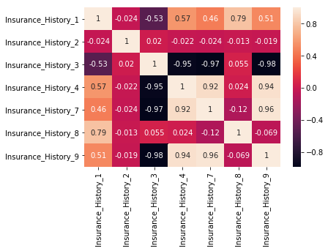
2. Removing Highly correlated columns
'Insurance_History_7’ and 'Insurance_History_9' they are highly correlated with 'Insurance_History_4’. So, we will drop both the Columns

Slide 10
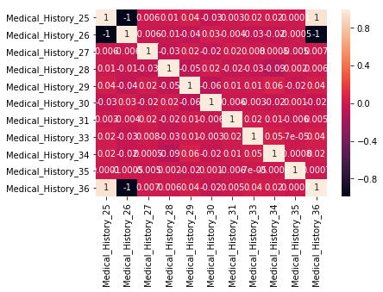
2. Removing Highly correlated columns
'Medical_History_36' is highly correlated with 'Medical_History_25'. So, we will drop 'Medical_History_36’ Column

Slide 11
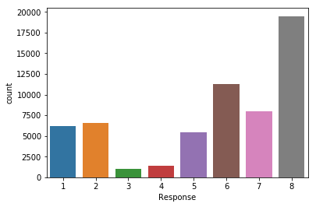
3. Separating Features (X) and Response (y) from data set
After Data Processing and removing the highly correlated Columns, only 114 Columns left to be considered as Features (X)
Response (Y) is the Ordinal in nature which contains values from 1 to 8
Count of each Response (Y) value is shown below:

Slide 12
4. Converting Alphanumeric data to numerical data using Label Encoder
“Product_Info_2” contains Alphanumeric Data.
So we need to convert it into numerical format as machine understands numerical data.
For this LABEL ENCODER is used which converts Alphanumeric data into Numerical data by assigning values in orderly manner.
Product_Info_2 | Product_Info_2_Encoded
A1 – A8 | 0-7
B1-B2 | 8-9
C1-C4 | 10-13
D1-D4 | 14-17
E1 | 18

Slide 13
5. Splitting (X) AND (Y) intO training and test dataset
After splitting, the data into 80% as Training Data and 20% as Testing Data
Then we get the four splitting outputs i.e. X_train, X_test, y_train and y_test
Training set contains a data of 47,504 rows
While testing set contains data of 11,877 rows

Slide 14
6. Decision tree Model
After fitting the Decision Tree model then accuracy score comes out to be 0.3923
Then further parameterization is done accuracy score comes out to be 0.5101

Slide 15
7. Random forest Model
After fitting the Random Forest model then accuracy score comes out to be 0.4662
Then further parameterization is done accuracy score comes out to be 0.5267

Slide 16
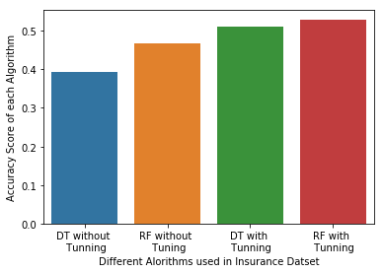
8. conclusion
After applying different basic ML Algorithms Accuracy Score of Insurance Data Set is increased from 0.3923 to 0.5267
Further increase in Accuracy Score is not possible with these Basic ML Algorithms
In future as a enhancement, we will use Advanced ML Algorithms like “xgboost” to further increase the Accuracy Score.

Slide 17
Thank you

