Slide 1
A comparative study of Natural Language
Processing Models
Vikas Rajashekar
Supervisors: Dominique Mercier & Syed Tahseen Raza Rizvi
Notes:
All the best

Slide 2
Contents
Natural Language Processing(NLP) Introduction
Applications of NLP
Key concepts of NLP
  Word Embeddings
  Language Models
  Transfer Learning
State-of-the-art NLP Architectures
  Transformers
  BERT
  XLNet

Slide 3
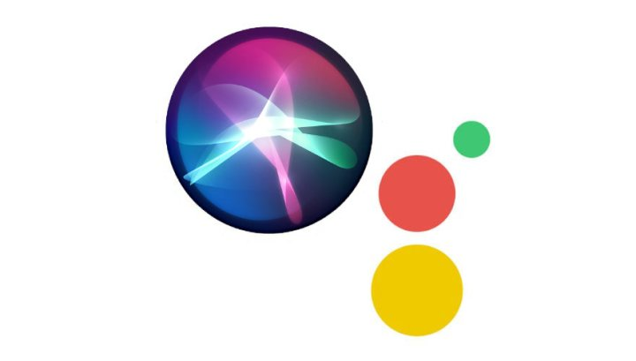
Natural Language Processing(NLP)
Natural Language:
Refers to the language spoken by people, e.g. English, Japanese, as opposed to artificial languages, like C++, Java, etc.
Natural Language Processing:
Sub-field of artificial intelligence. Devoted to make computers “understand” statements written in human language.
Related to human-computer interaction.
Notes:
NLP is big part of our day to day life.
Example: Google search we make,
Smart assistant like Siri, google assistant

Slide 4
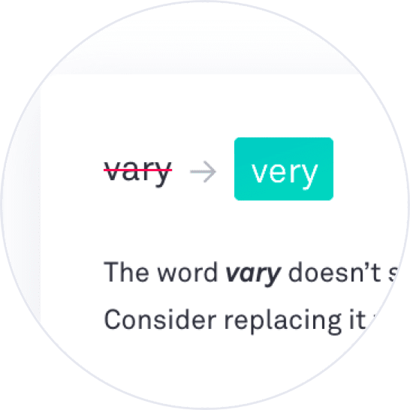
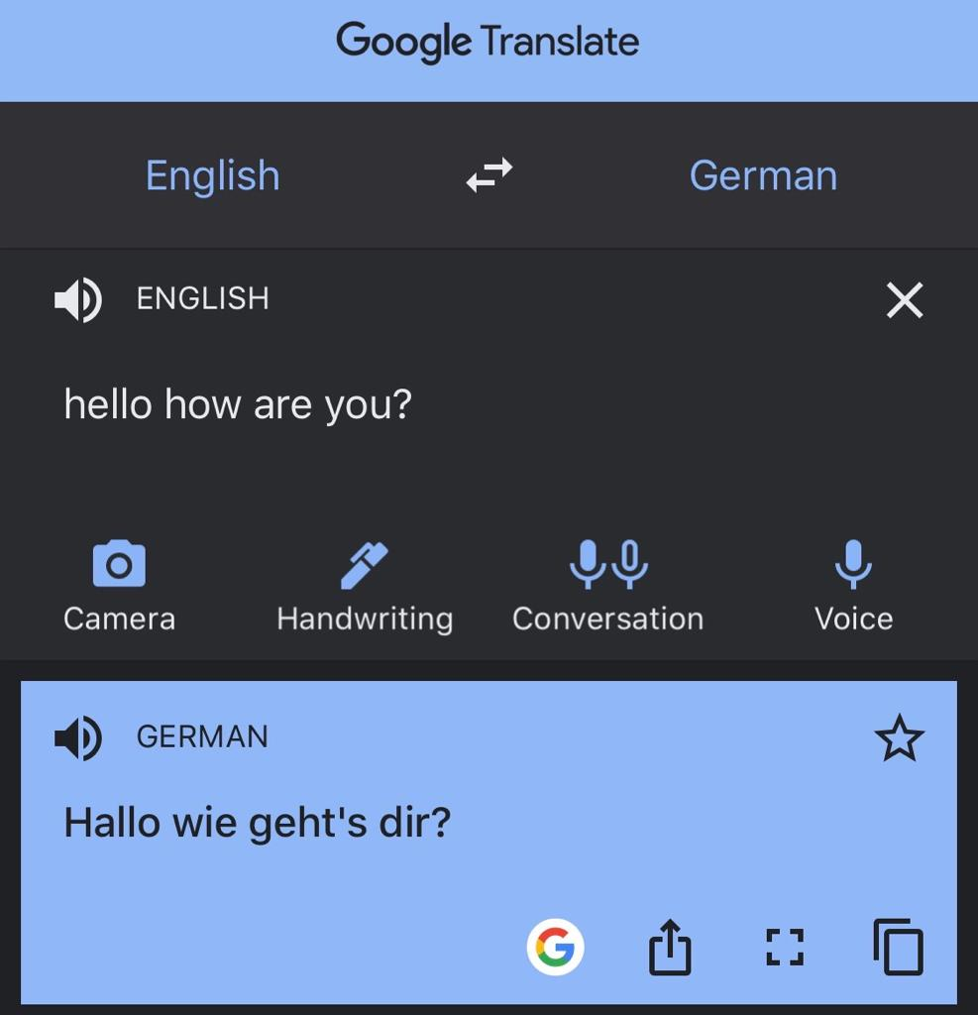

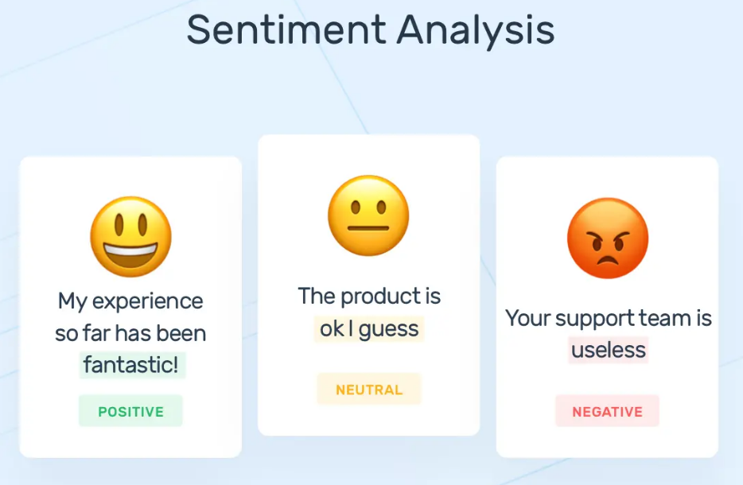
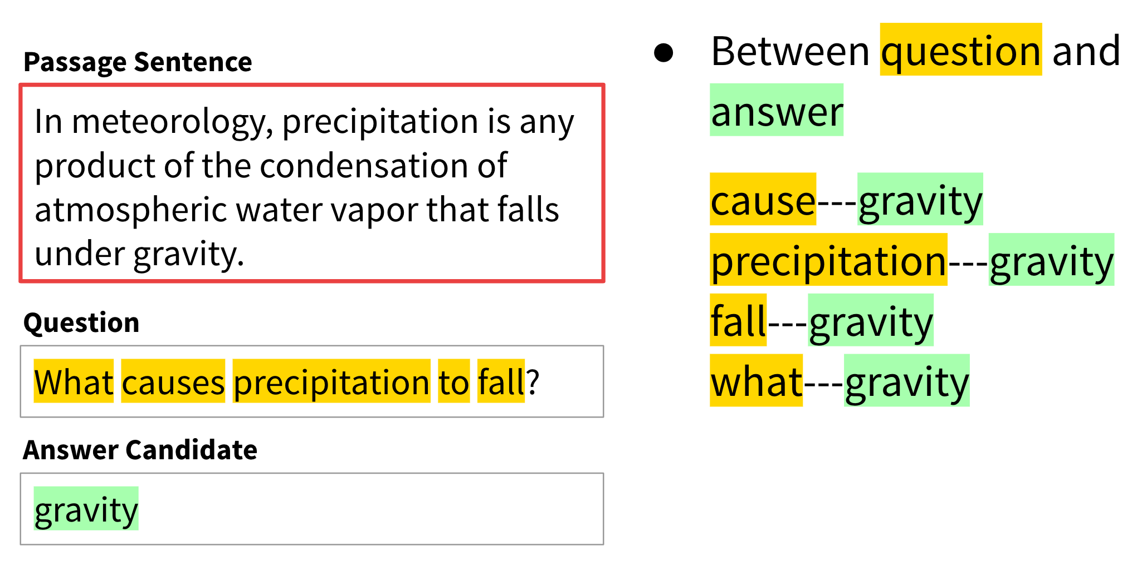
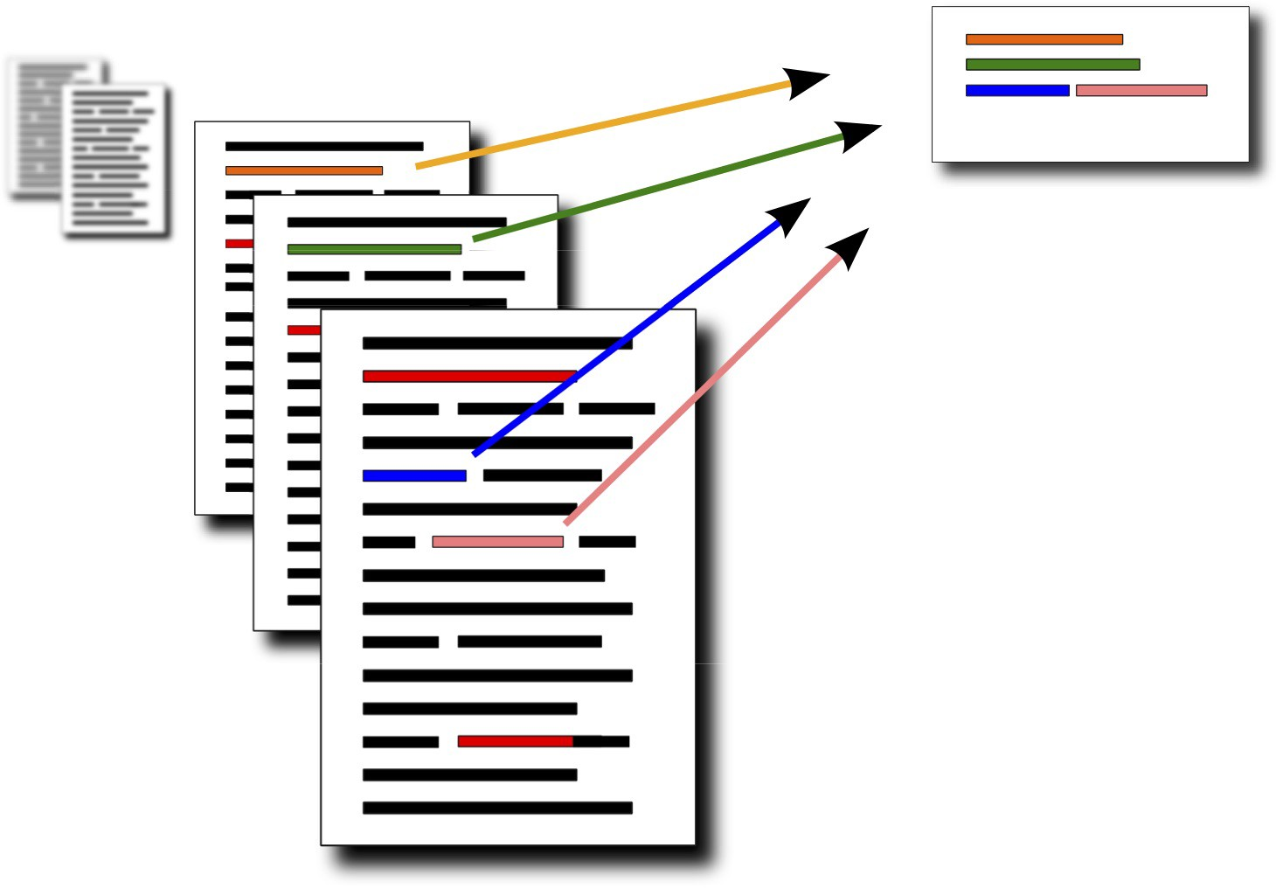

Natural Language Processing Applications
Machine Translation
Sentiment Analysis
Question Answering
Automatic Summarization
Chat bots
Text Classification
Spell Checking
Notes:
Machine Translation: automatic translation of texts from one language into another language
Sentiment analysis : interpretation and classification of emotions
Chat bots: Cutomer engagement, status checking etc

Slide 5
Key Concepts of NLP
Word Embeddings
Language Models
Transfer Learning

Slide 6
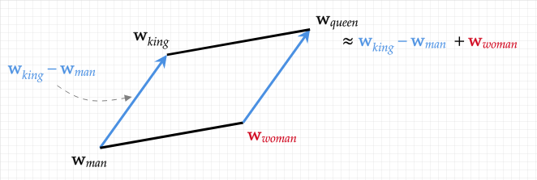
Word Embeddings: Finding a good representation
Each word is represented by a low dimensional vector
Similar words have similar vectors.
Static word embedding vs Dynamic word embedding
capable of learning linguistic regularities

Slide 7
Language Model: Probabilities to Words
Consider two sentences
The cat is small.
Small cat the is.
which sentence make more sense?
Probability is an absolute necessity to know which order to pick.
p(the cat is small) > p(small cat the is)
Defined as the task of assigning the probability distribution for the sequence of words that suits the language’s distribution.

Slide 8
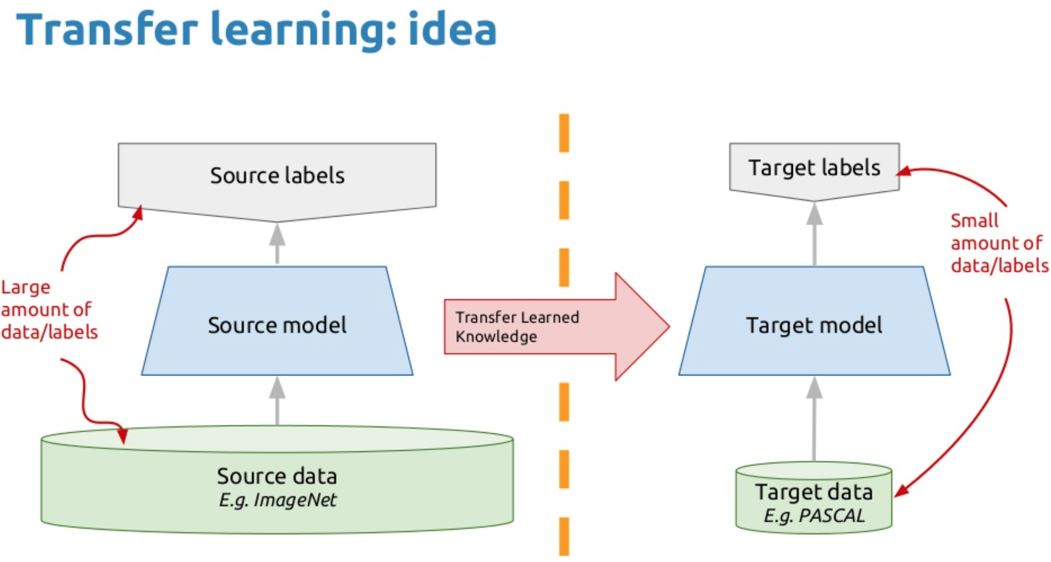
Transfer Learning: Knowledge Transfer
NLP task-related data sets are small and usually over-fits
Efficient to first pre-train a model on large data set and then fine-tune pre-trained model for different downstream NLP tasks.

Slide 9
State-of-the-art NLP Architectures
Transformers
BERT
XLNet

Slide 10
Need for Transformers
Before Transformers, Recurrence(RNN, LSTM,..) was used for most of NLP tasks.
Problems with recurrence:
  Sequential computation inhibits parallelization.
  Vanishing gradients for long sentences.

Slide 11
Transformers
Developed to solve the problem of sequence transduction.
All about attention mechanism used at all possible places.
Avoids the time-consuming recurrence and completely depends on the attention mechanism.

Slide 12
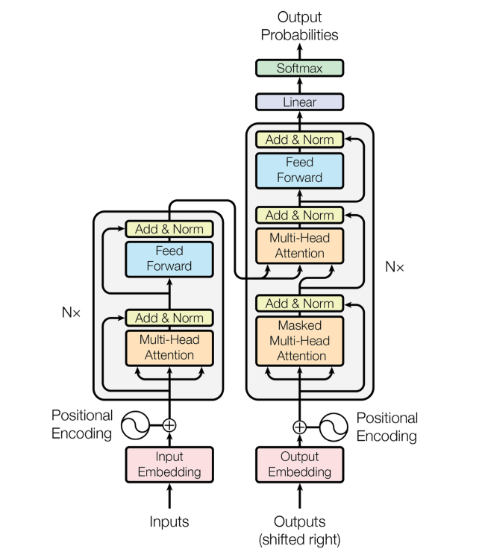
Transformer Model Architecture
Uses attention in three ways:
Encoder attention
Encoder-decoder attention
Decoder attention
Notes:
Encoder – Decoder Stacks consisting:
Multi-head self attention
Position-wise feed forward network
Positional encoding
Add and Norm
Each position in ….. attention to all position in …...

Slide 13
Attention Visualization
Transformers use Scaled Dot-Product Attention.
Multi-head attention allows the model to jointly attend to information from different representation sub-spaces at different positions.

Slide 14
Transformer Results
Model | EN-DE BLEU | EN-FR BLEU | EN-DE FLOPs | EN-FR FLOPs
GNMT + RL (LSTM) | 24.6 | 39.92
ConvS2S (CNN) | 25.16 | 40.46
MoE (LSTM+CNN) | 26.03 | 40.56
Transformer | 28.4 | 41.0
Estanlished new state-of-art results on WMT 2014 English-to-French translation and WMT 2014 English-to-German translation at a training cost of 1/4 of the previous best model.
Notes:
WMT 2014 English-to-French translation task
WMT 2014 English-to-German translation task
BLEU score: results are obtained by comparing the predictions over series of outputs and averaging the similarity

Slide 15
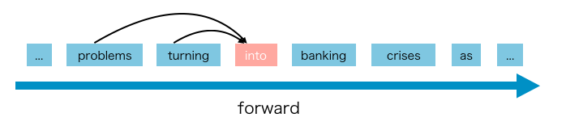
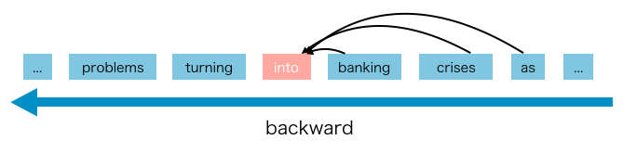
Need for BERT
Before BERT, Most language models like ELMo,OpenAI GPT were unidirectional.
Unidirectional Language models limits the power of pre-trained representations.

Slide 16
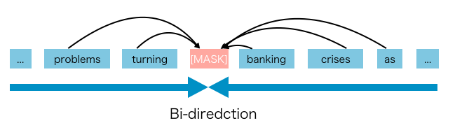
BERT: The Bi-direction Model
BERT (Bidirectional Encoder Representations from Transformers) is an open-sourced NLP pre-training model developed by researchers at Google.
Deeply bidirectional, unsupervised language representation, pre-trained using only a plain text corpus.
Major Features:
Bidirectional
Generalizable
High-performance
Universal
Notes:
Bidirectional: Bidirectional representations of unlabeled text are pre-trained by conditioning them together in both the left and right direction in all layers.
Generalizable: BERT can be fine-tuned easily for downstream tasks.
High-performance: Achieves state-of-the-art results for many NLP tasks.
Universal: BERT is trained on Wikipedia and book corpus with no requirement of a special data set.

Slide 17
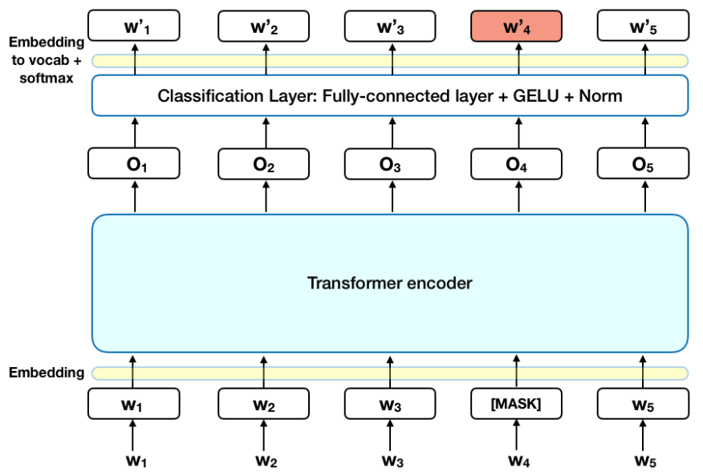
BERT Architecture
BERT makes use of transformers.
Since BERT aims to generate language model, only encoder part of Transformers is used.

Slide 18
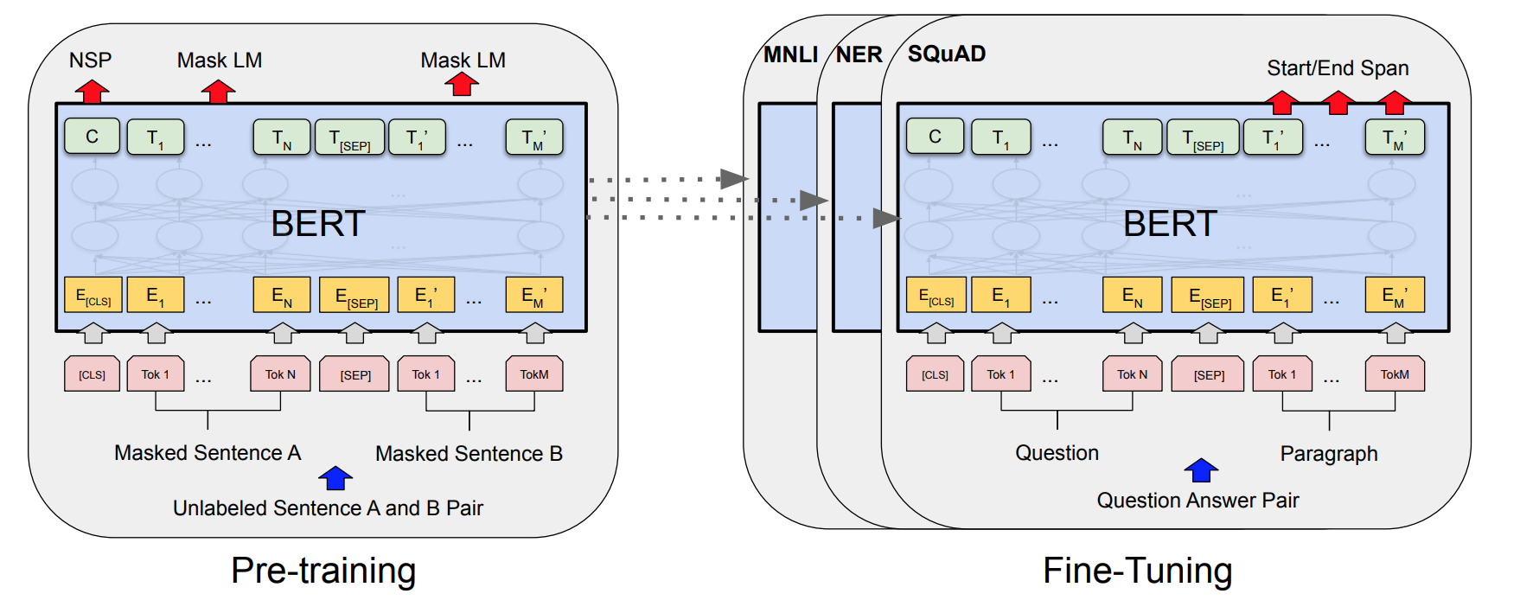
Pre-training and Fine-tuning of BERT
BERT consists of two major phases:
Pre-Training
Fine-Tuning
Notes:
Pre-Training: During pre-training, various pre-training tasks are used to train the model on unlabeled data
Fine-Tuning: The model is initialized to pre-trained parameters in this step,and is fine-tuned using downstream tasks data.

Slide 19
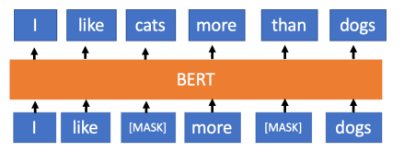
Pre-training Tasks in BERT
BERT uses 2 NLP tasks to pre-train the model:
Masked Language Model(MLM): Mask small percentage of input tokens and model predicts the masked tokens.
Next Sentence Prediction(NSP): Learns the relationship between two consecutive sentences.
Example 1: Man went to store. He bought milk.
IsNext=True
Example 2: Man went to store. Lion is wild animal.
IsNext=False

Slide 20
BERT Results
GLUE Score:
SQuAD 1.1 results:
System | Average GLUE Score
Pre-OpenAI SOTA | 74.0
BiLSTM+ELMo+Attn | 71.0
OpenAI GPT | 75.1
BERT | 82.1
System | Test EM | Test F1
R.M. Reader (Ensemble) | 82.3 | 88.5
BERT | 87.4 | 93.2
Notes:
The General Language Understanding Evaluation (GLUE) benchmark is a collection of resources for training, evaluating, and analyzing natural language understanding systems. GLUE consists of:
A benchmark of nine sentence- or sentence-pair language understanding tasks built on established existing datasets and selected to cover a diverse range of dataset sizes, text genres, and degrees of difficulty,
SQuAD2.0 tests the ability of a system to not only answer reading comprehension questions, but also abstain when presented with a question that cannot be answered based on the provided paragraph.

Slide 21
Need for XLNet
Disadvantages of BERT that XLNet tackles
At the time of fine-tuning, the artificial symbols like [MASK] used by BERT during pre-training are absent from real data causing the pretrain-finetune discrepancy.
BERT assumes that the predicted tokens are independent of each other, which is an oversimplified assumption.
Example input: I went to [MASK] [MASK] and saw the [MASK] [MASK] [MASK].
Valid output1: I went to New York and saw the Empire State building.
Valid output2: I went to San Francisco and saw the Golden Gate bridge.
Invalid output: I went to San Francisco and saw the Empire State building

Slide 22
XLNet : Permutations of word orderings
XLNet is a generalized auto-regressive pre-training method that uses the Auto-Regressive(AR) language model.
AR language model is a kind of model predicts the next word using a context word, that is constrained to only two directions, either forward or backward.
In XLNet, AR language model learn from bi-directional context to avoid the disadvantages brought by the MASK method in Auto Encoder(AE) language model.

Slide 23
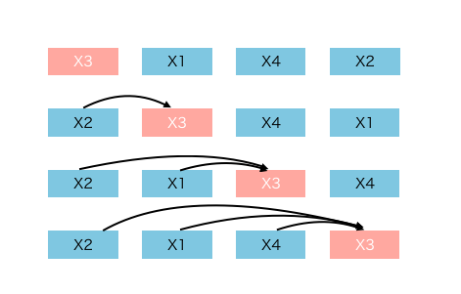
Pre-training in XLNet
In the pre-train phase,A new objective called Permutation language Modeling was proposed by XLNET that makes use permutations of different combinations of words.
The positional encoding is still used by the network to keep track of relative positions.

Slide 24
XLNet Results
XLNet outperforms BERT on 20 tasks, frequently by means of a big margin
Model | SQuAD1.1 | RACE | MNLI | QNLI | QQP | RTE | CoLA
BERT | 86.7/92.8 | 75.1 | 87.3 | 93.0 | 91.4 | 74.0 | 63.7
XLNet | 88.2/94.0 | 77.4 | 88.4 | 93.9 | 91.8 | 81.2 | 65.2

Slide 25
Conclusion
Basic understanding of following concepts:
NLP
NLP applications
NLP key concepts
NLP state-of-the-art architectures

Slide 26
Thank you!

Slide 27
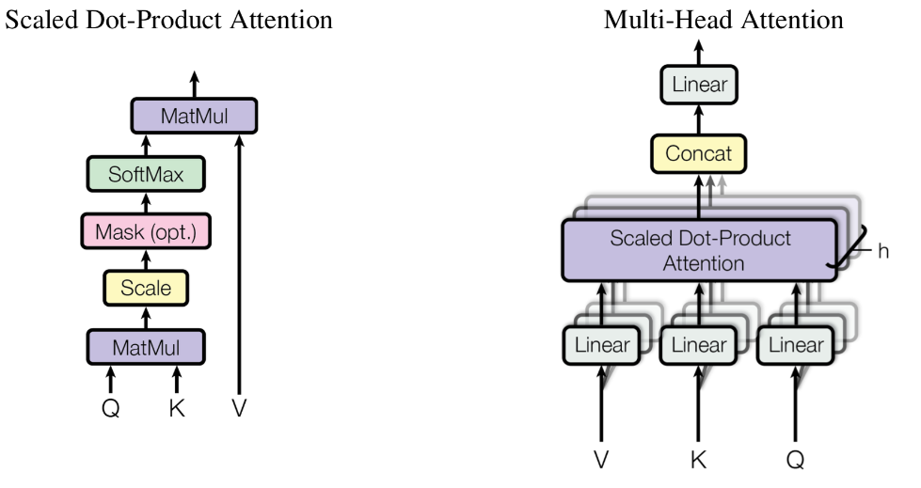
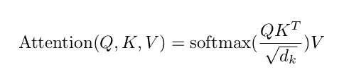
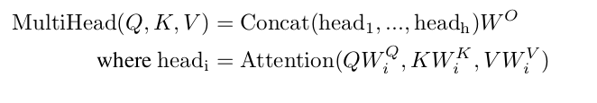
Attention in Transformer
Tranformers use Scaled Dot-Product Attention as shown in Figure
Multi-head attention allows the model to jointly attend to information from different representationsubspaces at different positions.

Slide 28
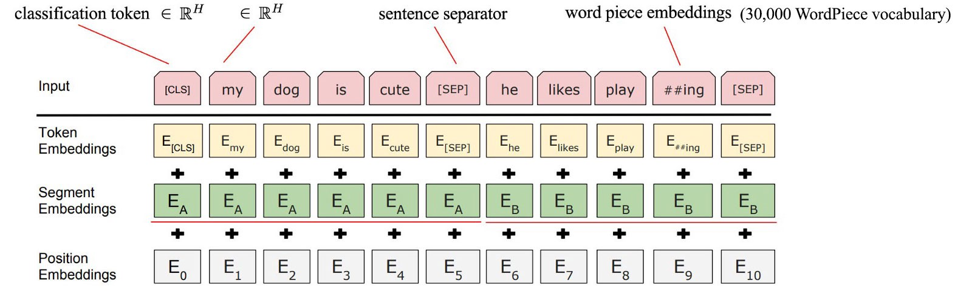
Input-Output Representations in BERT
All the inputs must contain a special classification token i.e., [CLS] in the beginning. Also, if the input consists of two sequences then a separator token i.e. [SEP] has to be placed between two sequences.
BERT generates a series of outputs as shown in fig. 4. For classification purposes, only the output C is to be used. For non-classifications tasks, the series of outputs excluding C is used.
the input representation is creating by adding its token, segment and positional embeddings.

Slide 29
Two-Stream Self-Attention in XLNet
There are two requirements that a standard Transformer cannot do:
To predict the token x_t, the model should only see the position of x_t, not the content of x_t
to predict the token x_t, the model should encode all tokens before x_t as the content
XLNet proposes Two-Stream Self-Attention to achieve this.
Content stream attention: Normal transformer attention
Query stream attention: contains only the position information of the token to be predicted

Slide 30
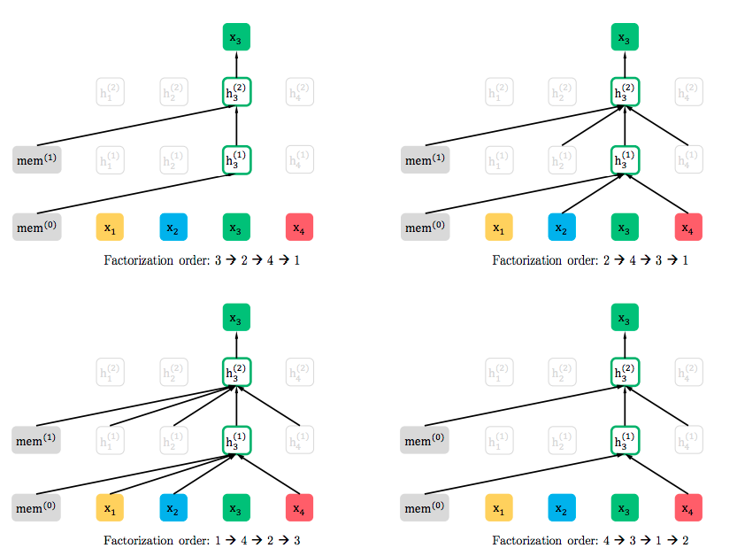
Pre-training in XLNet

Slide 31
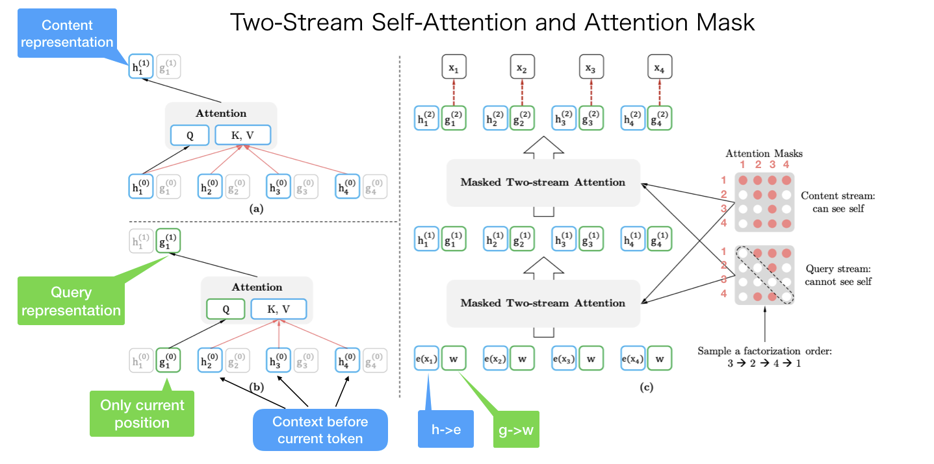
Two-Stream Self-Attention in XLNet

