Slide 1
presenter Vikas Singh Hero-Vired – Batch 13
U.S. Food and Drug Administration (FDA)’S Report

Slide 2




SQL ASSIGNMENT
Task 01 : Identifying Approval Trends
1) Determine the number of drugs approved each year and provide insights into the yearly trends.
Answer :- In first year 1939 there were 12 drugs approved. And in last year 2016, 2339 drugs were approved. In all these years Lowest drugs were approved in 1945 that was 5 and Highest drug were approved in 2002 that was 5661.
2) Identify the top 3 years that got the highest and lowest approvals, in desc and ascorder, respectively.
Answer :- As we see in tables Highest drug approved –
5661 in 2002 & lowest drug approved 5 in 1945
3) Explore approval trends over the years based on sponsors.
Answer :- AS I had observed there was no specific trend in the approvals. For some years it increasing and for some years it was decreasing. But we can see Highest as well as Lowest approval by sponsor in below table -

Slide 3

4) Rank sponsors based on the total number of approvals they received each year between 1939 and 1960.
Answer :- Between 1939 to 1960, LEDERLE had 13 approvals, KING PHARMA had 11,10 & 9 approvals.
And there were many entries between 1939 to 1960 having only 1 approvals.
Task 02 : Segmentation Analysis Based on Drug MarketingStatus
1) Group products based on MarketingStatus. Provide meaningful insights into the segmentation patterns.
Answer :- We can see it clearly in table -
2) Calculate the total number of applications for each MarketingStatus year-wise after the year 2010.
Answer :- Here’s the complete table for this -
ProductMKStatus | 2011 | 2012 | 2013 | 2014 | 2015 | 2016 | Total
1. | 4373 | 4419 | 6654 | 6637 | 5941 | 4626 | 32650
2. | 129 | 202 | 224 | 253 | 246 | 218 | 1272
3. | 778 | 659 | 1009 | 773 | 743 | 462 | 4424
4. | 91 | 149 | 111 | 137 | 222 | 292 | 1002
Total | 5371 | 5429 | 7998 | 7800 | 7152 | 5598 | 39348

Slide 4

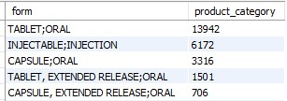
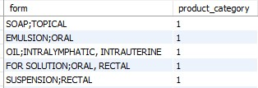
3) Identify the top MarketingStatus with the maximum number of applications and analyze its trend over time.
Answer :- Here the table is for total applications ProdudtMKStatus wise .
For time trend – we had seen that in early years, before 1952 all total applications
Were maximum 1 or 2 digit number but after that it increase drastically.
From 18 applications in 1952 to 4626 application in 2016. Highest was in 2002 i.e.
7115 and Lowest is 1 in 1943
Task 03 : Analyzing Products
1) Categorize Products by dosage form and analyze their distribution.
Answer :- Here’s the tables for it – On Left – Highest distributed Form and ON Right Lowest distributed Form

Slide 5
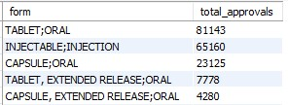
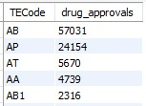
2) Calculate the total number of approvals for each dosage form and identify the most successful forms.
Answer :- Here are top 5 dosage form –
3) Investigate yearly trends related to successful forms.
Answer :- TABLET ;ORAL was most successful over the years with Highest 4203 approvals in 2002.
And since INJECTABLES;INJECTION have shown a magnificent growth over the years.
Task 04: Exploring Therapeutic Classes and Approval Trends
1) Analyze drug approvals based on the therapeutic evaluation code (TE_Code).
Answer :- Here’s top 5 TE_Code with highest drug approval
And BT TE_Code Lowest with 6.

Slide 6
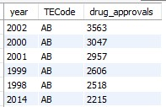
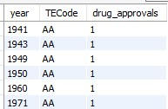
2) Determine the therapeutic evaluation code (TE_Code) with the highest number of Approvals in each year.
Answer :- The highest no of approvals comes in 2002 as we can see in below table, followed by 2000 and so on. And the lowest
no. of approvals comes in 1941 as shown below.

Slide 7
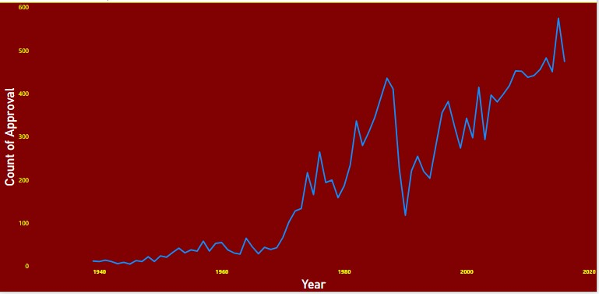
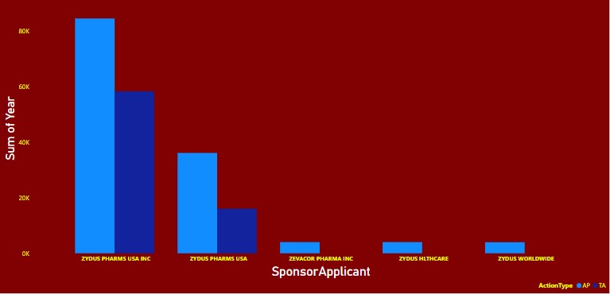
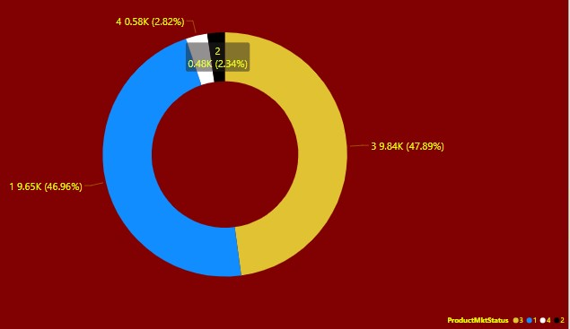
Power bi assignment
Visualize the yearly approval trends of drugs. Highlight any
significant patterns and/or fluctuations, if any.
Answer :- Initially No. of approval was constant but after 1982 (2.9k)
it was start increasing till 2002(5.7k). After that there is declined in no.
of Approval. The highest approvals was in 2002 (5.7k).
2) Visualize the yearly approval trends of drugs. Highlight any significant
patterns and/or fluctuations, if any
Answer:- ZYDUS PHARMS USA INC has got the highest number of
approvals. The change in the approval rate among the sponsors moved
from ZYDUS WORLDWIDE to ZYDUS PHARMS USA INC from the year2005.
3) Visualize the segmentation of products based on MarketingStatus.
Answer :- ProductMktStatus with Excellent status i.e. with 3 covers 47.89%,
1 covers 46.96%, 4 covers 2.82%and 2 covers 2.34% of market share.

Slide 8
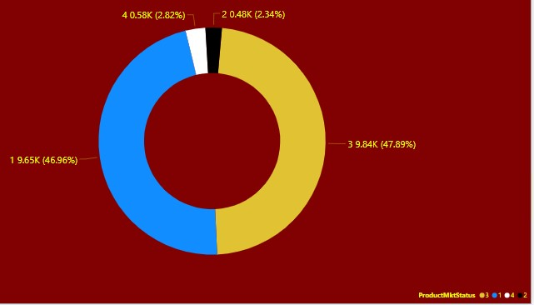
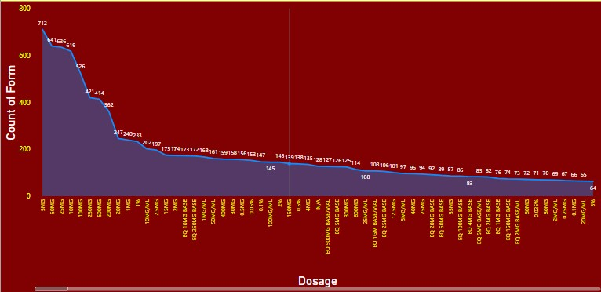
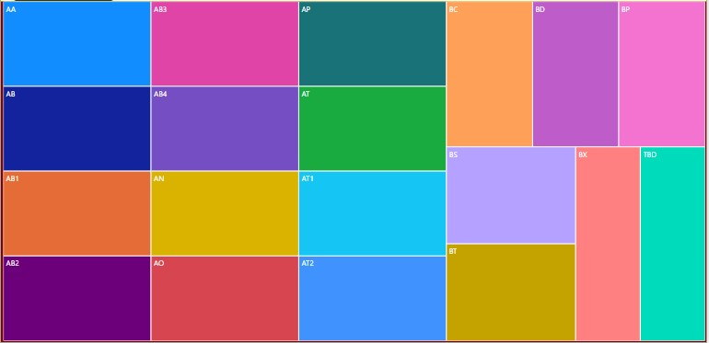
4) Show the total number of applications for each MarketingStatus.
Enable users to filter by years and MarketingStatus for detailed analysis.
Answer :- Total no. of application with respect to marketingstatus is – for 1 it is 9651,
For 2 it is 480, for 3 it is 9841 and for 4 it is 579 .
5) Analyze the grouping of drugs by dosage form. Visualize the
distribution of approvals across different forms. Identify the most
successful dosage form.
Answer:-The most popular form is TABLET ;ORAL. And in addition
Most popular dosage type is 5mg.
Hence most popular Dosage Form is TABLET ;ORAL 5mg
6) Visualize drug approvals based on therapeutic classes. Identify
classes with the highest number of approvals..
Answer :-The highest number of approved therapeutic class based on
therapeutic code is AB with 57031 approvals following by AP with 24154 approvals

Slide 9
Thank you
RECOMMENDATIONS :-
ZYDUS PHARMS USA INC was most successful Sponsor so we can give them additional offers so then can invest more.
TABLET ;ORAL 5mg is most popular Dosage Form we can increase production of it.
INJECTABLES;INJECTION have shown magnificent growth we can also increase production as well as we can advertise it more.
There some Form like SOAP;TOPICAL and EMULSION;ORAL etc. had not shown any growth at all we should organize and root cause analysis to find reason behind it and we can promote them more so they can show some growth.

