Slide 1

Clinical Decision Support using Machine Learning
A
Project Progress Report
(Covering Period: January-2018 to March-2018)
By
Sushant Bindra, Vikas Kumar Ojha
(159101145, 159101160)
(School Of Computing & Information Technology)
MANIPAL UNIVERSITY JAIPUR
JAIPUR-303007
RAJASTHAN, INDIA

Slide 2
Introduction
Breast cancer represents one of the most widespread diseases that make a high number of deaths every year.
In 2018, an estimated 266,120 new cases of invasive breast cancer are expected to be diagnosed in women in the U.S., along with 63,960 new cases of non-invasive (in situ) breast cancer.
In many countries with advanced medical care, the five-year survival rate of early stage breast cancers is 80–90 per cent.
The utilization of data science and machine learning approaches in medical fields is proving to be prolific.
Classification and data mining methods are an effective way to classify data.

Slide 3
Research objectives
Performance comparison is conducted on the Wisconsin Breast Cancer dataset between different machine learning models:
1. Linear Regression
2. Decision Tree
3. Support Vector Machine (SVM)
4. k-Nearest Neighbors (k-NN)
5. Artificial Neural-net
Assess the correctness in classifying data with respect to efficiency and effectiveness of each algorithm in terms of accuracy, precision, sensitivity and specificity

Slide 4
Machine Intelligence Libraries
numpy
- provides a high-performance multidimensional array object, and tools for working with these arrays.
Matplotlib
Plotting library which produces quality figures in a variety of formats.
Provides an object-oriented API
Full control of line styles, font properties, axes properties, etc.
Scikit-learn
- Simple and efficient tools for data analysis and machine learning. - Provides various learning algorithms like logistic regression, SVM, random forest.
Tensorflow
- An open-source software library for dataflow programming across a range of tasks. - It uses data flow graphs. Nodes in the graph represent mathematical operations, while the graph edges represent the multidimensional data arrays communicated between them.

Slide 5
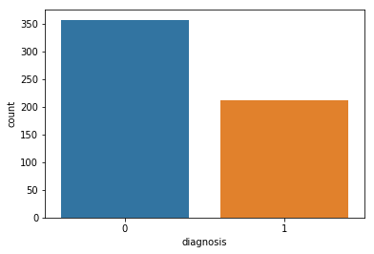
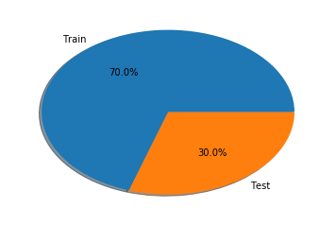
The Dataset
The dataset consists of features which were computed from a digitized image of a fine needle aspirate (FNA) of a breast mass. The said features describe the characteristics of the cell nuclei.
The dataset features are as follows:
radius,
texture,
perimeter,
area
smoothness,
compactness,
concavity,
concave points,
symmetry
fractal dimension.
357 Benign (0)
212 Malignant (1)
569 examples

Slide 6
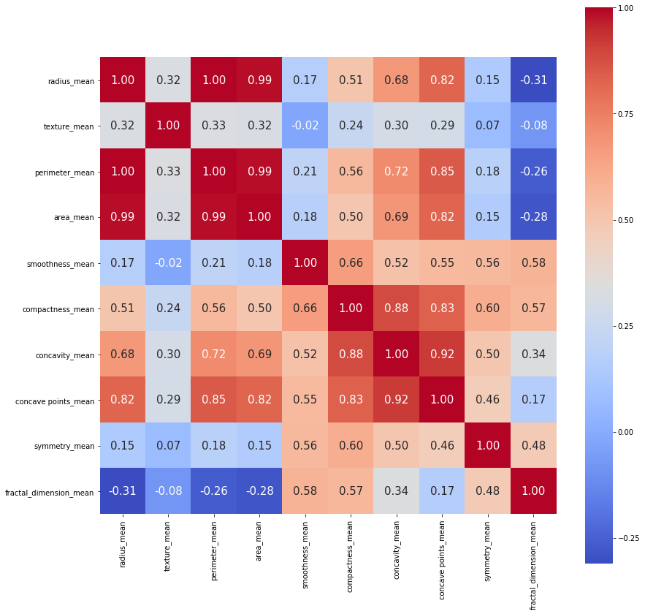
Feature Selection (selecting the right variables)
radius, perimeter and area are highly correlated as expected from their relation.
Compactness, concavity and concave point are highly correlated.
So selected Parameters for use is perimeter, texture, smoothness, compactness, and symmetry.

Slide 7
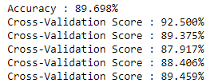
Linear Regression
Linear regression is a linear model, that is a model that assumes a linear relationship between the input variables (x) and the output variables (y).
Given, an independent and a dependent variable, we fit equation of a line to perform predictions on unseen data.

Slide 8
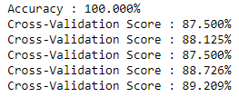
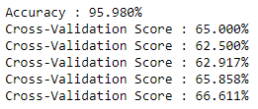
Decision Tree
A decision tree is a flowchart-like structure.
This methodology is more commonly known as learning decision tree from data
Decision Tree algorithms are referred to as CART or Classification and Regression Trees.
The feature importance is clear and relations can be viewed easily.

Slide 9
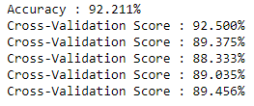
k-nearest Neighbors (k-NN)
It is a non-parametric method used for classification and regression.
The input consists of the k closest training examples in the feature space.
In k-NN classification, the output is a class membership
An object is classified by a majority vote of its neighbors, with the object being assigned to the class most common among its k nearest neighbors .

Slide 10
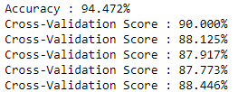
Support Vector Machine (SVM)
SVM functions by selecting critical samples from all classes known as support vectors.
It then separates the classes by generating a linear function that divides them as broadly as possible using these support vectors.
This linear classifier aims to maximize the distance between the decision hyperplane and the nearest data point

Slide 11
Results
Algorithm | Time (s) | Accuracy (%) | Mean Cross-validation Score (%)
Linear Regression | 0.074 | 89.69 | 87.21
Decision-Tree | 0.049 | 95.98 | 65.85
k-NN | 0.027 | 92.21 | 90.03
Support Vector Machine (SVM) | 0.177 | 94.47 | 91.23

Slide 12
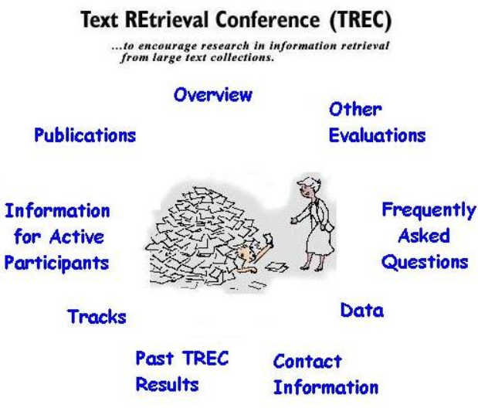
Future Work
Perform hyper parameter- tuning for SVM with Grid Search to obtain the best results.
Test the data with Artificial Neural Net.
After completion of project, we shall prepare a research paper for submission in TREC con

