Slide 1

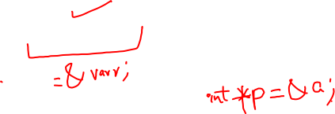
Solve using C++ Programming
Pointers

Slide 2
Course Objectives
Learn the syntax and semantics of the C++ programming language.
Learn how to use Pointers in C++ programs.
Analyse a problem and construct a C++ program that solves it.
Critique a C++ program and describe ways to improve it

Slide 3
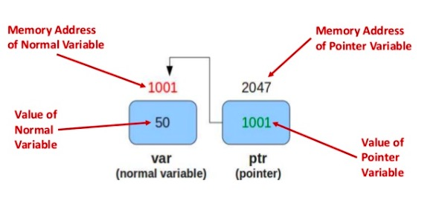
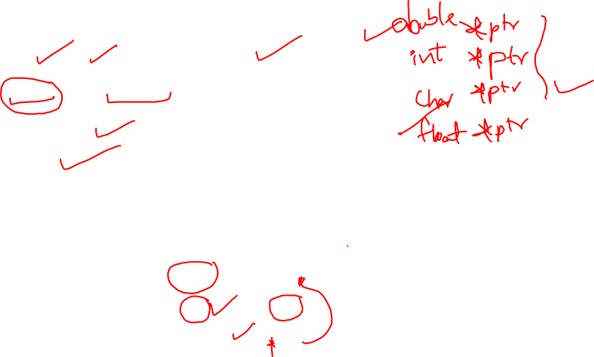
Pointers
Pointer is a variable in C++ that holds the address of another variable.
They have data type just like variables.
For example:
a) An integer type pointer can hold the address of an integer variable
b) A character type pointer can hold the address of char variable.

Slide 4
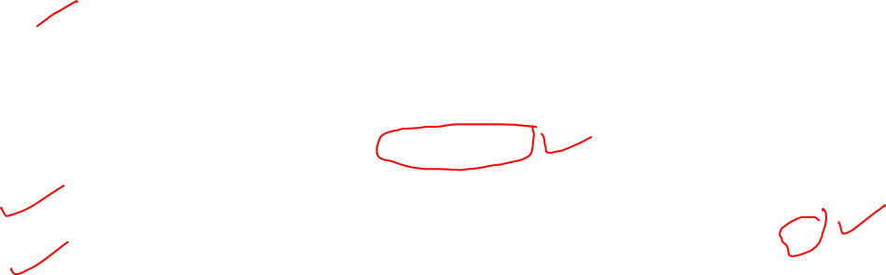
Pointers in c++
A pointer in C++ is a way to share a memory address among different contexts (primarily functions). They are primarily used whenever a function needs to modify the content of a variable, of which it doesn't have ownership.
In order to access the memory address of a variable, val , we need to prepend it with & sign. E.g., &val returns the memory address of val.
int *p = &val
This memory address is assigned to a pointer and can be shared among various functions. E.g. int *p = &val will assign the memory address of val to pointer p .
To access the content of the memory to which the pointer points, prepend it with a *.
For example, *p will return the value reflected by val and any modification to it will be reflected at the source ().

Slide 5
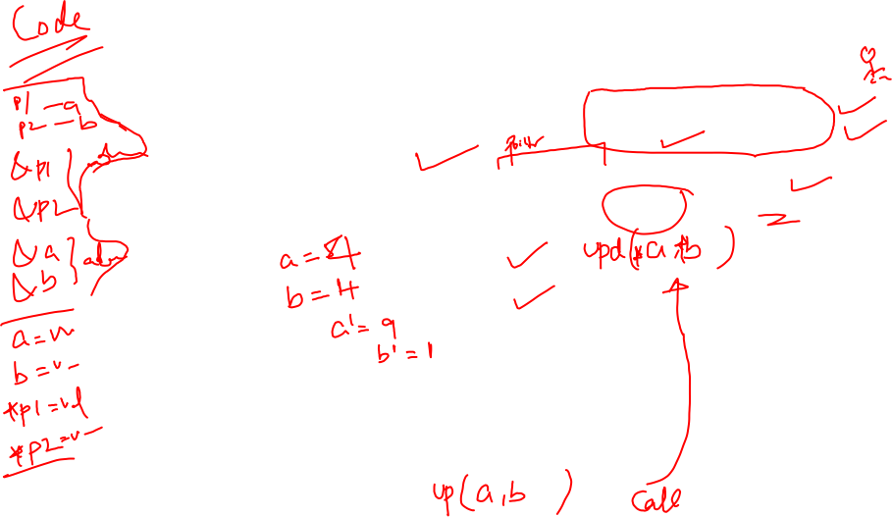
Q) Find sum & difference of two numbers using pointers
You have to write the function void update(int *a,int *b), which reads two integers as argument, and sets a with the sum of them, and b with the absolute difference of them.
a¹ = a + b
b¹ = a – b
Input Format
Input will contain two integers, a and b, separated by a newline.
Output Format
You have to print the updated value of a and b , on two different lines.

Slide 6
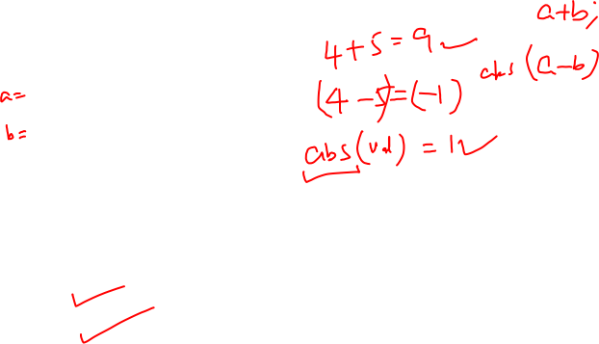
Sample I/O
Input
4
5
Output
9
1

Slide 7
C++ CODE
#include <iostream>
using namespace std;
void update(int *a, int *b)
{ int add, sub;
add = *a + *b;
sub = abs( *a - *b);
*a = add;
*b = sub;
} int main()
{
int a, b;
int *pa = &a, *pb = &b;
cin >> a >> b;
update(pa, pb);
cout<<a<<endl;
cout<<b<<endl;
return 0;
}

Slide 8
Thank You

