Slide 1

TECHNICAL SESSION
C2TC PROGRAM 2020

Slide 2
What if..?
Less development time. Less memory. Less execution time. Enhanced performance. Reduce redundancy to get consistent results and less storage cost.

Slide 3
Inheritance
Concepts
Implementation
Notes:
Are your classroom colors different than what you see in this template? That’s OK! Click on Design -> Variants (the down arrow) -> Pick the color scheme that works for you!
Feel free to change any “You will…” and “I will…” statements to ensure they align with your classroom procedures and rules!

Slide 4

Definition
Inheritance is the process by which objects of one class acquire the properties of objects of another class. It supports the concept of hierarchical classification.

Slide 5
How….?
CPP Inheritance is the creation of new class acquiring the properties and characteristics of already existing class.
The class which gives its properties to newly generated class is called as Super class (or) Parent class (or) Base class.
The class which inherits or takes the properties from the existing class is called as Sub class (or) Child class (or) Derived class.

Slide 6
Characteristics
The child class can even have its own characteristics.
Code is re-used.
Method over-riding.
Reduces execution time.

Slide 7
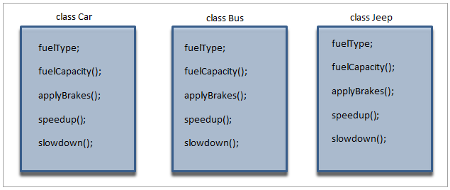
Why Inheritance..?

Slide 8
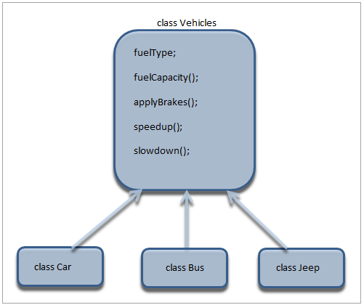
Solution..!

Slide 9
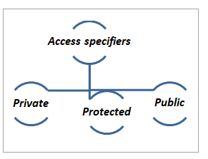
Syntax:
class derived_classname: access_specifier base_classname { };

Slide 10
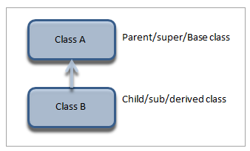
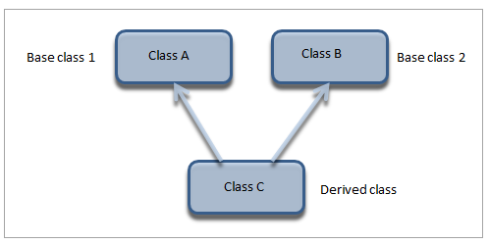
Types ….
Single inheritance
Multiple inheritance

Slide 11
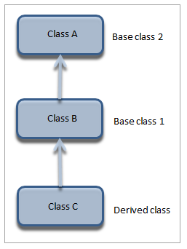
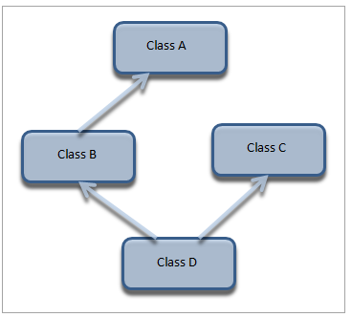
Types ….
Multilevel Inheritance
Hybrid Inheritance

Slide 12
Problem!!!
Create two classes:
Rectangle The Rectangle class should have two data fields-width and height of int types. The class should have display() method, to print the width and height of the rectangle separated by space.
RectangleArea The RectangleArea class is derived from Rectangle class, i.e., it is the sub-class of Rectangle class. The class should have read_input() method, to read the values of width and height of the rectangle. The RectangleArea class should also overload the display() method to print the area of the rectangle.

Slide 13
Further References!!!
https://www.splessons.com/lesson/cpp-inheritance/
https://www.youtube.com/watch?v=5pJyKzON8Ww

