Slide 1
TECHNICAL OVERVIEW · ENGINEERING AUDIENCE
Application Architecture
Three surfaces. One engine.
Portage converts a SAP Hybris commerce monolith — Java/Spring, items.xml, and a Spartacus storefront — into a deployable Salesforce project of Apex, LWC, and metadata, with a human review gate at every consequential step.
SAP HYBRIS
──▶
PORTAGE ENGINE
──▶
SALESFORCE
Python 3.12 · FastAPI
React 18 + Vite · TypeScript
85 automated tests
PORTAGE · ARCHITECTURE
01 / 10

Slide 2
01 · SYSTEM CONTEXT
Everything is a client of one function.
run_agentic_migration() in orchestrator.py is the single entry point. The CLI, the VS Code extension, and the web cockpit are three ways to call it — they differ only in which of its optional hooks they pass.
CLI
VS CODE EXTENSION
WEB COCKPIT
python -m src.main agent-migrate
TypeScript + webview
React SPA + FastAPI
— Direct, in-process call
— Also: ingest · repo-migrate · impex · cronjob · metadata · report
— The reference implementation
— Spawns the CLI as a child process
— Bootstraps its own .venv
— Ships a synced copy of the engine
— Imports the engine in-process
— Runs it on a worker thread
— Which is what makes live events and blocking gates possible
run_agentic_migration(input, output, *, on_event, gate, should_cancel, on_blackboard, state_dir)
on_event
gate
should_cancel
on_blackboard
streams every stage, decision and artifact to the UI
suspends the run and waits for a human verdict
cooperative cancellation at every safe point
exposes live state for diff, regenerate, Copilot
WHY IT MATTERS
Every hook defaults to None — so the engine has no knowledge of HTTP, of VS Code, or of a browser. That is what keeps all three surfaces at feature parity without a shared UI layer, and why adding the cockpit changed no CLI behaviour.
PORTAGE · ARCHITECTURE
02 / 10

Slide 3
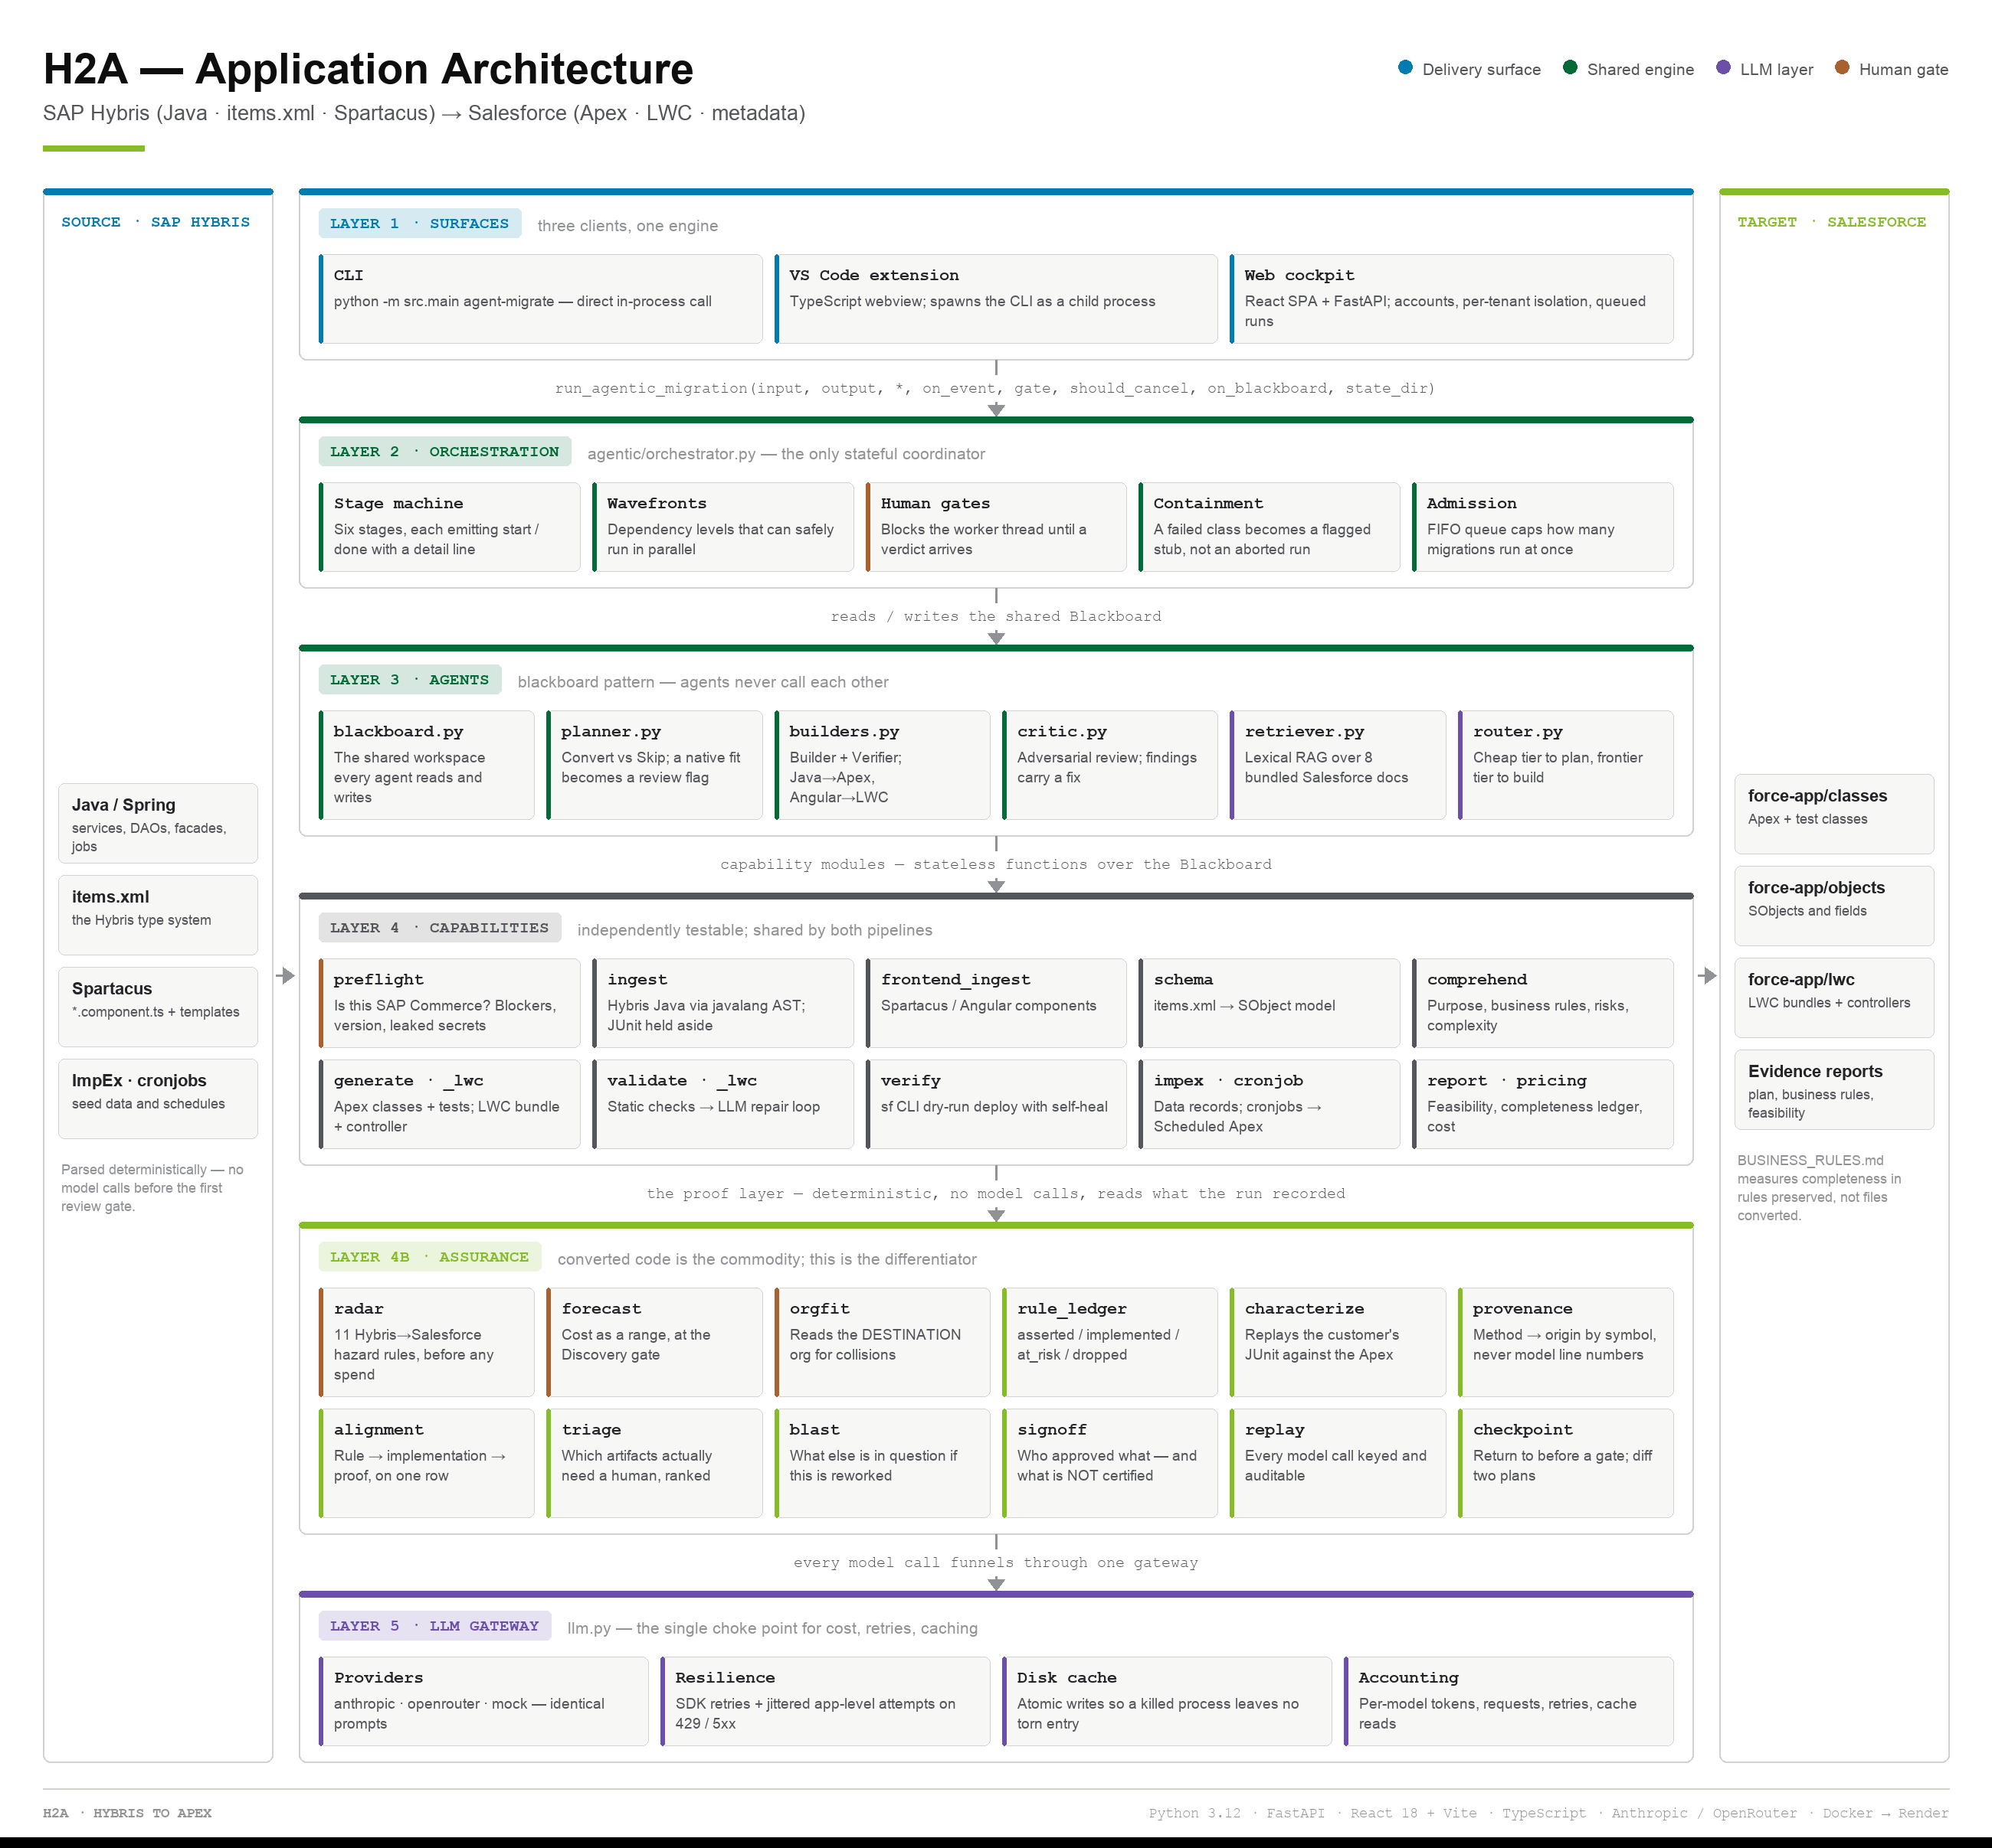
02 · ARCHITECTURE AT A GLANCE
Five layers, two rails.
PORTAGE · ARCHITECTURE
03 / 10

Slide 4
03 · THE FIVE LAYERS
What each layer owns, and what it must not know.
SURFACES
CLI · VS Code extension · Web cockpit
Know how to talk to a human. Know nothing about migration.
▼
ORCHESTRATION
orchestrator.py
Stages, dependency wavefronts, human gates, checkpoints, failure containment.
▼
AGENTS
Blackboard · Planner · Builder · Critic · Verifier
Agents never call each other — they read and write one shared workspace.
▼
CAPABILITIES
ingest · schema · generate · validate · verify · rule_ledger · report
Stateless functions. Independently testable. Shared by both pipelines.
▼
LLM GATEWAY
llm.py → anthropic · openrouter · mock
Routing, retries, caching and cost accounting — one choke point, no bypass.
PORTAGE · ARCHITECTURE
PORTAGE · ARCHITECTURE
04 / 10
04 / 10

Slide 5
04 · THE AGENTIC CORE
A shared blackboard, not a call graph.
BLACKBOARD
planner.py
builders.py
critic.py
Convert vs Skip per target. A native-product fit becomes a review flag — never a dropped class.
Builder + Verifier. Branches on layer: Java → Apex, Angular Component → LWC bundle.
Adversarial review of each artifact. Findings carry severity, category and a concrete fix.
· schema
· comprehensions
· plan (PlanItem)
· artifacts (Artifact)
· decisions
· open questions
retriever.py
router.py
incremental.py
Lexical RAG over 8 bundled Salesforce docs. No vector DB — zero infra, zero drift.
Cheap tier for comprehend and plan; frontier tier for generate, repair and critic.
Fingerprints source, deps, schema and plan so an unchanged class is never re-generated.
WHY A BLACKBOARD
Because every intermediate state stays inspectable. That is precisely what makes the human review gates, the per-file diff, the regenerate-one-file action and the full audit trail possible at all — none of which you can bolt onto agents that call each other directly.
PORTAGE · ARCHITECTURE
05 / 10

Slide 6
05 · THE PIPELINE
Six stages, three human gates.
STAGE 1
STAGE 2
STAGE 3
STAGE 4
STAGE 5
STAGE 6
Analyze
Comprehend
Plan
Build + Critic
Reconcile
Verify
Ingest Java + Angular, parse items.xml, build the dependency graph and domain schedule.
One structured LLM pass per class: purpose, business rules, queries, side effects, risks.
Group classes into Salesforce targets; decide Convert vs Skip; attach review suggestions.
Generate Apex/LWC, validate, repair, then adversarially review each artifact.
Merge artifacts, augment schema, write the SFDX tree, emit data, schedules and reports.
Optional real sf dry-run deploy; compiler errors feed the repair loop and redeploy.
Deterministic — no model calls
Fully parallel
Cheap model tier
One wavefront at a time
Deterministic merge
Needs a live org
⏸ DISCOVERY GATE
⏸ PLAN GATE
⏸ BUILD GATE
THE GATE THAT COSTS NOTHING
The Discovery gate fires before a single LLM call is made. A reviewer sees the complete repository understanding — file tree, architecture, every class and the data model — and can walk away at zero cost. Verified: 0 model requests before approval.
PORTAGE · ARCHITECTURE
06 / 10

Slide 7
06 · A SUPERVISED RUN
How a review gate actually works.
REQUEST LIFECYCLE
WHY POLLING, NOT SSE
1 Reviewer uploads a .zip and enables supervised mode
2 POST /api/runs → FastAPI spawns a worker thread
3 Client begins polling GET /api/runs/{id} every 1.2 s
4 Analyze completes — still zero model calls
5 gate("discovery") blocks the worker thread on an Event
6 Cockpit renders the scan; reviewer approves
7 Event.set() releases the thread; Comprehend begins
8 Plan and Build gates repeat the same exchange
9 run_complete carries ledger, rule_ledger, cost, decisions
An SSE endpoint still exists, but the shipped client does not use it. Corporate proxies were silently killing idle connections while a supervised run sat quiet at a gate. The client polls a replay-by-index endpoint instead — less elegant, dramatically more likely to work.
WHAT THE REVIEWER CAN DO
— Approve, or reject with written feedback
— Inspect any file side-by-side against its Java origin
— Regenerate a single class without re-running the migration
— Ask the Copilot to rework a target
THE HARD PART
The engine runs on a worker thread and a gate blocks that thread while HTTP stays responsive. An early version waited with no timeout and held the global run lock forever — which made a stopped migration un-restartable. Gates now honour cancellation, and a new run auto-cancels the previous one.
PORTAGE · ARCHITECTURE
07 / 10

Slide 8
07 · WHAT GOES IN, WHAT COMES OUT
Code is half the deliverable.
IN — SAP HYBRIS
OUT — SALESFORCE DX
OUT — EVIDENCE
Java / Spring
force-app/classes
MIGRATION_PLAN.md
services, DAOs, facades, jobs
Apex + a test class for each
every target, decision and rationale
items.xml
force-app/objects
BUSINESS_RULES.md
the Hybris type system
▶
SObjects and fields
▶
every rule traced to code and test
Spartacus
force-app/lwc
FEASIBILITY_REPORT.md
*.component.ts + templates
LWC bundles + @AuraEnabled Apex
per-artifact confidence + completeness
ImpEx · cronjobs
data/
PARITY · DATA · CRON
seed data and schedules
records converted from ImpEx
coverage, records, schedules
THE DIFFERENTIATOR
Any tool can emit Apex. BUSINESS_RULES.md measures completeness in business rules preserved rather than files converted — and names the rules that no generated artifact carries at all. That is the row nothing else reports.
PORTAGE · ARCHITECTURE
08 / 10

Slide 9
08 · TECHNOLOGY STACK
What each piece is, and why it is there.
ENGINE
AI
Python 3.12
host language for the pipeline
anthropic SDK
primary provider; per-stage thinking effort
javalang
real Java AST — classes, methods, annotations
openai SDK → OpenRouter
alternate provider, OpenAI-compatible
pydantic · pyyaml
structured-output validation; config + mappings
bundled lexical RAG
8 Salesforce docs, top-3 per prompt — no vector DB
rich
CLI rendering
mock provider
keyless, deterministic; CI and safe demos
WEB
DELIVERY
FastAPI + uvicorn
15 JSON routes + SPA catch-all
VS Code API
webview + self-bootstrapping venv
React 18 + TypeScript 5.5
the cockpit, typed to the event contract
Salesforce CLI (sf)
dry-run deploy — the only objective gate
Vite 5 + Monaco
lazy-chunked diff editor; ~61 kB gzipped main bundle
Docker multi-stage → Render
node builds the SPA, python serves it
markdown
renders .md reports to HTML in-app
pytest
85 tests across pipeline, planner, LWC, rule ledger
PORTAGE · ARCHITECTURE
PORTAGE · ARCHITECTURE
09 / 10
09 / 10

Slide 10
09 · ARCHITECTURAL DECISIONS
The choices that shaped everything else.
Blackboard over a message bus
Optional hooks, never subclassing
Convert everything, flag natives
Agents read and write one shared workspace; the orchestrator decides who runs when.
Every integration point is a keyword argument defaulting to None.
A better native home (CPQ, Flow, Approvals) produces a review flag on converted code.
Every intermediate state stays inspectable — which is what the review gates need.
The cockpit was added without touching a single CLI code path.
Silently dropping logic is how migrations lose requirements until go-live.
Deterministic parallelism
One LLM choke point
Polling over SSE
Concurrency bounded by dependency wavefronts; results merge in fixed order.
Routing, retries, caching and cost accounting all live in llm.py.
The client polls a replay-by-index endpoint instead of holding a stream open.
A 7× speed-up is worthless if it makes output non-reproducible.
No call site can accidentally bypass the retry or the cost meter.
Chosen after SSE plus heartbeats still failed on a real locked-down network.
PORTAGE · ARCHITECTURE
PORTAGE · ARCHITECTURE
10 / 10
10 / 10

