Slide 1
Capstone Project - 2
Bike Sharing Demand Prediction
Submitted by
Vikash Kumar Diwakar
Data science trainee, Almabetter

Slide 2

Agenda
Problem Statement
Data Summary
Feature Engineering
Exploratory Data Analysis (EDA)
Modelling Approach
Predictive Modelling
Model comparison
XG boost model explanations
Challenges faced and Conclusions

Slide 3

Problem Statement
Currently Rental bikes are introduced in many urban cities for the enhancement of mobility comfort
It is important to make the rental bike
available and accessible to the public at the right time as it lessens the waiting time, eventually, providing the city with a stable supply of rental bikes
The goal of this project is to build a ML model that is able to predict the demand of rental bikes in the city of Seoul.

Slide 4
Data Summary
Date
Rented Bike count
Hour - Hour of the day
Temperature - Celsius
Humidity - %
Windspeed - m/s
Visibility - 10m
Dew point temperature
Celsius
Solar radiation - MJ/m2
Rainfall - mm
Snowfall - cm
Seasons
Holiday
Functional Day
Day of week
Month
– ● Weekend

Slide 5
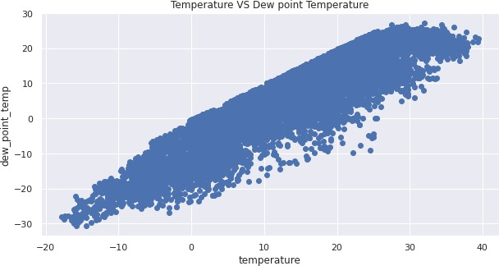
Feature Engineering
Td = T - ((100 - RH)/5)
➔ Td = dew point temperature
➔ T = Temperature
➔ RH = Relative humidity (%)
Also these variables are highly correlated (0.912798)
Hence we can drop dew point
temperature
There are no missing values in
the dataset

Slide 6
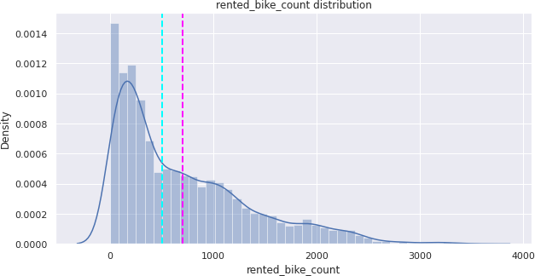
Exploratory Data Analysis (EDA)
The dependent variable - rented bike counts is positively skewed
Normally distributed attributes: temperature, humidity.
Positively skewed attributes: wind, solar radiation, snowfall, rainfall.
Negatively skewed attributes: visibility.

Slide 7
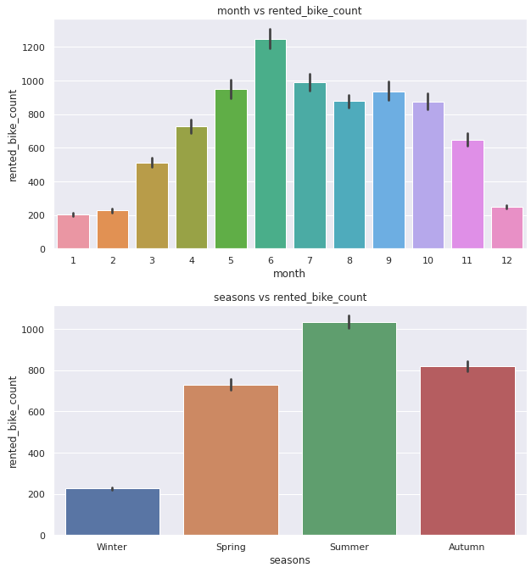
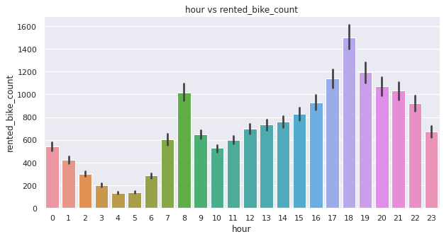
EDA (Contd.)
Highest demand - June
Lowest demand - January
On a typical day, there is a surge
in demand for rental bikes during the rush hours

Slide 8
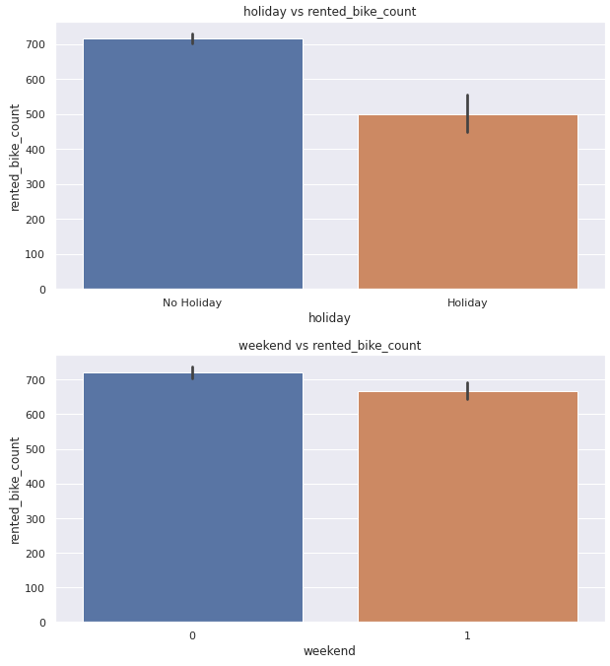
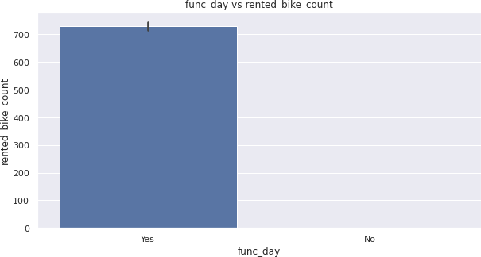
EDA (Contd.)
Demand for rental bikes is lower
on holidays and weekends
On a non functional day, no bikes were rented in all instances

Slide 9
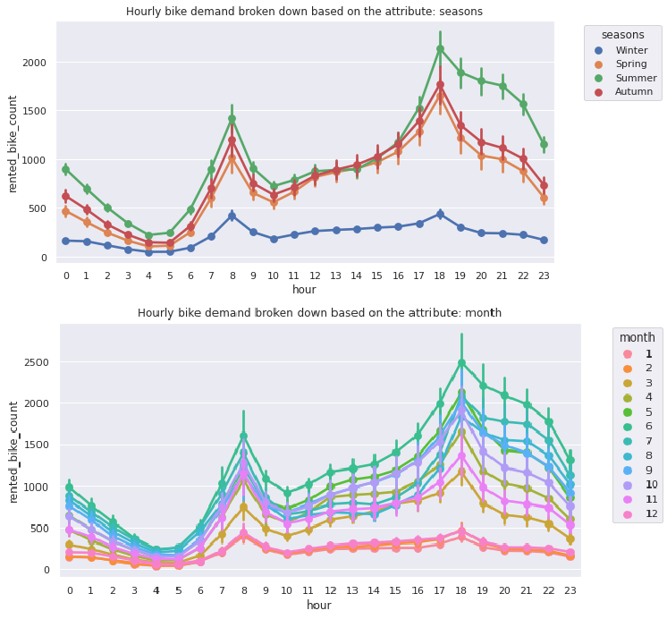
EDA (Contd.)
Lowest demand - Winter
Highest demand - Summer
In autumn and spring, the demand on average is
similar throughout the day

Slide 10
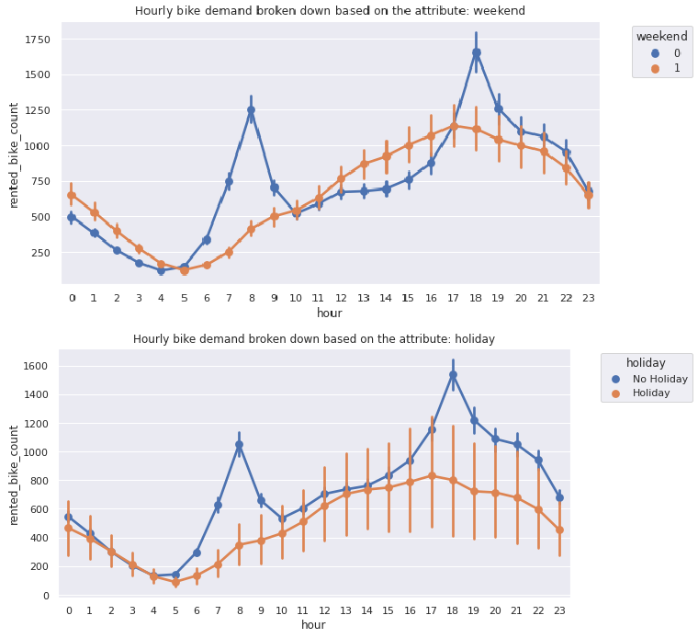
EDA (Contd.)
On a regular day, there is a surge in demand for rental bikes during rush hours
On holidays and weekends,
the demand for rental bikes increases gradually throughout the day

Slide 11
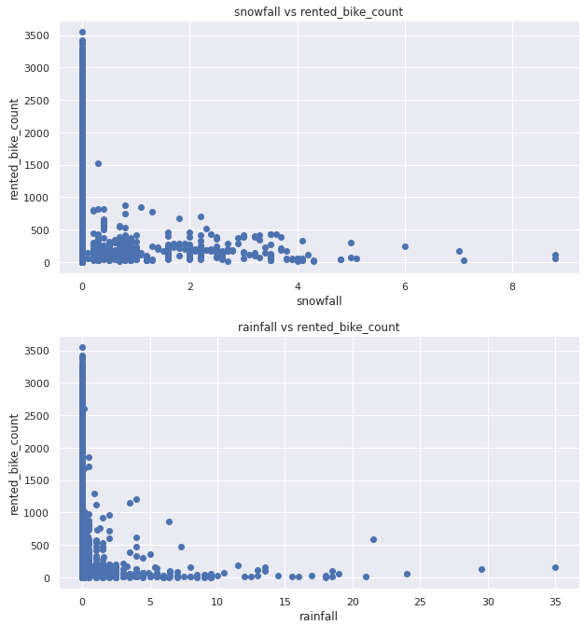
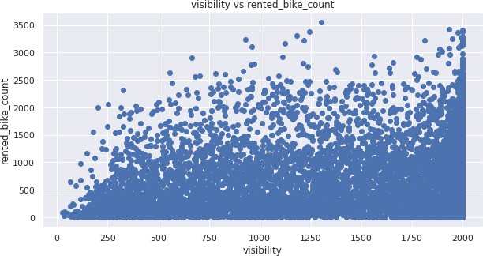
EDA (Contd.)
The demand for rental bikes is typically lower when there is rainfall / snowfall, and on days with low visibility

Slide 12
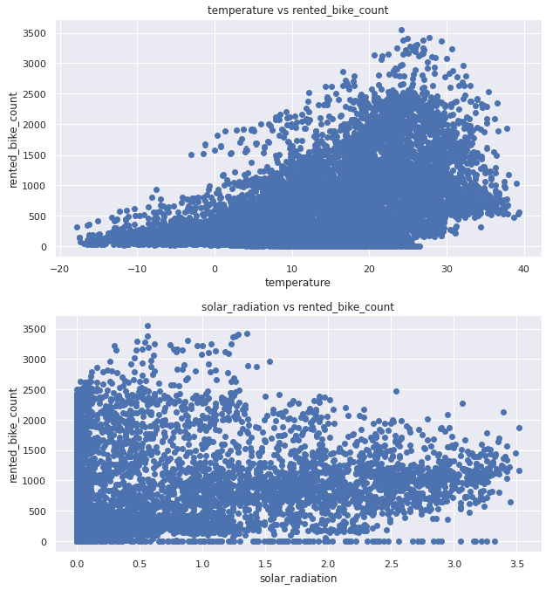
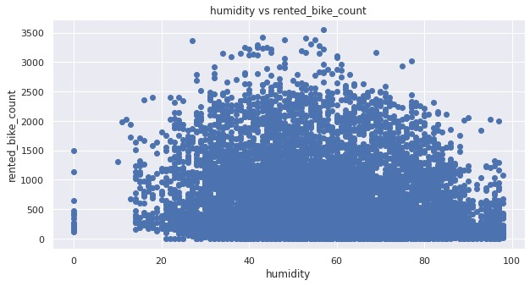
EDA (Contd.)
The demand for rental bikes remains low for days with very low temperatures, and on days with high intensity of solar radiation

Slide 13
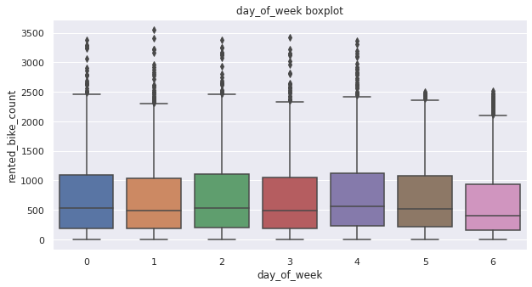
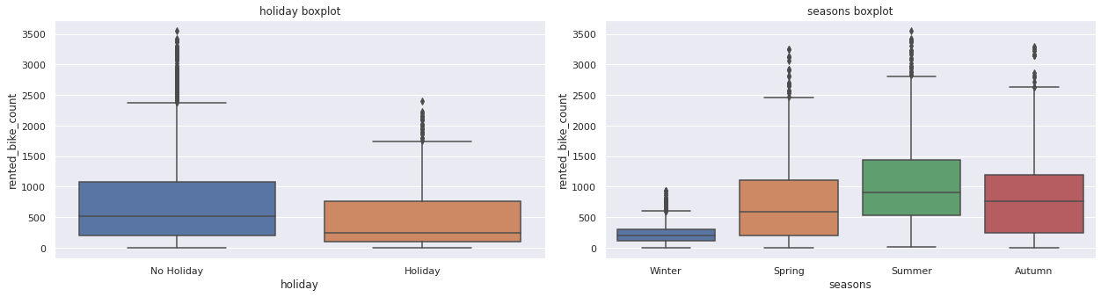
EDA (Contd.)
There are outliers in the data
We cannot handle them since we may eliminate patterns we had discovered earlier

Slide 14
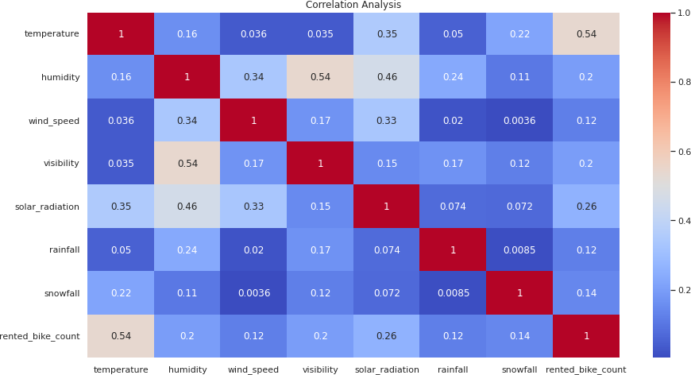
EDA (Contd.)
Correlation
magnitude
There is no
multicollinearity
in the attributes
Temperature has the highest correlation with the dependent variable

Slide 15
EDA Summary
The dependent variable - rented bike counts is positively skewed
Demand for rental bikes is lowest in the winters; highest in summers
On regular days, there is a surge in demand for rental bikes during
rush hours, this was absent during holidays and weekends
The demand for rental bikes remains low when there is snowfall / rainfall, and on days with low visibility
The demand for rental bikes remains low for days with very low
temperatures, and on days with high intensity of solar radiation
The data contains outliers, all the numeric variables were log transformed to handle skew, and all datapoints beyond 3 standard deviations from the mean were replaced with the median value
Temperature has the highest correlation with dependent variable

Slide 16
Modelling Approach
Numeric features: rainfall, snowfall, and visibility were converted to
categorical variables
Since there are many categorical attributes, It won’t be wise to fit linear models, as they will give high errors.
We can use tree models instead, since they can handle outliers and categorical attributes better than linear models.
We can use decision tree as a baseline model.
Subsequently, to get better predictions, we can use ensemble
models: Random forests, GBM, XG Boost.
Final choice of model will depend on whether interpretability or
accuracy is important to the stakeholders.

Slide 17
Modelling Approach (Contd.)
Choice of split is taken as K-fold cross validation, with k=6, because
of the computational power available and to reduce overfitting
Model evaluation metric is taken as RMSE to punish outliers.
σ(𝒀 − 𝒀෡)^{𝟐}
𝑹𝑴𝑺𝑬 =
𝑵
Apart from RMSE, R2 score was also calculated to explain the model
performance to the general audience.
_{𝑹}𝟐
=
𝑺𝒖𝒎 𝒐𝒇 𝑺𝒒𝒖𝒂𝒓𝒆𝒔 𝒐𝒇 𝑹𝒆𝒔𝒊𝒅𝒖𝒂𝒍𝒔
𝑻𝒐𝒕𝒂𝒍 𝑺𝒖𝒎 𝒐𝒇 𝑺𝒒𝒖𝒂𝒓𝒆𝒔
Hyperparameter tuning is done using Grid Search

Slide 18
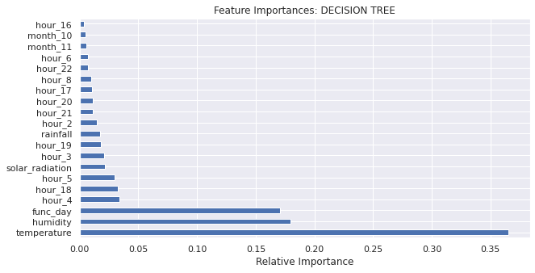
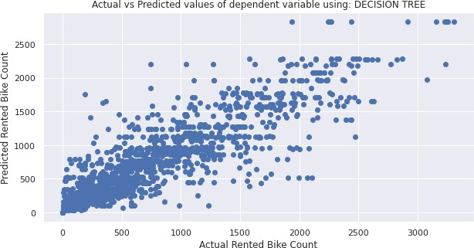
Decision Tree
Parameters:
Max_depth = 24
Min_samples_leaf = 30
Evaluation metrics:
Train RMSE = 263.27
Test RMSE = 294.39
Train R2 Score = 0.833
Test R2 Score = 0.7929

Slide 19
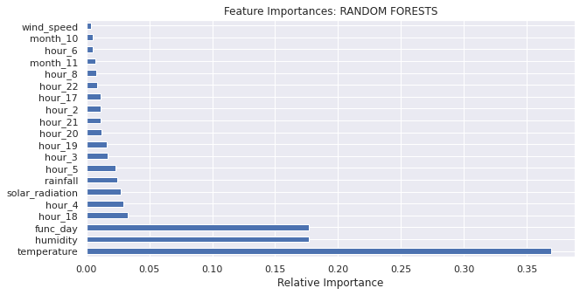
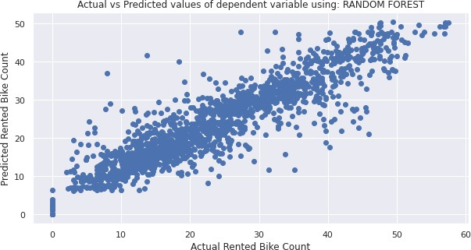
Random Forests
Parameters:
N_estimators = 500
Min_samples_leaf = 25
Evaluation metrics:
Train RMSE = 255.13
Test RMSE = 279.28
Train R2 Score = 0.8432
Test R2 Score = 0.8136

Slide 20
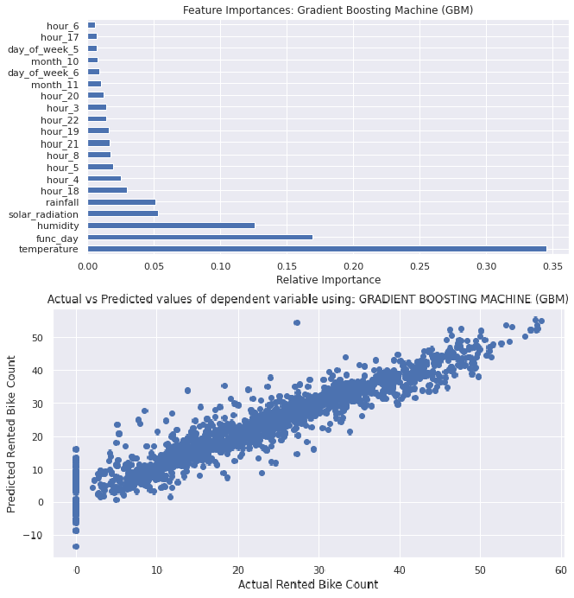
Gradient Boost
Parameters:
N_estimators = 500
Min_samples_leaf = 25
Evaluation metrics:
Train RMSE = 171.52
Test RMSE = 204.5
Train R2 Score = 0.9291
Test R2 Score = 0.9

Slide 21
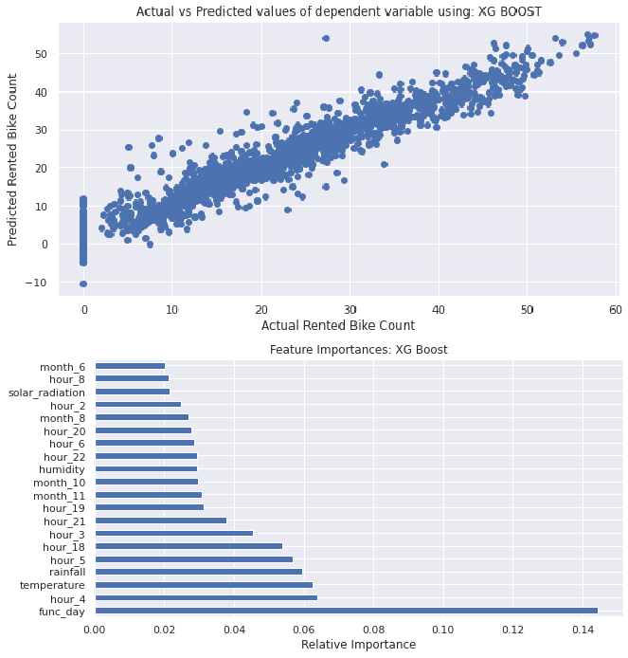
XG Boost
Parameters:
N_estimators = 500
Min_samples_leaf = 25
Evaluation metrics:
Train RMSE = 167.93
Test RMSE = 199.72
Train R2 Score = 0.932
Test R2 Score = 0.9046

Slide 22
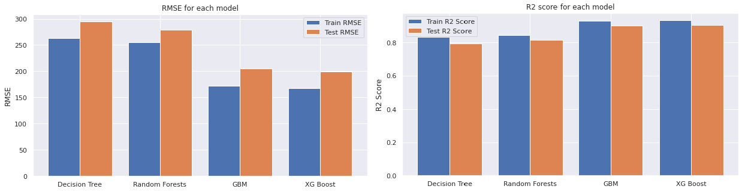
Model Comparison
The XG Boost model was able to give best predictions for the
demand of rental bikes.

Slide 23
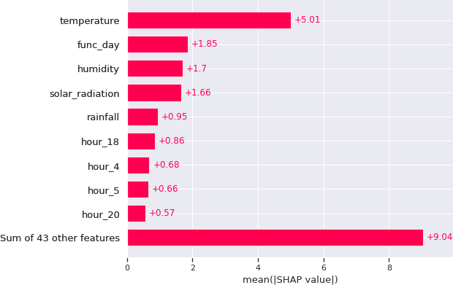
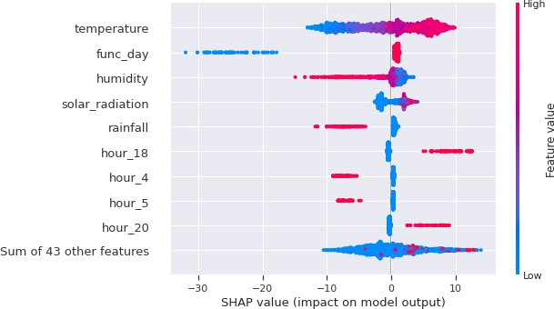
XG Boost Model Explanation Shapley Values
Temperature is the most important feature in determining the value of the dependent variable followed by functioning day, humidity, solar radiation, and rainfall.

Slide 24
Challenges Faced
Comprehending the problem statement, and understanding the
business implications
Feature engineering – deciding on which features to be dropped / kept / transformed
Choosing the best visualization to show the trends among different features clearly in the EDA phase
Deciding on how to handle outliers
Choosing the ML models to make predictions
Deciding the evaluation metric to evaluate the models
Choosing the best hyperparameters, which prevents overfitting

Slide 25
Conclusion
We have successfully built predictive models that can predict the demand for rental bikes based on different weather conditions and other factors and, they were evaluated using RMSE
The XG Boost prediction model had the lowest RMSE
We developed Shapely value plots to understand the predictions obtained from the XG Boost model
The final choice of model for deployment depends on the business need; if high accuracy in results is necessary, we can deploy XG Boost model
If the model interpretability is important to the stakeholders, we can
choose deploy the decision tree model.

Slide 26
Thank You!

