Slide 1
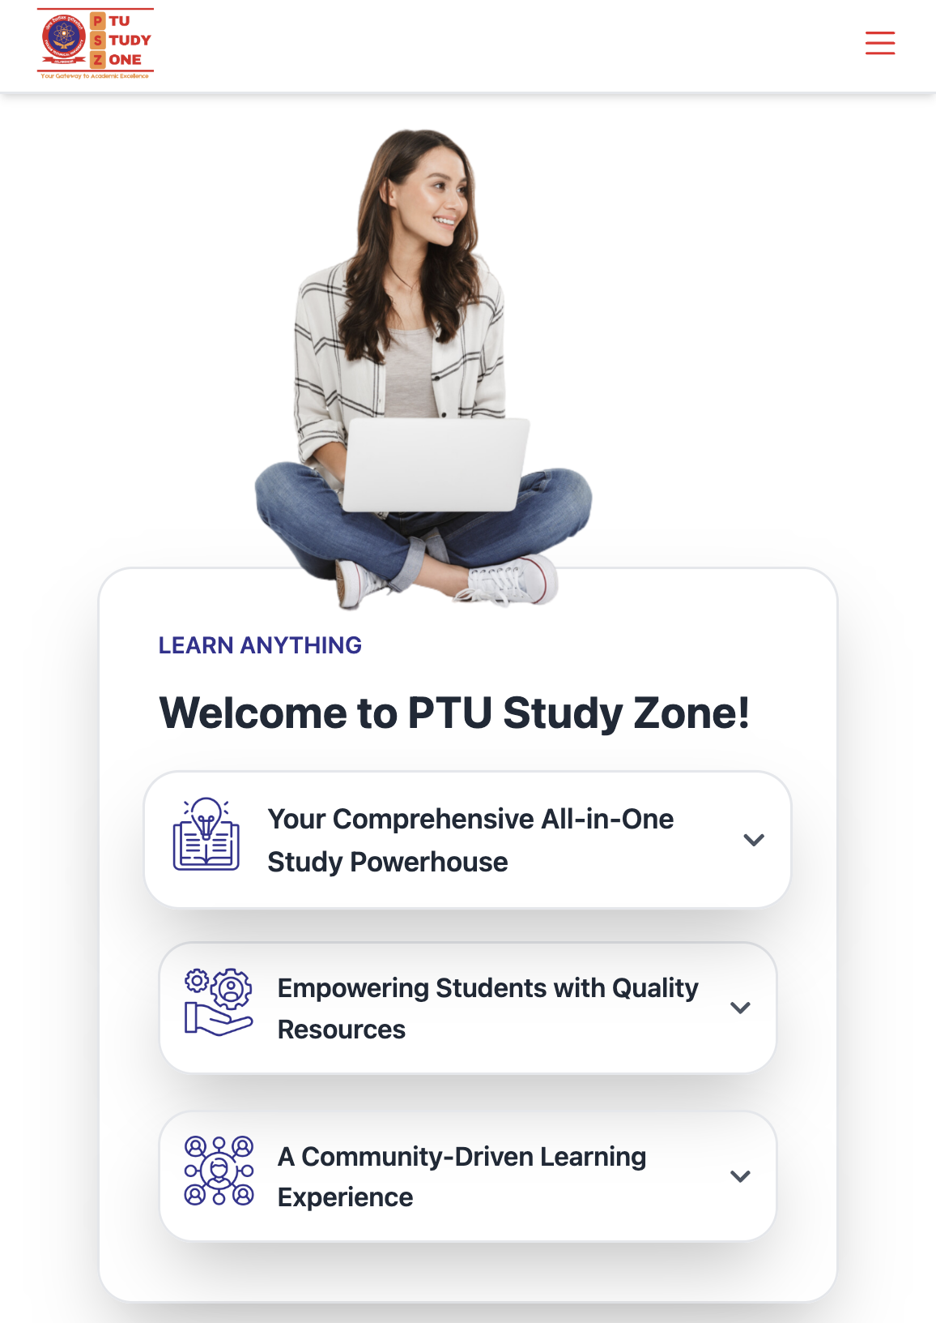
PTU STUDY ZONE
PTU Study Zone is a comprehensive resource hub for PTU students, designed to address the lack of centralized resources and communication gaps within the university.
By Vikash Bharal and Sahil Jamwal

Slide 2

Why We Need PTU Study Zone
1
Lack of Centralized Resources
PTU lacks a centralized platform for students to access academic resources like syllabus, PYQs, Books and curated YouTube channels.
Especially in the first year, students often feel lost, not knowing what to study, where to find reliable academic content, and how to stay on track
There is no online system for students to directly communicate their problems or concerns to the Head of Department (HOD), creating a disconnect.
2
Comparison with Other Universities
Universities like LPU have centralized web apps with integrated study materials, student-teacher interactions, and other academic resources.
3
Communication Gap
At PTU, there is a lack of community support among students. Students often feel isolated, with no direct communication channel to voice their grievances or connect with faculty.

Slide 3

Problems PTU Study Zone Solves
All-in-One Resource Hub
Vision for the Future
PTU Study Zone provides a single platform for accessing syllabus, PYQs, curated YouTube channels, a blog section, and a Student Grievances section.
PTU Study Zone aims to bridge the gap between students and faculty by integrating teachers into the platform for real-time interaction and support.

Slide 4





Key Features
Syllabus Access
The syllabus for each semester and subject is available in one centralized location, making it easier for students to stay on track.
Books Available
A curated collection of recommended books for each subject is provided to enhance student learning.
Previous Year Questions (PYQs)
A repository of previous year question papers for every semester, helping students understand exam patterns and prepare effectively.
Community Support
A blog section where students can share insights, tips, experiences, and learn from others, fostering a sense of community and peer-to-peer learning.
Student Grievances:
An online panel where students can submit their complaints and issues, ensuring the HOD is directly informed and can take timely action.

Slide 5

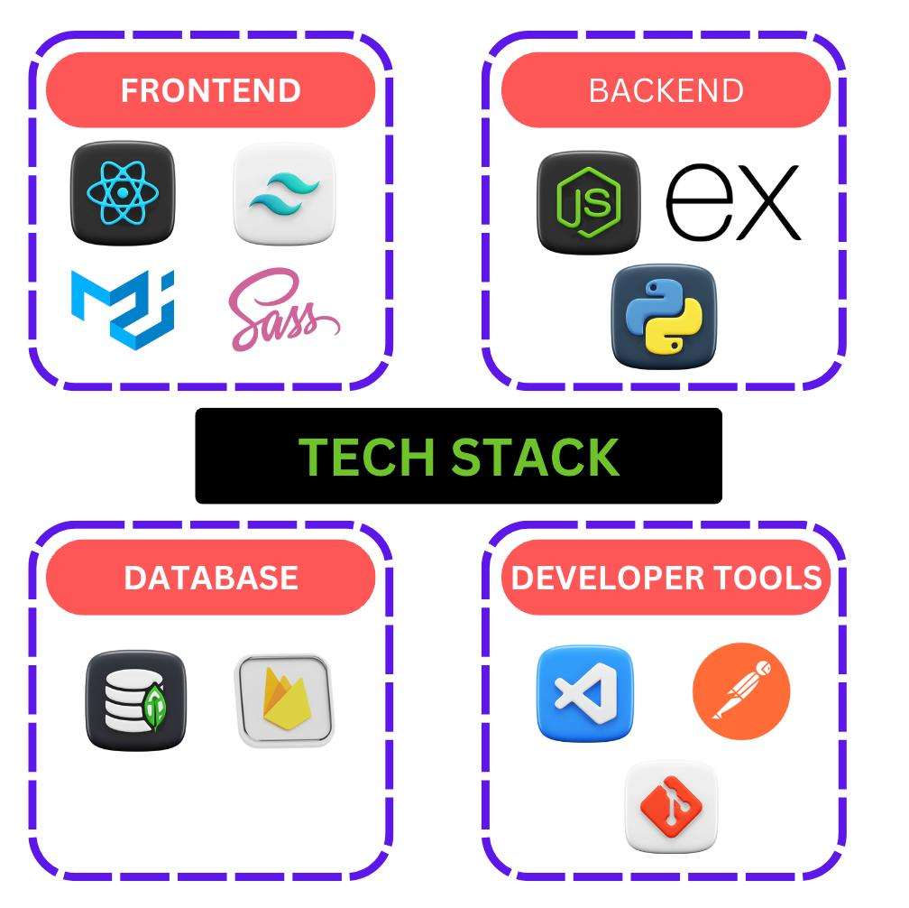
Technologies Used

Slide 6





Future Vision
Teacher Panel
Expand the platform to include a Teacher Panel of
or real-time communication between students and faculty
Personalized Learning Paths
Future updates will offer personalized learning paths based on each student’s performance, making learning more tailored and effective.
Interactive Materials
The platform will offer interactive study materials and assignments to make learning more engaging and intuitive.
Discussion Forum
A space where students can ask questions, share resources, collaborate on projects, and support each other in a shared academic journey.

Slide 7



Conclusion
Recap
PTU Study Zone is a well-rounded platform that solves key problems faced by PTU students, such as the lack of centralized academic resources, communication gaps, and community support.
Thank You
We appreciate your attention and are happy to answer any questions.

