Slide 1
Crimes On Women
(2001-2021)

Slide 2
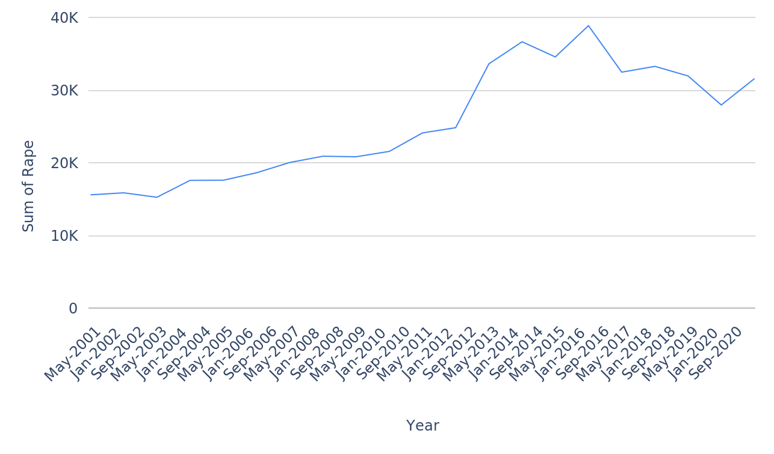
Yearly Trend of Reported Rape Cases
2

Slide 3
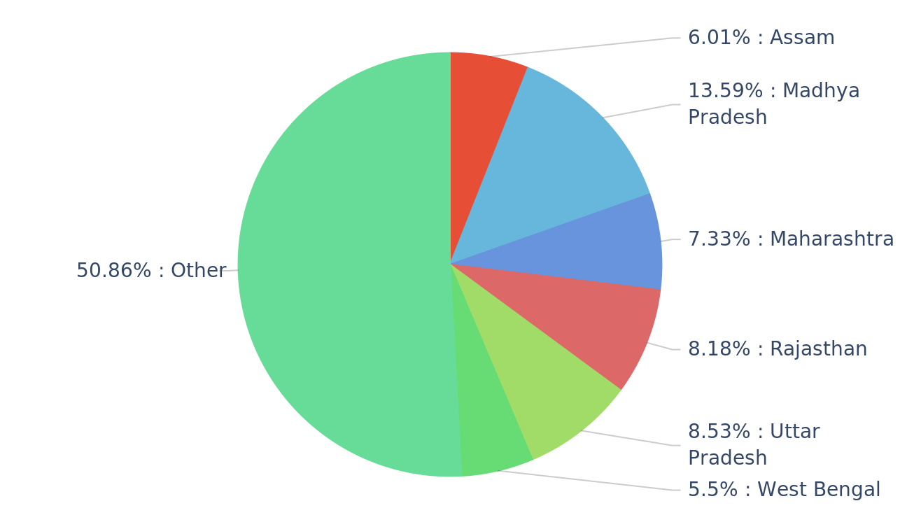
Rape per State
Madhya pradesh has the highest number
3

Slide 4
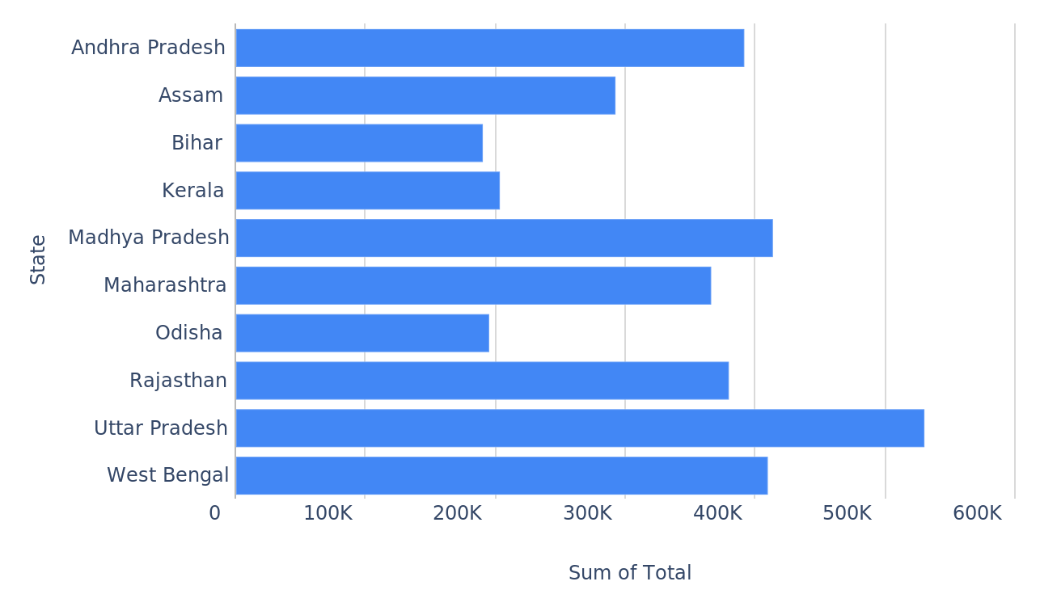
Comparing total crimes across different states
Crime per State
Uttar Pradesh has the highest number of crime against women
4

Slide 5
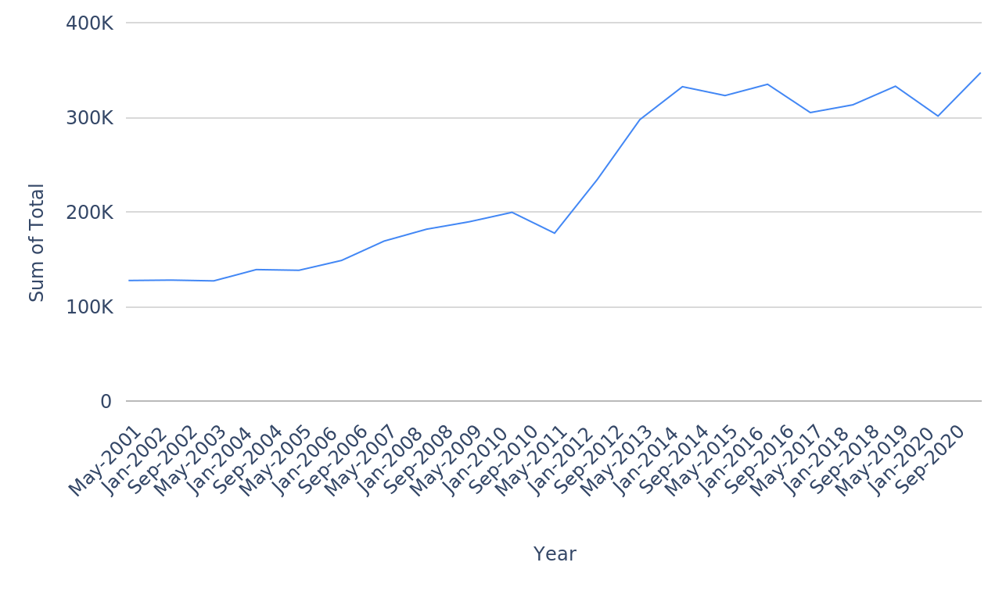
Tracking total crimes over the years
Total per Year
5

Slide 6
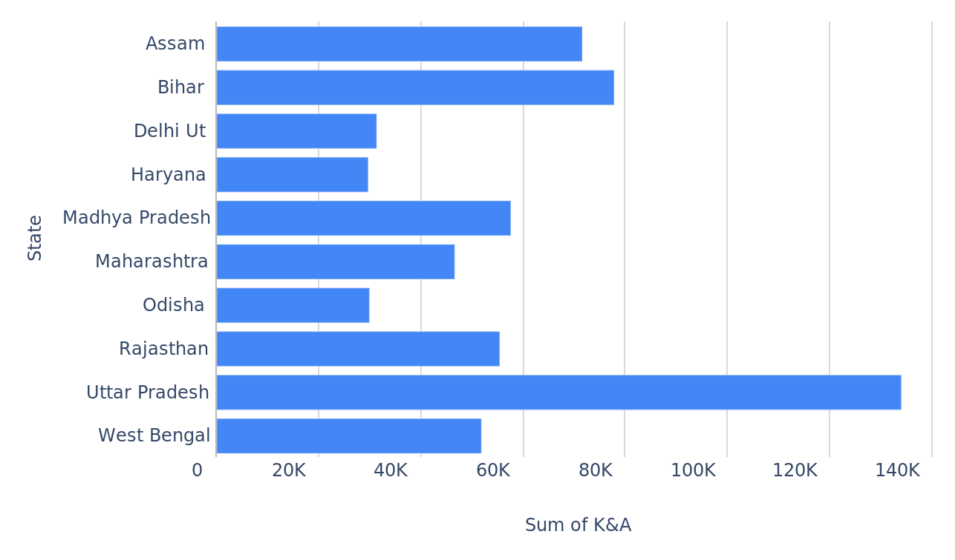
Comparing kidnapping and abduction cases across different states
K&A per State
6

Slide 7
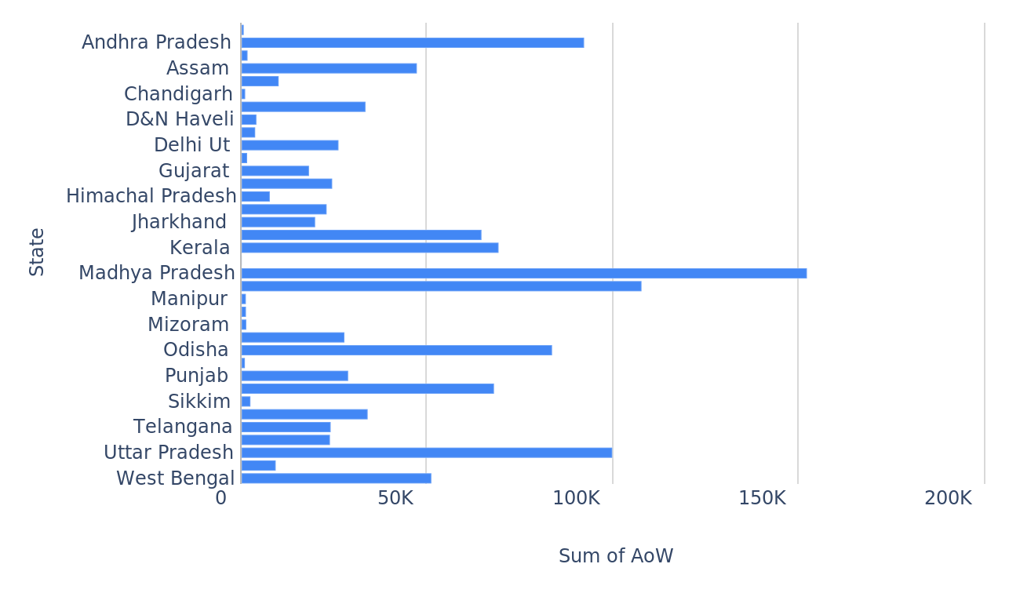
Comparing assaults on women cases across different states
AoW per State
7

Slide 8
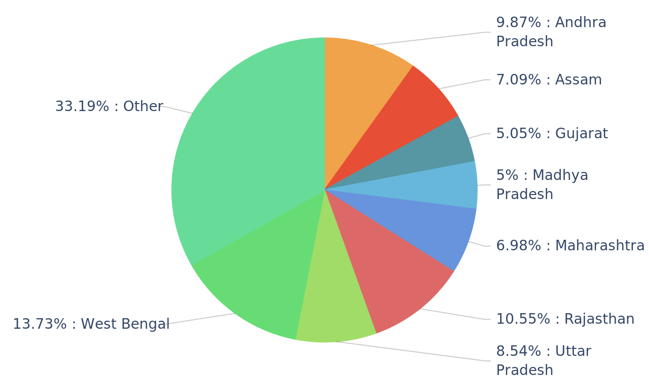
Comparing domestic violence cases across different states
DV per State
Domestic Violence is more in West Bengal
8

Slide 9
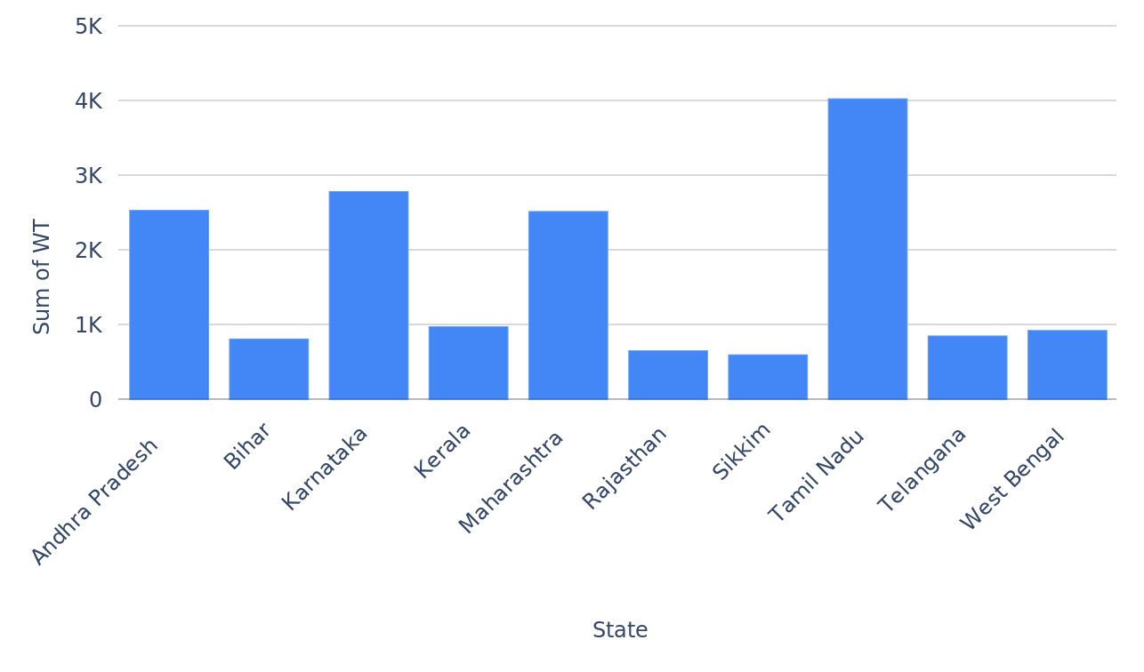
Comparing women trafficking cases across different states
WT per State
9

Slide 10
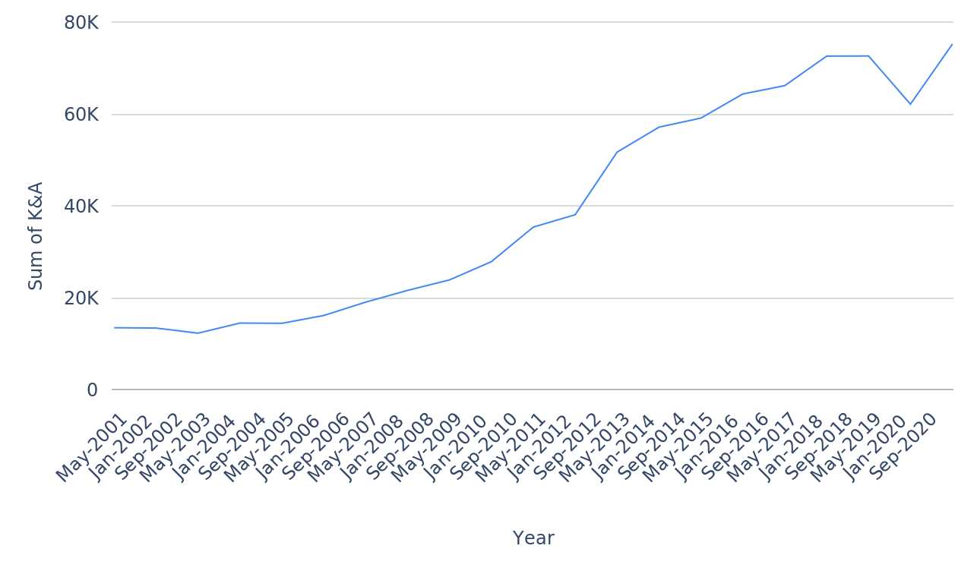
Tracking kidnapping and abduction cases over the years
K&A per Year
10

Slide 11
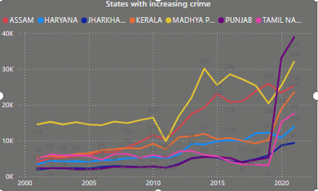
States with increasing crime on women
Kerala and Punjab have exhibited the highest increase in crimes against women over the observed period.

Slide 12
Created by Vikash Verma

