Slide 1
Environmental metagenomics
Read-based analyses

Slide 2
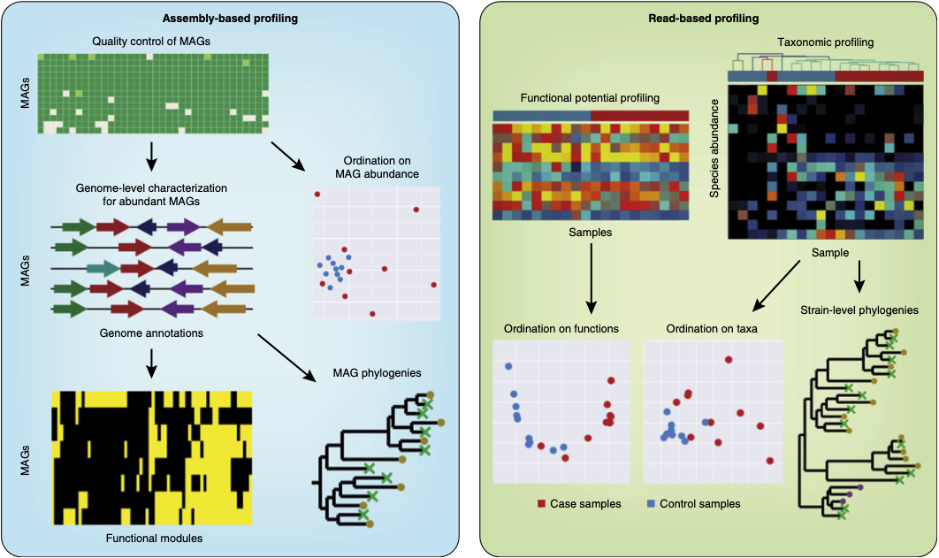
Read- vs. assembly-based
Read-based analyses
Fast
Comprehensive
Limited

Slide 3
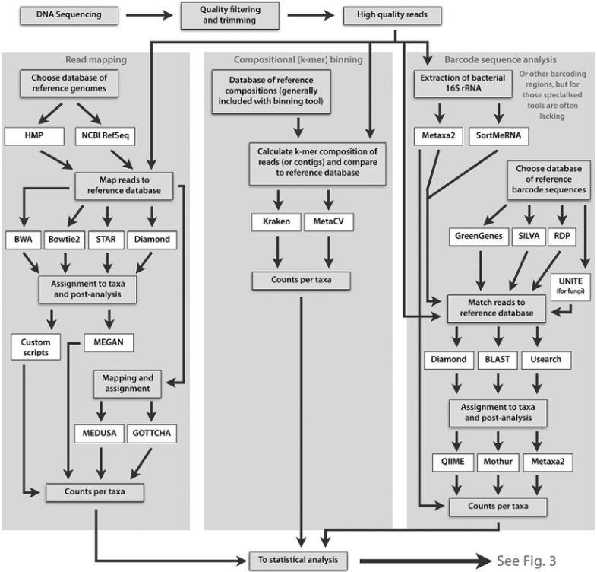
Approaches to taxonomic profiling
Read mapping and compositional binning
All reads
Reference database of sequenced genomes
Mapping: slow, requires lots of CPU and RAM
Compositional binning: faster but less accurate

Slide 4
Approaches to taxonomic profiling
Read mapping and compositional binning
Reference database of sequenced genomes
Mapping: slow, requires lots of CPU and RAM
Compositional binning: faster but less accurate
Barcoding
Specific genes (e.g. 16S rRNA)
Better databases (e.g. SILVA)
Much faster, but more limited

Slide 5
MEGAN
DO a walkthrough with one sample
Then they will do the other 4

Slide 6
Other alternatives
Humann
Metaphlan

Slide 7
Further reading
https://www.nature.com/articles/nbt.3935
https://www.sciencedirect.com/science/article/pii/B9780081022689000033
If you don’t have access to these, let me know
SciHub, cough cough

