Slide 1
Environmental metagenomics
Course outline and practical info

Slide 2
Welcome!
Instructors:
Igor Pessi, University of Helsinki
Antti Karkman, University of Helsinki
Participants:
Introduction

Slide 3
Course outline
Day 1: Basics of UNIX and working with the command line
Day 2: Handling of Illumina data
Day 3: Genome assembly
Day 4: Check-up and report
Day 5: Genome annotation
Day 6: Metabolic pathway analysis
Get reads
Sequence quality trimming
Genome assembly
Genome annotation
Metabolic pathways

Slide 4
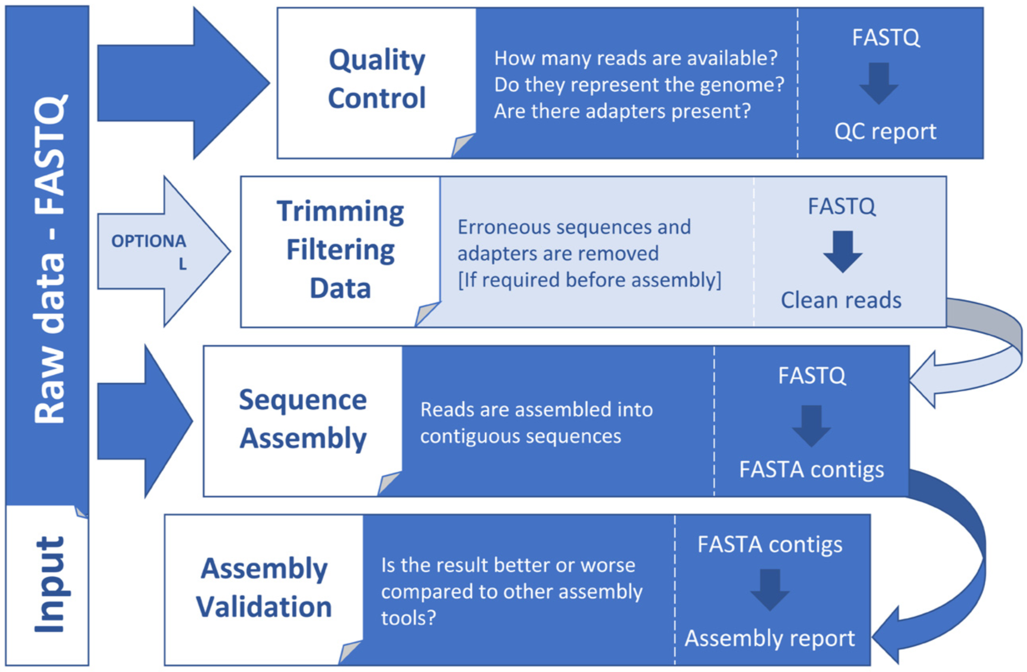
Dominguez Del Angel et al. 2018
F1000Reseach
doi: 10.12688/f1000research.13598.1

Slide 5
Practical info
The course will take place in Zoom (link by e-mail) from 9 AM to 4 PM (CET)
Something about Amazon Cloud?
Everyone creates a folder
Raw data is already there
Everything is installed
Folder with scripts, copy to your folder and launch with sbatch

Slide 6
Samples

Slide 7
Some practical things
All exercises and presentations can be found in:
https://github.com/karkman/physalia_metagenomics
We will start everyday at 9 AM (CET) with an introductory lecture
You can (and should) interrupt us any time
If possible, leave your camera on ☺

Slide 8
Cloud computing
How to login
Mac/Linux: terminal
Windows: Putty
Screen?
Folder with scripts
Running jobs
bash SCRIPT.sh
FOR LOOPS?

