Slide 1
Environmental metagenomics
Read-based analyses

Slide 2
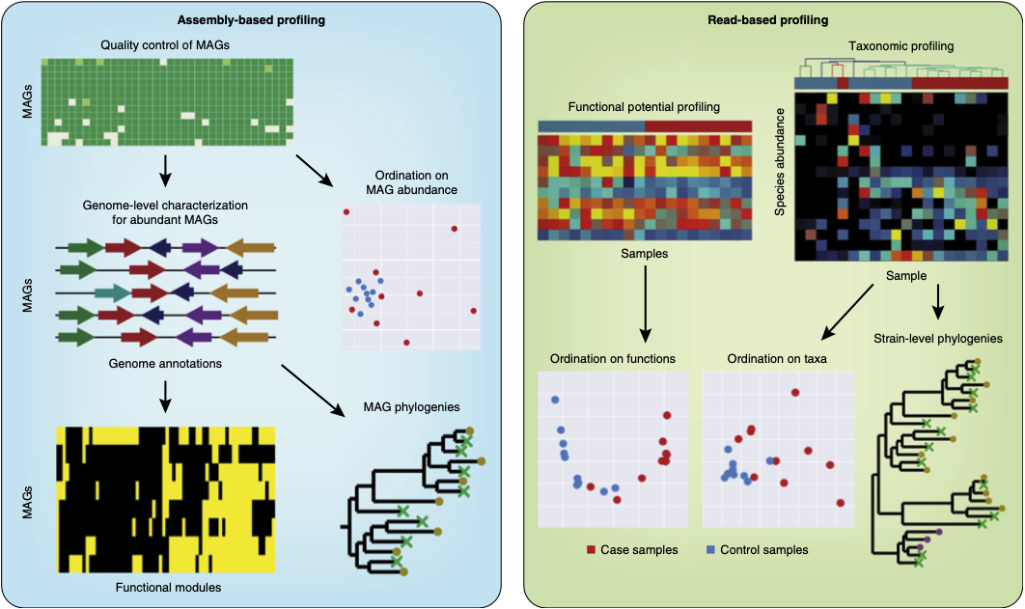
Read- versus assembly-based analyses
Read-based profiling
Fast
Quantitative
Limited
Somewhat outdated (assembly-based are preferred)
Can give interesting preliminary insights
Usually done as a ”quick-and-dirty” estimate prior to assembly
Quince et al. 2017

Slide 3
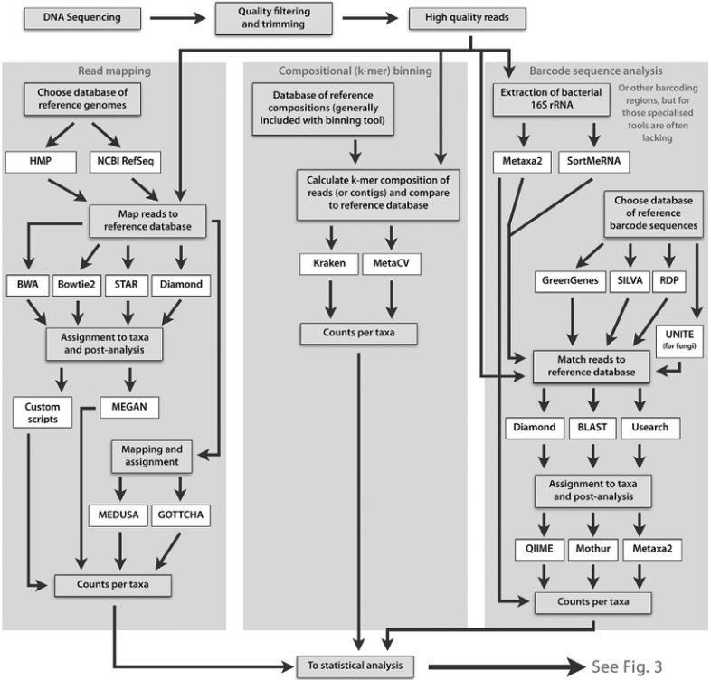
Approaches to taxonomic profiling
Bengtsson-Palme, 2018
Read mapping and compositional binning
Analysis of all reads
Reference database of sequenced genomes
Mapping: slow, requires lots of CPU and RAM
Compositional binning: faster but less accurate

Slide 4
Approaches to taxonomic profiling
Bengtsson-Palme, 2018
Barcode sequence analysis
Analysis of specific barcode genes (e.g. 16S rRNA)
Curate database of barcode sequences (e.g. SILVA)
Much faster than the other approaches, but provides lower resolution

Slide 5
Approaches to taxonomic profiling: how to choose?
Analysis of all reads suffer from limited databases of reference genomes
More suitable for environments that are better described (e.g. human gut)
Analysis of barcode genes suffer from lower resolution
More suitable for environments with a high fraction of unknown microorganisms (e.g. soil)

Slide 6
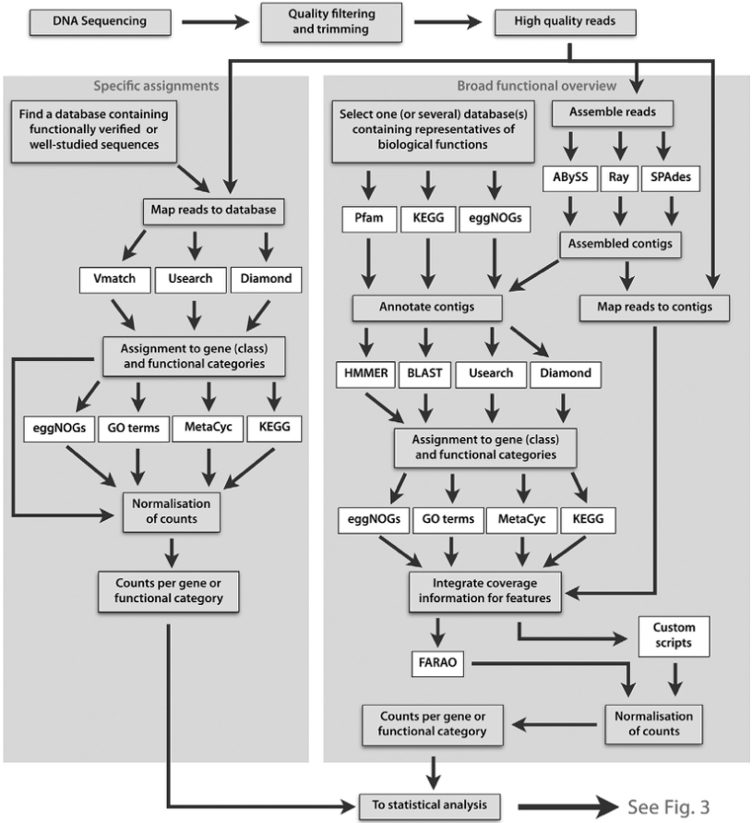
Approaches to functional profiling
Bengtsson-Palme, 2018
Broad versus specific profiling
Broad DBs: entire functional universe (e.g. KEGG, PFAM)
Specific DBs: focusing on one or few processes (e.g. CAZy, CARD)

Slide 7
Approaches to functional profiling: how to choose?
Broad databases give an overview of the functional potential of microbial communities
Suitable for investigating major differences across environments
Specific databases are often highly curated and can give substrate-level information
Suitable for investigating e.g. gene variants across environments

Slide 8
Things to pay attention
Curation level of the database
Are sequences verified experimentally to perform the expected function?
Comprehensiveness of the database
Both taxonomic- and functionally
Speed versus sensitivity tradeoff
E.g. BLAST versus DIAMOND
Choice of identity, bitscore/e-value and coverage cutoffs
No way to generalise for all genes, things have to be checked more or less manually, e.g. by looking at the literature for the gene

Slide 9
Always sanity check
Especially for “bold” and unexpected findings:
Redo with more strict thresholds
Redo with a different tool (e.g. BLAST versus DIAMOND)
Investigate other genes belonging to the same pathway

Slide 10
CONTINUE WITH SECTION 3.5

Slide 11
Read- versus assembly-based analyses
Assembly-based analyses
Slow
Less quantitative
Read section 3.3 in Bengtsson-Palme
Quince et al. 2017

Slide 12
MEGAN
DO a walkthrough with one sample
Then they will do the other 4

Slide 13
Other alternatives
Humann
Metaphlan

Slide 14
MEGAN walkthrough
Install MEGAN6 in your computer
https://software-ab.informatik.uni-tuebingen.de/download/megan6/welcome.html
Preparing the data (launched yesterday):
Subsample reads with SEQTK
Sequence similarity against NCBI nr (DIAMOND blastx)
Run MEGAN within the cluster to parse the DIAMOND results against taxonomic (NCBI and GTDB) and functional databases (EC, EGGNOG, INTERPRO2GO, SEED)

Slide 15
MEGAN walkthrough
Let’s do one sample together

Slide 16
Further reading
https://www.nature.com/articles/nbt.3935
https://www.sciencedirect.com/science/article/pii/B9780081022689000033
If you don’t have access to these, let me know
SciHub, cough cough

