Slide 1
CAPSTONE PROJECT 2025
Workplace Incident
Outcome Prediction
Leveraging Machine Learning on OSHA ITA Case Data
to Classify Incident Severity & Support Safety Decisions
Dataset: ITA Case Detail Data 2024 | 686,806 Records
Final Model: LightGBM | Accuracy: 82% | ROC-AUC: 0.952
Capstone Presentation • 25 min

Slide 2
Problem Definition
Slide 2
Business Problem
Dataset at a Glance
Workplace incidents cause 683,962 injury records annually. Predicting incident severity helps OSHA & employers deploy prevention resources before harm escalates.
686K+
Total Records
39
Technology Goal
Original Features
Build a multiclass classifier that predicts Incident Outcome (Death / Days Away / Job Transfer / Other Case) from incident features, occupational data & text narratives.
4
Outcome Classes
80/20
Value Additions
Train / Test Split
Proactive risk flagging, early intervention for high-severity cases, data-driven resource allocation, and support for policy decisions.
586
Features After Engineering
Target: incident_outcome (1=Death 2=Days Away 3=Job Transfer 4=Other Case)

Slide 3
Exploratory Data Analysis
Target Variable Distribution
Slide 3
35.7%
Days Away From Work
244,181 cases — most common outcome; employees need recovery time off.
34.0%
Other Recordable Case
232,651 incidents that are recorded but don't require absence or transfer.
30.3%
Job Transfer / Restriction
206,931 cases requiring modified duties or role reassignment.
0.03%
Death (Rare Class)
Only 199 fatalities — extreme class imbalance requiring special handling.
Key Challenge: Severe class imbalance (Death: 199 vs Others: ~230K+) impacts model training

Slide 4
EDA – Industry & Occupation Insights
Slide 4
Key Insights from EDA
California reports the highest incidents, followed by TX & NY — large industrialized states dominate. Physical Injuries account for ~82% of all cases; Respiratory conditions are 2nd, especially COVID-related. Private Industry accounts for ~93% of incidents vs. State/Local Government. Summer months show slightly elevated incident counts — seasonal safety interventions may be warranted.
Healthcare, logistics & warehousing are the highest-risk industries

Slide 5
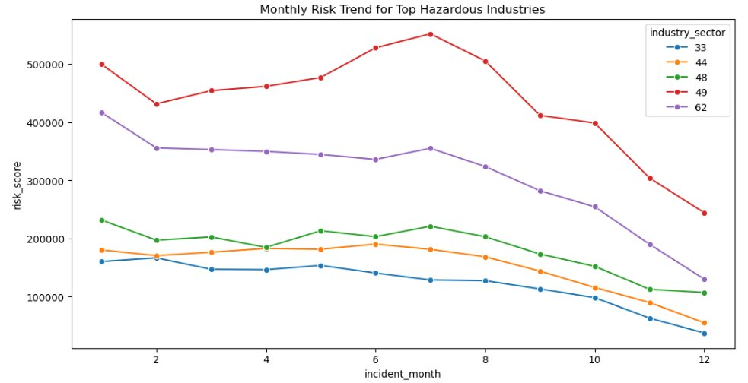
Monthly Risk Trend – Top Hazardous Industries
Slide 5
Key Insights
Transportation (NAICS 49)
Highest risk sector year-round; peaks Jun–Jul (~550K). Courier & delivery surges drive summer spikes.
Healthcare (NAICS 62)
2nd highest; stable ~350–415K Jan–Aug. Patient handling and COVID-related illnesses dominate.
Warehousing (NAICS 48)
Mid-range risk 100–230K; peaks mid-year aligned with peak logistics seasons.
Mfg & Retail (33/44)
Lowest but consistent risk. Manufacturing shows a steady decline through Q3–Q4.
Risk Score = Total Incidents × Avg Severity | All industries show declining risk in Q4 (likely data cutoff effect)

Slide 6
Correlation Heatmap – Numerical Variables
Slide 5
 | size | employees | hours | soc_prob | dafw | djtr | inc_hr | start_hr
size | 1.00 | -0.45 | -0.41 | 0.02 | 0.04 | 0.03 | 0.01 | 0.00
employees | -0.45 | 1.00 | 0.91 | -0.01 | 0.05 | 0.04 | -0.01 | 0.01
hours | -0.41 | 0.91 | 1.00 | -0.01 | 0.06 | 0.05 | -0.02 | 0.01
soc_prob | 0.02 | -0.01 | -0.01 | 1.00 | 0.00 | 0.00 | 0.01 | 0.00
dafw | 0.04 | 0.05 | 0.06 | 0.00 | 1.00 | 0.12 | 0.01 | 0.00
djtr | 0.03 | 0.04 | 0.05 | 0.00 | 0.12 | 1.00 | 0.01 | 0.00
inc_hr | 0.01 | -0.01 | -0.02 | 0.01 | 0.01 | 0.01 | 1.00 | 0.18
start_hr | 0.00 | 0.01 | 0.01 | 0.00 | 0.00 | 0.00 | 0.18 | 1.00
Heatmap Insights
Strong +0.91
annual_average_employees ↔ total_hours_worked
More employees = more hours logged.
Moderate −0.45
size ↔ employees
Size category inversely reflects actual headcount.
Weak +0.18
incident_hour ↔ start_hour
Incidents cluster near shift start times.
Near Zero
Severity metrics (dafw, djtr) are largely independent of establishment size.
Variables related to incident severity show very weak correlation with establishment characteristics

Slide 7
Data Preparation & Feature Engineering
Slide 6
01 Data Cleaning
03 Encoding & Text
▸ Removed 5 identifier columns (id, EIN, case_no…)
▸ Label encoding for high-cardinality categoricals
▸ Dropped 2,844 duplicates & rows with missing SOC codes
▸ Geo-encoding: ZIP → latitude/longitude
▸ Final clean dataset: 683,962 rows × 34 columns
▸ TF-IDF on 5 text narrative columns (NLP features)
02 Feature Engineering
04 Final Feature Space
▸ Extracted: incident_hour, start_hour, hours_after_start, season, shift, is_weekend, incident_day
▸ 586 total features after all transformations
▸ Log-transform: employees, total_hours, soc_probability (reduce skewness)
▸ Sparse[bool] TF-IDF + float64 numeric features
▸ Severity score = dafw_num_away + djtr_num_tr
▸ 80/20 stratified train-test split + StandardScaler
Outlier capping at 99th percentile for employees & hours_worked | Constant column year_filing_for removed

Slide 8
Algorithms Considered
Slide 7
Model | Accuracy | MCC Score | ROC-AUC | Notes
Logistic Regression (Baseline) | 71.7% | 0.580 | 0.892 | Linear; class_weight='balanced'; good baseline
Random Forest (Balanced) | 77.0% | 0.656 | 0.919 | 300 trees, max_depth=12; improved minority class recall
XGBoost | 83.1% | 0.746 | 0.952 | 400 trees; strong boost but similar to LightGBM on rare class
LightGBM ★ BEST | 82.7% | 0.742 | 0.953 | class_weight='balanced'; detected rare class (Death) — chosen final model
Why LightGBM?
Key Limitation
✓ Leaf-wise growth handles high-dim sparse TF-IDF features efficiently ✓ class_weight='balanced' improved rare class (Death) recall to 17% ✓ Fastest training on 547K+ samples with 585 features
✗ Death class (199 samples) remains challenging — 17% recall ✗ Data scarcity, not model weakness — SMOTE or more data needed ✗ High memory usage: 2.7 GB with 586 sparse + dense features
All models trained with class balancing | XGBoost marginally higher accuracy but LightGBM better on rare class

Slide 9
LightGBM – Final Model Results
Slide 8
82%
0.742
0.741
0.953
Accuracy
MCC Score
Cohen Kappa
ROC-AUC
Class | Label | Precision | Recall | F1-Score | Support
0 | Days Away From Work | 0.79 | 0.72 | 0.75 | 48,883
1 | Death (Rare) | 0.35 | 0.17 | 0.23 | 52
2 | Job Transfer / Restriction | 0.70 | 0.77 | 0.73 | 41,226
3 | Other Recordable Case | 0.99 | 0.99 | 0.99 | 46,632
 | Weighted Avg | 0.83 | 0.83 | 0.83 | 136,793
Death class detection improved from 0% (XGBoost) to 17% recall with LightGBM class balancing

Slide 10
Model Performance Comparison
Slide 9
Final Selection
LightGBM
82%
Accuracy on 136K test samples
0.953
Highest ROC-AUC score
0.742
Strong MCC (balanced classes)
17%
Recall on rare Death class
Fastest
Training among tree models
LightGBM selected for best balance of accuracy, rare-class detection, and computational efficiency

Slide 11
Conclusions & Path to Production
Slide 10
✔ 82% Accuracy Achieved
✔ Feature Engineering Matters
LightGBM successfully classifies incident severity across 136K+ test records with weighted F1 of 0.83.
TF-IDF on incident narratives, geo-encoding, and temporal features significantly boosted model performance.
✔ Rare Class Detection
→ Future Work
Death class (199 samples) detected at 17% recall — a major improvement over baseline models that predicted 0 deaths.
SMOTE / oversampling for rare class, hyperparameter tuning, SHAP explanations, real-time API deployment via FastAPI.
Save Model (Pickle/ONNX)
FastAPI Endpoint
Docker Container
OSHA Dashboard
Monitoring & Retrain

Slide 12
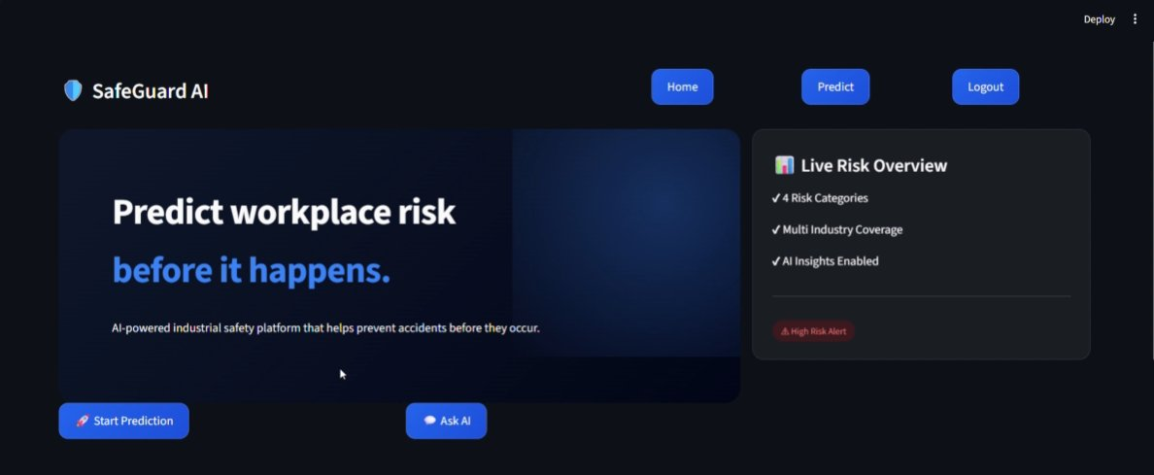
SafeGuard AI – Production Application
Slide 12
App Features
🚀 Start Prediction
Input incident details and get instant outcome classification from the LightGBM model.
💬 Ask AI
Conversational interface for safety queries and incident risk assessment.
📊 Live Risk Overview
Real-time dashboard showing risk categories, multi-industry coverage & AI insights.
⚠️ High Risk Alerts
Automated flagging of high-severity incidents for immediate safety intervention.
Built with React + FastAPI | LightGBM backend | Deployed as containerized microservice

Slide 13
Thank You!
Workplace Incident Outcome Prediction • LightGBM • 82% Accuracy
Questions & Discussion
10 minutes Q&A
Dataset: ITA Case Detail Data 2024 | OSHA | Model: LightGBM (Gradient Boosting) | Records: 683,962 cleaned

