Slide 1

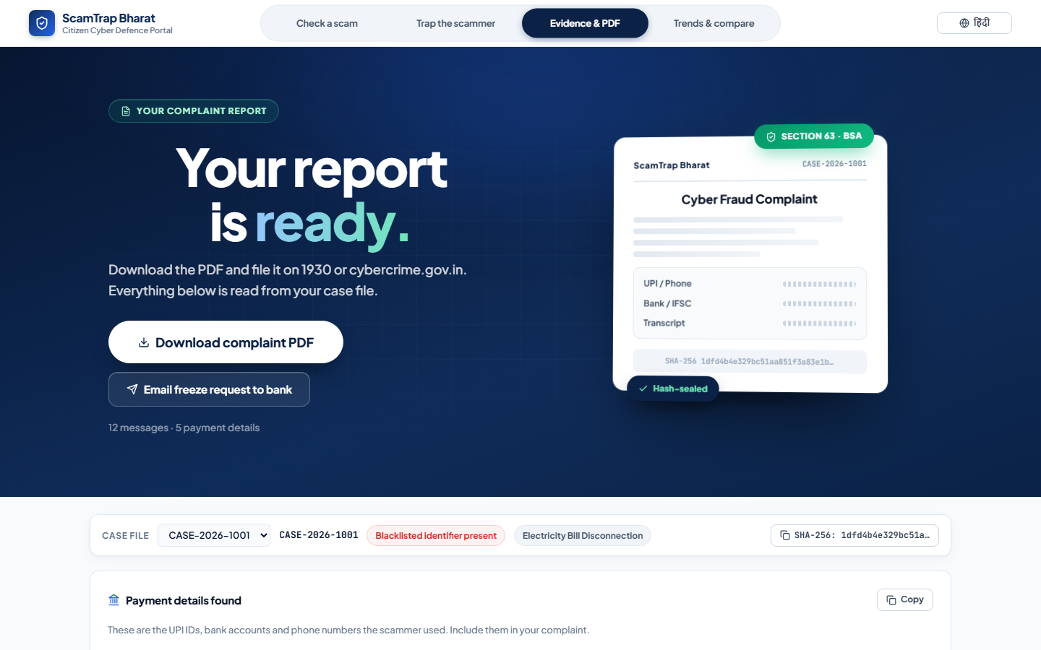
HACK FOR SOCIAL CAUSE 2027 · MoYAS × IIT BOMBAY
ScamTrap Bharat
India's First Active Pre-Fraud Interception Engine
Theme
Cyber Safety & Digital Fraud Prevention
Team Name
Team Valora
Team ID
HSC|RJ|00111
State / UT
Rajasthan
Institution
Apex Institute of Engineering & Technology, Jaipur
₹22,495 Cr
lost by Indians to cyber-fraud in 2025 · 28.15 lakh complaints

Slide 2
Team
Valora
Problem – Proposed Solution
🔴 The Problem
🟢 Our Solution — ScamTrap Bharat
Indians lost ₹22,495 Cr in 2025 to cyber-fraud (28.15 lakh complaints, +24% YoY)
76% = investment / digital-arrest scams — victims pay over DAYS
Elderly, first-time digital users, rural populations are most affected
Existing tools fail because they are REACTIVE:
• Truecaller — flags numbers AFTER money is gone
• Sanchar Saathi — SIM revocation takes days
• 1930 helpline — only works if victim reports FAST
NO tool in India intercepts the scam BEFORE the victim pays.
4-tab offline-first cyber safety portal that intercepts scams BEFORE payment:
🔍 Check a Scam — instant rules-engine scoring of UPI / phone / text
🤖 AI Honeypot — offline LLM baits scammers into revealing mule accounts
📄 Evidence & PDF — one-click NCRP complaint with SHA-256 hash + Sec 63 BSA
📊 Trends & Compare — real I4C / NCRP / IC3 data, India vs World
Innovation & Uniqueness:
✓ ONLY tool in India that catches scams BEFORE money moves
✓ 100% offline — works on any laptop without internet or cloud
✓ AI decoy actively baits scammers to expose their mule network
✓ Court-admissible evidence with cryptographic integrity
THE GAP: Pre-fraud interception — not post-facto recovery
India — Cyber-fraud losses (₹ Cr)
2023
15.6K
2024
22.8K
2025
22.5K
@HSC submission - Team Valora

Slide 3
Team
Valora
Technical Approach
Backend
AI Engine
Frontend
PDF
WhatsApp
FastAPI
+ SQLite
Ollama
(deepseek-r1)
Vanilla JS
+ CSS system
ReportLab
+ SHA-256
whatsapp
-web.js
Implementation Flow
INPUT
ANALYZE
DECOY
EVIDENCE
WhatsApp text
UPI / Phone / QR
Screenshot
→
5-layer rules
entity extraction
risk scoring
→
offline LLM
Hinglish persona
mule extraction
→
NCRP PDF
SHA-256 hash
Sec 63 BSA
Repository & Resources
GitHub:
github.com/VikashJakhar444/ScamTrap_Bharat
README with setup steps & env variables
Architecture docs, sample data, test cases (6/6 passing)
MIT License — fully open-source
🤖 Extent of AI Tool Usage
✓ Scam Detection — NO AI (deterministic rules-engine)
✓ Decoy Chat — Ollama offline LLM (primary, ~15% of codebase)
✓ Cloud Fallback — Groq / Gemini (optional, off by default)
✓ PDF / Evidence — NO AI (template-based ReportLab)
✓ Trends Dashboard — NO AI (official govt data)
— working prototype available at GitHub repository
@HSC submission - Team Valora

Slide 4
Team
Valora
Impact Potential
₹22,495 Cr
76%
₹60+ Cr
10 Cr+
Annual loss to
Indian citizens
Scams are pre-payment
(interception window)
Lost every single day
without interception
Potential beneficiaries
(elderly + rural users)
Impact on Target Audience
Stakeholders
👵 Elderly Citizens — verify suspicious calls/texts before paying
👩‍💻 First-time digital users — instant second opinion
🏠 Rural populations — works offline, no internet needed
👨‍💼 Professionals — AI honeypot traps scammers
👨‍🚒 State Police & Cyber Cells — ready-to-file evidence
🏥 Banking & Fintech — real-time fraud alerts integration
🏫 Schools & Colleges — digital literacy programs
👥 NGOs & Consumer Rights — awareness campaigns
🇮🇳 Government (I4C / NCRP) — citizen reporting layer
Benefits
💰 Economic — saves crores by preventing fraud before payment
🏛 Social — builds digital trust, protects vulnerable communities
⚖ Legal — court-admissible evidence, faster police action
🌍 National — reduces burden on 1930 helpline & cyber cells
🚀 Scalability
• Runs on ANY laptop — no server, no cloud, no cost
• Offline-first — works in rural / low-connectivity areas
• Open-source — state police can fork & deploy independently
• Multi-language — English + Hindi, extensible to 24 official languages
• Docker-ready → 1-click cloud deploy (AWS/GCP free tier)
• Phase-wise rollout: Local → Cloud → Android app → NCRP API → National (24 languages)
@HSC submission - Team Valora

Slide 5
Team
Valora
Feasibility and Risk Analysis
✅ Feasibility
⚠️ Potential Challenges & Risks
Technical — All components built & tested (6/6 smoke tests passing):
• FastAPI backend + SQLite — lightweight, runs on any laptop
• Ollama offline LLM — free, no API keys needed for core
• ReportLab PDF — deterministic, no AI dependency
Operational — Zero cost to run, offline-first design:
• No cloud hosting required — runs locally
• No internet needed for core detection (rules engine)
• MIT licensed — anyone can deploy without permission
1. Scammer adaptation — scammers may change tactics
→ Mitigation: Regular pattern updates from community reports
2. WhatsApp ban risk — bridge may trigger ToS detection
→ Mitigation: Secondary phone number, session rotation
3. False positives — legitimate UPI IDs flagged as risky
→ Mitigation: Explainable scoring, user feedback loop
4. Legal compliance — evidence admissibility in court
→ Mitigation: SHA-256 hash + Section 63 BSA compliance built-in
🛠 Deployment & Scaling Roadmap
✓ Community-driven pattern database — users report new scam formats, rules engine auto-updates
✓ Multi-layer AI fallback — rules engine works even if LLM unavailable (zero AI dependency for detection)
✓ Incremental rollout — start with state police pilot, then scale to national deployment
✓ Legal review — Section 63 BSA compliance built into PDF generation from day one
@HSC submission - Team Valora

Slide 6
Team
Valora
Team
V
Vikash Jakhar
A
Anisha Kuldeep
N
Navnit Kumar
Team Leader
Member
Member
Apex Institute of Engineering
& Technology, Jaipur
Rajasthan Institute of
Engineering & Technology, Jaipur
Apex Institute of Engineering
& Technology, Jaipur
B.Tech Cybersecurity · 3rd Year
B.Tech CSE · 3rd Year
BCA Cyber Security & Forensic · 3rd Year
Role:
Role:
Role:
Full-stack development, rules & AI engine architecture, team management and security implementation.
UI/UX design, frontend support, user testing
and PPT design.
Cybersecurity research, scam pattern analysis, WhatsApp bridge and Integration testing.
Challenges & Journey
🔥 Making the AI decoy convincing enough in natural Hinglish — solved with persona prompt engineering and local Ollama fine-tuning
🔧 Ensuring offline-first architecture without sacrificing functionality — every feature has a no-AI fallback path
📄 Generating court-admissible PDFs with cryptographic integrity — SHA-256 hashing + Section 63 BSA compliance built in
🌐 Bridging the language gap — 519 translation keys for Hindi + English, designed for 24-language expansion
Journey: Built in 48 hours by 3 cybersecurity students who saw their own relatives fall victim to scams. ScamTrap Bharat is our answer — technology that protects the people we love.
@HSC submission - Team Valora

Slide 7
Team
Valora
References
Government Sources:
• Ministry of Home Affairs (MHA) — NCRP / I4C Cyber-fraud data, Lok Sabha reply July 2026
→ https://www.mha.gov.in | https://cybercrime.gov.in | https://i4c.mha.gov.in
• CFCFRMS (Centralised Fraud Cyber Financial Risk Management System) — 1930 helpline data
→ https://www.cybercrime.gov.in (32.8 lakh complaints till Jun 2026)
International Sources:
• FBI Internet Crime Complaint Center (IC3) — 2025 Internet Crime Report
→ https://www.ic3.gov ($20.9B reported losses, 859,532 complaints in 2025)
Technical References:
• Ollama — Local LLM framework for offline AI deployment | https://ollama.ai
• ReportLab — Python PDF generation library | https://www.reportlab.com
• whatsapp-web.js — WhatsApp Web API for Node.js | https://wwebjs.dev
• FastAPI — High-performance Python web framework | https://fastapi.tiangolo.com
UN SDG Alignment:
• SDG 16 — Peace, Justice and Strong Institutions (Target 16.4: reduce illicit financial flows)
• SDG 9 — Industry, Innovation and Infrastructure (digital trust infrastructure)
@HSC submission - Team Valora

