Slide 1
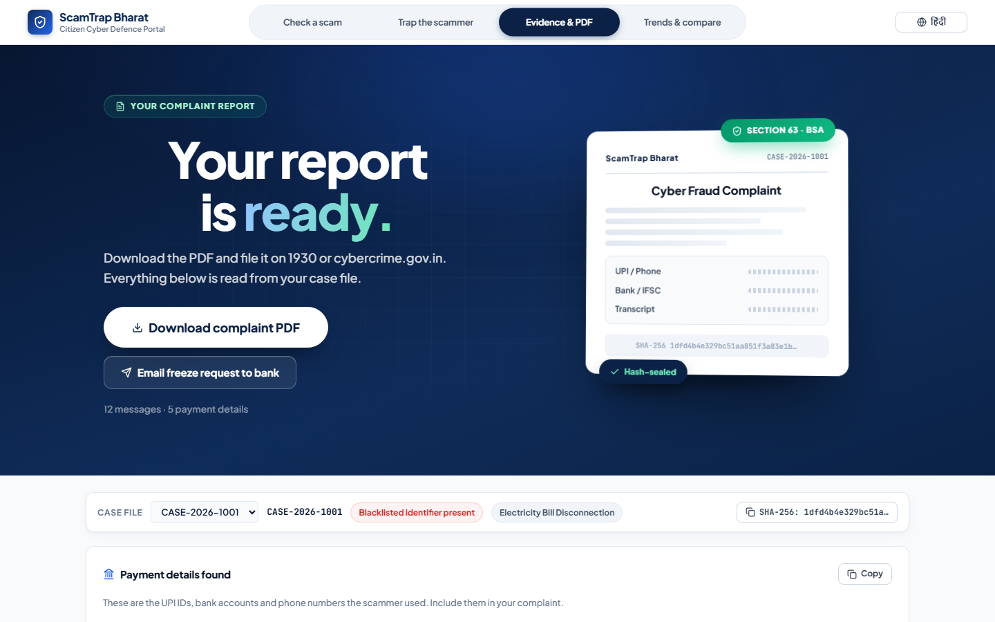
HACK FOR SOCIAL CAUSE 2027 · MoYAS × IIT BOMBAY
ScamTrap Bharat
India's First Active Pre-Fraud Interception Engine
₹22,495 Crore
lost by Indians to cyber-fraud in 2025 · 28.15 lakh complaints · +24% YoY
76% = investment scams · victims pay over DAYS · nobody intercepts BEFORE payment
MIT License · Open Source · github.com/VikashJakhar444/ScamTrap_Bharat

Slide 2
The Problem: India's Anti-Fraud System is REACTIVE
Every existing tool acts AFTER the money is gone. Nobody stops the payment before it happens.
India — Cyber-fraud losses reported per year (₹ Cr)
Truecaller
Reactive tagging
2021
₹5,500
Flags numbers AFTER victims lose money. No UPI/bank awareness.
2022
₹10,300
Sanchar Saathi
Days-to-weeks
2023
₹15,600
SIM revocation takes days of manual review. Money already moved.
2024
₹22,845
2025
₹22,495
1930 Helpline
Post-facto recovery
Works only if victim reports FAST. Most don't know they're being scammed.
Source: NCRP / I4C — MHA Lok Sabha reply, Jul 2026
THE GAP: No tool intercepts the scam BEFORE the victim sends money.
Victims of investment / digital-arrest scams voluntarily transfer money over DAYS. By the time they realise, mule accounts have layered funds across 5+ accounts.
▶ ScamTrap Bharat attacks the problem BEFORE the payment.

Slide 3
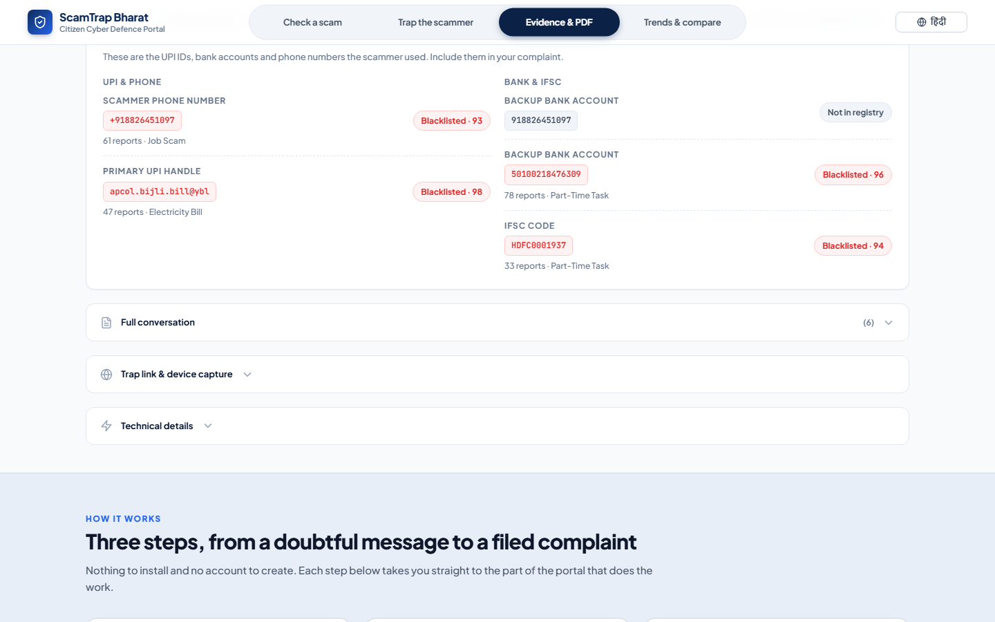
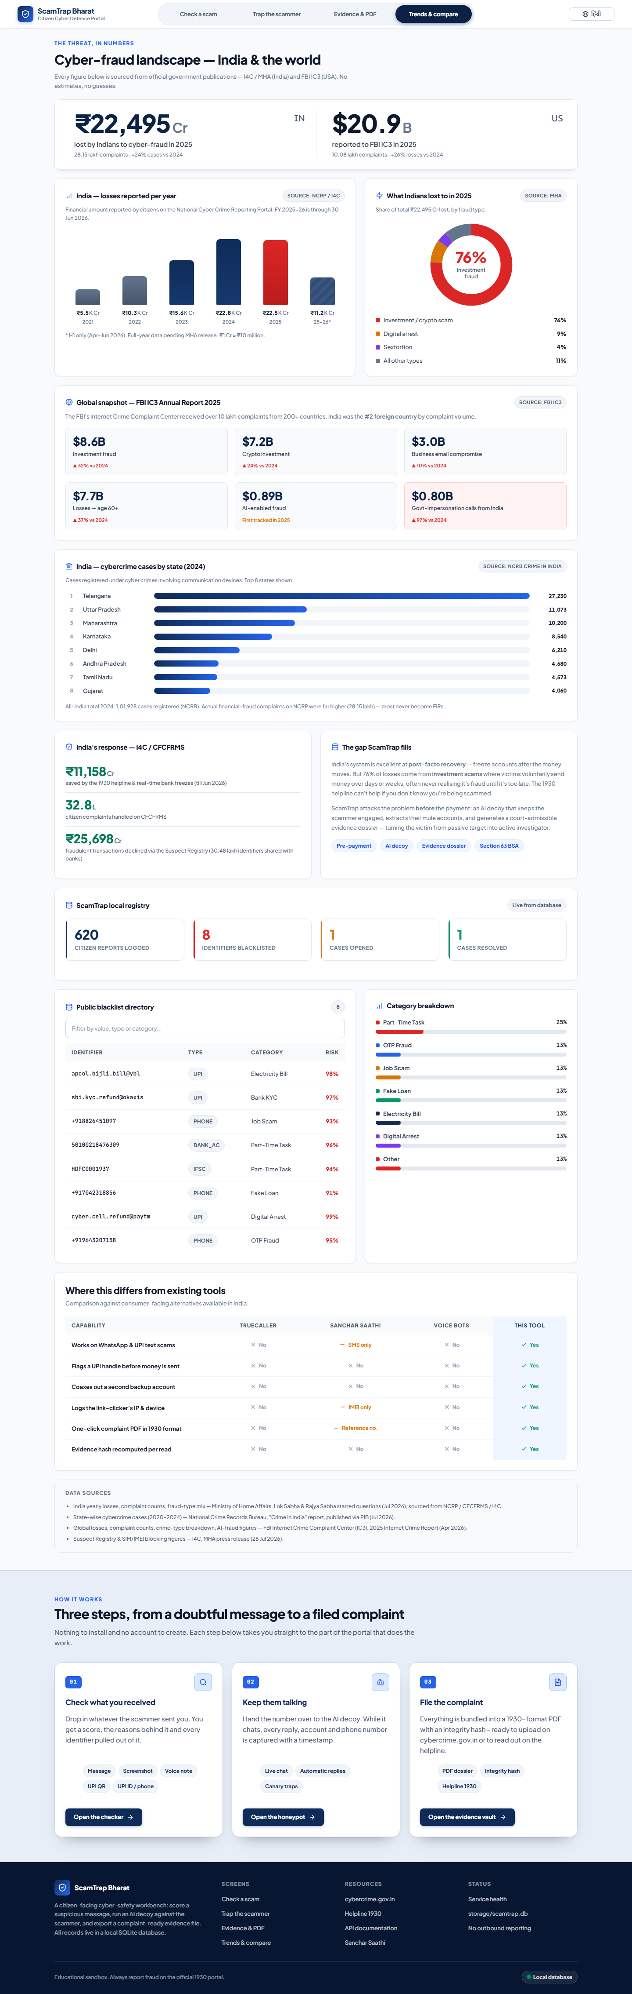
Solution: 4-Tab Citizen Cyber Safety Workbench
Score → Trap → Evidence → Trends. Every step local, every step offline-capable.
🔍 Tab 1
Check a Scam
Rules-engine scoring of UPI IDs, phones, bank accounts, WhatsApp text. 5-layer risk analysis with explainable principles.
Zero AI · deterministic · instant
🤖 Tab 2
AI Honeypot Co-Pilot
AI decoy engages scammer in Hinglish, baits them into revealing secondary mule accounts, IFSC codes, beneficiary names.
Ollama offline · cloud optional · rules fallback
📄 Tab 3
Evidence & PDF
1-click NCRP-format complaint PDF with SHA-256 hash, Section 63 BSA certificate, kill-chain visualisation, freeze-request draft.
ReportLab · court-admissible · hash-sealed
📊 Tab 4
Trends & Compare
Real national data (I4C / NCRP / FBI IC3). India vs World, state hotspots, gap analysis vs Truecaller / Sanchar Saathi.
Official govt sources · cited · no estimates

Slide 4
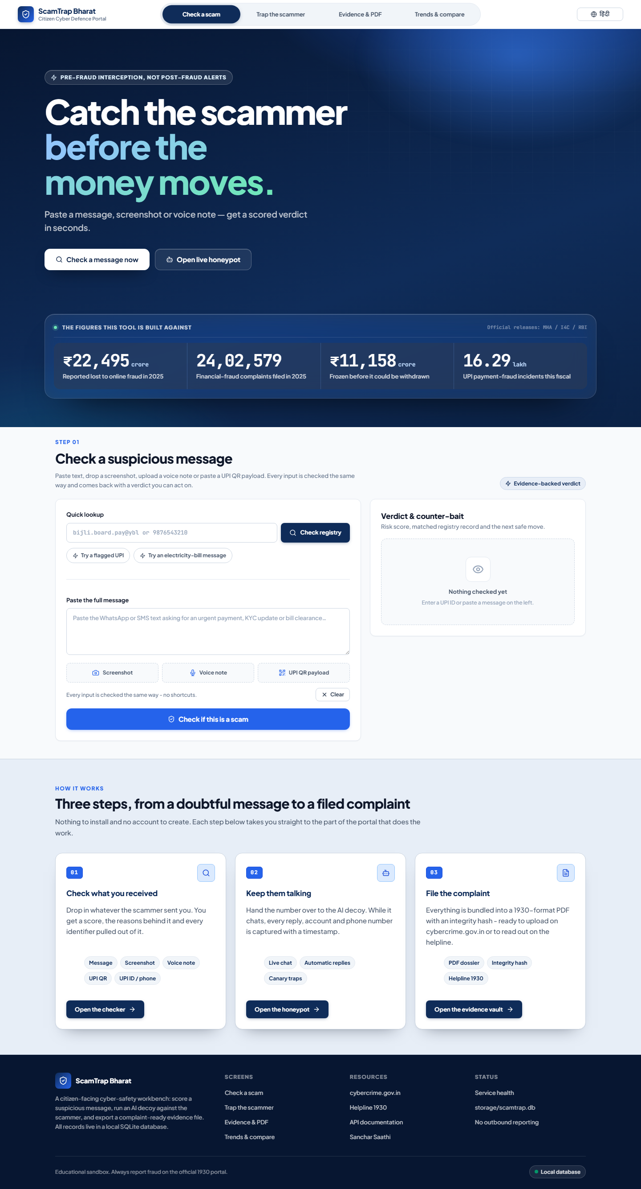
Architecture: Offline-First, Zero-Dependency Core
Works without internet, without API keys, without any cloud service.
INPUT
RULES ENGINE
AI DECOY
EVIDENCE
WhatsApp text
UPI / Phone / QR
Screenshot
Voice note
5-layer scoring
Pattern matching
Entity extraction
Risk scoring
Ollama offline LLM
Groq/Gemini fallback
Hinglish persona
Mule extraction
NCRP PDF
SHA-256 hash
Sec 63 BSA cert
Freeze draft
→
→
→
Tech Stack
Live Application
Backend
FastAPI + SQLite
Frontend
Vanilla JS + CSS design system
AI
Ollama (deepseek-r1) · Groq · Gemini
PDF
ReportLab + SHA-256 integrity
WhatsApp
whatsapp-web.js 2-phone bridge
i18n
English + Hindi (519 keys)

Slide 5
Impact & Scalability
₹22,495 Cr
76%
₹11,158 Cr
32.8 L
Lost by Indians
cyber-fraud 2025
Investment scams
(pre-payment)
Saved by 1930 helpline
(AFTER report)
CFCFRMS complaints
till Jun 2026
What Indians Lost To (2025)
Why ScamTrap Changes the Game
• India excels at POST-FACTO recovery — but 76% losses are PRE-payment
• 1930 can't help if victim doesn't know they're being scammed
• ScamTrap intercepts BEFORE payment — unique in India
Investment / crypto
Digital arrest
Sextortion
All others
India — Top Cybercrime States (2024)
Telangana
27,230
Scalability
Uttar Pradesh
11,073
Maharashtra
10,200
• Runs on ANY laptop — no server, no cloud
• Offline-first — works in rural / low-connectivity
• Open-source — state police can fork & deploy
• Multi-language — English + Hindi, extensible
Karnataka
8,540
Delhi
6,210
Sources: MHA / NCRP / I4C (Lok Sabha reply Jul 2026) · FBI IC3 2025 Annual Report

Slide 6
Implementation & AI Disclosure
HSC 2027 requirement: all AI tool usage disclosed with proportion estimate.
Implementation Status
🤖 AI Tool Disclosure
✓ 4-tab web portal (fully functional)
✓ Rules-engine scam detection (5 layers)
✓ AI decoy conversation (offline LLM)
✓ 1-click NCRP PDF with SHA-256 hash
✓ WhatsApp 2-phone honeypot bridge
✓ English + Hindi (519 i18n keys)
✓ MIT License, fully open-source
✓ 6/6 automated smoke tests passing
✓ Real government data (I4C/NCRP/IC3)
Scam Detection
NO AI — deterministic rules-engine
Decoy Chat
YES — Ollama offline LLM (primary)
Cloud Fallback
Groq / Gemini optional, off by default
Image OCR / QR
Gemini vision (optional) + OpenCV
Audio STT
Gemini (optional), graceful degradation
PDF / Evidence
NO AI — template-based ReportLab
Trends Dashboard
NO AI — official govt data
Proportion of AI-assisted work: ~15% (decoy conversation engine only).
All detection, evidence generation, and analytics are deterministic and offline-capable. No user data is sent to third-party AI services in default (offline) mode.

Slide 7
Team & Vision
V
Vikash Jakhar
A
Anisha Kuldeep
N
Navnit Kumar
Team Leader
Member
Member
Apex University, Jaipur
Rajasthan Institute of Engineering & Technology, Jaipur
Apex University, Jaipur
B.Tech Cybersecurity · 3rd Year
B.Tech CSE · 3rd Year
BCA Cyber Security & Cyber Forensic · 3rd Year
Roadmap
NOW
Phase 1
Phase 2
Phase 3
Working prototype
4 tabs, offline-first
MIT licensed
State police pilot
NCRP API integration
Regional languages
Mobile app (Android)
Bank partnership for
real-time freeze
National rollout
24 official languages
API for NGOs
The Cost of Inaction
Every day without pre-fraud interception, Indians lose ₹60+ crore. ScamTrap turns every citizen from a passive target into an active investigator.
github.com/VikashJakhar444/ScamTrap_Bharat
Hack for Social Cause 2027 · MIT · Open Source

