Slide 1

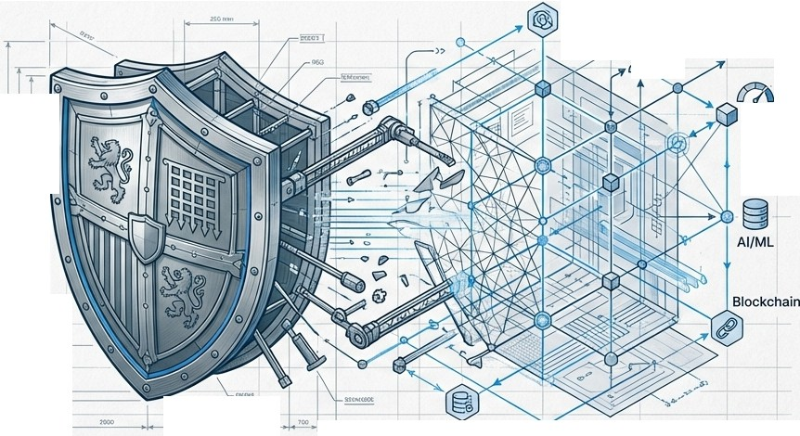

The Evolution of Integri
Navigating AML/CFT Compliance, De-Risking, and the Shift to Perpetual KYC
AML/CFT
�KYC
Risk
0
•
.... ....
1.
Data
PREPARED FORFINANCIAL COMPLIANCE STRATEGY LEADERS.
Isl\ NotebookLM

Slide 2

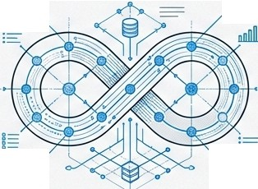

From Static Compliance to Dynamic Integrity
The Mandate The Friction
The Solution
·•-
-
o-
0⁻-
0
+
+
··•--_{-·}·
·_{·-}-
- [c,..,-------•
European regulators (NBB, DNB) demand robust, risk-based AML/CFT frameworks that do not compromise financial inclusion.
Traditional 'tick-box' compliance is failing. It creates operational bottlenecks, talent shortages, and leads to categorical
'de-risking' rather than true risk management.
+
Moving from periodic review to Perpetual KYC (pKYC)-leveraging data and technology to ensure continuous compliance and operational efficiency.
I'S\ NotebookLM

Slide 3
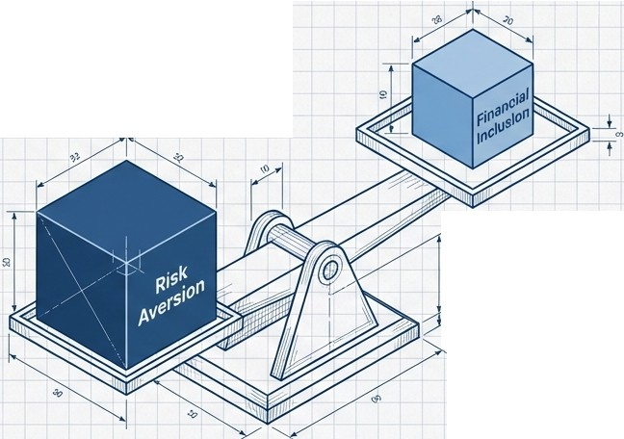

n,
The 'De-Risl<ing' Dilemma: A Failure of Management.
BanqueNationaleBank
OEBELGIQUE VANBELGIE
Eurosystem
NBB Warning:
De-risking-refusing business based on category rather than individual risk-suggests
"ineffective management" of ML/FT risks.
Societal Duty: Banks must balance AML duties with Financial inclusion, Contractual freedom, and Economic development.
al
.,
"Rejection without individual assessment is a sign of inadequate implementation of AML obligations."
Isl\ NotebookLM

Slide 4

Five Operational Challenges Stifling Financial Institutions
5. Obsolete Methods: The urgent need to move from periodic reviews to pKYC.
1. Negative Experience: Onboarding takes up to 100 days; 13% of corporates switch banks due to friction (Thomson Reuters).
4. Regulatory Flux:
6AMLD and increasingly
stringent rules.
2. Outreach Friction: Inefficient email exchanges and lack of alignment on requirements.
3. Talent Shortage: 15% of workforce in KYC; shortage of skilled analysts
Isl\ NotebookLM

Slide 5
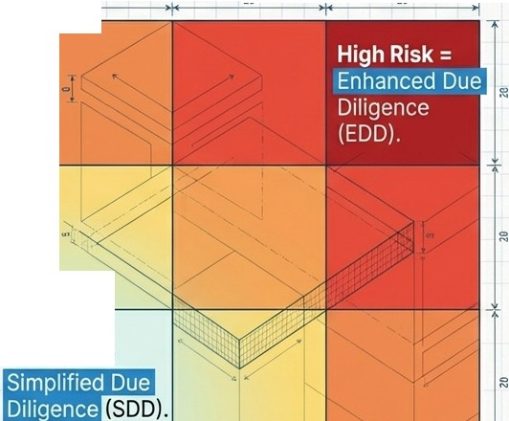
n,
The Risl<-Based Approach (RBA). One Size Does Not Fit All.
32
BanqueNationaleBank
DEBELGIQUE VANBELCIE
Eurosystem
28
20
- Core Principle: Institutions determine mitigation strategies based on their own risk assessment.
- The Reality: "Residual risk" is accepted; zero risk is impossible.
....,
u
ro
c..
₋E
- DNB Good Practice: Classify customers based on characteristics (sector, geography, product) to apply appropriate diligence measures.
Low Risk=
Likelihood
Isl\ NotebookLM

Slide 6
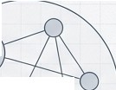
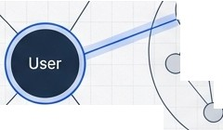
Customer Due Diligence: Beyond the Check-Box.
Identity (Static). Nature (Contextual).
�� | §25 | r:: ₋ L.! ^{u '} | - _{�-} ,_{f}§_{t}.@ - - :'.J O I,�6� -·\_'). <<<<<<<<<<<<<
 |  |  | <<<<<<<<<<<<<
Students
Peer Group
Sm.all
'-- ,,Business
Identity must be verified through reliable, independent sources.
Name-number check (e.g., 1 cent transfer) is insufficient on its own.
Purpose & Nature: Understanding WHY the relationship exists.
Technique: Use Reference Groups to determine if behavior fits the standard profile (e.g., "Students", "Small Business").
DNB Good Practice: Remote Identification solutions require specific policies detailing which steps are autonomous vs human intervention.
Isl\ NotebookLM

Slide 7

Architectural Editorial
BanqueNationale deBelgiqueti'
Bank vanBelgie
£urosys,tcm
Unmasking the UBO (Ultimate Beneficial Owner)
,,... The Legal Entity
The Layered Trap: Criminals hide behind complex, multi-layered international structures.
,₋...··-···.
''.\...-·-·>
The Pseudo-UBO: If no UBO is found, Senior Executives are designated.
'·
<-······-··
\
,
:
\
\.····--·····.·
'
\
,
Institutions must document the measures taken and difficulties encountered.
'•...
The UBO Structure (>25% ownership or Effective Control)
I'S\ NotebookLM

Slide 8






Transaction Monitoring: The Pulse of Compliance.
Stage 1
Pre-transaction
Stage 2
Post-transaction
Stage 3
Feedback Loop
'] i - - ->!
-• :,,- t
-
,
/4m'!J-----��
. ,.¼
+
<•----��
Real-time stopping power (e.g., sanction hits)
Pattern recognition (e.g., 'Smurfing' or unusual cash use)
Backtesting & Refinement
DNB Good Practice {Backtesting):
Retrospective analysis of transactions that did NOT generate alerts (false negatives).
Analysis of rules that generate excessive false positives.
Isl\ NotebookLM

Slide 9

Architectural Editorial
Banque Nationale �
r- Euro,ysttm
de Belgique �
Bank vanBelgie
Enhanced Due Diligence: PEPs & High-Risk Countries
Senior Management Approval Framework
l�.8,: � Senior Management
Senior management must sign
f-- off on high-risk relationships and receive regular reporting
r =- Sign-Off
-f====::;:::====-'--4-
 | High-Risk Third Countries (HRTCs)
 |  | Strict enhanced monitoring requir
0
Politically Exposed Persons (PEPs)
C')
Not automatically unacceptable.
Requires Source
of Wealth check.
ed.
1/-.::
Risk
'-----< :< Identification >.>---✓
�,,
Relationship Initiation
Isl\ NotebookLM

Slide 10


The Paradigm Shift: From Periodic to Perpetual.
The Old Way (Periodic Review)
R
"
-
-
wn
-
I
"'\.
Unkno
Risk Exposure
'/
- ..
/
I
'
,₋
/
-
-
'"-
'
Year1
Year 2
Year3
Year 4
Year 5
Potential savings by automating the end-to-end review process (CoorplD).
The New Way (pKYC)
 |  |  |  |  |  |  |  | •
 |  |  | ,:=j' Contin ' us Risk' anage ' ent uo M m - ⁻ -- |  |  |  |  | I
 |  |  | - -
 |  |  |  |  |  |  | '
Year1
Year 2
Year 3
Year 4
Year 5
I'S\ NotebookLM

Slide 11







Defining Perpetual
•
•
•
•
Digital Profiles
External Data Sources
Real-time Alerts
Continuous monitoring of customer profiles to validate information and identify changes immediately.
Efficiency Gain: Moving from 'Reviewing Everyone' to 'Reviewing Exceptions' (Material Changes only).
()Encompass
Isl\ NotebookLM

Slide 12















Six Pillars of a Strong pKYC Program.
<@>
·····b_
_:-I\��·
lh�
{�
Explainability
No "black box" Al.
Regulators must understand the algorithm.
Human Judgment
Tech reduces manual effort but does not replace oversight.
Residual Risk Management
Mitigating bad data ingestion.
@I� ?
097
0➔y0
0-0@}
Model Risk Management
Validation and "effective challenge" of models.
•••
fml.-v'V°I
@!➔�➔@!
§]�cg
Metrics
@I�
Data Governance
Lineage and provenance are critical.
Demonstrating effectiveness (e.g., faster alerts-to-SARs ratio).
Source: Capgemini / Encompass
Isl\ NotebookLM

Slide 13
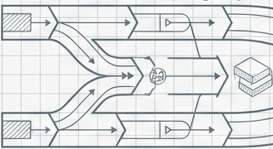


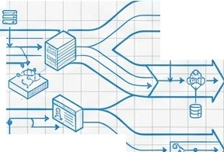
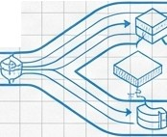
The Transition Phase: Strategic Co-Existence
Periodic Review (Legacy)
" Medium Term: /'
/
Co-existence '\i
pKYC (Future)
Q &
& + � �
Q
Strategy:
Start with high-quality data segments.
Run parallel models to build trust.
Increase pKYC coverage incrementally.
eEncompass
Isl\ NotebookLM

Slide 14





Conclusion: Compliance as Competitive Advantage
Integrity First:
Preventing financial crime, not just satisfying regulators.
Invest in pKVC:
The solution to talent shortages and efficiency cri•ses.
No More De-Risking: Use data to manage risk, not exclude customers.
Responsible Innovation is the expectation of the modern regulator.
Isl\ NotebookLM

