Slide 1

EditEdit MasterMaster texttext stylesstyles
Practical Lecture :Array

Slide 2

Quick Recap
Let’s take a quick recap of previous lecture –
A)
B)
C)
D)
E)

Slide 3
Today’s Agenda
Today we are going to cover -
Array.
Array declaration and accessing array.
Advantage and Disadvantage of Array.
Multidimentional array
Accessing Multidimensional Array
Array Object

Slide 4
C++
Let’s Get Started-

Slide 5
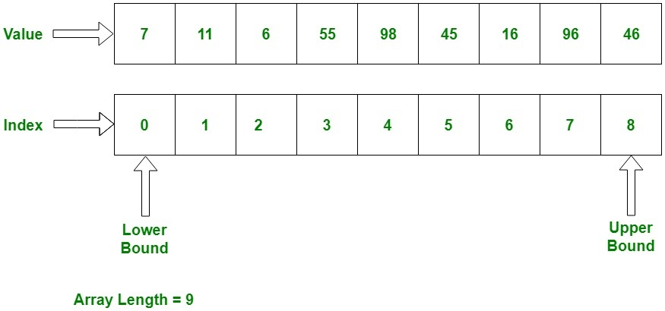
Array
An array is a collection of similar items stored in contiguous memory locations. In programming, sometimes a simple variable is not enough to hold all the data. For example, let's say we want to store the marks of 500 students, having 500 different variables for this task is not feasible, we can define an array with size 500 that can hold the marks of all students

Slide 6
Declaring array
Method 1:-int arr[5];
arr[0] = 10;
arr[1] = 20;
arr[2] = 30;
arr[3] = 40;
arr[4] = 50;
Method 2:-
int arr[] = {10, 20, 30, 40, 50};
Method 3:-
int arr[5] = {10, 20, 30, 40, 50};

Slide 7
Accessing Array
#include <iostream>
using namespace std;
int main(){
int arr[] = {11, 22, 33, 44, 55};
cout<<arr[0]<<endl;
cout<<arr[1]<<endl;
cout<<arr[2]<<endl;
cout<<arr[3]<<endl;
cout<<arr[4]<<endl;
return 0;
}

Slide 8
Advantage of Array
Random access of elements using array index.
Use of less line of code as it creates a single array of multiple elements.
Easy access to all the elements.
Traversal through the array becomes easy using a single loop.
Sorting becomes easy as it can be accomplished by writing less line of code.

Slide 9
Disadvantage of Array
Allows a fixed number of elements to be entered which is decided at the time of declaration. Unlike a linked list, an array in C is not dynamic.
Insertion and deletion of elements can be costly since the elements are needed to be managed in accordance with the new memory allocation.

Slide 10
Array Rotation
Write a program of array rotation .
Input array:-
1 2 3 4 5 6
The rotation of array by one will make :-
2 3 4 5 6 1
Input array:-
1 2 3 4 5 6
The rotation of array by two will make :-
3 4 5 6 1 2

Slide 11
Move all zeroes to end of array
Input : arr[] = {1, 2, 0, 0, 0, 3, 6} Output : 1 2 3 6 0 0 0 Input: arr[] = {0, 1, 9, 8, 4, 0, 0, 2, 7, 0, 6, 0, 9} Output: 1 9 8 4 2 7 6 9 0 0 0 0 0

Slide 12
Multidimensional Array
General Syntax:
type name[size1][size2]...[sizeN];
Eg.
int arr[3][2];

Slide 13
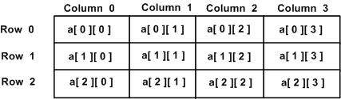
Multidimensional Array
Two Dimensional Array:
General Syntax:
type arrayName [ x ][ y ];
Eg.
int arr[3][4];
column
rows

Slide 14
Multidimensional Array
Initializing 2D arrays:
int a[3][4] = { {0, 1, 2, 3} , /* initializers for row indexed by 0 */
{4, 5, 6, 7} , /* initializers for row indexed by 1 */
{8, 9, 10, 11} /* initializers for row indexed by 2 */ };

Slide 15
Accessing Multidimensional Array
Takes Element from the 4th column
a[2][3]
Takes Element from the 3rd row

Slide 16
Accessing Multidimensional Array
Suppose there is a class:
Class c1{
int a[5][7];
};
It has an Object:
c1 obj1;
obj1.a[2][3]
Takes Element from the 4th column
Takes Element from the 3rd row

Slide 17
Array of Objects
Suppose there is a class:
class seat{
int id;
int studentid;
};
It has object array:
seat xii_b[10][10];

Slide 18
Array of objects
Takes Element from the 4th column
}
Xii_b[2][3]
Takes Element from the 3rd row
 | 0 | 1 | 2 | 3 | 4 | 5
0
1
2
3
4
5

Slide 19
Program to add two matrix
#include <iostream>
using namespace std;
int main()
{
int r, c, a[100][100], b[100][100], sum[100][100], i, j;
cout << "Enter number of rows (between 1 and 100): ";
cin >> r;
cout << "Enter number of columns (between 1 and 100): ";
cin >> c;
cout << endl << "Enter elements of 1st matrix: " << endl;
// Storing elements of first matrix entered by user.
for(i = 0; i < r; ++i)
for(j = 0; j < c; ++j)
{
cout << "Enter element a" << i + 1 << j + 1 << " : ";
cin >> a[i][j];
}

Slide 20
Program to add two matrix
// Storing elements of second matrix entered by user.
cout << endl << "Enter elements of 2nd matrix: " << endl;
for(i = 0; i < r; ++i)
for(j = 0; j < c; ++j)
{
cout << "Enter element b" << i + 1 << j + 1 << " : ";
cin >> b[i][j];
}
// Adding Two matrices
for(i = 0; i < r; ++i)
for(j = 0; j < c; ++j)
sum[i][j] = a[i][j] + b[i][j];

Slide 21
Program to add two matrix
// Displaying the resultant sum matrix.
cout << endl << "Sum of two matrix is: " << endl;
for(i = 0; i < r; ++i)
for(j = 0; j < c; ++j)
{
cout << sum[i][j] << " ";
if(j == c - 1)
cout << endl;
}
return 0;
}

Slide 22
Program to add two matrix
Enter number of rows (between 1 and 100): 2 Enter number of columns (between 1 and 100): 2 Enter elements of 1st matrix: Enter element a11: -4 Enter element a12: 5 Enter element a21: 6 Enter element a22: 8 Enter elements of 2nd matrix: Enter element b11: 3 Enter element b12: -9 Enter element b21: 7 Enter element b22: 2 Sum of two matrix is: -1 -4 13 10

Slide 23

QNA Time
Any Questions??
Any Questions ??

Slide 24
Thank You!
See you guys in next class.

