Slide 1

EditEdit MasterMaster texttext stylesstyles
Practical Lecture 2: Concepts & Basics of C++ Programming

Slide 2

Quick Recap
Let’s take a quick recap of previous lecture –
A)
B)
C)
D)
E)
F)

Slide 3
Today’s Agenda
Today we are going to cover -
Pointers
Structure
Enum
Union
Practice Questions
Quick Revision

Slide 4
MCQ Questions
Let’s Get Started-

Slide 5
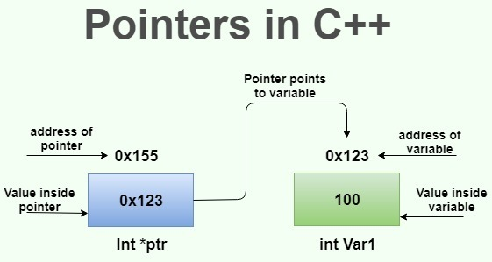
Pointers
Pointers :-The pointer in C++ language is a variable, it is also known as locator or indicator that points to an address of a value.

Slide 6
Pointers
Advantages of Pointers:-
1) Pointer reduces the code and improves the performance, it is used to retrieving strings, trees etc. and used with arrays, structures and functions.
2) We can return multiple values from function using pointer.
3) It makes you able to access any memory location in the computer's memory.

Slide 7
Pointers
#include <iostream>
using namespace std;
int main()
{
int number=30;
int ∗ p;
p=&number;//stores the address of number variable
cout<<"Address of number variable is:"<<&number<<endl;
cout<<"Address of p variable is:"<<p<<endl;
cout<<"Value of p variable is:"<<*p<<endl;
return 0;
}

Slide 8
Output
Address of number variable is:0x7ffccc8724c4
Address of p variable is:0x7ffccc8724c4
Value of p variable is:30

Slide 9
Practice Questions
Write a program to swap two number without using third variable using pointers.

Slide 10
Structure
We often come around situations where we need to store a group of data whether of similar data types or non-similar data types. We have seen Arrays in C++ which are used to store set of data of similar data types at contiguous memory locations.
Unlike Arrays, Structures in C++ are user defined data types which are used to store group of items of non-similar data types.
A structure is a user-defined data type in C/C++. A structure creates a data type that can be used to group items of possibly different types into a single type.

Slide 11
Structure Example
#include <iostream>
#include<string>
using namespace std;
struct Student{
string name;
int stuRollNo;
int stuAge;
};

Slide 12
Structure Example
int main(){
Student s;
cout<<"Enter Student Name: ";
cin>>s.name;
cout<<"ENter Student Roll No: ";
cin>>s.stuRollNo;
cout<<"Enter Student Age: ";
cin>>s.stuAge;
cout<<"Student Record:"<<endl;
cout<<"Name: "<<s.name<<endl;
cout<<"Roll No: "<<s.stuRollNo<<endl;
cout<<"Age: "<<s.stuAge;
return 0;
}

Slide 13
Enum
Enumerated type (enumeration) is a user-defined data type which can be assigned some limited values. These values are defined by the programmer at the time of declaring the enumerated type.
When we assign a float value in a character value then compiler generates an error in the same way if we try to assign any other value to the enumerated data types the compiler generates an error. Enumerator types of values are also known as enumerators. It is also assigned by zero the same as the array. It can also be used with switch statements.

Slide 14
Enum
#include <iostream>
using namespace std;
enum direction {East, West, North, South};
int main(){
direction dir;
dir = South;
cout<<dir;
return 0;
}

Slide 15
Enum
#include <bits/stdc++.h>
using namespace std;
enum year {Jan,Feb,Mar,Apr,May,Jun,Jul,Aug,Sep,Oct,Nov,Dec};
int main()
{
int i;
// Traversing the year enum
for (i = Jan; i <= Dec; i++)
cout << i << " ";
return 0;
}

Slide 16
UNION
#include <iostream>
using namespace std;
struct student1 { // defining a struct
int roll_no;
char name[40];
int phone_number;
};
union student2 { // defining a union
int roll_no;
char name[40];
int phone_number;
};

Slide 17
UNION
int main()
{
struct student1 s1;
union student2 u1;
cout << "size of structure : " << sizeof(s1) << endl;
cout << "size of union : " << sizeof(u1) << endl;
return 0;
}
OutPut:-
size of structure : 48
size of union : 40

Slide 18
UNION
Talking about the above example, the amount of memory required to store a structure is the sum of the memory sizes of all its members. In the above example, the memory sizes of the variables roll_no and phone_number will be 4 bytes each (since both are of type integer) and the memory size of the character array name[40] will be 40 bytes (since the array occupies the memory of 40 characters and the size of char is 1). Thus the memory occupied by the structure will be 4+40+4 = 48 bytes.
Now coming to the union, the memory size of a union is equal to the size of its member occupying the maximum space in the memory. The size of roll_no and phone_number is 4 bytes each and that of name[40] is 40 bytes. So, the union will occupy a memory space of 40 bytes.

Slide 19
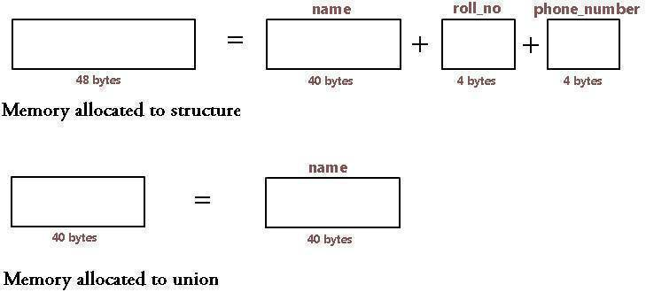
UNION

Slide 20
UNION
Talking about the above example, the amount of memory required to store a structure is the sum of the memory sizes of all its members. In the above example, the memory sizes of the variables roll_no and phone_number will be 4 bytes each (since both are of type integer) and the memory size of the character array name[40] will be 40 bytes (since the array occupies the memory of 40 characters and the size of char is 1). Thus the memory occupied by the structure will be 4+40+4 = 48 bytes.
Now coming to the union, the memory size of a union is equal to the size of its member occupying the maximum space in the memory. The size of roll_no and phone_number is 4 bytes each and that of name[40] is 40 bytes. So, the union will occupy a memory space of 40 bytes.

Slide 21
UNION
We can access only one member of union at a time because we have only one location in memory for it, so only one of the member can be used at a time. All the other members will contain the garbage value (i.e. will get corrupted). This is not the case with structures where we can access all the member's variables at the same time because each occupies a different memory space.

Slide 22

QNA Time
Any Questions??
Any Questions ??

Slide 23
Thank You!
See you guys in next class.

