Slide 1
SMART ATTENDANCE MONITORING SYSTEM
BATCH MEMBERS
1. P. Abirami (953723243001)
2. G.Vikashini (953723243059)
SUPERVISOR
Mr. P. Samayan, M.E, Assistant Professor/ECE

Slide 2
PROJECT OBJECTIVES
To design a real-time ICU patient monitoring system using IoT technology.
To continuously measure patient body temperature using the MLX90614 infrared temperature sensor.
To monitor heart rate (BPM) accurately using the HW-827 pulse sensor.
To collect and process biomedical data using Arduino Mega 2560 as the main controller.
To enable wireless transmission of patient health data using ESP32 Wi-Fi module.
To provide remote access of patient vital signs to doctors and caregivers in real time.
To reduce manual monitoring efforts and improve efficiency in ICU environments.
To ensure early detection of abnormal health conditions through continuous tracking.
To improve patient safety by enabling instant alerts during critical conditions (high fever, abnormal pulse).
To create a cost-effective and scalable IoT-based healthcare monitoring solution.

Slide 3
PROJECT DESCRIPTION
This project is designed to continuously monitor ICU patient vital signs using IoT technology.
It uses MLX90614 infrared temperature sensor to measure body temperature without physical contact.
The HW-827 heart rate sensor is used to detect and monitor the patient’s pulse rate (BPM).
An Arduino Mega 2560 acts as the central processing unit to collect and process sensor data.
The ESP32 Wi-Fi module enables wireless communication of patient health data to a remote server or cloud platform.
Real-time patient data is transmitted so that doctors and medical staff can monitor patients from anywhere.
The system displays continuous readings of temperature and heart rate for effective observation.
If abnormal conditions are detected (high temperature or irregular pulse), the system can be configured to trigger alerts.
The system reduces the need for constant manual checking by healthcare staff.
It improves response time in critical situations by enabling remote and continuous monitoring.
The project provides a low-cost and efficient solution for ICU patient monitoring.
It enhances patient safety by ensuring 24/7 tracking of vital health parameters.

Slide 4
ABSTRACT
This project focuses on developing an IoT-based system for real-time monitoring of ICU patients.
It aims to continuously track critical health parameters such as body temperature and heart rate.
The system uses the MLX90614 infrared temperature sensor for non-contact temperature measurement.
The HW-827 heart rate sensor is used to measure the patient’s pulse rate accurately.
An Arduino Mega 2560 is used as the main controller to process sensor data.
An ESP32 Wi-Fi module enables wireless transmission of health data to remote devices or cloud platforms.
The collected data can be monitored by doctors and healthcare staff in real time.
The system helps in early detection of abnormal conditions like fever or irregular heartbeat.
It reduces manual monitoring efforts and improves efficiency in ICU environments.
Alerts can be generated when vital signs exceed normal thresholds.
The project provides a cost-effective and scalable solution for modern healthcare monitoring.
Overall, it enhances patient safety and enables continuous remote healthcare supervision.

Slide 5
LITERATURE SURVEY: 1
Name of the Paper: | IOT based Patient Monitoring real time
Year of Publish: | 2020
Name of the Authors: | H.-T. Yew, S. K. Chung, M. F. Ng, A. Chekima, S. Z. Ping & J. A. Dargham
Name of the Journal: | IEEE Access
Methodology: | Threshold based inference system
Inferences: | IOT and Wireless network

Slide 6
LITERATURE SURVEY: 2
Name of the Paper: | Intelligent Healthcare monitoring System using ML
Year of Publish: | 2020
Name of the Authors: | Kumar et al.
Name of the Journal: | Remote Patient Monitoring
Methodology: | Machine Learning–based health data analysis
Inferences: | Uses structured vital sign data for smart healthcare monitoring and decision support

Slide 7
LITERATURE SURVEY: 3
Name of the Paper: | IoT Enabled Remote Patient Monitoring for Telemedicine Application
Year of Publish: | 2021
Name of the Authors: | Liu et al.
Name of the Journal: | International Journal of Telemedicine & Applications
Methodology: | IoT cloud architecture with wireless communication
Inferences: | Enables real-time remote monitoring but lacks intelligent risk classification

Slide 8
LITERATURE SURVEY: 4
Name of the Paper: | ML Based Early Warning System for ICU Patient
Year of Publish: | 2022
Name of the Authors: | Thiruvenkatam et al.
Name of the Journal: | Healthcare Informatics Journal
Methodology: | Predictive analysis using Machine Learning
Inferences: | Detects early patient deterioration but has limited real-time IoT integration

Slide 9
LITERATURE SURVEY: 5
Name of the Paper: | AI Enabled Smart Healthcare Monitoring Framework Using IoT
Year of Publish: | 2023
Name of the Authors: | Ahmed, Saleh et al.
Name of the Journal: | IEEE Access
Methodology: | Hybrid AI and IoT-based architecture
Inferences: | Supports intelligent monitoring but faces scalability and sensor reliability issues

Slide 10
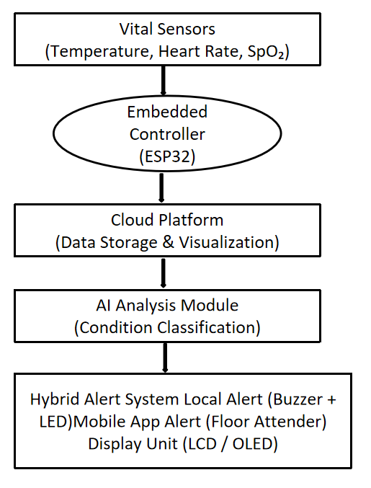
BLOCK DIAGRAM

Slide 11
RESULTS
The system successfully measures body temperature using the MLX90614 sensor in real time.
The readings are stable and suitable for continuous ICU patient monitoring.
The HW-827 heart rate sensor accurately detects pulse rate (BPM).
It provides consistent values that help in observing patient cardiac conditions.
Arduino Mega 2560 efficiently processes data from both sensors.
It ensures smooth coordination between hardware components without delays.
ESP32 successfully transmits patient health data over Wi-Fi.
The data can be viewed remotely on a mobile device or web interface.
Real-time monitoring of patient vitals is achieved without interruption.
This allows continuous observation even without physical presence.
The system is capable of detecting abnormal health conditions.
Alerts can be triggered when temperature or heart rate exceeds limits.
Data communication between sensors and cloud/server is reliable.
There is minimal data loss during transmission.
The overall system improves monitoring efficiency in ICU environments.
It reduces dependency on manual checking by healthcare staff.

Slide 12
PROJECT SUMMARY
The project develops an IoT-based ICU monitoring system for continuous patient health tracking.
It monitors key vital signs such as body temperature and heart rate in real time.
The MLX90614 sensor is used for accurate and non-contact temperature measurement.
The HW-827 sensor is used to measure the patient’s pulse rate (BPM).
Arduino Mega 2560 is used as the main controller to process sensor data.
ESP32 module enables wireless transmission of patient data through Wi-Fi.
The system allows remote monitoring of patient health conditions from anywhere.
It helps doctors and healthcare staff to observe patients without constant manual checking.
Abnormal health conditions can be identified quickly for faster response.
The system improves efficiency, accuracy, and reliability in ICU monitoring.
It reduces workload on hospital staff and supports better patient care.
Overall, the project provides a low-cost and effective smart healthcare solution.

Slide 13
FUTURE WORK
Add more health monitoring sensors
Apply advanced AI prediction models
Develop dedicated mobile monitoring application
Enable multi-patient ICU monitoring
Improve data security and cloud analytics
Support wearable and remote healthcare systems

Slide 14
REFERENCES
1. Pantelopoulos, A., Bourbakis, N.,
A Survey on Wearable Sensor-Based Systems for Health Monitoring, IEEE Systems Journal, 2010.
2.Haghi, M., et al.,
Wearable Devices in Medical Internet of Things, Sensors, 2017.
3.Istepanian, R. S. H., et al.,
Mobile Health Systems and AI Integration, IEEE Transactions on Information Technology in Biomedicine, 2011.
4. Rajasekaran, S.,
IoT-Based Healthcare Monitoring System, International Journal of Engineering & Technology, 2018.
5.Malasinghe, L. P., et al.,
Remote Patient Monitoring Using IoT and Cloud Computing, IEEE Access, 2019.

