Slide 1
SimplyFly – Air Ticket Booking System
PRESENTED BY: VIKASHINI M
TRAINER : Javeed Mohammed Husnuddin

Slide 2
SimplyFly
SimplyFly is a full-stack flight booking management system built with Angular and Spring Boot. It features role-based login for Admins, Users and Flight Owners. Core functionalities include booking flights, managing routes, creating flights and user-specific dashboards. The system uses JWT for secure authentication and MySQL for data storage.

Slide 3
Technologies Used
Frontend: Angular, Bootstrap, CSS
Backend :Spring Boot
Database: MySQL
API Communication : RESTful APIs
Containerization: Docker

Slide 4
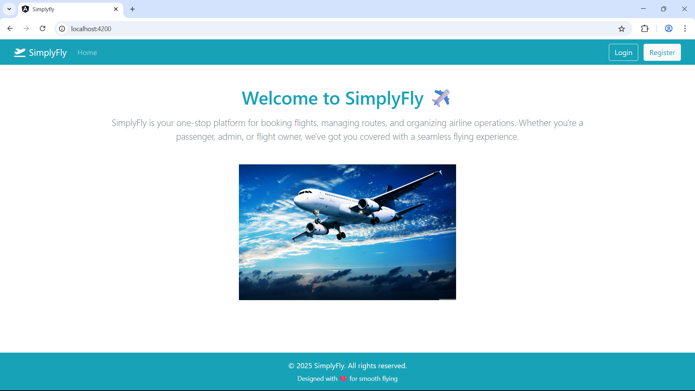
HOME PAGE

Slide 5
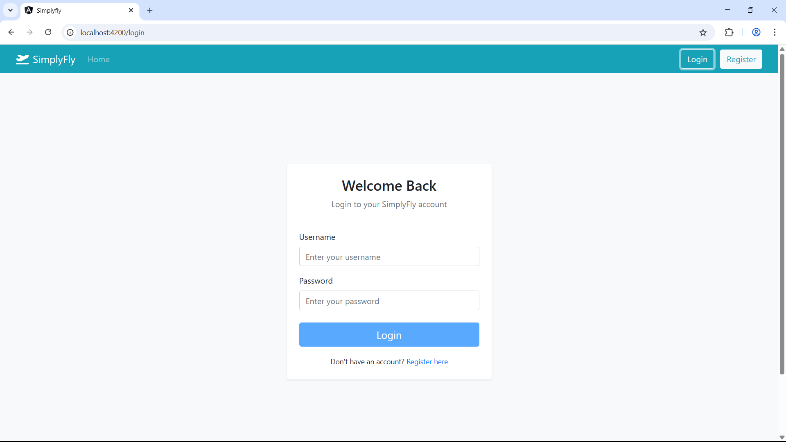
LOGIN PAGE

Slide 6
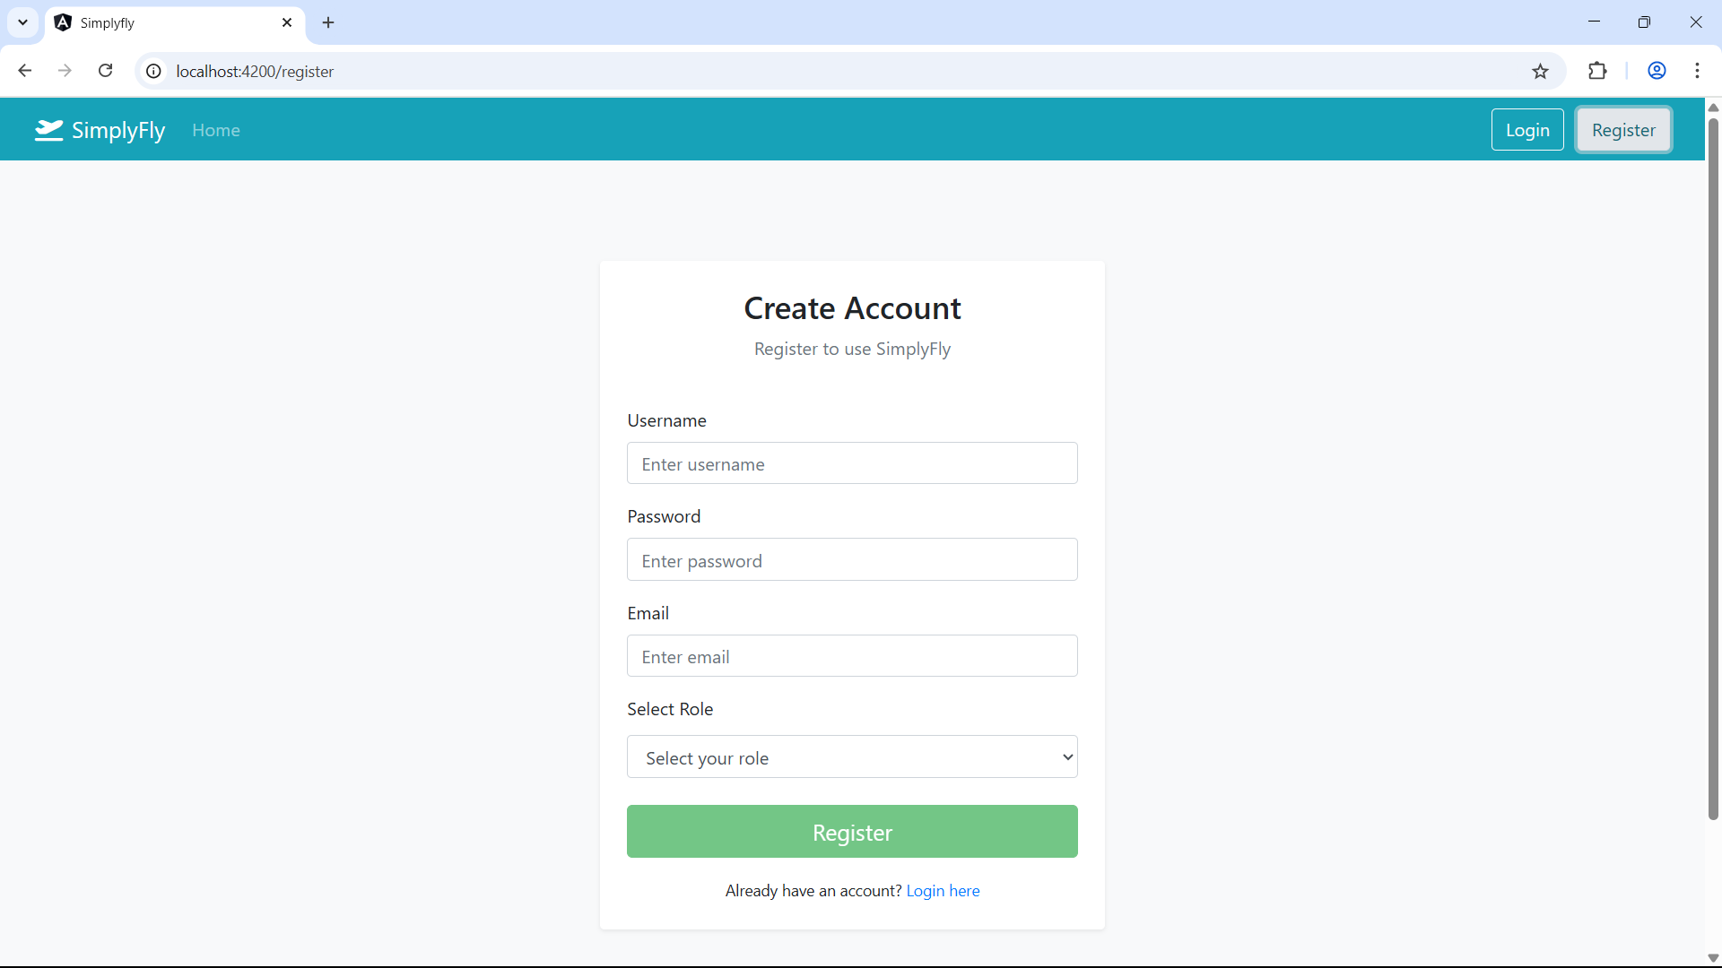
REGISTER PAGE

Slide 7
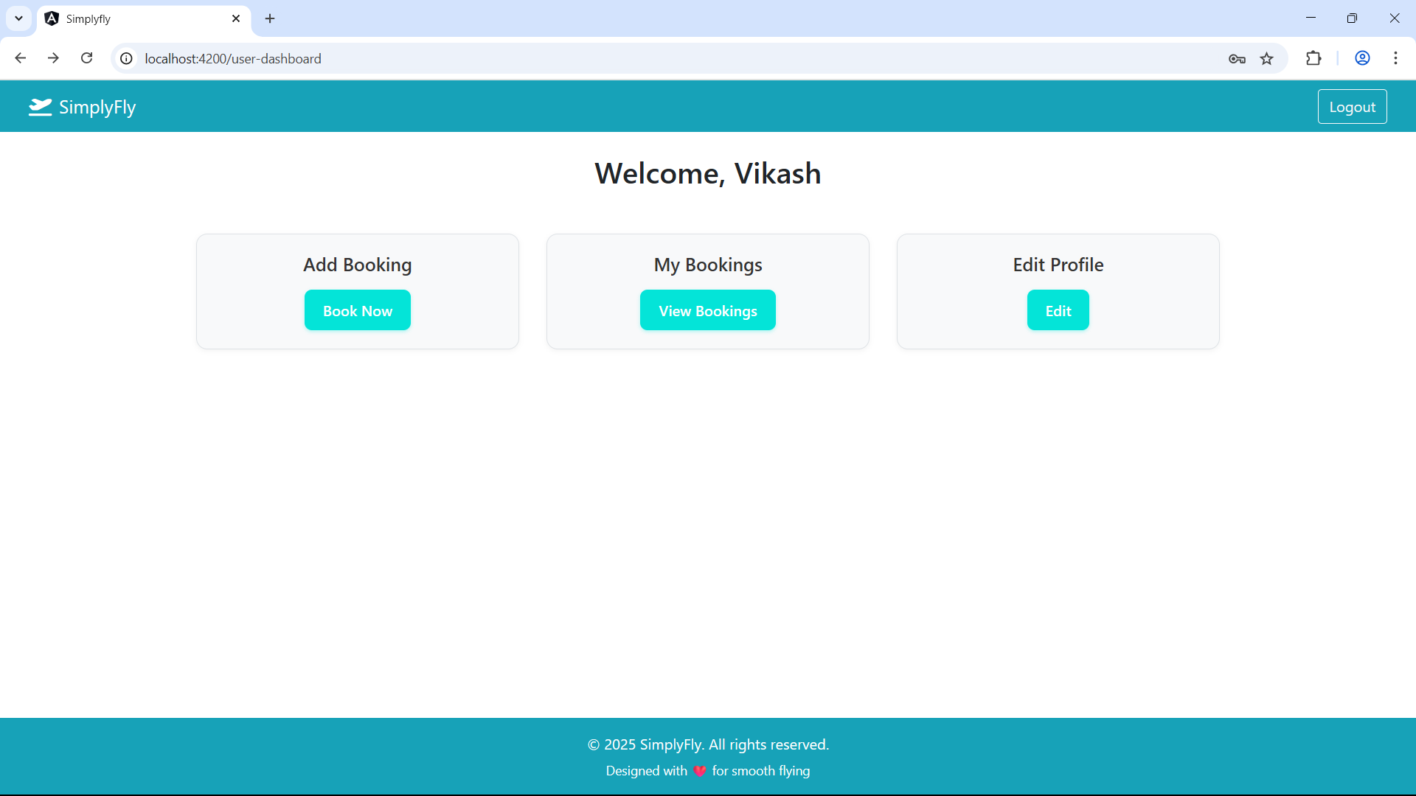
USER DASHBOARD PAGE

Slide 8
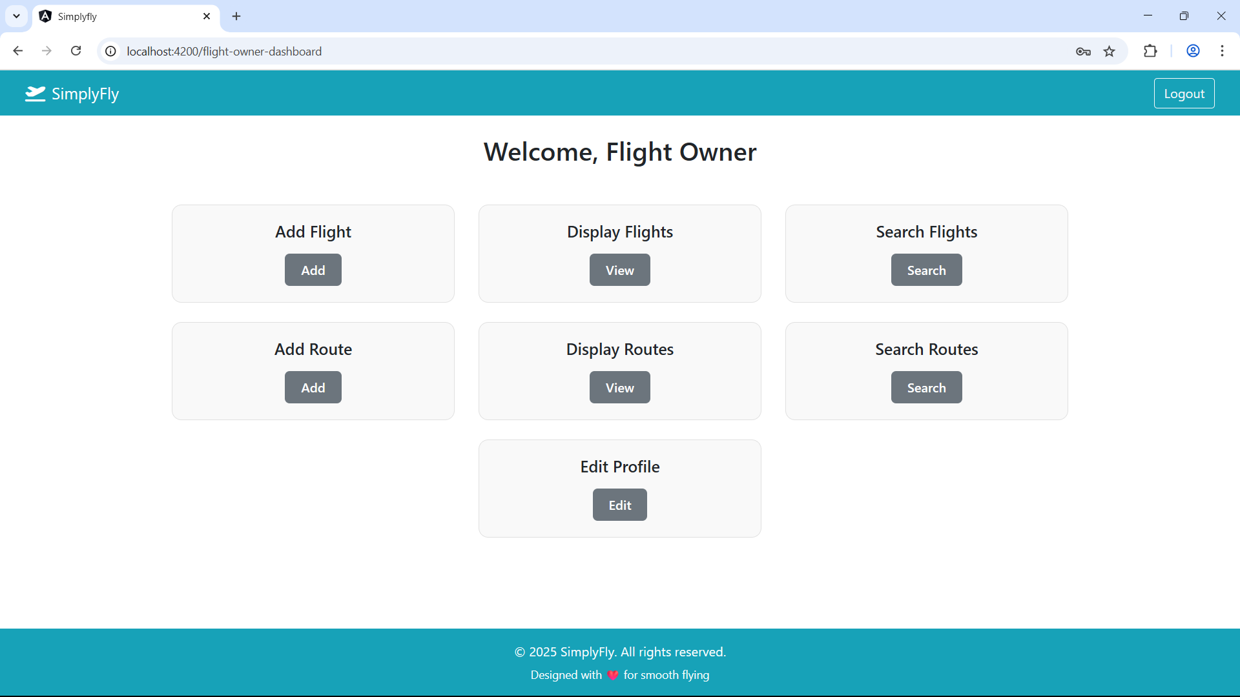
FLIGHT OWNER DASHBOARD PAGE

Slide 9
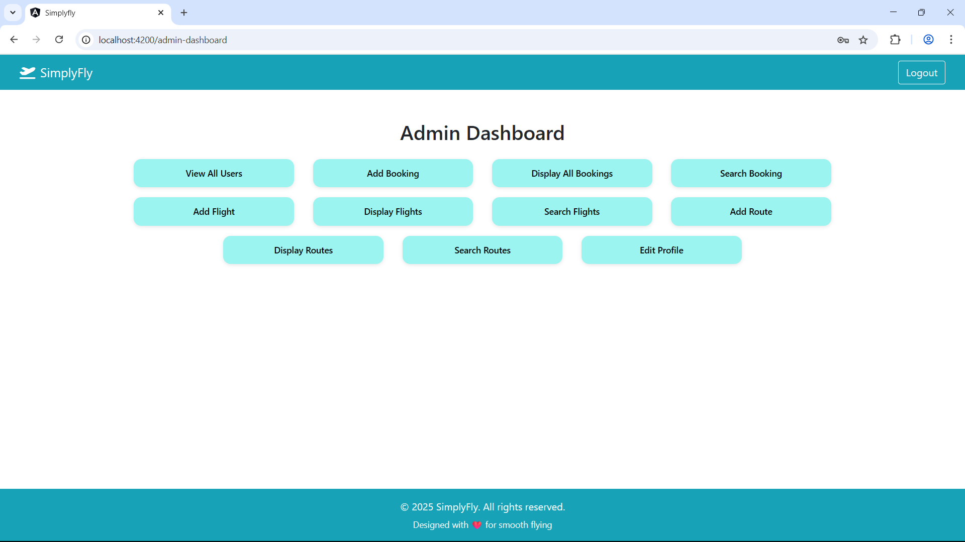
ADMIN DASHBOARD PAGE

Slide 10
THANK YOU

