Slide 1

Travel Management System
Python Project
By:- Vikash Kumar
Shaik Shareef

Slide 2
Introduction
This project has been developed to make travel management easy.
In this project an individual can book and cancel.
Users can also know about V.S Travels, services that we provide, can also give feedback.
Contact page, where user can contact with our customer care.

Slide 3
Modules Used
GUI Interface
Sql connector – Used to connect Database
User Input – takes input from User
Cancel - Cancel tickets
Payment Gateway - Making Payments
Feedback – Used to take feedback from user

Slide 4
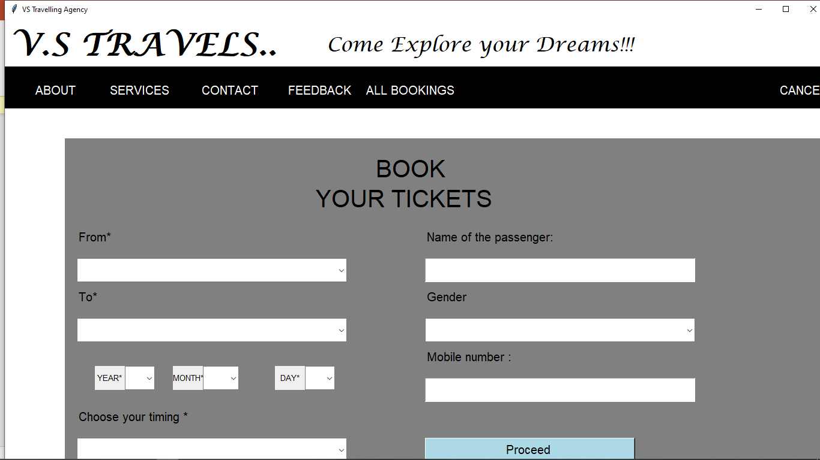
Main Interface

Slide 5
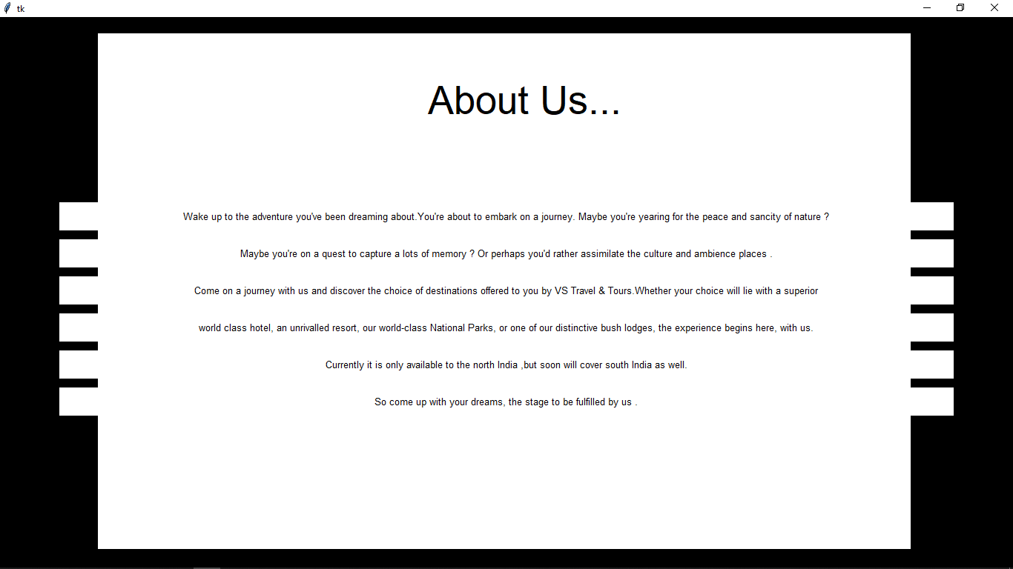
About Us

Slide 6
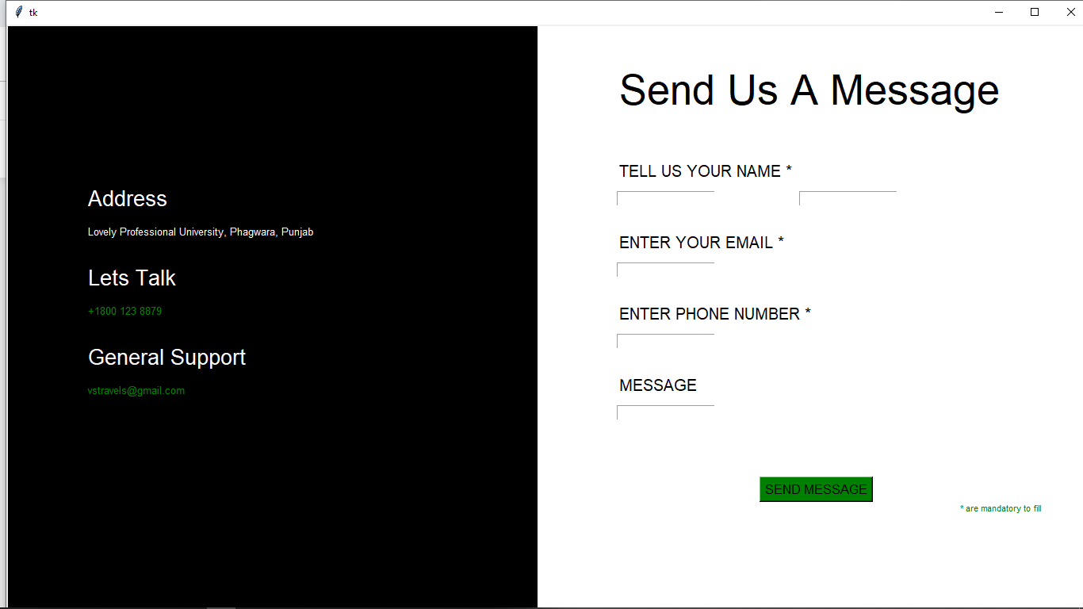
Contact

Slide 7
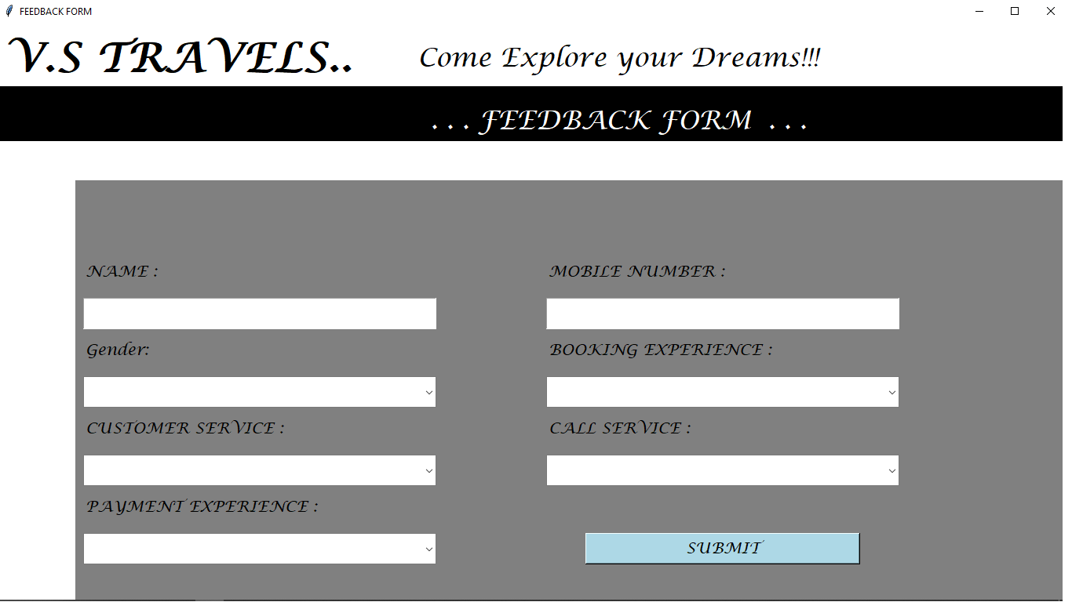
Feedback

Slide 8
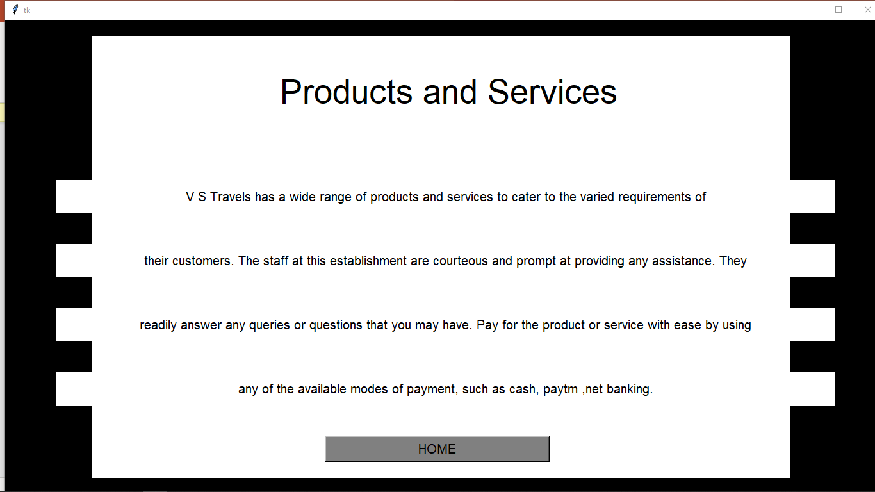
Services

Slide 9
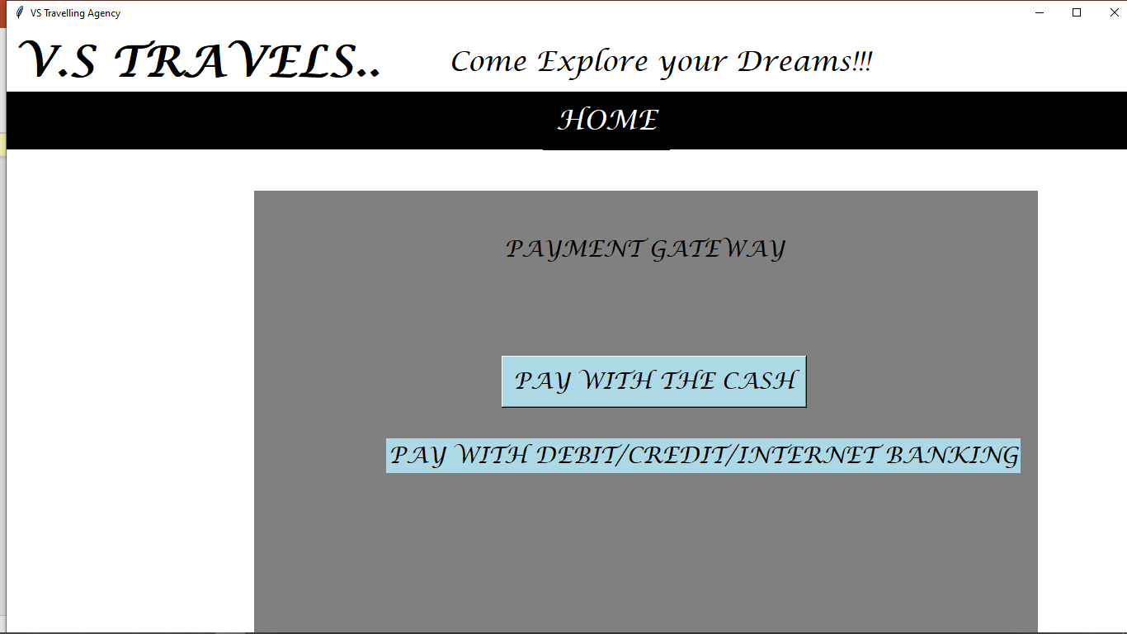
Payment Gateway

Slide 10

Thank you

