Slide 1
PROBLEM STATEMENT

Slide 2
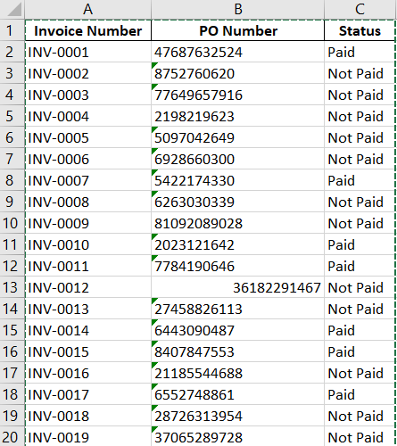
DATASET(IMAGENOW)

Slide 3
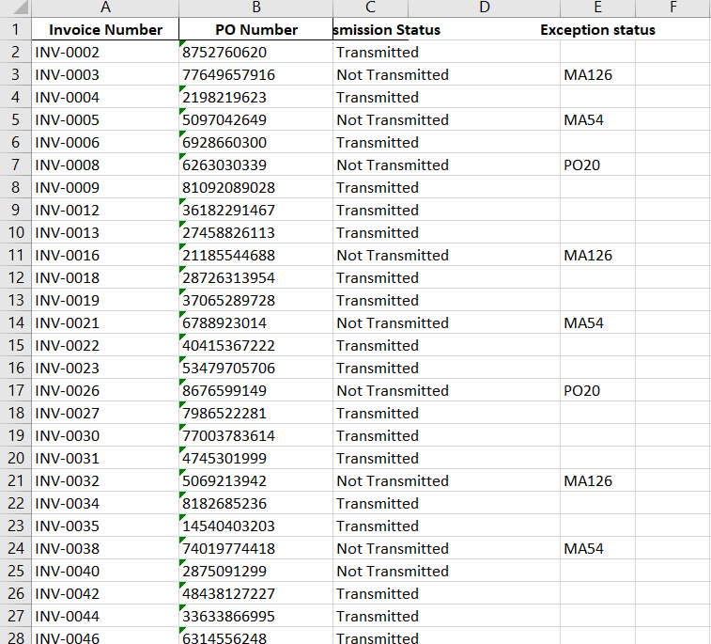
DATASET(IVALUA)

Slide 4
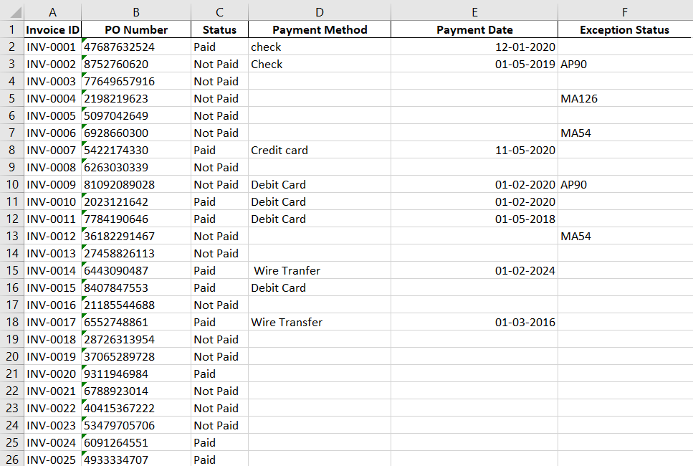
DATASET(LAWSON)

Slide 5
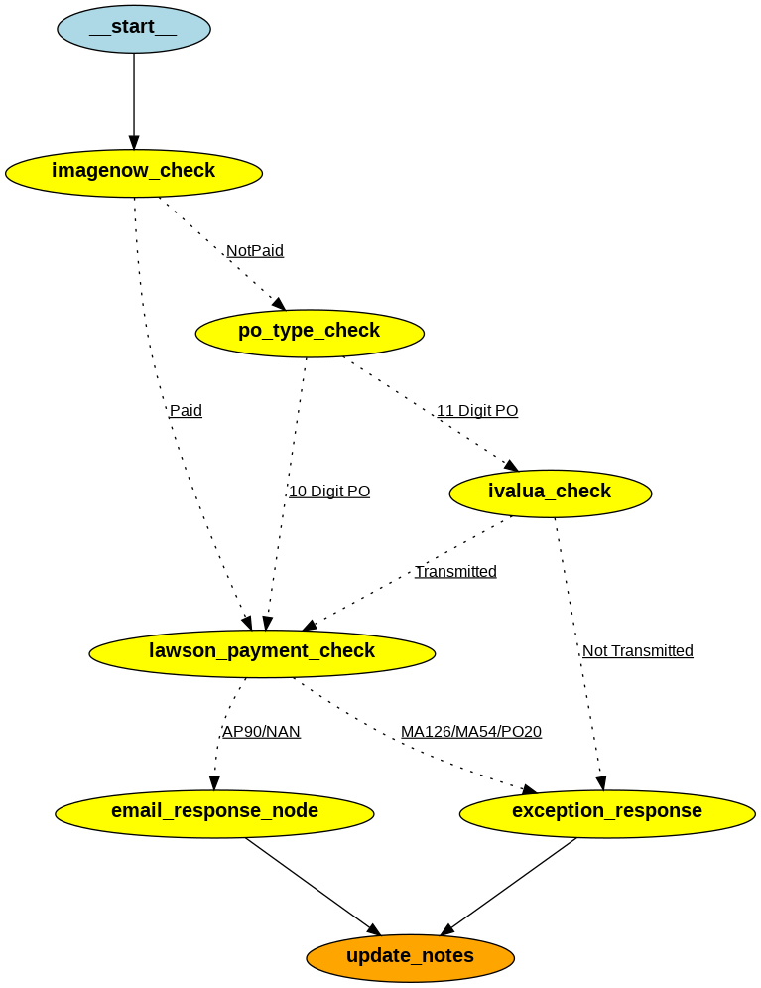
FLOW DIAGRAM

Slide 6
5 CASES
1) INVOICE IS PAID
2) INVOICE NOT PAID, 11 DIGIT , NOT TRANSMITTED
3) INVOICE IS NOT PAID , TRANSMITTED, EXCEPTION STATUS AP90
4) INVOICE IS NOT PAID, TRANMITTED ,EXCEPTION STATUS MA126,MA54,PO20
5) INVOICE IS NOT PAID, 10 DIGIT PO, EXCEPTION STATUS MA126,MA54,PO20

Slide 7
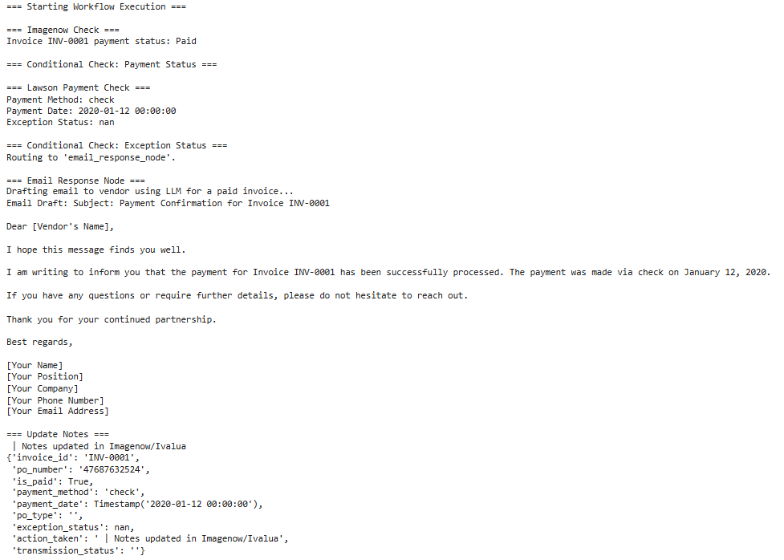
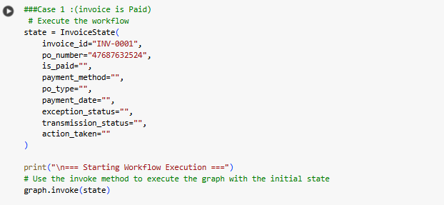
CASE 1:(Invoice is Paid)

Slide 8
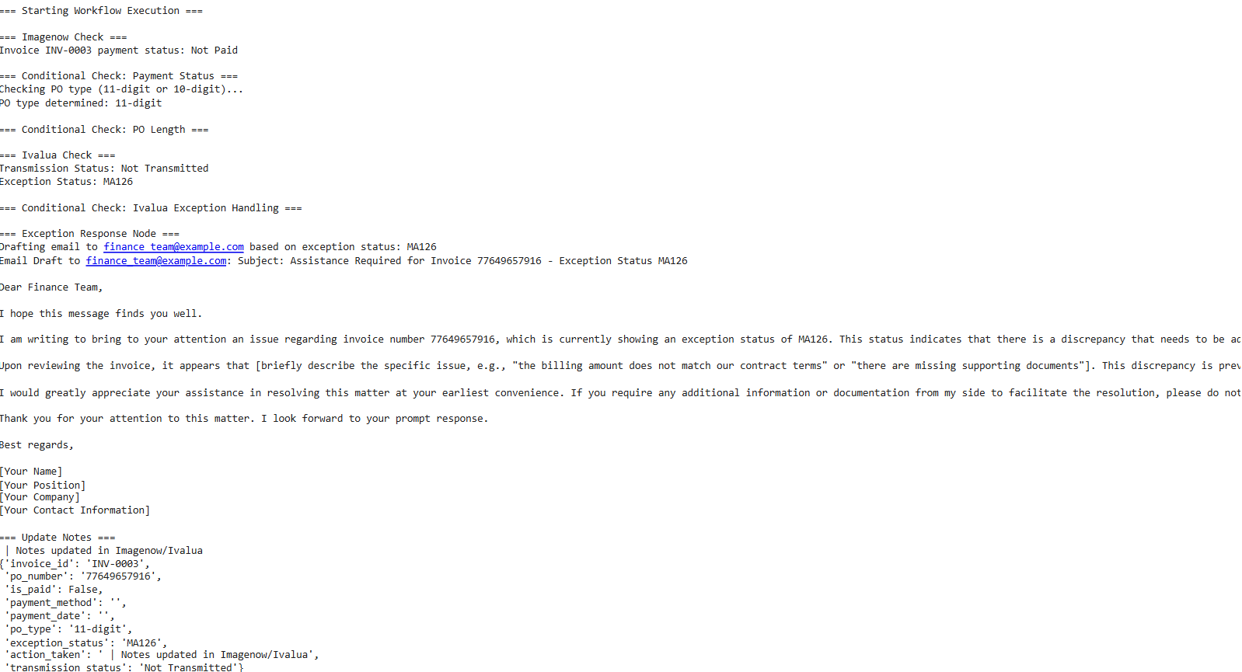
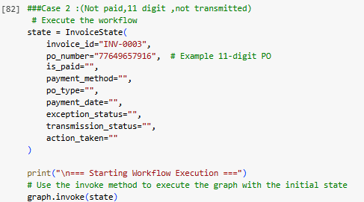
CASE 2:(Invoice is Not Paid,11 digit PO, not Transmitted )

Slide 9
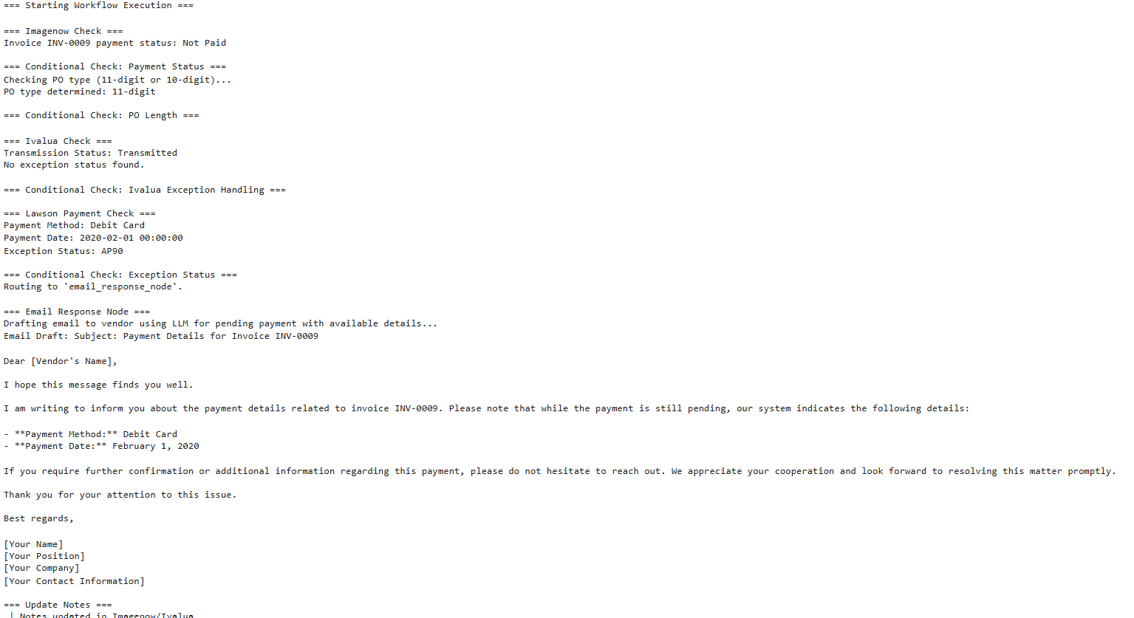
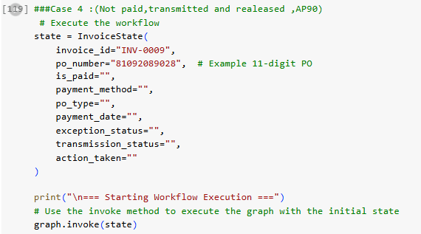
CASE 3:(Invoice is Not Paid,11 digit PO, Transmitted,AP90 )

Slide 10
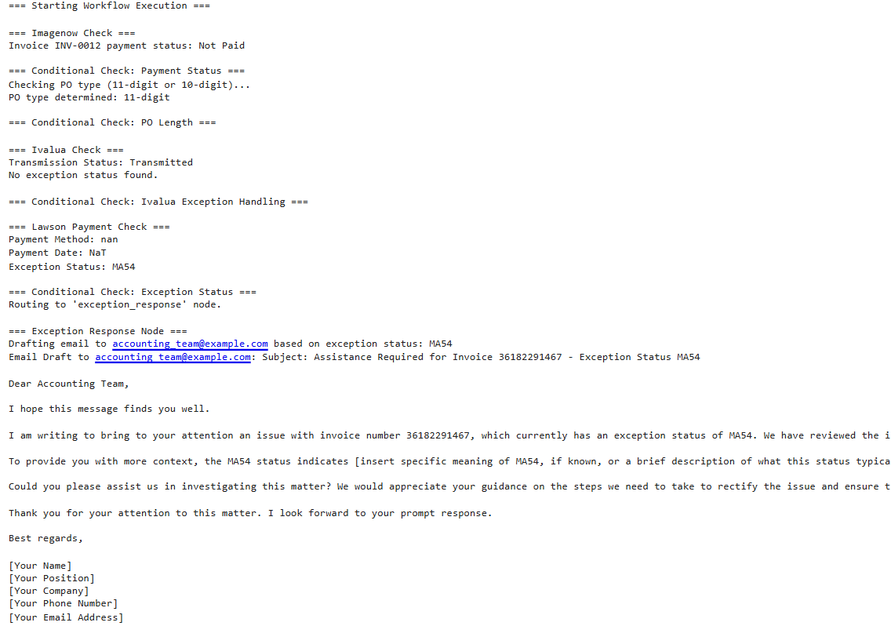
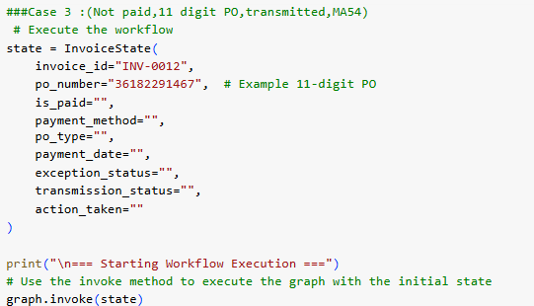
CASE 4:(Invoice is Not Paid,11 digit PO, Transmitted,MA126,MA54,PO20 )

Slide 11
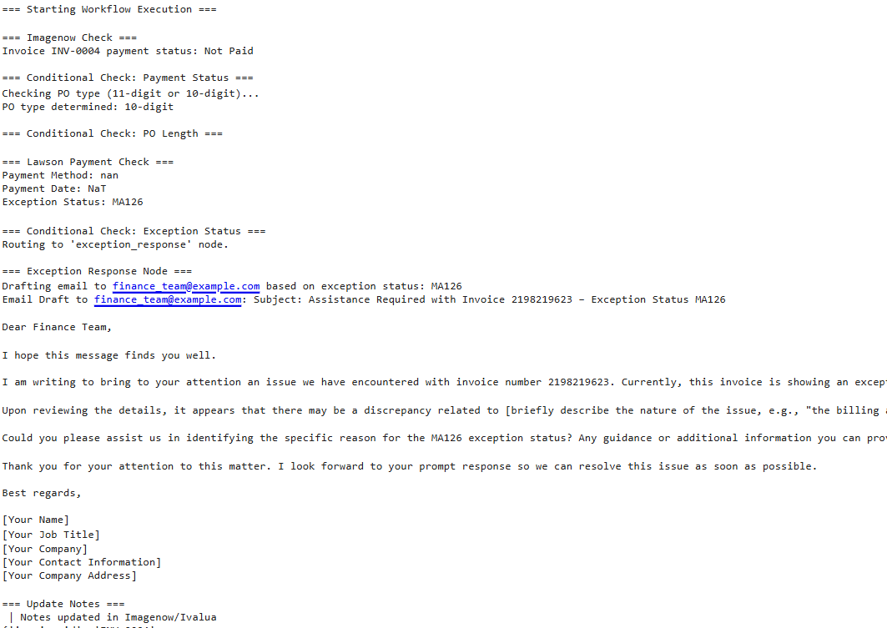
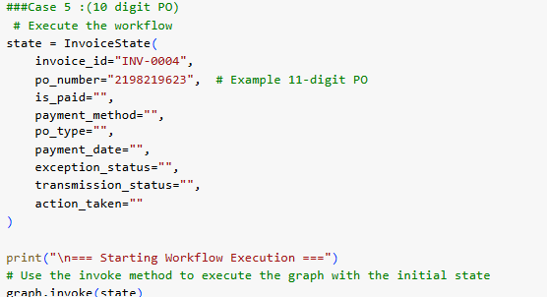
CASE 5:(Invoice is Not Paid,10 digit PO)

