Slide 1
PROBLEM STATEMENT (Actions Needed)
Email category 1
Email category 2

Slide 2
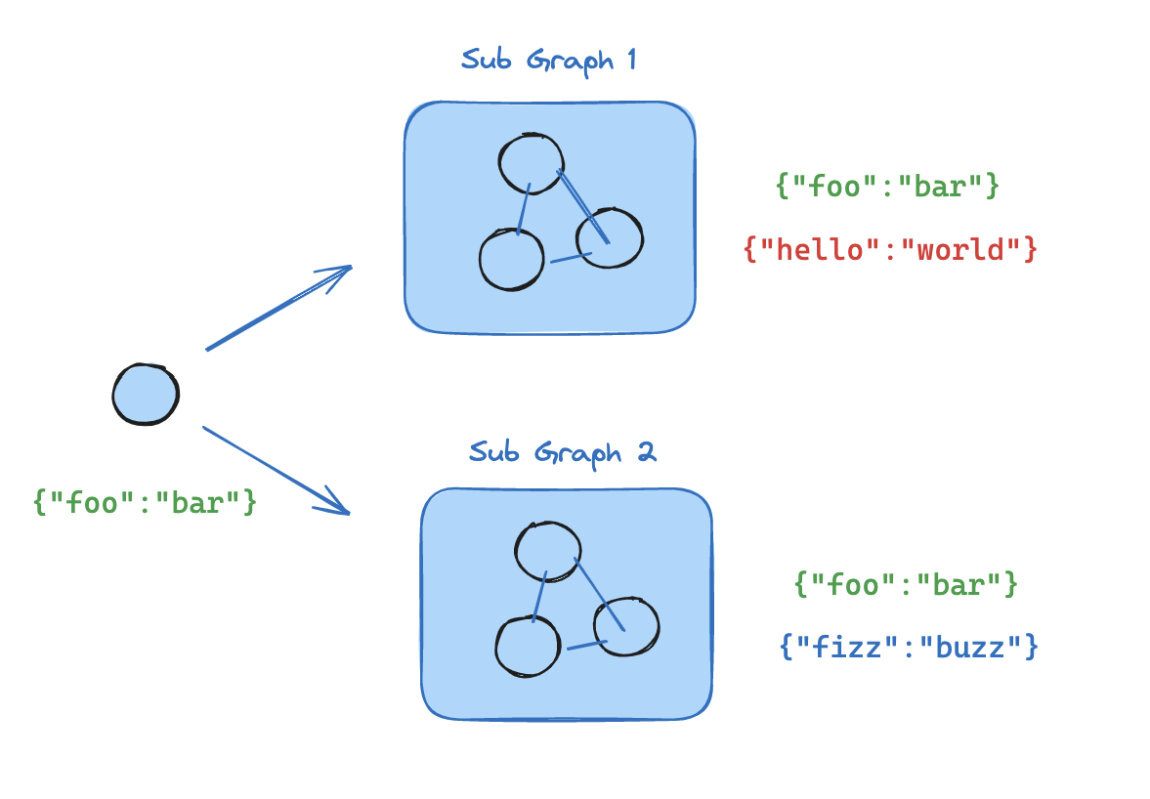
STEPS FOLLOWED
SubGraph for each category
Parent graph to classify the email
Parent graph to route to various subgraphs based on email Category
LLM agent used in parent graph to classify the email
LLM agent used in subgraph to decide

Slide 3
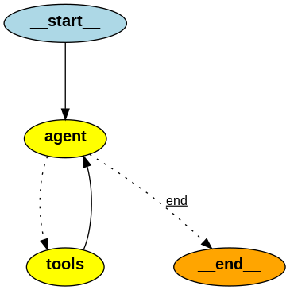
Architecture 1

Slide 4
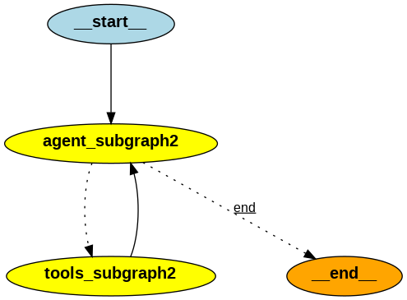
Architecture 2

Slide 5
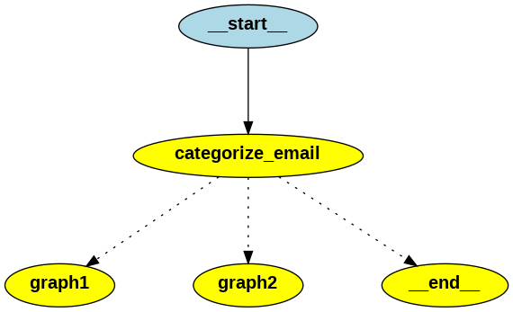
Final Architecture

Slide 6
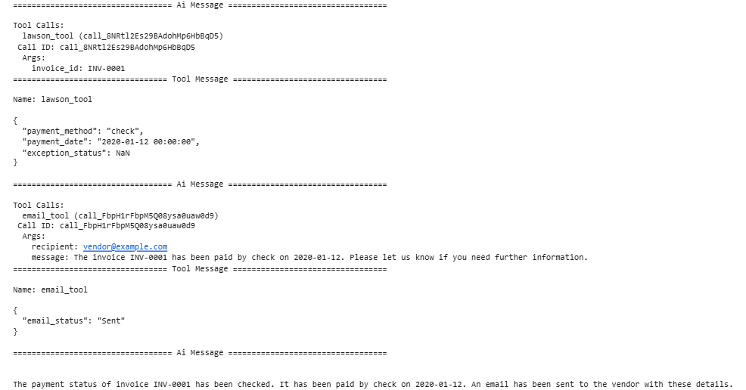
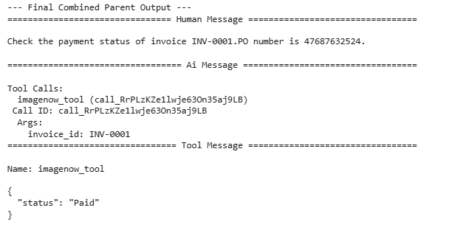
OUTPUT 1

Slide 7
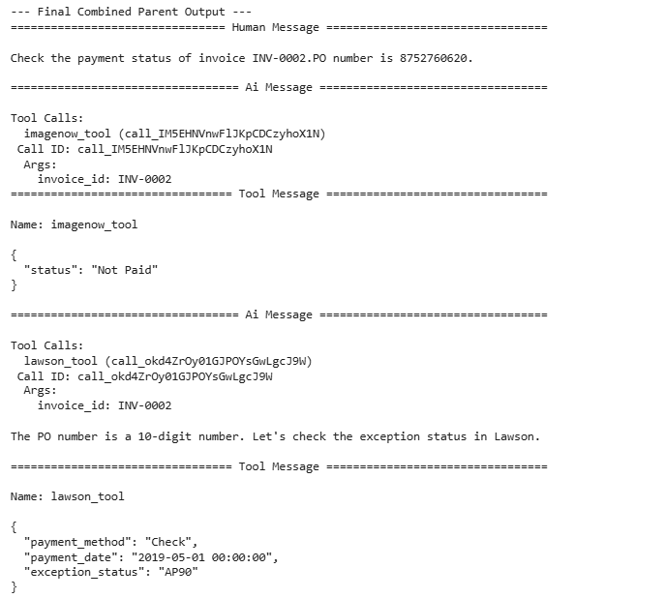
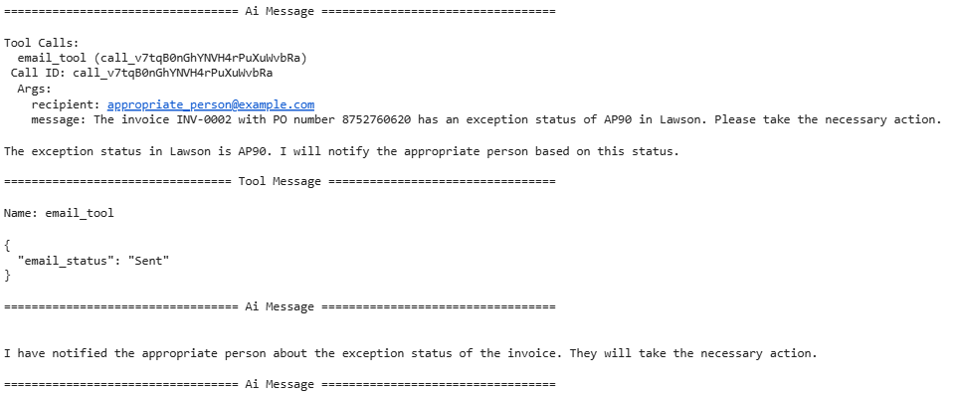
OUTPUT 2

Slide 8
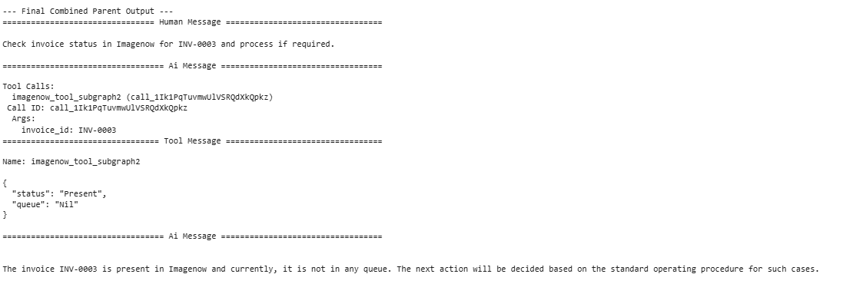
OUTPUT 3

