Slide 1
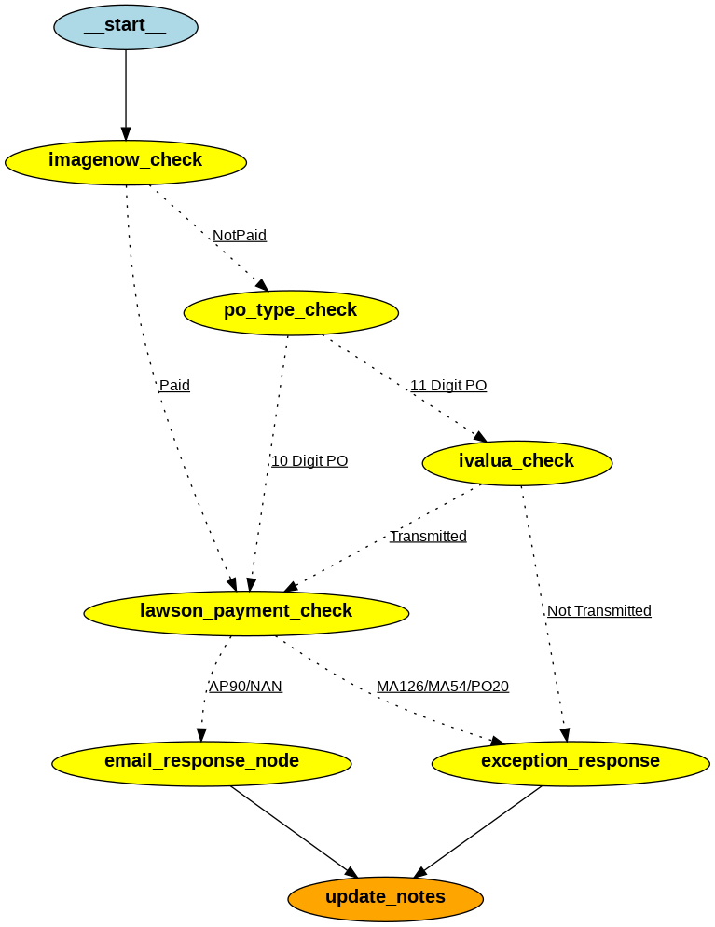
Architecture 1

Slide 2
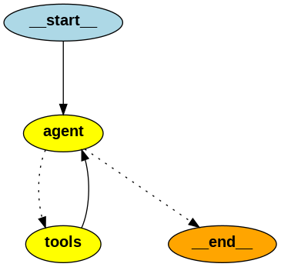
Architecture 2

Slide 3
Comparison
Parameter | Architecture 1 | Architecture 2
Workflow | Actions to be taken are hard coded. | Actions to be taken are decided by LLM.
Complexity | More complex as many nodes and edges are there. | Less complex, fewer nodes and edges.
Execution Time | Execution time is less | Execution time is more
Development Time | Development time is less | Development time is more
Scalability | Less scalable | More scalable
Reliability | Equally Reliable | Equally reliable

