Slide 1
PROBLEM STATEMENT

Slide 2
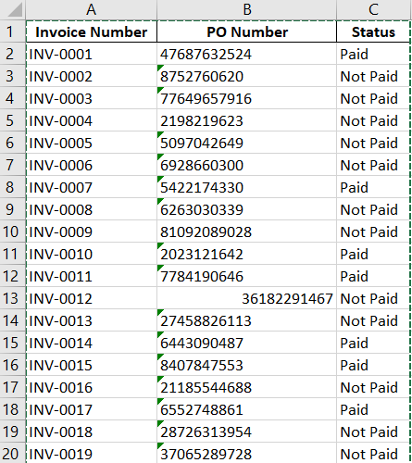
DATASET(IMAGENOW)

Slide 3
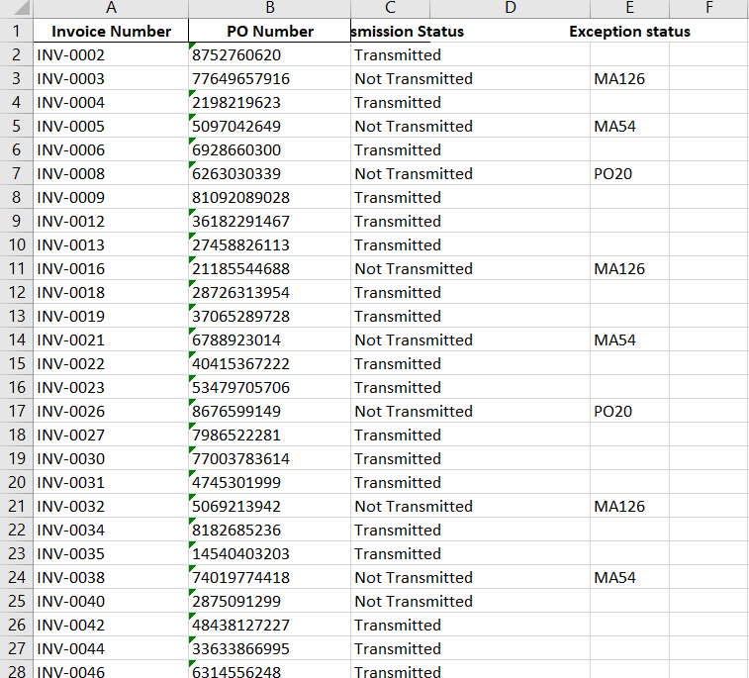
DATASET(IVALUA)

Slide 4
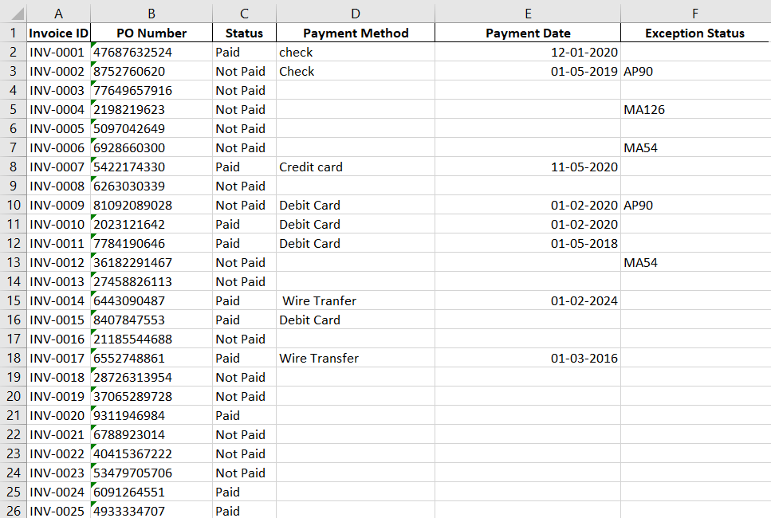
DATASET(LAWSON)

Slide 5
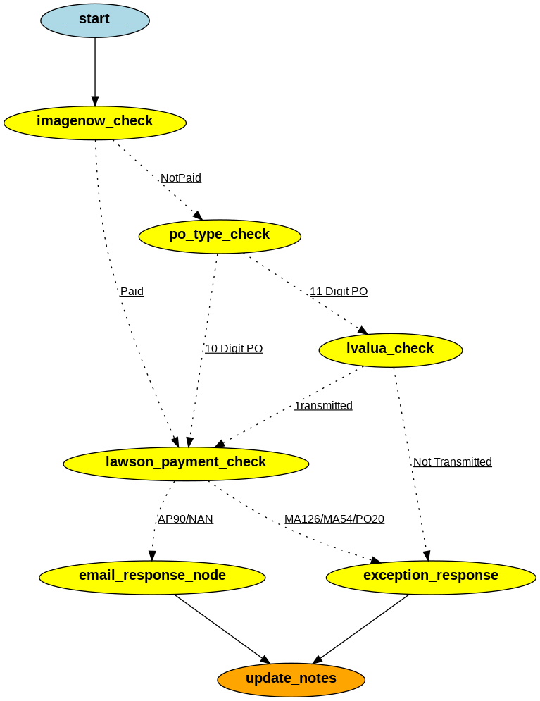
FLOW DIAGRAM

Slide 6
5 CASES
1) Invoice is paid
2) Invoice not paid, 11 digit, not transmitted
3) Invoice is not paid, transmitted, exception status AP90
4) Invoice is not paid, transmitted ,exception status MA126,MA54,PO20
5) Invoice is not paid, 10 digit PO, exception status MA126,MA54,PO20

Slide 7
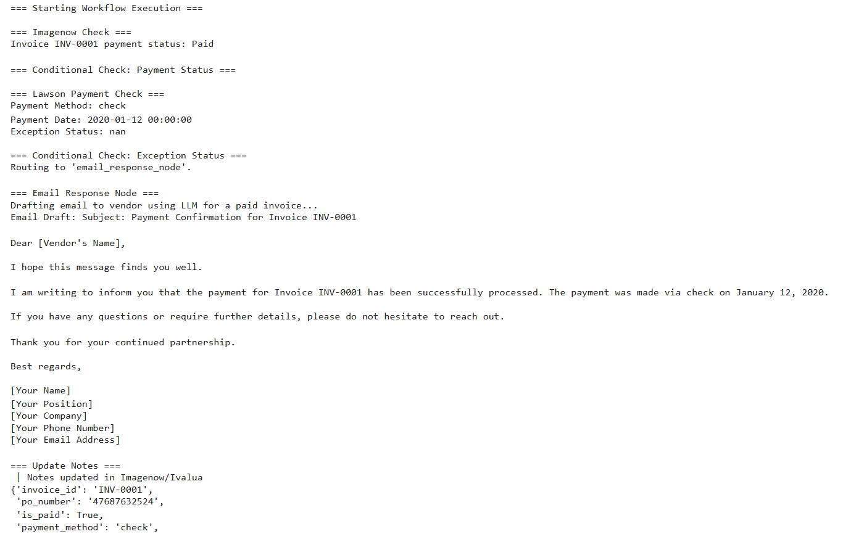
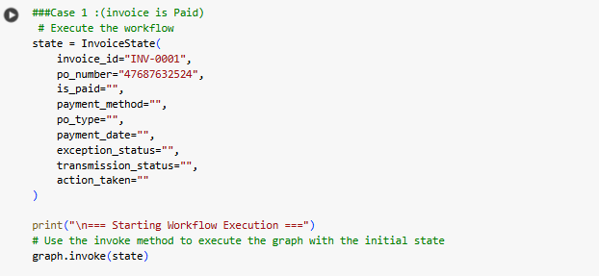
CASE 1:(Invoice is Paid)

Slide 8
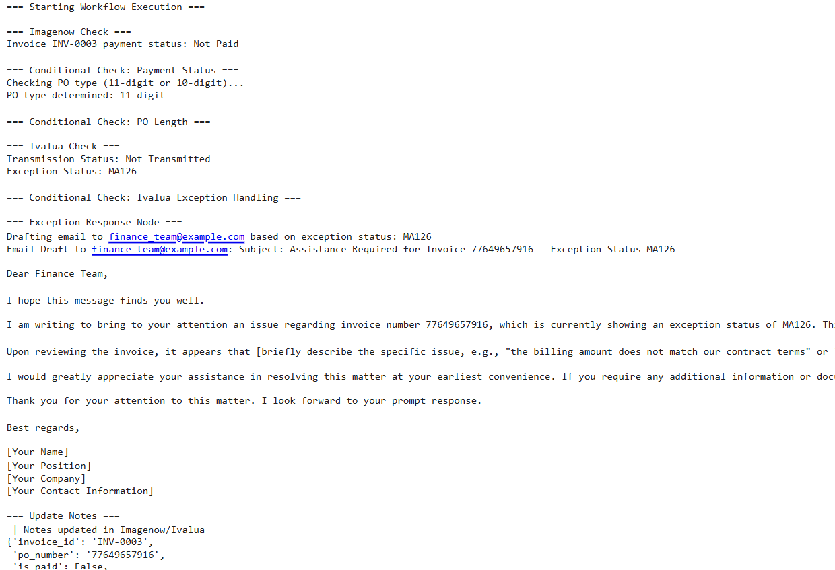
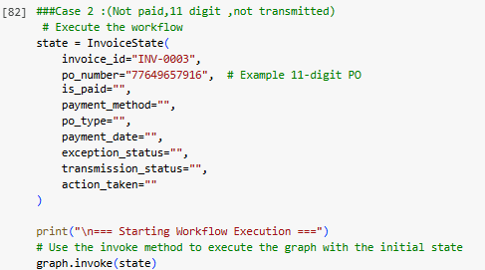
CASE 2:(Invoice is Not Paid,11 digit PO, not Transmitted )

Slide 9
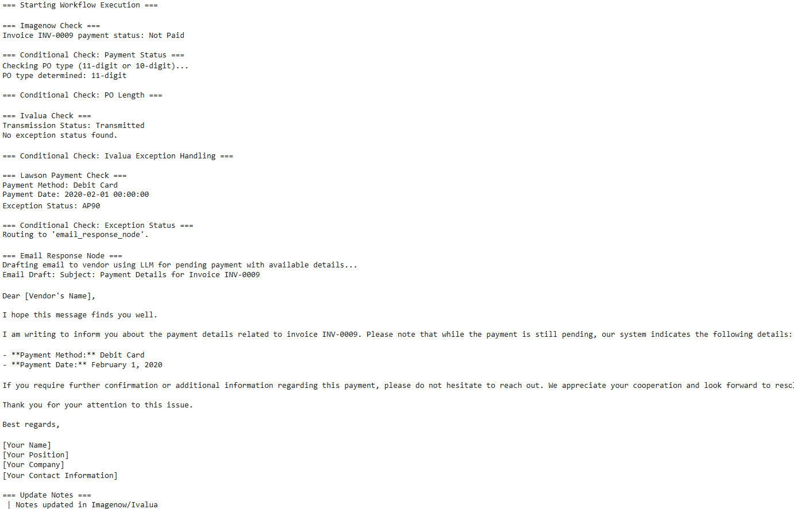
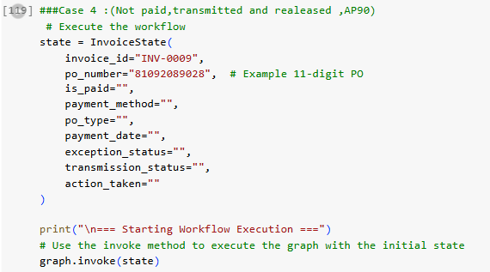
CASE 3:(Invoice is Not Paid,11 digit PO, Transmitted,AP90 )

Slide 10
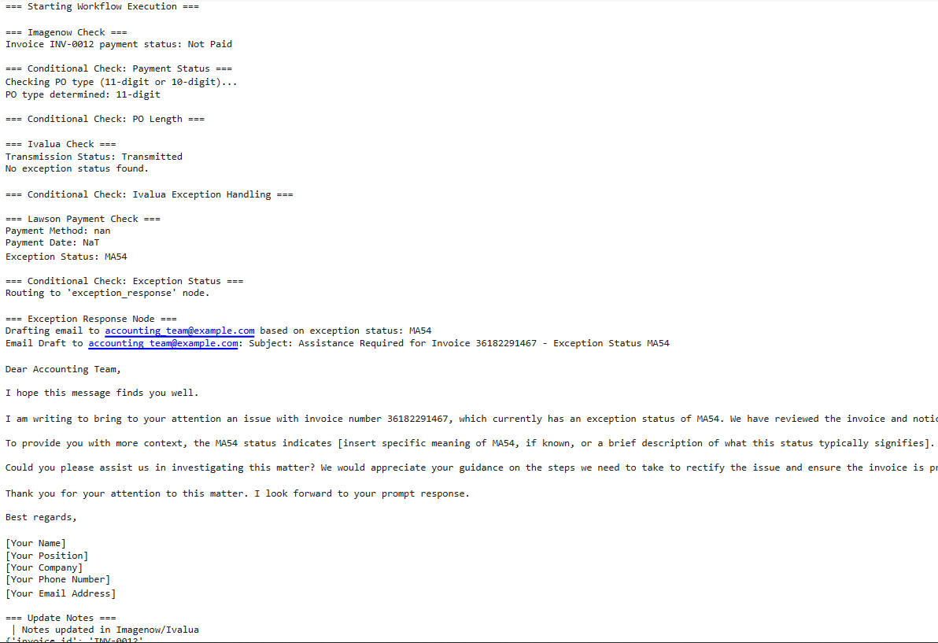
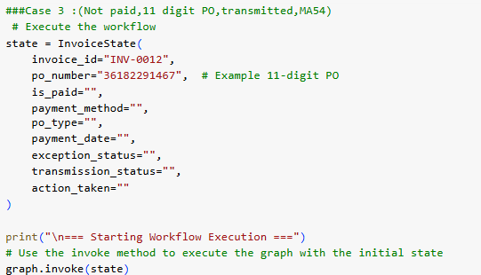
CASE 4:(Invoice is Not Paid,11 digit PO, Transmitted,MA126,MA54,PO20 )

Slide 11
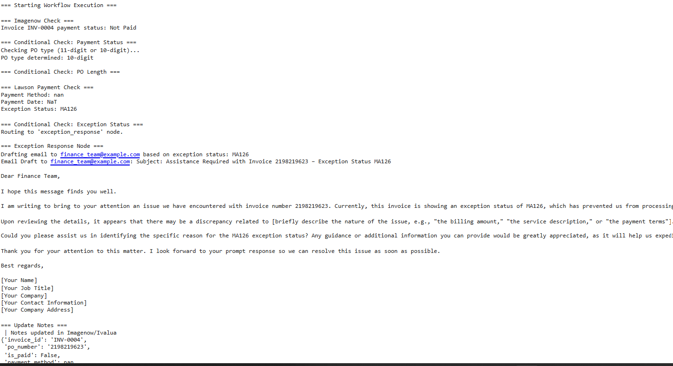
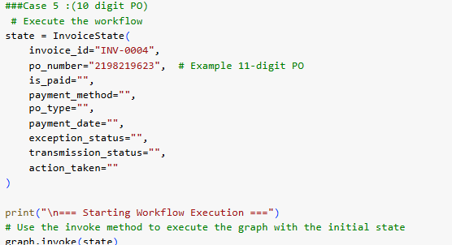
CASE 5:(Invoice is Not Paid,10 digit PO)

