Slide 1

IDEA 2025
Symposium on “Innovation, Discovery, Exploration, Achievement”
“Impact of Renewable Energy in Reducing Energy Inequality”
Vishwas Khandelwal & 230291412459

Slide 2



Motivation and Objective
⚡ Energy Inequality = Development Inequality
Millions still lack reliable electricity, especially in rural areas
Urban regions often have 2–3× more access than rural ones
🌿 Renewable Energy = A Beacon of Hope?
Clean, scalable, and decentralized
But does it really reduce the urban-rural access gap?
🎯 Objective:
Analyze the role of renewable energy in addressing the urban-rural electricity access gap.

Slide 3


Relevance and Research Gap
⚠️ Despite significant investments in renewables, their impact on bridging electricity access gaps remains unclear.
🌐 Urban-rural electrification disparity still exists, particularly in low- and middle-income regions.
📉 What’s Missing in Existing Research
Focus mostly on environmental & economic benefits, not on energy equality.
Limited to specific countries; lacks holistic global + regional perspective.
Few studies link renewable share in TFEC directly with urban-rural access disparity.

Slide 4
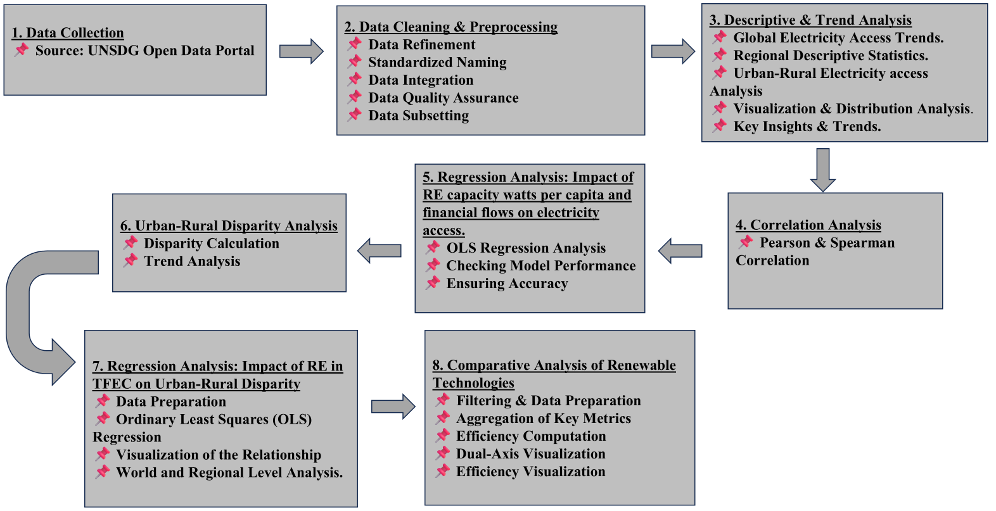
Research Methodology

Slide 5
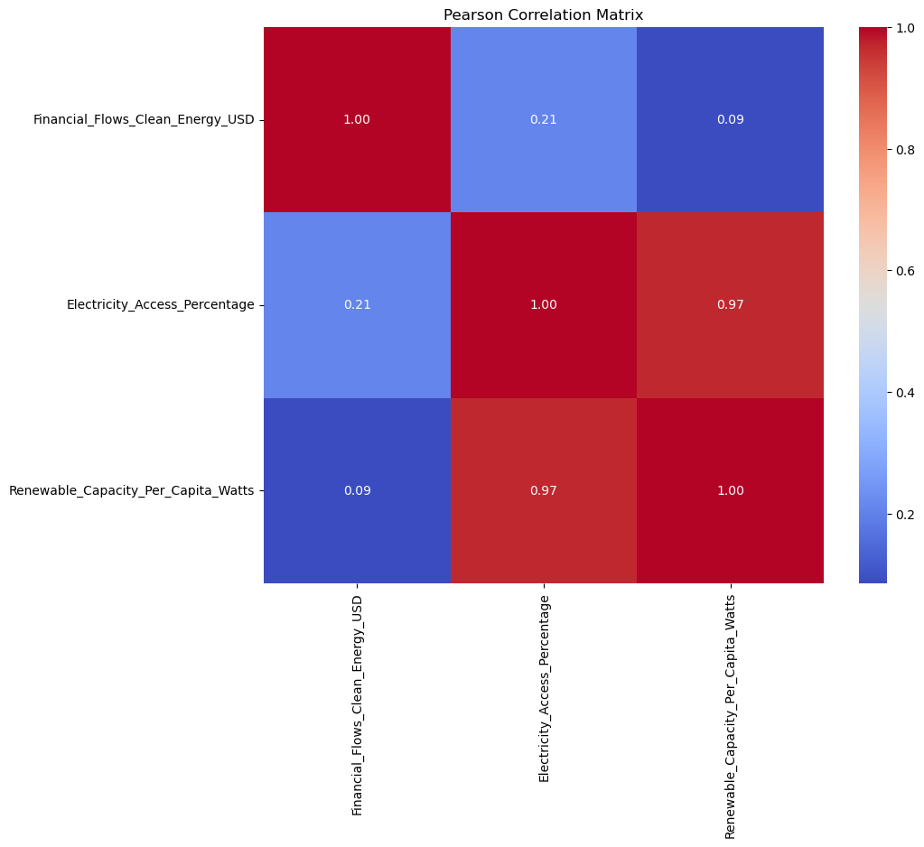
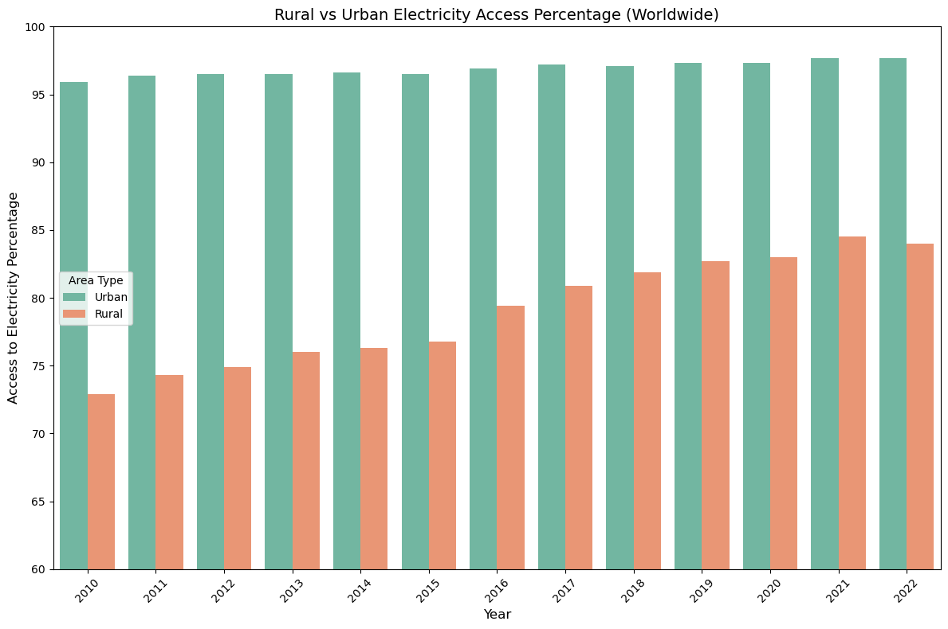
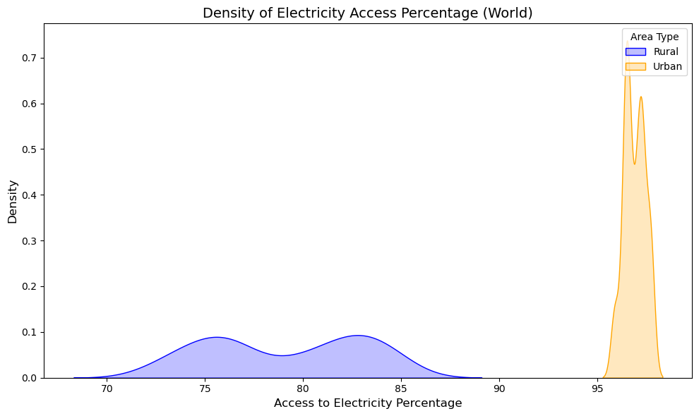
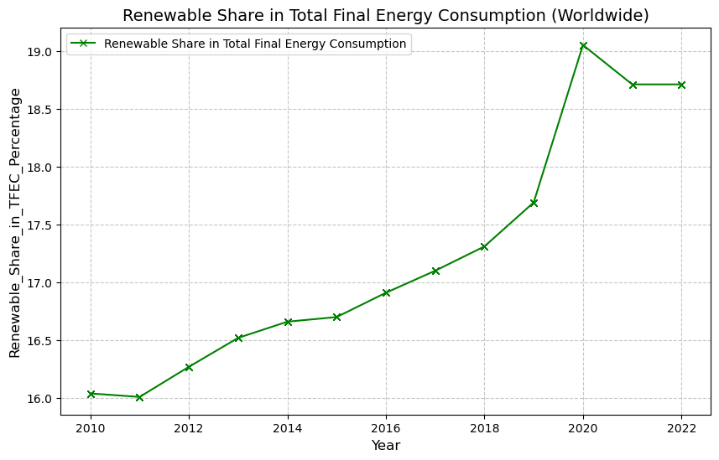
Key Findings

Slide 6
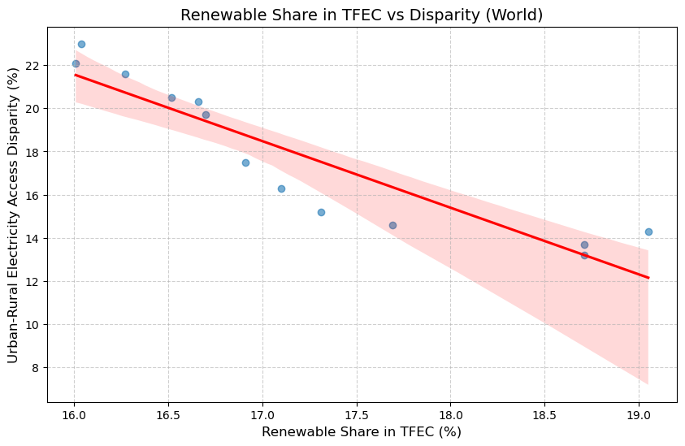
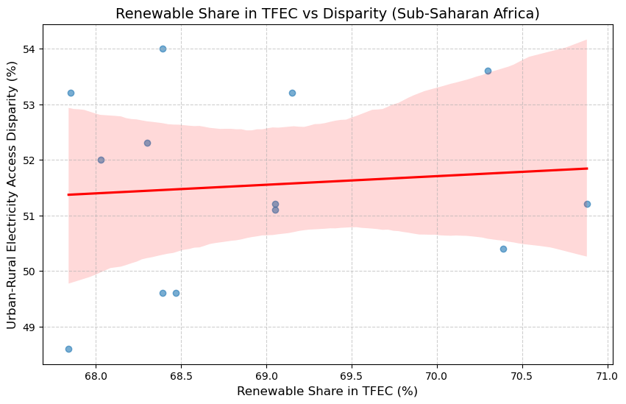
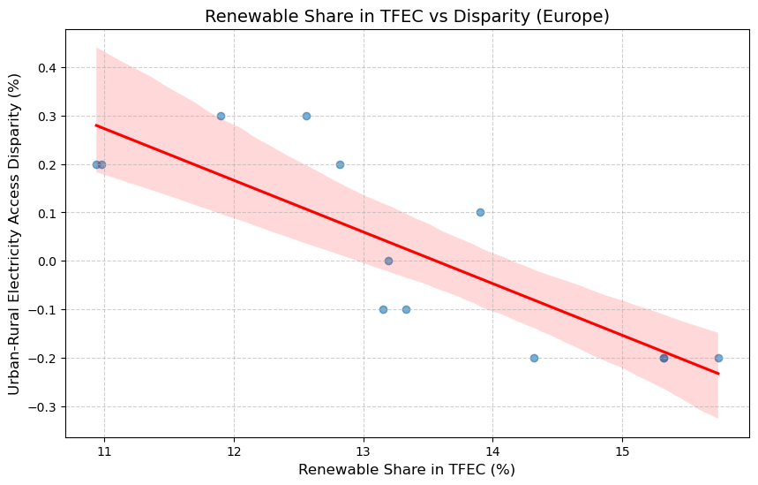
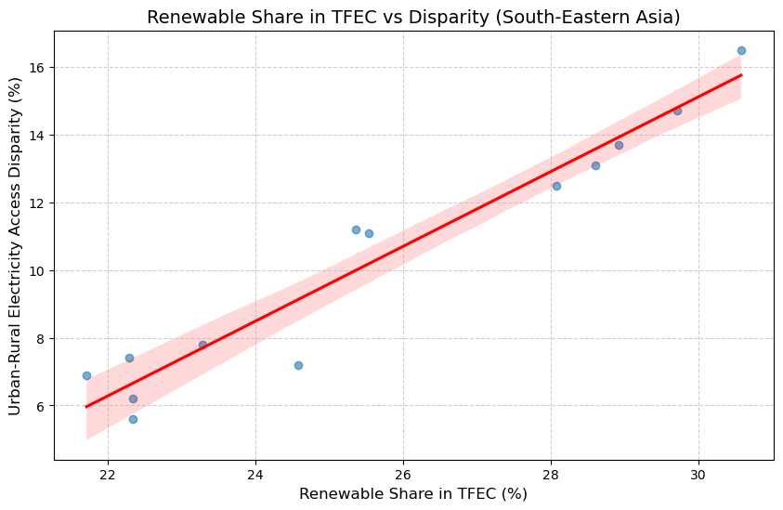

Slide 7
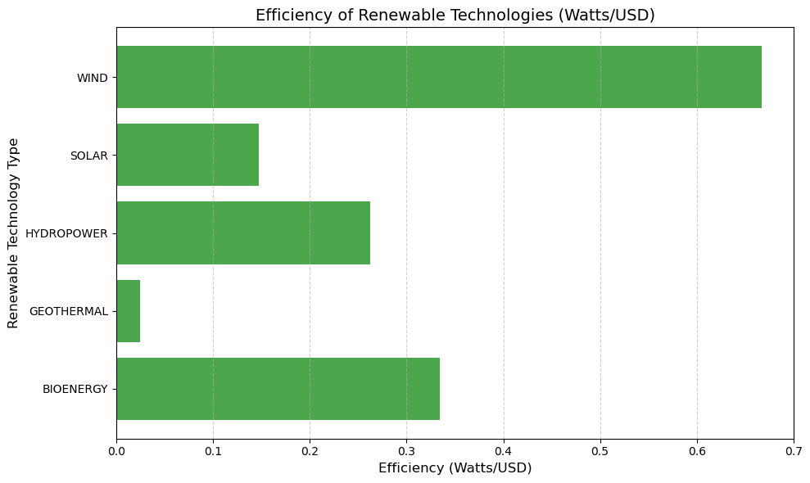

Implications and Conclusion
👨‍⚖️ Policymakers:
Renewable energy can reduce disparity, but only with targeted rural strategies
Focus on decentralized energy, equitable funding, and grid expansion
Hydropower and wind should be prioritized for infrastructure development
🧩 Energy Planners:
RE share alone doesn’t ensure equity—context matters
Design plans that combine renewables with rural electrification programs
Invest in cost-effective tech (e.g., wind) and bridge regional infrastructure gaps
🔬 Researchers:
Investigate why disparity reduces even when RE share stagnates
Explore advanced models like LSTM for trend prediction
Study region-specific strategies for long-term sustainable energy equity
✅ Conclusion:
Renewable energy is a key tool for reducing energy inequality— but its success depends on how it's implemented, distributed, and supported by policy.

Slide 8
References:
Volodzkiene L, Streimikiene D. Towards Energy Equity: Understanding and Addressing Multifaceted Energy Inequality. Energies. (2024); 17(17):4500. https://doi.org/10.3390/en17174500
Daniel Adu, Du Jianguo, Stephen Ntiri Asomani, Agnes Abbey, "Energy generation and carbon dioxide emission—The role of renewable energy for green development,", ISSN 2352-4847, https://doi.org/10.1016/j.egyr.2024.07.013.
Sun, Chenzhou; Sun, Shurui; Yue, Xiaolu, "Does the transition to low-carbon energy alleviate urban-rural energy inequality? The case of China," Heliyon, Volume 10, (2024), Elsevier, https://doi.org/10.1016/j.heliyon.2024.e31355.
Volodzkiene, L.; Streimikiene, D., "Energy Inequality Indicators: A Comprehensive Review for Exploring Ways to Reduce Inequality," Energies, Volume 16, (2023), 6075, https://doi.org/10.3390/en16166075.
Emami Meybodi, Mehdi & Owjimehr, Sakine. (2024). The nexus of climate policy uncertainty, renewable energy and energy inequality under income disparities. Energy Strategy Reviews. 53. 101381. 10.1016/j.esr.2024.101381.
Streimikiene, D.; Baležentis, T.; Volkov, A.; Morkūnas, M.; Žičkienė, A.; Streimikis, J., "Barriers and Drivers of Renewable Energy Penetration in Rural Areas," Energies, Volume 14, (2021), 6452, https://doi.org/10.3390/en14206452.
Julius Alexander McGee, Patrick Trent Greiner, "Renewable energy injustice: The socio-environmental implications of renewable energy consumption," ISSN 2214-6296, https://doi.org/10.1016/j.erss.2019.05.024.
Mehmood, U.; Agyekum, E.B.; Tariq, S.; Ul Haq, Z.; Uhunamure, S.E.; Edokpayi, J.N.; Azhar, A. "Socio-Economic Drivers of Renewable Energy: Empirical Evidence from BRICS," Int. J. Environ. Res. Public Health (2022), 19, 4614, https://doi.org/10.3390/ijerph19084614
Mert Topcu, Can Tansel Tugcu, The impact of renewable energy consumption on income inequality: Evidence from developed countries, Renewable Energy (2019), https://doi.org/10.1016/j.renene.2019.11.103
Leire Urkidi Azkarraga, Mikel Gurrutxaga, "Making space for environmental justice in renewable energy planning," Energy Research & Social Science, Volume 118, (2024), 103806, ISSN 2214-6296, https://doi.org/10.1016/j.erss.2024.103806
Jawad Abbas, Lisu Wang, Samira Ben Belgacem, Puja Sunil Pawar, Hina Najam, Jaffar Abbas, "Investment in renewable energy and electricity output: Role of green finance, environmental tax, and geopolitical risk: Empirical evidence from China," Energy, Volume 269, (2023), 126683, ISSN 0360-5442, https://doi.org/10.1016/j.energy.2023.126683.
Sikandar Abdul Qadir, Hessah Al-Motairi, Furqan Tahir, Luluwah Al-Fagih, "Incentives and strategies for financing the renewable energy transition: A review," Energy Reports, Volume 7, (2021), Pages 3590-3606, ISSN 2352-4847, https://doi.org/10.1016/j.egyr.2021.06.041.
Sławomir Śmiech, Lilia Karpinska, Stefan Bouzarovski, "Impact of energy transitions on energy poverty in the European Union," Renewable and Sustainable Energy Reviews, Volume 211, (2025), 115311, ISSN 1364-0321, https://doi.org/10.1016/j.rser.2024.115311
Fergus Green, Noel Healy, "How inequality fuels climate change: The climate case for a Green New Deal," One Earth, Elsevier, ISSN 2590-3330, https://doi.org/10.1016/j.oneear.2022.05.005
Kanchan Kumar Sen, Shahadat Hosan, Shamal Chandra Karmaker, Andrew J. Chapman, Bidyut Baran Saha, "Clarifying the linkage between renewable energy deployment and energy justice: Toward equitable sustainability," Sustainable Futures, Volume 8, (2024), 100236, ISSN 2666-1888, https://doi.org/10.1016/j.sftr.2024.100236.
Erna Farina Mohamed, Azlina Abdullah, Amar Hisham Jaaffar, Romanus Osabohien, "Reinvestigating the EKC hypothesis: Does renewable energy in power generation reduce carbon emissions and ecological footprint?" Energy Strategy Reviews, Volume 53, (2024), 101387, ISSN 2211-467X, https://doi.org/10.1016/j.esr.2024.101387

