Slide 1
Job Check – Detecting Fake Job Post
TEAM- 3
T. SAI VIKHIL REDDY
M. MOUNIKA
B. RITIKA
R. JAGADEESH

Slide 2
CONTENTS
Problem Statement
Data Collection & Data Preprocessing
Model Training
StreamLit App
Conclusion

Slide 3
PROBLEM STATEMENT
In recent years, online job portals have become a major platform for employment opportunities. However, the growing number of fraudulent job postings has led to financial losses, data theft, and exploitation of job seekers. The challenge lies in automatically identifying fake job listings based on textual patterns, company details, and job descriptions using machine learning techniques to ensure safe and trustworthy recruitment.
Approach:
Collect real-world job data
Clean and preprocess textual information
Train a classification model to detect fraud
Deploy an interactive web app using StreamLit

Slide 4
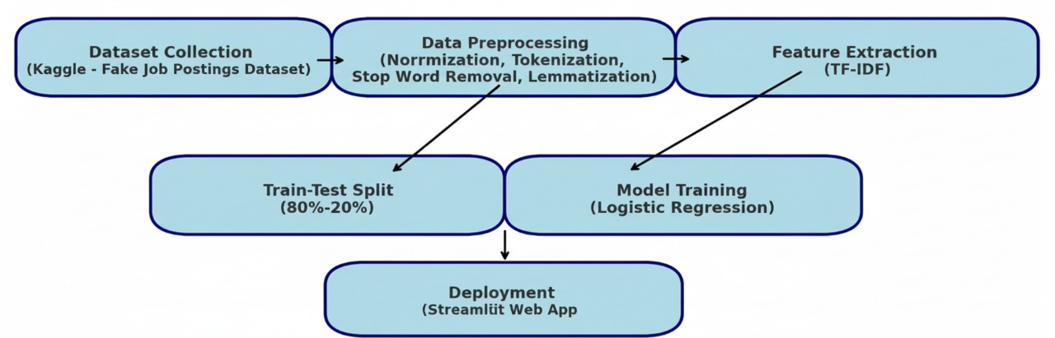
FLOWCHART OF THE PROJECT

Slide 5
DATASET COLLECTION
Source: Kaggle – Fake Job Postings Detection Dataset
Dataset Size: ~18,000 job postings
Attributes:
Text-based: title, company_profile, description, requirements, benefits
Categorical: employment_type, required_experience, required_education, industry, function
Target Label: fraudulent (0 = Real, 1 = Fake)
The dataset provides a balanced view of both real and fake job posts, ideal for classification tasks.

Slide 6
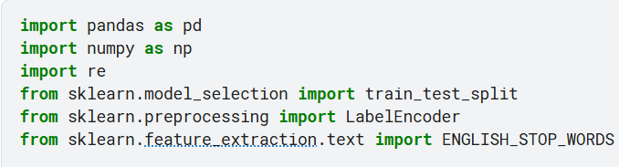
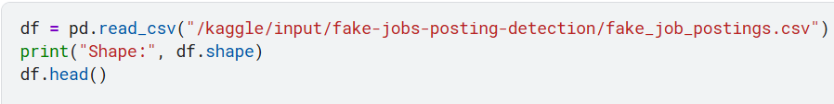
DATA PREPROCESSING NG
Step 1: Import Required Libraries
Step 2: Load Dataset

Slide 7
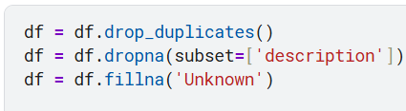
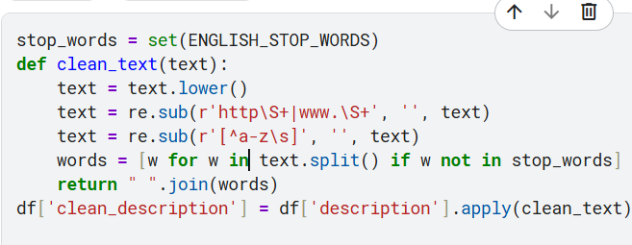
Step 3: Data Cleaning
Removed duplicates and missing values.
Dropped records without job descriptions.
Filled other missing entries with "Unknown".
Step 4: Text Preprocessing
Converted text to lowercase
Removed URLs, special characters, and numbers
Removed stop words and extra spaces
Created a clean_description column

Slide 8
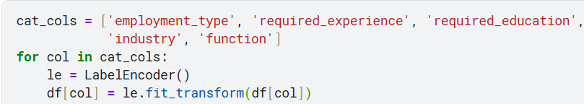
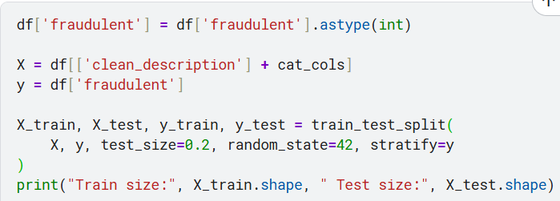
Step 5: Encoding Categorical Features
Converted categorical features to numerical form using Label Encoding.
Step 6: Target Variable & Split Data
Divided dataset into Training (80%) and Testing (20%) sets using train_test_split.

Slide 9

PREPROCESSING OUTPUT
OUTPUT:
Shape (17880, 18): Dataset has 17,880 job posts and 18 features.
Train size (14303, 6): 80% data (14,303 rows, 6 selected columns) used for training.
Test size (3576, 6): 20% data (3,576 rows, 6 columns) used for testing model performance.

Slide 10
MODEL TRAINING
Algorithm Used: Logistic Regression
Text Vectorization: TF-IDF (Term Frequency–Inverse Document Frequency)
Features: Combined text columns (title, description, requirements, benefits, etc.)
Target Variable: fraudulent

Slide 11
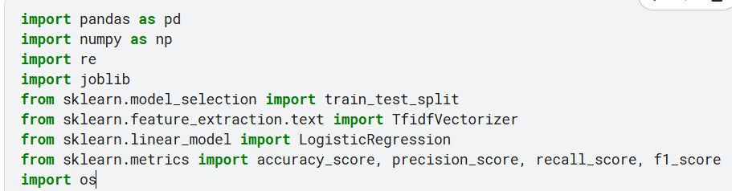
Step 1: Importing Libraries
Step 2: Data Collection
Step 3: Text Preprocessing
Step 4: Train-Test Split

Slide 12

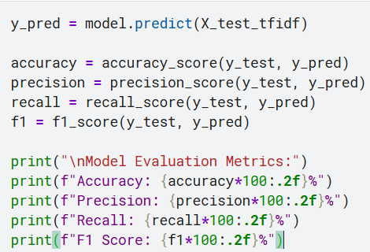
Step 5: TF-IDF Vectorization
Step 6: Model Training (Logistic Regression)
Step 7: Model Evaluation

Slide 13
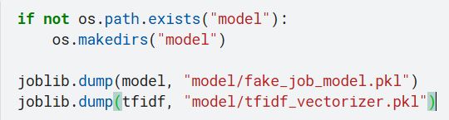
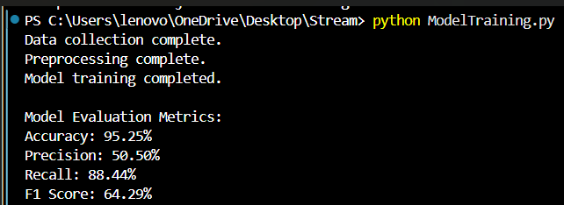
Step 8: Save Model & Vectorizer
OUTPUT:

Slide 14
STREAMLIT APP
PURPOSE: Deploy the trained model as an interactive web app for real-time fake job detection.
FEATURES:
User Input: Enter or paste job description text.
Model Prediction: Displays “ Real” or “ Fraudulent” with probability scores.
Performance Metrics: Shows accuracy, precision, recall, F1-score.
Feedback Section:
Users can mark prediction as correct or incorrect.
Feedback saved to improve model through retraining.
Retrain Button: Updates model automatically using new feedback.
TECH STACK:
Frontend: Streamlit
Backend ML: Logistic Regression (Scikit-learn)
Data Handling: Pandas, NumPy
Vectorization: TF-IDF

Slide 15
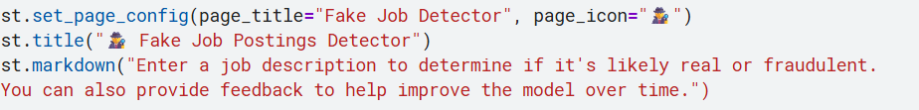
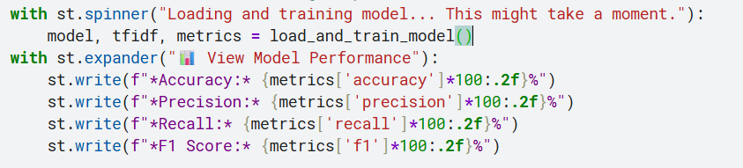
Step 1: Text Preprocessing Function
Step 2: Model Testing & Training
3. StreamLit UI
4. Model Evaluation Display

Slide 16
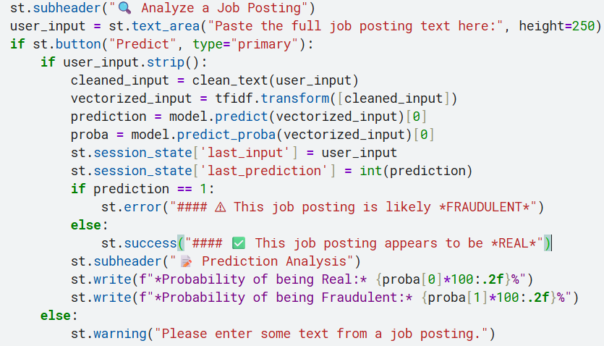
5. Prediction input

Slide 17
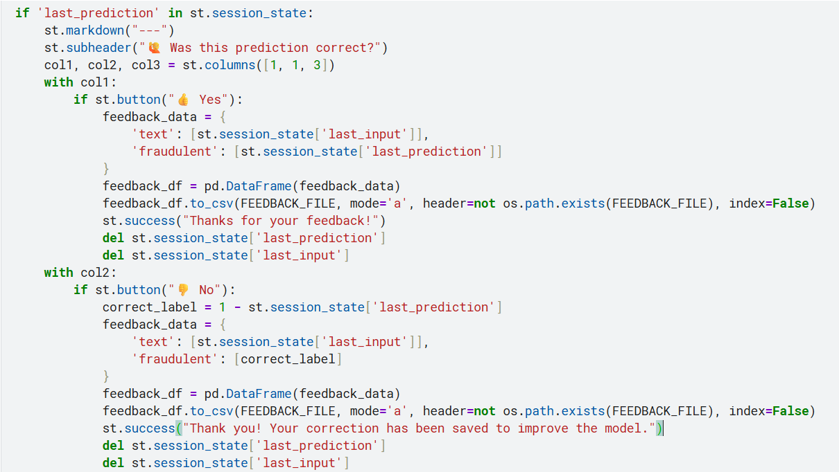
6. Feedback Section

Slide 18
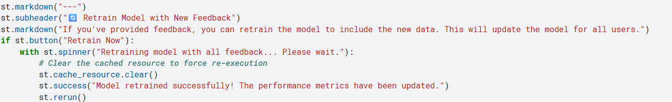
7. Retraining Feature

Slide 19
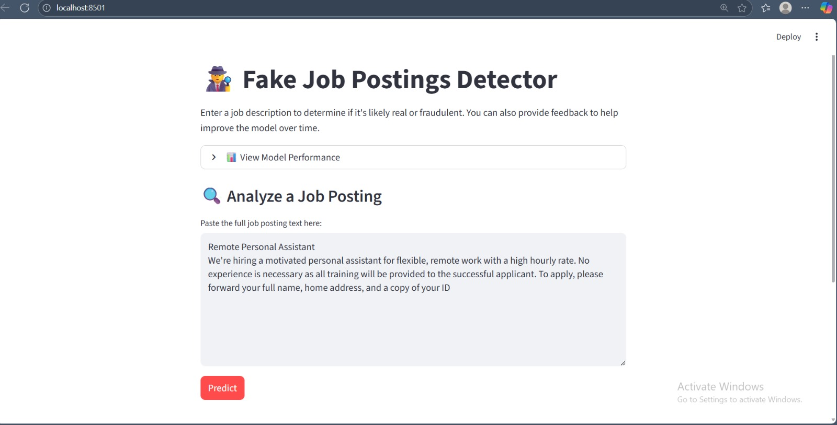
FINAL OUTPUT

Slide 20
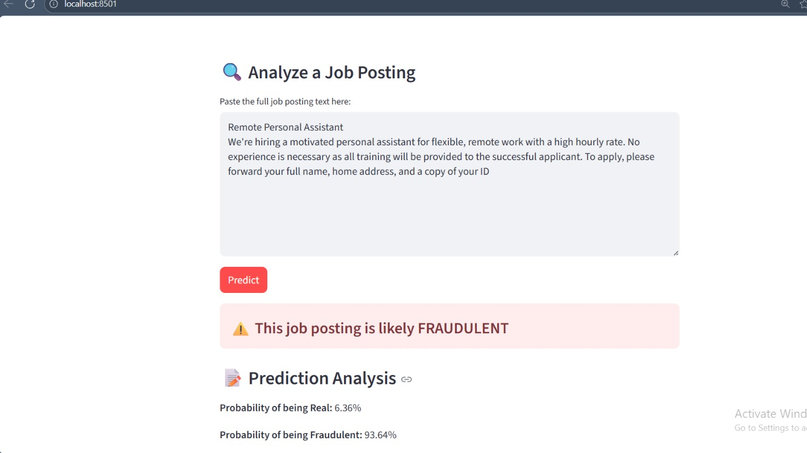

Slide 21
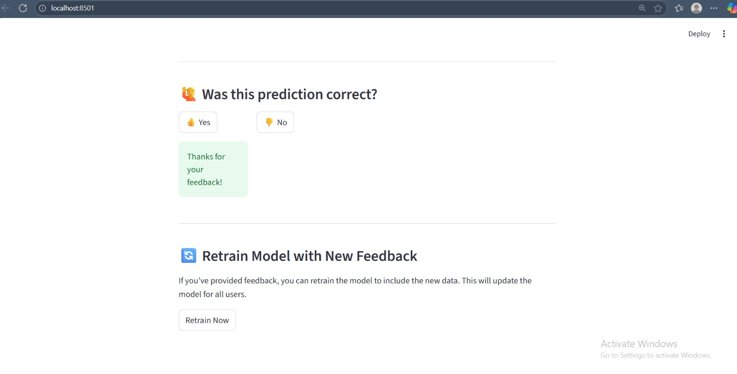

Slide 22
CONCLUSION
The JobCheck project successfully detects fake job postings using NLP.
It helps users identify scam job offers before applying.
The integration of user feedback and retraining makes the system adaptive and continuously improving.
OUTCOME:
Robust and explainable model
Real-time detection through an interactive app

Slide 23
THANK YOU

