Slide 1
ELEMENTS OF COMPUTING

Slide 2
Write a Jack code to reverse the strings “Avengers” and “redivider”.
1
DONE BY M.PRASANNA TEJA

Slide 3
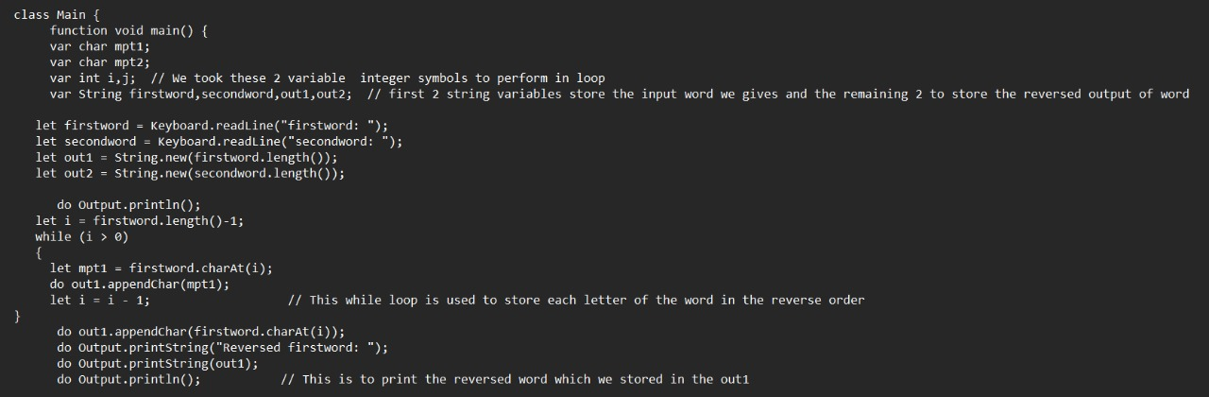
CODE

Slide 4
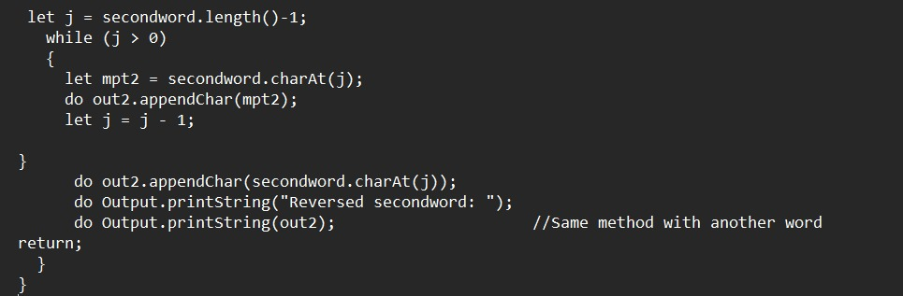
CODE

Slide 5
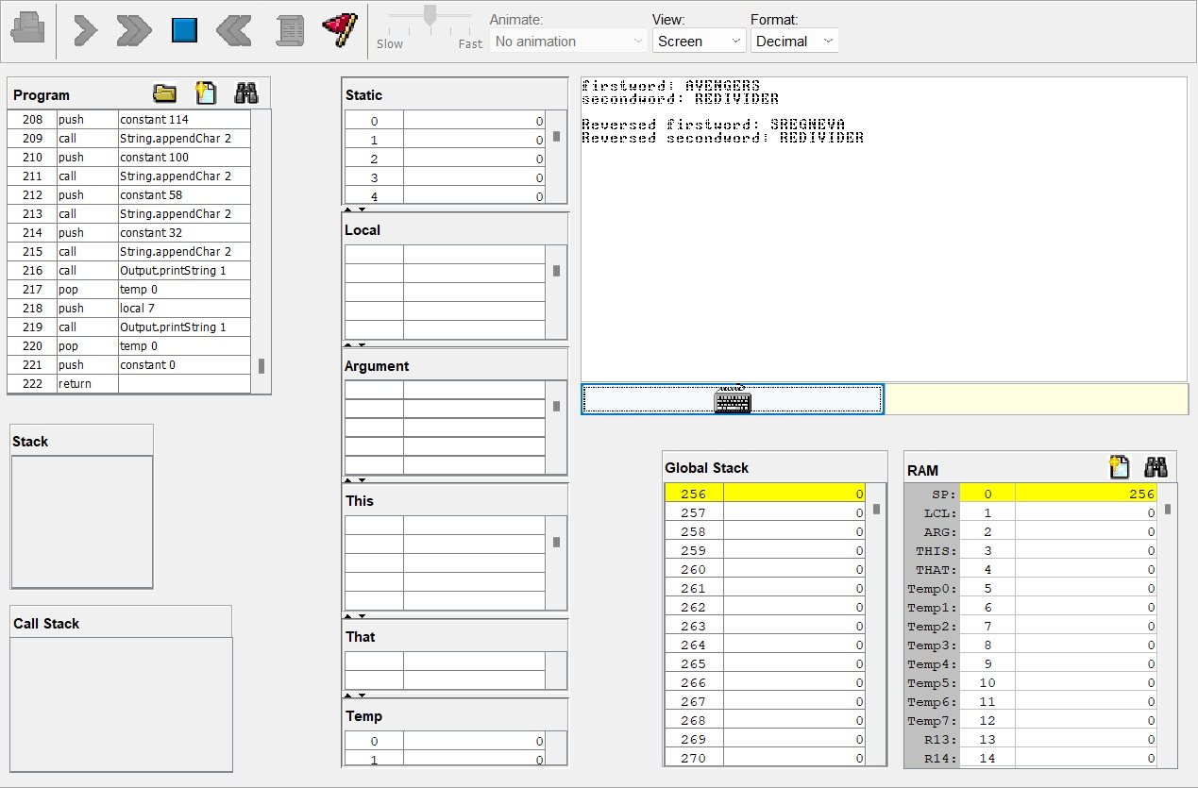
OUTPUT

Slide 6
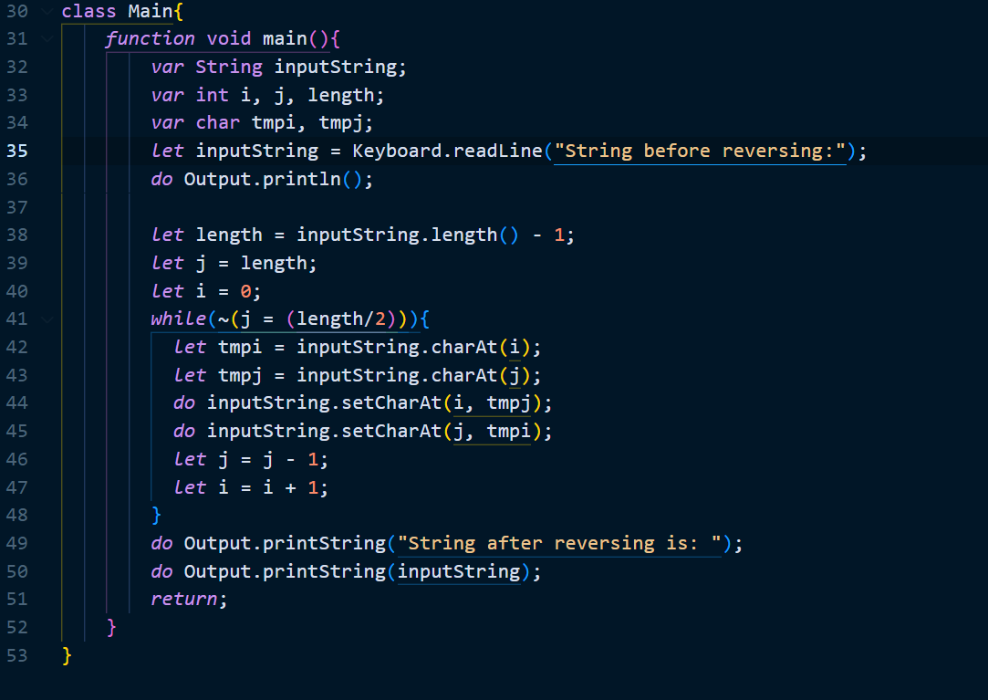
ALT-CODE

Slide 7
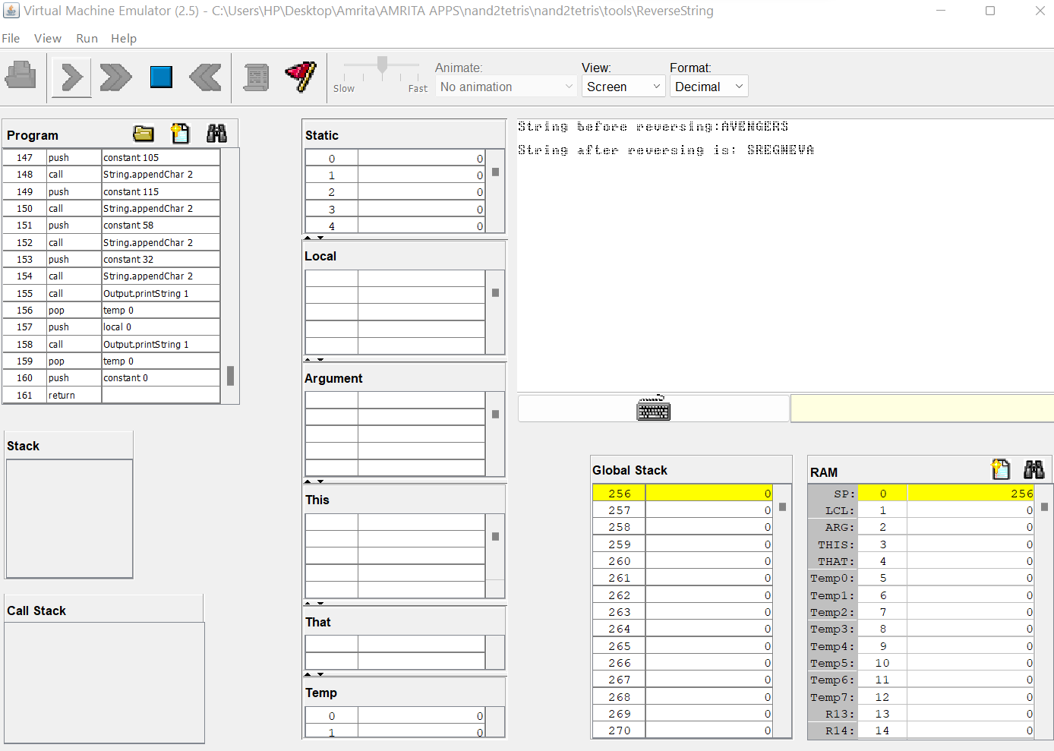
Compiler

Slide 8
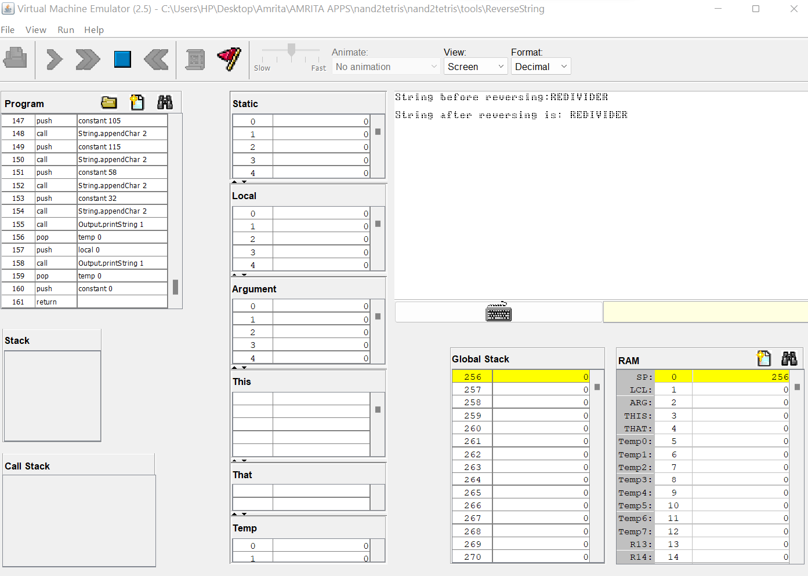
OUTPUT

Slide 9
Write a JACK program to perform MERGE sort using recursion
2

Slide 10
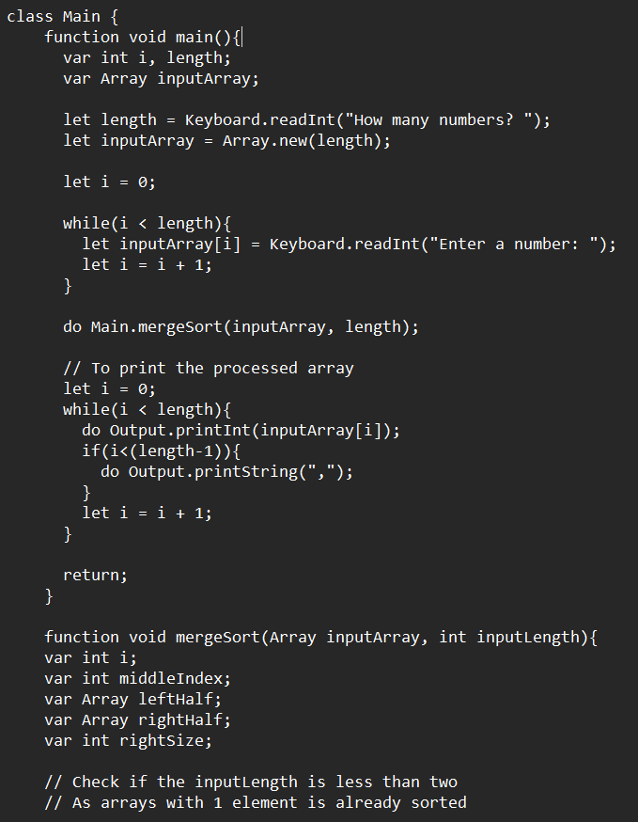
CODE

Slide 11
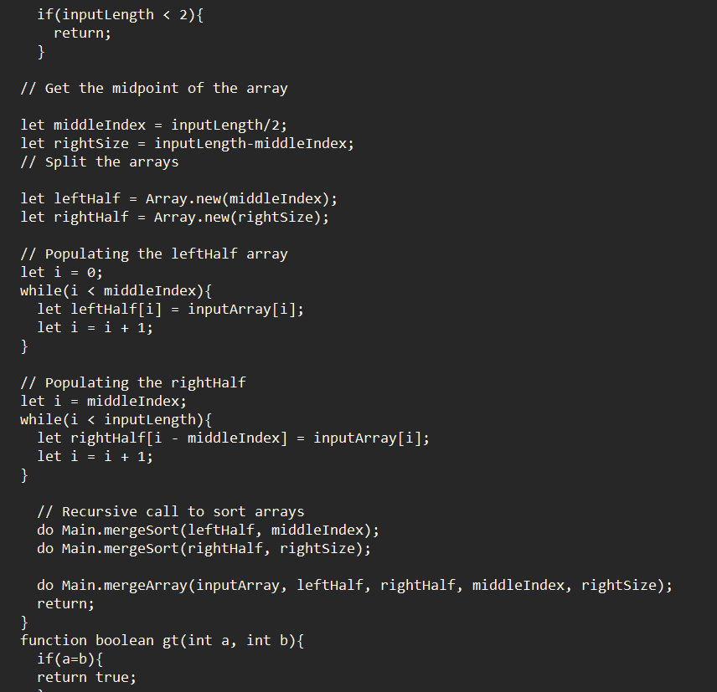
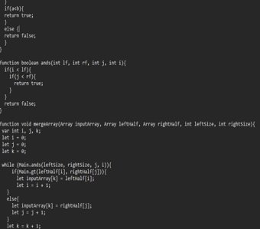
OUTPUT

Slide 12
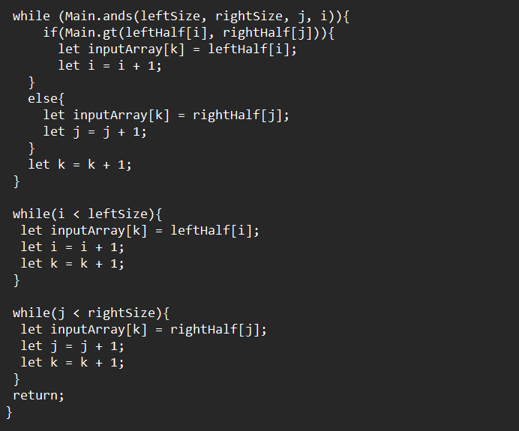
OUTPUT

Slide 13
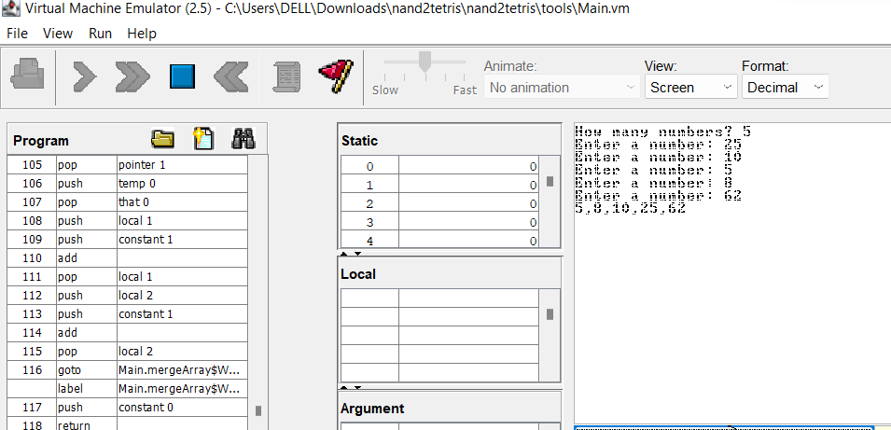
output

Slide 14
Write a JACK program to perform BINARY Search
3

Slide 15
Binary Search
1)Another divide-and-conquer-based technique is binary search, which helps locate the index of an element in a sorted array.
2)Using the merge sort method we established, we can sort the array.
3)In a nutshell, binary search is similar to looking up a word in a dictionary.
Because the dictionary is arranged alphabetically.
4)We can look for the letter by taking half of it and then checking if the letter matches if it is discovered.

Slide 16
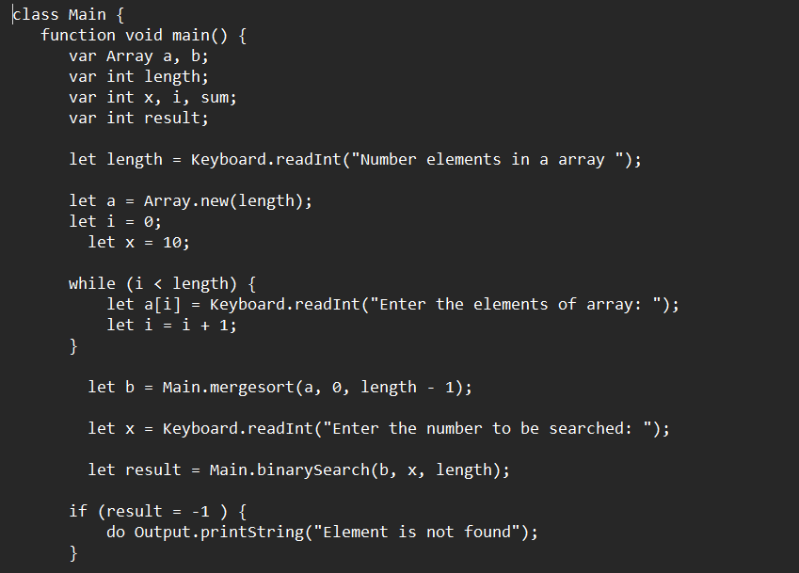
Jack code

Slide 17
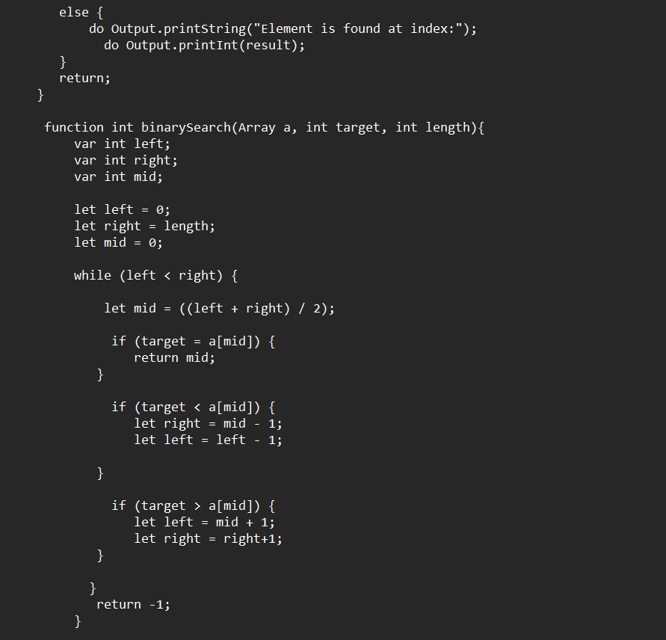

Slide 18
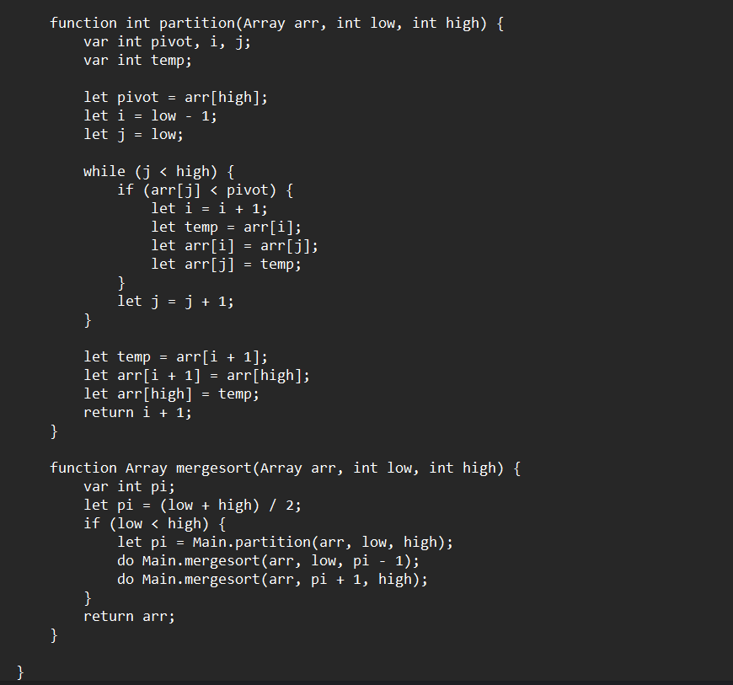

Slide 19
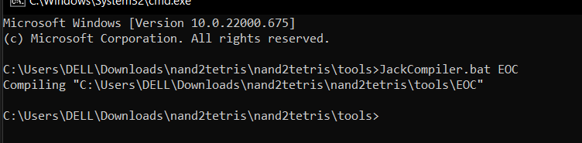
Next we have to compile that in command prompt

Slide 20
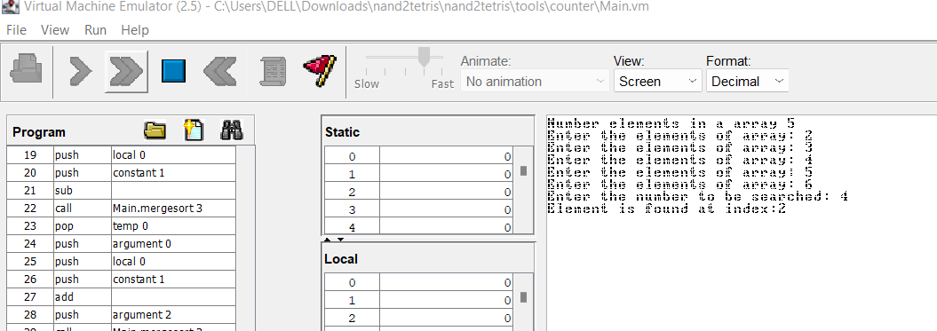
OUTPUT

Slide 21
Write a JACK program to find the smallest and largest number in an array.
4

Slide 22
We will take the length of an array as an input from user. We will take the elements of the array as an input from the user. We will create a separate function which will check whether our array contains equal elements or not. Finally, we will create a main function which will contain the while loop and if-condition which will check the smallest and largest array.
Logic

Slide 23
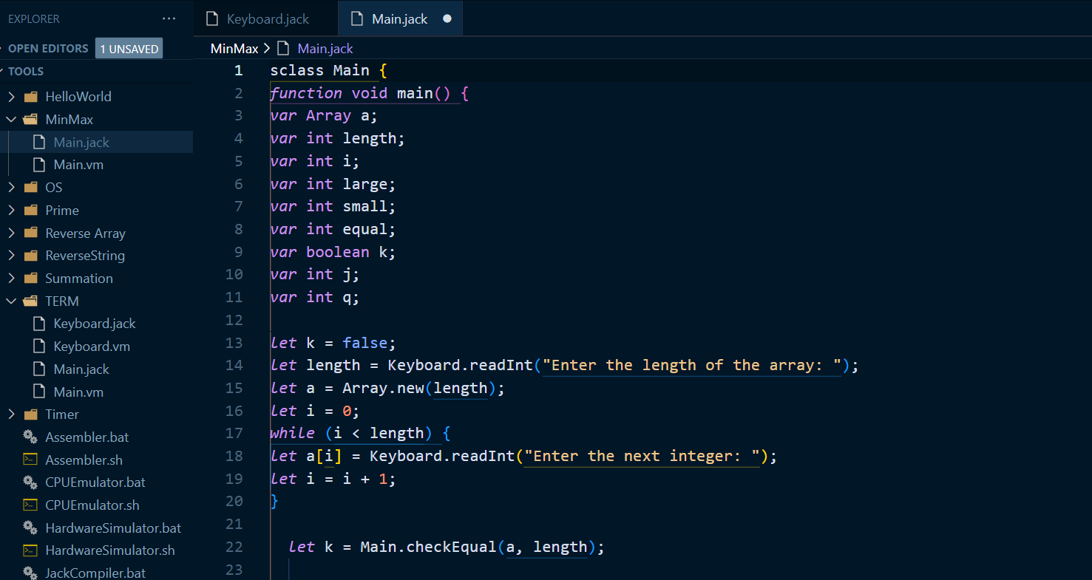
CODE

Slide 24
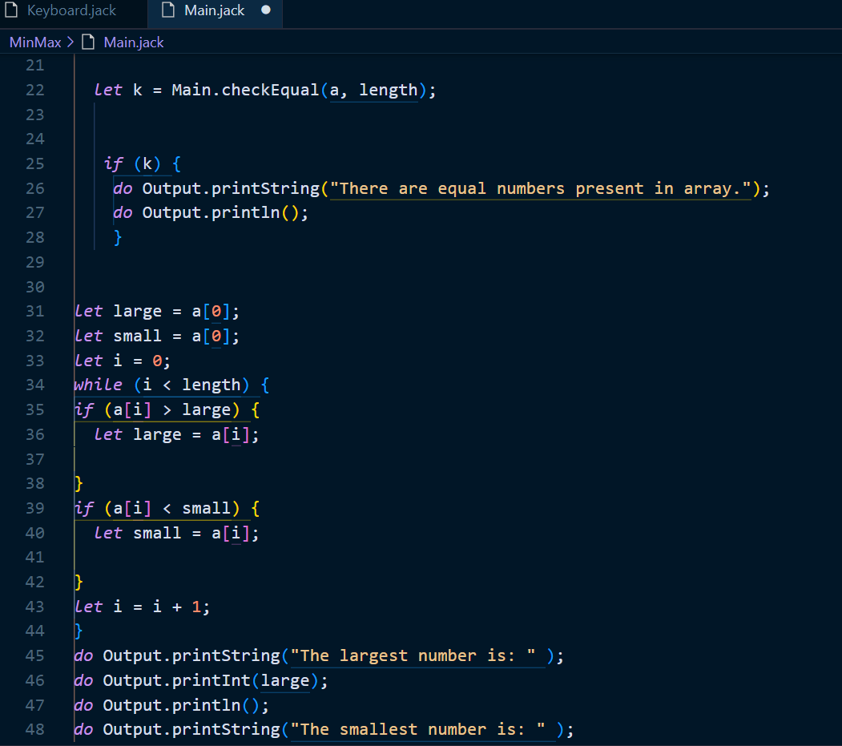
CODE

Slide 25
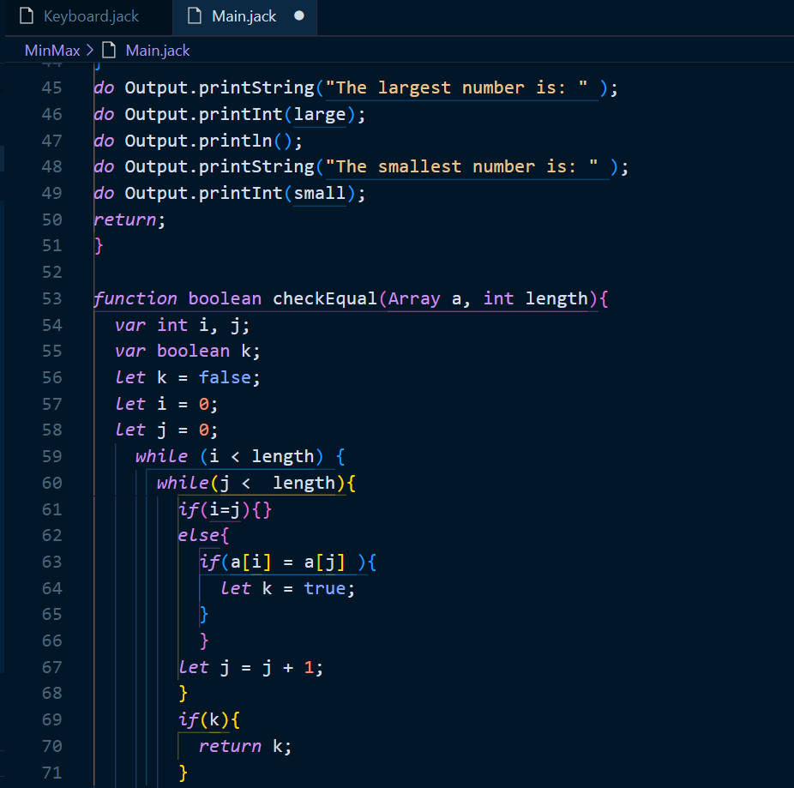
CODE

Slide 26
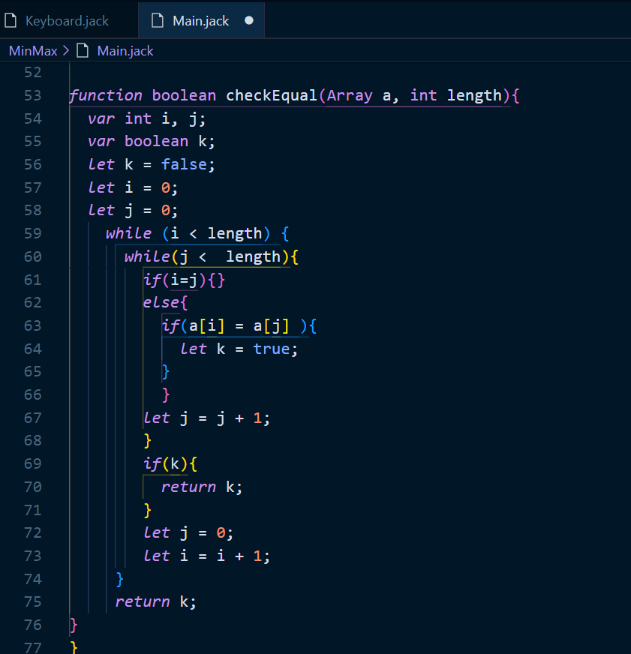
CODE

Slide 27
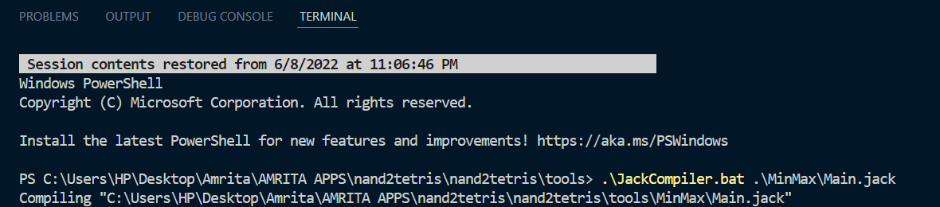
Compile

Slide 28
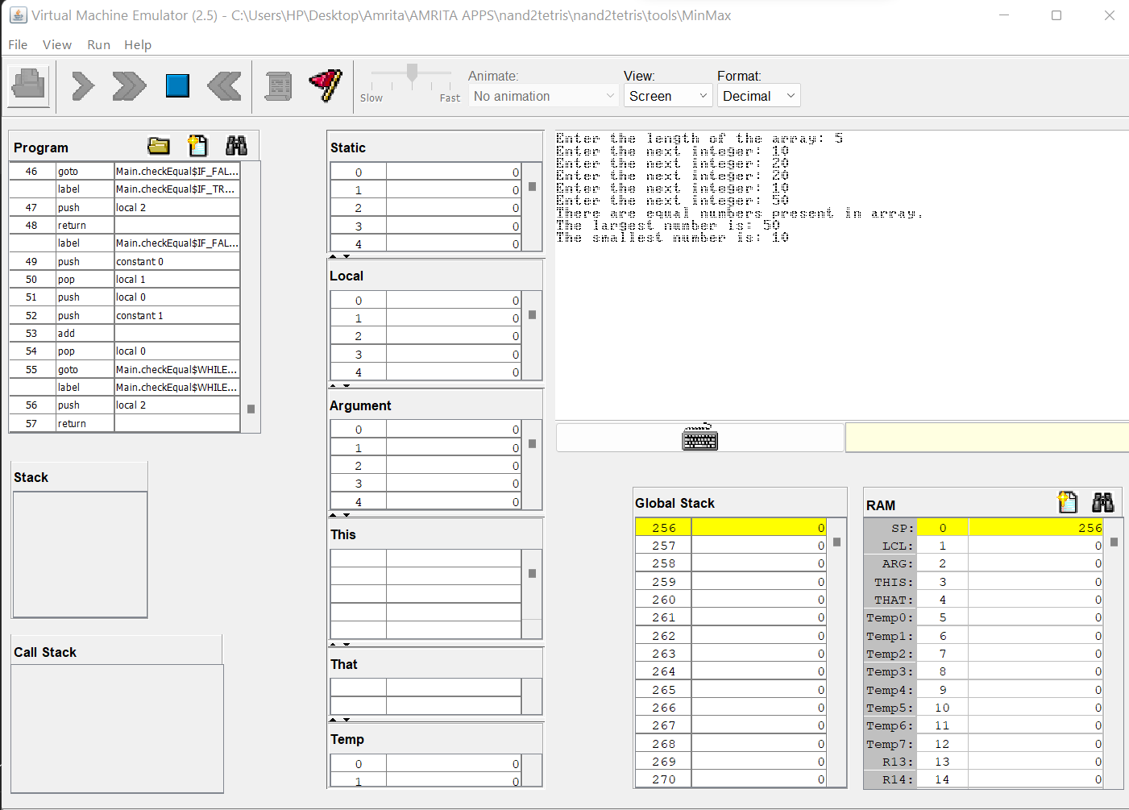
OUTPUT

Slide 29
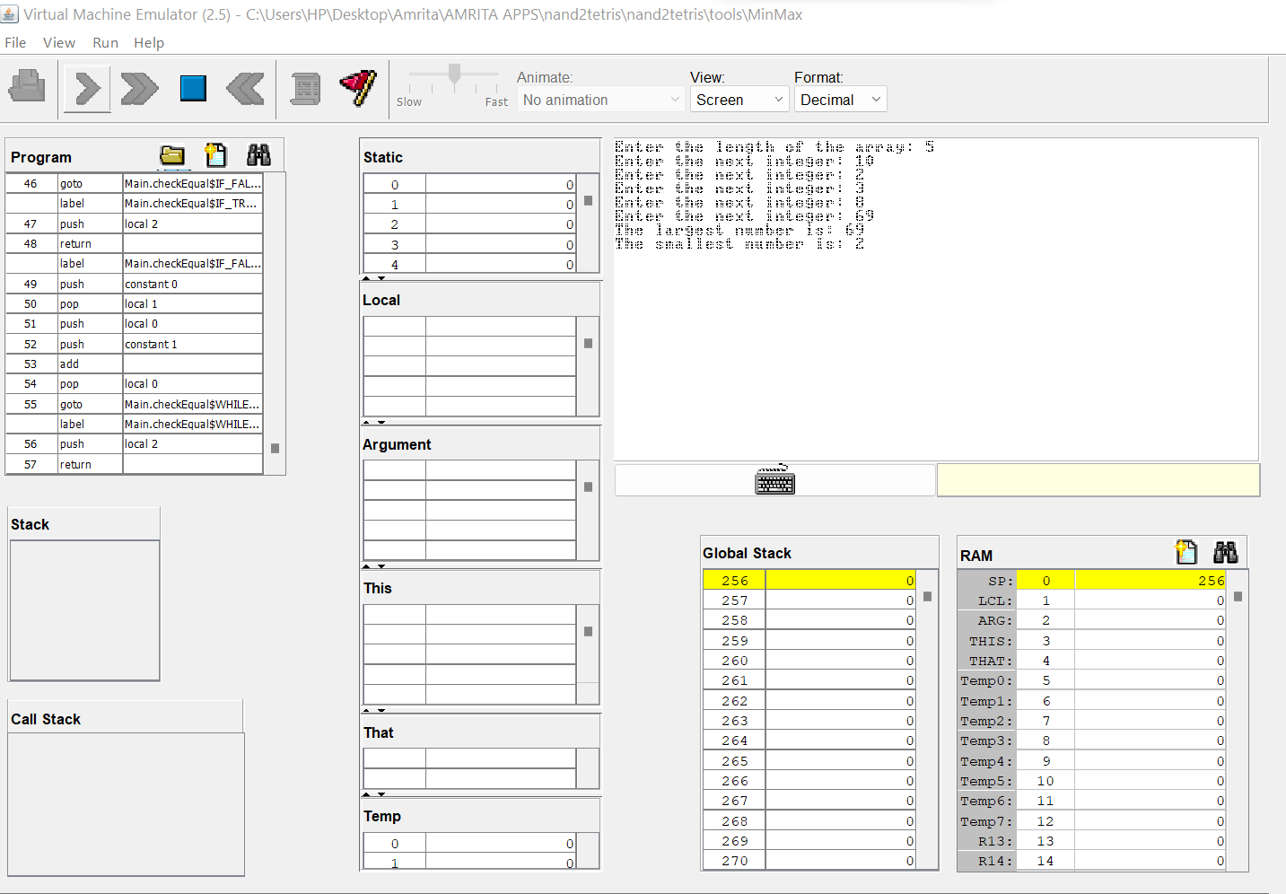
OUTPUT

Slide 30
5
Give a detailed description of JACK Syntax Analyzer. Explain various steps involved in Tokenizer and Parser including the API
DONE BY M.PRASANNA TEJA

Slide 31
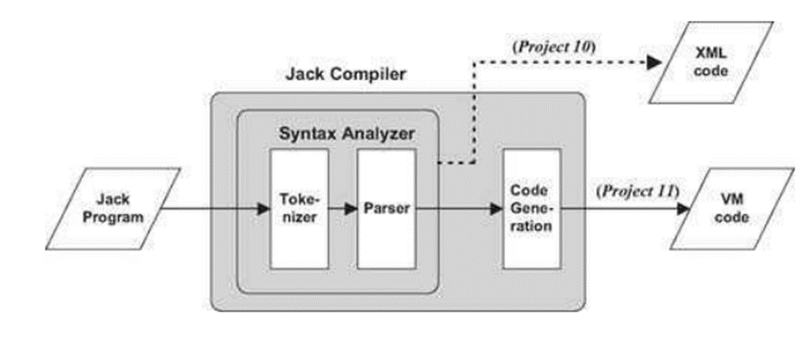
CODE
Jack being a high-level language needs to be compiled into VMCode (then to assembly).
Various steps are undergone till the compiler can output VMCode.
Programming languages are usually described using a set of rules called context-free grammar.

Slide 32
Syntax analyzer is one of the integral part in converting the high-level Jack code to VMCode.
The syntax analyzer has mainly two part:
Tokenizer
Parser
The Tokenizer groups characters into tokens.
The parser has a set of rules which help it to parse the code.

Slide 33
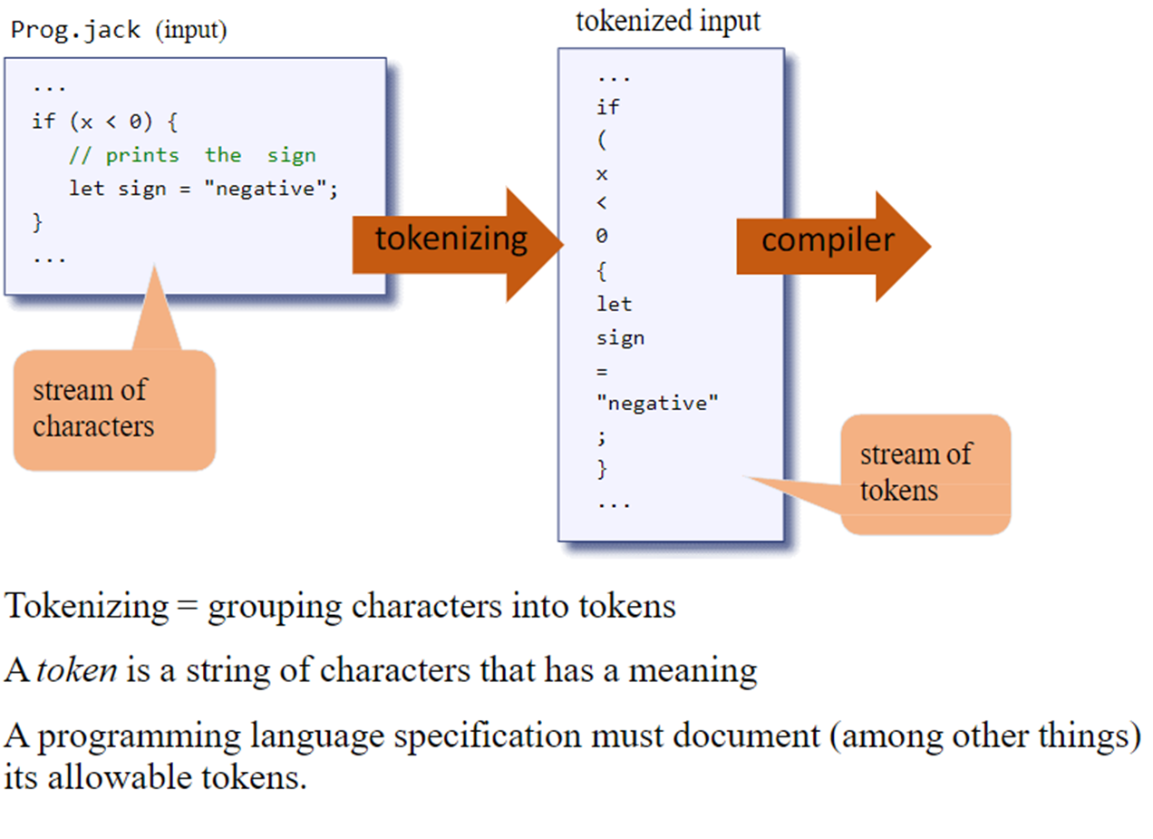
Tokenizer:

Slide 34
The first step in the syntax analysis of a program is to group the characters into tokens (as defined by the language syntax), while ignoring white space and comments.
This step is usually called lexical analysis, scanning, or tokenizing.
Once a program has been tokenized, the tokens (rather than the characters) are viewed as its core component and the tokens stream becomes the main input of the compiler.

Slide 35
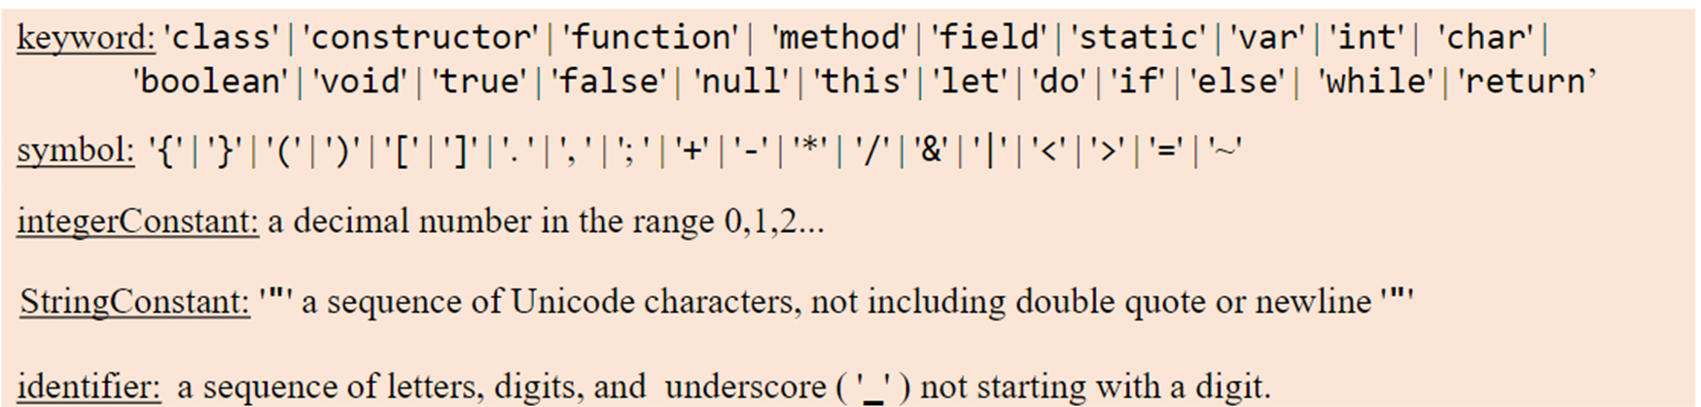
Jack Tokens include:
Keywords
Symbols
Integers
Strings
Identifiers

Slide 36
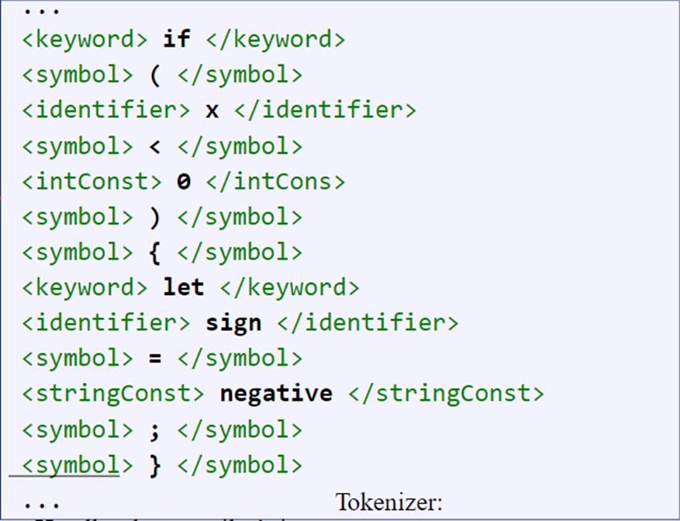
After Tokenization
As observable, each of the language 'items' has been classified, tokenized.
This step also helps to verify the correctness of the compiled program by checking the XML file.

Slide 37
PRASER
The act of checking whether a grammar “accepts” an input text as valid is called parsing.
A grammar is a set of rules, describing how tokens can be combined to create valid language constructs.
Since the grammar rules are hierarchical, the output generated by the parser can be described in a tree-oriented data structure called a parse tree or a derivation tree.

Slide 38
The parser that Jack uses (included with Nand2tetris) represent the program’s structure implicitly, generate code and reporting errors on the fly.
Such compilers don’t have to hold the entire program structure in memory, but only the subtree associated with the presently parsed element.

Slide 39
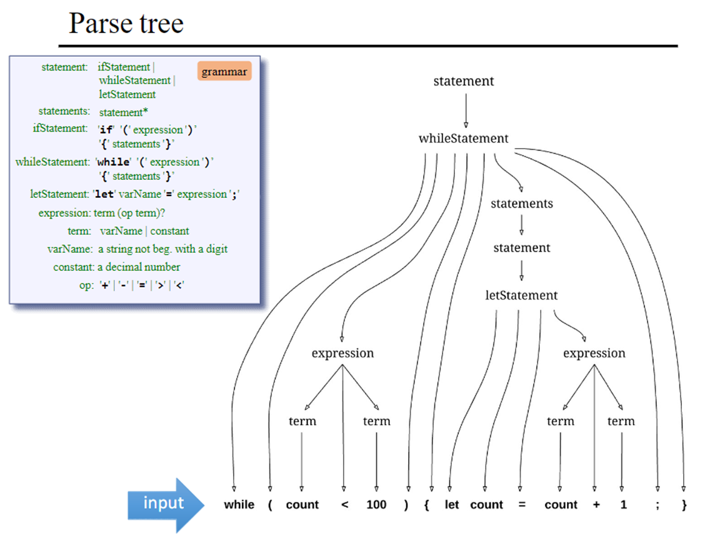
PARSE TREE
The parse tree is the representation of the "Recursive Descent Parsing" method employed.
The parser consists of a set of compile xxxmethods
Each compile xxx method implements the right-hand side of the grammar rule describing xxx.

Slide 40
JACK SYNTAX ANALYZER
The Syntax analyzer when run in a directory with .jack files will translate it to readable .XML files and save it to the same directory and also maintains the file name.
Each .jack file is a stream of character, and these characters are tokenized by the Syntax Analyzer.
The tokens may be separated by an arbitrary number of space characters, newline characters, and comments, which are ignored.

Slide 41
Comments are of the standard formats /* comment until closing /, /* API comment */, and // comment to end of line.
The Syntax Analyzer has three modules:
Jack Analyzer: top-level driver that sets up and invokes the other modules.
Jack Tokenizer: tokenizer.
Compilation Engine: recursive top-down parser.
The Jack Tokenizer ignores all comments and white spaces in the input stream and serializes it into Jack-Language tokens.

Slide 42
CONSTRUCTOR
Arguments: Input File/Stream.
Function: Opens the input file/stream and gets ready to tokenize it.
hasMoreTokens
Checks if there is more tokens in the input and returns a Boolean.
Returns true if there is more tokens else returns false.

Slide 43
advance
Gets the next token from the input and makes it the current token.
This method should only be called if hasMoreTokens() is true.
Initially there is no current token.
Token Type
Returns the type of current token.

Slide 44
Return types:
Keyword
Symbol
Identifier
INT_CONST
STRING_CONST

Slide 45
SYMBOL
Returns the character which is the current token. Should be called only when tokentype() is SYMBOL.
Return Type:
Char
Identifier
Returns the identifier which is the current token. Should be called only when tokenType() is IDENTIFIER
Return Type:
String

Slide 46
intVal
Returns the integer value of the current token should be called only when tokenType() is INT_CONST.
Return Type:
Int
stringVal
Returns the string value of the current token, without the double quotes Should be called only when tokenType() is STRING_CONST.
Return Type:
String

Slide 47
COMPILATION ENGINE
Gets its input from a Jack Tokenizer and emits its parsed structure into an output file/stream.
The output is generated by a series of compilexxx ( ) routines, one for every syntactic element xxx of the Jack grammar.
The contract between these routines is that each compilexxx ( ) routine should read the syntactic construct xxx from the input, advance ( ) the tokenizer exactly beyond xxx, and output the parsing of xxx.

Slide 48
This module emits a structured printout of the code, wrapped in XML tags. In the final version of the compiler, this module generates executable VM code.
Thus, compilexxx ( ) may only be called if indeed xxx is the next syntactic element of the input.

Slide 49
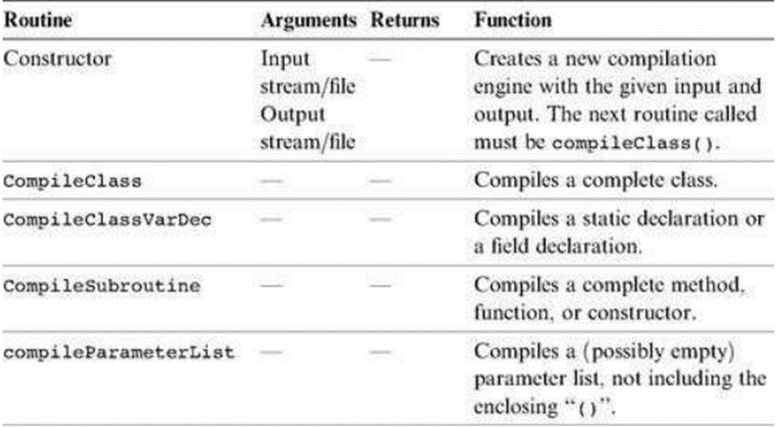
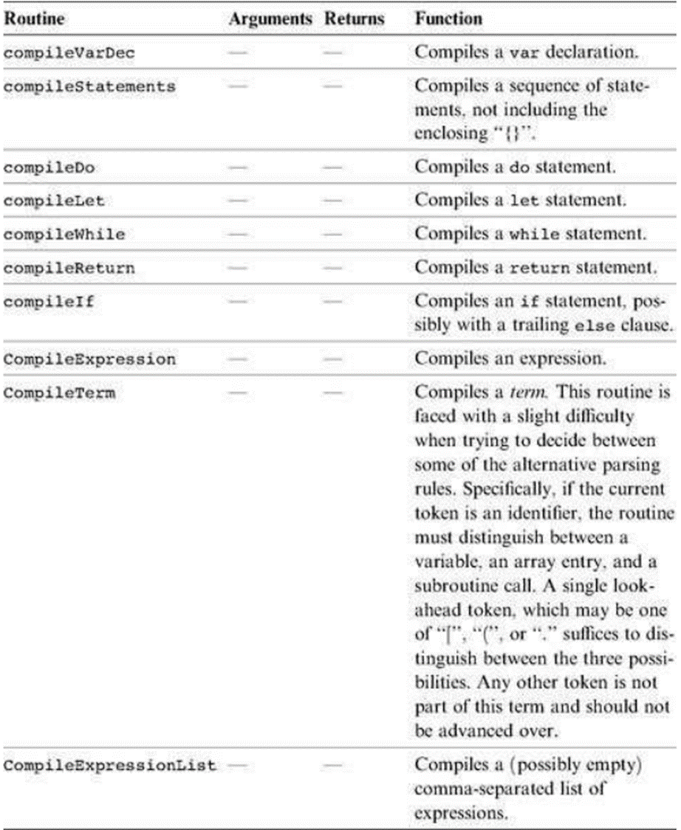

Slide 50
THANK YOU

