Slide 1
Assignment:19AIE104 Introduction to Electrical Engineering
SUBMITTED BY BATCH A GROUP 11
Names of Group members :
1. VIKHYAT BANSAL[CB.EN.U4AIE21076]
2. VIGNESH M [CB.EN.U4AIE21075]
3. YARRAM SRI SATHWIK REDDY [CB.EN.U4AIE21077]
4.MARREDDY MOHIT SASANK REDDY[CB.EN.U4AIE21031]

Slide 2
For the DC generator with specification as below, analyze and comment on the relationship between the following parameters:-
1.
1. Rating -- 200 V, 1500 RPM
2. 4 Poles, 50 mWb
1.Generated EMF and Magnetic flux intensity
2.Generated EMF and Speed of rotation
3.Magnetic Flux and Speed of rotation
Prove your analysis with respective plots. Submit the
supporting files used for plotting.
3. Assume that EMF generated is available at the output​
While assessing the inter-dependence of parameters, consider the remaining parameters if any, to be constants.

Slide 3
GIVEN;
1. Rating -- 200 V, 1500 RPM
2. 4 Poles, 50 mWb
3. Assume that EMF generated is available at the output
I.e the generated emf=generated output
SOLTUION:
So, to get a relation between the number of armature conductors (Z) and the number of parallel paths(A)
E_{g}=((N*ϕ*Z)*P)/(60*(A)) E_{g} : EMF Generated
E_{g}=200 ϕ : Magnetic Flux Intensity
200=(1500*50*10^(-3)*4*Z)/(60*A) P : Number of Poles
2A=(0.05*Z) N : Speed of armature in rpm
Z=40*A equation (1) A: Number of Windings
Z: Total number of Armature Conductors
Now , we got a relation between Z and A

Slide 4
1. Relation between GENERATED EMF (E_{g}) AND MAGNETIC FLUX INTENSITY(ϕ)
E_{g}=(1500*ϕ*Z*P)/(60*A)
From equation (1),
E_{g}=(1500*ϕ*P*(40*A))/(60*A)
E_{g}=(1000*A*ϕ*P)/A
E_{g}=4000*ϕ equation (2)

Slide 5
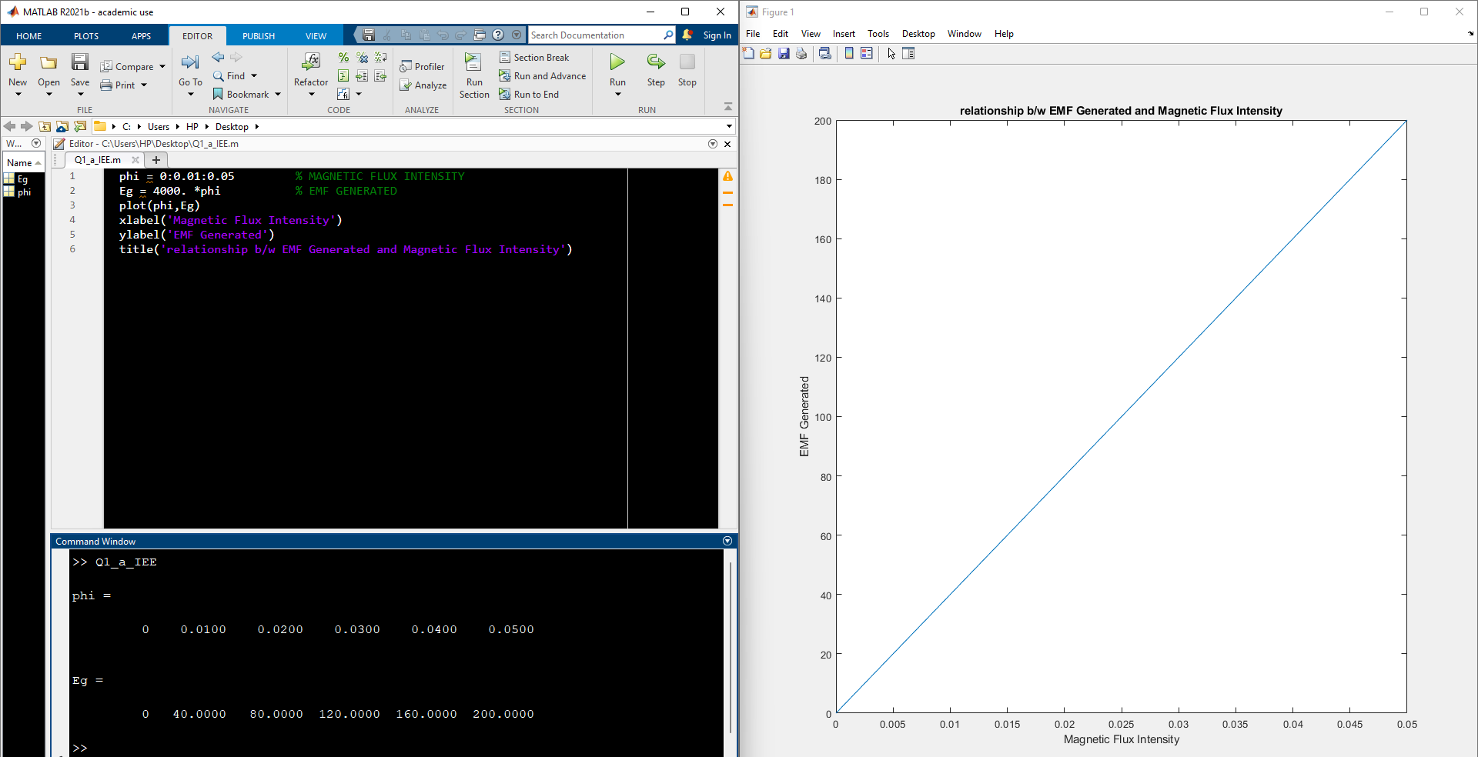
GRAPH:
Now let's write a MATLAB code for relation between E_{g} and ϕ .

Slide 6
2. Relation between GENERATED EMF (E_{g}) AND SPEED OF ROTATION.
E_{g}=(0.05*Z*N*P)/(60*A)
E_{g}=(0.05*N*40*4)/(60*A)
E_{g}=(4*N)/30 equation (3)
Now we got relation between E_{g} and N.

Slide 7
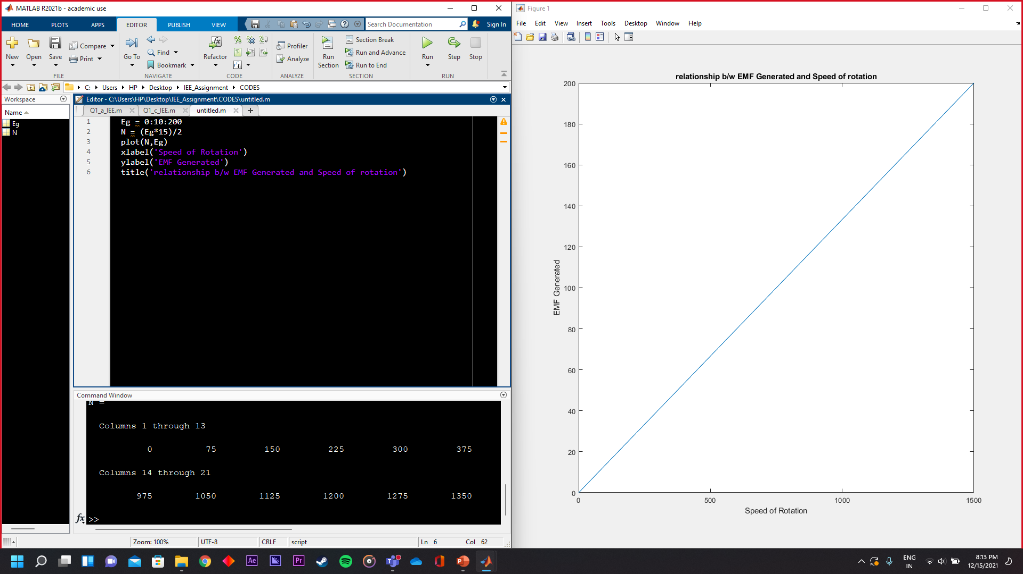
GRAPH:
Now let us write a MATLAB code for graph

Slide 8
3. Relation between MAGNETIC FLUX INTENSITY AND SPEED OF ROTATION.
E_{g}=(Z*ϕ*N*P)/(60*A)
From equation (1)
E_{g}=(ϕ*40*A*N*P)/(60*A)
200=(ϕ*40*A*N*4)/(60*A)
ϕ =75/N equation (4)
Now we got a relation between ϕ and N

Slide 9
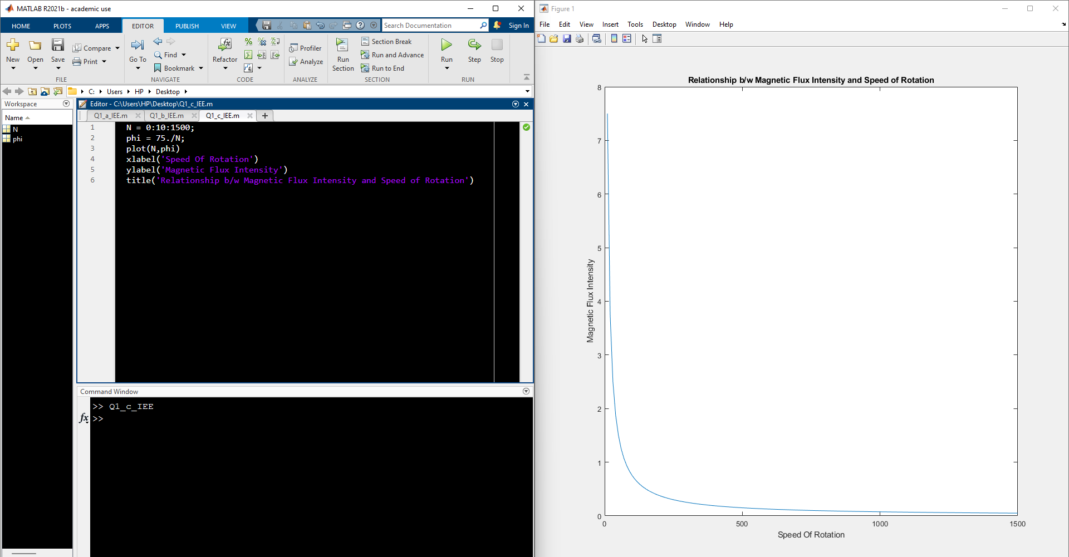
GRAPH:
Now let us write the MATLAB code for graph.
Relation between E_{g} and N.

Slide 10
The magnetic flux and the rotating speed of a DC generator is changed relative to each other such that the generated voltage is constant. The range of variation of flux is 5 to 10mWb and that of speed is 1000 to 1500 RPM. If the generated voltage is 250 V at 1500 RPM and 5mWb, plot the flux vs speed characteristics.
A)In Q2, if the flux is maintained constant at 8 mWb, plot the EMF generated vs speed characteristics
B)In Q2, for a feasible constant speed of rotation of your choice, plot the EMF vs flux characteristics
2

Slide 11
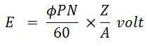
Sol :
We know that,
EMF generated
ϕ = Flux (or)pole in Wb
Z = Total no .of armature conductors
P = No .of poles
N = Speed of armature in rpm
A = No . Of parallel paths
Given that,
E = 250v
N = 1000 to 1500 rpm
Flux = 5 to 10m Wb

Slide 12
250 = (5*10^-3*1500/60)*(Z/A)
Solving this we get
Z/A = 2000
If the generated voltage is 250 V at 1500 RPM and 5mWb, plot the flux vs speed characteristics.
BY this in the given question,
We can write the equation as
250 = (ϕ*N)*(2000/60)
ϕ = 7.5*(1/N)
Plotting graph using Matlab

Slide 13
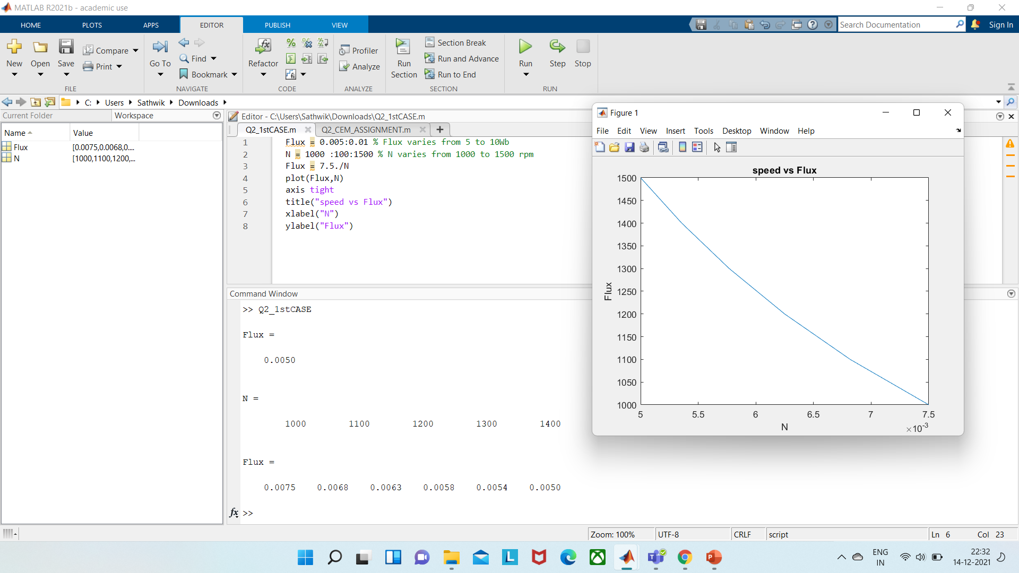

Slide 14
A)In Q2, if the flux is maintained constant at 8m Wb, plot the EMF generated vs speed characteristics
Given that,
Total Flux =8mWb
Eg = (Z*N/60*A)*ϕ*P
[ Z/A =2000 ]
[ϕ*P = total Flux]
= ((2000/60)*(8*10^-3)*N)
Eg = 0.266N
From this we can calculate the graph of EMF generated vs speed character's
Using Matlab.

Slide 15
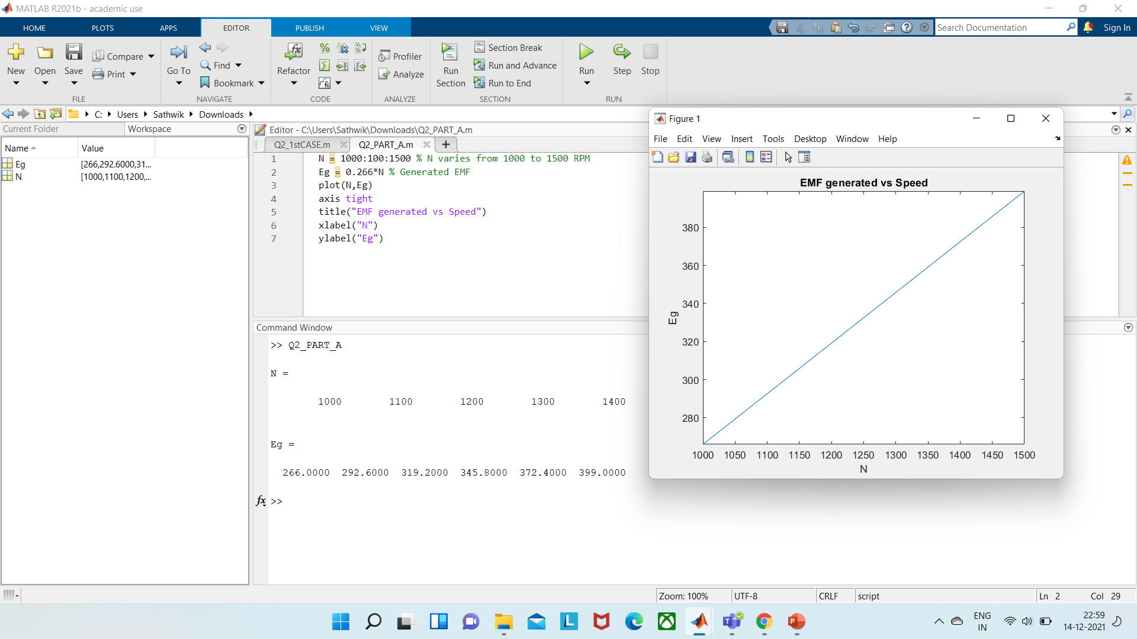

Slide 16
B)In Q2, for a feasible constant speed of rotation of your choice, plot the EMF vs flux characteristics
I'm taking
N = 1500 rpm
Eg = ((2000*1500/60)*ϕ*P)
[ϕ*P = total Flux]
Eg = 50000*Total Flux
From this we can calculate the graph of EMF generated vs Flux
Using Matlab.

Slide 17
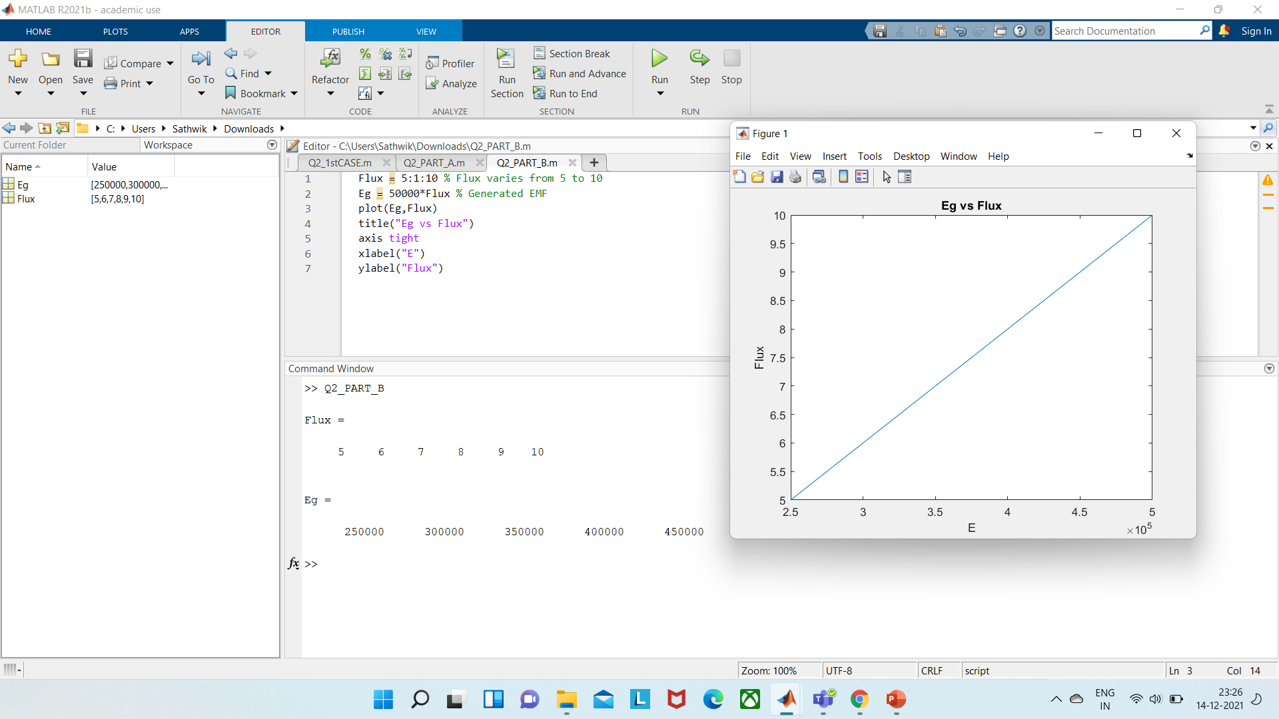

Slide 18
3.
A DC generator is to be constructed with armature winding of resistance 0.1Ω and field winding of 5KΩ. The generator output voltage supposed to be stable at 220V while supplying a load of 2.2KW alongside powering up the field winding.

Slide 19
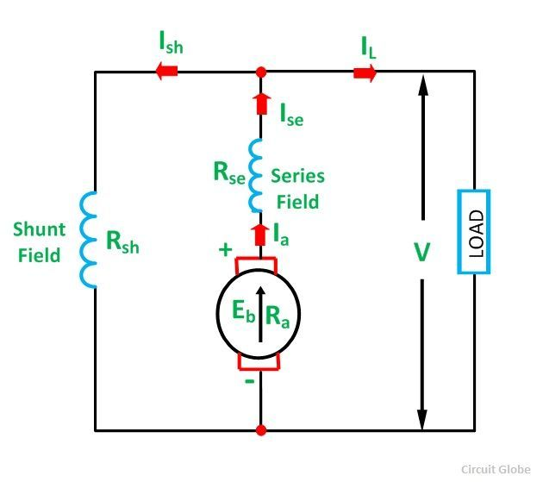
A ) With the above instructions decide which type of DC generator construction is suitable for this application .
SHUNT EXCITED DC GENNERATO (DC cumulative compound generator) is suitable for this application which gives most stable VOLTAGE output and power loss is less.

Slide 20
B) Plot the V-I characteristics for the opted generator model, if the load current varies from 0 to 10A.
Given that ,
Terminal voltage (v) = 220V
Number of poles (P) = 2200
Armature resistance ( R_{a} ) = 0.1
Resistance field winding ( R_{sh} ) = 5000
Shunt field current (Ish) = V/R_{sh}
Series field current (Ia) = I_{L} + I_{sh}

Slide 21
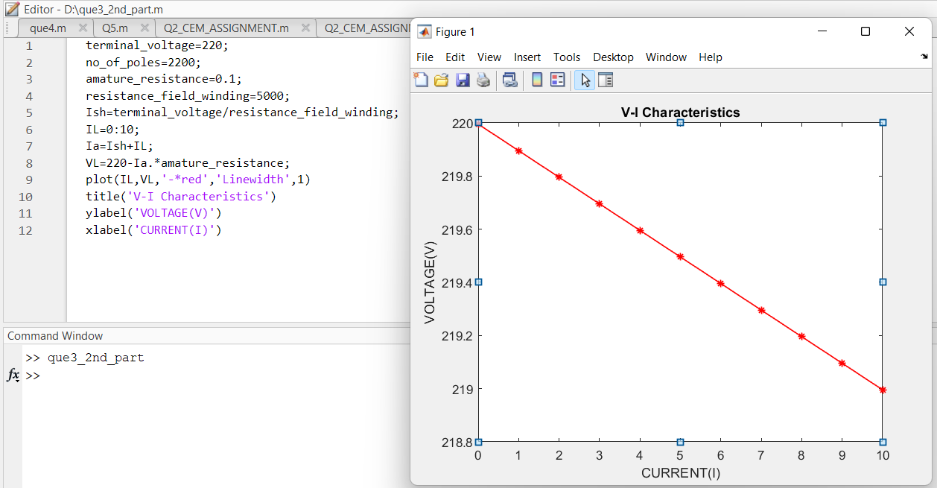

Slide 22
THANK YOU

