Slide 1
IEE(19AIE102)
VIVA PPT-1

Slide 2
TEAM-11 BATCH-A
TEAM MEMBERS
VIKHYAT BANSAL[CB.EN.U4AIE21076]
VIGNESH M [CB.EN.U4AIE21075]
YARRAM SRI SATHWIK REDDY [CB.EN.U4AIE21077]
MARREDDY MOHIT SASANK REDDY[CB.EN.U4AIE21031]

Slide 3
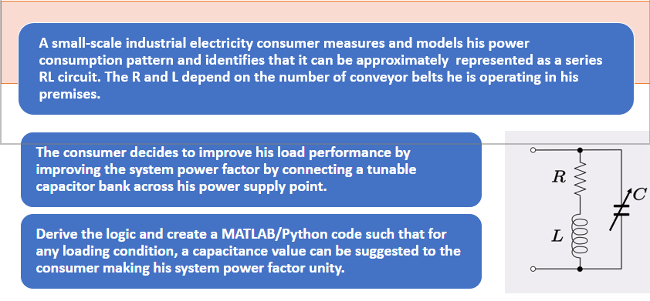
QUESTION:

Slide 4
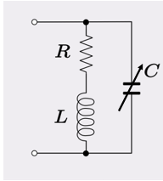
1) the resistor and inductor part:
Z₁=(R² +X_{L}²)^{½}
2)the capacitor part:
Z₂=(R² + X_{c}²) ^{½}
Since R=0
Z₂=(X_{c}²)^{½}
Since Z₁ & Z₂ are parallel then ,
1/Z_{eff}=1/Z₁+1/Z ₂
1/Z_{eff} = 1/(R² +X_{L}²)^{½} + 1/X_{c}

Slide 5
For the power factor to be unity . The required condition will be R=Z ( cosΦ = R/Z=1)
So , R=Z i.e. 1/R=1/Z
1/R= 1/(R² +Xc²)^{½} +1/X_{c}
1/X_{c}=((R² +X_{L}²)^{½} - R)/R*(R² + XL²)^{½})
X_{c}=R*(R² + X_{L}²) ^{½}/((R² +X_{L}²)^{½} - R)
For MATLAB code,
Consider y=(R² +X_{L}²)^{½}

Slide 6
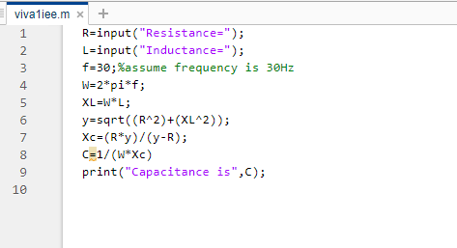
MATLAB CODE FOR CAPACITANCE VALUE:

Slide 7
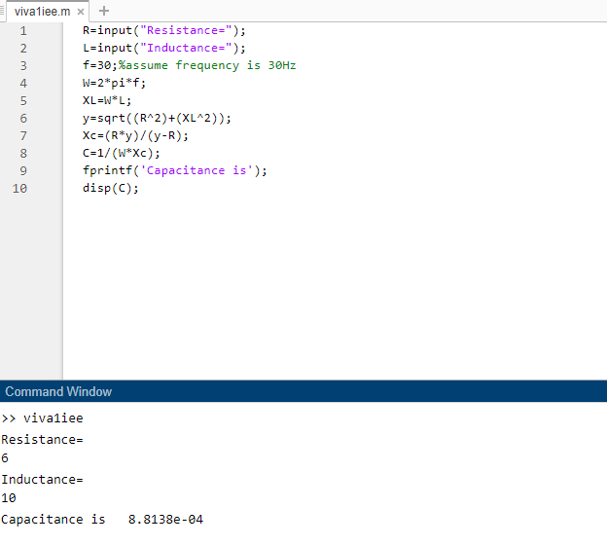
TESTING THE CODE USING SOME RANDOM VALUES OF R AND Z:

Slide 8
Thank you!

