Slide 1
EOC W3 VIVA PPT-1

Slide 2
TEAM-11 BATCH-A
TEAM MEMBERS
VIKHYAT BANSAL[CB.EN.U4AIE21076]
VIGNESH M [CB.EN.U4AIE21075]
YARRAM SRI SATHWIK REDDY [CB.EN.U4AIE21077]
MARREDDY MOHIT SASANK REDDY[CB.EN.U4AIE21031]

Slide 3
Design an 8-bit ALU, which can perform arithmetic and logic operations. Implement the chip logic designed in HDL and test the chip using a hardware simulator (Use interactive simulation). Show the output of x+y, x&y, !x (Take 'x' as your group number and 'y' as 63 in the three operations given, wherever applicable).
01

Slide 4
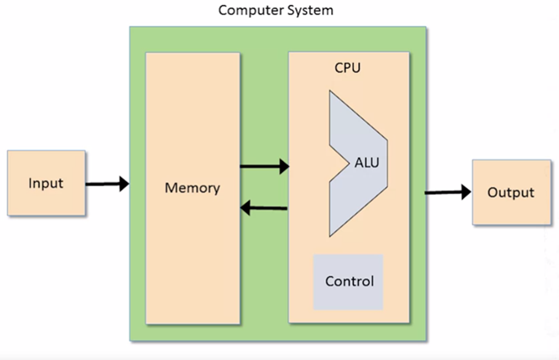
The Arithmetic Logical Unit

Slide 5
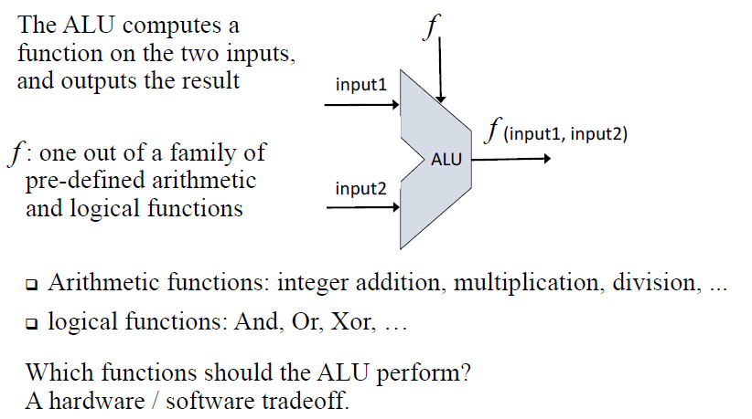
WHAT IS AN ALU?
The Arithmetic Logical Unit

Slide 6

The Hack ALU
Operates on two 8-bit, two’s complement values
Output a 8-Bit, two’s complement value
Which function must be used with the two input bits is set by 1-bit inputs.
Computes one out of a family of 18 functions
Also outputs two 1-Bit value namely zr ,ng

Slide 7
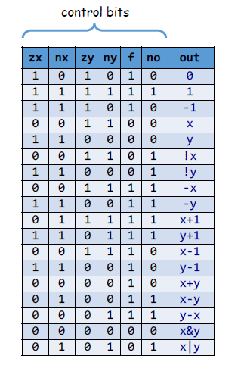
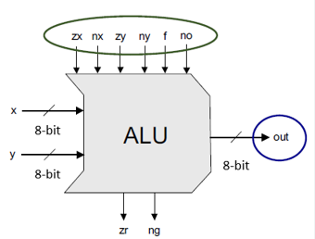
The Hack ALU
To cause the ALU to compute a function, set the control bits to one of the binary combinations listed in the table.

Slide 8
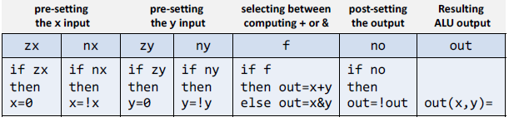
The Hack ALU operation
Remember in above chart
If zx means that zx =1 then x = 0
If nx means that nx = 1 then x = !x
If zy means that zy = 1 then y = 0
If ny means that ny = 1 then y = !y
If f means that f = 1 then out = x+y , if f = 0 then out x&y
If no means that no = 1 then out = !out

Slide 9

The Hack ALU output control bits

Slide 10
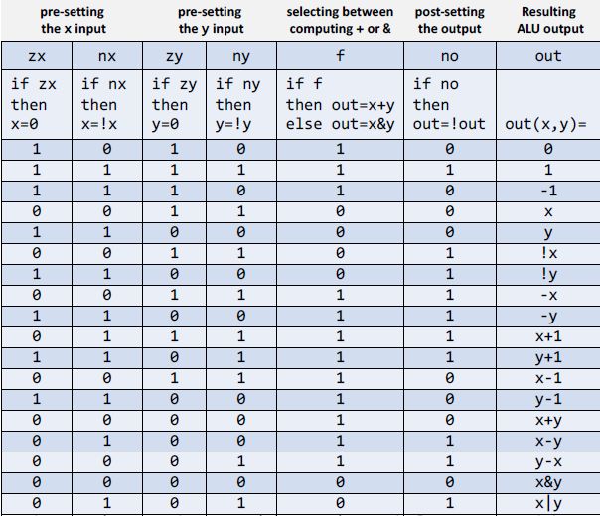
The Hack ALU operation

Slide 11
8-Bit ALU
HDL CODE

Slide 12
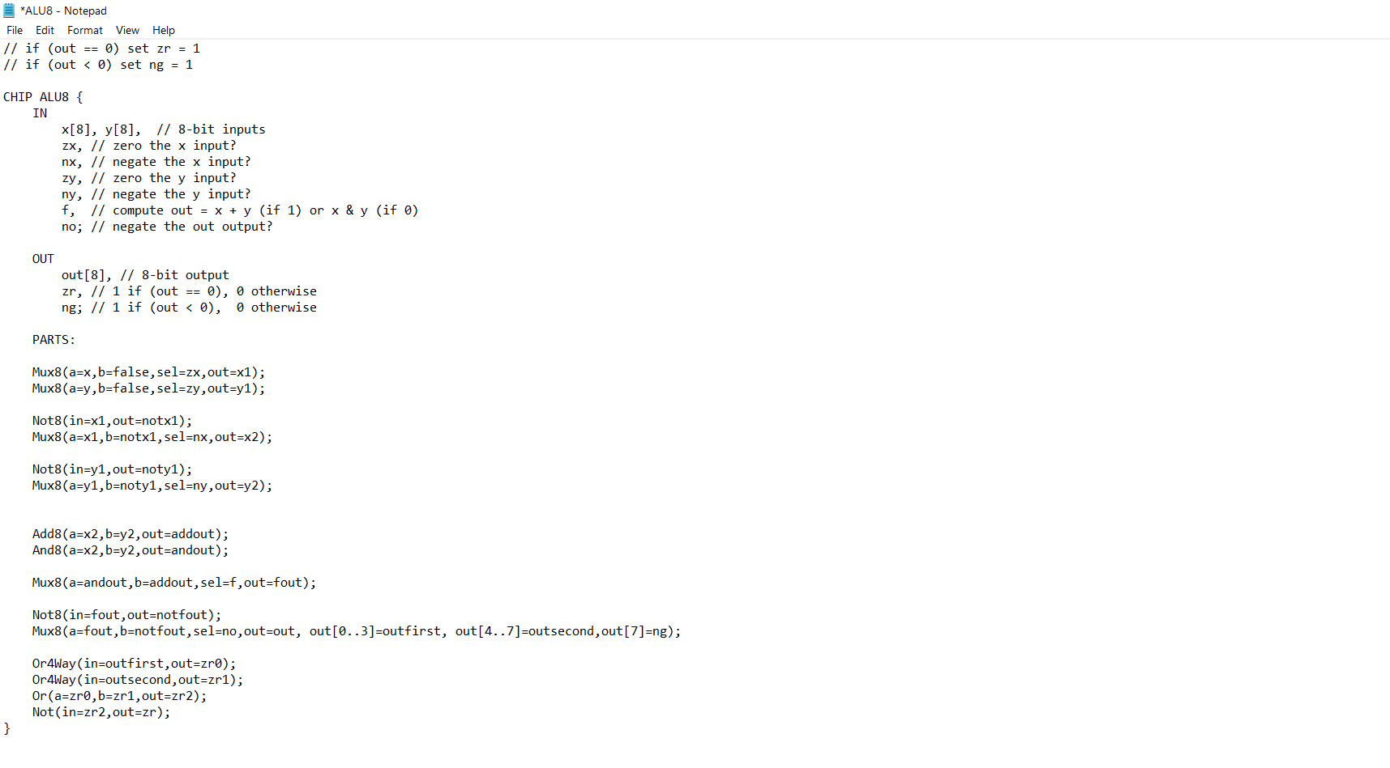

Slide 13
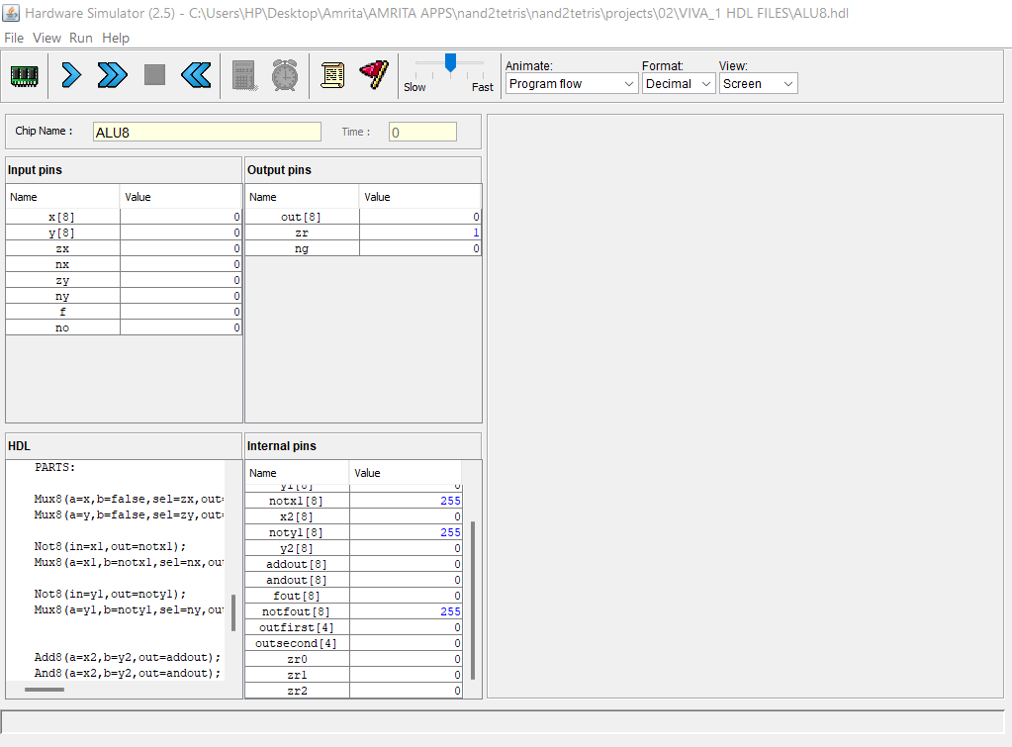
Working on HARDWARE SIMULATOR

Slide 14
Output 1: X+Y (Binary and Decimal)
→Value of X (GROUP NUMBER) : 11
→Value of Y (MENTIONED) : 63
Only 1 input pin(f) will be one out of 6 input pins , in order to create addition function

Slide 15
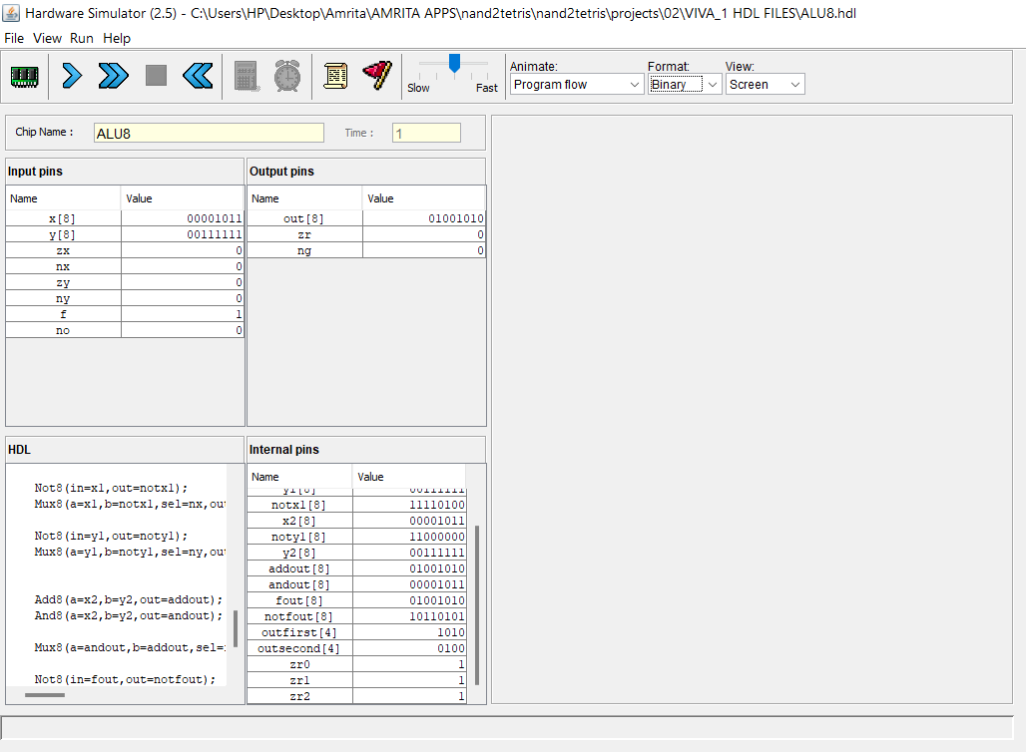

Slide 16
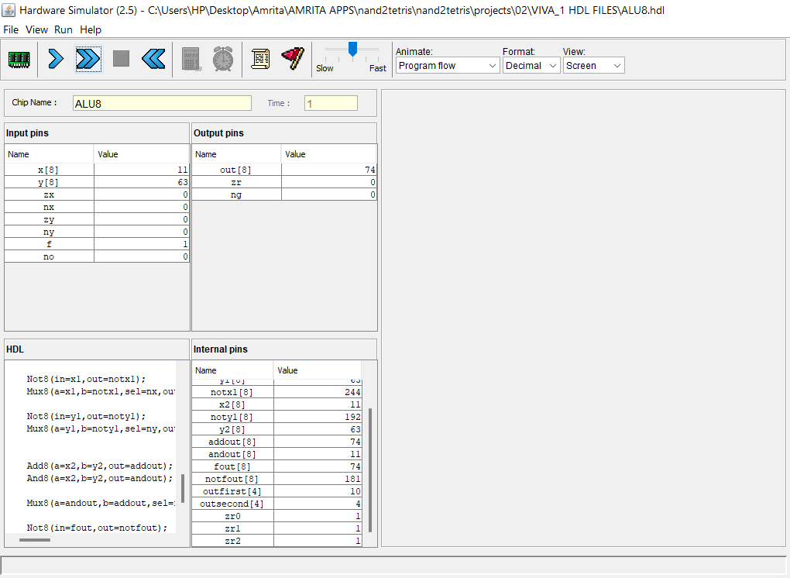

Slide 17
Output 2: X&Y (Binary and Decimal)
→Value of X (GROUP NUMBER) : 11
→Value of Y (MENTIONED) : 63
All input pins will be zero out of 6 input pins in order to create AND function

Slide 18
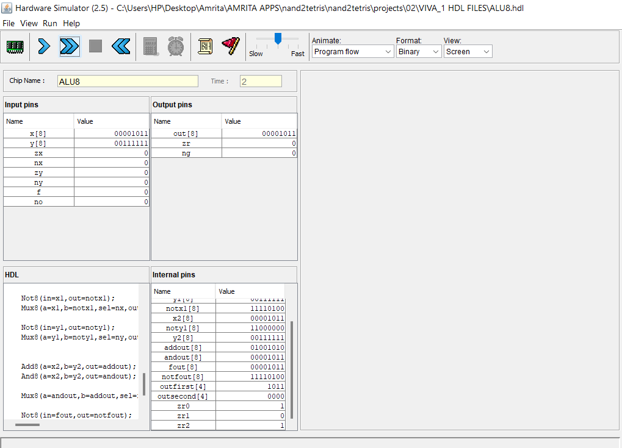

Slide 19
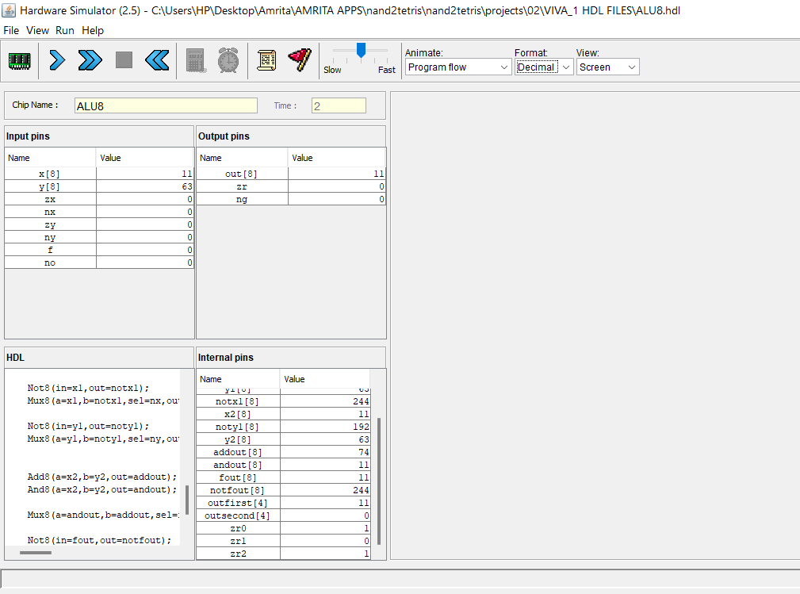

Slide 20
Output 3: !X (Binary and Decimal)
→Value of X (GROUP NUMBER) : 11
→Value of Y (MENTIONED) : 63
3 input pins (zy ,ny ,no) will be equal to one out of 6 input pins in order to create the negation
X function

Slide 21
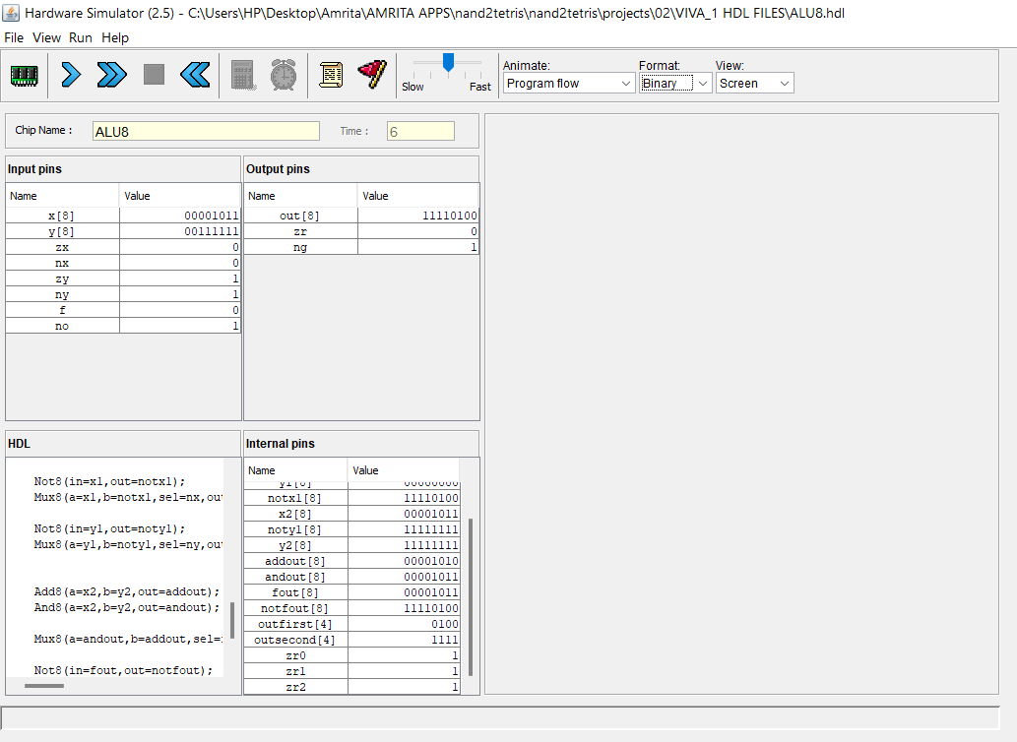

Slide 22
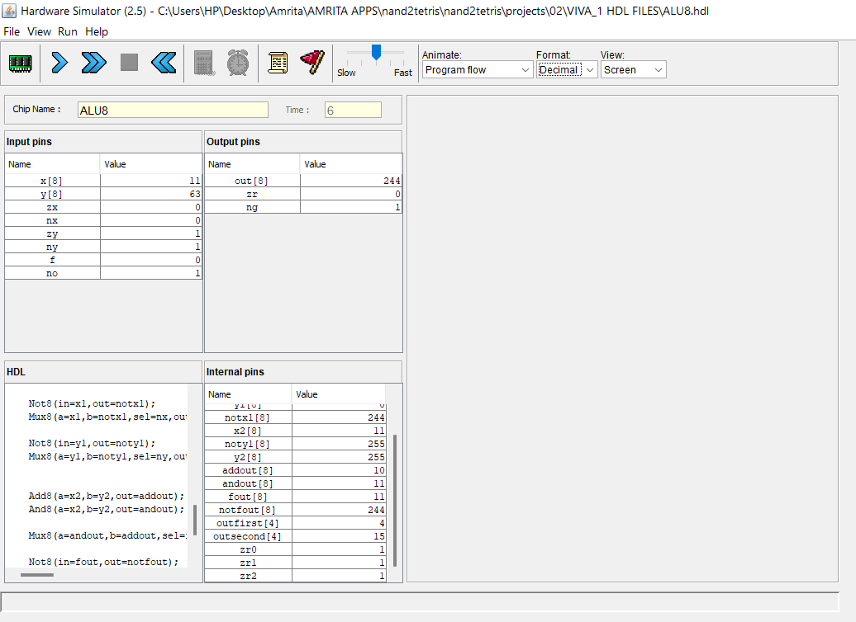

Slide 23
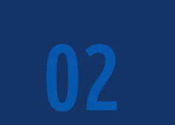
Design 4 to 16 Decoder using 2 to 4 Decoders. Implement the chip logic in HDL and test the chip using the hardware simulator.

Slide 24
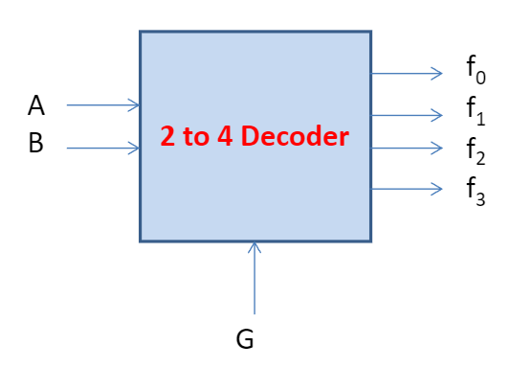
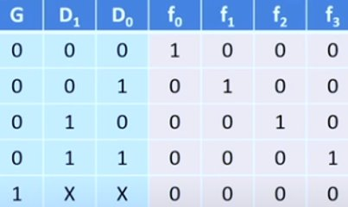
In the given question we need to design 4-16 decoders using 2-4 decoders.
• A decoder typically has an enabled input.
• If G=0 The decoder is enabled, if g=1 all the out puts are deactivated
2-4 decoder :
A
B

Slide 25
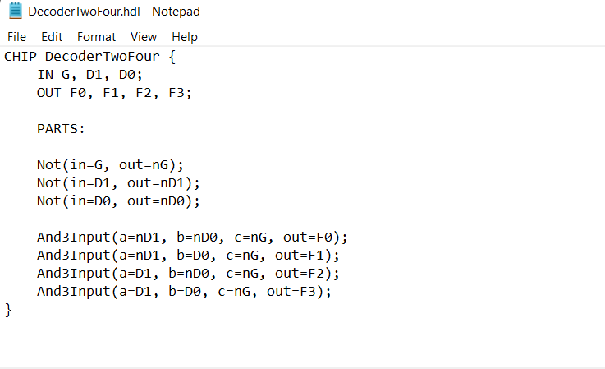
HDL Code For Decoder Two-Four :

Slide 26
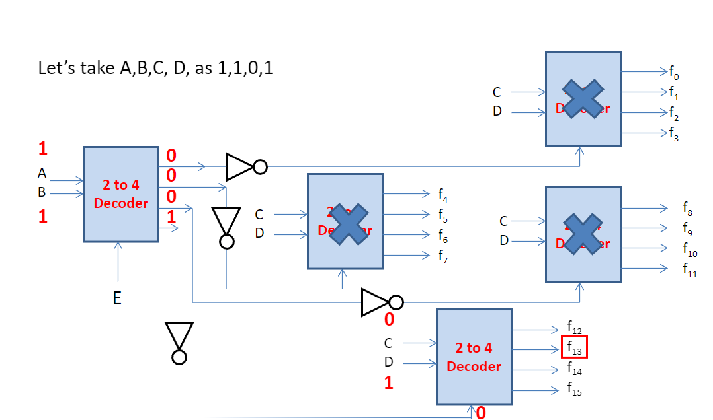
We are Designing 4-16 decoder using "5" 2-4 decoders.
(2)
(1)
(3)
(4)
(5)

Slide 27
Lets take A,B,C,D as our inputs for our 4-16 Decoder as 1,1,0,1.
Now 1st take one 2-4 Decoder and give 2 inputs as A and B which is 1,1.
Here E= 0, so the decoder is activated now, and it will give output in v3 (output line in 2-4 decoder (1) ) as "1".
Then v3 is going to pass through NOT gate and then v3 is converted to "0".
Here v3 will act as selection line for the 5th 2-4 decoder. So here the decoder is activated and it's ready to give output.
In the 5th 2-4 decoder we have 2 inputs C and D as 0,1.
So, we will get our output as 1 at f13.

Slide 28
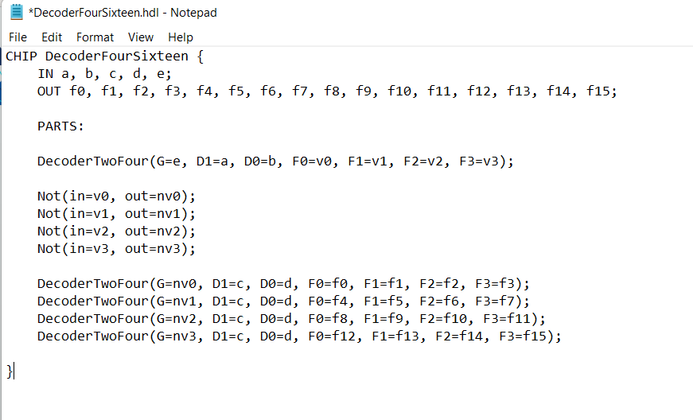
HDL code for 4-16 decoder :

Slide 29
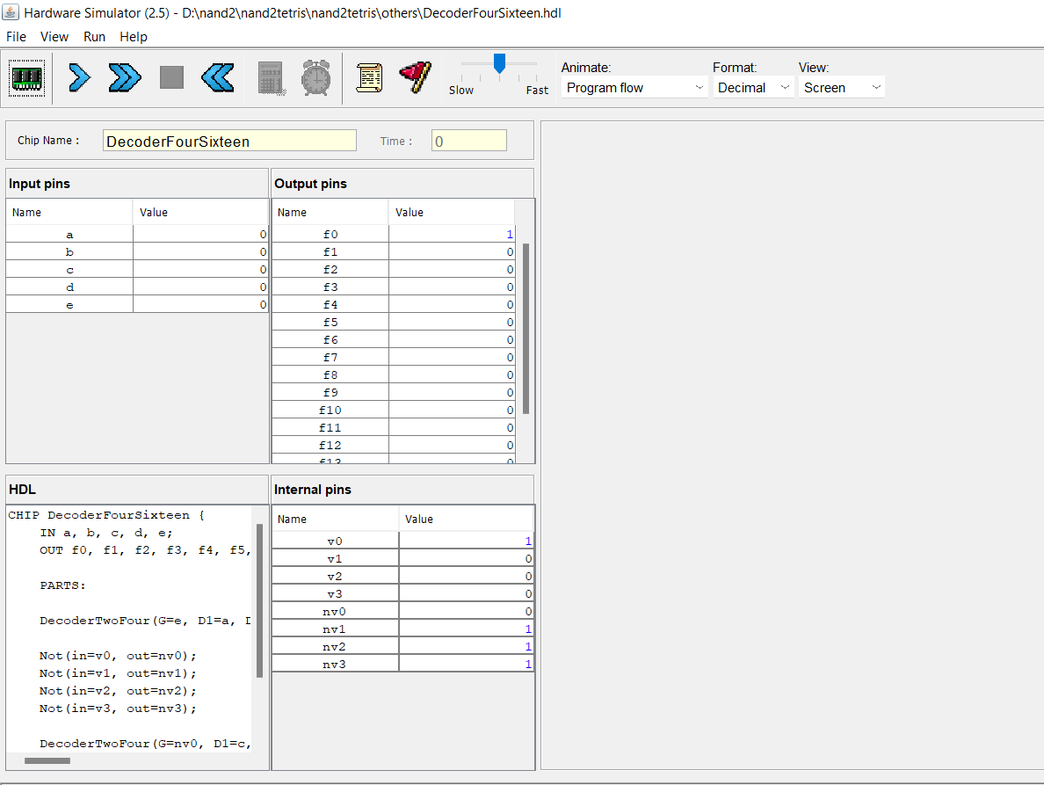
Working on HARDWARE-SIMULATOR (4-16 decoder) :
Default 4-16 Decoder with all inputs as "ZERO" (0,0,0,0) :

Slide 30
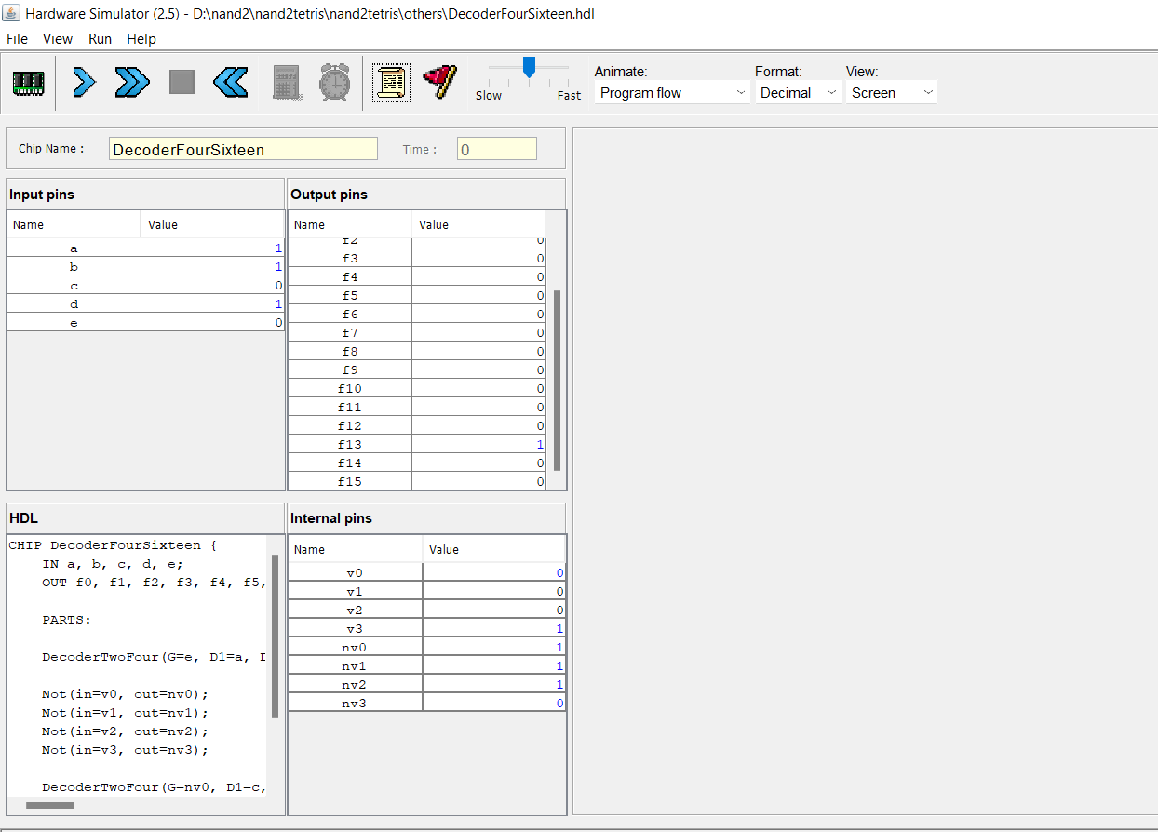
4-16 Decoder with inputs 1,1,0,1 as taken in our example :

Slide 31
Thank you!

