Slide 1
EOC Written Assignment_4

Slide 2
BATCH A TEAM 11 Team Members
VIKHYAT BANSAL [CB.EN.U4AIE21076]
VIGNESH M. [CB.EN.U4AIE21075]
YARRAM SRI SATHWIK REDDY [CB.EN.U4AIE21077]
MARREDDY MOHIT SASANK REDDY [CB.EN.U4AIE21031]

Slide 3
1.
Design the program counter (PC) chip. Implement the chip logic designed in HDL and test the chip using a hardware simulator (Use script-based simulation).

Slide 4
Program Counter:
A register in the control unit of the CPU that is used to keep track of the address of the current or next instruction.
As each instruction gets fetched the program counter increases its stored value by 1. After each instruction is fetched, the program counter points to the next instruction in the sequence. When the computer restarts or is reset, the program counter normally reverts to 0.

Slide 5
A program counter is designed to support three control operations
1)RESET:
we use reset to start the process from the beginning .we reset the PC to zero. (PC=0)
2)NEXT:
execution of instruction happens in an order. So next is used to fetch the next instruction.(PC=++).
3)GOTO:
to fetch a particular instruction n . (PC=N)

Slide 6
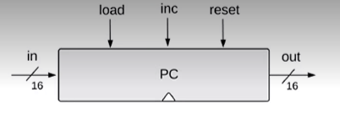
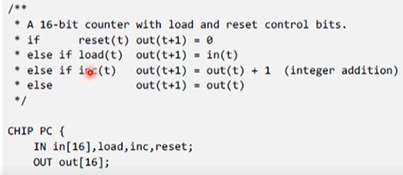
LOGIC OF PC: (16bit)
Here , we have 3 control inputs load, inc and reset.
PC works on a principle of priority logic. The priority follows reset then load and then increment pin (high to low).
1) If reset(t)=0 then out(t+1)=0(1st priority)
2)if reset is not asserted then output will be
The previous input I.e out(t+1)=in(t) for load=1.
3)if both reset and load are not 1 and increment is
1 then it will add to previous output
out(t+1)=out(t)+1 .

Slide 7
If the reset , load and increment are all 0 then output will be previous output
I.e out(t+1)=out(t) .
USAGE:
1)To read : we have to read the output.
2)To set: we have to assert load and other controls bits as 0.
3)To reset : we have to assert reset and set other control bits to 0.
4) To count: assert inc and set other control bits to 0.

Slide 8
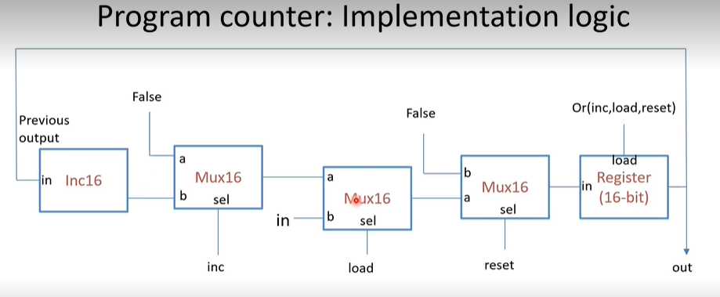

Slide 9
For implementing the chip,
1)We use 3 Mux16 chips.
The SEL of Mux16 chips is used for asserting reset , load and inc control operations.
2)We use a register(16bit) chip.
The load for the register is or(reset,load,inc).
3)Inc16 chip is also used.
Input for this chip is the previous output.
These chips are connected as shown in the picture(previous slide). Let us see the HDL code.

Slide 10
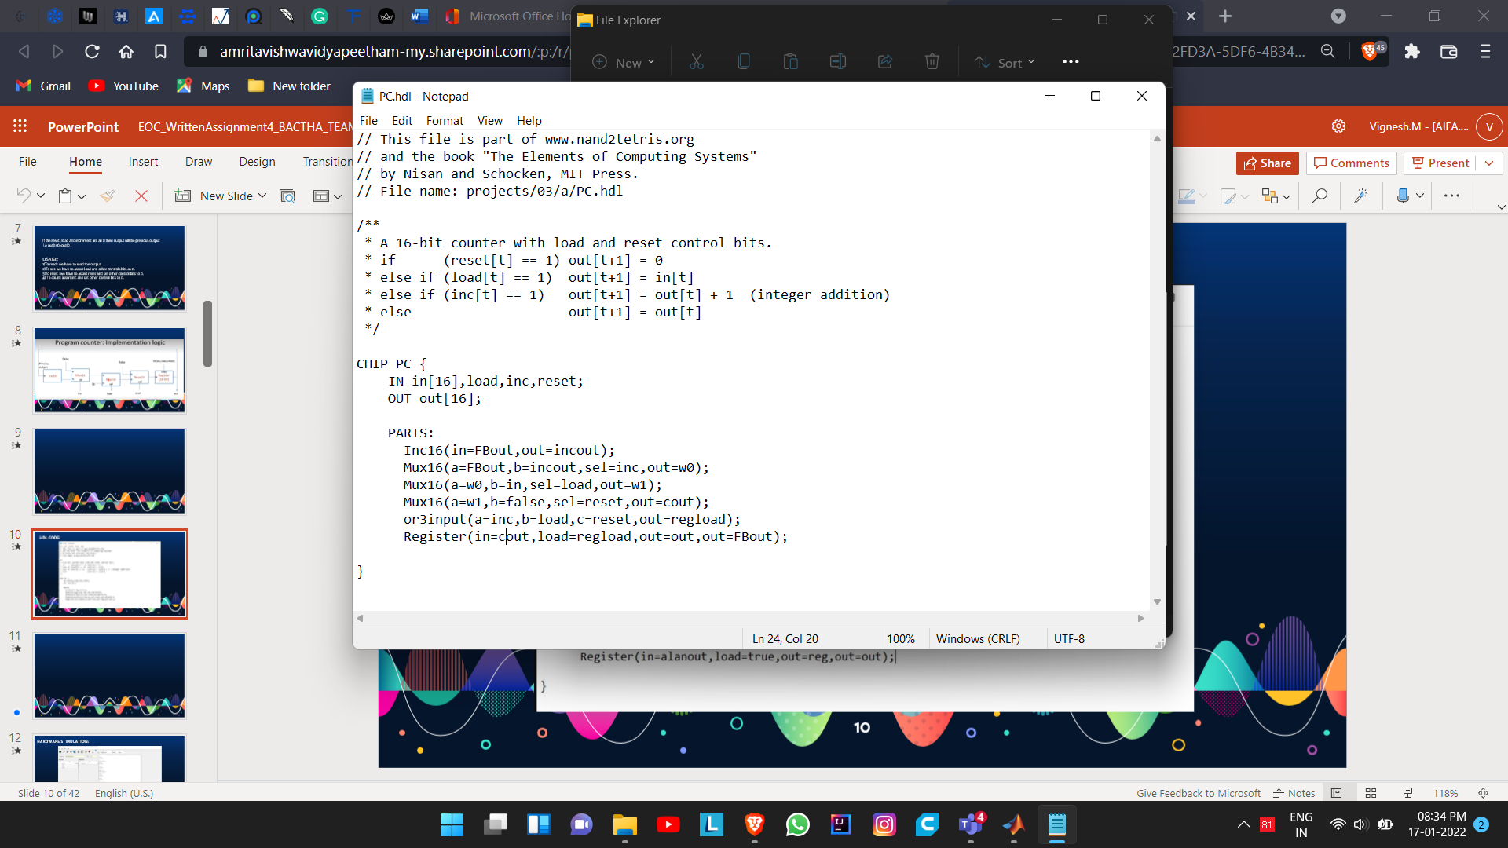
HDL CODE:

Slide 11
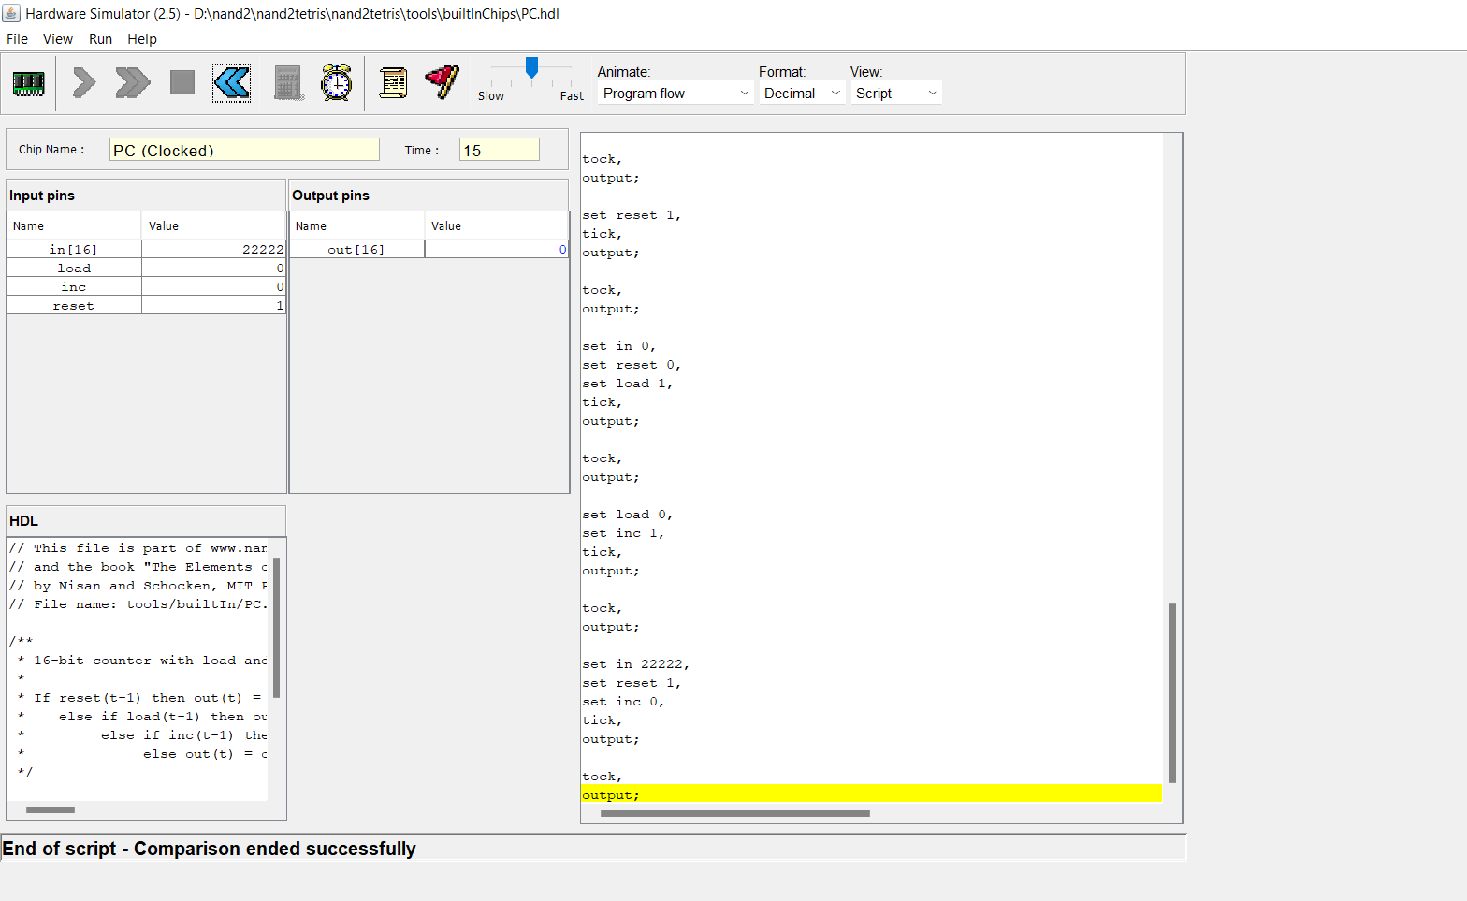
HARDWARE STIMULATION:

Slide 12
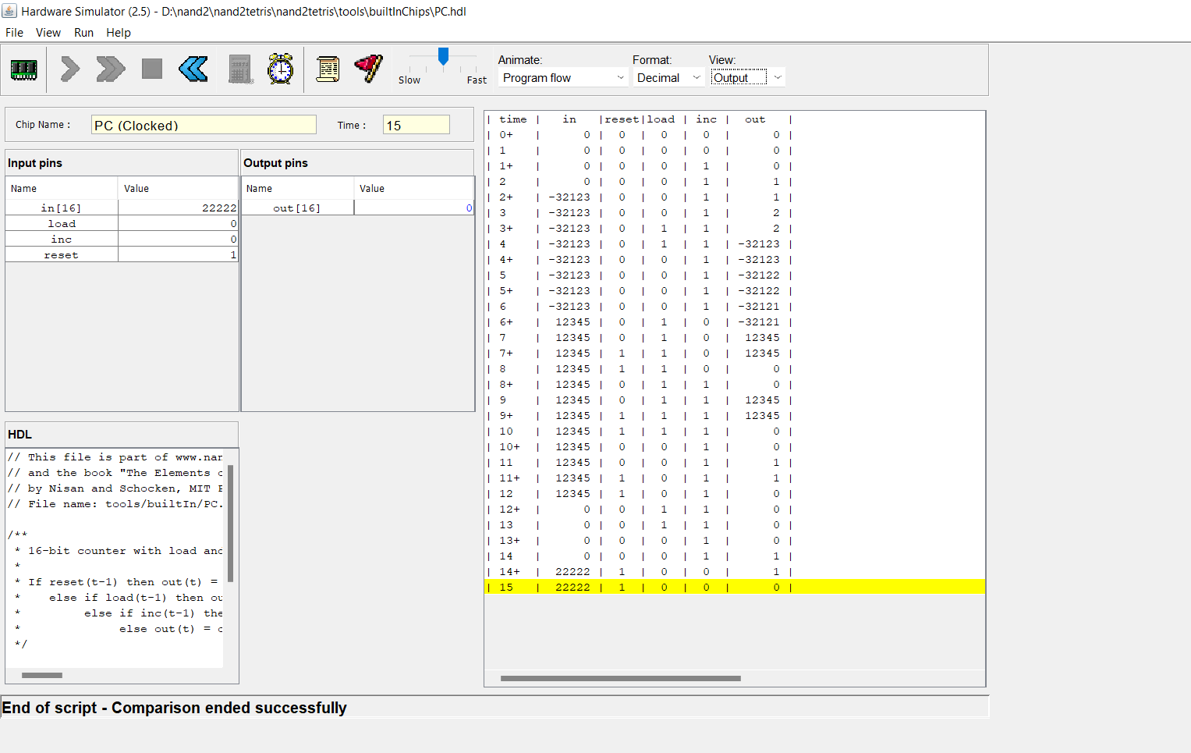
OUTPUT :

Slide 13
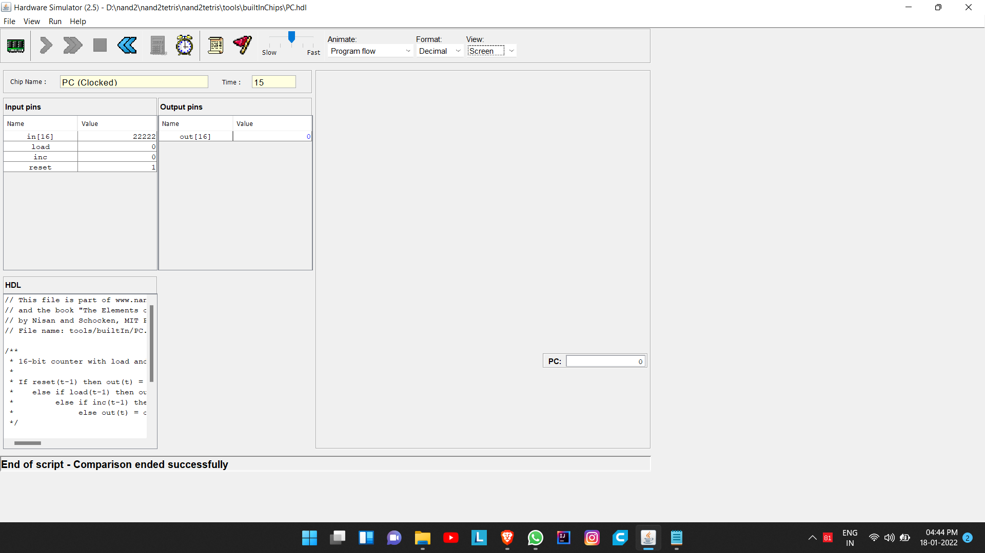

Slide 14
2. Design a digital system which checks if two 2-bit inputs are equal, and one of the input is greater than other input and vice versa.

Slide 15
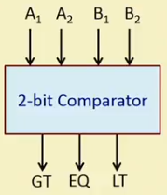
Comparator
An n-bit comparator compares the magnitude of two numbers A and B, and produces three outputs GT,EQ,LT
GT =1 if and only if A>B
EQ=1 if and only if A=B
LT=1 if and only if A<B
Sidenote :-
Very useful in computers for comparison work.
We can use any other notations , it is not necessary to use GT,EQ,LT

Slide 16
2 BIT COMPARATOR
A1 | A2 | B1 | B2 | A>B | A<B | A=B
0 | 0 | 0 | 0 | 0 | 0 | 1
0 | 0 | 0 | 1 | 0 | 1 | 0
0 | 0 | 1 | 0 | 0 | 1 | 0
0 | 0 | 1 | 1 | 0 | 1 | 0
0 | 1 | 0 | 0 | 1 | 0 | 0
0 | 1 | 0 | 1 | 0 | 0 | 1
0 | 1 | 1 | 0 | 0 | 1 | 0
0 | 1 | 1 | 1 | 0 | 1 | 0
1 | 0 | 0 | 0 | 1 | 0 | 0
1 | 0 | 0 | 1 | 1 | 0 | 0
1 | 0 | 1 | 0 | 0 | 0 | 1
1 | 0 | 1 | 1 | 0 | 1 | 0
1 | 1 | 0 | 0 | 1 | 0 | 0
1 | 1 | 0 | 1 | 1 | 0 | 0
1 | 1 | 1 | 0 | 1 | 0 | 0
1 | 1 | 1 | 1 | 0 | 0 | 1
From the truth table it can be seen that when two bits each of 2 bit are given as input we will have 16 combinations to work with where values of each bit will vary from 00,01,10,11(from 0 to 3 in decimal form)

Slide 17
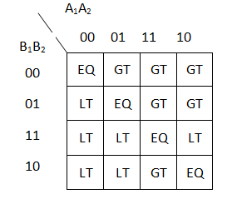
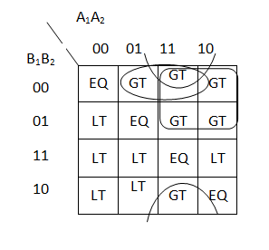

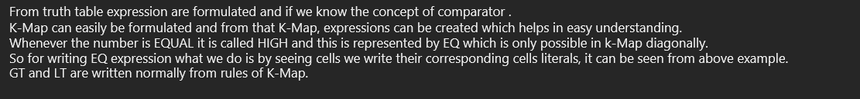
Similarly, we can find

Slide 18
BLOCK SCHEMATIC DIAGRAM FOR 2-BIT COMAPARATOR
MADE USING THE EXPRESSION DERIVED FROM K-MAP

Slide 19
DIAGRAM

Slide 20
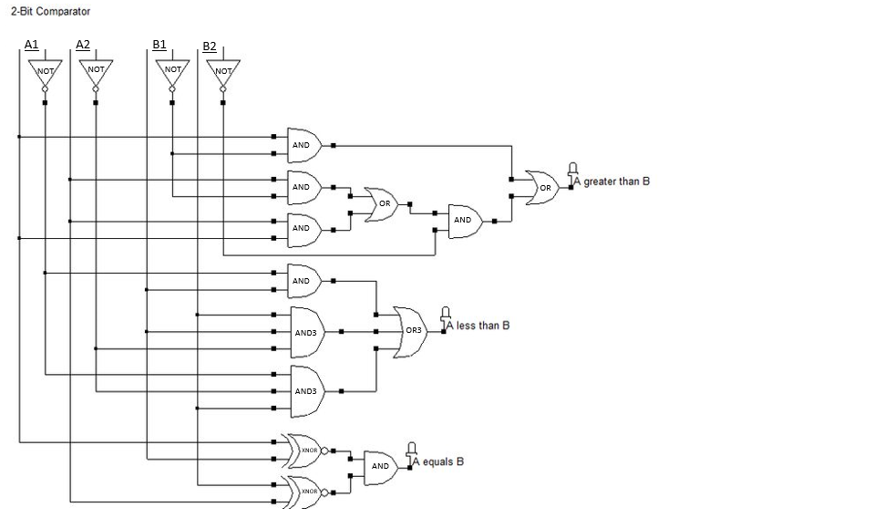

Slide 21
HDL CODE-1

Slide 22
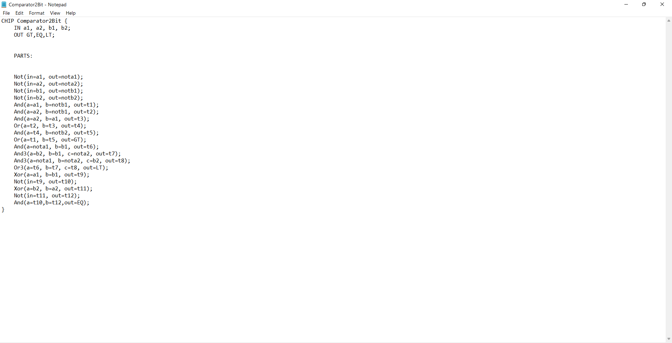

Slide 23
OUTPUT USING HDL CODE - 1

Slide 24
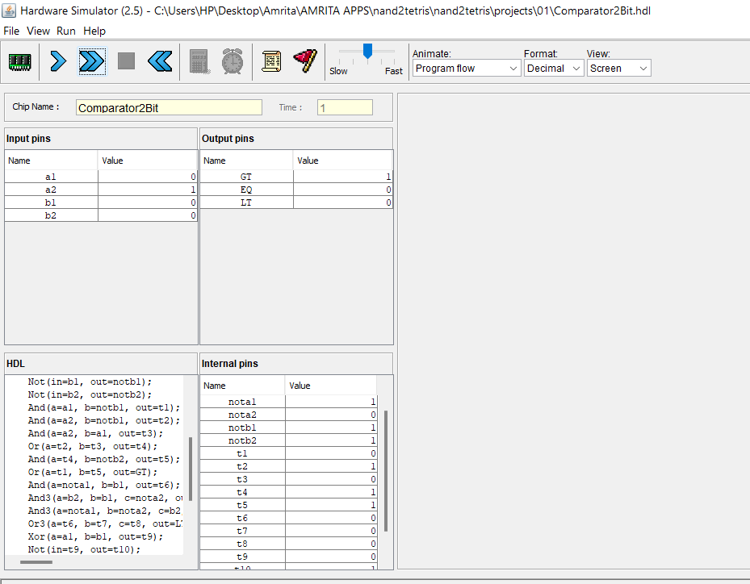
A is greater than B A>B

Slide 25
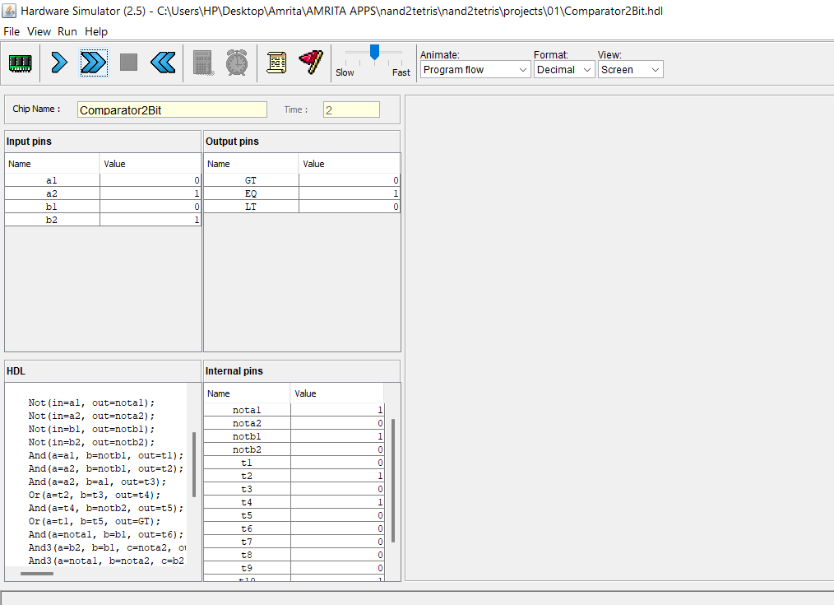
A is equal to B A=B

Slide 26
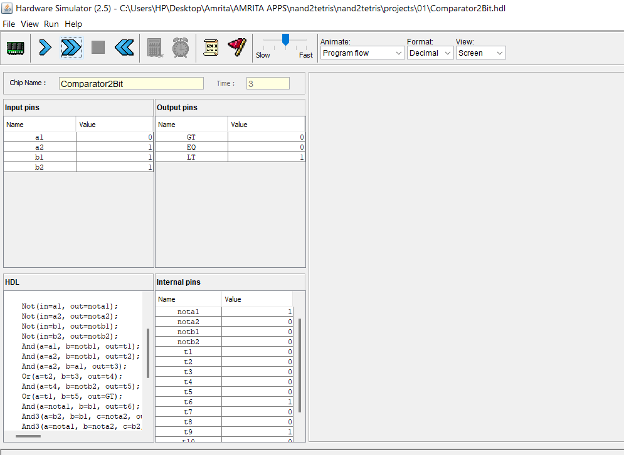
A is less than B A<B

Slide 27
HDL CODE-2

Slide 28
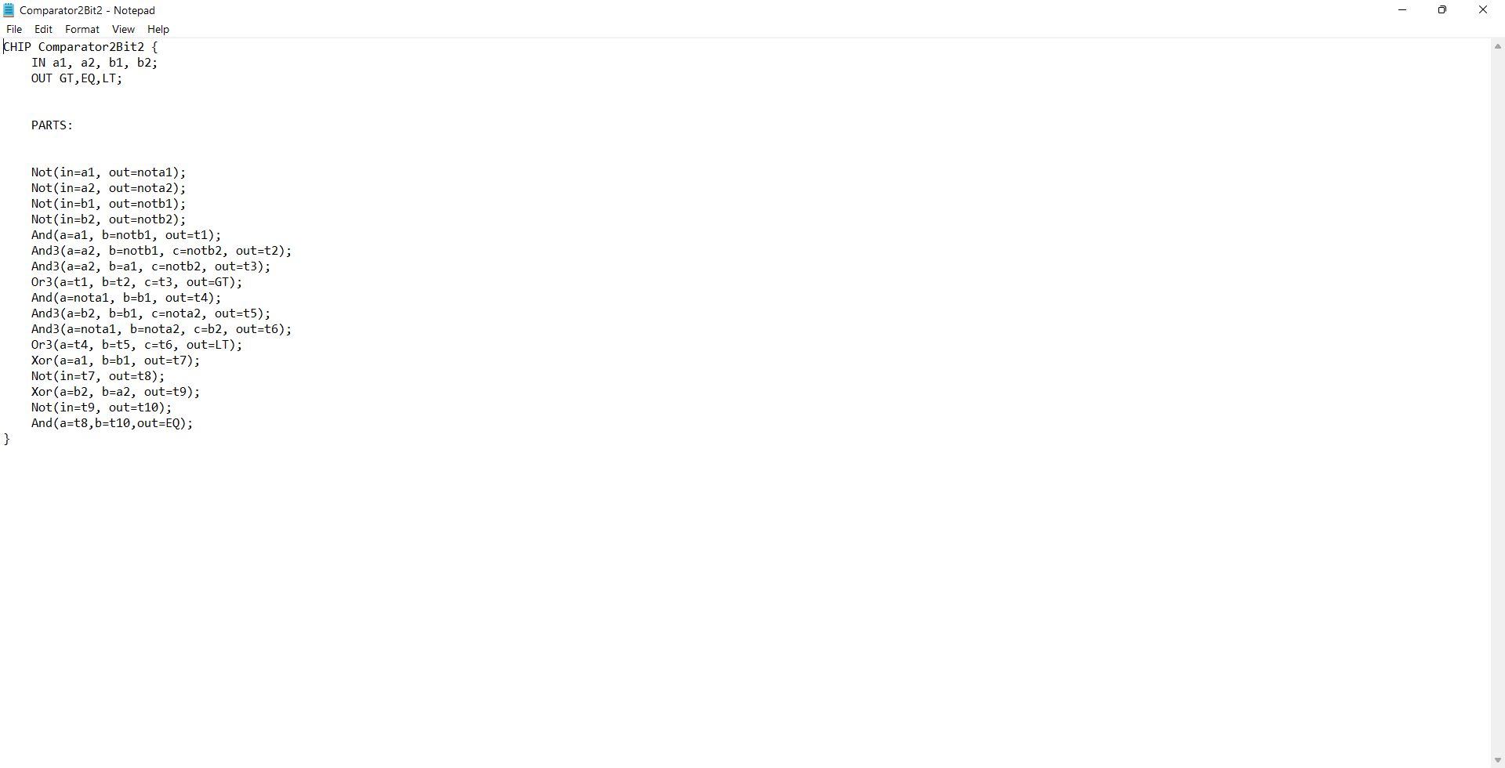

Slide 29
OUTPUT USING HDL CODE - 2

Slide 30
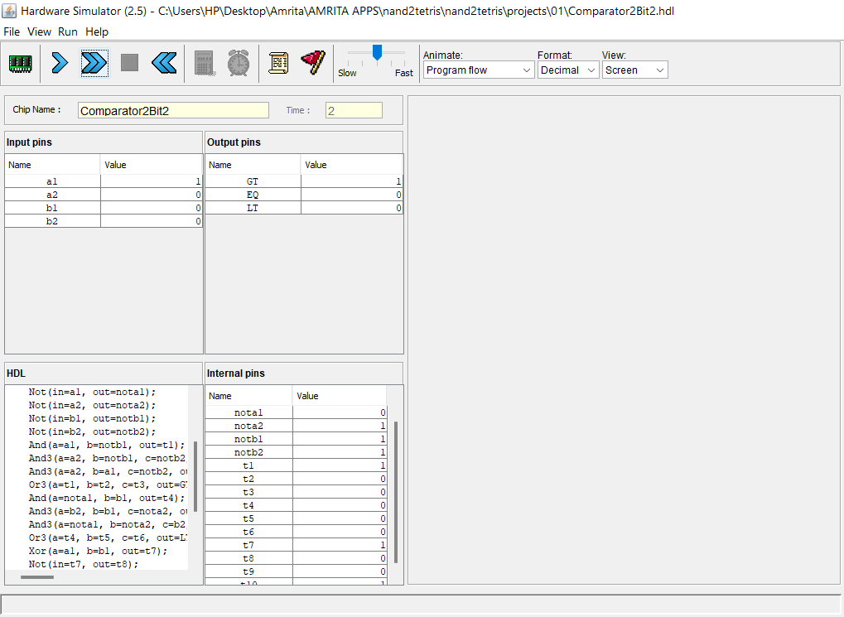
A is greater than B A>B

Slide 31
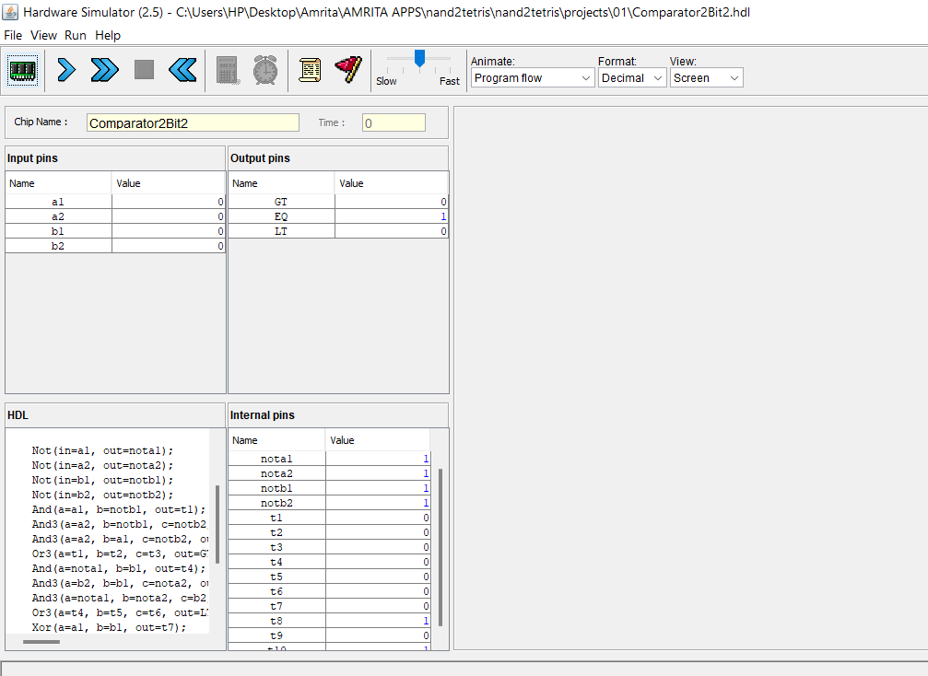
A is equal to B A=B

Slide 32
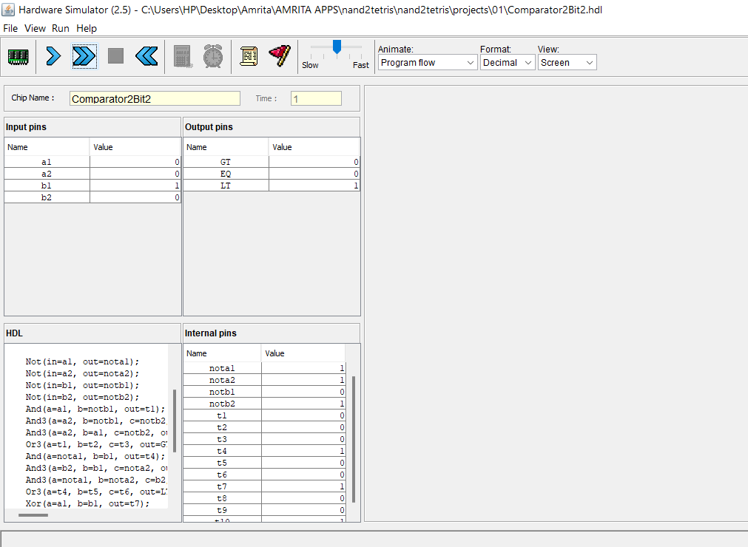
A is less than B A>B

Slide 33
THANKS!

