Slide 1

ELEMENTS OF COMPUTING
Group assignment 4

Slide 2
TEAM PRESENTATION
BATCH-A​​ | TEAM-7​​
GAJULA SRI VATSANKA​​ | CB.EN.U4AIE.21010​​
GUNNAM HIMAMSH​​ | CB.EN.U4AIE.21014​​
M.PRASANNA TEJA​​ | CB.EN.U4AIE.21035​​
VIKHYAT BANSAL​​ | CB.EN.U4AIE.21076​​

Slide 3
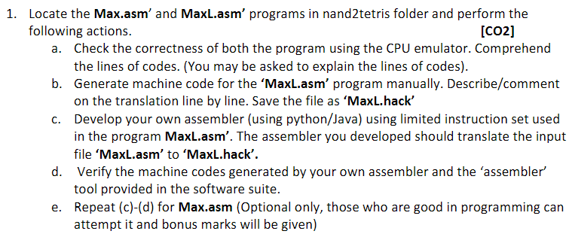
GAJULA SRI VATSANKA(a,b) & VIKHYAT BANSAL(c,d,e)
1

Slide 4
a)SOLUTION
Both the MAX.asm and MAXL.asm files are located in nand2tetris project 06 folder.
I have given, which instruction is used in each line including the opcode ,destination ,comparision and jump as comments in each code.
MAX.asm | MAXL.asm
Used for symbolic program | Used without symbols
Computes max(R0,R1) and | puts the result in R2.

Slide 5
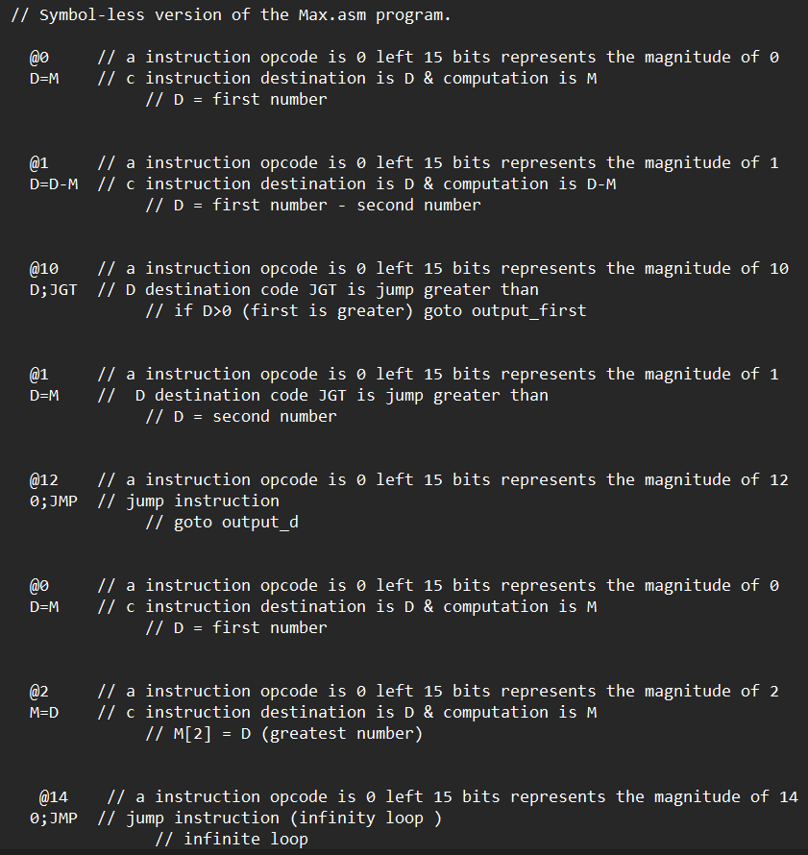
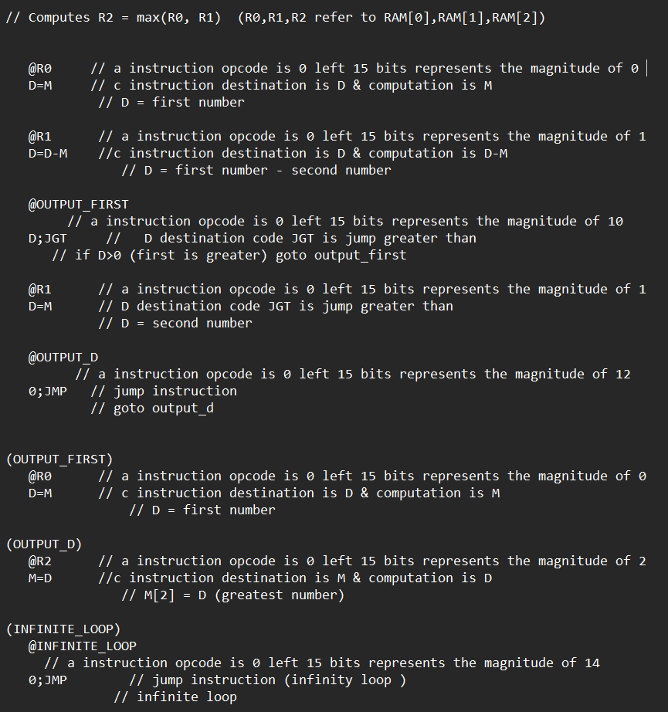
MAX.asm code
MAXL.asm code

Slide 6
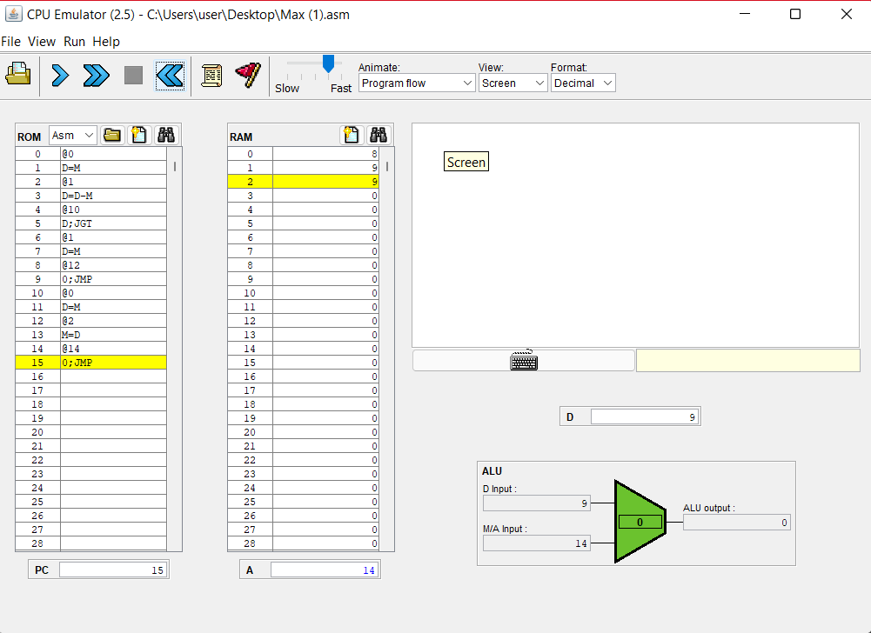
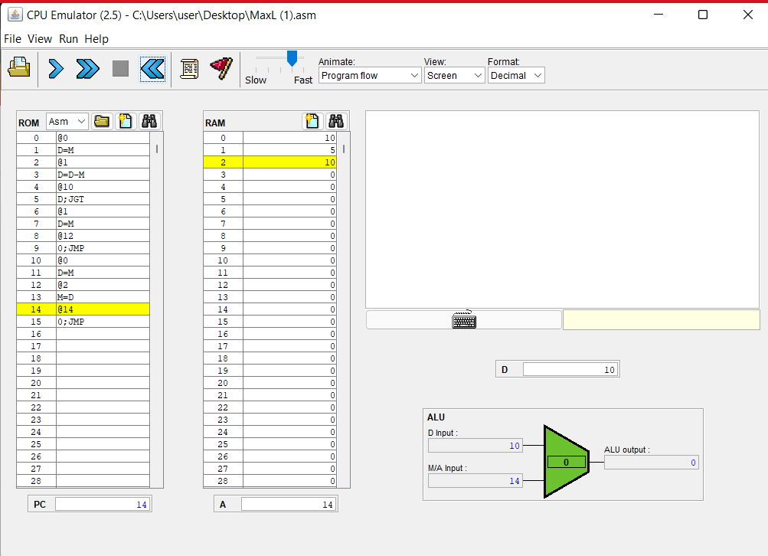
Output of MAX.asm file
I have given the values of @0=8 & @1=9
Output of MAXL.asm file
I have given the values of @0=10 & @1=5

Slide 7
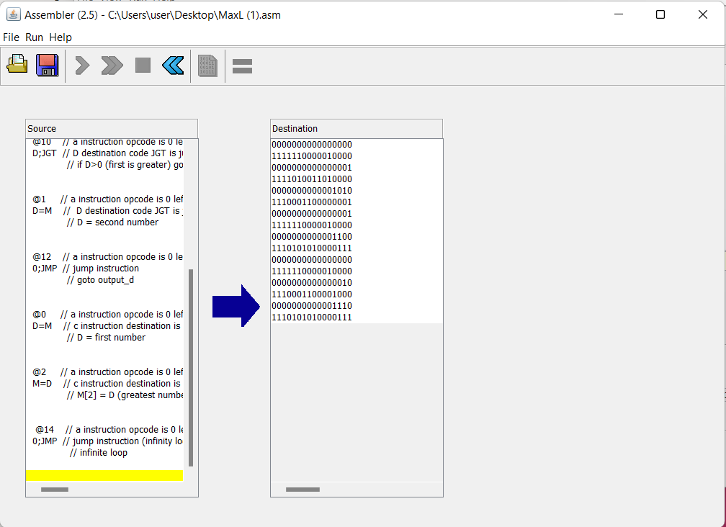
b) SOLUTION
Open the MAXL.asm file in assembler tool and run the source code.

Slide 8
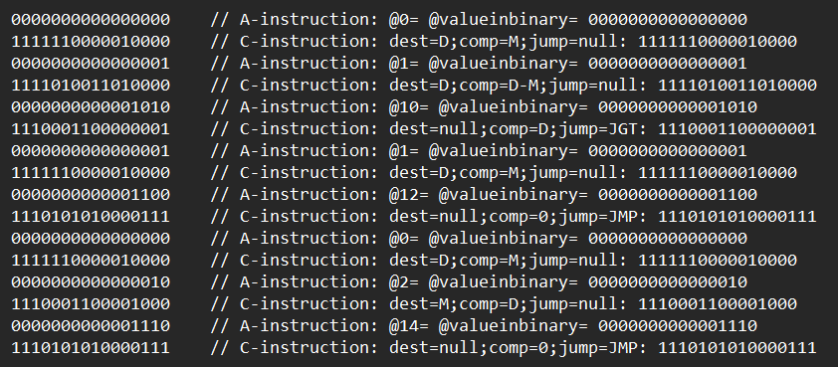
I have given, which instruction is used in each line including the opcode ,destination ,comparision and jump as comments.

Slide 9
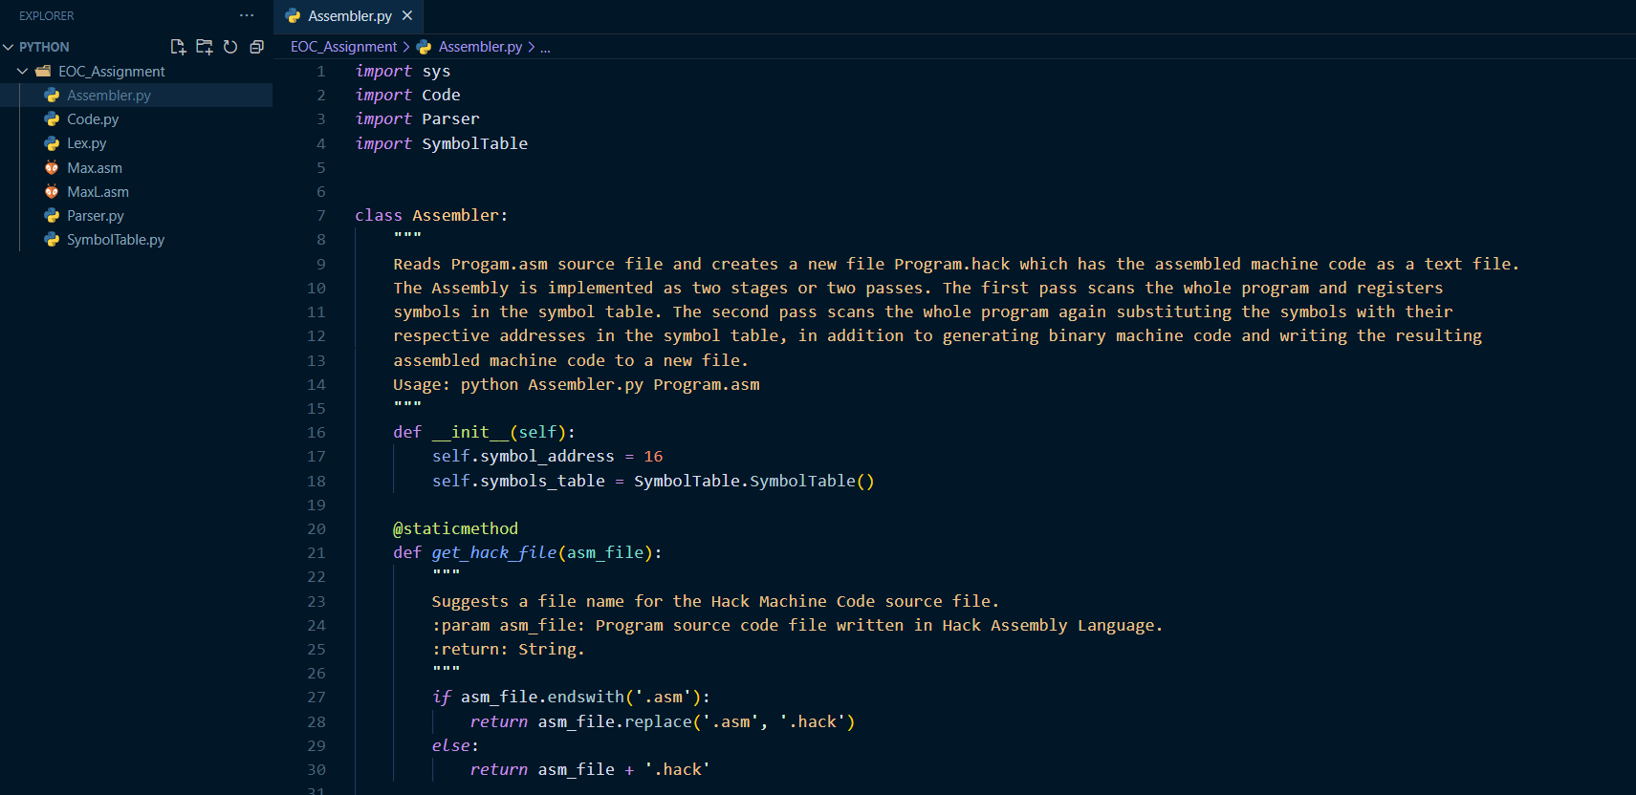
Q1 C) Complete Assembler is developed in python using different libraries and packages
Python Code:

Slide 10
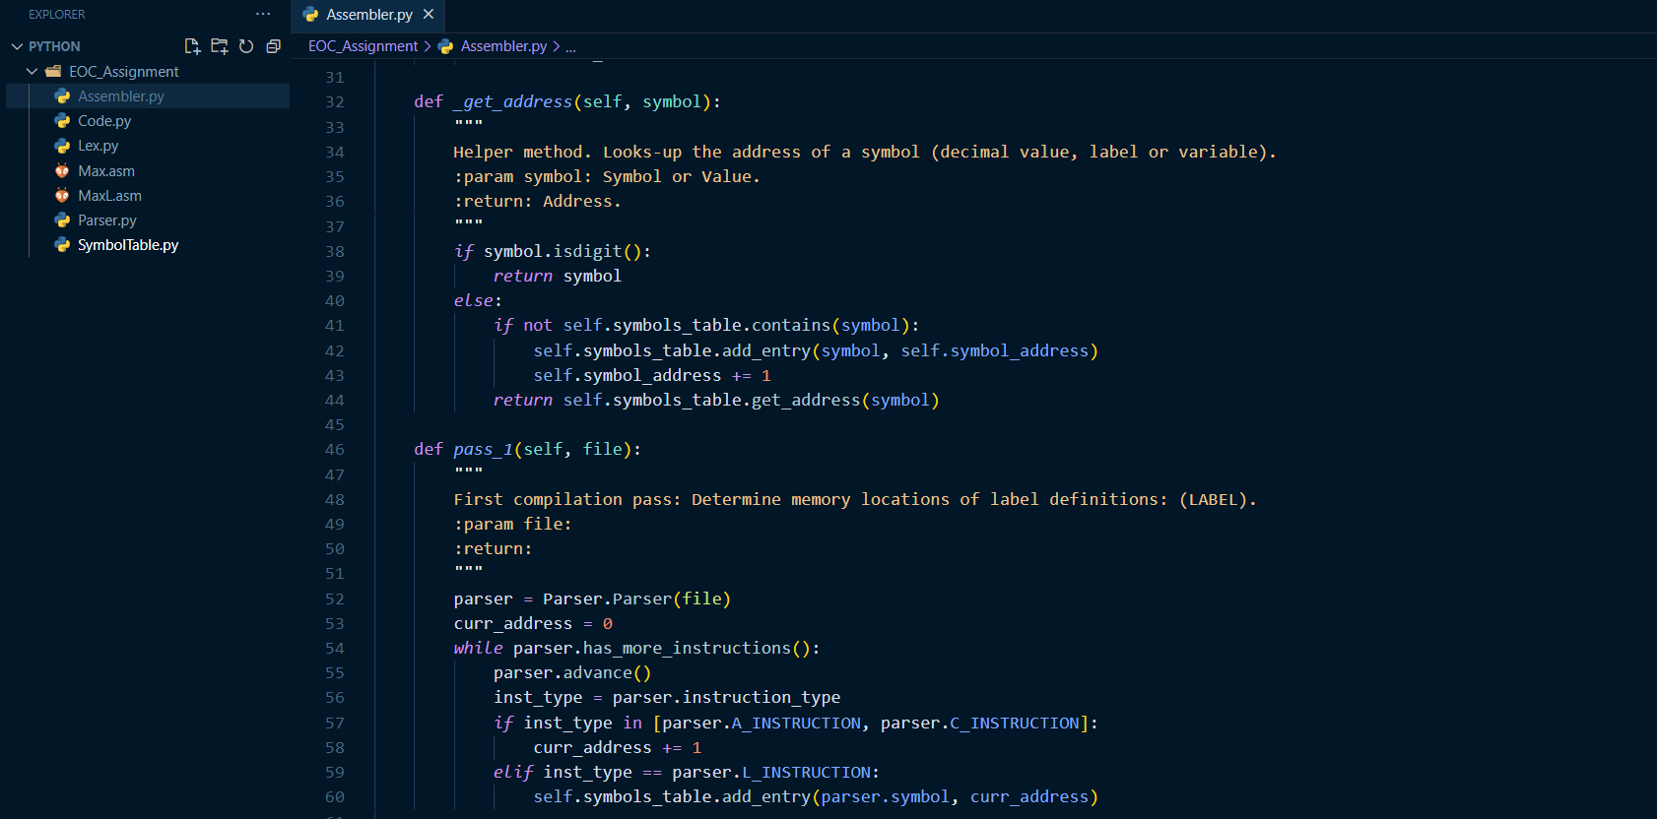

Slide 11
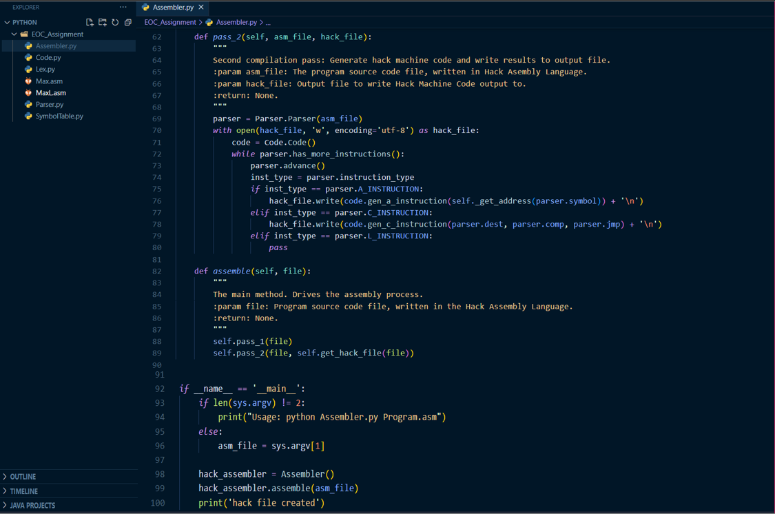

Slide 12
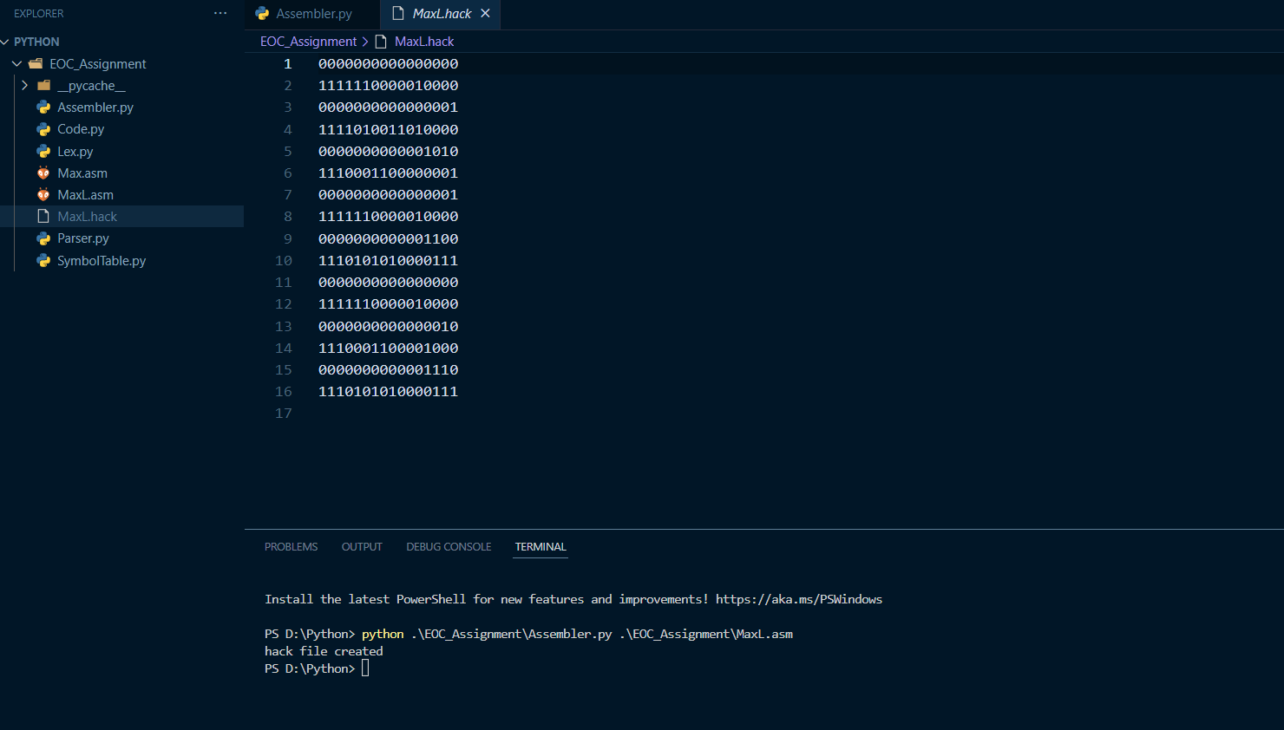
Output: Output obtained when an .asm file is passed through the code
Hack file appears
.hack file for MaxL.asm is created

Slide 13
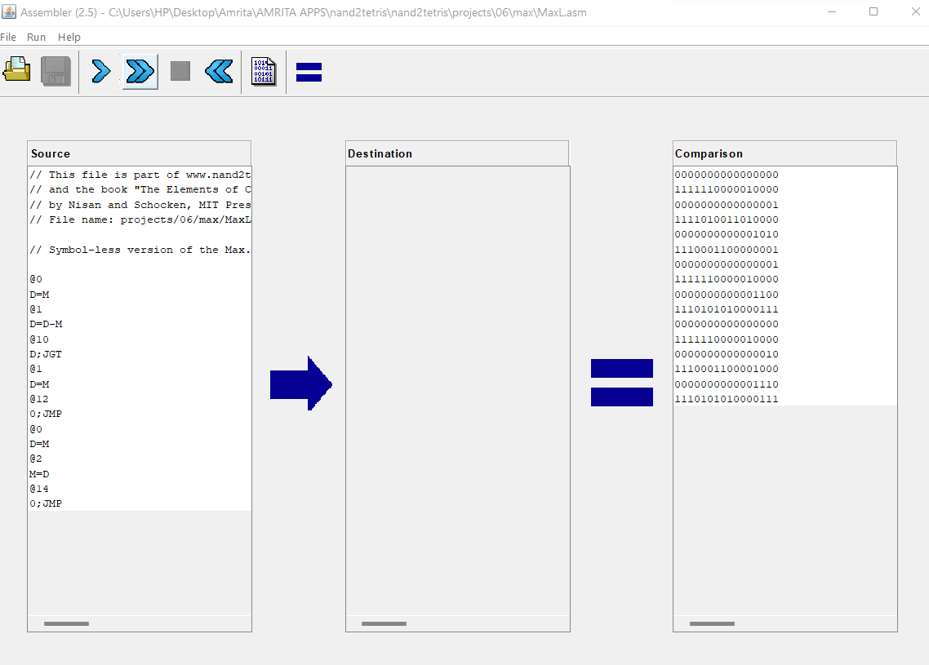
Q1 D) Verification of .hack file using assembler suite tool
File created using python code

Slide 14
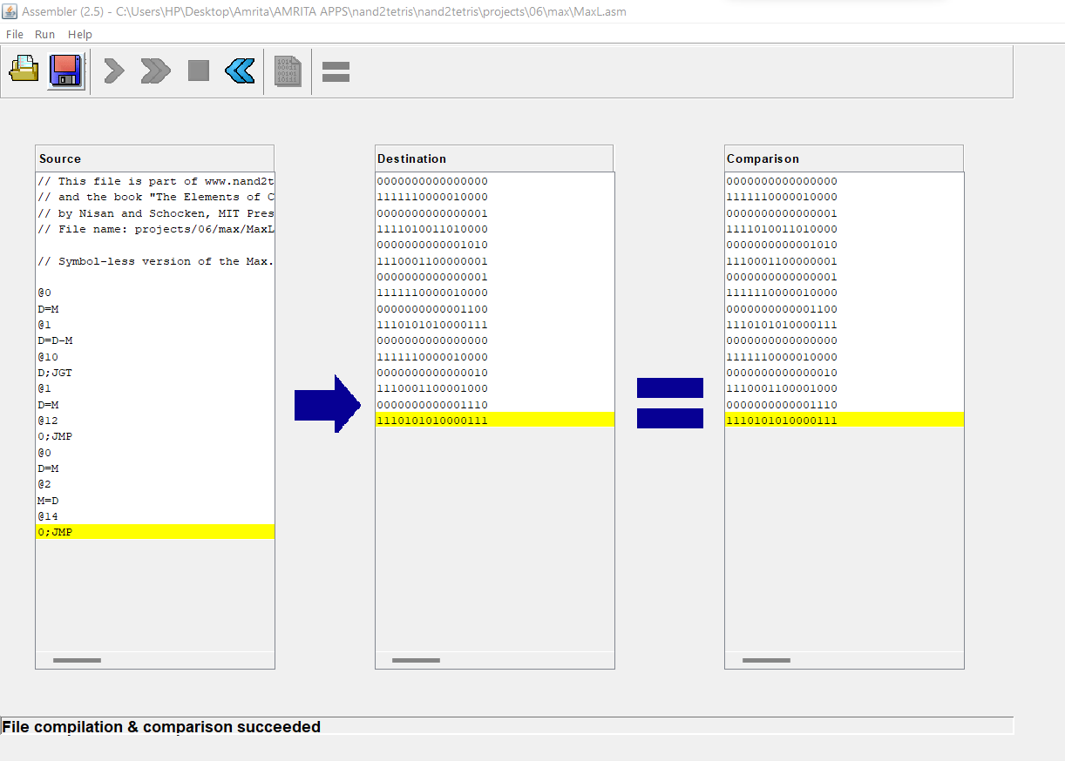
Note: All the essential python files required to create an assembler are included in submission folder.

Slide 15
Q1 E) i) Complete Assembler is developed in python using different libraries and packages
Python Code:

Slide 18
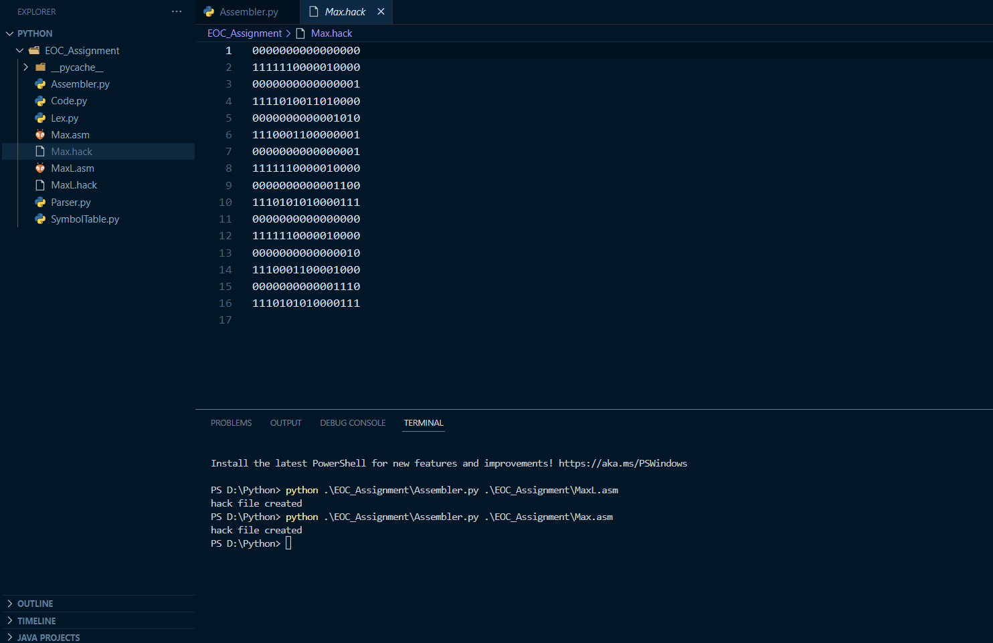
Output: Output obtained when an .asm file is passed through the code
Hack file appears
.hack file for Max.asm is created

Slide 19
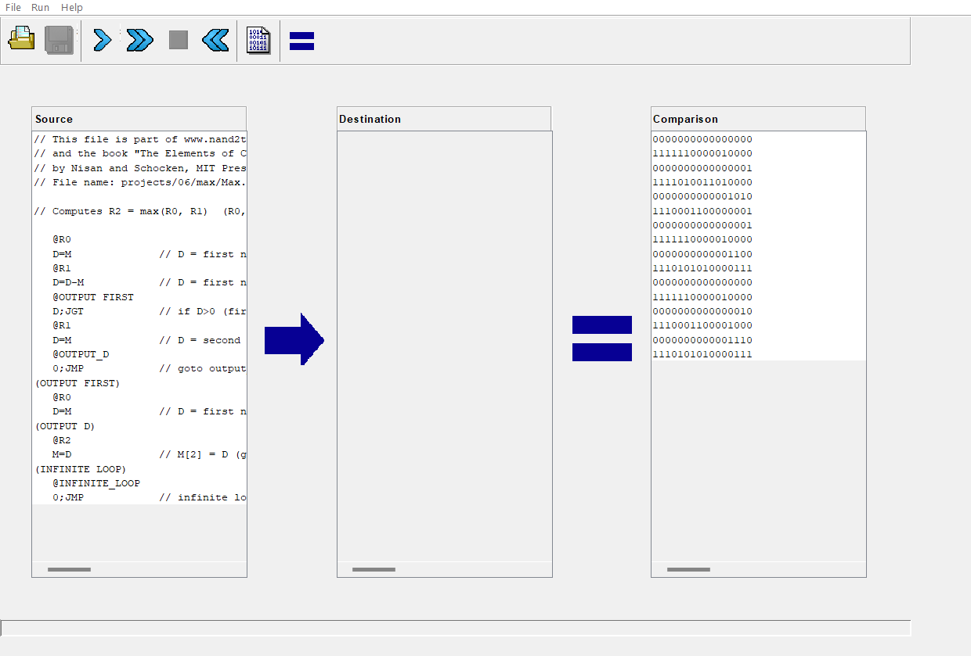
Q1 E) ii) Verification of .hack file using assembler suite tool
File created using python code

Slide 20
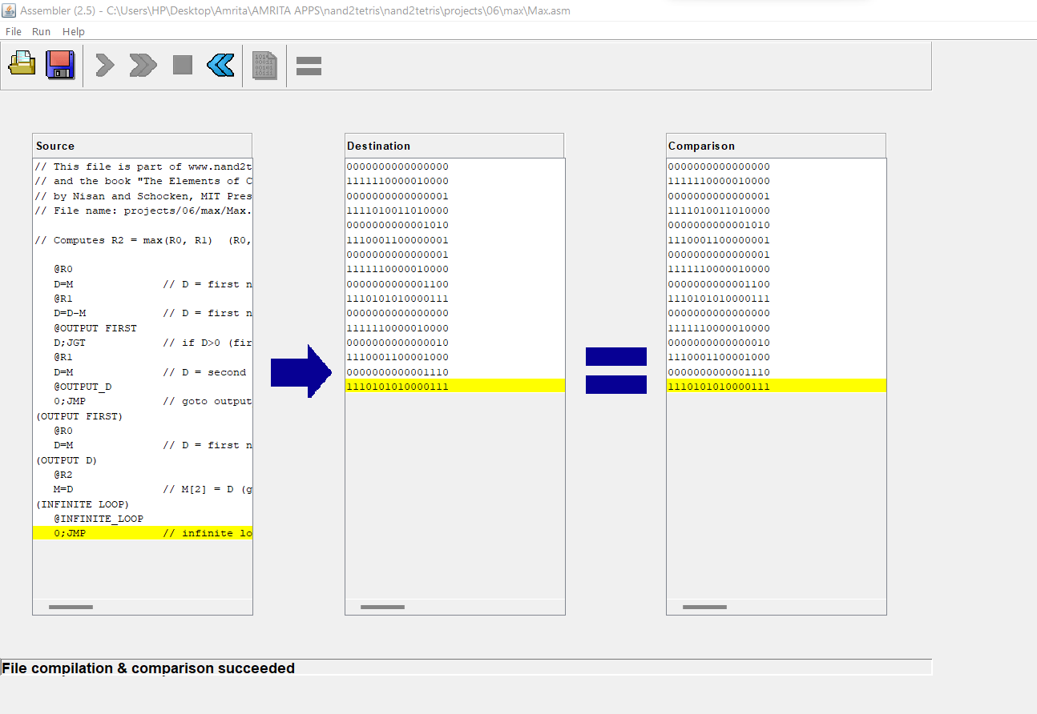

Slide 21
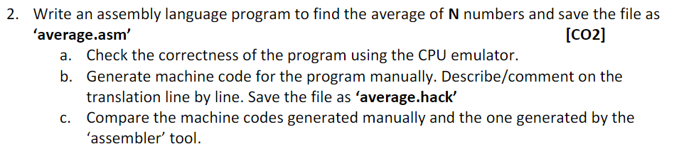
GUNNAM HIMAMSH & M.PRASANNA TEJA
2

Slide 22
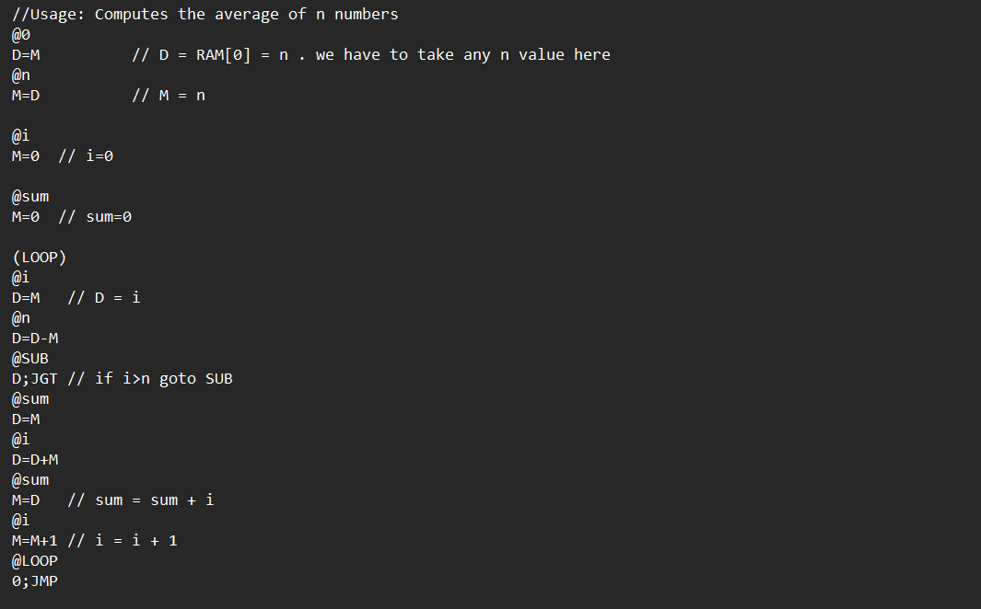

Slide 23
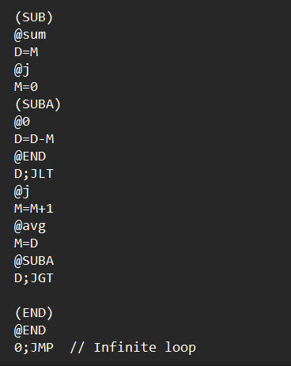

Slide 24
EXPLAINATION
The above assembly code is to get average of n numbers.
First, we take n in the memory, and we can keep whatever value we want in place of n in the RAM
So, after storing the value in the RAM we to take the data and after that we have to take another variable, we have to store the data in that memory as this is the first variable it will be stored as @16 .
We have to take another 2 variables @sum and @I for selecting the value for the loop and sum to store the final value we will give 0 for those to initially .
We will start the loop by starting using @I as we progress in the loop, I value increments by 1 and by this loop and the code we use we will find the sum .
The loop continues until I value is greater than n , n will be taken as our wish.

Slide 25
CONTINUTION
After that we will find the average and the formula is sum of total number of elements divided by total number of elements.
As we do not have any operation to divide two number, we can do it by subtraction.
In this we subtract 10 with the value in the variable sum and continue this process until we get the last positive number and this the average value of array elements.
We will store this value in a variable avg and the program by writing an infinite loop.
And at last, we will make the end loop so to make program ends here with an unconditional jump and hence, our values are swapped.

Slide 26
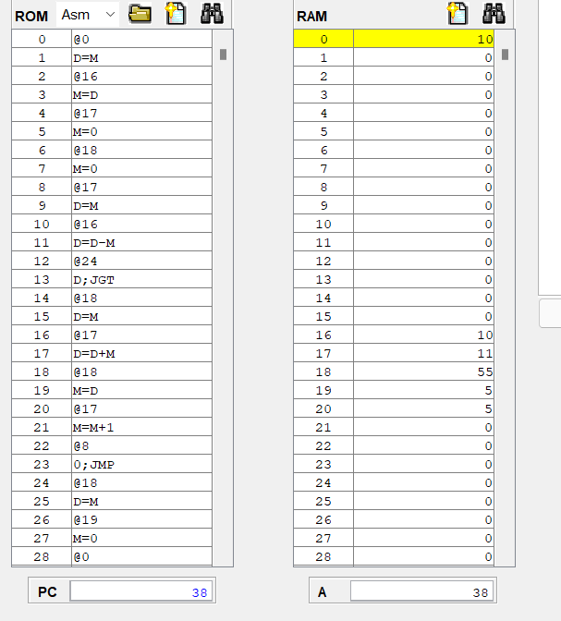

Slide 27
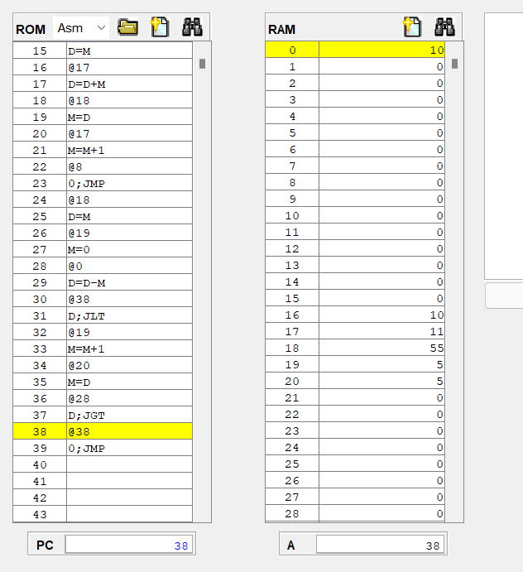

Slide 28
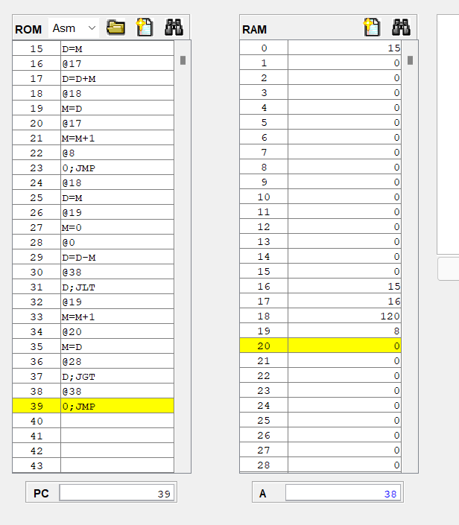

Slide 29
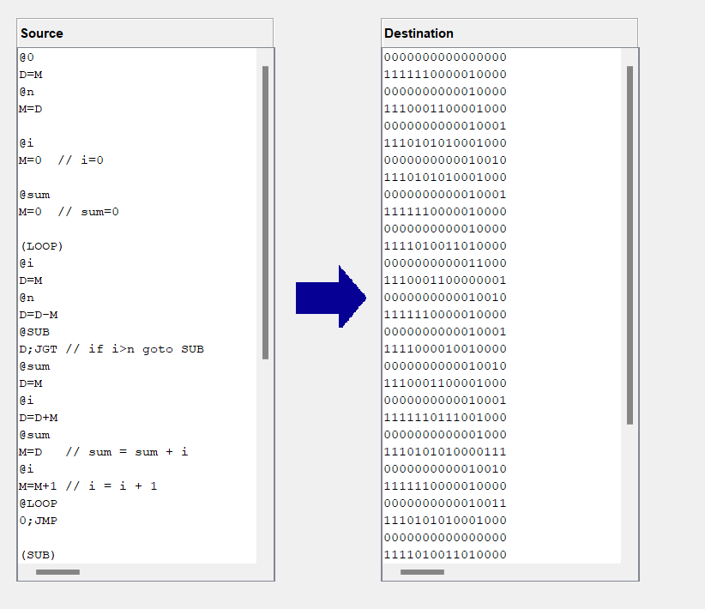

Slide 30
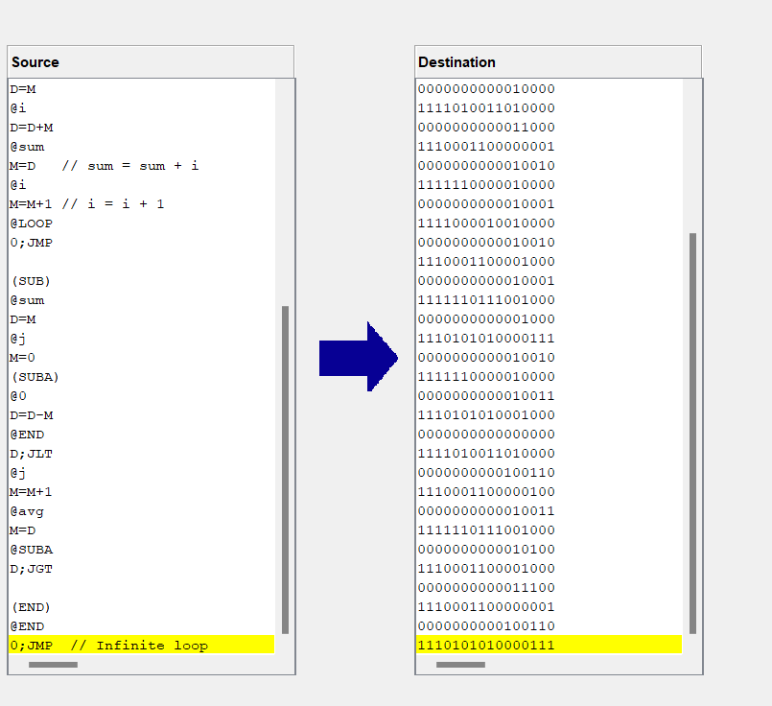

Slide 31
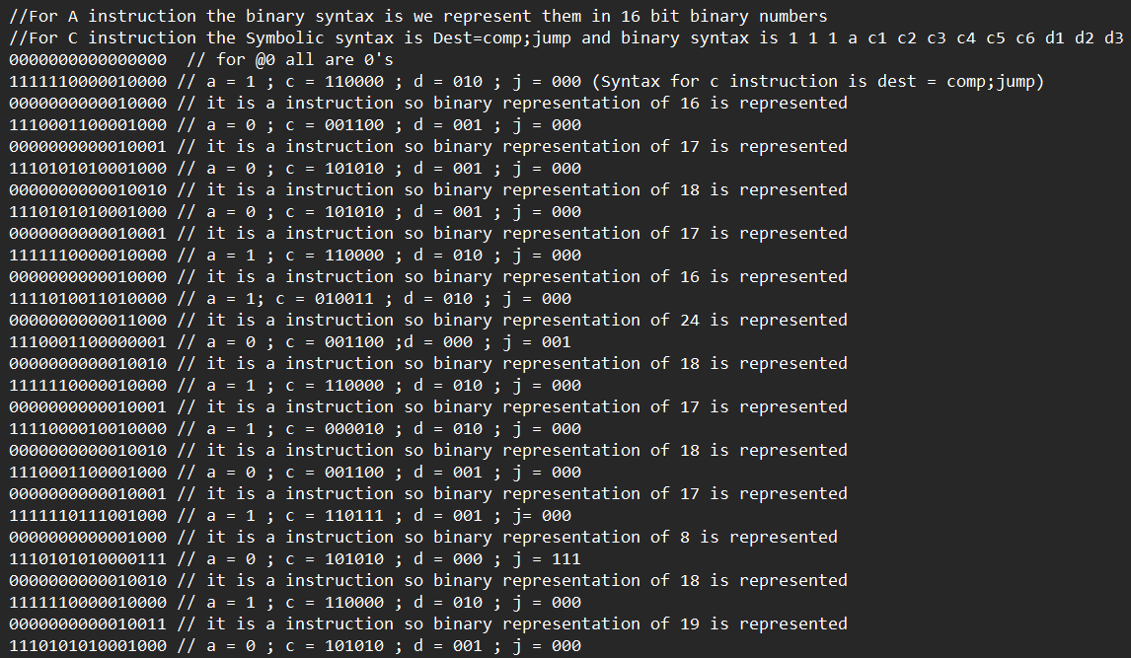

Slide 32
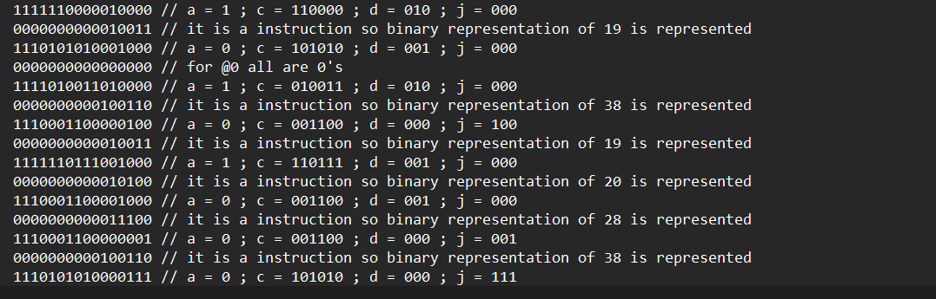

Slide 33
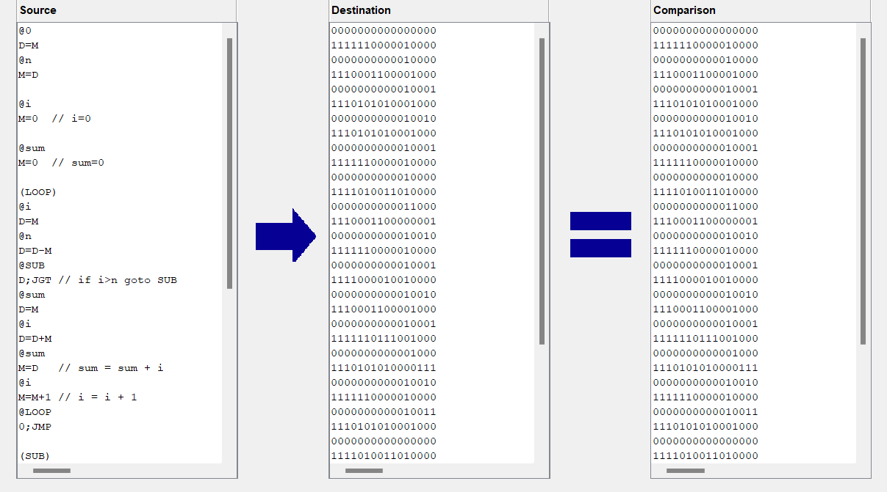

Slide 34
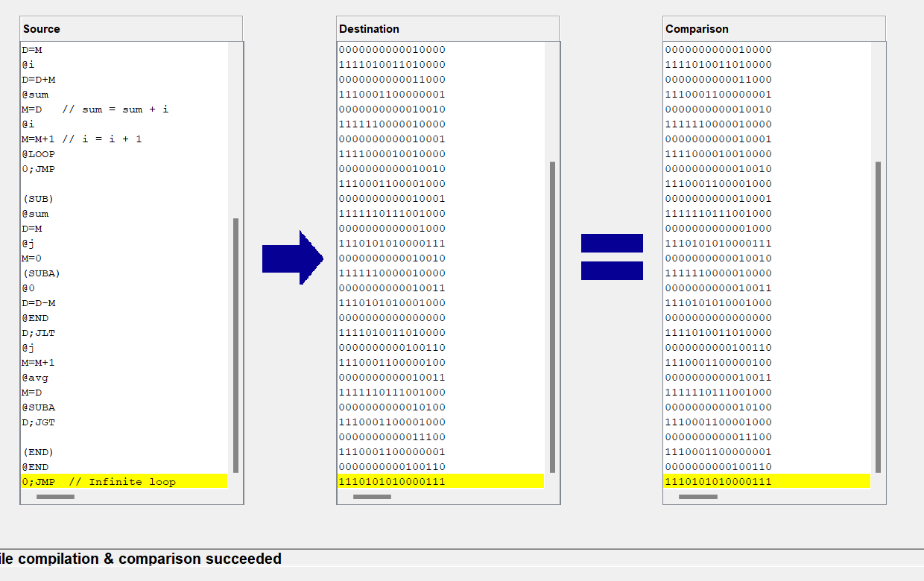

Slide 35
THANK YOU

