Slide 1
Proximal Methods and ADMM

Slide 2
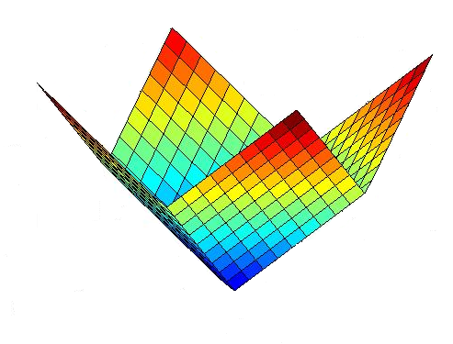
Non-smooth functions
Non Smooth Function - l1 norm

Slide 3
Non-smooth+Smooth

Slide 4
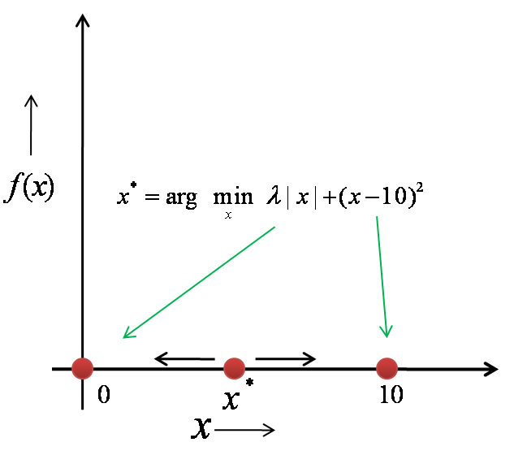
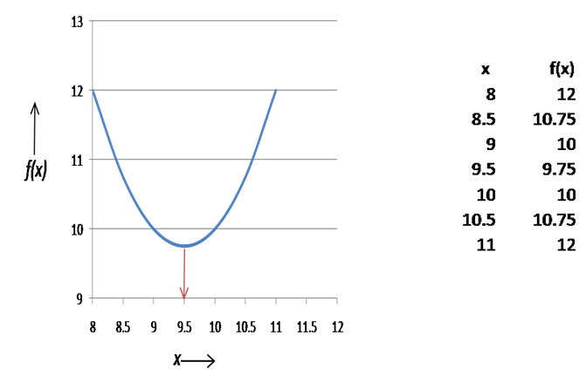
Non-smooth + Smooth=well behaved Finding optimal point
Solution point is always between 0 and location
of vertex of parabola which is c

Slide 5
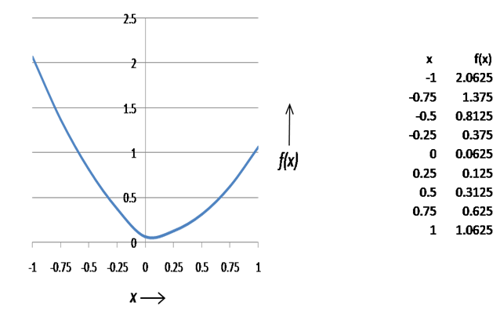
Sign inversion
Algorithm for 1D
if
Else
Shrink towards zero but do not cross

Slide 6
2D
other wise 0
other wise 0

Slide 7
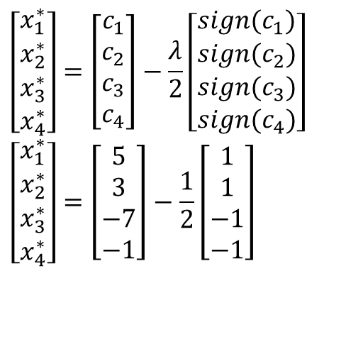
Exercise
$$\left[\begin{matrix}x_{1}^{∗} \\ x_{2}^{∗} \\ x_{3}^{∗} \\ x_{4}^{∗}\end{matrix}\right]=\left[\begin{matrix}c_{1} \\ c_{2} \\ c_{3} \\ c_{4}\end{matrix}\right]−\frac{λ}{2}\left[\begin{matrix}sign(c_{1}) \\ sign(c_{2}) \\ sign(c_{3}) \\ sign(c_{4})\end{matrix}\right] \\ \left[\begin{matrix}x_{1}^{∗} \\ x_{2}^{∗} \\ x_{3}^{∗} \\ x_{4}^{∗}\end{matrix}\right]=\left[\begin{matrix}5 \\ 3 \\ −7 \\ −1\end{matrix}\right]−\frac{1}{2}\left[\begin{matrix}1 \\ 1 \\ −1 \\ −1\end{matrix}\right]$$

Slide 8
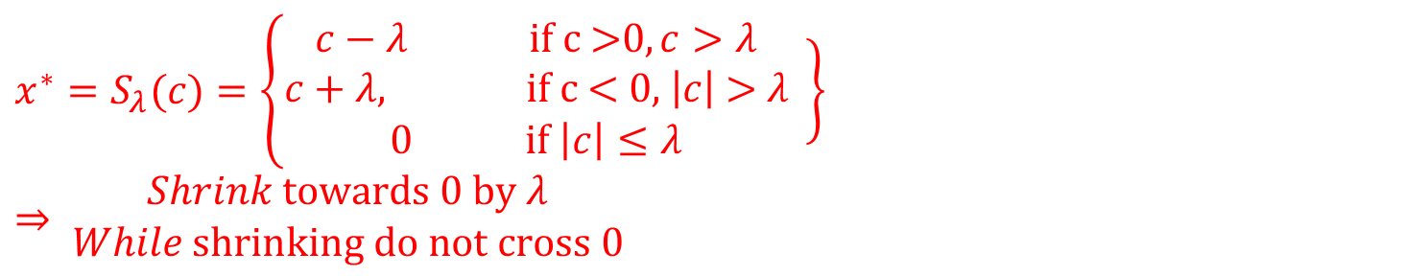
Another equivalent form
Algorithm
$$x^{∗}=S_{λ}(c)=\left\{\begin{matrix}c−λ \text{if} \text{c}\text{ >0}, c>λ \\ c+λ, \text{if} \text{c}\text{ < 0, }\left|c\right|\text{ > }λ \\ 0 \text{if} \left|c\right|≤λ\end{matrix}\right.\left.\begin{matrix} \\ \\ \end{matrix}\right\}⇒ \begin{matrix}Shrink \text{towards}\text{ 0 }\text{by} λ \\ While \text{shrinking} \text{do} \text{not} \text{cross}\text{ 0}\end{matrix}$$
Notes:
X* = c – lambda/2(sign©) when |c|>lambda/2

Slide 9
Proximal methods and Proximal Operators
Notation used in ADMM
Proximal operator of a function

Slide 10
ADMM-Alternating Direction Method of Multipliers

Slide 11
Why ADMM ?
ADMM is a simple and powerful iterative algorithm for convex optimization problems.
It is almost 80 times faster for multivariable problems than conventional methods.
ADMM put linear and quadratic programming in a single framework.

