Slide 1
MIS-4 END TERM TEAM - 1

Slide 2
ALADIN – α An open-source MATLAB toolbox for distributed non-convex optimization

Slide 3
TEAM MEMBERS
VIKHYAT BANSAL CB.EN.U4AIE21076
AMAN SIROHI CB.EN.U4AIE21003
RAKHIL ML CB.EN.U4AIE21048
R SRIVISWA CB.EN.U4AIE21046

Slide 4
Table of contents
Introduction
01
Problem Formulation & Implementation
02
Structure & Features
03
Examples
04
ADMM – Implementation with example
05

Slide 5
INTRODUCTION
01

Slide 6
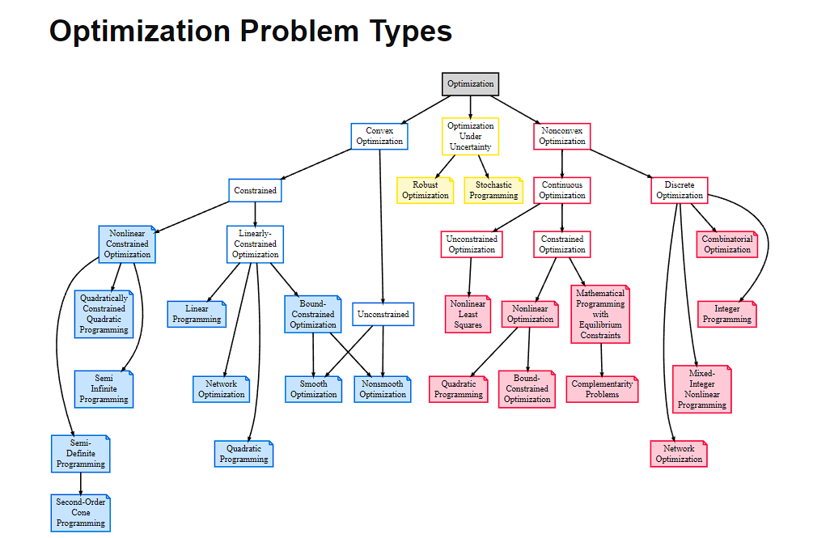

Slide 7
Convex & Non-Convex Optimization
Many methods in machine learning are based on finding parameters that minimize some objective function. If the objective function is convex, that comes with nice guarantees. Most importantly, if a function is strictly convex, it is guaranteed to have a unique global minimum, and it can be found by various standard methods.
Non-convex functions may have several local minima, that is multiple points satisfying that they are the best point in their local neighborhood, but which are not globally optimal. Therefore, if you have a non-convex problem, there is usually no way to test if the solution you have found is indeed the best solution.
Furthermore, if a problem is convex, it is usually easier to analyze the asymptotic behavior of the algorithm, that is how fast it converges as you observe more and more data.
Examples of convex optimisation problems in machine learning:
linear regression/ Ridge regression, with Tikhonov regularisation, etc
sparse linear regression with L1 regularisation, such as lasso
support vector machines
parameter estimation in linear-Gaussian time series (Kalman filter and others)
Typical examples of non-convex optimisation in ML are
neural networks
maximum likelihood mixtures of Gaussians

Slide 8
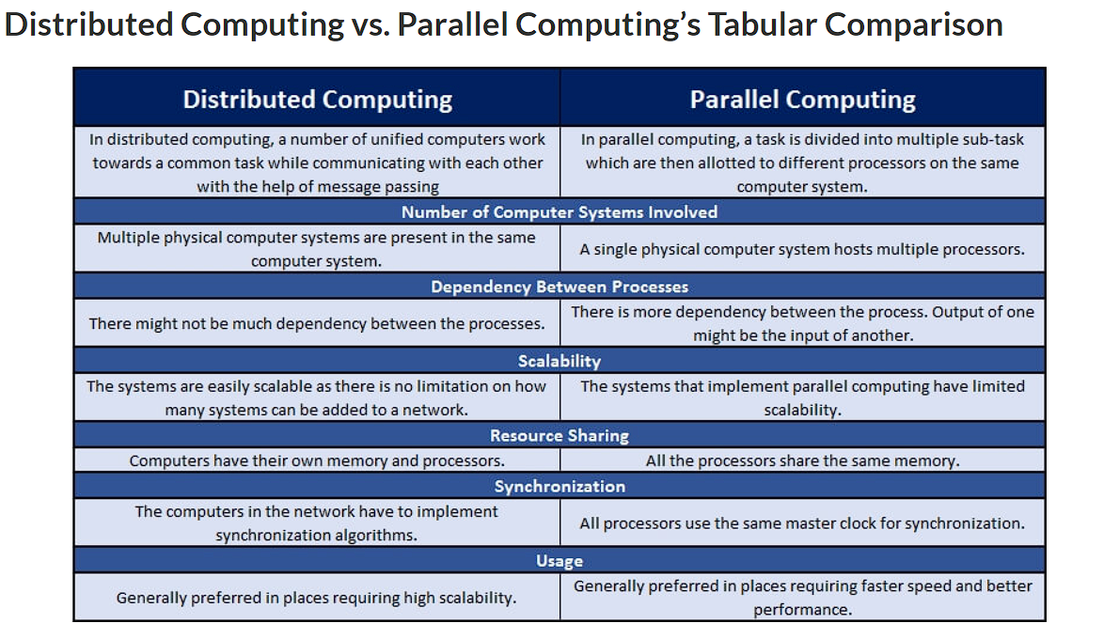

Slide 9
Existing Tools
A closed-source parallel interior point software is OOPS.
The open-source package qpDunes is tailored towards parallel solutions of Quadratic Programs (QPs) arising in model predictive control.
For general QPs, the partially parallelizable solver OSQP seems promising.
PIPS is a collection of algorithms solving structured linear programs, QPs, and general Nonlinear Programming Problems (NLPs) in parallel.
The software HiOp is tailored towards structured and very large-scale NLPs with few nonlinear constraints based on interior point methods.
Moreover, combining parallel linear algebra routines (e.g. PARDISO) with standard nonlinear programming solvers (e.g. IPOPT) also leads to partially parallel algorithms.
ALADIN-α is a toolbox intended for rapid algorithmic prototyping exhibiting convergence guaranteed at a superlinear or even quadratic rate for problems with differentiable nonconvexities. Algorithm is Augmented Lagrangian Alternating Direction Inexact Newton (ALADIN).

Slide 10
PROBLEM FORMULATION
02

Slide 11
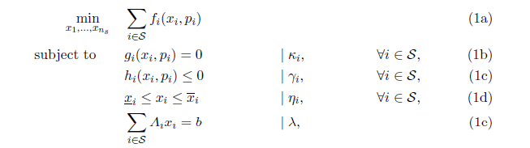
Equations
ALADIN-α solves structured optimization problems of the form
Where S is a set of subproblems
f_{i} are objective functions,
g_{i} and h_{i} are constraint functions for all subproblems
Matrices A_{i} contain the affine coupling information between the subproblems.
Lagrange multipliers k assigned to a constraint g are denoted by g(x) = 0 | k

Slide 12
Standard ALADIN
ALADIN solves convex and non-convex optimization problems in a distributed fashion.
ALADIN can be described as a mix between ADMM and a Sequential Quadratic Programming (SQP) combining distribution computation from ADMM with fast convergence properties and guarantees from SQP.
Similar to ADMM, ALADIN adopts a parallel step- i.e., several NLPs are solved locally and in parallel minimizing local objective functions fi (plus augmentation terms a_{i} accounting for coupling to other subsystems) subject to local constraints g_{i} and h_{i}.
Sensitivities such as gradients, Hessians and Jacobian matrices of the local problems are evaluated locally in the next step of ALADIN.
These sensitivities are collected in a coordination QP adopted from SQP methods.
The coordination QP is equality-constrained and strongly convex (under certain regularity assumptions)|thus it can be reformulated as a linear system of equations. The primal and dual solution vectors of this coordination QP are broadcasted to the local subproblems and the next ALADIN iteration starts.

Slide 13
Bi-level ALADIN
The main advantage of standard ALADIN over other existing approaches are convergence guarantees and fast local convergence. On the other hand, the coordination QP makes ALADIN distributed but not decentralized and the coordination
step in standard ALADIN is quite heavy and communication intense compared with other approaches such as ADMM.
Bi-level ALADIN tries to overcome these drawbacks by constructing a coordination QP of smaller dimension lowering communication. This lower-dimensional QP is solved in a decentralized fashion leading to an overall decentralized algorithm.
Bi-level ALADIN tackles the coordination QP in decentralized fashion based on neighbor-to-neighbor communication.
ALADIN-α comes with two decentralized algorithms: a decentralized version of the Conjugate Gradient (CG) method and a decentralized version of ADMM.
Although these decentralized algorithms deliver only a certain level of precision, bi-level ALADIN is guaranteed to converge if certain error bounds hold

Slide 14
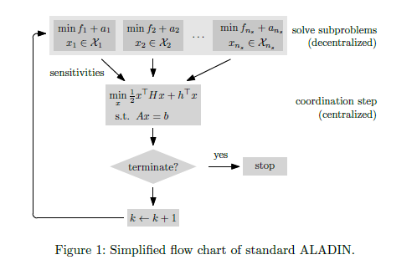
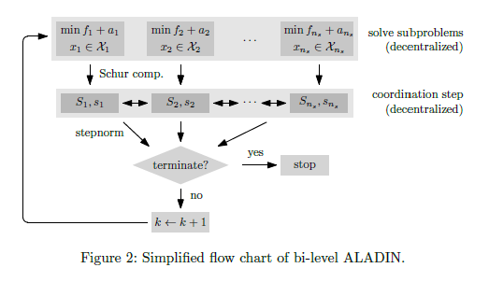
Standard ALADIN-and also bi-level ALADIN-exhibit convergence guarantees.
The set of assumptions required for ALADIN to converge are standard regularity conditions such as the Linear Independence Constraint Qualification (LICQ) and a slightly stronger form of the second-order sufficient condition.
If these conditions hold, if the coordination step is computed exactly, and if certain technical conditions hold, then ALADIN is guaranteed to converge locally at a super-linear/quadratic rate.

Slide 15
IMPLEMENTATION
02

Slide 16
ALADIN - Implementation Details
Each ALADIN iteration executes three main steps:
Step 1: It solves local NLPs for fixed and given values for primal iterates and dual iterates in parallel.
The parameter sequences and are user-defined.
Step 2: It gets the termination criterion and returns it
and positive definite
Step 3: It computes local sensitivities such as the gradient of the local objectives
approximations of the local Hessian matrices where
is the set of active inequality constraints in subproblems
is a user-defined parameter which can be specified via the actMargin option.
and
We define combined inequality constraints
and Jacobians of active constraints for all
Step 4: With this sensitivity information, it solves an equality constrained quadratic program serving as a coordination problem.
based on the solution to (A2). To achieve global convergence guarantees, the
Step 5: It updates
and
has to be properly chosen by a globalization routine.
A smaller stepsize can be specified via the stepSize option which might stabilize ALADIN - α

Slide 17
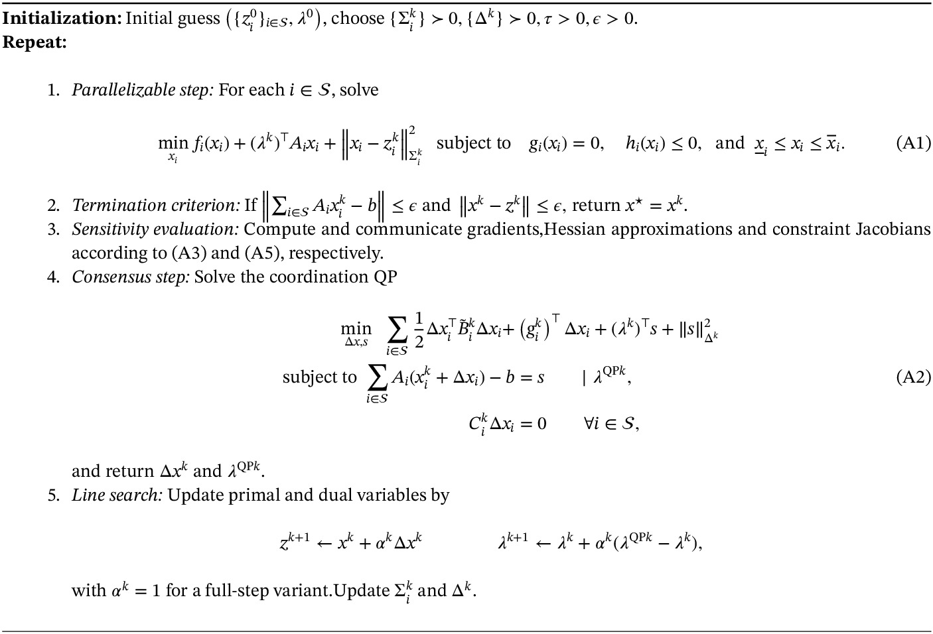

Slide 18
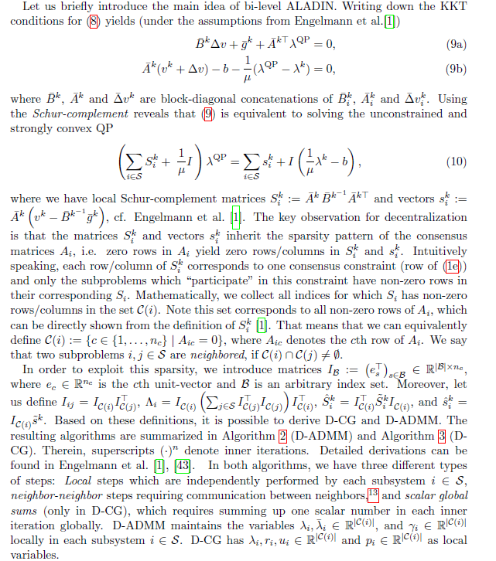
Bi-level ALADIN
Implementation Details

Slide 19
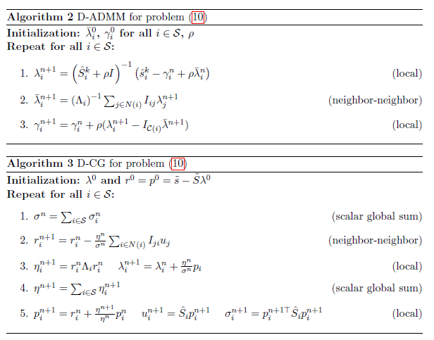
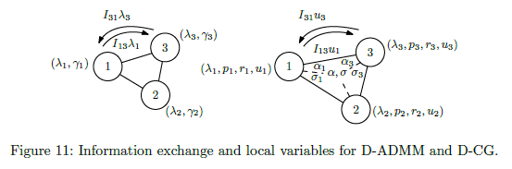

Slide 20
STRUCTURE
03

Slide 21
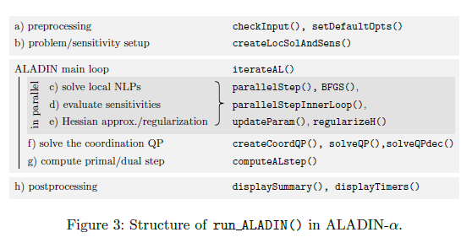
CODE STRUCTURE
The overall structure of run_ALADIN()—the main function of ALADIN – α is given below
A preprocessing step performs a consistency check of the input data and provides default options.
The createLocSolAndSens() function initializes the local NLPs and sensitivities for all subproblems.
In the main loop iterateAL(), the function parallelStep() solves the local NLPs and evaluates the Hessian of the Lagrangian, the gradient of the objective, and the Jacobian of the active constraints

Slide 22
CODE STRUCTURE
Furthermore, a regularization procedure is executed if needed. Moreover, in case the nullspace method or bi-level ALADIN is used, the computation of a nullspace basis and the computation of the Schur-complement is performed locally shifting substantial computational burden from the centralized coordination step to parallelStep(). The function updateParam() computes dynamically changing ALADIN parameters for numerical stability and speedup.
The coordination QP is constructed in the function createCoordQP().
Different dense and sparse solvers for solving the coordination QP are available in solveQP(). Most of them are based on solving the first-order necessary conditions which is a system of linear equations. Available solvers are the MATLAB linear algebra routines linsolve(), pinv() and MA57.
In case of convergence problems from remote starting points it can help to reduce the primal-dual stepsize of the QP step by setting the stepSize in the options to a value smaller than 1.

Slide 23
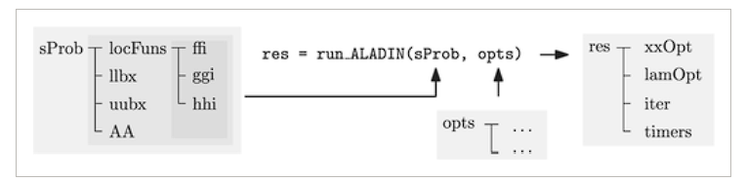
DATA STRUCTURE
The main data structure for defining problems in form of objective and constraint functions is a struct called sProb.
sProb collects lower/upper bounds in cells called llbx and uubx.
The coupling matrices {A} are collected in AA. Optionally, one can also provide NLP solvers and sensitivities-in this case the problem setup in createLocSolAndSens() is skipped leading to a substantial speedup in runtime for larger problems. This way, problem setups can be saved and reused.
For a minimal working example of ALADIN-α one only needs to specify ffi and AA. Optionally one can provide initial guesses zz0 and initial Lagrange multipliers lam0.
The second ingredient for ALADIN-α is an opts struct, which specifies the ALADIN variant and algorithm parameters.
ALADIN – α returns a struct as output. This struct contains the cell xxOpt with local minimizers.
{x} and the optimal Lagrange multipliers lambda(λ) of the consensus constraints.
Moreover the field iter contains information about the ALADIN iterates such as primal/dual iterates and timers collects timing information.
Notes:
Refer the given link for further explanation - https://alexe15.github.io/ALADIN.m/options/

Slide 24
FEATURES
03

Slide 25
FEATURES
These features can be activated/deactivated by setting corresponding options.
Hessian approximations Instead of exact Hessians, approximations such as the Broyden–Fletcher–Goldfarb–Shanno (BFGS) update can be used either to reduce communication and/or to reduce computational complexity in sensitivity computation. The BFGS Hessian is activated by setting the Hess option either to BFGS for standard BFGS or to DBFGS for damped BFGS.
Parametric NLP setup A parametric problem setup is possible in the objective functions f_{i} and the equality/inequality constraints g_{i}/h_{i} via the parameters p_{i}. This feature is especially useful in combination with the reuse option which returns the internally constructed CasADi solvers and derivatives. If one uses this returned problem formulation in a new run ALADIN() run, the problem setup will be skipped which can lead to a substantial speedup.
Parallelization ALADIN – α also supports parallel computing on multiple processors via
the MATLAB parallel computing toolbox. Here, we exploit the fact that the local NLPs are independent from each other, that is, they can be solved in parallel.
Application examples We provide numerical examples highlighting applicability of ALADIN – α to a wide range of problems.

Slide 26
EXAMPLES
04

Slide 27
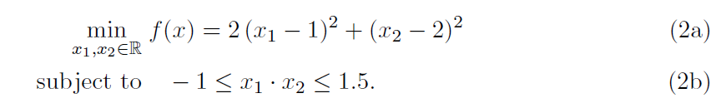
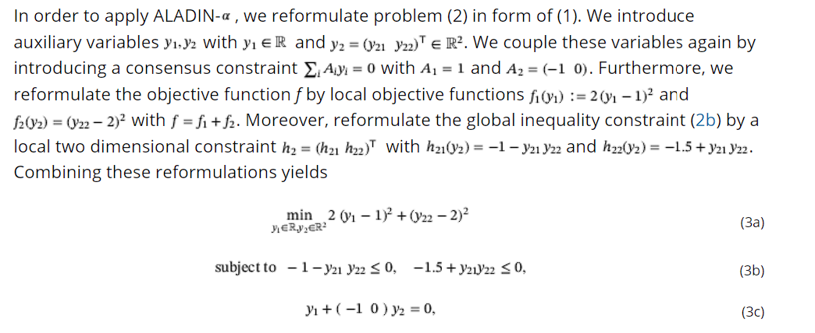
EXAMPLE 1 - PROBLEM
Let us consider the non-convex NLP
In order to apply ALADIN – α, the problem must be reformulated in form of objective function with constraints .

Slide 28
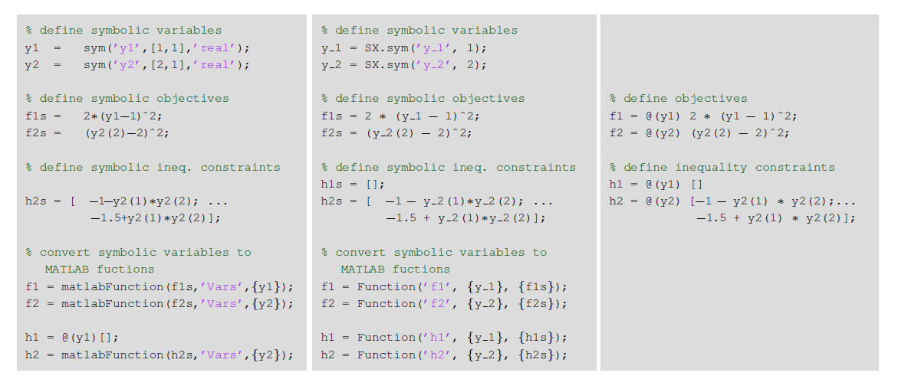
EXAMPLE 1 - CODE
We transcribe above in the struct sProb as illustrated in Subsection Data Structure . To highlight different possibilities of problem setup, we construct the problem in three different ways: a) via the MATLAB symbolic toolbox, b) via the CasADi symbolic framework, and, c) directly via function handles

Slide 29
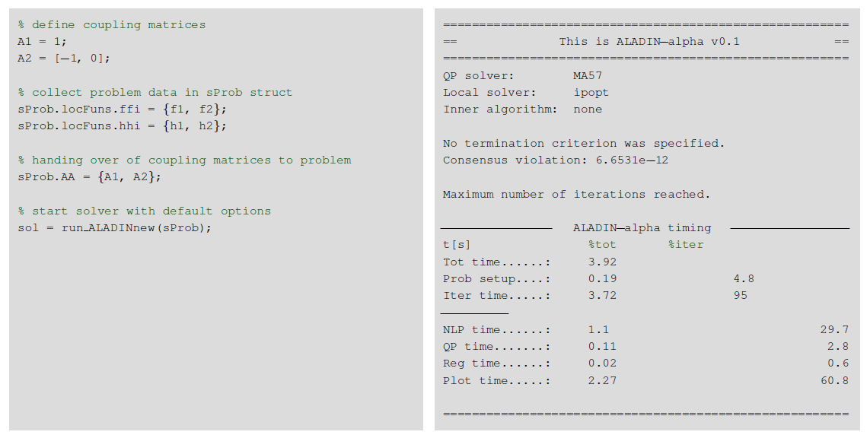
EXAMPLE 1 - SOLUTION
After defining objective and constraint functions, all function handles and the coupling matrices are collected in sProb. We call run_ALADIN() with an empty options struct leading to computation with default parameters. The code and the resulting ALADIN – α report after running run_ALADIN() are shown in output window.
The consensus violation , the local step sizes , the step size in the coordination step , and the changes in the active set are being displayed above.

Slide 30
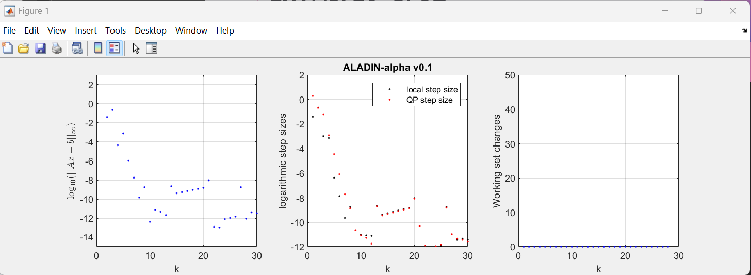
EXAMPLE 1 - PLOT

Slide 31
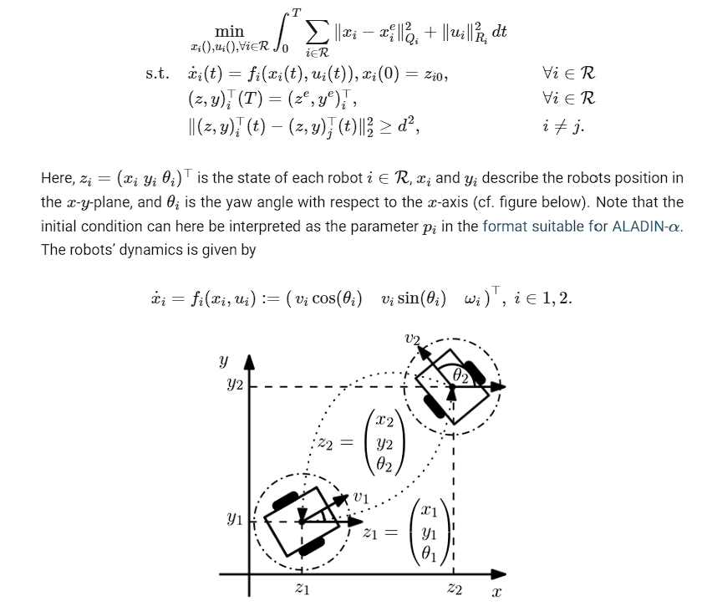
EXAMPLE 2 – PROBLEM - Distributed MPC for Mobile Robots
Here we give an example how ALADIN-M can be used for distributed Model Predictive Control. In particular, we show how the distributed parametric programming option and the problem reuse option of ALADIN-M are useful. The goal here is that two mobile robots exchange their positions while keeping a certain distance.

Slide 32

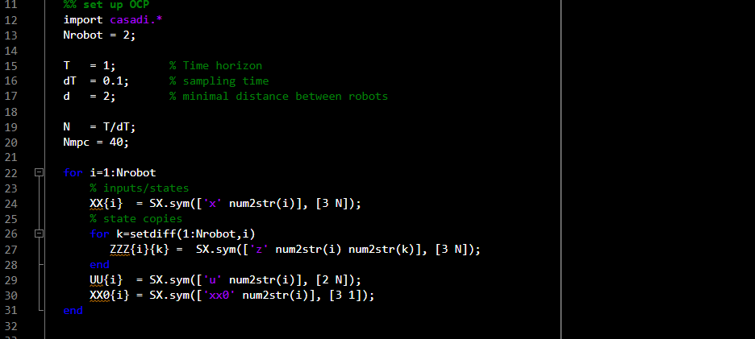
EXAMPLE 2 - CODE
Next, we prepare ourself for setting of the robots’ OCPs. We construct our problem using CasADi. Specifically, we create cells XX and UU containing the CasADi symbolic variables for the states z and the inputs u over the horizon length T

Slide 33
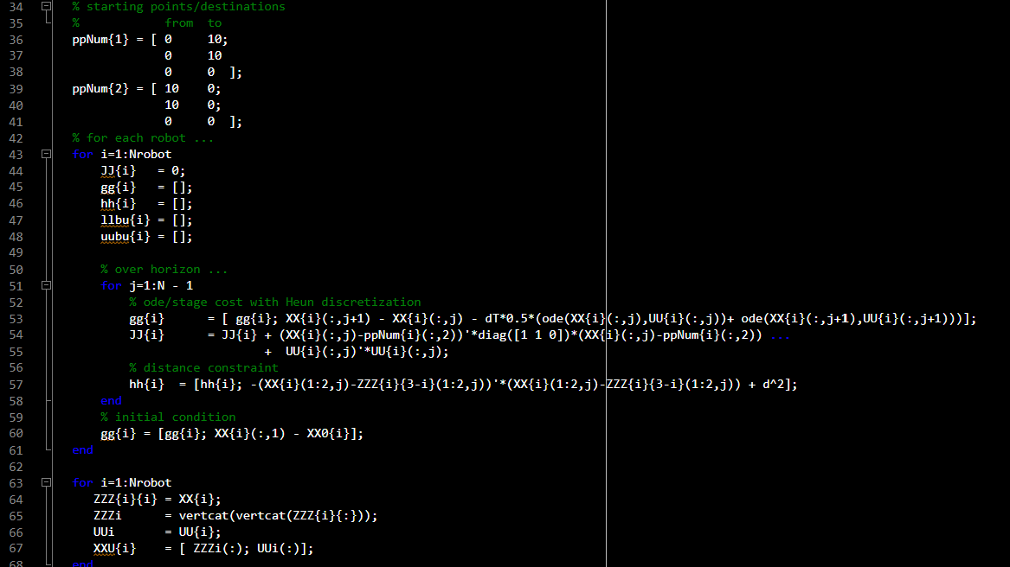
EXAMPLE 2 - CODE
Discretized version of the above OCP. we construct this OCP in a loop setting up the OCPs for all robots individually.

Slide 34
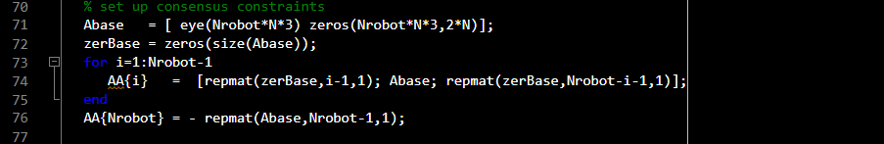
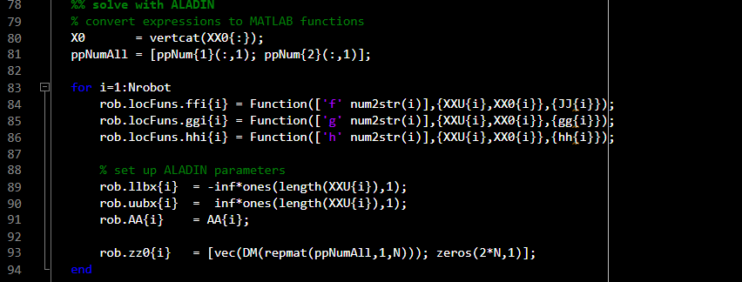
EXAMPLE 2 - CODE
Next, we construct the consensus matrices {A_{i}}_{i∈R.} We construct them such that the original trajectories coincide with the copied trajectories.
In a last step, we convert the CasADi symbolic expressions to evaluable and set up the initial guesses z⁰_{i} and λ⁰. Note that the local equality constraints collected in rob.locFuns.gg are parametrized with initial condition x0 for the ode of robots.

Slide 35
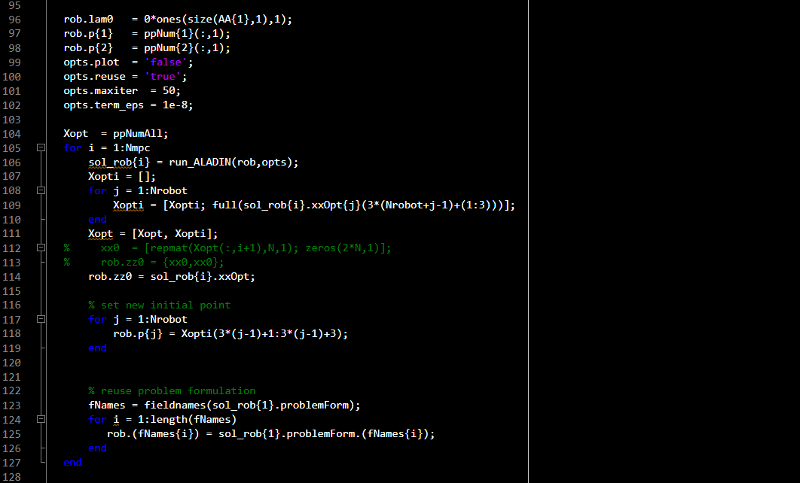
EXAMPLE 2 - CODE
After setting up some options, the discretized OCP can be solved with ALADIN – α. Here we do that within an Model Predictive Control loop, where we use the reuse option of ALADIN – α in order to construct the derivatives and local solvers only once. Note that the initial position of the robots changes in each iteration.

Slide 36
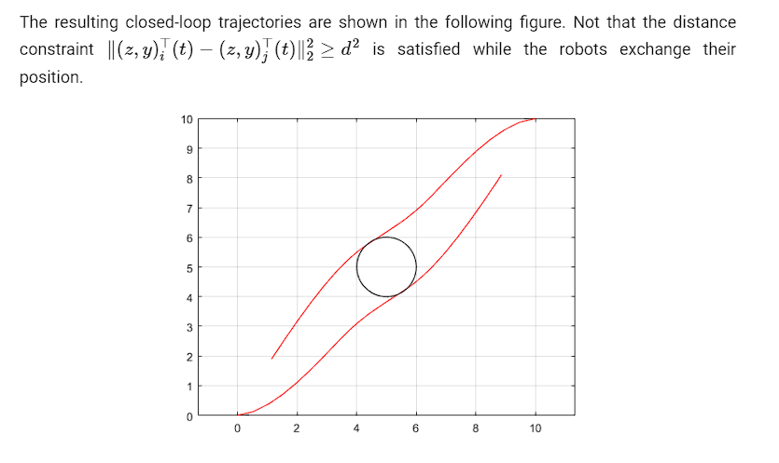
EXAMPLE 2 – OUTPUT - PLOT

Slide 37
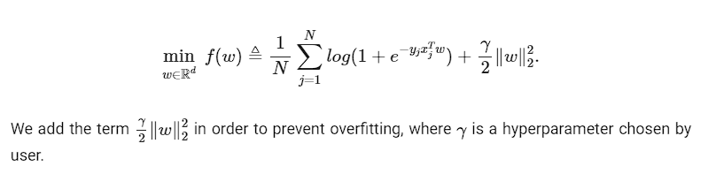
EXAMPLE 3 – PROBLEM – Machine Learning
Here we give a simple classification example how ALADIN-α can be used for machine learning problems. The goal here is finding a suitable parameter w that classify the input data into its label.
Loss Function
Let x_{j} be the j-th input data and y_{j} be its label, let N be the number of input data, let n_{x} be the dimension of input data, let w be the decision variable. We consider a ℓ₂-regularized logistic regression loss function

Slide 38
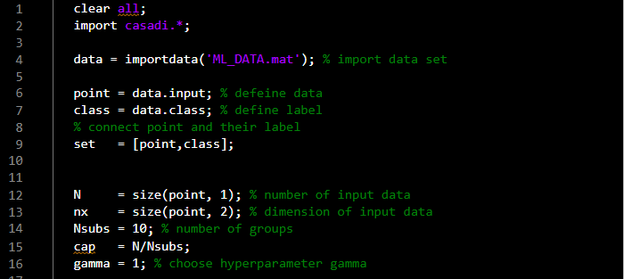
EXAMPLE 3 - CODE
To solve this problem, we divide the input data set into several groups and each group specifies a subsystem. We set the number of subsystems N_{subs} to 10, that is, the capacity of each subsystem is cap=N/N_{subs}.
Next, we define the decision variable w and set up the OCP (Optimal Control Problem. Because the volume of each group is cap and the dimension of data point is n_{x}, the dimension of w should be cap∗n_{x}. It is obvious that we can also divide w into cap groups.

Slide 39
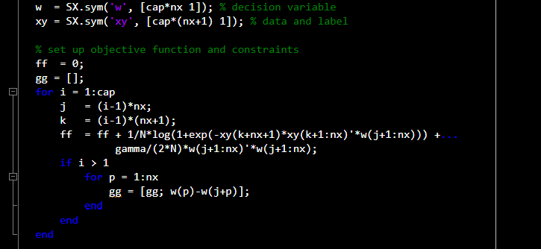
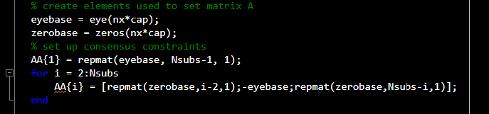
EXAMPLE 3 - CODE
The form of the objective functions for each subsystem are same, so we define the objective function with parameter xy, which represents the input data and their labels for each subsystem.
Next, we construct the consensus matrix {A_{i}},i=1,2,...N_{subs}.

Slide 40
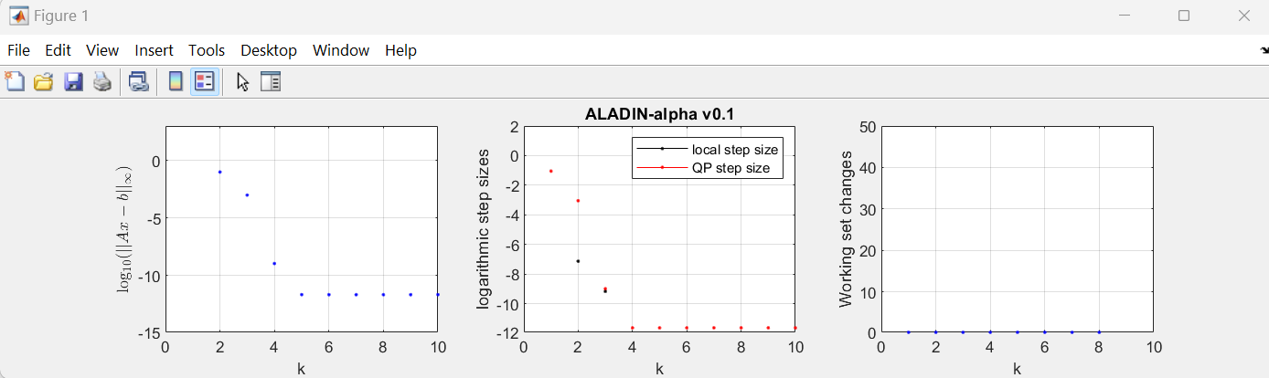
EXAMPLE 3 – OUTPUT - PLOT

Slide 41
EXAMPLE 4 – PROBLEM – Optimal Power Flow
The Optimal Power Flow (OPF) model represents the problem of determining the best operating levels for electric power plants in order to meet demands given throughout a transmission network, usually with the objective of minimizing operating cost.
The most common objective functions of optimal power flow are fuel cost minimization, minimization of emissions, real power losses, and reduction of voltage deviation with satisfying operational constraints in power systems.
Here, we consider an OPF problem, which is one of the most important optimization problems in power systems. Distributed optimization is particularly important here due to large problem sizes and due to the necessity of a reduced information exchange between subsystems.
Reducing Communication
There are different ways of reducing the communication overhead in ALADIN-α. Compared with ADMM for example, the coordination step of ALADIN is quite heavy due to the necessity to exchange derivative information. However, there are different ways to reduce the communication overhead of ALADIN-α. Which one works best also depends on the problem at hand.

Slide 42
EXAMPLE 4 – WORKING OF CODE
The first option is to use Hessian approximations instead of exact Hessians. The advantage here is, that with the Broyden-Fletcher–Goldfarb-Shanno (BFGS) formula for example, the Hessian matrix is approximated based on two subsequent gradients. Gradients scale with O(n) whereas symmetric matrices with O(n²) in general making Hessian approximations preferable over exact Hessians.
BFGS and damped BFGS can be activated in ALADIN-α with the Hessian option with BFGS or DBFGS respectively.
Another option is based on the so-called reduced-space or nullspace method. The idea here is to eliminate all active constraints by computing a basis of the nullspace they span. With that, the dimension of the problem can be reduced by two-times the number of constraints and thus the communication-overhead can be substantially smaller - especially in case of many active constraints.
On this reduced problem it is then also possible to use the both proposed variants of bi-level ALADIN which solves this reduced coordination problem purely on a neighbor-to-neighbor basis yielding one of the first decentralized algorithms for non-convex optimization with convergence guarantees. The used inner algorithms are variants of the Alternating Direction of Multipliers Method (ADMM) and the Conjugate Gradient (CG) method.

Slide 43
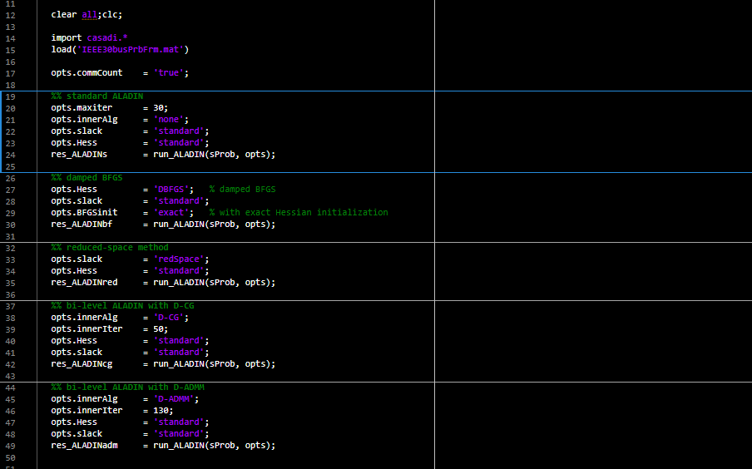
EXAMPLE 4 - CODE

Slide 44
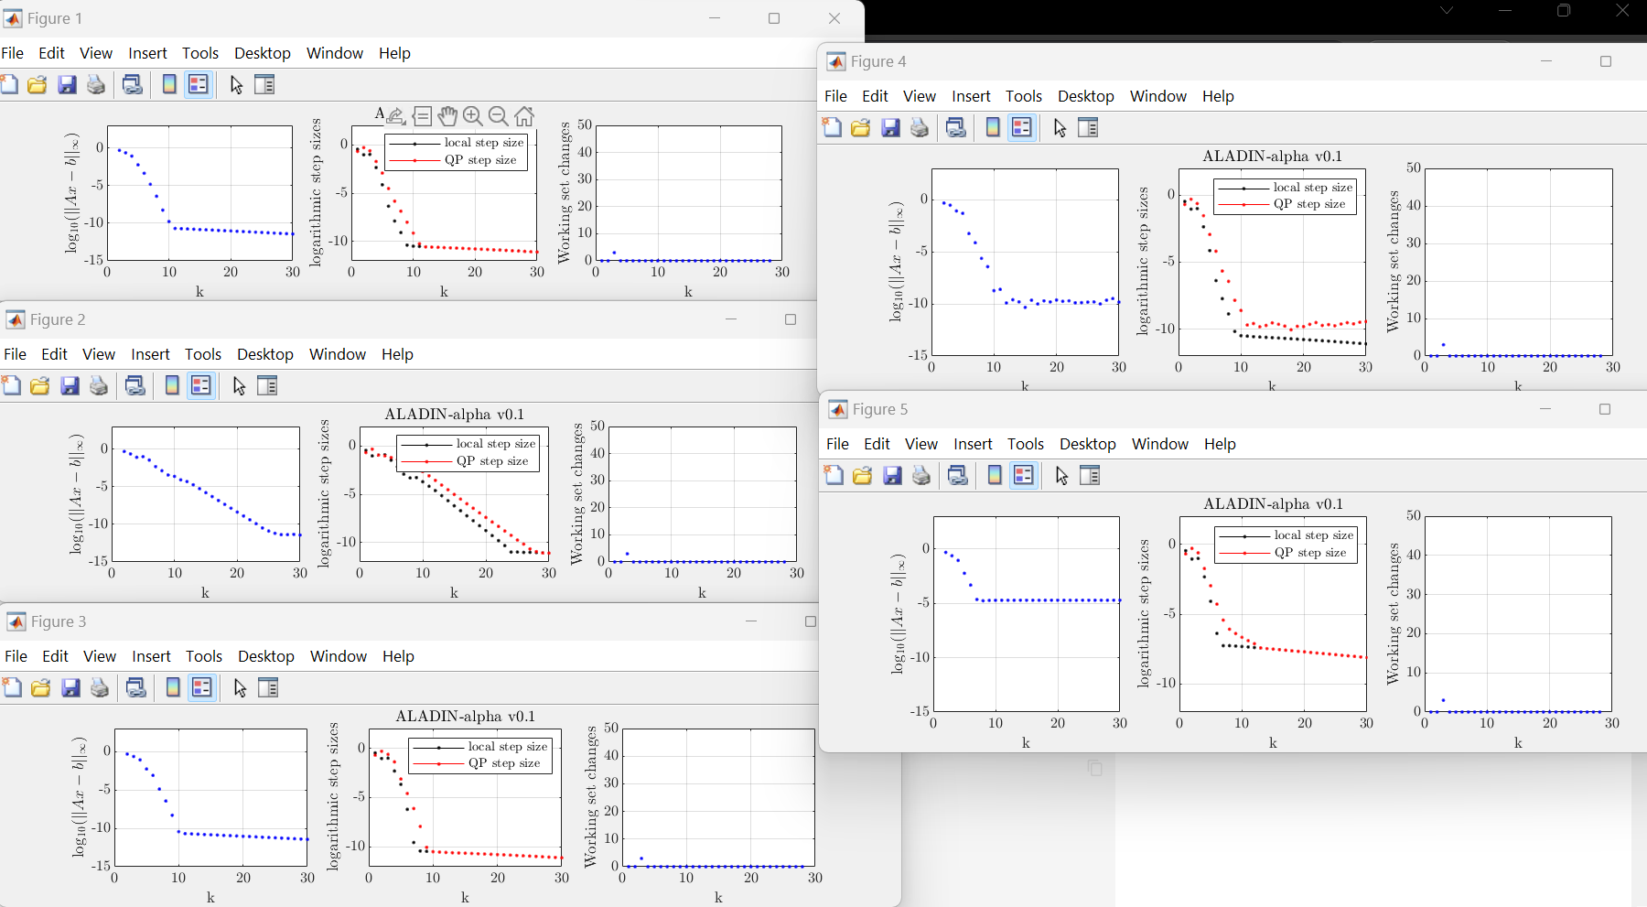
EXAMPLE 4 – OUTPUT - PLOT

Slide 45
ADMM
05

Slide 46
ADMM
The Alternating Direction Method of Multipliers (ADMM) is an iterative algorithm for solving convex optimization problems. It decomposes the problem into smaller pieces, making it easier to handle. ADMM is gaining popularity because it allows optimization to be done in a distributed manner, making problems of ever-increasing size tractable. It is a simple and powerful iterative algorithm for convex optimization problems, and it is almost 80 times faster for multivariable problems than conventional methods.
It has wide application in a number of areas, including linear programming (LP) and quadratic programming (QP).

Slide 47
Linear Programming (LP)
Problem Description
The LP problem can be formulated as follows:
minimize c^{T}x subject to Ax = b x >= 0
where A is an m x n matrix, b is an m-dimensional vector, and c is an n-dimensional vector.

Slide 48
How ADMM can be used in this problem
ADMM can be used to solve the LP problem by reformulating it as a constrained optimization problem.
The ADMM algorithm for LP involves splitting the optimization variable into two parts, x and z, and solving programs of the form:
minimize f(x) + g(z) subject to Ax + Bz = c
where f and g are convex functions, and B is a matrix that defines the coupling between x and z.

Slide 49
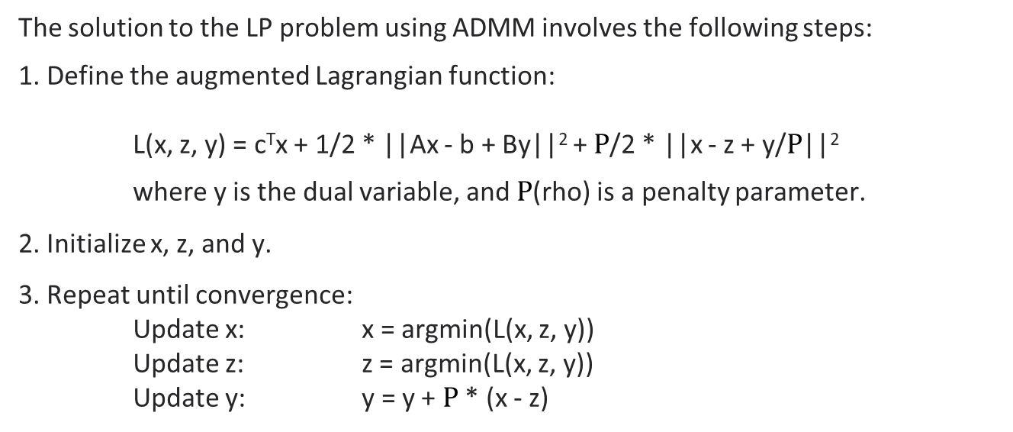
Solution to the problem
The solution to the LP problem using ADMM involves the following steps:
1. Define the augmented Lagrangian function:
L(x, z, y) = c^{T}x + 1/2 * ||Ax - b + By||² + $Ρ$/2 * ||x - z + y/$Ρ$||²
where y is the dual variable, and $Ρ$(rho) is a penalty parameter.
2. Initialize x, z, and y.
3. Repeat until convergence:
Update x: x = argmin(L(x, z, y))
Update z: z = argmin(L(x, z, y))
Update y: y = y + $Ρ$ * (x - z)

Slide 50
MATLAB CODE

Slide 51
Brief Explanation
The code uses the ADMM algorithm to solve the L1-regularized least squares problem, which is a special case of the LP problem.
The objective function is defined as:
minimize 1/2*|| Ax - b ||₂² + $λ$ || x ||₁
where A is an m x n matrix, b is an m-dimensional vector, x is an n-dimensional vector, and $λ$(lambda) is a regularization parameter.
The code initializes x, z, and u, and then iteratively updates them until convergence.
The shrinkage function is used to update z, and the objective function is used to compute the objective value at each iteration.

Slide 52
Quadratic Programming (QP)
Problem Description
The QP problem can be formulated as follows:
minimize (1/2)x^{T}Qx + q^{T}x subject to Ax <= b
where Q is an n x n symmetric matrix, A is an m x n matrix, and b is an m-dimensional vector.

Slide 53
How ADMM can be used in this problem
ADMM can be used to solve the QP problem by reformulating it as a constrained optimization problem.
The ADMM algorithm for QP involves splitting the optimization variable into two parts, x and z, and solving programs of the form:
minimize (1/2)x^{T}Qx + q^{T}x + r(z) subject to Ax + Bz <= c
where r is a convex function, and B is a matrix that defines the coupling between x and z.

Slide 54
Solution to the problem
The solution to the QP problem using ADMM involves the following steps:
1. Define the augmented Lagrangian function:
L(x, z, y) = (1/2)x^{T}Qx + q^{T}x + r(z) + y^{T} (Ax + Bz - c) + ($Ρ$/2)*||Ax + Bz - c||²
where y is the dual variable, and $Ρ$(rho) is a penalty parameter.
2. Initialize x, z, and y.
3. Repeat until convergence:
Update x: x = argmin(L(x, z, y))
Update z: z = argmin(L(x, z, y))
Update y: y = y + $Ρ$ * (Ax + Bz - c)

Slide 55
MATLAB CODE

Slide 57
Brief Explanation
This code solves the standard form box-constrained QP problem via ADMM. The function r(z) is a user-defined function that computes the proximal operator of a convex function. The output history is a structure that contains the objective value, the primal and dual residual norms, and the tolerances for the primal and dual residual norms at each iteration.

Slide 58
Resources
https://github.com/alexe15/ALADIN.m
https://onlinelibrary.wiley.com/doi/full/10.1002/oca.2811
https://arxiv.org/pdf/2006.01866v2.pdf
https://web.stanford.edu/~boyd/papers/admm/
http://users.isr.ist.utl.pt/~jmota/DADMM/
https://github.com/guojunyao419/OPF-ADMM

Slide 59
THANK YOU!!

