Slide 1
MATHEMATICAL INTELLIGENCE SYSTEMS
GROUP ASSIGNMENT

Slide 2
TEAM MEMBERS
BATCH-A​​​​ | TEAM-7​​​​
GAJULA SRI VATSANKA​​​​ | CB.EN.U4AIE.21010​​​​
GUNNAM HIMAMSH​​​​ | CB.EN.U4AIE.21014​​​​
M.PRASANNA TEJA​​​​ | CB.EN.U4AIE.21035​​​​
VIKHYAT BANSAL​​​​ | CB.EN.U4AIE.21076​​​​

Slide 3
QUESTION-1
Perform linear convolution of the below two sequences and verify using DFT in MATLAB (Using FFT command) x=[ 1 2 2 1];y=[ 1 3 2 1];

Slide 4
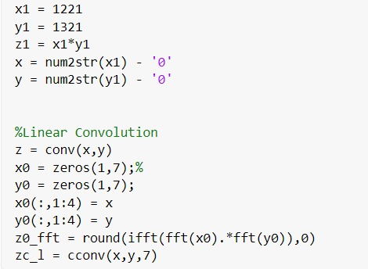
MATLAB CODE

Slide 5
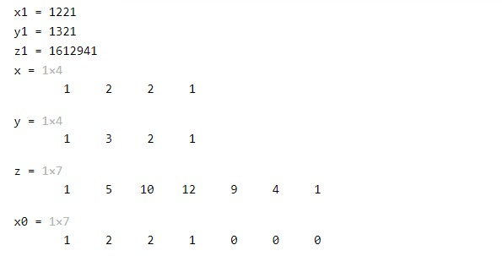
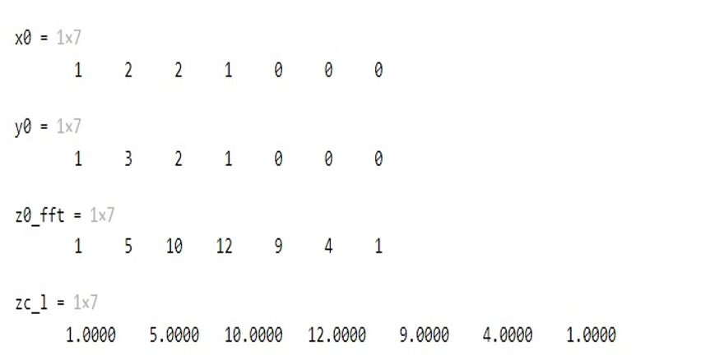

Slide 6
QUESTION-2
Perform linear convolution of sequence {1,1} 50 times using FFT in MATLAB.

Slide 7
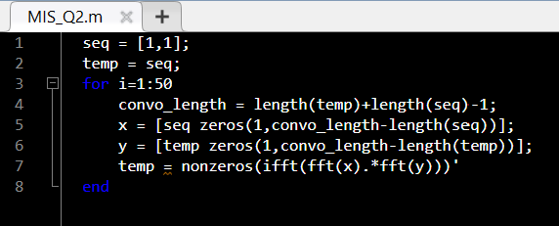
MATLAB CODE

Slide 8
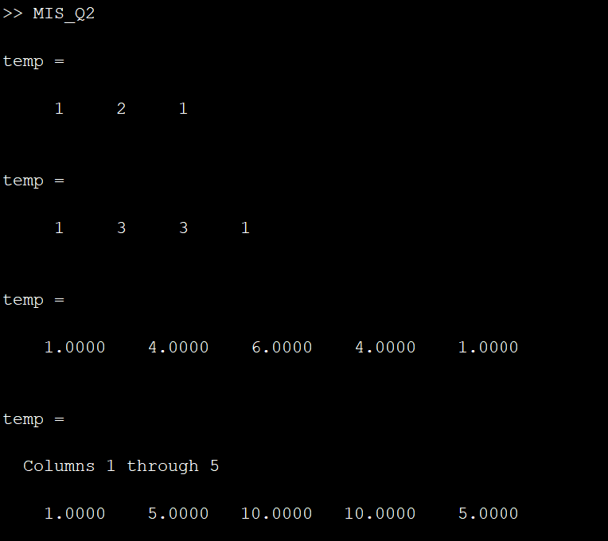
First page OUTPUT
……

Slide 9
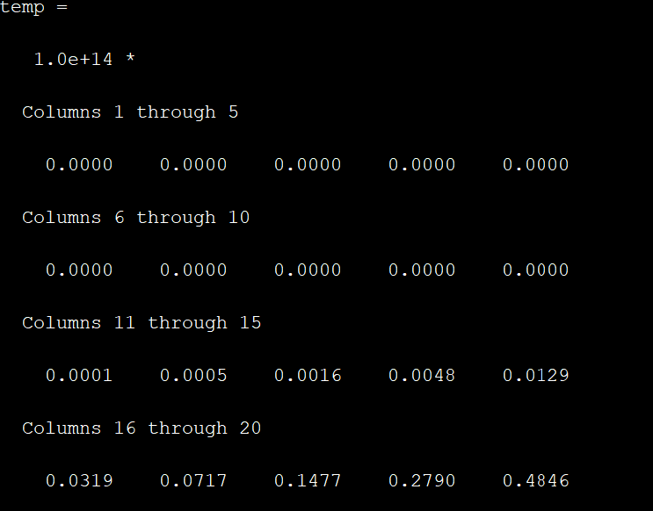
Last Page OUTPUT

Slide 10
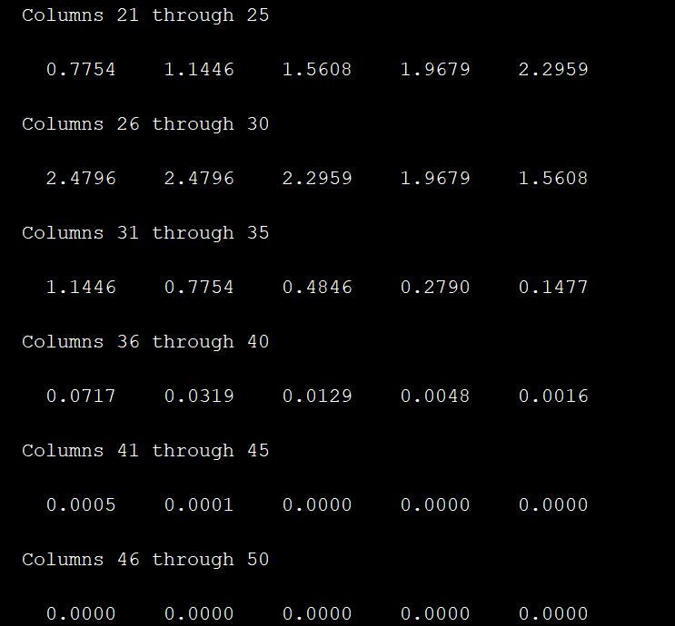
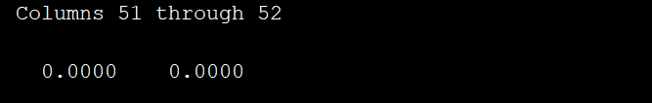
Last Page OUTPUT

Slide 11
QUESTION-3
A coin is tossed 3 times. Find the probability of getting 0 Head, 1 Head, 2 Head and 3 Head using convolution. Also verify using FFT in MATLAB.

Slide 12
CALCULATING NUMERICALLY
We already know how to calculate the probability of getting 0 Head, 1 Head and 2 Head and 3 Head numerically using the simple formulae.
All the outcomes = {HHH,HHT,HTH, HTT ,THH,TTT,TTH,THT}
P(0) = Number of zero heads / Total number of outcomes
= 1/8 = 0.125
P(1) = Number of one heads / Total number of outcomes
= 3/8 = 0.325 P(2) = Number of two heads / Total number of outcomes
= 3/8 = 0.325
P(3) = Number of three heads/ Total number of outcomes
= 1/8 = 0.125

Slide 13
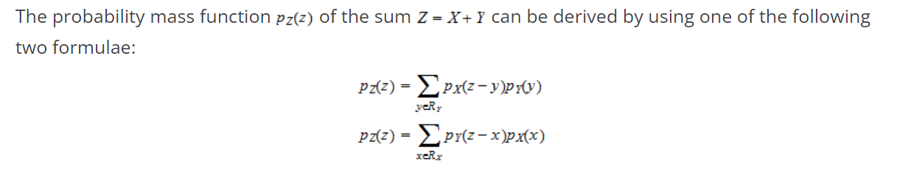
Using Convolution

Slide 14
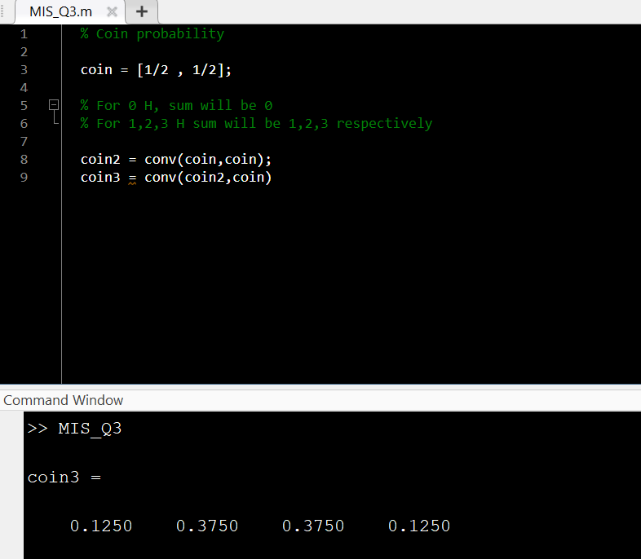
Probability of getting 0 Head, 1 Head , 2 Heads and 3 Heads using MATLAB

Slide 15
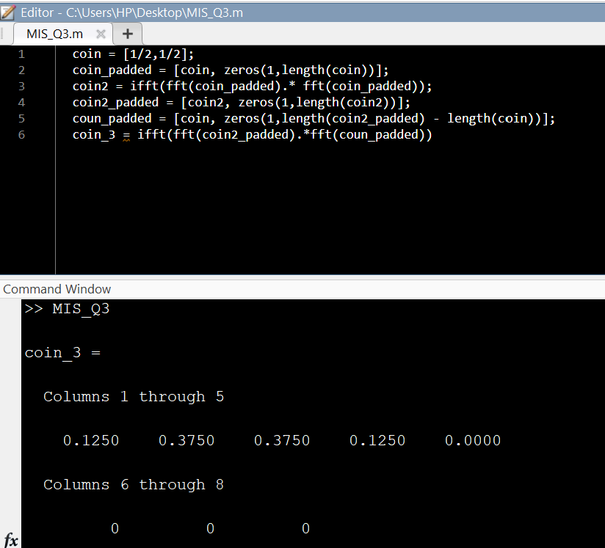
Using FFT in MATLAB

Slide 16
QUESTION-4
A die is thrown 20 times. Compute probabilities of getting all possible sums (20 to 120) using FFT in MATLAB.

Slide 17
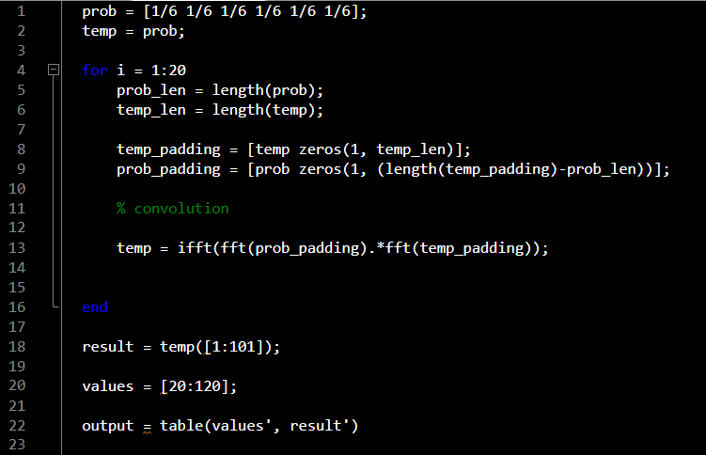
4
Convolution using FFT in MATLAB

Slide 18
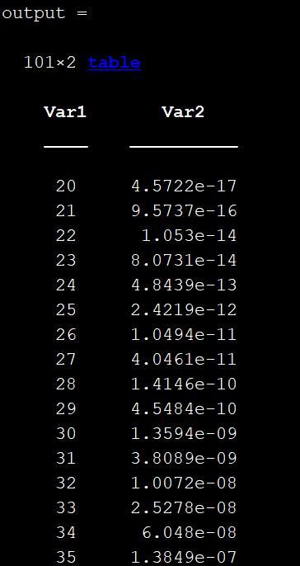
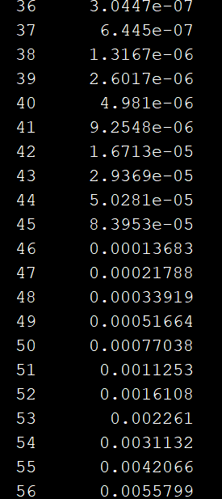
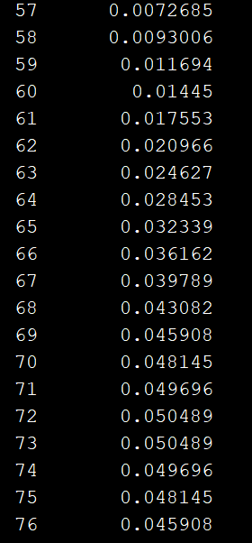
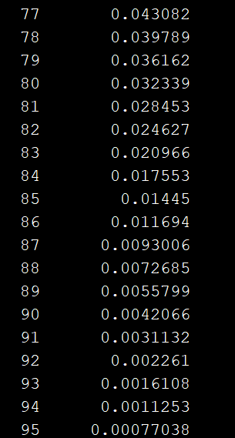

Slide 19
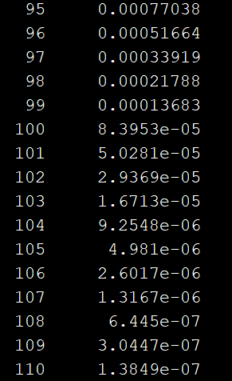
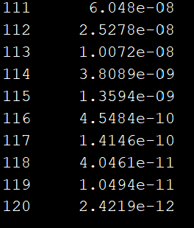

Slide 20
output =
Var1 Var2
20 4.5722e-17
21 9.5737e-16
22 1.053e-14
23 8.0731e-14
24 4.8439e-13
25 2.4219e-12
26 1.0494e-11
27 4.0461e-11
28 1.4146e-10
29 4.5484e-10
30 1.3594e-09
31 3.8089e-09
32 1.0072e-08
33 2.5278e-08
34 6.048e-08
35 1.3849e-07
36 3.0447e-07
37 6.445e-07
38 1.3167e-06
39 2.6017e-06
40 4.981e-06
41 9.2548e-06
42 1.6713e-05
43 2.9369e-05
44 5.0281e-05
45 8.3953e-05
46 0.00013683
47 0.00021788
48 0.00033919
49 0.00051664
50 0.00077038
51 0.0011253
52 0.0016108
53 0.002261
54 0.0031132
55 0.0042066
56 0.0055799
57 0.0072685
58 0.0093006
59 0.011694
60 0.01445
61 0.017553
62 0.020966
63 0.024627
64 0.028453
65 0.032339
65 0.032339
66 0.036162
67 0.039789
68 0.043082
69 0.045908
70 0.048145
71 0.049696
72 0.050489
73 0.050489
74 0.049696
75 0.048145
76 0.045908
77 0.043082
78 0.039789
79 0.036162
80 0.032339
81 0.028453
82 0.024627
83 0.020966
84 0.017553
85 0.01445
86 0.011694
87 0.0093006
88 0.0072685
89 0.0055799
90 0.0042066
91 0.0031132
92 0.002261
93 0.0016108
94 0.0011253
95 0.00077038
96 0.00051664
97 0.00033919
98 0.00021788
99 0.00013683
100 8.3953e-05
101 5.0281e-05
102 2.9369e-05
103 1.6713e-05
104 9.2548e-06
105 4.981e-06
106 2.6017e-06
107 1.3167e-06
108 6.445e-07
109 3.0447e-07
110 1.3849e-07
111 6.048e-08
112 2.5278e-08
113 1.0072e-08
114 3.8089e-09
115 1.3594e-09
116 4.5484e-10
117 1.4146e-10
118 4.0461e-11
119 1.0494e-11
120 2.4219e-12

Slide 21
QUESTION-5
A die is thrown 10 times. Compute probability of getting the sum on the die as more than 40 using FFT in MATLAB

Slide 22
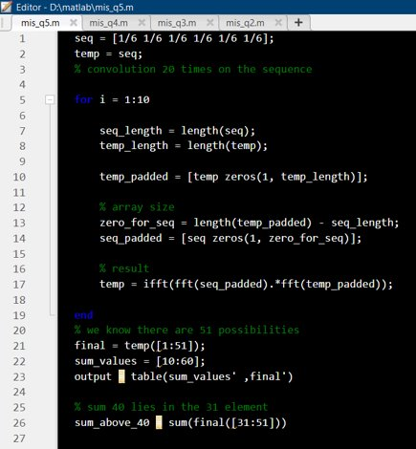
​
MATLAB Code:

Slide 23
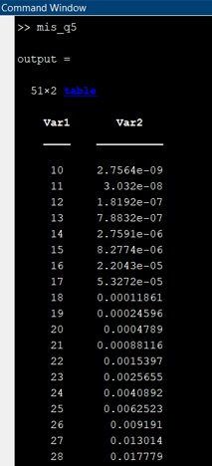
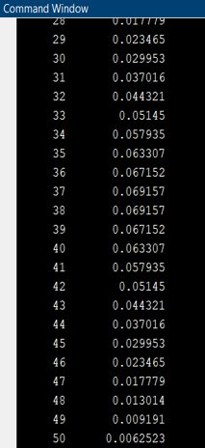
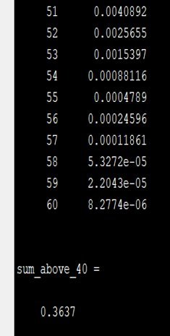
Output:
Probability of getting the sum on the die as more than 40 is 0.3637

Slide 24
QUESTION-6
Explain how you will convert product of two 3-digit numbers into a convolution followed by a sum of sequences.

Slide 25
Convolution Sum
A convolution Sum takes the form:
Such types of sums have a wide range of applications in various fields.
They are used in Linear time Invariant systems to denote the sum of scaled and shifted impulse responses with the delay k.
It is used as a tool in Probability theory to find the probability mass function of a variable dependent in a specific way on two independent variables and the integral form of the convolution sum is used to calculate the probability density distribution.

Slide 26
To portray the product of two 3-digit numbers as a convolution and a sum of Sequences.
Let us take two 3-digit numbers X and Y, X=324 and Y=416.
We can write these as entries in X and Y as X={3,2,4} and Y={4,1,6}.
Let z=x*y.
z=Σx_{i}*10^{i} *Σy_{j}*10^{j} = Σx_{i}*y_{j}*10^{(i+j)}
We can write this as entries/sequences in Z.
z_{k}= Σx_{i}*y_{(k-i)}
Nota bene: In the sequential representation of the numbers, the rightmost digit has index n, and each number to the left has an index value increase of 1.
By multiplying each number by 10n (where n is the index of the number) and adding the total of sequences, the sequential representation of X,Y, and Z may be transformed to the conventional decimal format.

Slide 27
To convert the product of two 3-digit numbers into convolution:
Write the sequences in X and the Sequence in Y, one below the other.
Match the indices n=0 from both X and Y, vertically below each other.
Now, Multiply the numbers that fall along the same vertical line and add the products to get the sum.
Note down the sum right below the position that index n=0 of Y takes, (i.e. write the sum right below 6) and shift the position of Sequence Y to the left.
The numbers/Sequences in Z are the sums of the products that were noted down.
The Sequence of Z can be considered as the products of the Sequences of X and Y.
3 2 4
6 1 4
24
3 2 4
6 1 4
16 24
3 2 4
6 1 4
36 16 24
3 2 4
6 1 4
11 36 16 24
3 2 4
6 1 4
12 11 36 16 24

Slide 28
We now have the sequence in zk. ​
Z = {12,11,36,16,24}
X*Y Equals Z
The product is not read as 12,11,36,16,24, but the indices n=0 to n=4 have a power of 10n associated with them.
As a result, the total of the sequences is 12*104 + 11*103 + 36*102 + 16*101 + 24*100 = 1,34,784. ​
After convolution, we may obtain the sum of any digit number as a sum of sequences.

Slide 29
/*THANK YOU*/

