Slide 1
Assignment
MIS3

Slide 2
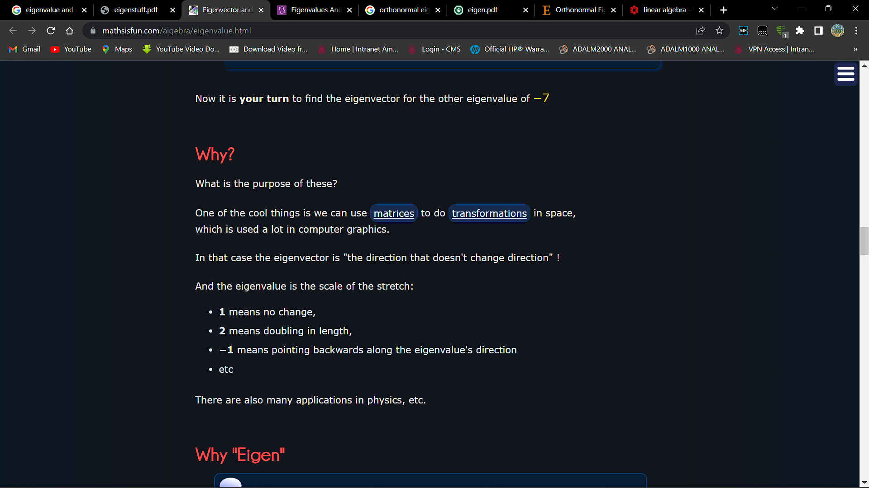
Two vectors are orthogonal if their inner product is zero. In other words ⟨u,v⟩=0. They are orthonormal if they are orthogonal, and additionally each vector has norm 1. In other words ⟨u,v⟩=0and ⟨u,u⟩=⟨v,v⟩=1.

Slide 3
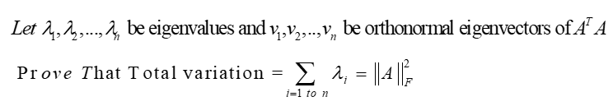
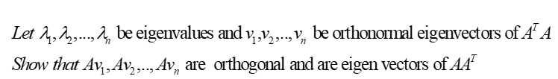
Prove and verify the following using Matlab
Notes:
Q1 part 3 is incomplete in MATLAB

Slide 4
2. Demonstrate Jacobi and Gauss-Seidel and SOR iterations for the following data

Slide 5
Jacobi implementation (refer class PPT)
We can simplify above for fast computation
Based on ith equation, ith variable x_{i} is updated
for i=1:nRow
xnew(i)=xold(i)+ ( b(i)-A(i,:)*xold )/A(i,i);
End
xold=xnew

Slide 6
Gauss –Seidel implementation (refer class PPT)
A slight change in the Jacobi code
Think of this trick
Dot_product
xnew=xold; % the crucial step
for i=1:nRow
xnew(i)=xnew(i)+ ( b(i)-A(i,:)*xnew )/A(i,i);
End
xold=xnew
Based on ith row , ith variable x_{i} is updated

Slide 7
SOR
xnew=xold; % the crucial step
for i=1:nRow
xnew(i)=xnew(i)+ omega*( b(i)-A(i,:)*xnew )/A(i,i);
end
xold=xnew

