Slide 1
Myautomata
In Excel

Slide 2
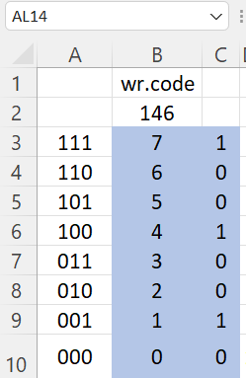
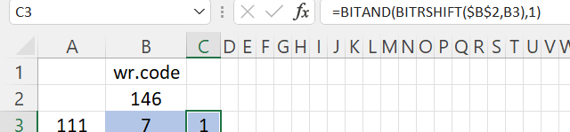
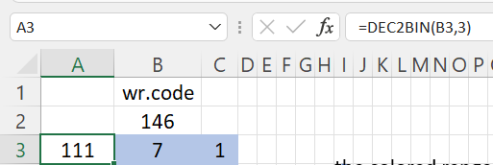
Preparing Excel sheet for automata
1.Enter 146 in B2
2. Enter 7 to 0 in B3 to B10
3. Enter formula in C3
4.This is not required. Just for understanding
Write formula in A3 and drag

Slide 3
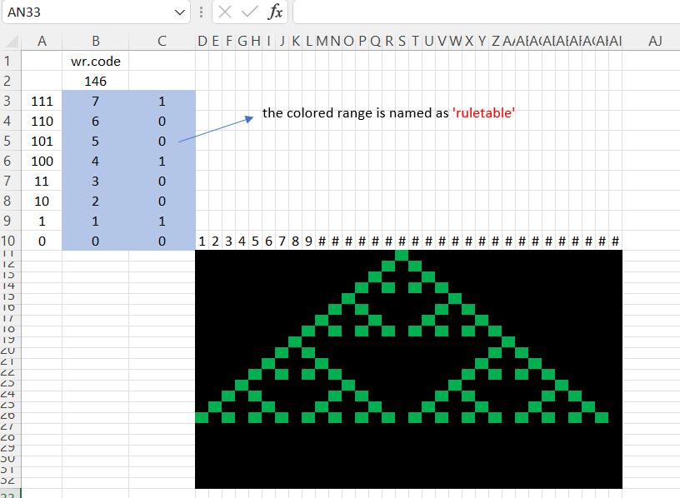
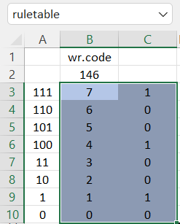
steps
Create rule table and name it
Select the range and in the name box write ruletable and press ctrl +shift+enter keys

Slide 4
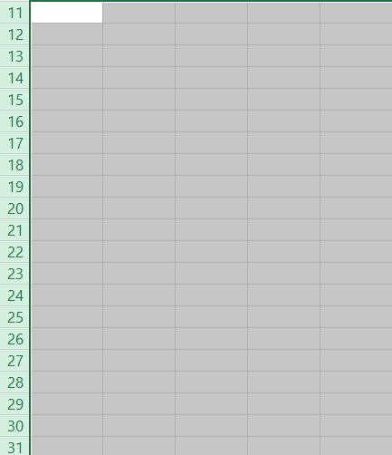
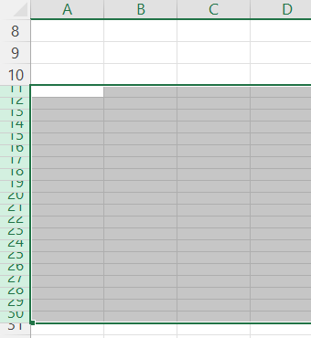
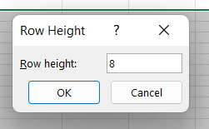
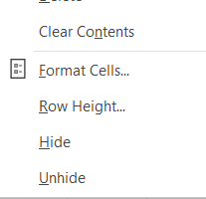
Let us create a 31 by 32 matrix for drawing the automata
Select Rows 11 to 31. To do it bring the cursor on row
number tab 11 on left and drag to tab 31
Right click on mouse and select Row height
Put it as 8

Slide 5
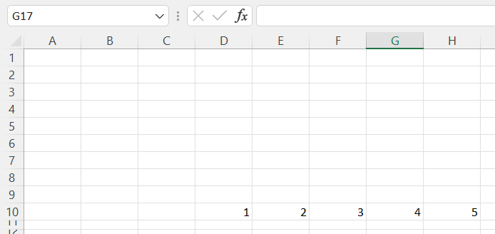
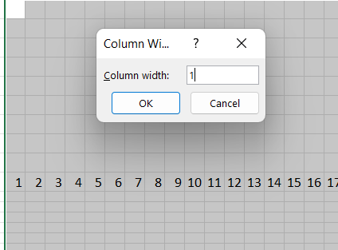
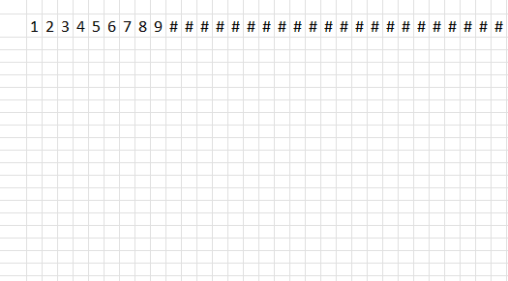
In D10 put 1, in D 11 put 2 . Select the two cells and drag to AI10 . This is to highlight 32 columns
Select D tab and drag to AI to select 32columns.
Rightclick mouse and select column width . Put it as 1

Slide 6
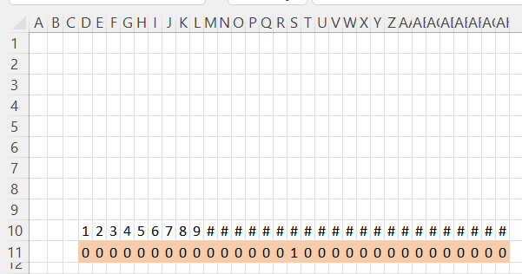
In D11 to AH11 put 0 except S11. In S11 put 1
Write formula in the left boarder cell
Write formula in the second cell E12 and drag to AH11
Write formula in the right boarder cell AI12
Select D12 to AI12 and drag formula down to row 32

Slide 7
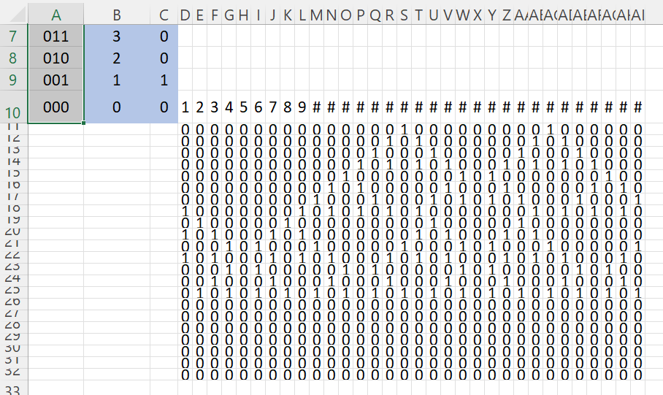
Excel sheet look like this

Slide 8
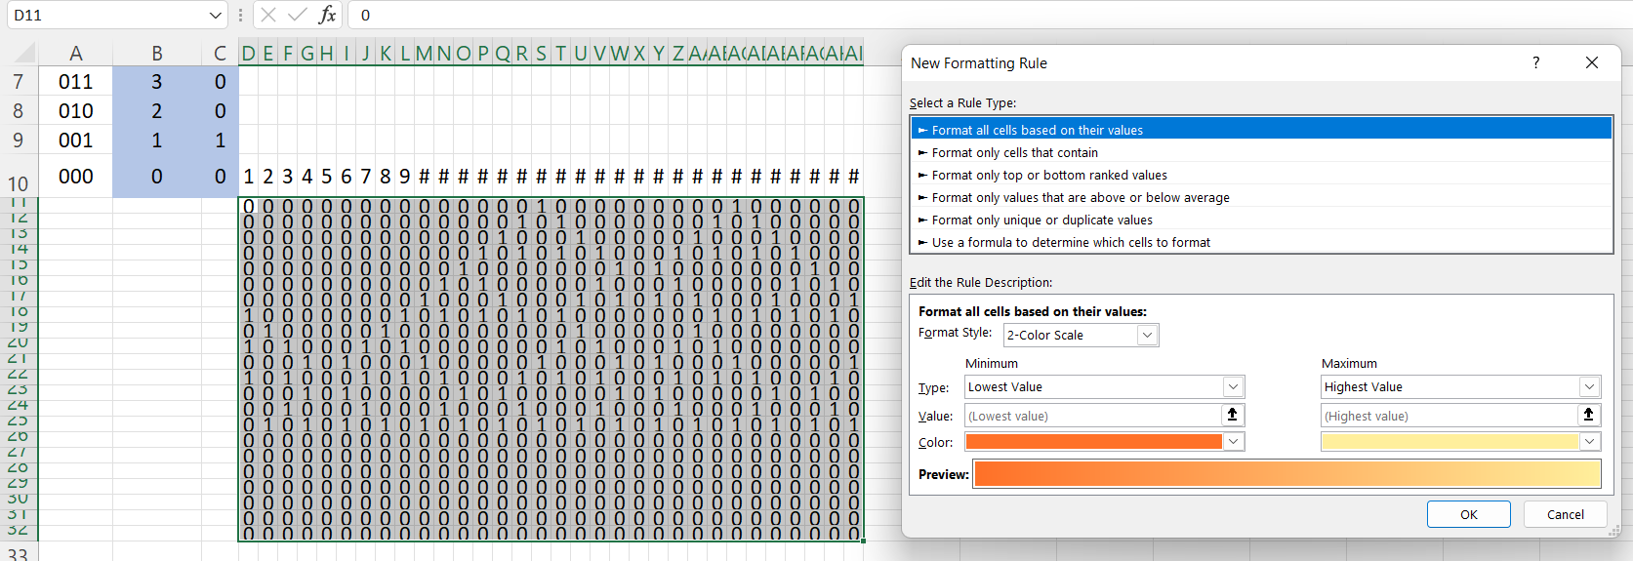
Select the rectangular cells (matrix containing 0s and 1s) and on conditional formatting Tag

Slide 9
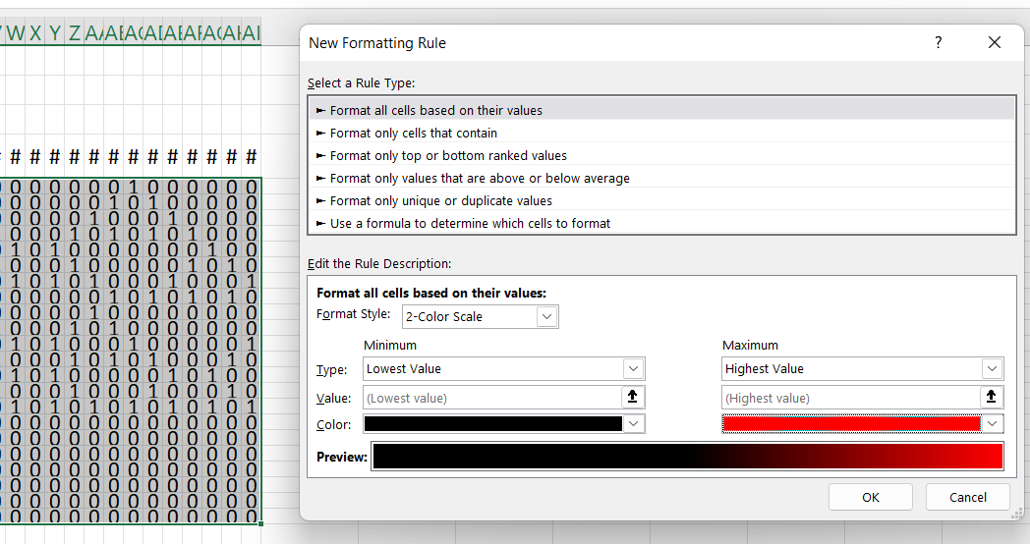
Choose two colors click okay

Slide 10
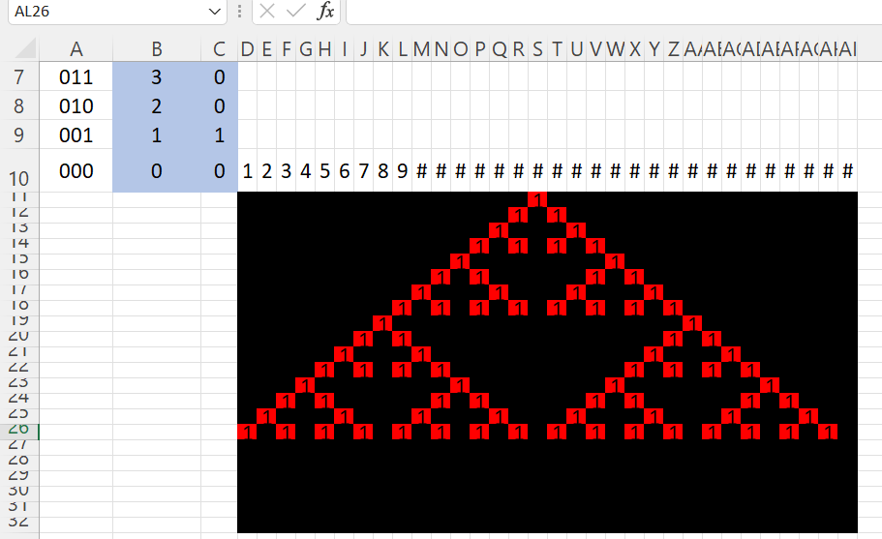
Excel sheet will look like this

Slide 11
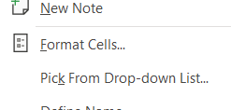
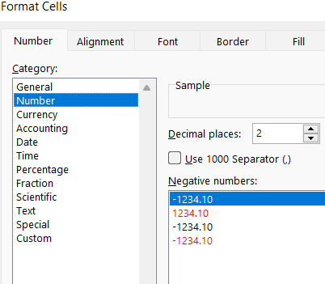
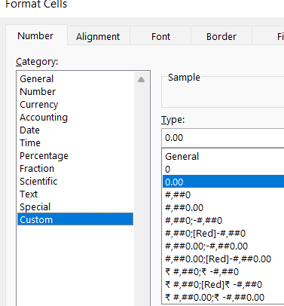
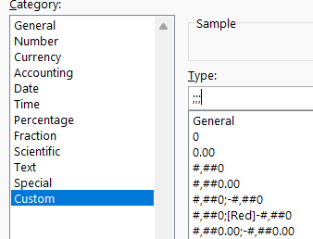
How to hide numbers in cell
Select again matrix of 0s and 1s , right click and go for formatting cells
Type ;;; and click okay
Select number
Select Custom
Three semicolons

Slide 12
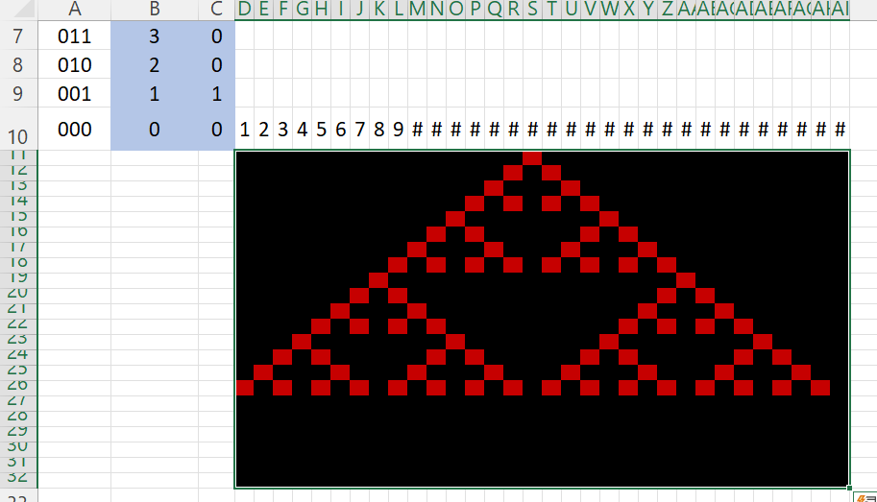
output
On top row put 1 in two more positions

Slide 13
Do it and send to Dr Neethu Mohan
Matrix size
Row size = integer part of (Your serial number +15)/12
Column size = integer part of (Your serial number +15) + 1
For doing you get 5 marks
For not doing you get -10 marks
Last date of submission October 6

