Slide 1
Reinforcement learning
Project Presentation

Slide 2
Team Members
Rachit Agarwal [CB.EN.U4AIE21150]
Vikhyat Bansal [CB.EN.U4AIE21076]

Slide 3
Problem Statement
Comparative Study of Proximal Policy Optimization (PPO), Twin Delayed DDPG (TD3), and Soft Actor-Critic (SAC) algorithms on the Walker v2 environment to discern their respective performances in continuous control tasks

Slide 4
About Environment
The continuous controlling task in the Mujoco is a Markov Decision Process. That is both stochasticity and determinism are contained in continuous controlling tasks in Mujoco.
The observation of states, transition after actions, and rewards include randomness due to the noise and other settings of the environments but is partly controllable since the actions can be selected by agent itself .
The interaction between agents and the environment can be denoted as a Markov chain, which contains the state, action, transition, and rewards.
The Markov chain is the experience that enables the deep reinforcement learning algorithms to learn the optimal policy.
Deep reinforcement learning algorithms automatically extract the best policy from Markov chain to maximize the accumulated rewards

Slide 5
Objective
Conduct a comparative analysis of Proximal Policy Optimization (PPO), Twin Delayed DDPG (TD3), and Soft Actor-Critic (SAC) reinforcement learning algorithms.
Evaluate and compare the training efficiency, sample efficiency, robustness to hyperparameters, exploration-exploitation trade-off, and final performance of each algorithm.
Provide insights into the capabilities and suitability of PPO, TD3, and SAC for continuous control tasks in the Walker v2 environment.

Slide 6
PPO
1. Parameterization of Policy: Utilizes a neural network to output mean and variance of a probability distribution for continuous action spaces.
2. Policy Gradient Estimation: Estimates advantages for actions through collected samples to update the policy.
3. Clipped Surrogate Objective: Constrains policy updates by clipping the difference between old and new policies, ensuring stability.
4. Value Function Estimation: Estimates expected cumulative reward from states, aiding in policy updates and stability.
5. Batch Updates and Mini-batching: Processes experiences in minibatches for more efficient learning and utilization of data.
6. Hyperparameter Tuning: Requires careful adjustment of parameters like learning rate, clipping parameter, entropy coefficient, and batch size for optimal performance.

Slide 7
Twin Delayed DDPG
1. Actor-Critic Architecture: Employs both actor and critic neural networks to learn a deterministic policy and evaluate its quality, respectively.
2. Twin Critic Networks: Utilizes two critic networks to mitigate overestimation bias and enhance the stability of value estimation.
3. Clipped Double Q-Learning: Helps to address the issue of overestimation bias by taking the minimum of Q-values from the two critic networks.
4. Target Networks: Stabilizes training by periodically updating target networks to track the learned policy and value functions.
5. Policy Smoothing: Adds noise to the target policy during training to improve robustness and exploration capability.
6. Off-Policy Learning: Learns from a replay buffer of experiences, enhancing sample efficiency and enabling decorrelation of samples for better learning.

Slide 8
Soft actor critic
1. Policy and Value Networks: Utilizes actor and critic neural networks to respectively learn a stochastic policy and evaluate the value of actions.
2. Entropy Regularization: Maximizes the entropy of the policy in addition to expected rewards, promoting exploration and robustness.
3. Soft Q-Learning: Minimizes a combination of expected return and policy entropy, balancing exploration and exploitation.
4. Target Networks: Incorporates target networks to stabilize training by periodically updating them to track learned policies and values.
5. Off-Policy Learning: Learns from a replay buffer of experiences, improving sample efficiency and facilitating decorrelation of samples.
6. Policy Evaluation: Estimates the Q-value using the maximum entropy framework, combining expected return and policy entropy for robust policy learning.

Slide 9
Literature Review
An Evaluation of DDPG, TD3, SAC, and PPO: Deep Reinforcement Learning Algorithms for Controlling Continuous System by Shijie liu
TD3 and SAC outperformed DDPG and PPO in continuous control tasks in Mujoco environments like Ant, Half Cheetah, Hopper, and Swimmer.
DDPG showed weaker performance compared to TD3 and SAC across most tasks.
PPO's performance varied; while it performed well in some cases, it didn't match TD3 and SAC consistently. Its stability may be impacted by batch size.
Environment and hyperparameters significantly influenced algorithm performance, with different environments favoring different algorithms. Adjusting hyperparameters could enhance performance.
The researchers recommend that further research is needed to improve hyperparameter adjustment methods.

Slide 10
Methodology
Environment Setup: Initialize the Walker v2 environment with standard parameters and configurations.
Algorithm Implementation: Implement PPO, TD3, and SAC algorithms using established libraries with default settings.
Baseline Training: Train each algorithm for a fixed number of episodes to establish baseline performance metrics.
Hyperparameter Optimization: Perform limited hyperparameter tuning for each algorithm, focusing on key parameters such as learning rates and neural network architectures.

Slide 11
Methodology
Training and Evaluation: Train each algorithm on the Walker v2 environment while monitoring key performance metrics such as average episode reward and convergence speed.
Comparative Analysis: Compare learning curves, convergence rates, and final performance metrics across algorithms.
Statistical Assessment: Conduct basic statistical analysis to identify significant differences in performance between algorithms.
Documentation: Document experimental procedures and results for future reference and reporting.

Slide 12
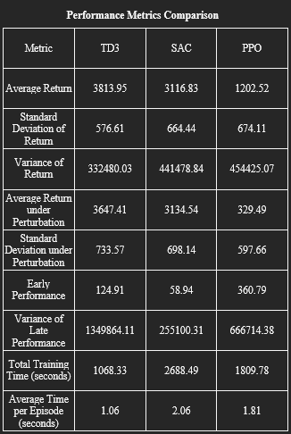
Results – Metric Table

Slide 13
Results – TD3
TD3 (Twin Delayed Deep Deterministic Policy Gradient):
Performance: TD3 shows the highest average return (3813.95), indicating strong performance in the Walker2d environment.
Stability: The relatively low standard deviation of return (576.61) suggests stable performance, though the variance of late performance is quite high (1349864.11), indicating some instability towards the end of training.
Robustness: TD3 maintains a good average return under perturbation (3647.41) with an increased standard deviation (733.57), showing robustness but slightly affected by perturbations.
Sample Efficiency: The early performance of 124.91 suggests slower initial learning compared to PPO but better than SAC.
Computational Efficiency: TD3 is the most computationally efficient, with a total training time of 1068.33 seconds and the fastest average time per episode (1.06 seconds).

Slide 14
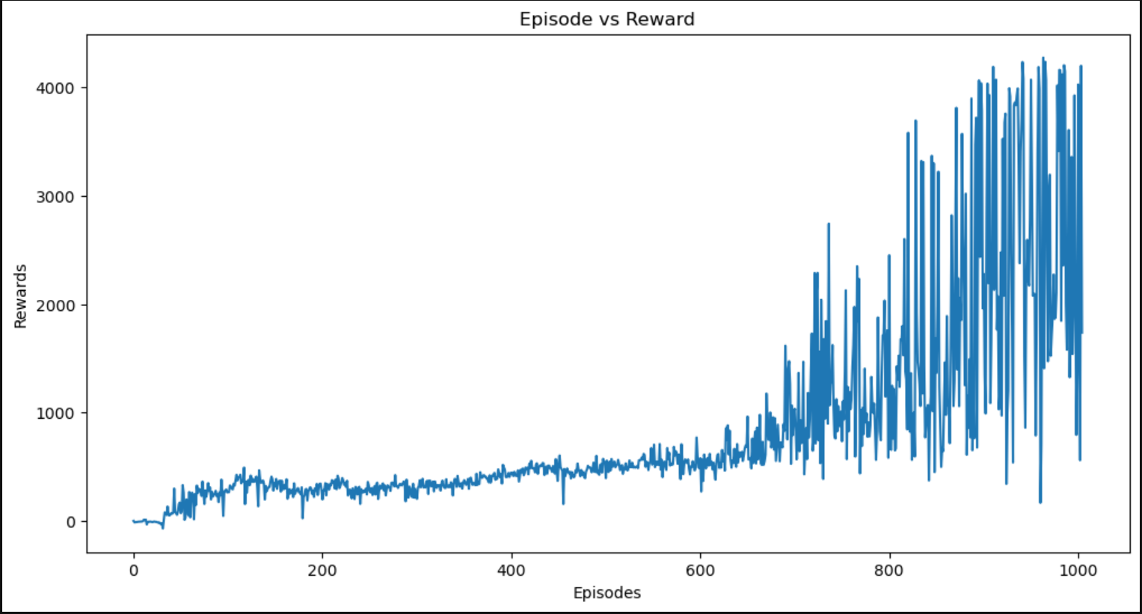
Results – TD3

Slide 15
Results – SAC
SAC (Soft Actor-Critic):
Performance: SAC has a lower average return (3116.83) than TD3 but higher than PPO, indicating decent performance.
Stability: The standard deviation of return (664.44) suggests more variability in performance compared to TD3, and the variance of late performance is the lowest (255100.31), indicating good stability in later stages.
Robustness: SAC’s performance under perturbation is consistent (3134.54) with a slight increase in standard deviation (698.14), showing robustness similar to its normal performance.
Sample Efficiency: SAC has the lowest early performance (58.94), indicating slower initial learning.
Computational Efficiency: SAC is the least computationally efficient, with the highest total training time (2688.49 seconds) and the slowest. Average time per episode (2.06 seconds).

Slide 16
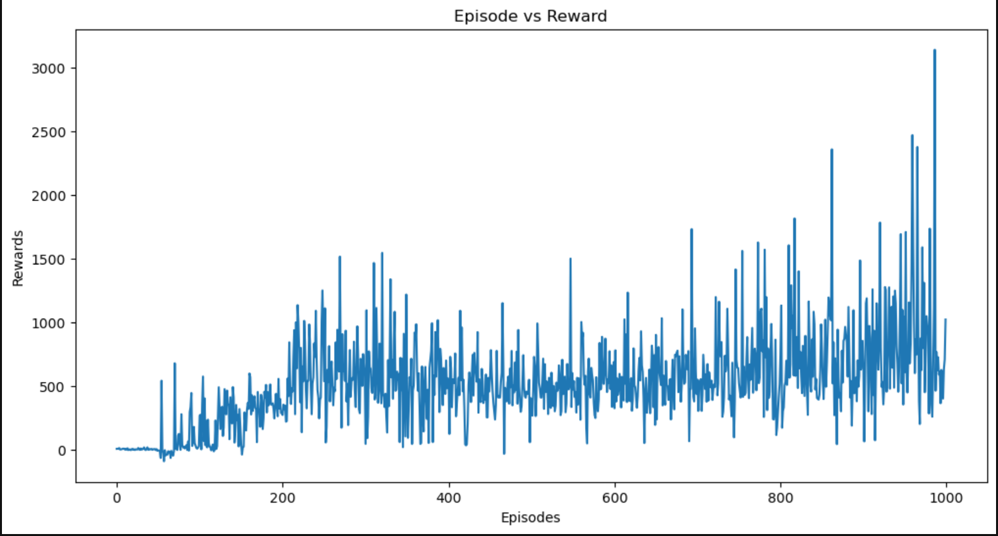
Results – SAC

Slide 17
Results – PPO
PPO (Proximal Policy Optimization):
Performance: PPO has the lowest average return (1202.52), indicating weaker performance in the Walker2d environment compared to TD3 and SAC.
Stability: PPO has the highest standard deviation of return (674.11), suggesting significant variability in performance, and its variance of late performance is also relatively high (666714.38), indicating less stability.
Robustness: PPO's performance drops significantly under perturbation (329.49) with a lower standard deviation (597.66), indicating high sensitivity to changes.
Sample Efficiency: PPO shows the highest early performance (360.79), indicating faster initial learning.
Computational Efficiency: PPO is moderately efficient, with a total training time of 1809.78 seconds and an average time per episode of 1.81 seconds, falling between TD3 and SAC.

Slide 18
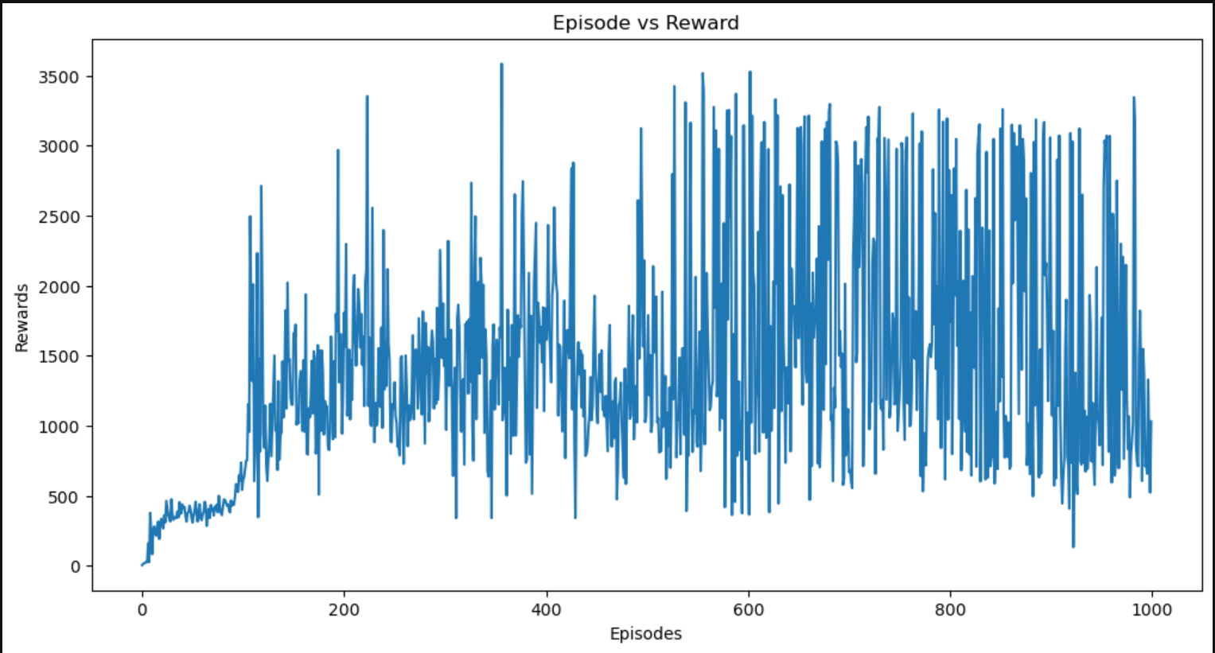
Results – PPO

Slide 19
References
OpenAI — Spinng Up : https://spinningup.openai.com/en/latest/algorithms/td3.html
OpenAI — Spinng Up : https://spinningup.openai.com/en/latest/algorithms/ppo.html
Addressing Function Approximation Error in Actor-Critic Methods, Fujimoto et al, 2018
Schulman, John, Filip Wolski, Prafulla Dhariwal, Alec Radford, and Oleg Klimov. “Proximal policy optimization algorithms.”
Byrne, Donal. “TD3: Learning To Run With AI.” Medium.
Tuomas Haarnoja, Aurick Zhou, Pieter Abbeel, Sergey Levine "Soft Actor-Critic: Off-Policy Maximum Entropy Deep Reinforcement Learning with a Stochastic Actor"

