Slide 1
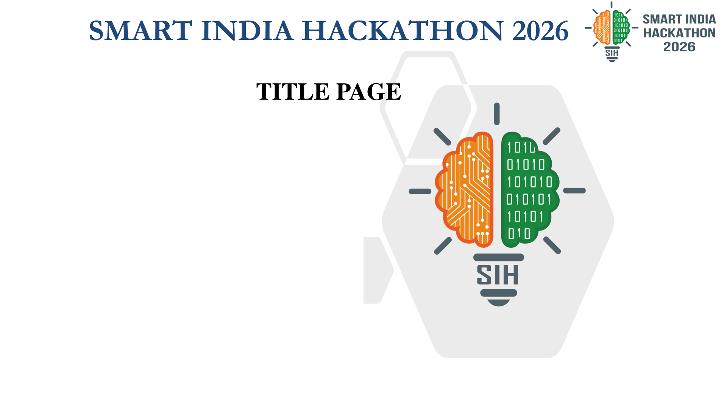
PROBLEM STATEMENT ID
SIH26171
PROBLEM STATEMENT TITLE
On-device Visual Perception for Light-weight Browser Agents
THEME & CATEGORY
Smart Automation | Software
SUBMITTING ORGANIZATION
ISRO / Department of Space
TEAM DETAILS
Team ID: 169984 | Team Name: Techy Guys

Slide 2
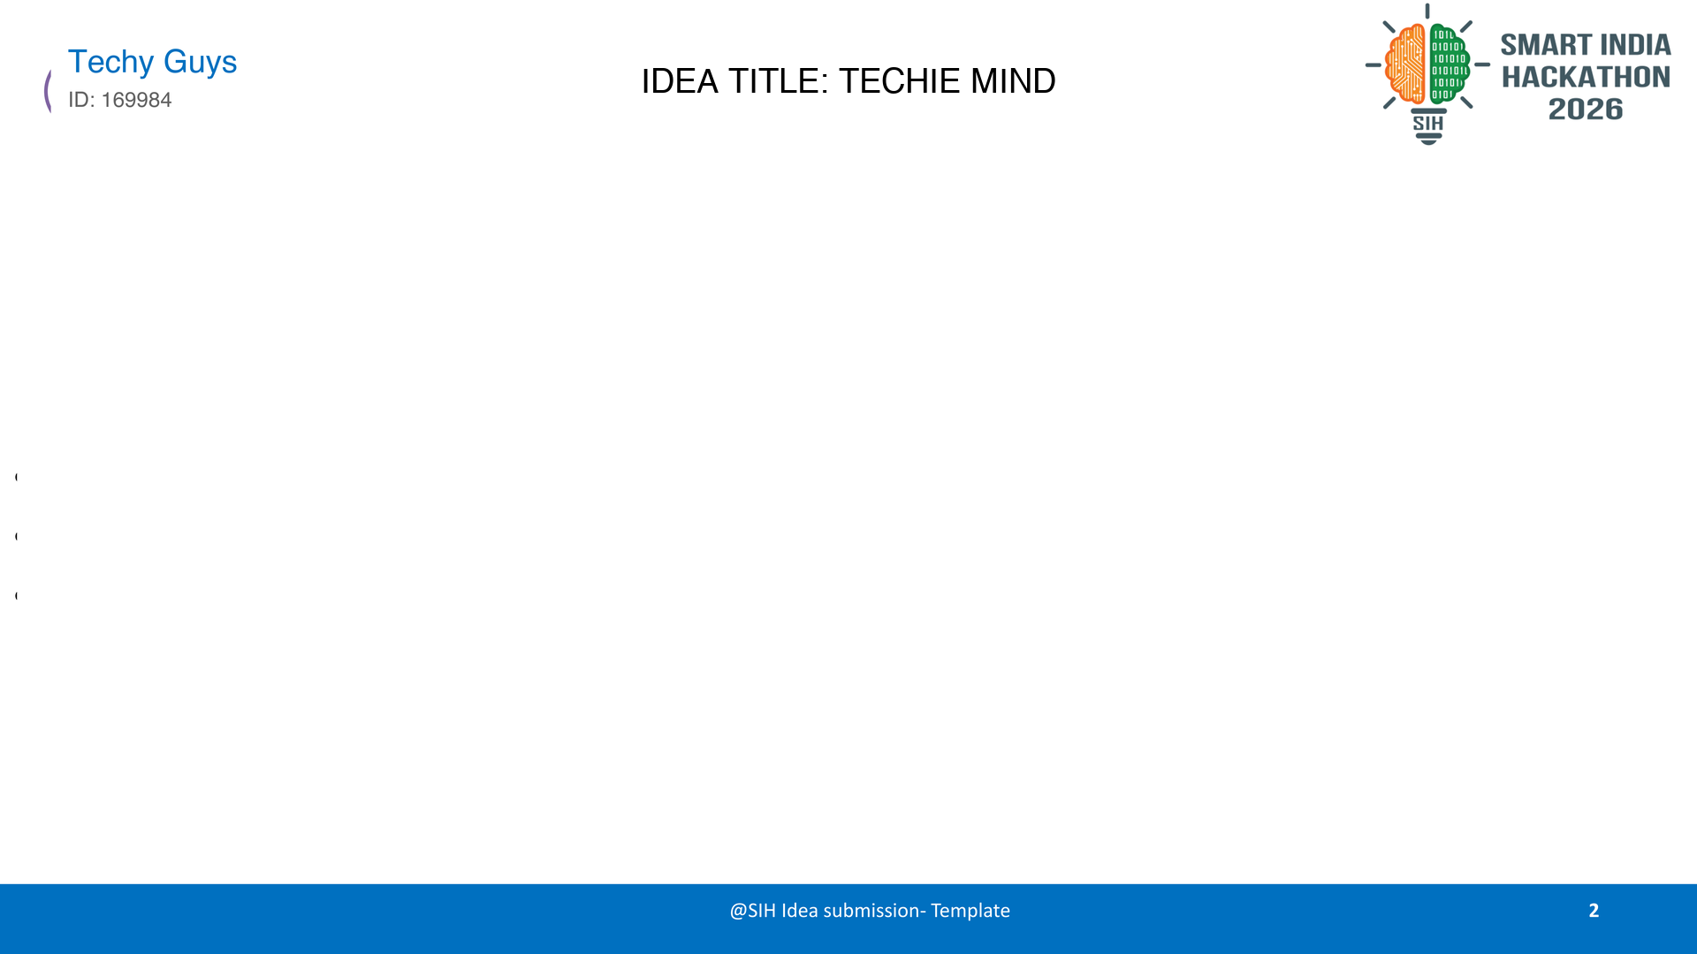
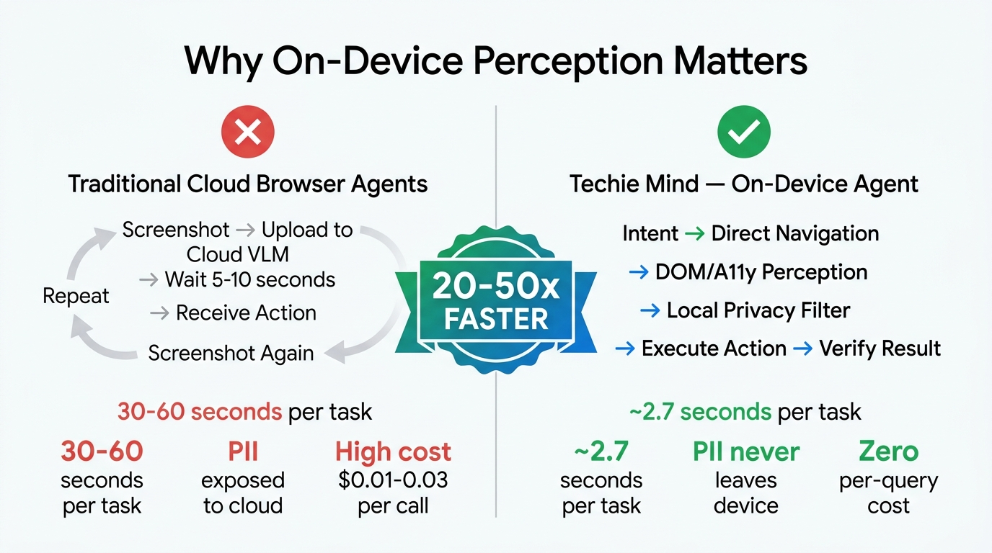
PROPOSED SOLUTION: On-Device Autonomous Browser Agent with Zero-Cloud Privacy
• Techie Mind Overview: Autonomous browser agent running directly inside Chrome/Firefox without cloud dependencies or per-query API bills.
• 4-Level Local Perception Stack: Hierarchical cascade: DOM Observer → Accessibility Tree → Semantic Grounding → Local Florence-2 VLM (runs via WebGPU only when needed).
• Local Privacy & Redaction Engine: Detects & redacts Aadhaar, PAN, phone, passwords, and credit cards in memory. Raw sensitive data NEVER leaves user's computer.
• Action Firewall Architecture: Separates AI reasoning from execution authority. Model only proposes; local engine verifies schema, page state, and safety constraints.
• Human Handover Protocol: Payments, OTPs, and CAPTCHAs strictly paused for user control — preventing unauthorized transactions.
• Vernacular Multi-Lingual Support: Understands commands in English, Hindi, Kannada, Tamil, Telugu, and Hinglish via text and voice.
• 20–50x Faster than Cloud VLMs: Typical task execution completes in ~2.7s (vs 30–60s on cloud VLM screenshot loops).

Slide 3
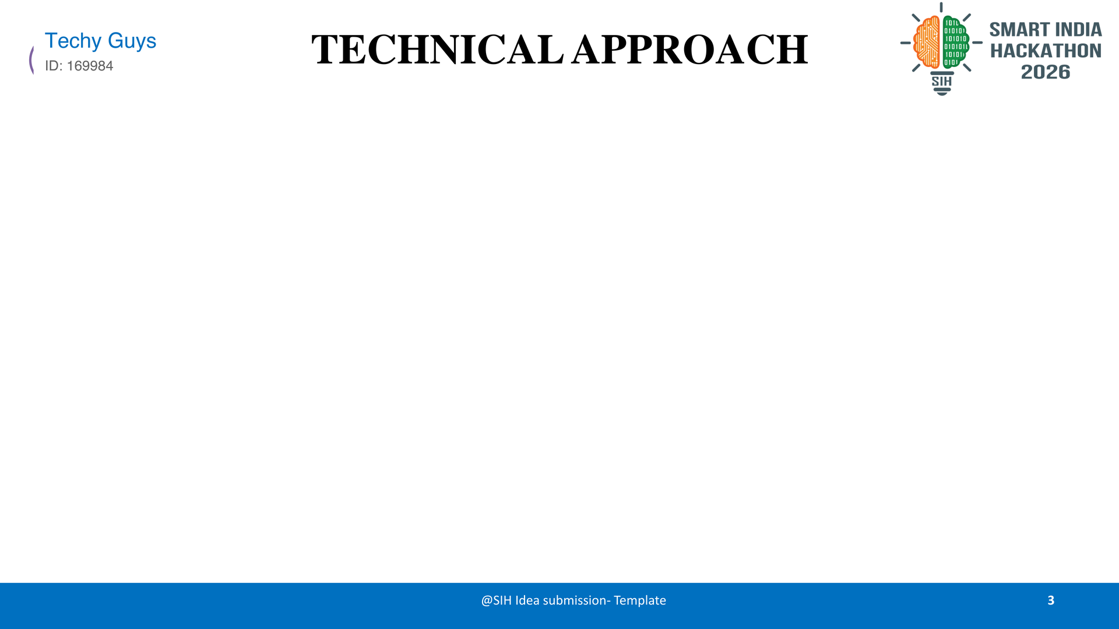
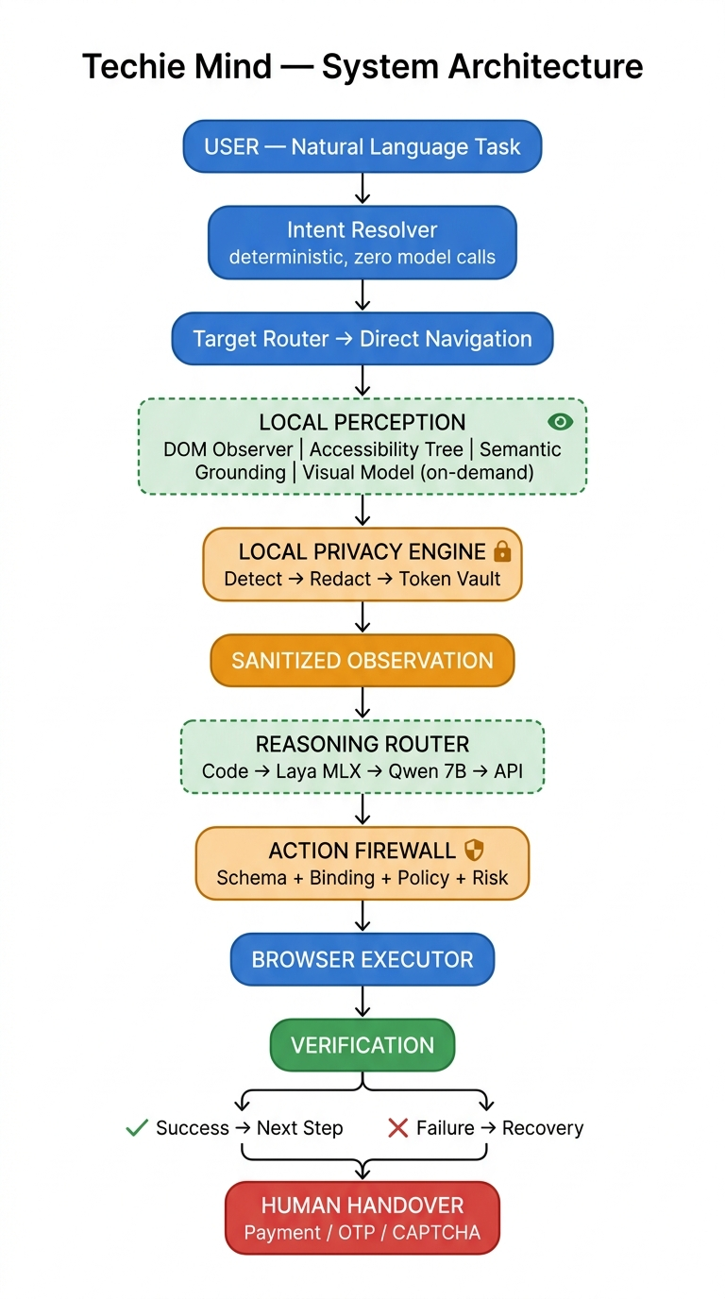
METHODOLOGY & ARCHITECTURE: 6-Step Deterministic-First Agent Pipeline
• Step 1 — Intent Resolution: Deterministic parsing extracts action and parameters in 5.3 ms with 0 AI model calls.
• Step 2 — Direct Navigation: Navigates directly to target domains without searching via Google, saving 2-3 round-trips.
• Step 3 — Local Perception Cascade: Extracts interactive DOM + A11y tree first; invokes Florence-2 ONNX VLM via WebGPU only if visual ambiguity exists.
• Step 4 — Hardware-Boundary Privacy: PII detector redacts credentials & sensitive tokens into a secure, TTL-limited in-memory vault.
• Step 5 — Action Firewall Validation: Validates proposed action against Zod runtime schema, target binding, and risk classification rules.
• Step 6 — Execution & Verification: Dispatches synthetic events, inspects post-action DOM state, and engages a 6-level recovery ladder upon failure.
Runtime | Perception | Reasoning | Validation
Chrome MV3 / Firefox | DOM + A11y Tree | Deterministic Code | Zod Schemas (Runtime)
TypeScript Strict | Florence-2 (WebGPU) | Laya MLX (Local) | Playwright Chromium
Preact (~3KB UI) | WAI-ARIA Grounding | Qwen 2.5:7B (Ollama) | Vitest Unit Test Suite

Slide 4
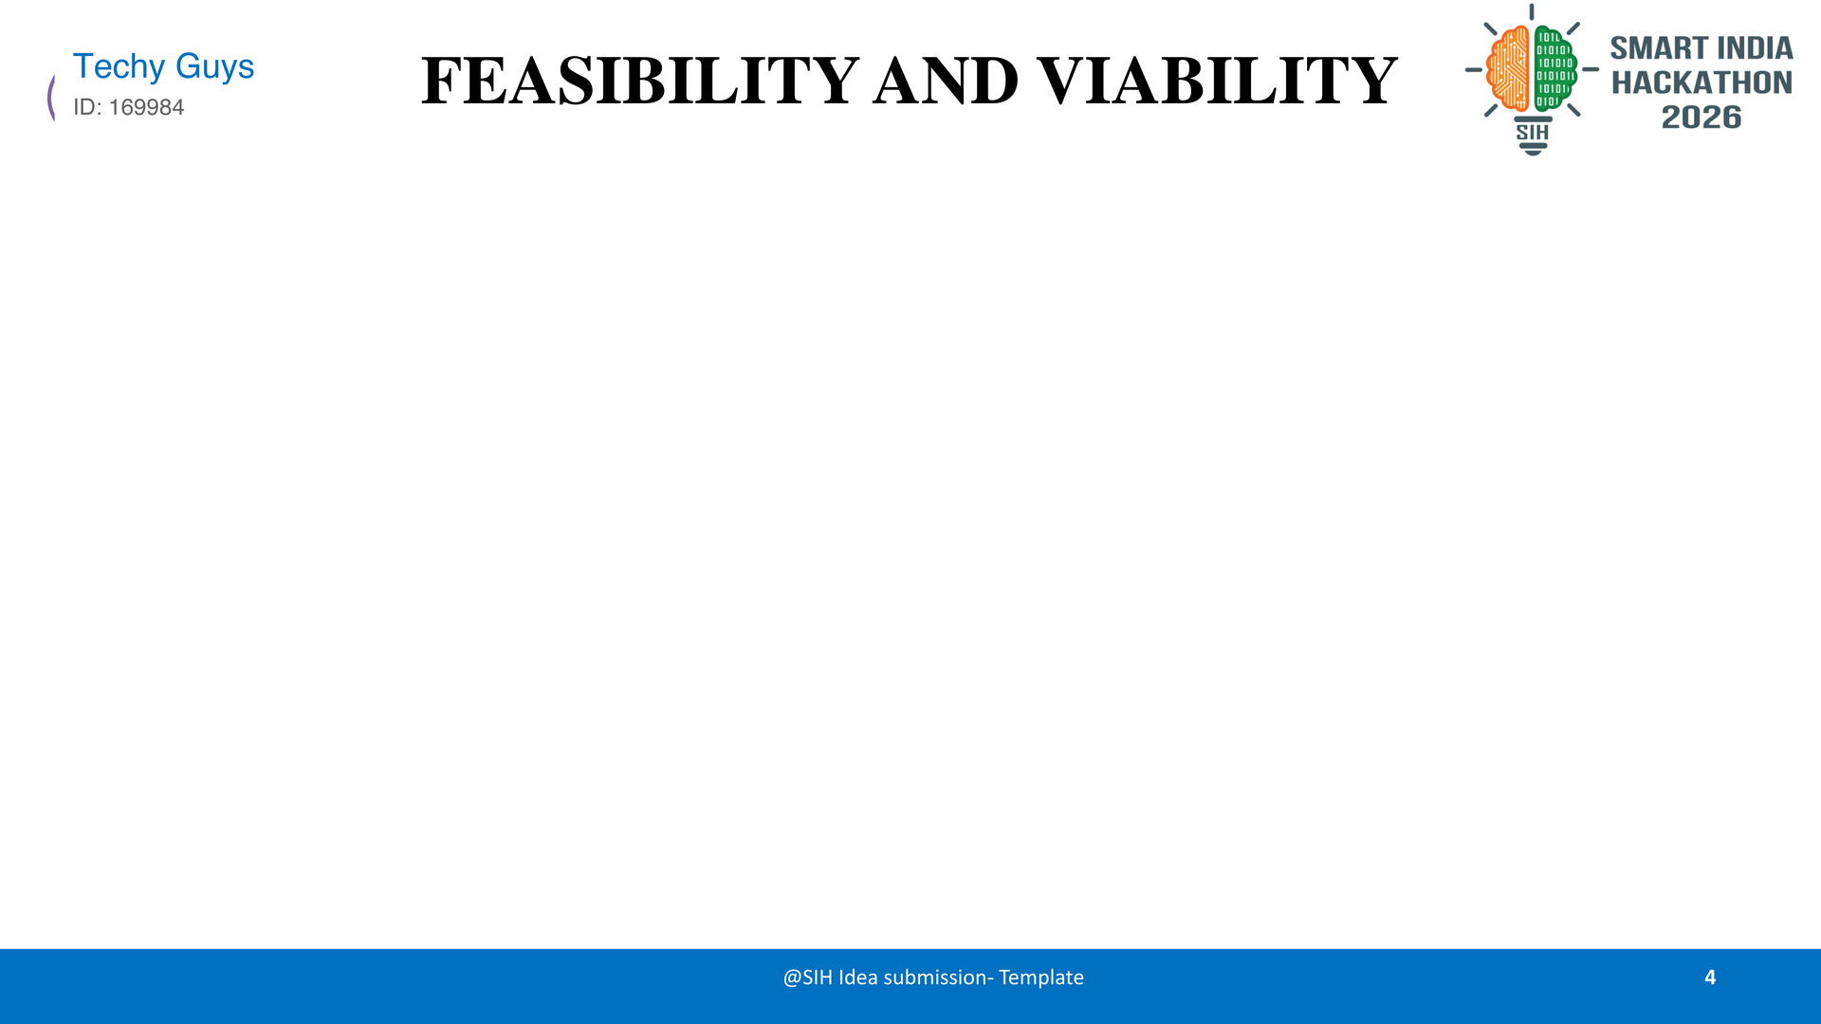
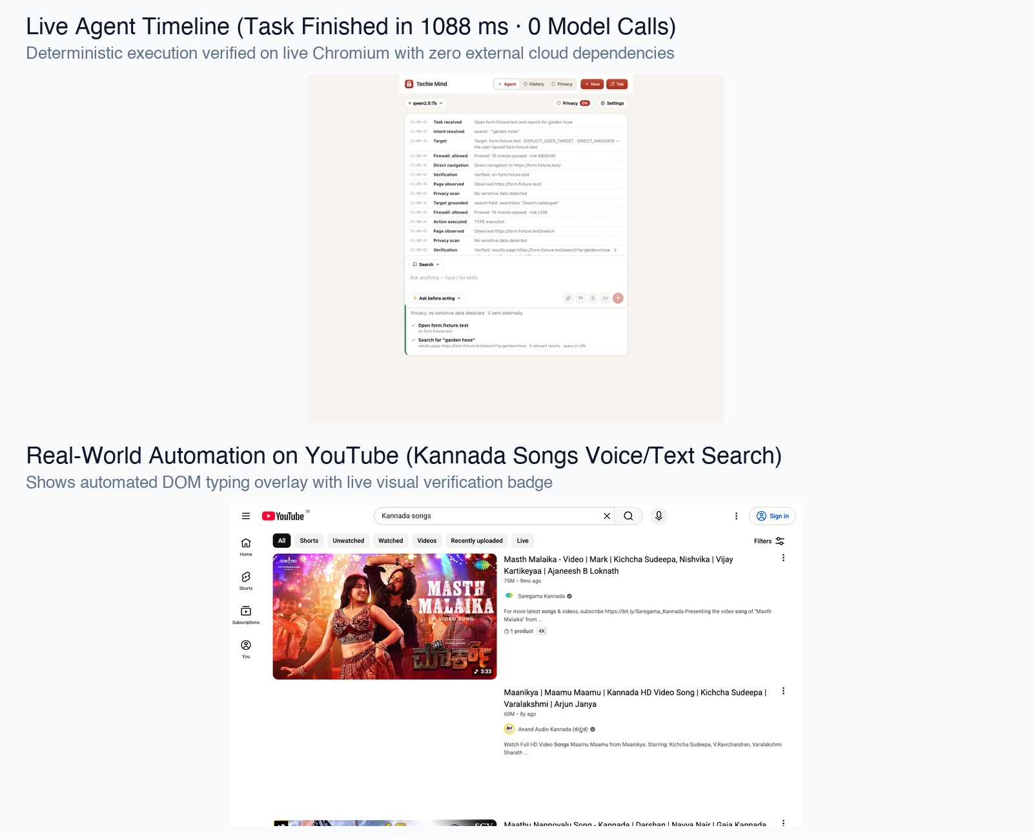
FEASIBILITY & EMPIRICAL BENCHMARKS: Verified Live on Real Chromium (YouTube & Flipkart)
Implementation & Testing Rigor:
✓ Phase 0 (Foundation) & Phase 1 (Agent Core) 100% COMPLETE & PASSING.
✓ 189 Unit Tests + 21 Real-Chromium Browser Tests + 9 Live-Site Tests.
✓ Tested live on YouTube (Kannada/English search) and Flipkart (Product search).
Measured Live Execution Benchmarks (Real Data):
Pipeline Stage | Median Latency
Intent Resolution (NL → Structured) | 5.3 ms
Navigation & Page Readiness | 1,533.0 ms
DOM & Accessibility Observation | 38.0 ms
Semantic Element Grounding | 0.4 ms
Action Dispatch & Execution | 10.8 ms
Post-Action State Verification | 1.9 ms
TOTAL END-TO-END (0 Model Calls) | ~2,731 ms (2.7s)
Key Mitigations: WebGPU unsupported devices fall back seamlessly to WebAssembly; dynamic websites handled by semantic grounding without brittle selectors.

Slide 5
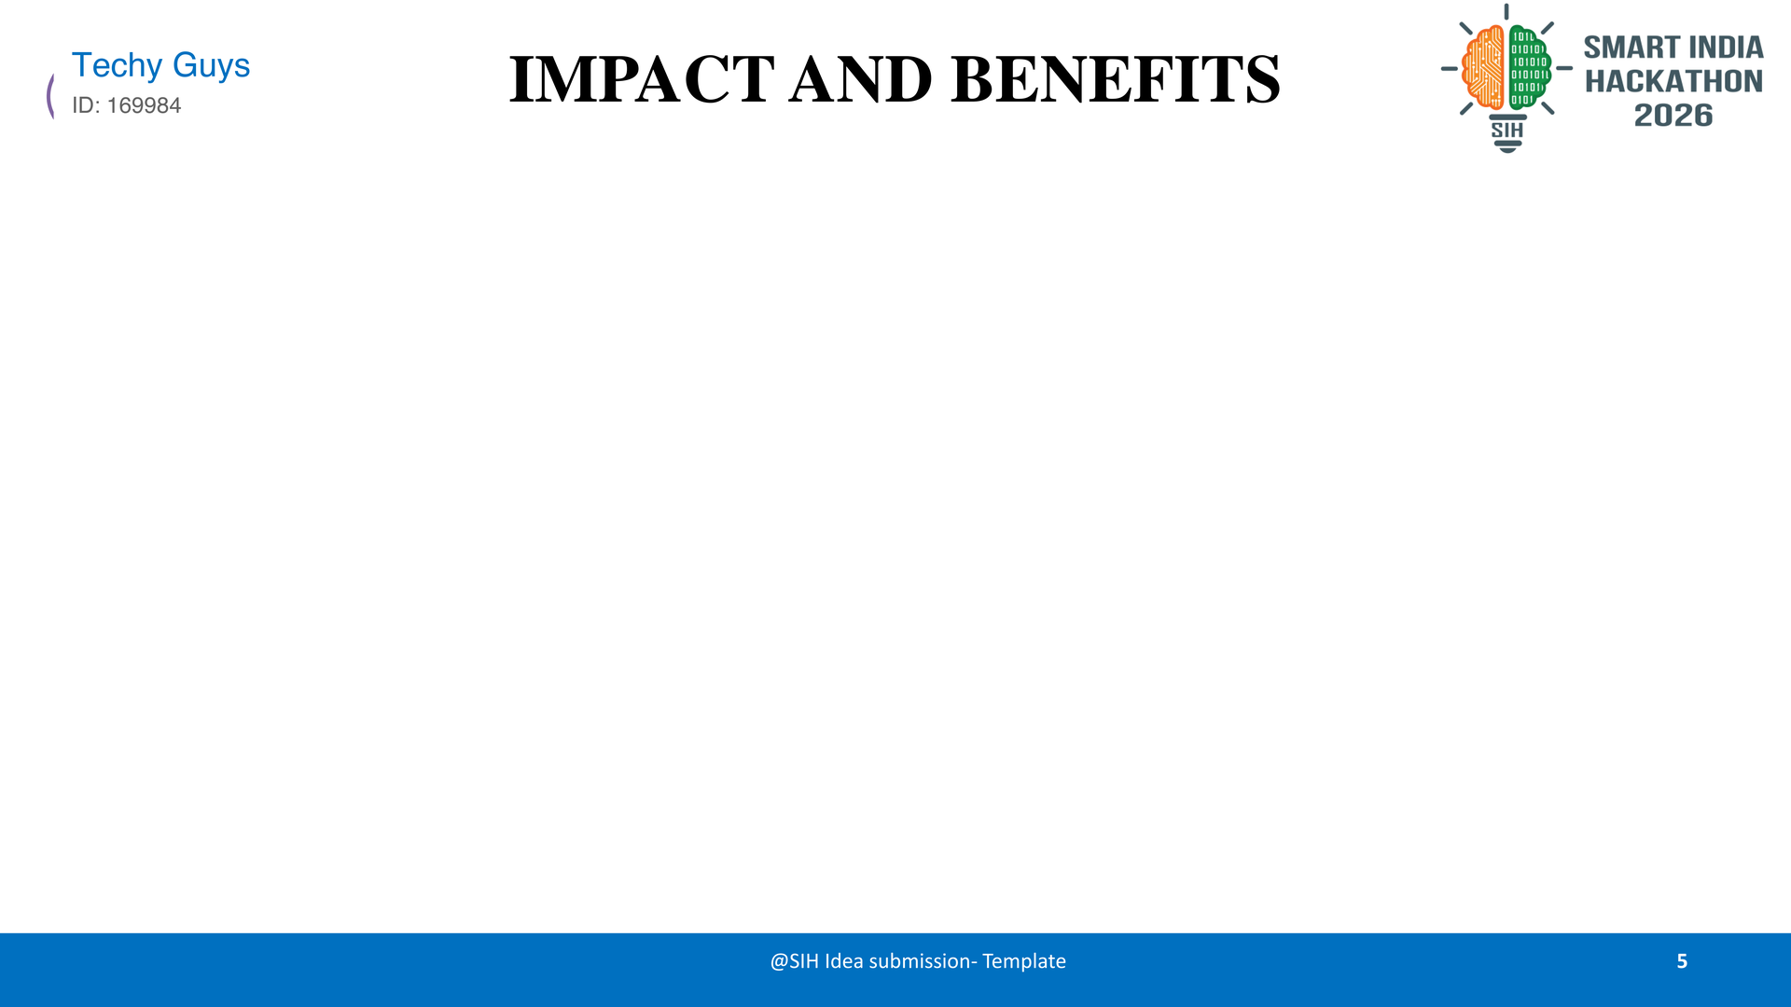
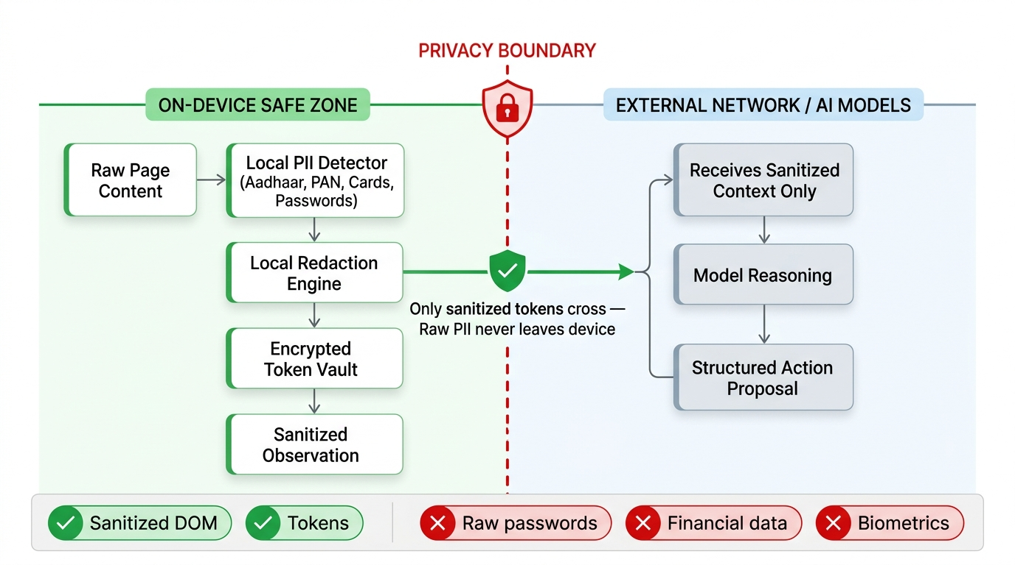
IMPACT & BENEFITS: Digital Inclusion, Data Sovereignty, and Multi-Dimensional ROI
Target Audience & Societal Impact:
• Differently-Abled Users: Hands-free web browsing via voice commands combined with Accessibility Tree perception.
• Vernacular Indian Users: Voice & text navigation in 6+ Indian languages removes digital literacy barriers.
• National Data Sovereignty: Zero-cloud processing guarantees sensitive data never leaves Indian borders.
Comprehensive Value Dimensions:
Dimension | Strategic Benefit
🔒 Privacy | Hardware-enforced redaction prevents Aadhaar & financial leaks
💰 Economic | Zero per-query cost (cloud VLM agents cost $0.01-$0.03/step)
⚡ Performance | 20-50x faster execution (~2.7s vs 30-60s on cloud agents)
🌱 Environmental | No power-hungry cloud GPU roundtrips, lowering carbon emissions
🇮🇳 Strategic | Demonstrates cutting-edge on-device AI developed for Indian users

Slide 6
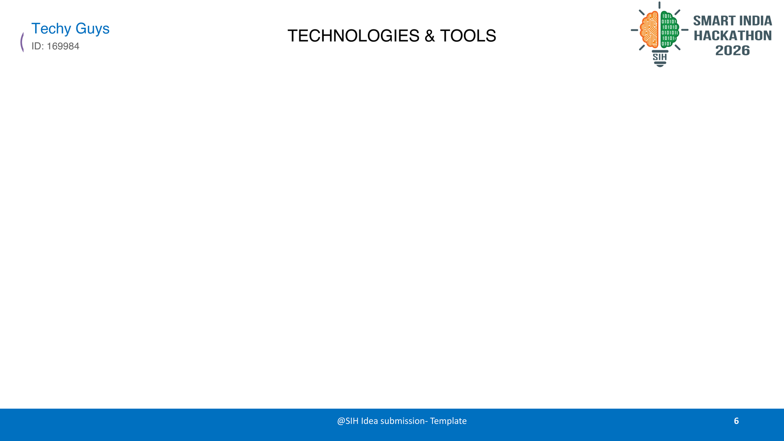
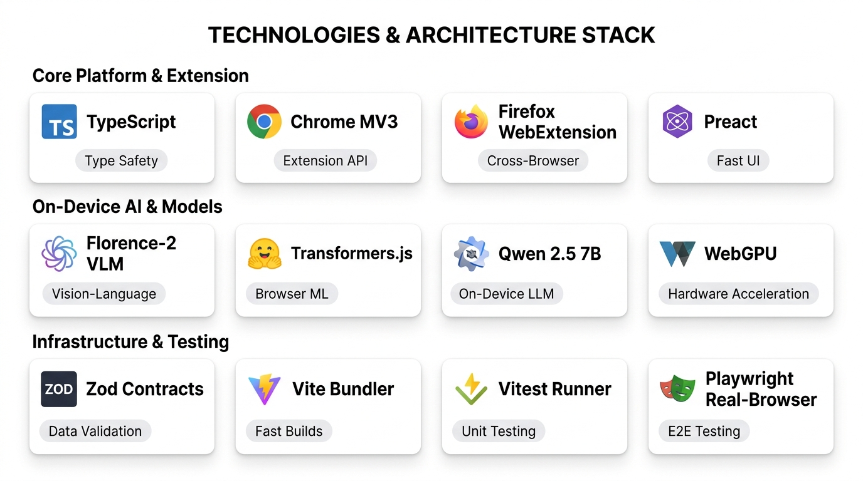
TECHNOLOGY STACK: 12 Open-Source, Production-Grade Technologies Across Runtime, AI & Testing
100% On-Device Execution: All perception models and reasoning pipelines run locally without sending page context to cloud servers.

Slide 7
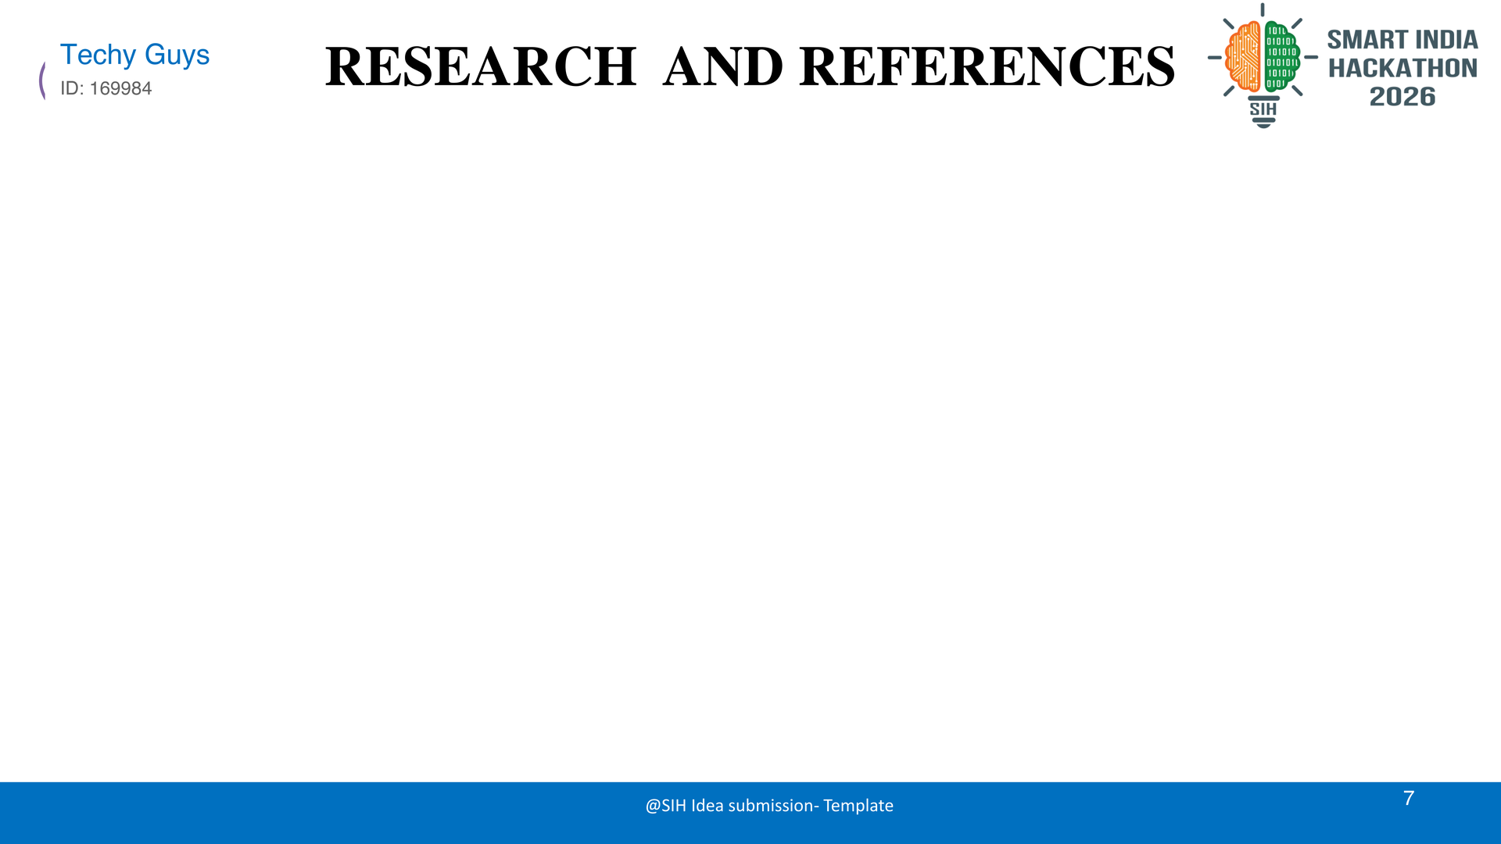
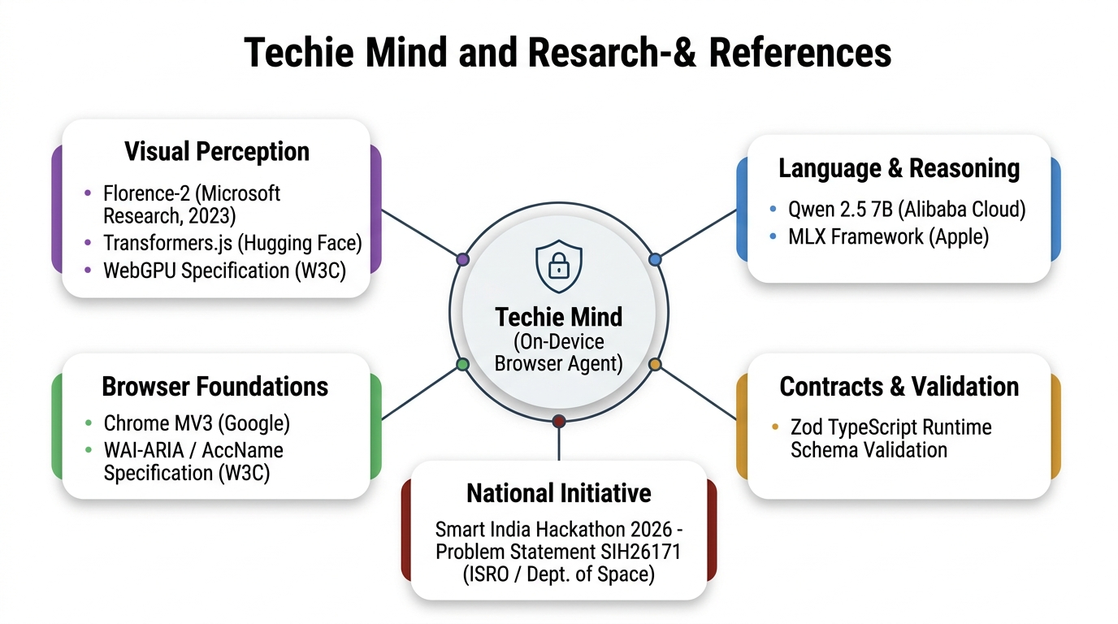
RESEARCH & REFERENCES: Grounded in State-of-the-Art Vision-Language & Web Standards
1. SIH Problem Statement SIH26171: On-device Visual Perception for Light-weight Browser Agents (ISRO / Dept. of Space)
2. Microsoft Research (2023): Florence-2: Advancing a Unified Representation for a Variety of Vision Tasks (arXiv:2311.06242)
3. Hugging Face Transformers.js: State-of-the-art machine learning in the browser via ONNX Web
4. W3C WebGPU Specification: Next-generation browser acceleration standard for on-device ML compute
5. Alibaba Cloud Qwen 2.5: Open-weight foundational language models for lightweight reasoning
6. Apple Machine Learning: MLX framework for efficient local model inference
7. Google Chrome Extensions MV3: Manifest V3 architecture, service workers, and native sidepanel APIs
8. W3C Accessible Name & Description (AccName 1.2): Accessible tree computation for semantic browser interaction
9. Zod Runtime Schema Validation: Type-safe runtime contracts and schema boundaries
10. Microsoft Playwright: Cross-browser end-to-end automated testing across real Chromium & WebKit

