Slide 1
Product life cycle. Methodologies
softserve
Mentor: Yehorova Yevheniia
Notes:
<number>

Slide 2
AGENDA
Who is QA?
Differences between the tester, QC and QA
Differences between the Dev and QA
Product life cycle
Software Development Models/Methodologies
SCRUM/Kanban
Q&A

Slide 3
PRODUCT LIFE CYCLE
Requirements analysis
Requirements analysis
Design
Development and
programming
Testing
Implementation and
maintenance

Slide 4
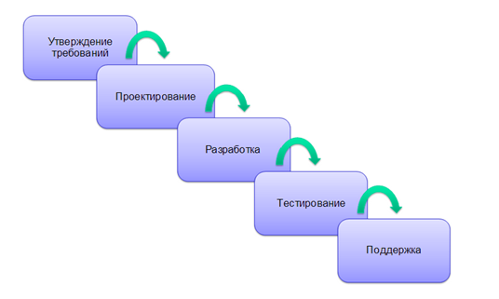
Waterfall model

Slide 5
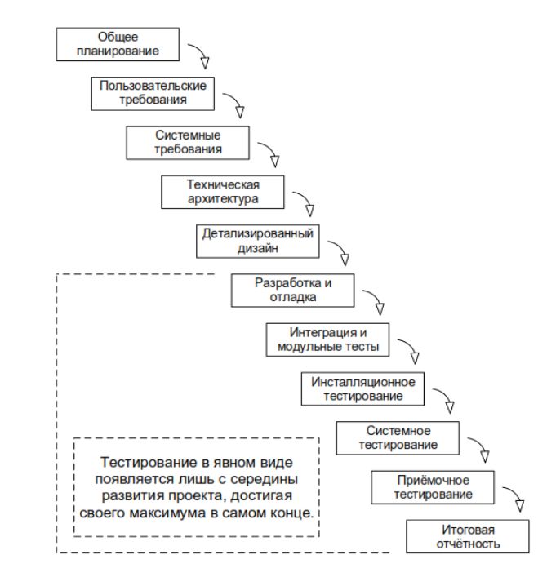
Waterfall model

Slide 6
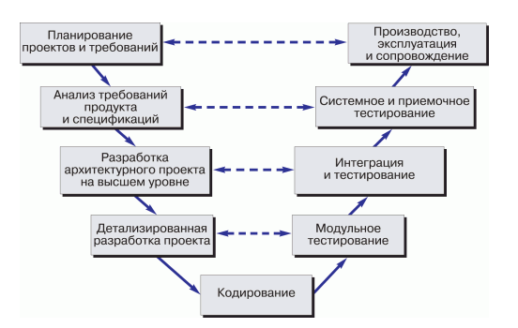
V-model

Slide 7
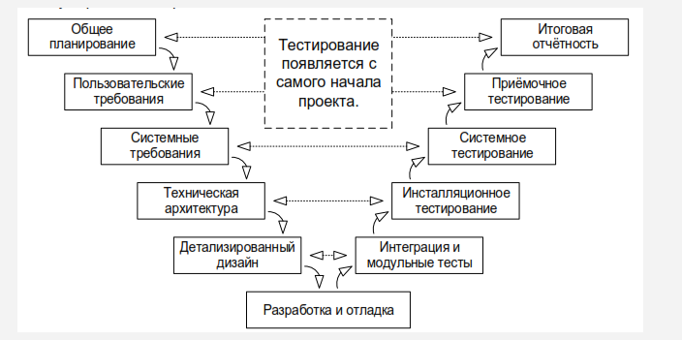
V-model

Slide 8
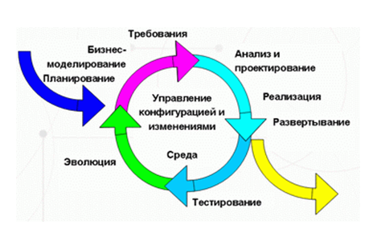
Iterative incremental model

Slide 9
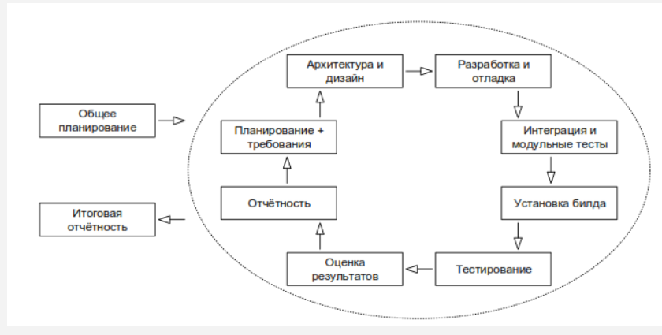
Iterative incremental model

Slide 10
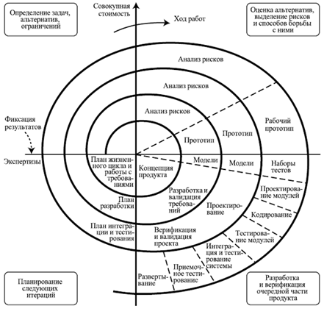
Spiral model

Slide 11
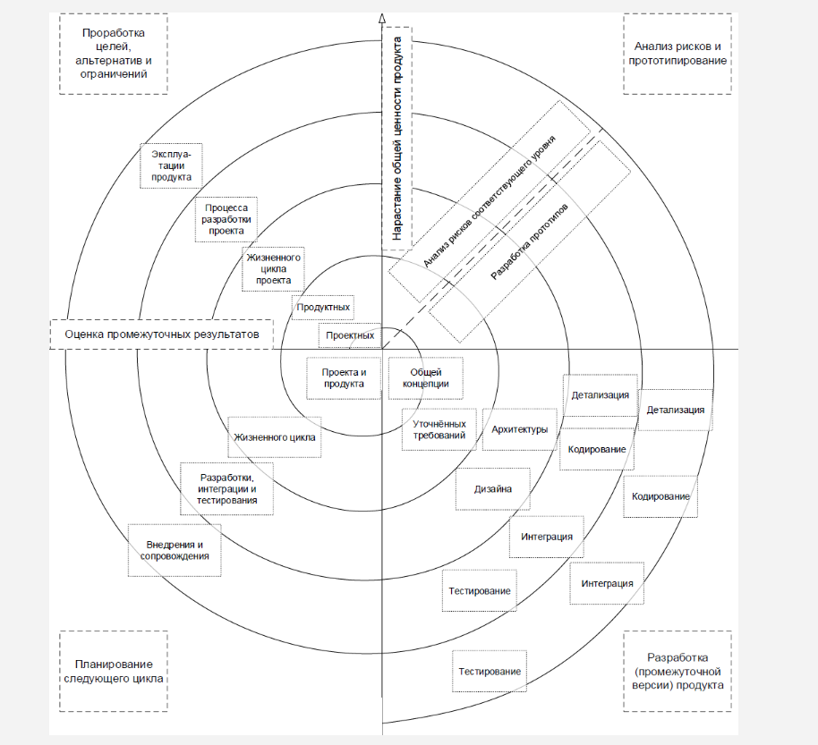
Spiral model

Slide 12
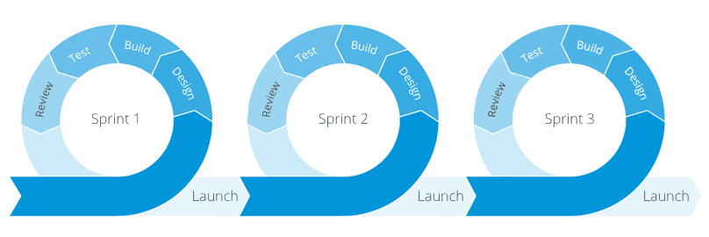
Agile model

Slide 13
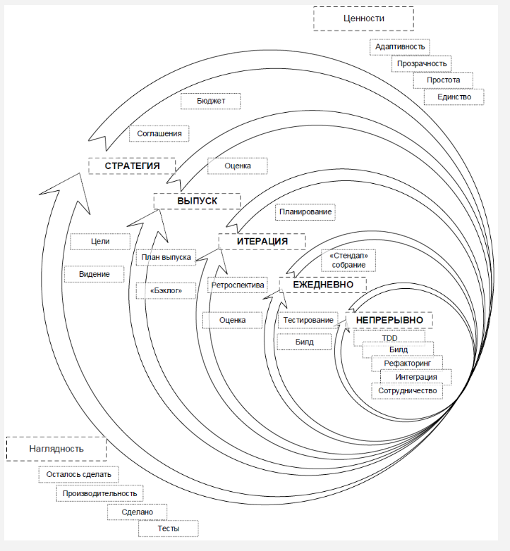
Agile model

Slide 14
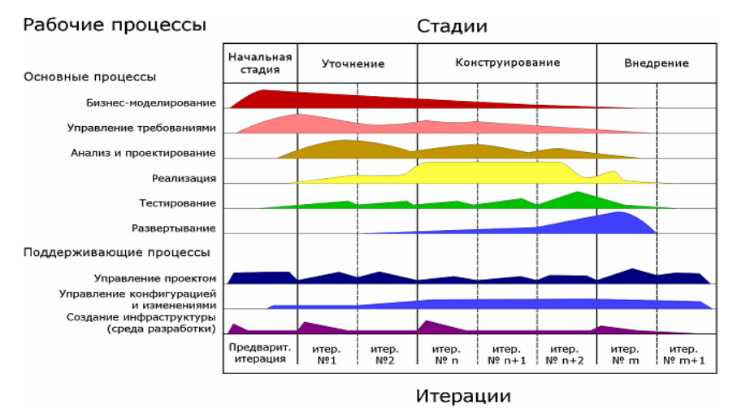
Rational Unified Process (RUP)
1. Начало (Inception)
2. Уточнение (Elaboration)
3. Построение (Construction)
4. Внедрение (Transition)

Slide 15
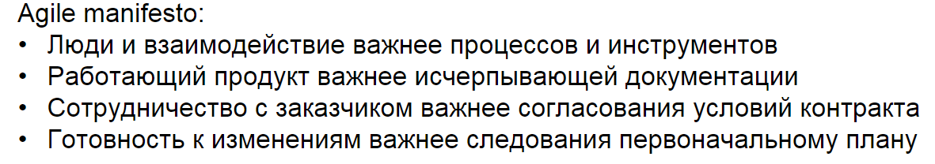
Agile

Slide 16
WELCOME TO THE FUTURE

