Slide 1

DATA ENGINEERING 2
Different Shapes of Data
VIKTÓRIA MÉSZÁROS
BRÚNÓ HELMECZY
ATTILA SERFŐZŐ

Slide 2
Executive Summary
Analysis Question
Solution
Results
What is the association pattern between Countries’ Satisfaction Scores and:
GDP per capita
Greenhouse Emission
Life Expectancy
Employment Rate
Weekly Working hours
Population
The most strongly correlating variables with Life Satisfaction are Weekly working hours, GDP per capita & Life expectancy.
Collected data from 2 sources, the Eurostat-, & World Development Indicators’ (WDI) and utilized 3 methods
SQL
R
API in KNIME
Automated KNIME based workflow creating scatterplots and linear regression after some clicks
90%
Positive correlation between average life satisfaction, life expectancy & GDP per capita of European countries, and a negative correlation with average weekly working hours.
The model with these variables captured 65% of the variation in Satisfaction.

Slide 3
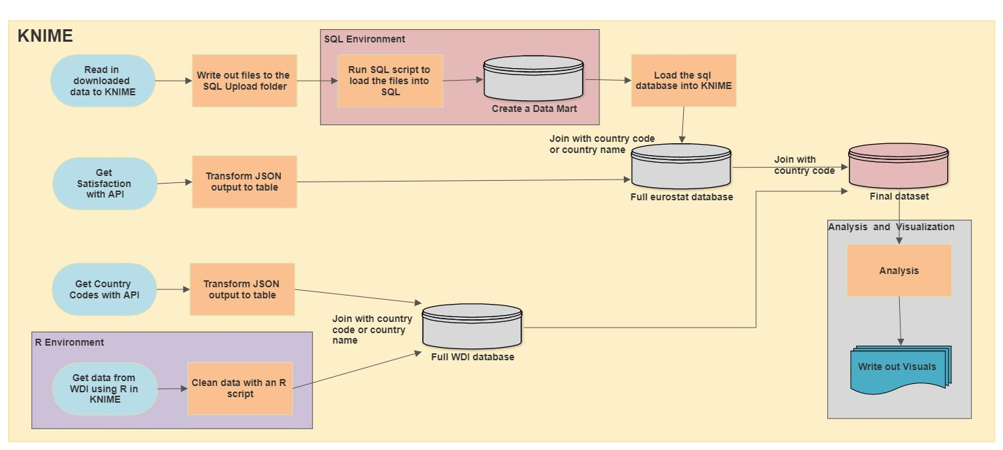
Workflow
Run File reader part of KNIME
Configure SQL node
Set up path to image write out
Load data to SQL
Do R setup if needed

Slide 4

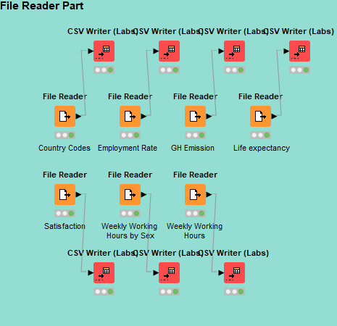
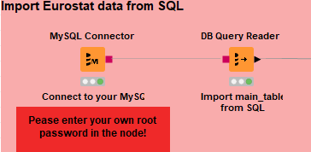
Data Collection - SQL
Download data from Eurostat
Read data into KNIME Write out data to the SQL Upload folder
Run SQL load code and create an Analytics layer
Configure SQL in KNIME
Load in the relational database into KNIME

Slide 5

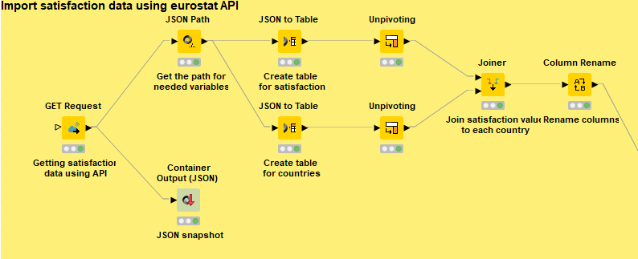
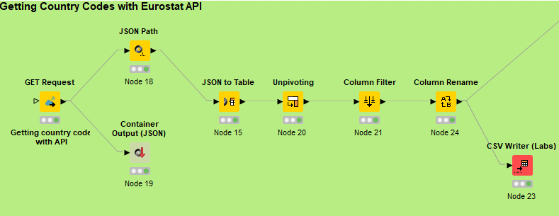
Data Collection - API
In order to easily connect various datasets we use ISO2 country codes
Also used API for downloading the Y variable Avg. rate of satisfaction
We used Eurostat query builder and postman
Results were JSON files, so we transformed it into table
http://ec.europa.eu/eurostat/wdds/rest/data/v2.1/json/en/demo_mlexpec?precision=1&sex=T&unit=YR&time=2018&age=Y_LT1
fixed part with host URL
format + lang
datasetCode
filters
JSON + english
All sex + time frequency and units in years + 2018 + age class is less than 1 year

Slide 6

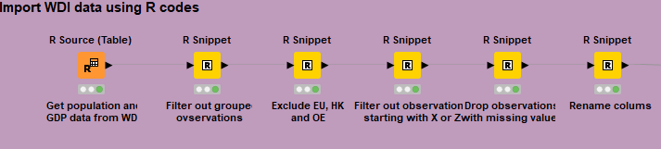

Data Collection - R
Get Population and GDP per capita for countries from WDI
KNIME Interactive R Statistics Integration extension was needed to be added to KNIME
Also, Rserve R package needed to be installed
R script downloaded data with WDI package
264 observations needed to be cleaned, we used tidyverse package
Ended up with 184 observations

Slide 7
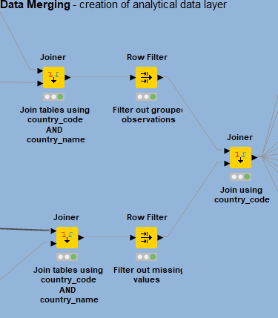
Joining the datasets
Inner Join Satisfaction with SQL RDBS
Match with country code or country name
Left Outer Join Eurostat & WDI datasets
Match with country code
Right Outer Join
WDI dataset with country codes
Match with country code or country name

Slide 8
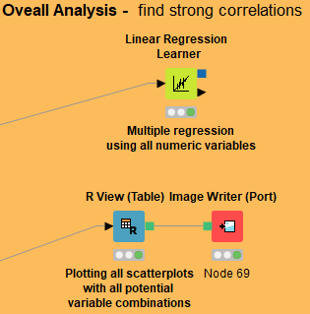
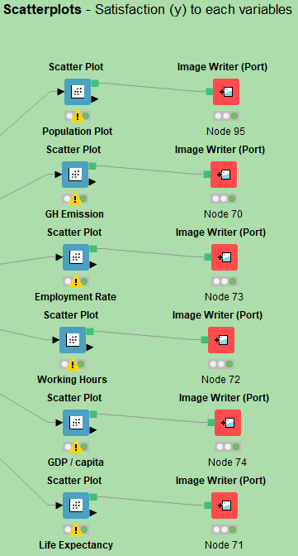
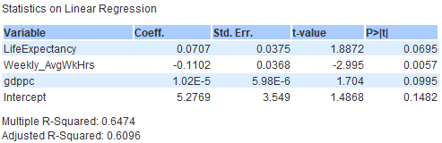
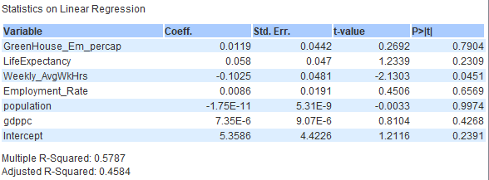
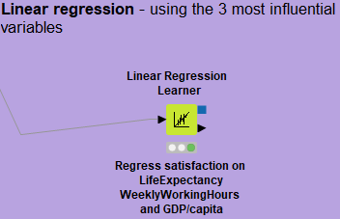
Visualization & Analytics
The most strongly correlating variables with Life Satisfaction are Weekly working hours, GDP per capita & Life expectancy.
With 90% CONFIDENCE WE CAN CONCLUDE THAT:
Positive correlation between average life satisfaction, life expectancy & GDP per capita of European countries, and a negative correlation with average weekly working hours.
The model with these variables captured 65% of the variation in Satisfaction.
Results

Slide 9
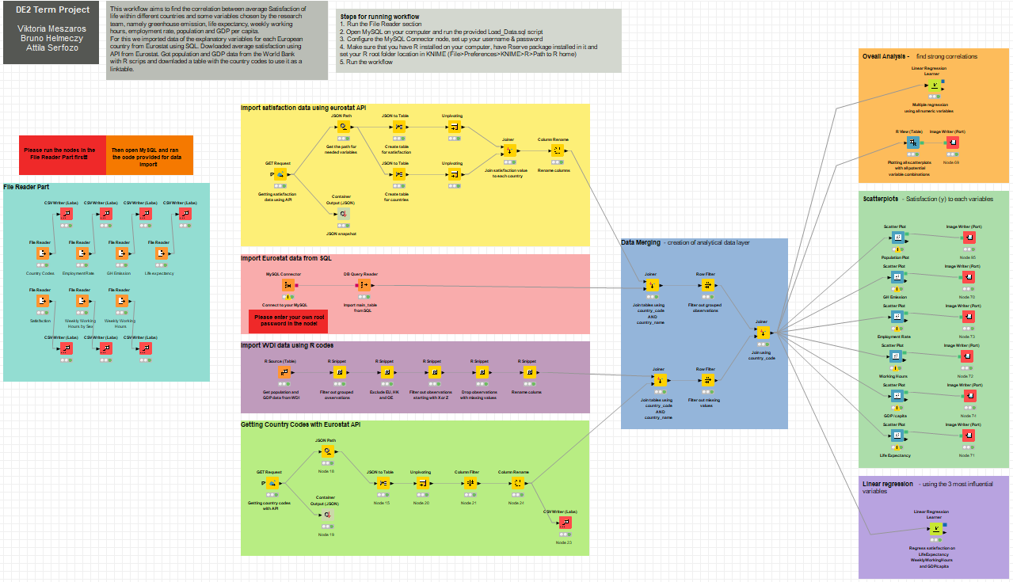

Slide 10

Q&A?

Slide 11
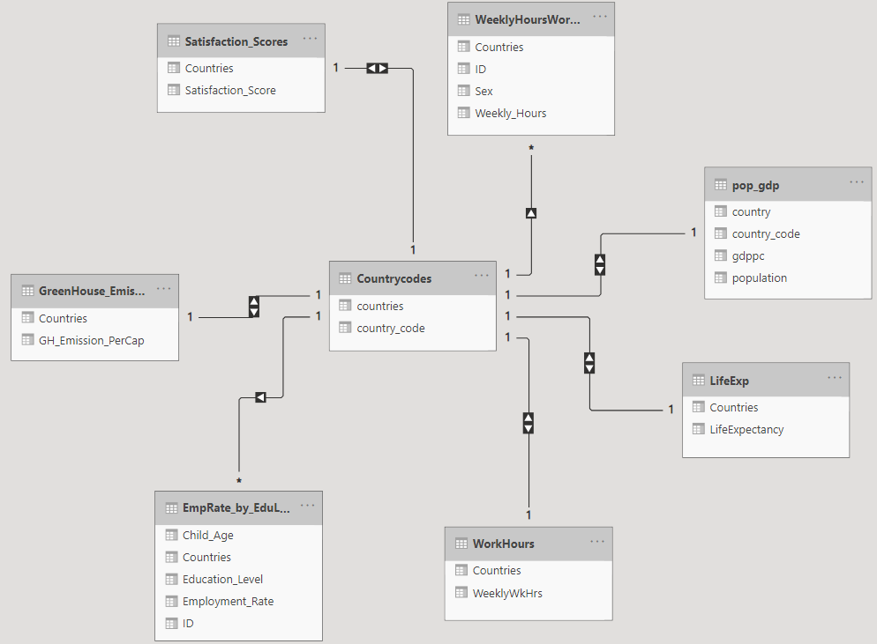
Appendix – Data model

Slide 12
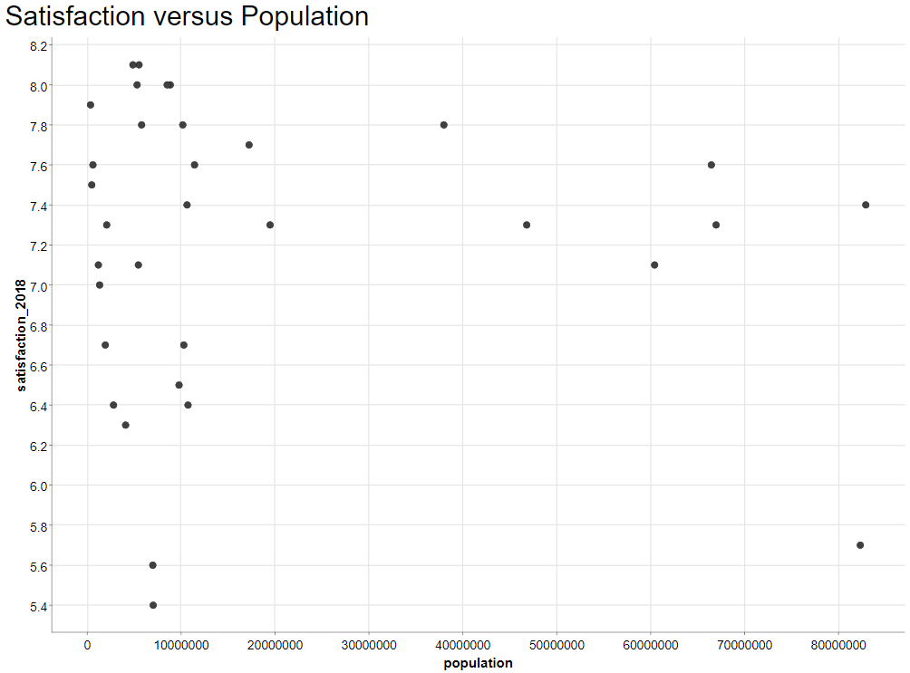
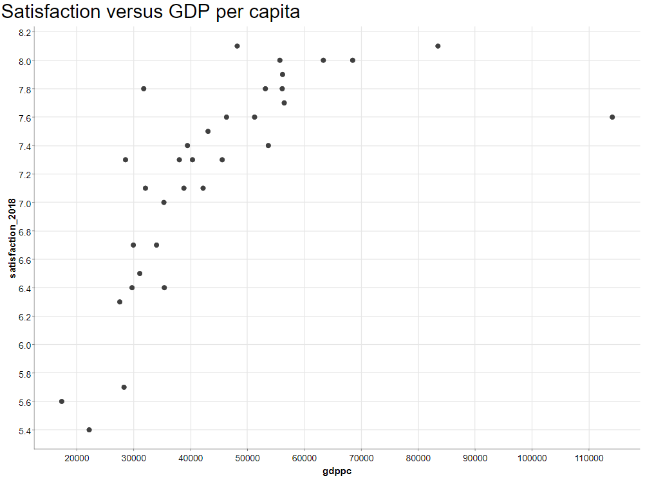
Appendix – Scatterplot Pop; GDP

Slide 13
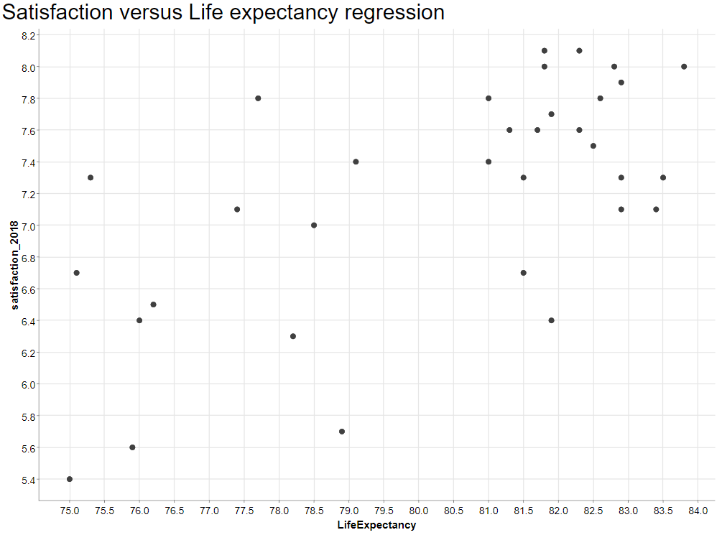
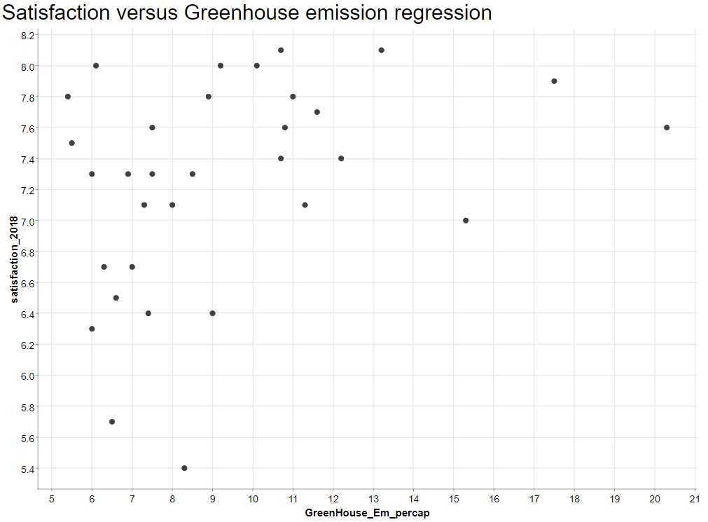
Appendix – Scatterplot LifeExp; Emission

Slide 14
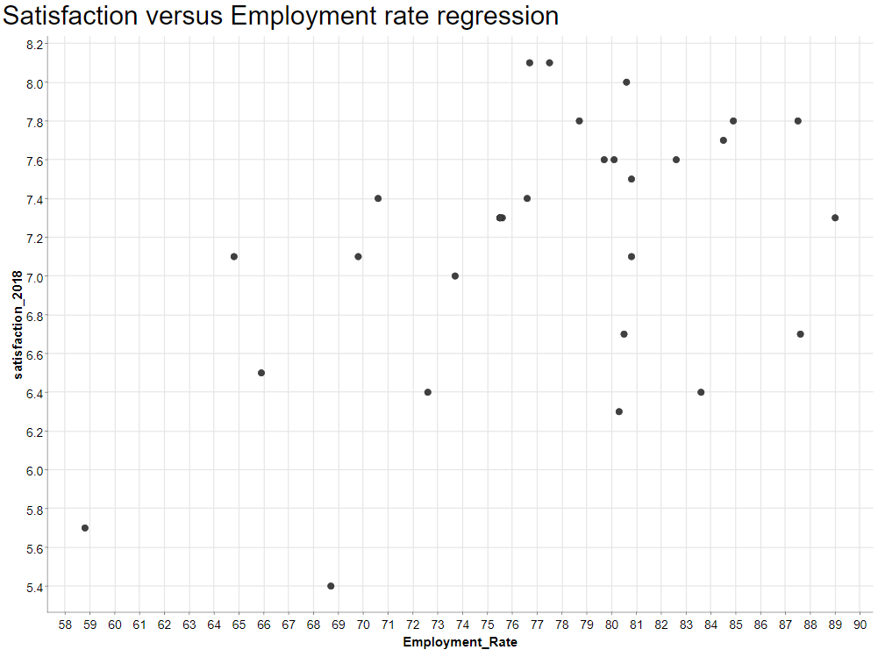
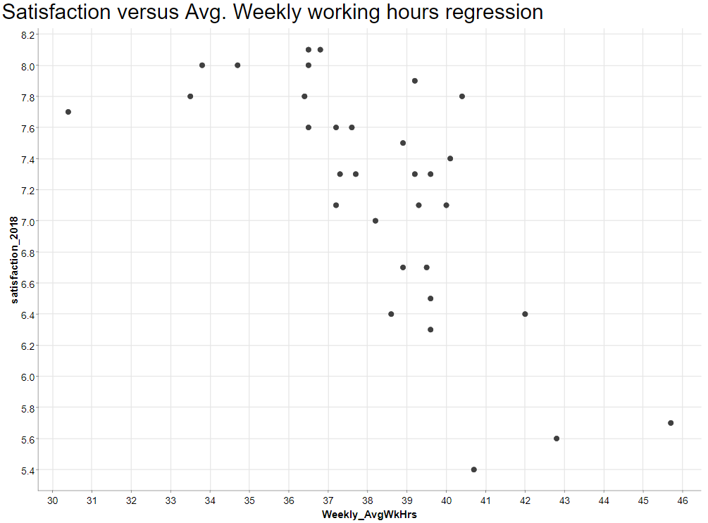
Appendix – Scatterplot Employment, Working Hours

