Slide 1
APPLIED CASE STUDY • CED6150 MODULE 7
Predicting market volatility risk
Can liquidity and market signals identify high-risk trading days?
ANALYSIS FRAMEWORK
01
Integrate signals
02
Identify stress regimes
ETF liquidity proxies · VIX · Machine learning
An individual applied risk analytics project
03
Predict next-day risk
04
Evaluate alerts
YANG LIU
SPY · QQQ · VIX | 2018–2025
01

Slide 2
RESEARCH QUESTION • CED6150 MODULE 7
Why an early-warning signal matters
Problem
Target
Decision
Large next-day price moves can affect a portfolio before analysts can react.
High risk = |next-day SPY return| above 1.5%.
Send a monitoring alert rather than trigger an automatic trade.
ILLUSTRATIVE COST ASSUMPTIONS
Missed high-risk day = 5 units • False alarm = 1 unit
SPY · QQQ · VIX | 2018–2025
02

Slide 3
DATA & METHOD • CED6150 MODULE 7
Two information streams, one modeling panel
01 Market trading data
02 Market-risk signal
SPY + QQQ daily OHLCV
Amihud illiquidity
Corwin–Schultz spread proxy
Rolling return volatility
VIX index levels and changes
Market-wide forward volatility expectations
Joined by trading date
+
Train: 2018–2024 → Out-of-time test: 2025 | chronological validation
SPY · QQQ · VIX | 2018–2025
03

Slide 4
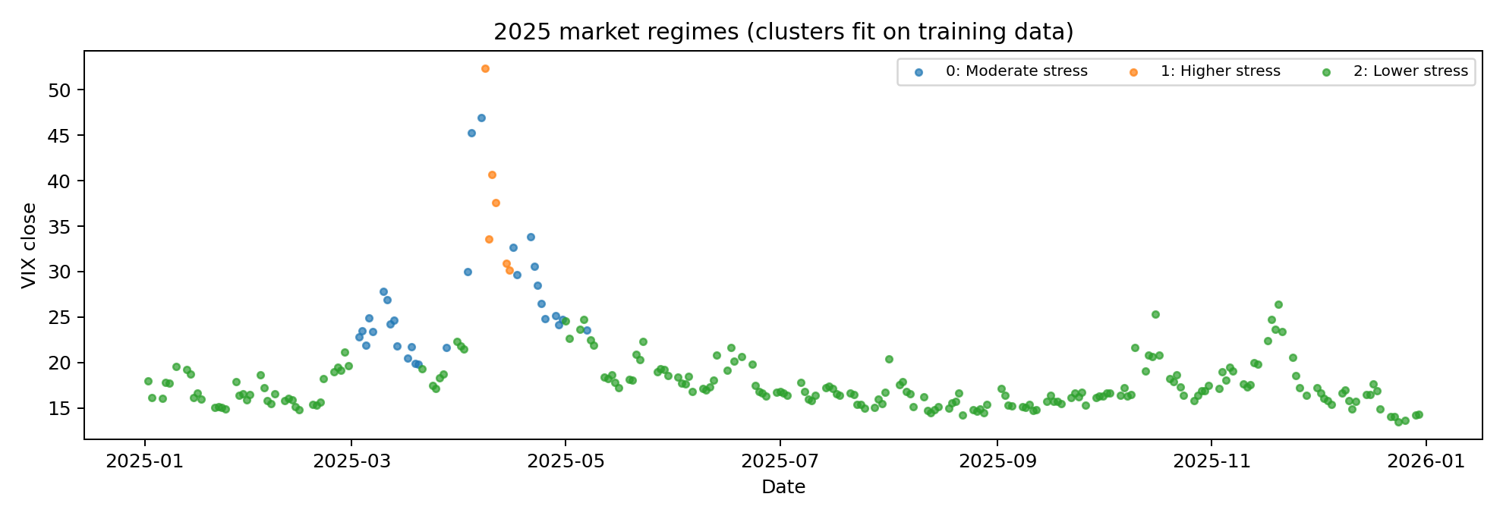
UNSUPERVISED INSIGHTS • CED6150 MODULE 7
Three interpretable market-stress regimes
6.8%
Lower-stress frequency
27.3%
Moderate-stress frequency
72.0%
Higher-stress frequency
Training cluster proportions; not calibrated forecasts.
SPY · QQQ · VIX | 2018–2025
04

Slide 5
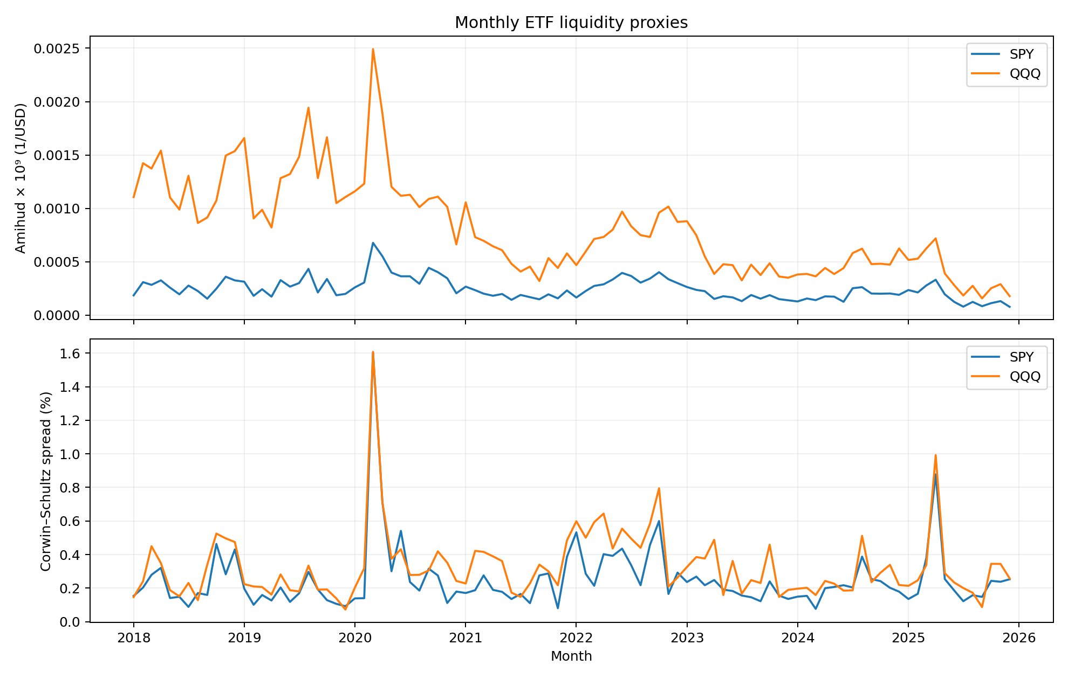
LIQUIDITY DYNAMICS • CED6150 MODULE 7
Trading conditions change across market episodes
QQQ
Often higher Amihud illiquidity proxy than SPY.
2020
Estimated spreads rose sharply during early-pandemic stress.
SPY · QQQ · VIX | 2018–2025
05

Slide 6
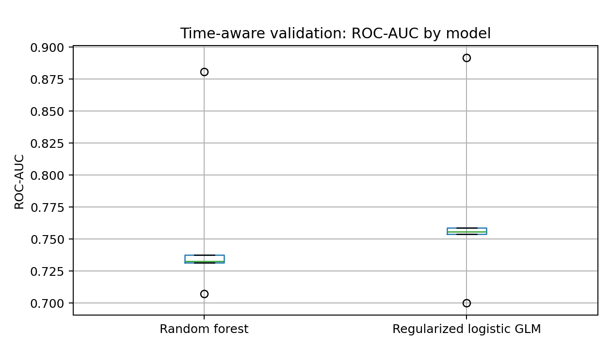
MODEL VALIDATION • CED6150 MODULE 7
GLM slightly outperforms the ensemble
0.772
Logistic GLM mean CV AUC
0.758
Random forest mean CV AUC
TUNING CHECK
GLM C = 0.03
Tuned CV AUC = 0.778
SPY · QQQ · VIX | 2018–2025
06

Slide 7
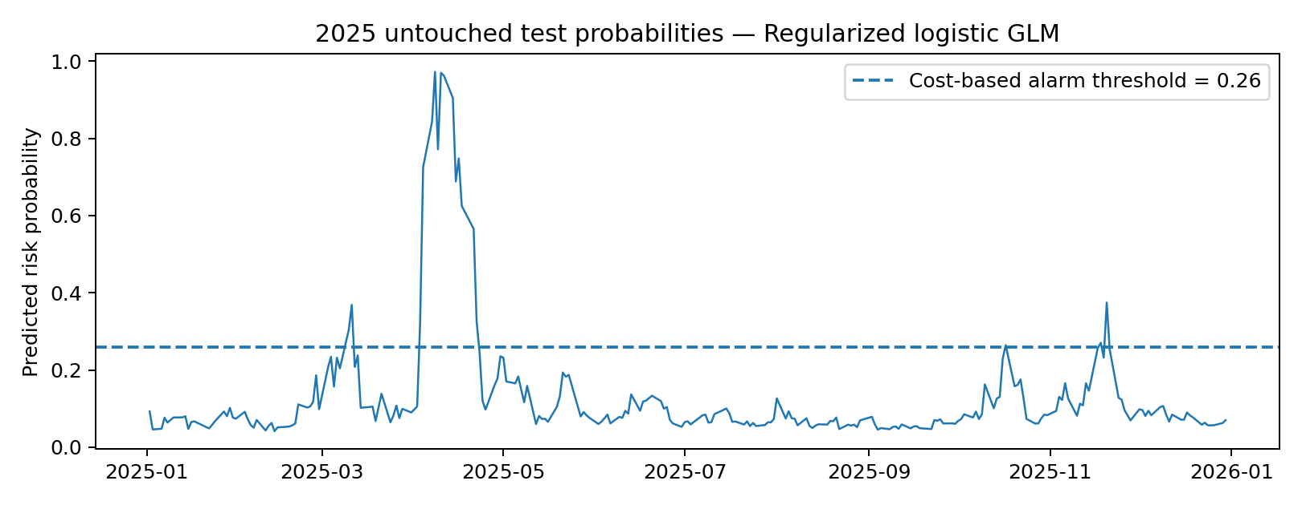
DECISION ALIGNMENT • CED6150 MODULE 7
A good ranking model still misses many risky days
0.804
2025 test ROC-AUC
0.26
Alert probability threshold
9 of 33
Actual high-risk days detected (27% recall)
SPY · QQQ · VIX | 2018–2025
07

Slide 8
CONCLUSION
Finding 01
Finding 02
Use the GLM as an additional monitoring signal—not an automatic trading rule.
Liquidity feature removal did not reduce CV AUC: 0.772 → 0.777.
Limitations
Next step
Daily spread estimates are proxies; model recall is low and market regimes can shift.
Test new periods, review costs and thresholds, and add richer liquidity data.
SPY · QQQ · VIX | 2018–2025
08

Slide 9
Thank you！
SPY · QQQ · VIX | 2018–2025
08

