Slide 1
SECURE DATA HIDING IN IMAGES USING STEGANOGRAPHY
CAPSTONE PROJECT
Presented By: Viki Sonwane
Student Name : Viki Sonwane
College Name & Department : MCA ,Iicmr Nigdi pune

Slide 2
OUTLINE
Problem Statement
Technology used
Wow factor
End users
Result
Conclusion
Git-hub Link
Future scope

Slide 3
Problem Statement
With increasing digital communication, securing sensitive information is crucial. Traditional encryption methods protect data, but their presence can raise suspicion. This project integrates AES encryption with LSB-based image steganography to securely hide and retrieve encrypted messages within images. The system ensures confidentiality while making the hidden message undetectable to casual observers.

Slide 4
Technology used
Libraries:
cv2 (OpenCV) – For image processing and manipulation.
Crypto (PyCryptodome) – For AES encryption and decryption.
base64 – For encoding encrypted messages.
secrets – For generating secure AES keys.
Platforms:
Compatible with Windows, Linux, and macOS.
Requires Python 3.x for execution.
Can be deployed on local machines or cloud platforms like AWS, Azure, or Google Cloud if extended with web-based functionalities.

Slide 5
Wow factors
Combination of AES Encryption & Steganography
Unlike standard steganography projects, this system encrypts the message first using AES (Advanced Encryption Standard) before embedding it in an image. This provides double-layer security.
Least Significant Bit (LSB) Image Steganography
The encrypted message is hidden in the LSB of the red channel, making it visually undetectable while preserving the original image quality.
Automated Key Management
A random AES key is generated and stored securely in a file, ensuring that only authorized users can decrypt the message.
End Marker for Message Retrieval
Uses a unique end marker (1111111111111110) to accurately detect the hidden message, preventing errors in extraction.

Slide 6
End users
Cybersecurity Enthusiasts & Researchers
Individuals exploring data security, cryptography, and steganography for secure communication.
Journalists & Whistleblowers
People who need to send sensitive information discreetly without raising suspicion.
Government & Intelligence Agencies
For secure covert communication where traditional encryption might attract unwanted attention.
Corporate Organizations & Enterprises
Protecting confidential business data from industrial espionage by hiding it in images.
Privacy-Conscious Individuals
Regular users who want to securely store or share personal information without being detected.
Forensic Investigators & Law Enforcement
Used for hiding or recovering critical evidence in forensic investigations.
Students & Developers
Learners interested in cryptography, image processing, and ethical hacking for academic projects or skill development.

Slide 7
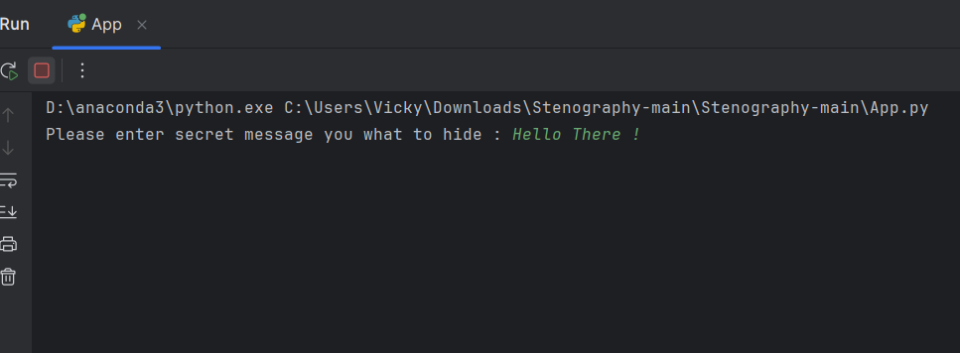
Results

Slide 8

Results

Slide 9
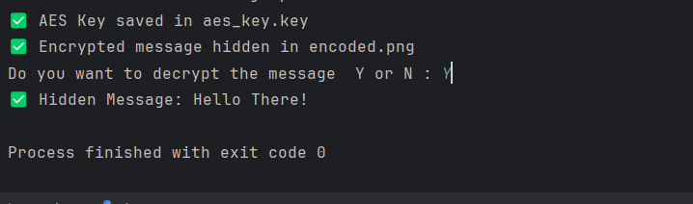
Results

Slide 10
Conclusion
This project successfully addresses the challenge of secure and undetectable communication by combining AES encryption with LSB-based image steganography. By encrypting the message before embedding it into an image, it ensures confidentiality and prevents unauthorized access. The system is designed to be lightweight, efficient, and cross-platform compatible, making it accessible for cybersecurity professionals, journalists, and privacy-conscious users. With potential for further enhancements like GUI integration, cloud storage support, or mobile applications, this project provides a strong foundation for secure data hiding and transmission.

Slide 11
GitHub Link
https://github.com/VikiSonwane/SECURE-DATA-HIDING-IN-IMAGES-USING-STEGANOGRAPHY.git

Slide 12
Future scope(optional)
Graphical User Interface (GUI) Integration
Develop a user-friendly GUI using Tkinter or PyQt to simplify message encryption, hiding, and extraction for non- technical users.
Mobile & Web Application
Develop Android, iOS, or web-based applications to make the tool more accessible for secure communication on the go.
Adaptive Steganography
Implement AI-based steganography techniques to dynamically adjust embedding based on image properties, reducing the risk of detection.

Slide 13
THANK YOU

