Slide 1
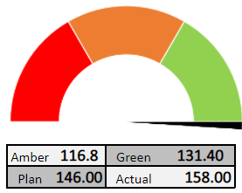
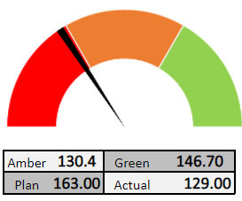
DNA
Overall status: G
Project Description | project details text | project details text
Engagement Type | project details text | project details text
Start Date | project details text | project details text
Team Size | project details text | project details text
Stakeholders | project management details
Engineering Manager(s) | project management details
Scrum Master | project management details
Technology | project management details
Team Name : Project Name : Browse safaris | Team Name : Project Name : Browse safaris
Key Milestones | Status | Remarks
testing text | testing text | testing text
testing text | testing text | testing text

Slide 2
Trust & Growth
Overall status: G
Project Description | Partnering in A/B Testing, Prototype development, tech transition, feature development, support & maintenance initiatives for key apps/services in People (Onboarding) & Trust domains.
Engagement Type | Fixed Capacity | Delivery Model :- Agile Scrum
Start Date | Krypton: JAN 2020 | End Date : NA
Team Size | 9 + 2
Stakeholders | Kevin Christiansen & Partha Sarathy
Engineering Manager(s) | Arockiam, Muralisankar
Scrum Master | Murali & Arockiam
Technology | AWS, JAVA, React JS, Node
Skynet: Community Profile: Phase 2.4 Local Profile, FullProfile, Get PhotoId APIS are delivered in L3. L3 testing is completed. Planned for L2 testing next week 90% of API.ashx development and Test plan is in progress. Test plan preparation and Automation script development for 2.4 APIs – in-progress Message Boards Spanish language development – Planning for L1 canary Redwood light changes is started in this sprint 22 | Growth: Experimentation: Split-manager – Swagger implementation – in progress Split-manager – Unit testing improvement and api documentation – in progress On-Boarding: Checkout : Membership highlight one pager – completed and QA testing is in progress Checkout : Change the tab space of paypal CTA on m-web
Key Milestones | Status | Remarks
2.4 - API's into L1 | 80% in L1
Me-Experience in L1 | 10%

